Slide 1

“Ecco Domani”
Global Tomography and Mantle Dynamics
7 of 7
7 of 7
Adam M. Dziewonski
in cooperation with
Ved Lekic and Barbara Romanowicz
CIDER 2014; July 10, 2014

Slide 2
“Top Down” or “Bottom Up” ?
Short answer: Rather than being mutually exclusive, these opposite views of mantle dynamics are complementary, but act on different spatial and temporal scales

Slide 3
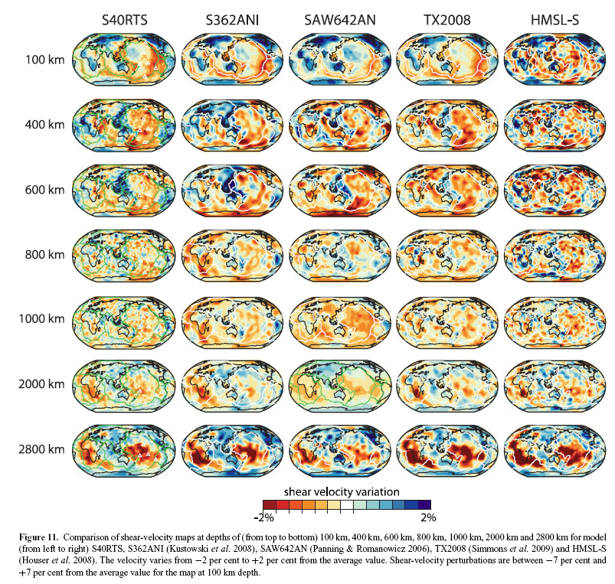
Convergence of 3-D models
+/- 7%
Ritsema et al., 2011

Slide 4
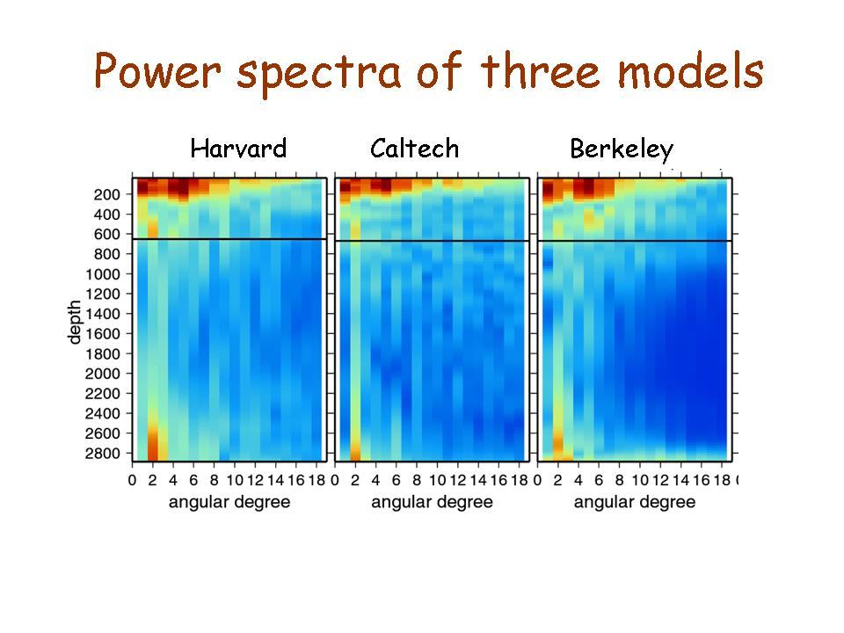
Power spectra of 3 models
S362ANI S20RTS SAW624AN

Slide 5
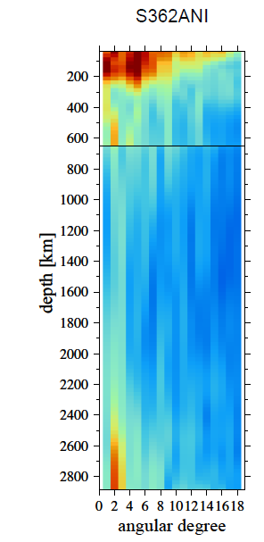
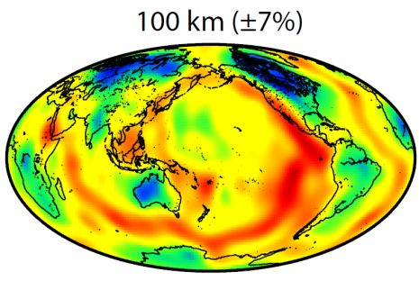
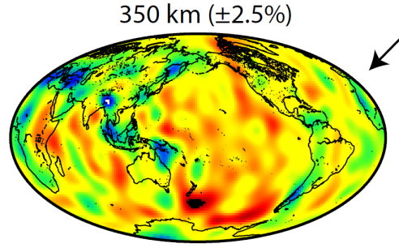
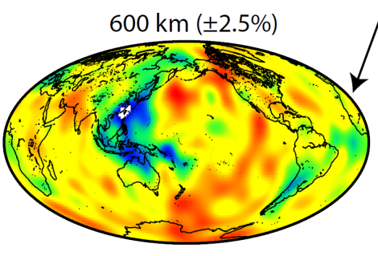
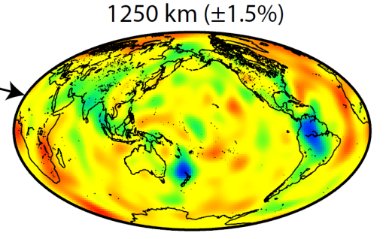
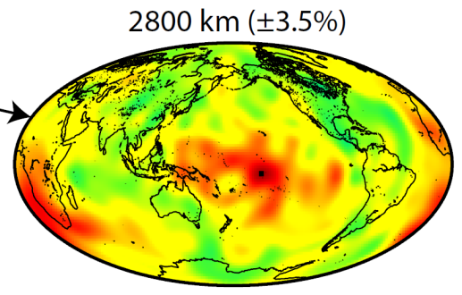
Heterosphere
IPIZ
Super-Plume
Planet

Slide 6
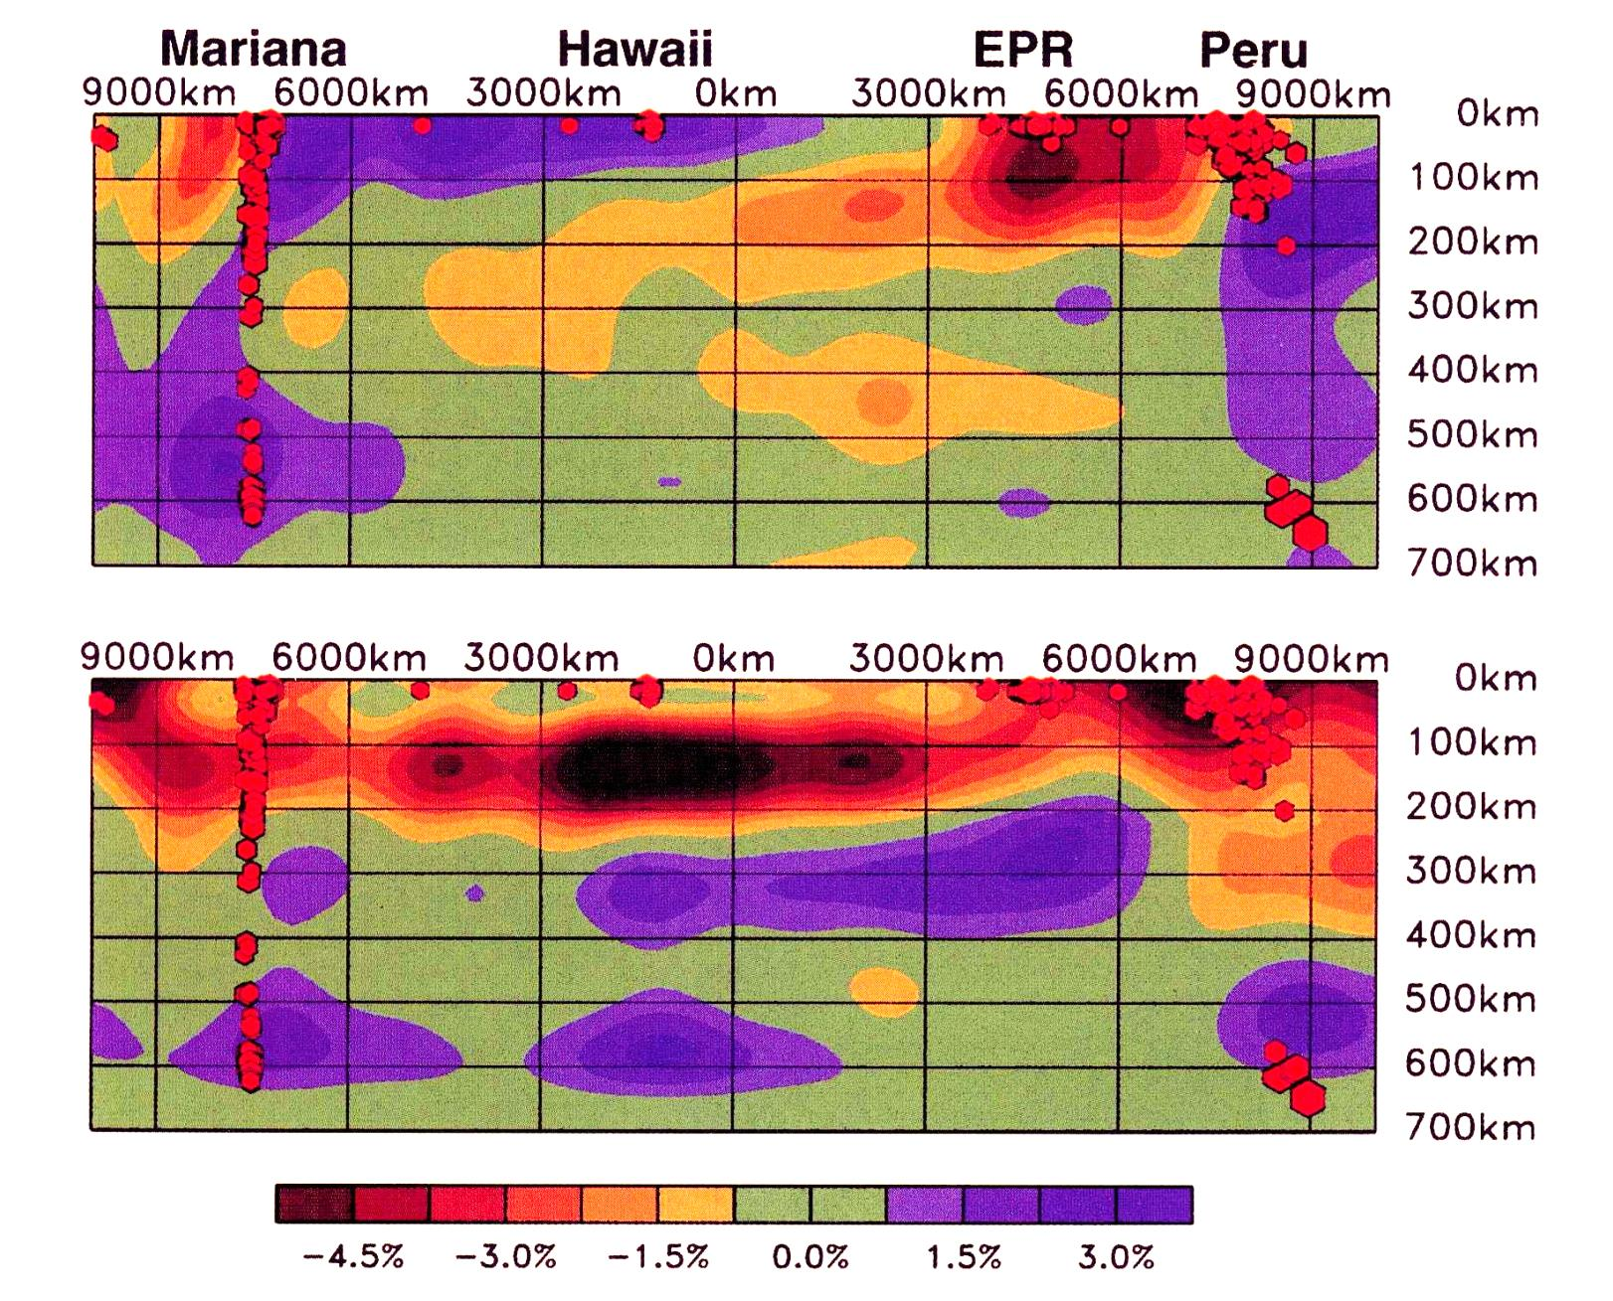
Heterosphere
isotropic
anisotropic
(Ekström, 2000)

Slide 7
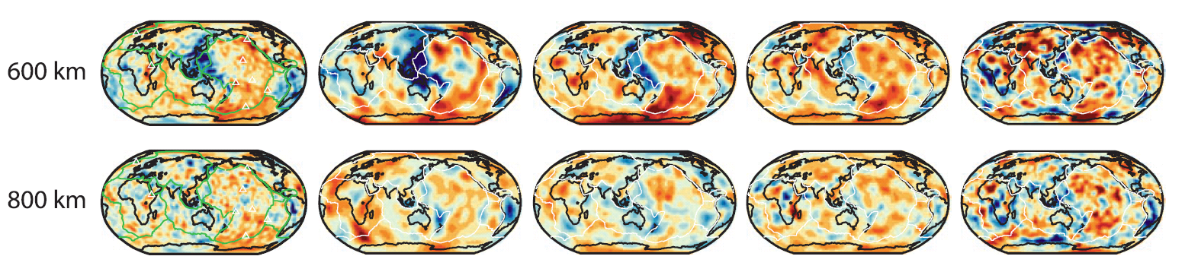
Crossing the 650 km discontinuity
Model TX2008 has weak constrains in transition zone
Model HMSL-S has no constraints in transition zone
After Ritsema et al., 2011

Slide 8
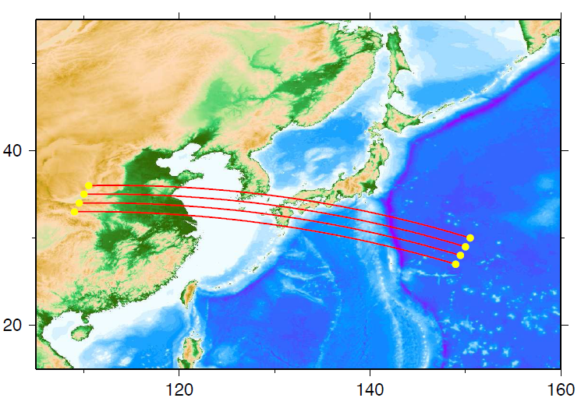
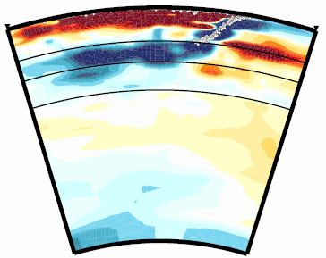
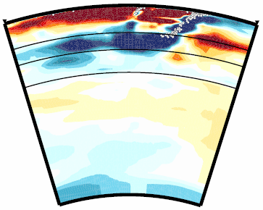
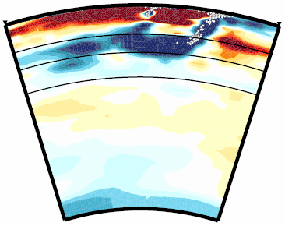
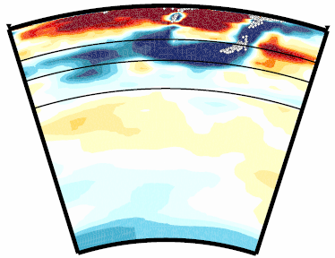
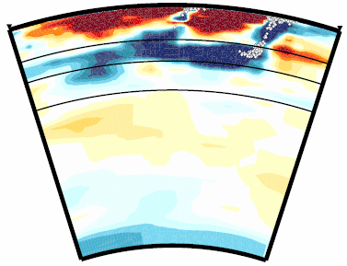
Northern Bonin
Fukao et al., 2012

Slide 9
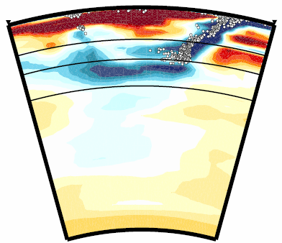
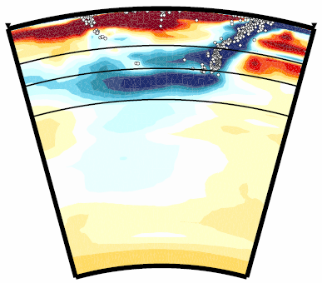
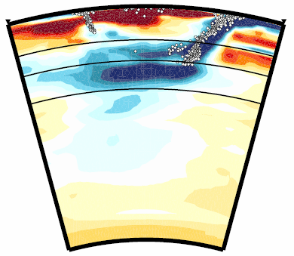
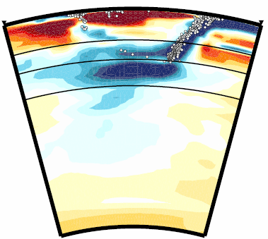
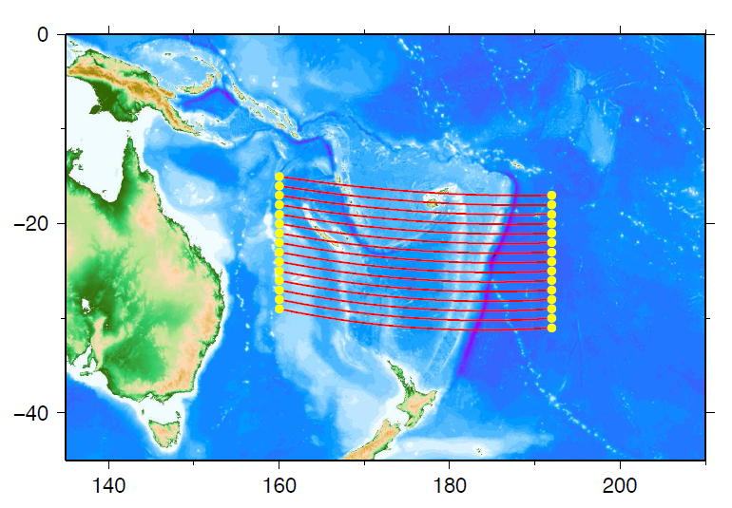
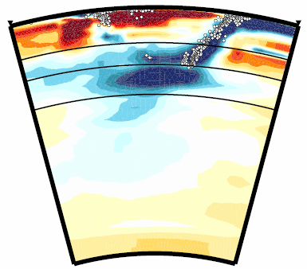
Tonga
Fukao et al., 2012
06
07
410
660
±1.5%
1000
08
09
10
Notes:
These are the successively southward cross-sections across the Tonga arc and across the Kermadec arc. In the Tonga region we see two horizontal slabs, one above the 660 and the other below it in the uppermost lower mantle. These two horizontal slab images are consistent with the two trends of seismicity at greatest depths, one in the down-dip direction and the other in the horizontal direction. In the Kermadec region the slab is trapped well in the uppermost lower mantle. The trapped slab extends subhorizontally both forward and backward of the subduction direction.

Slide 10
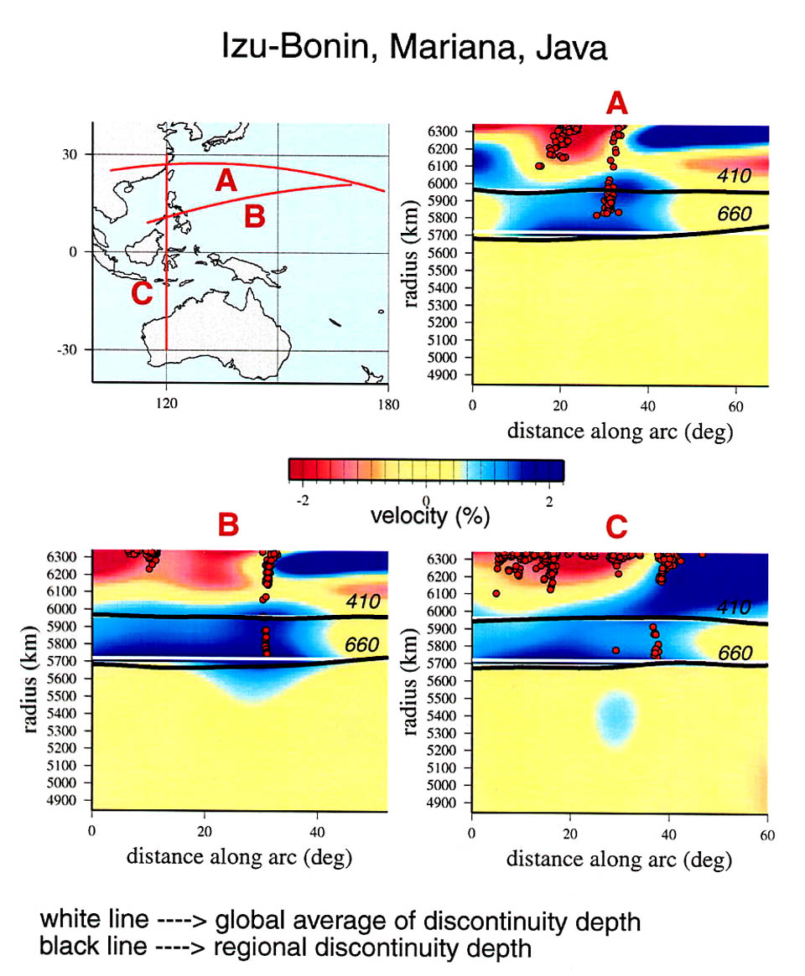
Stagnant slabs; Depressed boundaries
Gu al., 2001
Notes:
Also added from Gu et al., 2003

Slide 11
Lower Mantle
Ritsema et al., 2011

Slide 12
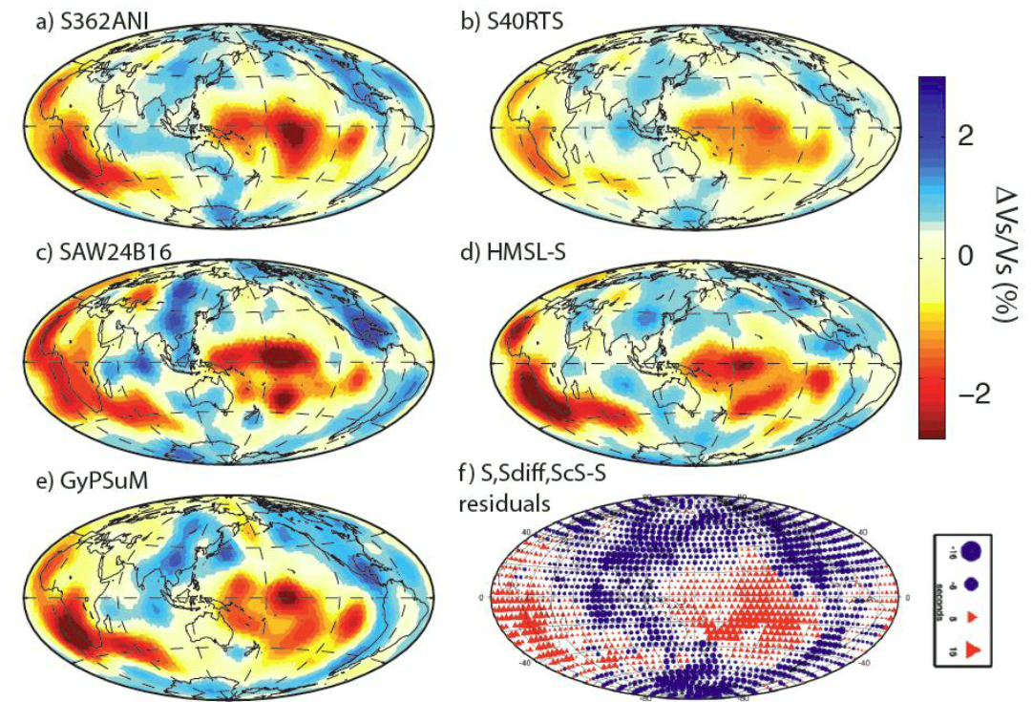
Models and Data

Slide 13
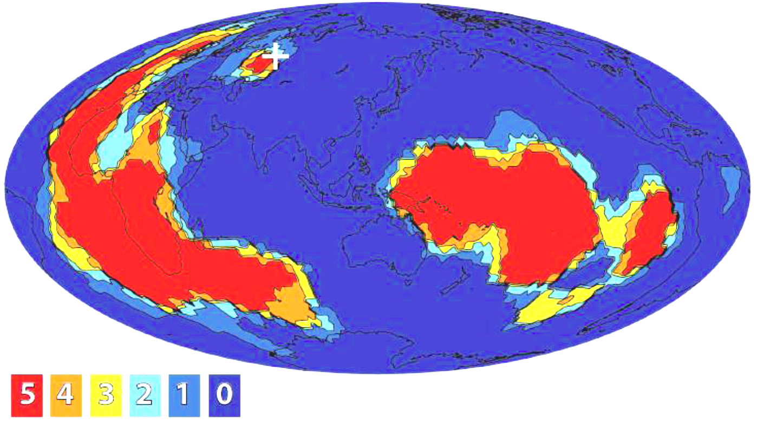
Convergence of models in the
abyssal layer (2400 – CMB)
Five models voting:
“Slow” or “Fast”
All slow
All fast
Lekic et al. 2012

Slide 14
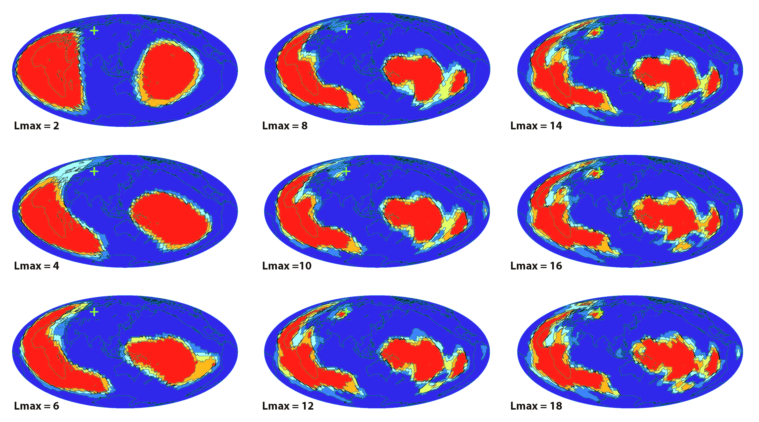
Voting vs. harmonic order
Lekic et al., 2012

Slide 15
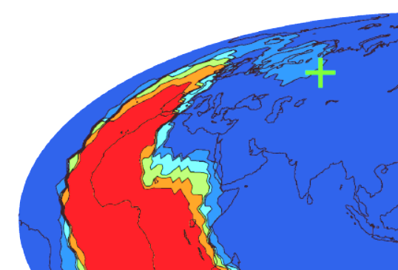
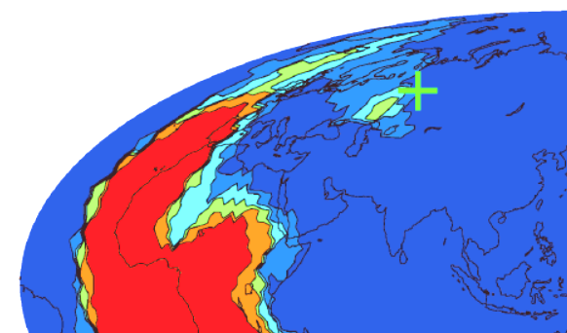
Resolution
lmax = 8
lmax = 10
lmax = 12

Slide 16
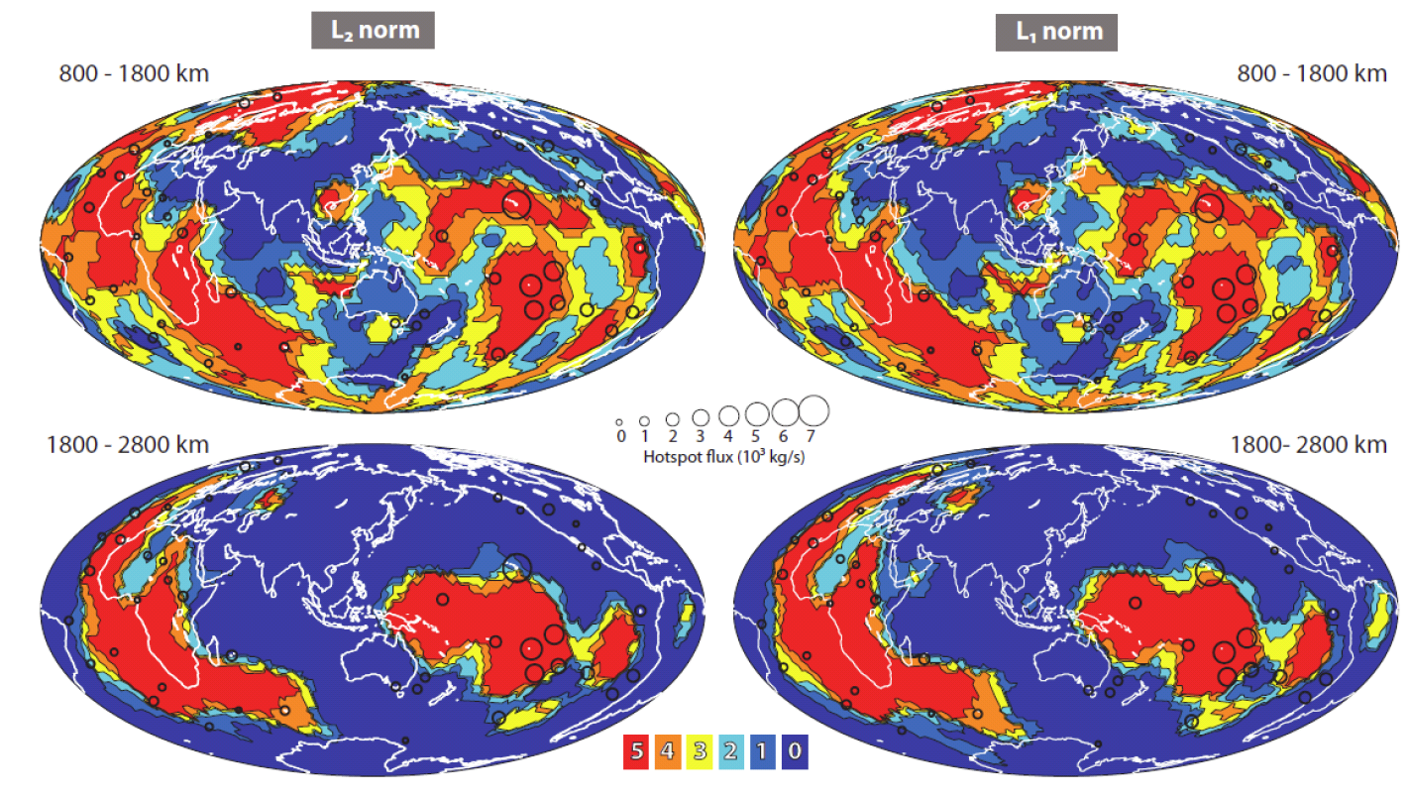
What happens to the Superplumes the middle mantle?
They appear to continue; even though the signal to noise ratio is lower

Slide 17
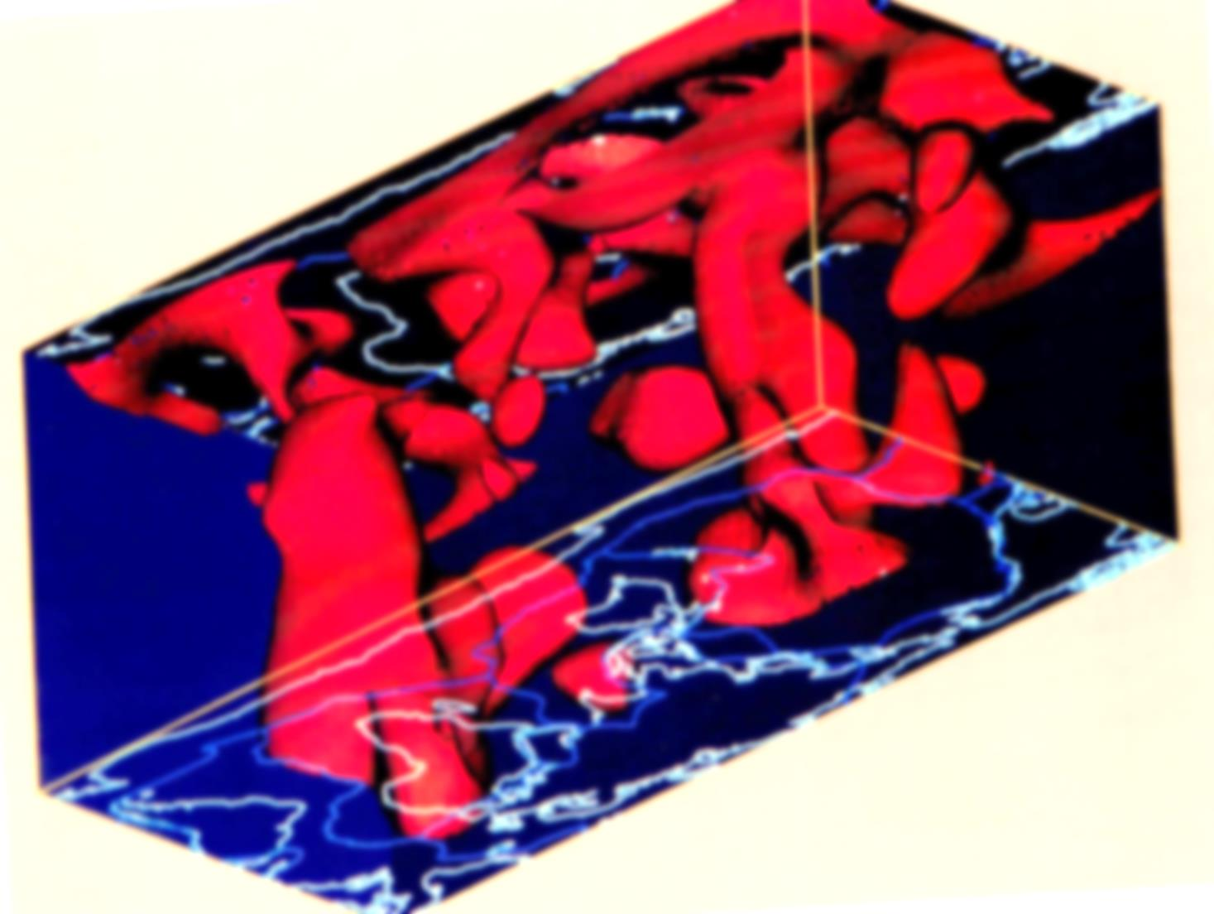
Pillars of the Earth
Iso-surface of -0.6% velocity anomaly. View from below; depth range 2890 km to Moho. Degree 12 model of Su et al. (1994). The African Super-plume is on the left.

Slide 18
A slab sinking paradox:
Geodynamic functions; degrees 2 & 3 only
Geoid
Hot spots
Seismic structure
at 2800 km
Subduction 0 – 120 Ma
Richards & Engerbretsen, 1992

Slide 19
Slabs at depth
72 km
362 km
652 km
942 km
1377 km
After Lithgow-Bertelloni
and Richards, 1998
2102 km
j
2827 km

Slide 20
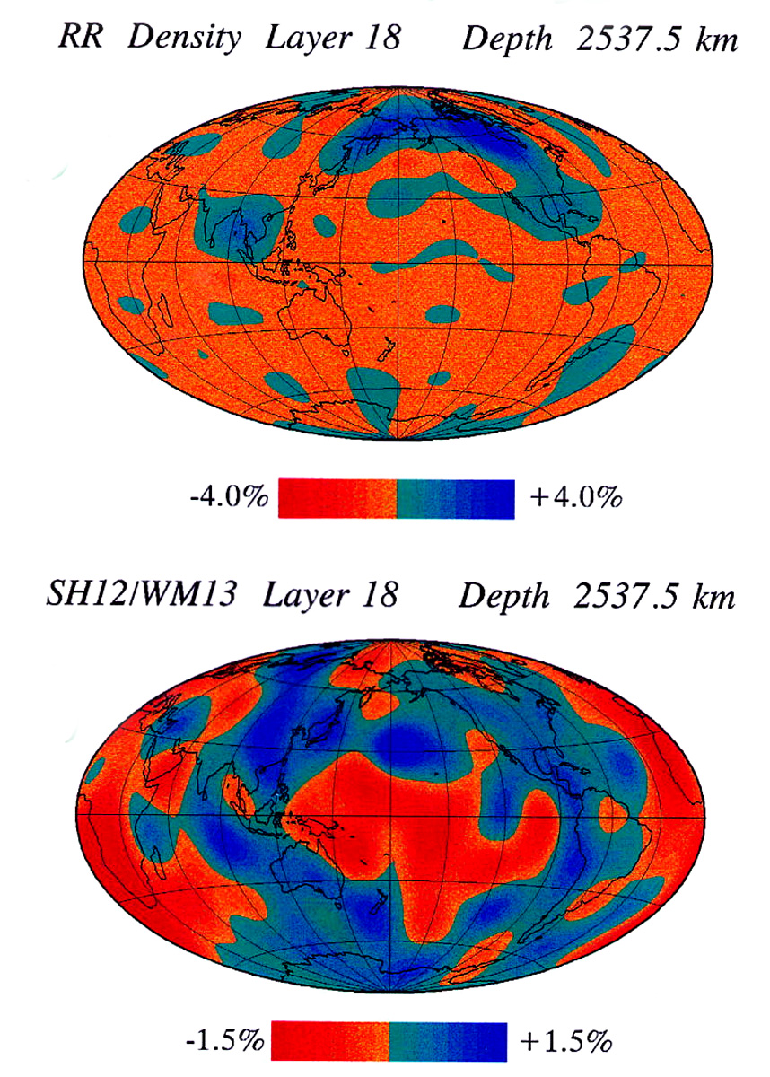
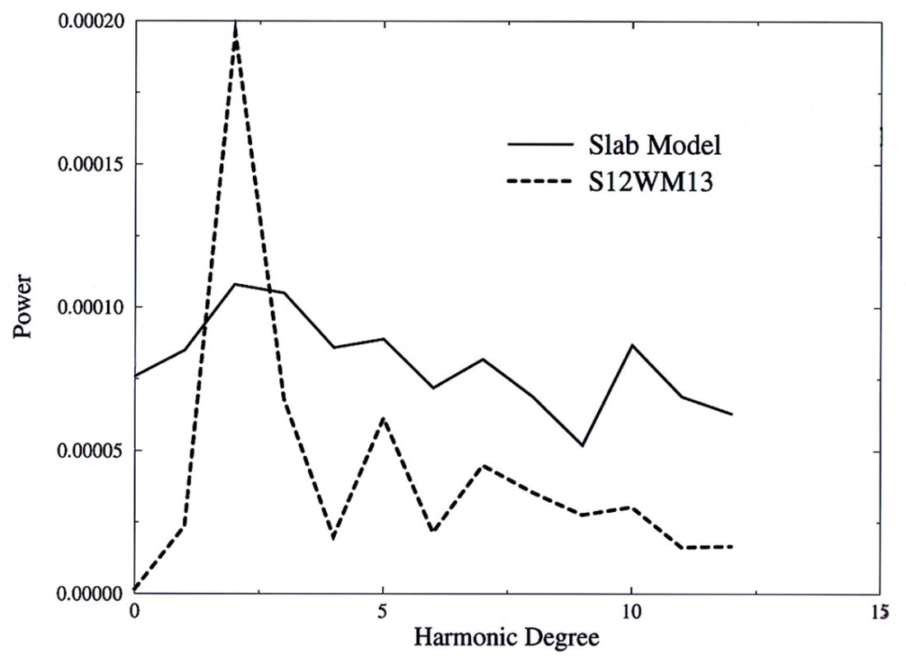
It does not work!
Slabs and seismic velocities;
Degrees 1-12
Power spectra

Slide 21
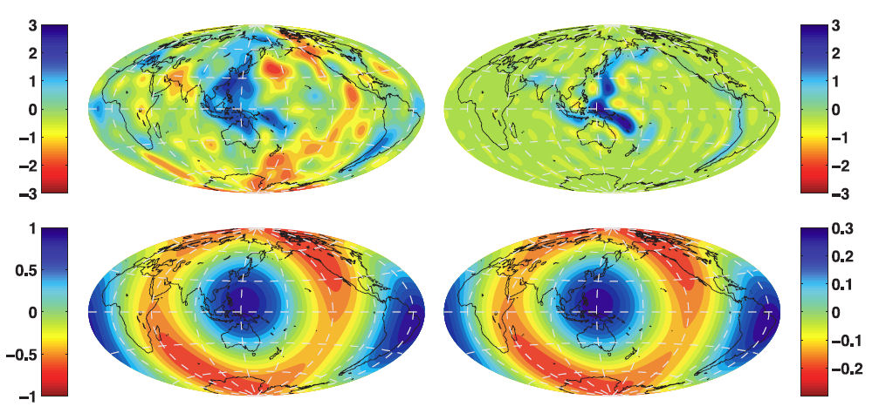
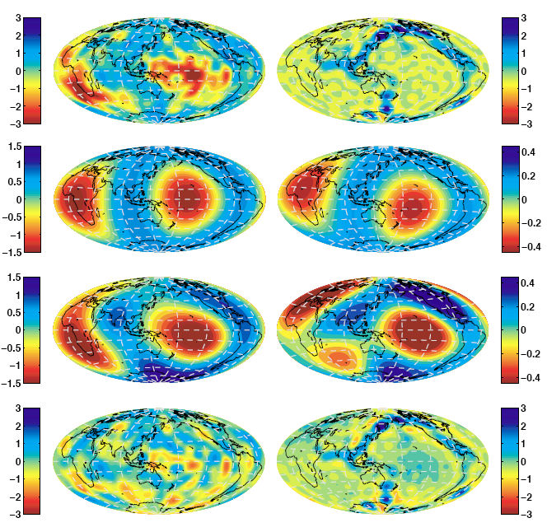
Slabs at depth
72 km
Sum: upper mantle
362 km
652 km
942 km
1377 km
After Lithgow-Bertelloni
and Richards, 1998
Sum: whole mantle
2102 km
j
2827 km

Slide 22
Upper mantle test
Sum of subducted slabs
Moho – 650 km
Velocity at 600 km
Upper row: degrees 1 – 18
Lower row: degree 2

Slide 23
Velocity anomalies at 2800 km depth and integrated subduction
Degrees 1 -18
Degree 2
Degrees 2 & 3
Degrees 4 - 18

Slide 24
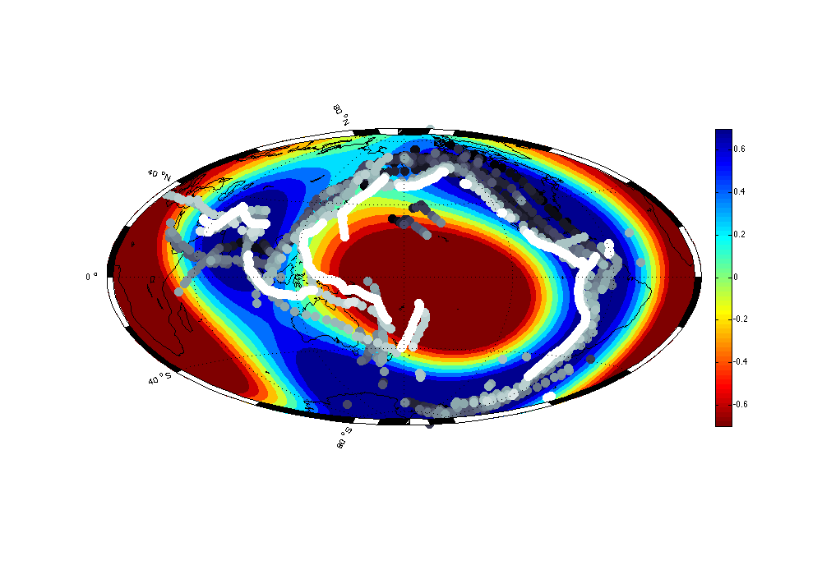
What does it mean?
This means that the degree 2 and 3 velocity anomalies in the lowermost mantle correspond to a long time average of the tectonic processes. It is difficult to say how long, but TPW reconstructions indicate that it could be more than 1 billion years. Hence, Dziewonski et al. (2010) call it the “Mantle Anchor Structure”.
Shorter time changes in location of subduction during the last 100 Ma, appear to be confined to the perimeter outlined by the fast velocity anomaly; the time scale of the change of location of subduction is on the order of 10-30 Ma.
To find out whether these two time scales also correspond to variations of seismic anomalies as a function of depth we apply the Principal Component Analysis,

Slide 25
Principal Component Analysis (PCA)
A multi-dimensional function – a 3-D velocity model, for example – may be represented by a sum of multi-dimensional functions that are orthogonal:
Δv(r,θ,φ) = ∑ λi • fi (r, θ, φ)
Where λi are eigenvalues and
∫ fi • fj dV = δij
The advantage of PCA is to determine the importance of different elements of the model.
Then, the model can be reconstructed using a limited number of the largest PC’s and variance reduction with respect to the original model computed.

Slide 26
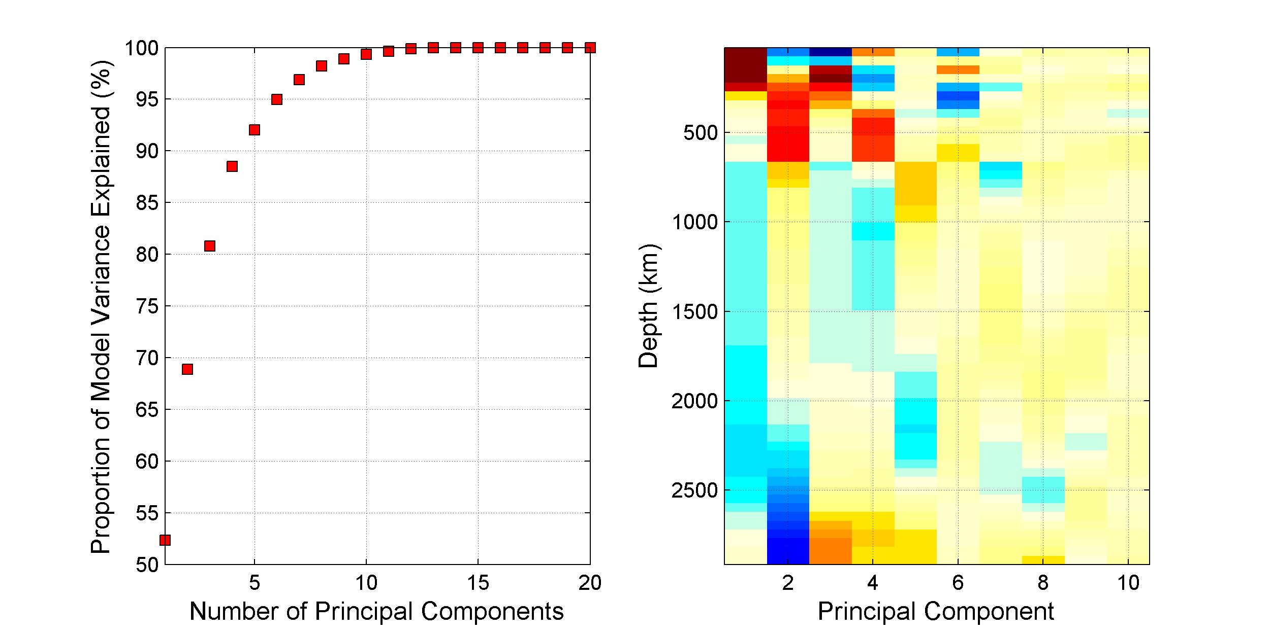
S362ANI Principal Components
Variance reduction
Radial functions

Slide 27
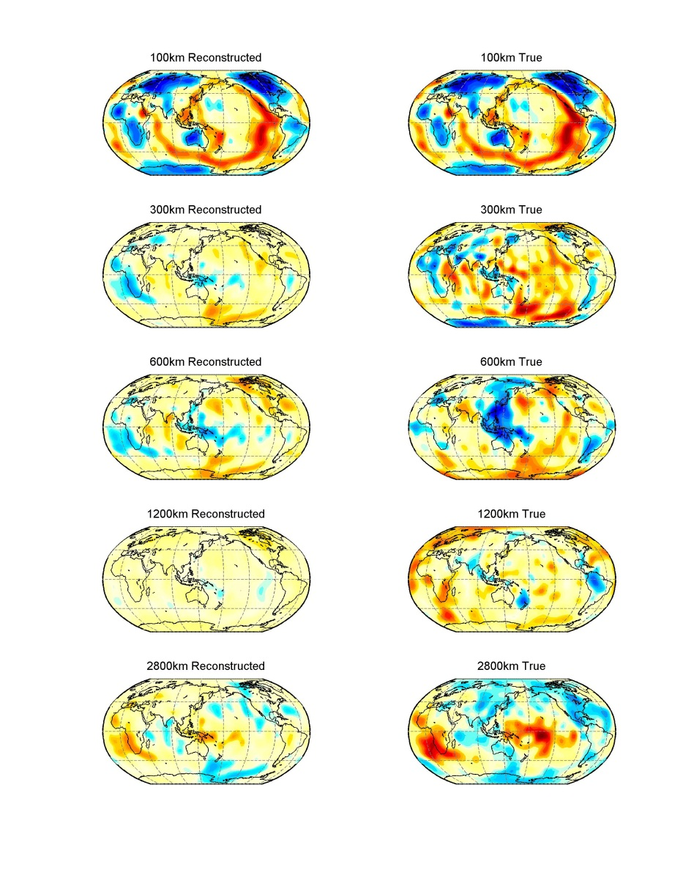

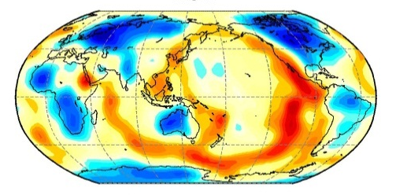
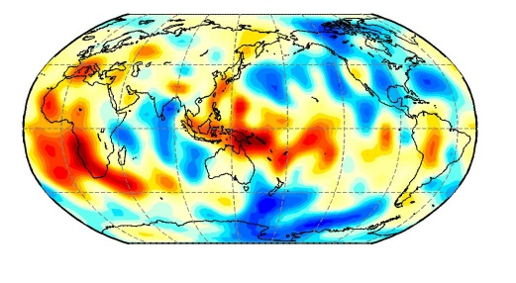
The Two Largest Principal Components
radial
horizontal
100 km
PC 1
300 km
PC 2
600 km
1200 km
2800 km
68% var. red.
362ANI

Slide 28
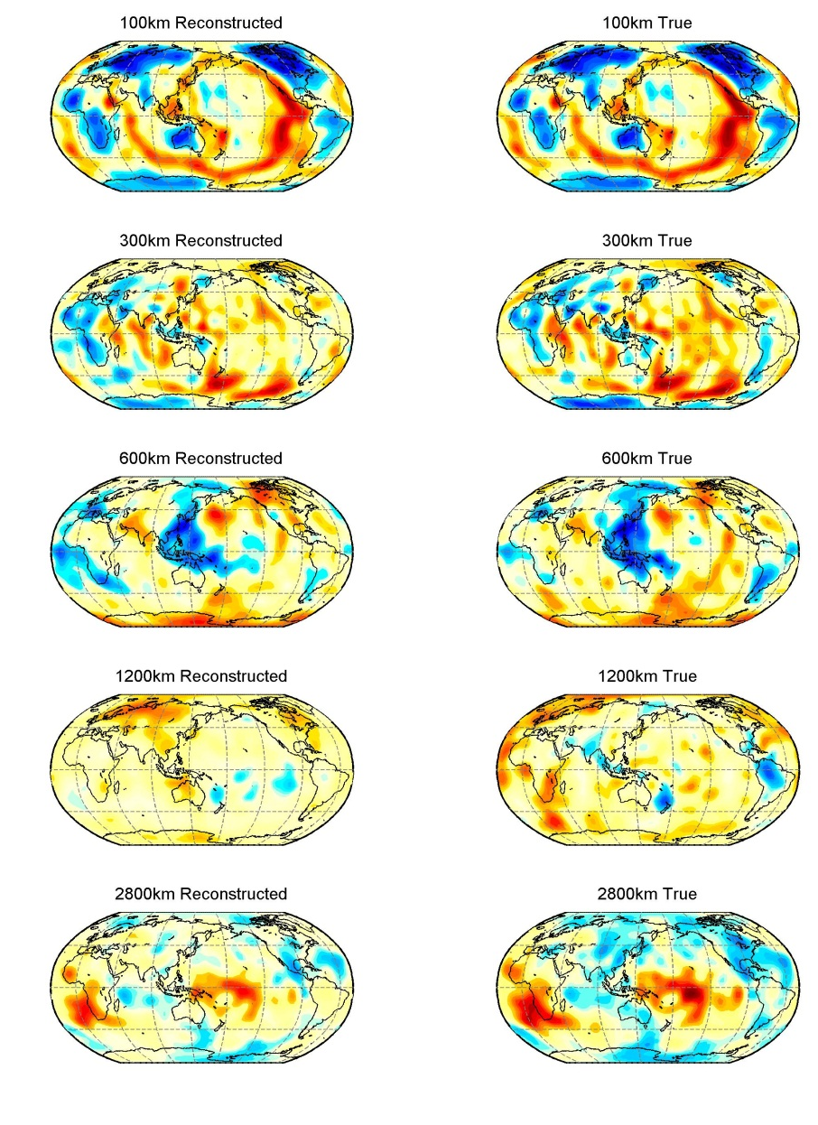
Reconstruction using 6 largest PC’s
100 km
300 km
600 km
1200 km
2800 km
Var. red. 95%
S362ANI

Slide 29
Interpretation of the PSA results
The first principal component is nearly identical To the
image of the velocity anomalies at a depth of 100 km. It
reflects the present day signature of the plate tectonics:
slow mid-ocean ridges, cooling of plates with age, contours
of the cratons. The thickness of the most heterogeneous
region is the same as the “Heterosphere”. It reduces the
variance of the entire 3-D model by 52%.
The second component contributes primarily to the deep
mantle (the “Super-plume” planet) and the “Extended
Transition Zone”. It reduces the variance by another 18%.
The first six principal components reduce the variance by
95% and reproduce essential features of the large
wavelength velocity anomalies.
It connects our earlier interpretation of subduction history
With the spatial distinction between “Plate Tectonic Planet
And Super-plume Planet. The “Extended Transition Zone”
Is the crucial but little understood link between the two.
The s

Slide 30
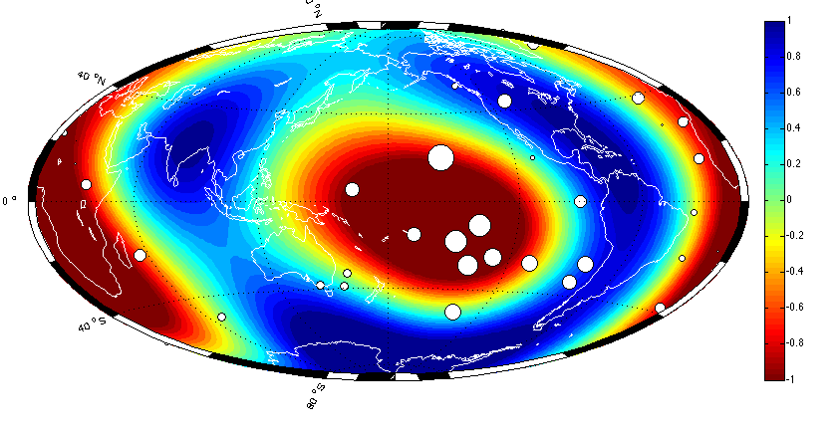
Degree 2 & 3 vs. subduction history and hotspot distribution
Top: “Slablets” as a
function of time; recent
white, oldest -- black.
Most of subduction is
inside the fast ring
Bottom: hotspot distribution
with size as a function of
flux. Most of hotspots are
within the slow velocity
field.

Slide 31
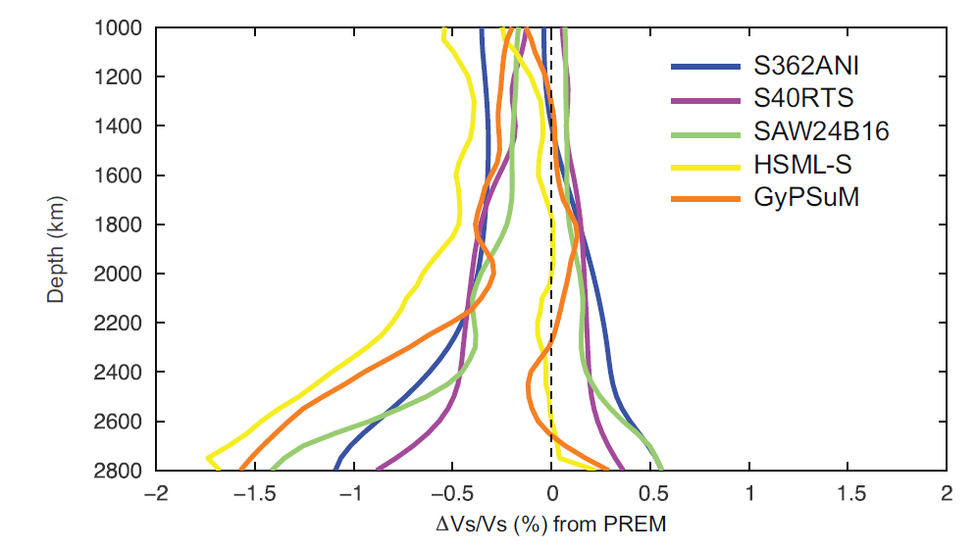
Five Models: Average “Slow” and “Fast” Structures
Abyssal Layer
A hypothetical increase in the velocity of the 1-D reference model is shown
with a heavy broken line. Such a modification would strengthen negative
anomalies in the 3-D model and weaken the positive ones, giving an
appearance of the negative velocity structure as the only anomaly.

Slide 32
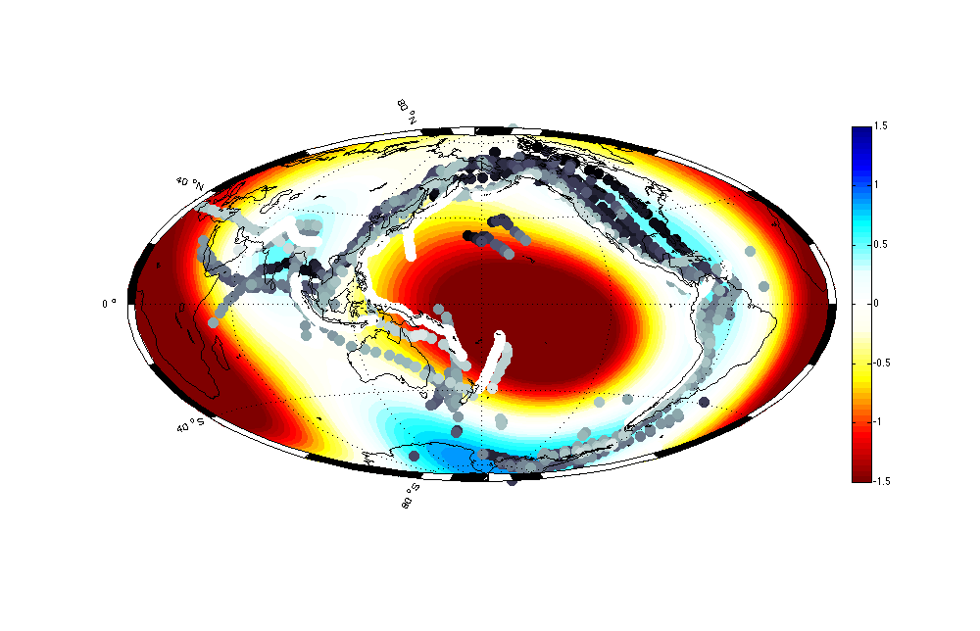
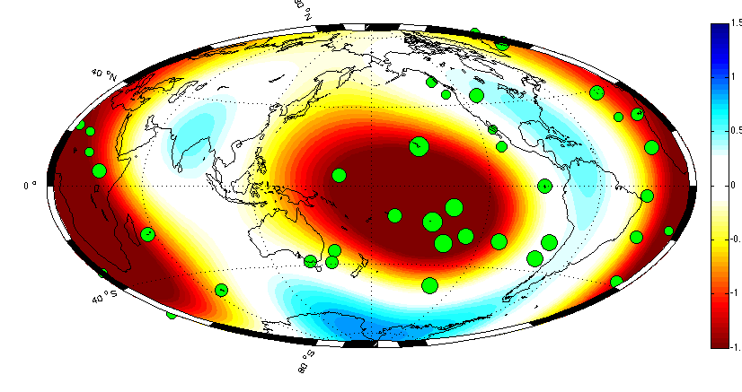
Changed reference model
contai
Nearly all hotspots. A 3-D model is a
sum of the 1-D model
and a 3-D perturbation.
Usually 3-D part has
zero average at
any depth. But it is
possible to add a constant to
the reference model
and subtract it from the 3-D
Part. A constant of 0.5%
has been added to PREM
and the same amount subtracted
From S362ANI at 2800 . It
Appears that there are only
Negative anomalies, which

Slide 33
A Planet Within a Planet
Crust
Moho
Plate Tectonics Planet
250 km
Interplanetary Interaction Zone
650 km
Superplume Planet
CMB
Core

Slide 34
Top down or bottom up
These are not mutually exclusive possibilities.
The “top” is very energetic and contains most of the spectral power of heterogeneity. It is characterized by shorter wavelength structures. The “bottom” power is concentrated in very large wavelength anomalies.
A speculation is that the processes at the “top” are relatively short lived. On the other hand, the “bottom” processes may have a time scale on the order of the age of the Earth.

