Slide 1
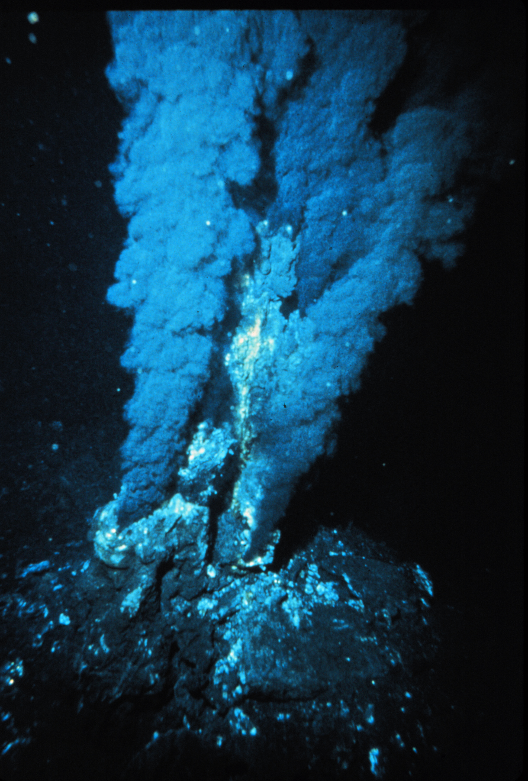
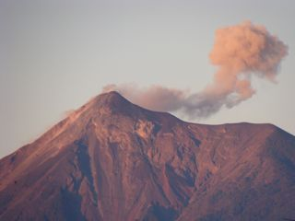
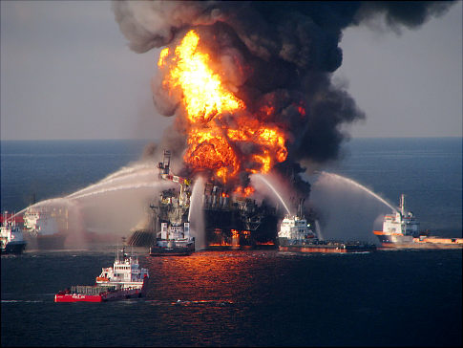
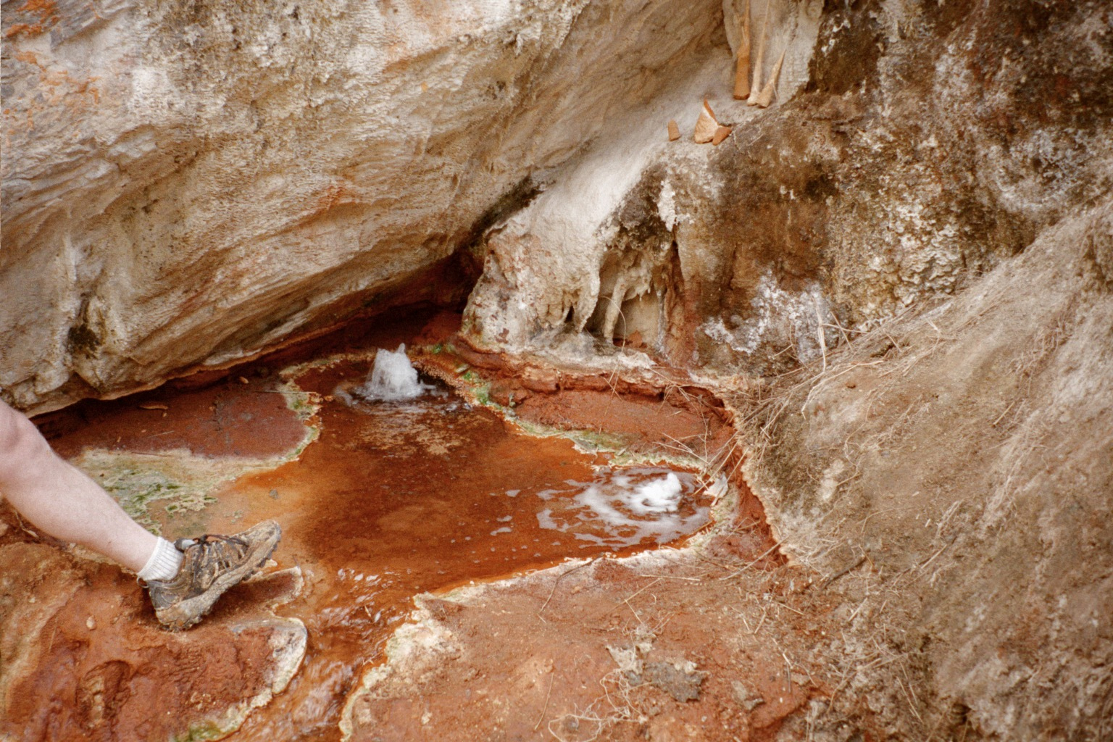
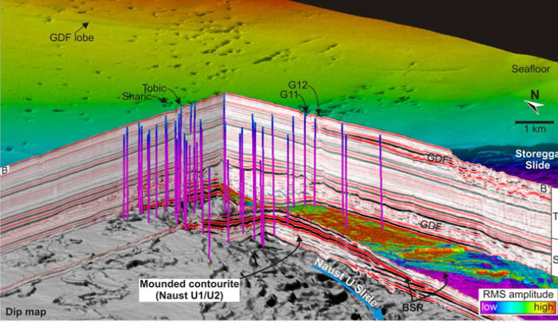
The exogenic carbon cycle (or, a few aspects, anyway)
Sources of CO₂ at the Earth’s surface
(and CH₄)
Arc CO₂
(Fuego, Guatemala)
MORs
Metamorphic degassing CO₂
pockmark fields
CH₄ vents
Oxidation of C_{org}
MCT zone
Nepal

Slide 2
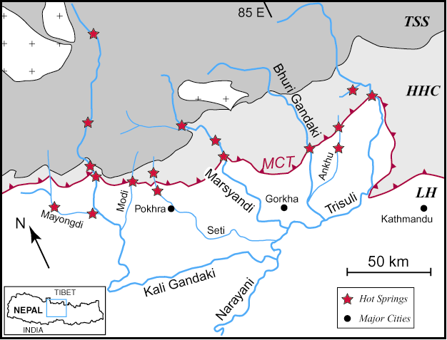
Notes:
Spring locations on geology map

Slide 4
3) CO₂ sources and fluxes
(Aggrandisement de zone d’AOC du Champagne)
Champagne bubbler, Marsyandi
pCO₂ > 1 bar, T = 55˚C
Notes:
Bubbler photo

Slide 5
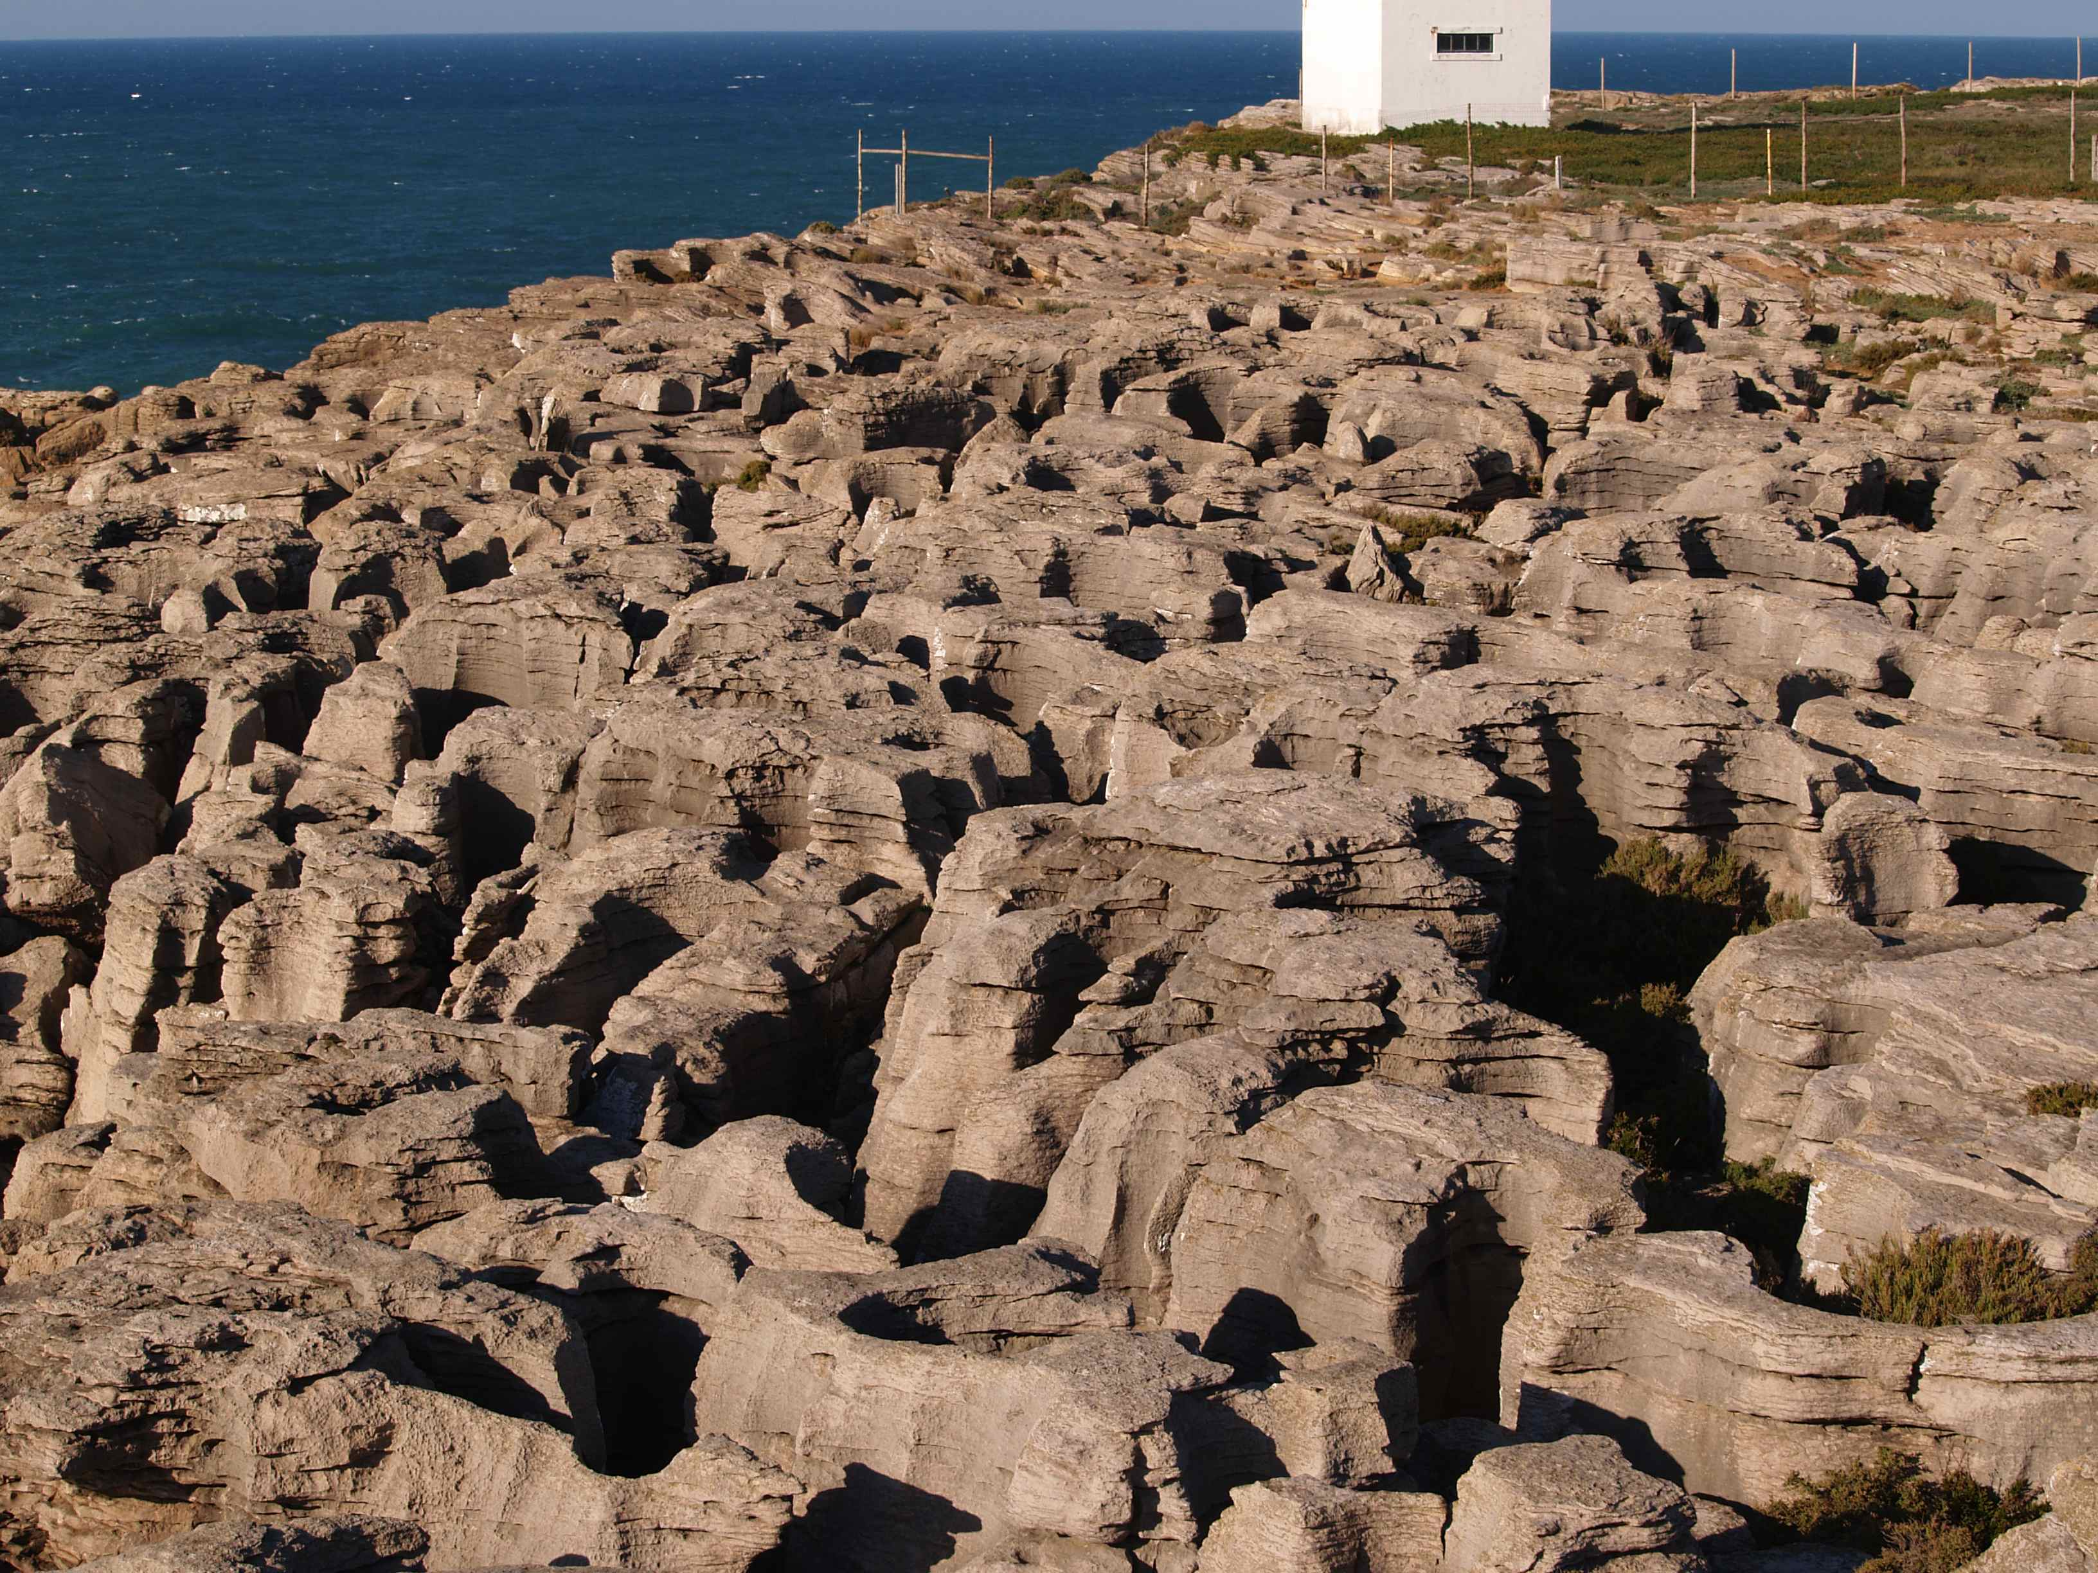
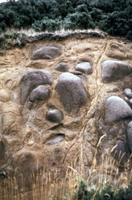
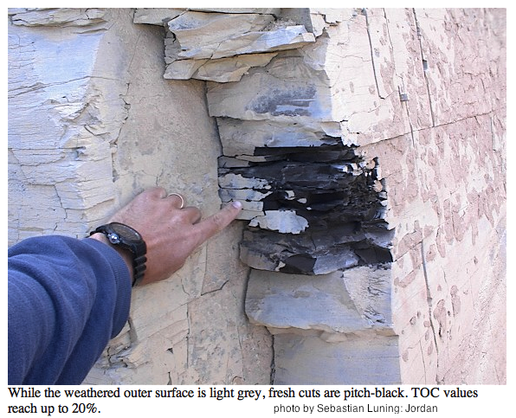
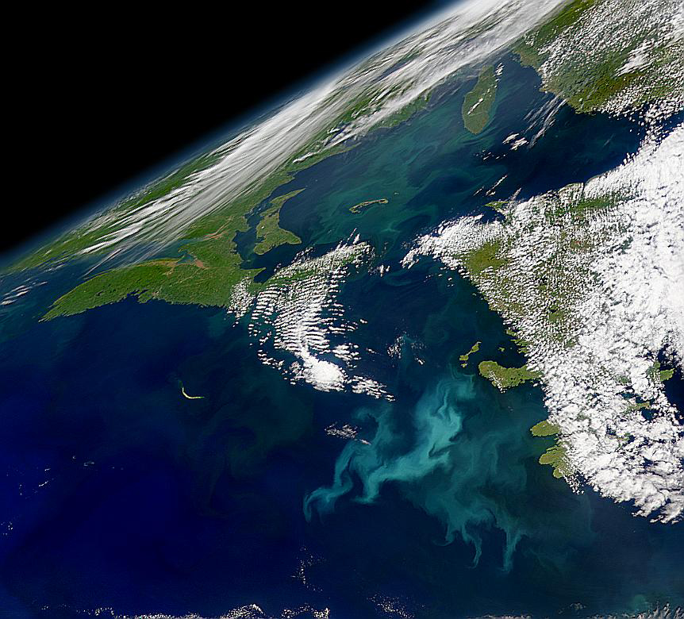
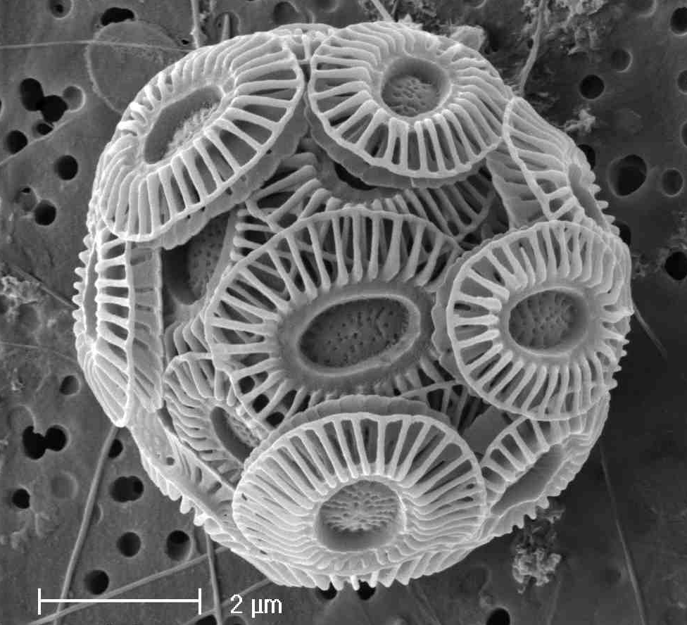
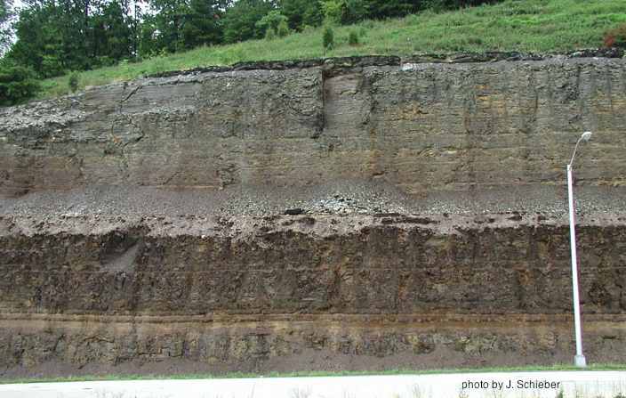
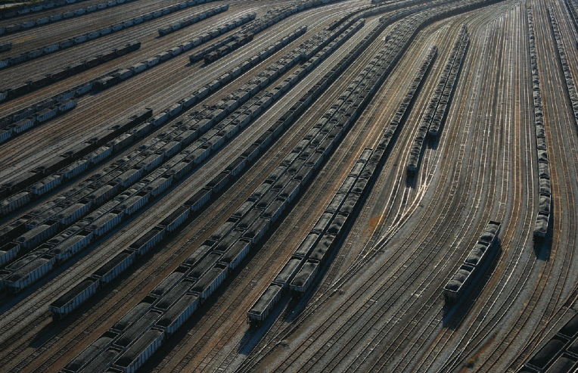
Sinks of C in the near surface environment = carb and C_{org} sediments
Carb weathering
Silicate weathering
Burial of C_{org}
(reduced C)
Cretaceous OAE
New Albany Shale
(Devonian)
Carbonate deposition in oceans
Appalachian coal

Slide 6
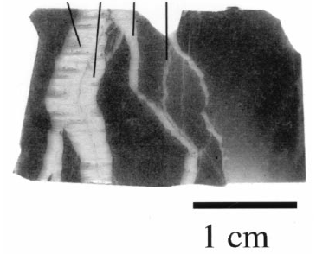
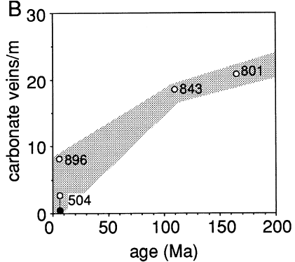
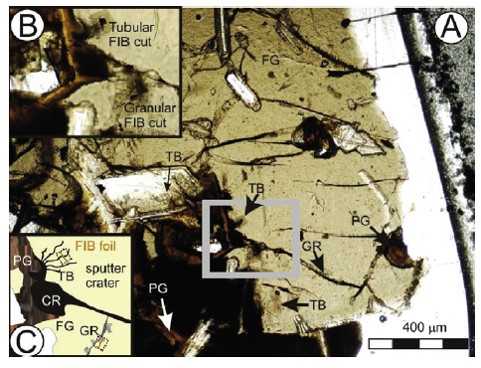
Carbonate veins
The “hidden” carbon sink
Alteration of the oceanic crust
f(time), f(ocean chem, T)
Includes both CaCO₃ and C_{red}
Fliegel et al 2012
Alt & Teagle 1999

Slide 7
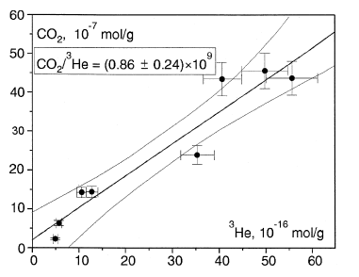
Estimates of global scale CO₂ degassing:
One approach is to scale to mantle ³He flux. ³He only has a mantle source. CO₂ contents of magmas must be corrected for partial degassing using ⁴He/⁴⁰Ar or δ¹³C.
Marty & Tolstikhin (1998)
Hilton et al. (2002) uses CO₂/SO₂ to estimate arc degassing.
CO₂/³He in N-MORB
Global ≈ 3.7±1.9 Tmol y⁻¹
but plume flux not so well known
and variable in time
MOR ≈ 2.2±0.9 ×10¹² mol yr⁻¹
Arcs ≈ 1.6±0.9
Plumes << 3?

Slide 8
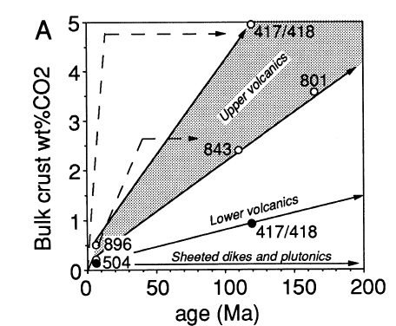
Alteration of oceanic crust (OC) as it ages is a major sink for CO₂
OC uptake of CO₂ ≈ 1.5 to 2.4×10¹² mol yr⁻¹ (Alt & Teagle, 1999 GCA)
This basically balances MOR degassing rate, within ±.

Slide 9
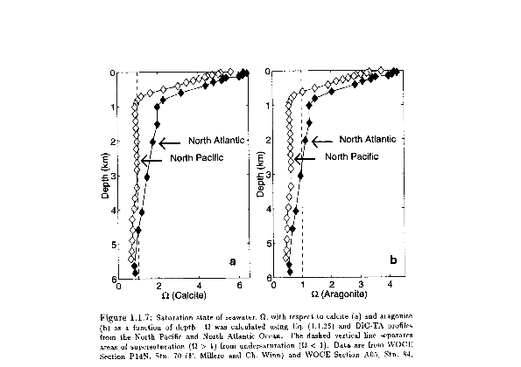

Slide 10
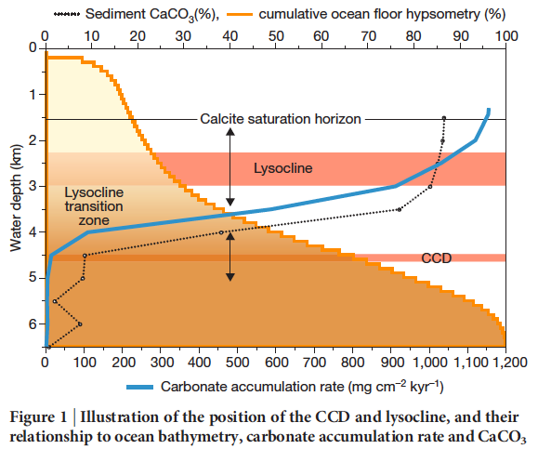
Palike et al.
Science 2012

Slide 11
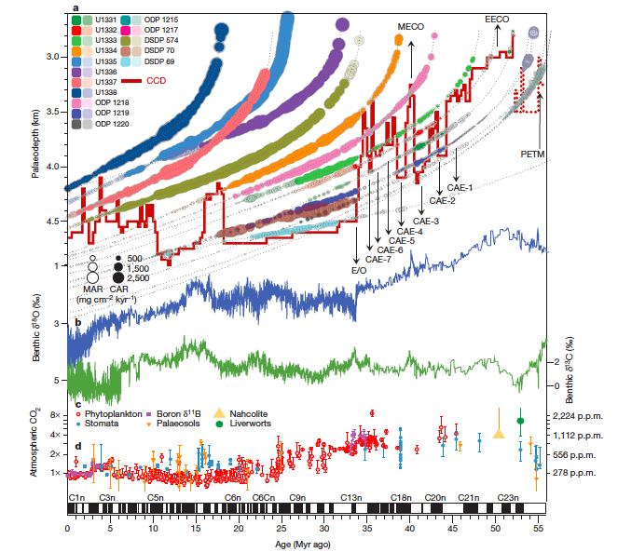
Palike et al.
Science 2012

Slide 12
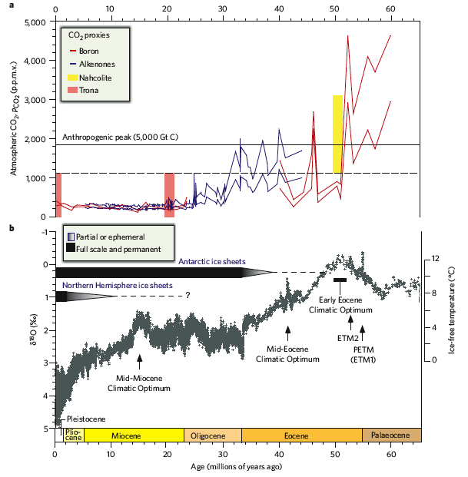
Zachos et al 2008

Slide 13
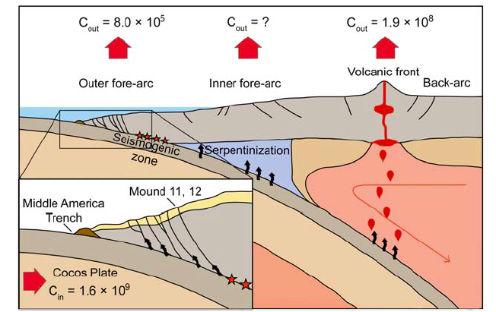
Costa Rica margin C balance (Furi et al, G3, 2010)
Input > 1.6×10⁹ g C km⁻¹ yr⁻¹ Output ≈ 2×10⁸ g C km⁻¹ yr⁻¹
i.e. ≤ 12%
Implication: most C introduced to subduction zone is recycled to mantle.
Should help maintain “steady state” surface C reservoir over long time scales
Notes:
Furi et al., Geochem. Geophys. Geosyst. 2010

Slide 14
Sedimentary sinks
Global sediment flux (modern preanthro) = 14 Gton/yr (Syvitski et al, 2005)
carbonate burial flux 24±4 Tmol/yr est. from sediment inventories and
river chemistry
weathering ≈ carbonate sedimentation (to preserve mass and alkalinity balance)
How can we estimate Corg burial flux? Inventory methods are less well-suited
Stable isotope mass balance (steady state version):
J_{Ctot} = J_{carb} + J_{org} mass fraction: X_{org} + X_{carb} = 1, or X_{org} = 1-X_{carb}
δ¹³C_{carb} = δ¹³C_{org} + ∆, where ∆ is (roughly) the effective SW – org isotopic fractionation
Then steady state mass balance requires that isotopes in = isotopes out
δ¹³C_{in} = X_{org}δ¹³C_{org} + (1-X_{org})δ¹³C_{carb}

Slide 15
0.24 × 24 Tmol yr⁻¹ J_{carb} ≈ 6 Tmol yr⁻¹ C_{org} burial
δ¹³C_{carb}, ∆_{carb-org} vary in time,
but mean mantle input δ¹³C_{in} probably doesn’t (much)

Slide 16
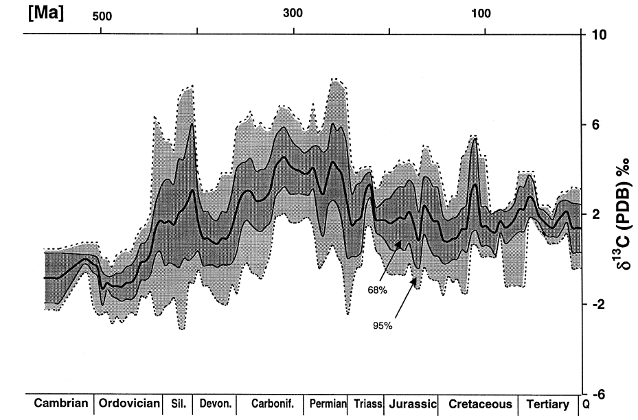
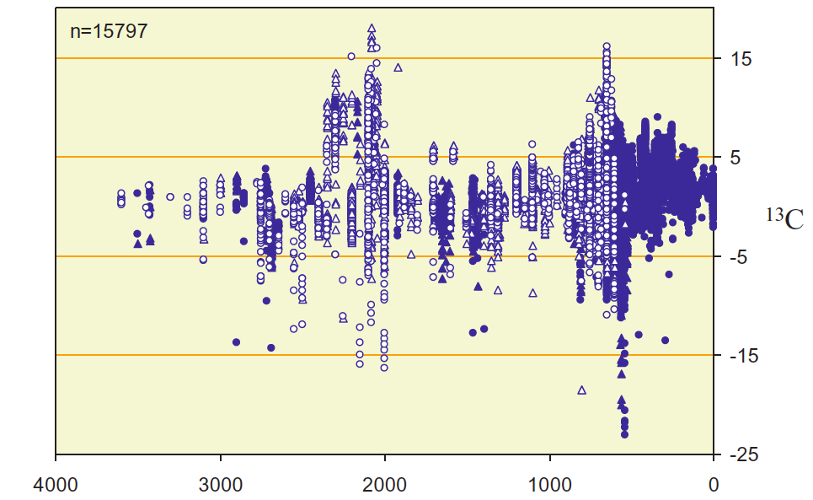
δ¹³C_{carb} variations indicate
changes in C_{org}/C_{carb} ratio entering sediments with time. It’s a separate question to estimate the total C sedimentation flux
How much of this variation is primary, and how much is caused by later alteration? Sometimes hard to answer for some critical cases …

Slide 17
What are consequences of Corg burial?
nCO₂ + nH₂O -> C_{n}H_{2n}O_{n} + nO₂, n ≈ 6 for glucose synthesis
So for each mole of C fixed, one mole of O₂ is produced. Ordinarily respiration (the back reaction) consumes all O₂, but if reduced C is buried oxidation is prevented, and you have net O₂ production.
If O₂ is produced, what happens to it?
Oxidation of old sedimentary C_{org} (weathering of kerogen)
Oxidation of Fe, S, reduced gases from mantle and crust
Accumulate in atmosphere

Slide 18
Start with oxidation of oceanic (OC) and continental crust (CC)
OC produced at MOR with Fe3+/∑Fe ≈ 0.07 (Lecuyer & Ricard, 1999)
or Fe3+/∑Fe ≈ 0.15 (Bach & Edwards, 2003)
L&R estimate whole OC, B&E upper 500 m
With time, the crust is oxidized by fluid flow, and altered crust has
Fe3+/∑Fe ≈ 0.22 (Lecuyer & Ricard, 1999)
or Fe3+/∑Fe ≈ 0.45 (Bach & Edwards, 2003)
Consider ∑Fe of OC (≈ 7-8 wt%), and production rate (≈ 5×10¹³ kg/yr)
also consider S_{red} = 0.125 wt% -> sulfate
This implies an O₂ consumption rate ≈ 0.6 to 1.9 Tmol yr⁻¹
If we carry out same analysis for CC, we get -∆O₂ ≈ 0.6 Tmol yr⁻¹
Sum -∆O₂ ≈ 1.7±1.3 (ish) Tmol yr⁻¹ TAX on O₂ production

Slide 19
If we produce ≈ 6 Tmol yr⁻¹ O₂ from C_{org} burial, but require 1.5 to 2 to oxidize Fe and S in the OC and CC, that only leaves 4+ Tmol yr⁻¹ to react with older C_{org}
So we have less O₂ to return to carbon cycle than the amount of C_{red} we produced. In other words, the C_{org} reservoir cannot be at steady state if pO₂ is even close to steady state
O₂ in atm ≈ 3.7×10¹⁹ mol, i.e.τ_{O2} ≈ 6 Myr, so “steady state” for O₂ not a really bad idea
6
≈ 4.3 so at most ≈ 70% of
C_{org} can be reoxidized. 30% has to be “stored” someplace
1.7
It’s actually worse than this ….

Slide 20
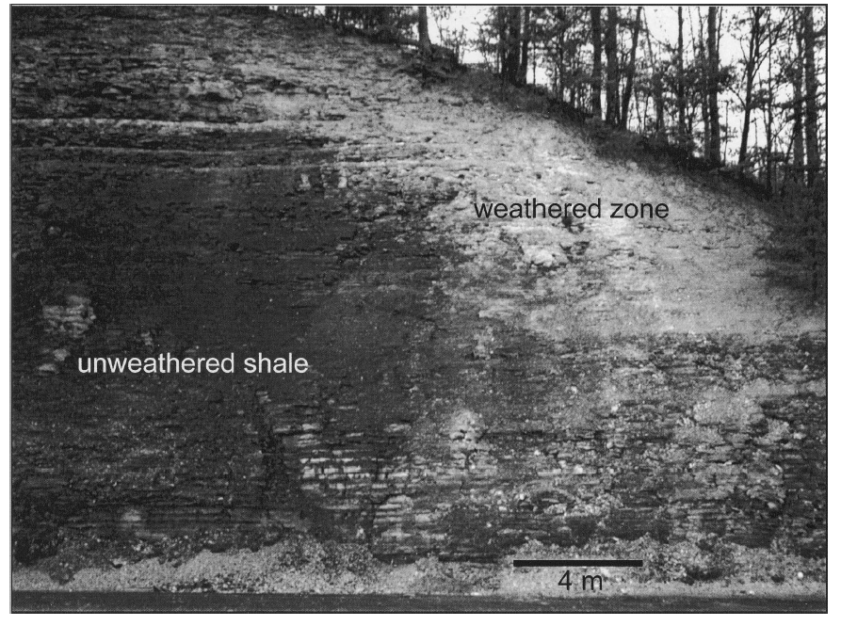
Kerogen in outcrop weathers, but weathering may be a strong function of pO₂ (so there can be an important feedback) and erosion rate (link to tectonics)
How complete is this weathering today?
i.e.
How efficient is recycling of sedimentary C_{org} under modern, high pO₂ conditions?
What might this have looked like under low pO₂ conditions?
What other pathways are important?
Devonian New Albany shale ≈ 7% TOC
Petsch et al., 2001

Slide 21
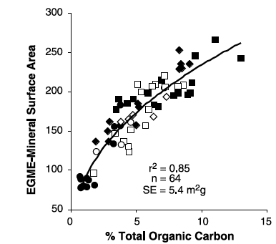
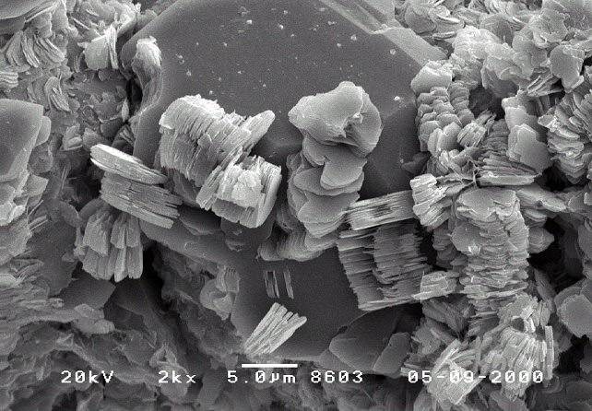
C_{org} is protected in sediments by adsorption to mineral surfaces
Recall what weathering does to mineral surface area. Weathering promotes C_{org} storage.
Mineral surface area highly correlated with %OC
Kennedy et al., 2002 Science

Slide 22
During biosynthesis and diagenesis, decarboxylation (loss of CO₂) and methylation (addition of CH₂) produces C_{org} that is more reduced than primary photosynthate
Very schematically (don’t write this down, it’s wrong)
C₆H₁₂O₆ -> C₃H₆ + 3 CO₂ decarboxylation reaction
O/C = 1 -> O/C = 0 net reduction
Instead of C₆H₁₂O₆ + 6O₂ -> + 6 CO₂ + 6 H₂O (1 O₂ per C)
We now may have something like an alkane and
C₆H₁₄ + 9.5 O₂ -> 6 CO₂ + 7 H₂O i.e. 1.5 O₂ per C

Slide 23
At higher temperatures, alkanes decompose thermally to generate CH₄ and ultimately graphitic carbon (C)
C_{n}H_{2n+2} + 2 H₂O -> 2CH₄ + CO₂ + C_{n-2}H_{2n-2} (H/C decreases)
This will ultimately yield graphitic C as a “residue”
Graphitic C is very unreactive, even in the presence of O₂
Graphitic C should be a long term stable reservoir of reduced C in the crust.
Methane oxidation is efficient and has high O₂ demand
CH₄ + 2 H₂O -> CO₂ + 2 H₂O i.e. 2 O₂ per mol of C

Slide 24
Methane fluxes from sedimentary basins are large, placing further demands on O₂ supply
Etiope estimates 3.3 Tmol yr⁻¹ of CH₄ is released from sedimentary basins
This flux alone may exceed the oxidizing capacity of the steady state system, implying a) it’s overestimated, or b) lack of steady state
There are too many parameters we don’t know well to solve satisfactorily, and some parameters certainly change with time.

Slide 25
Assume “steady state” oxygen balance (Phanerozoic changes < 2×)
Assume δ¹³C of mantle input remains quasi-constant
Use Monte Carlo approach to investigate solution space

