Slide 1
I am not Mark Pagani
Louis Derry - Cornell

Slide 2
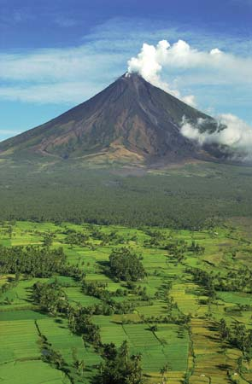
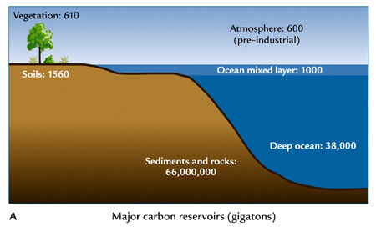
Terr – atm exchange (GPP)
1.0×10⁴ Tmol/yr
≈ 6-8 Tmol/yr
Anthro CO₂ emissions: 790 Tmol/yr
5×10⁴ Tmol
3.2×10⁶ Tmol
5.5×10⁹Tmol
1 gigaton = 1x10⁹ tons = 1x10¹⁵ g (1 petagram, Pg)

Slide 3
Residence time:
where R_{a} is the reservoir a and F_{b→a} is a flux from some other reservoir b to the reservoir a. In plain English; the reservoir size divided by the input flux.
Importantly τ is approximately the relaxation time constant
Some relevant residence (relaxation) times: both the reservoir and flux must be identified for τ to have any meaning
wrt to biological cycling
wrt to volcanic degassing

Slide 4

The carbon cycle is like a complex clock mechanism. “Cycles” with very different time constants from diurnal (<10⁻² years) to >10⁹ years are coupled.
If the problem is largely linear, it’s OK to ignore the fast cycles when considering long time scale sand vice versa. If it’s non-linear, not so much…
The full problem is very “stiff” because the time constants span 11 or more orders of magnitude.

Slide 5
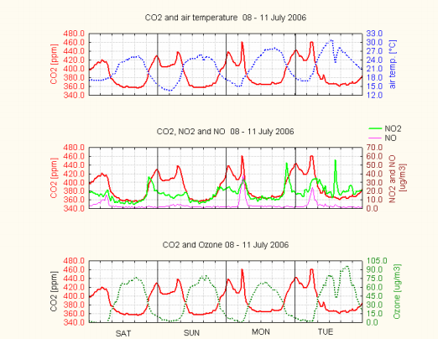
Diurnal cycle, Diekirch Forest, Luxembourg
Notes:
Massen et al. 2007

Slide 6
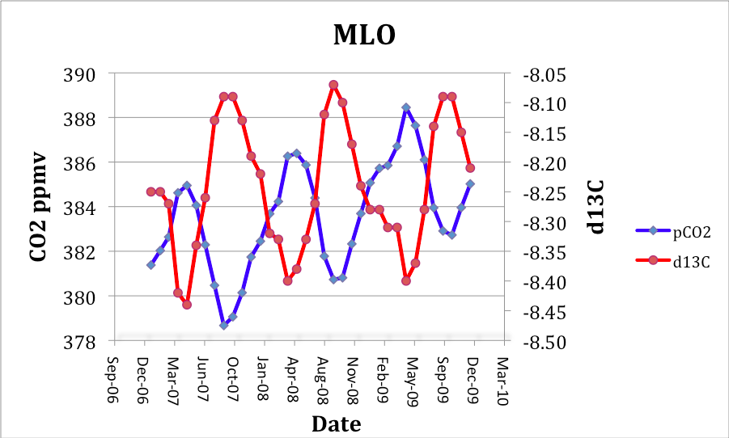
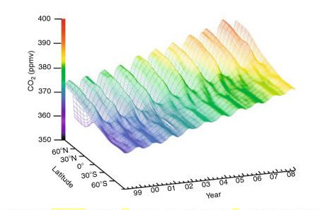
Seasonal variation in N hemisphere atm CO₂ consistent with short residence time wrt to terrestrial uptake

Slide 7
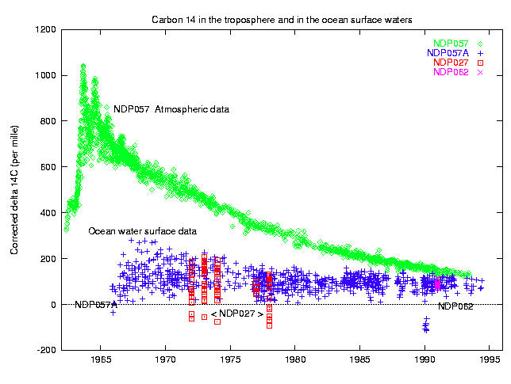
Bomb carbon spike in 1964
Exponential fit to declining ¹⁴C content of atm yields τ ≈ 17 yrs
so our simple calculation is “OK”

Slide 8
EPICA Dome C ice core results
CO₂, ppmv
Age, yr bp
so why doesn’t CO2 go all over the place in 10 kyr?
There must be strong stabilizing feedbacks
Notes:
ftp://ftp.ncdc.noaa.gov/pub/data/paleo/icecore/antarctica/epica_domec/edc-co2.txt

Slide 9
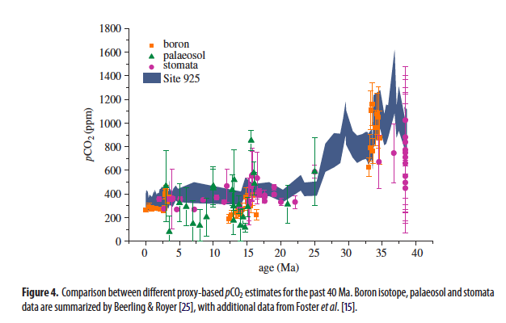
Zheng et al. 2013
Notes:
Zheng et al Phil Trans R Soc 2013

Slide 10
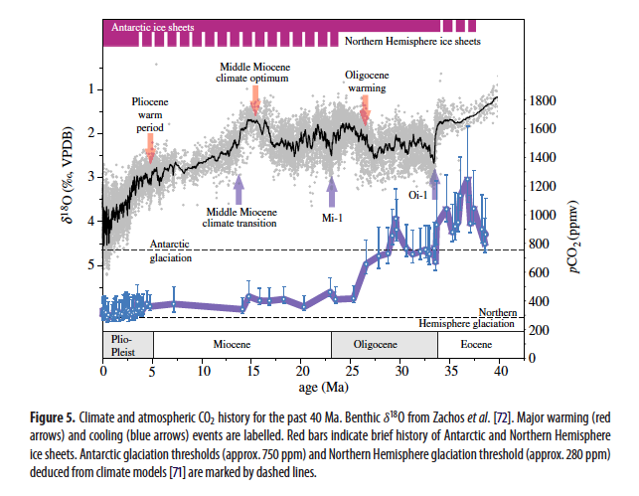
Zheng et al. 2013
Notes:
Zheng et al Phil Trans R Soc 2013

Slide 11
CO₂ + H₂O → H₂CO₃ carbonic acid
H₂CO₃ → HCO₃⁻ + H⁺ bicarbonate ion
HCO₃⁻ → CO₃⁼ + H⁺ carbonate ion
Ca⁺⁺ + CO₃⁼ → CaCO_{3 (S)} calcite, aragonite
Some basic reactions and nomenclature:
If some process (volcanism, burning coal) adds CO₂ to the atmosphere what happens in the oceans?
CO₂ + H₂O + CO₃⁼ → 2HCO₃⁻ acidification
H₂CO₃ + CaCO₃ → Ca⁺⁺ + H₂O + 2HCO₃⁻ carbonate dissolution
So adding CO₂ to the ocean-atmosphere system should
Acidify the water
Dissolve calcium carbonate
OK, let’s see if any of that happens ….

Slide 12
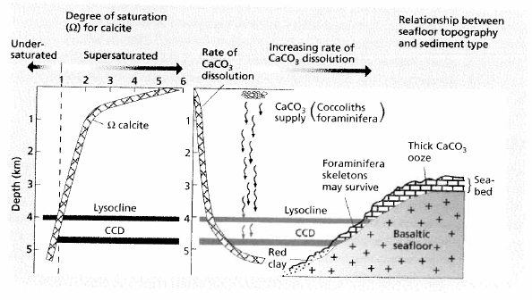

Slide 13
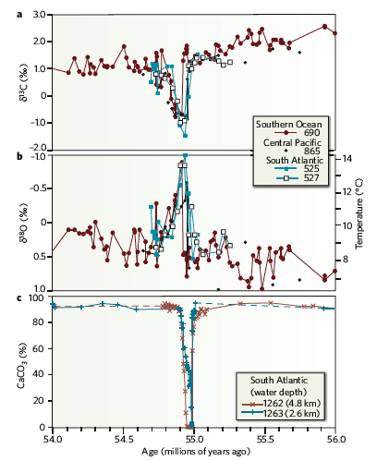
Zachos et al. 2008
Nature

Slide 14
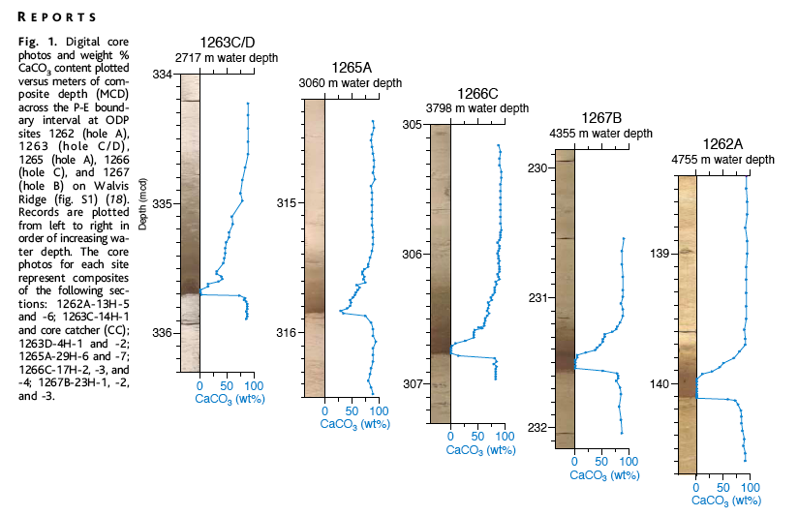
Zachos et al., 2005 Science

Slide 15
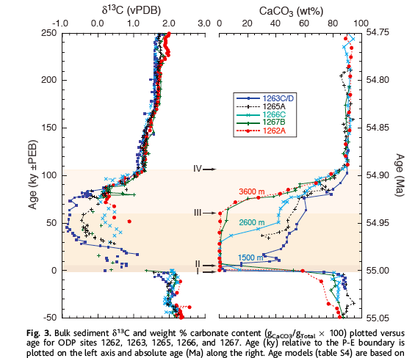
Zachos et al., 2005 Science

Slide 16
So, what restores CaCO₃ over 100 kyr?
We need to supply new Ca⁺⁺ to “titrate out” extra CO₂ that was added.
We can do that via weathering
What does weathering do?
Acid-base reaction where carbonic acid is neutralized by reaction with base cation-containing minerals
H₂CO₃ + CaCO₃ → Ca⁺⁺ + H₂O + 2HCO₃⁻
H₂CO₃ + CaAl₂Si₂O₈ → Ca⁺⁺ + 2HCO₃⁻ + Al₂Si₂O₅(OH)₄
Weathering reactions deliver cations and bicarbonate to the oceans
Some of these (Ca, Mg) form carbonates. Others (Na,K) cannot.
So, what you weather matters!

Slide 17
The “missing” charge is mostly HCO₃⁻ and CO₃⁼, and is ≈ constant for short time scales.
ALK ≈ [HCO₃⁻] +[ CO₃⁼] + … quasi-conservative
Weathering generates ALK. Carbonate precipitation removes it.

Slide 18
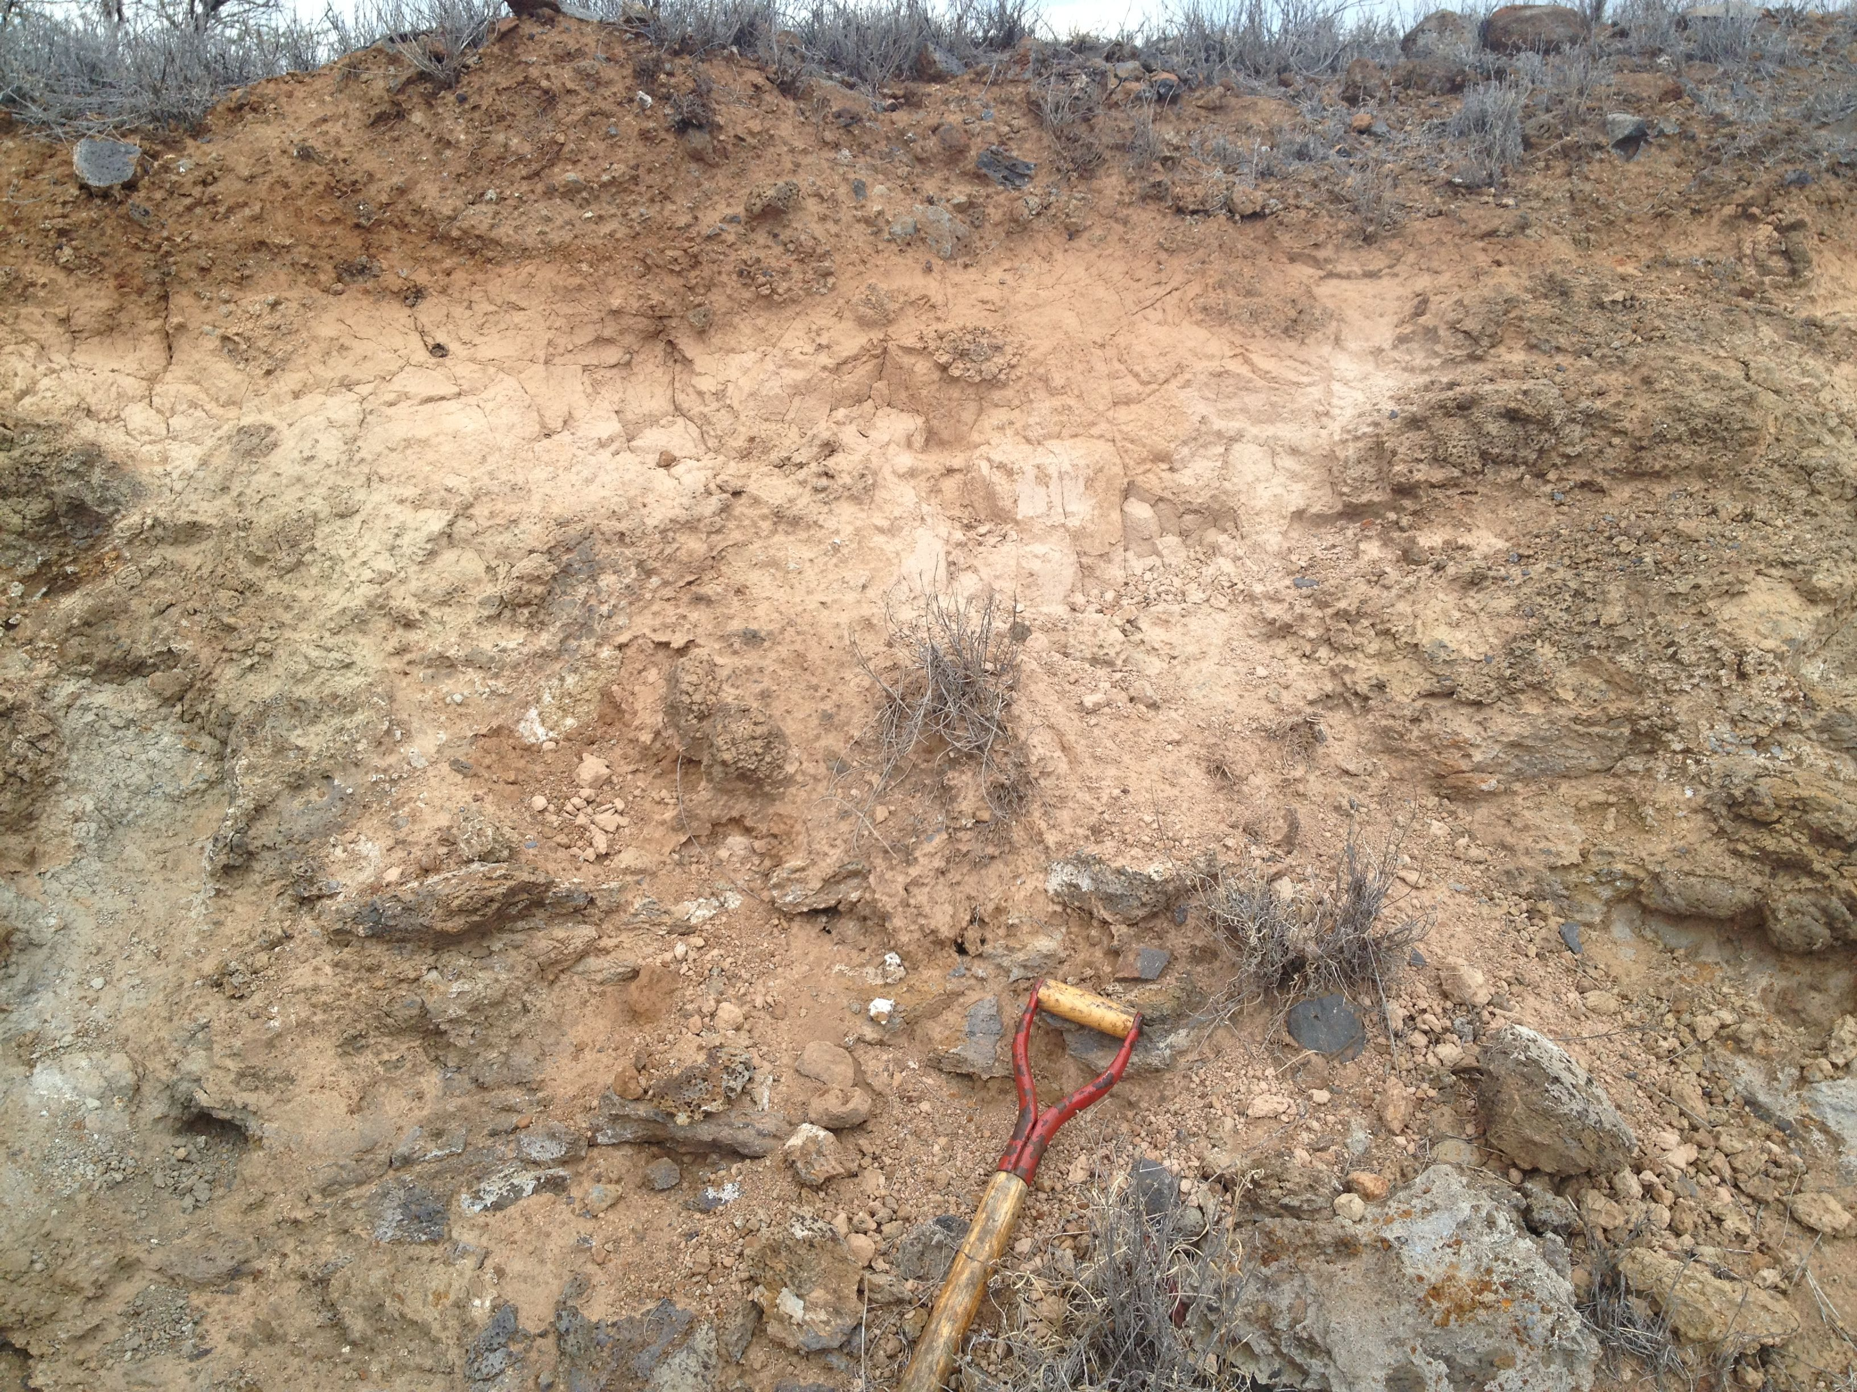
….. to this, and why do we care?
Amorphpus Fe-oxides and Si-Al mineraloids, organic matter,rock fragments
Gibbsite clay Al(OH)₃
Pedogenic carbonate
Notes:
Outcrop of weathered Pololu basalt (ca. 350 ka) near Kohala coast, Hawaii (Derry photo)

Slide 19
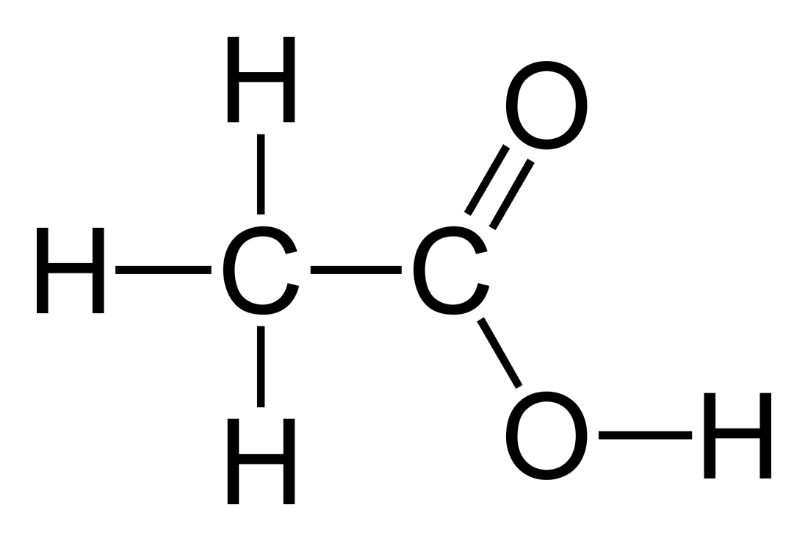
Generation of acidity – hydrolysis of CO₂
      CO₂ + H₂O <-> H₂CO₃ carbonic acid
      H₂CO₃ <-> H⁺ + HCO₃⁻ bicarbonate ion
      HCO₃⁻ <-> H⁺ + CO₃⁼ carbonate ion
[H+] ≈ √(pCO₂) pCO₂ = 400 ppm -> pH = 5.66 atmosphere
pCO₂ = 4000 ppm -> pH = 5.16 e. g. soil gas
Organic acids from biosynthesis and decomposition
CH₃COOH <-> H⁺ + CH₃COO⁻ acetic acid as a simple
example of carboxylic acids:
citric acid, oxalic acid, etc …
Ligands also play key role in
enhancing solubility of Al, Fe, etc.

Slide 20
Weathering of carbonates:
Acid-base reaction
CaCO₃ + H₂CO₃ <-> Ca⁺⁺ + 2 HCO₃⁻
Ca⁺⁺ + 2 HCO₃⁻ <-> CaCO₃ + H₂O + CO₂
_________________________________________________________________
Carbonic acid consumed, base cation and bicarbonate produced
In oceans, reaction is reversed resulting in sedimentation and pH ≈ 8.3
Net is zero change in CO2
Carbonate weathering is an important buffer
but not a long term sink for CO₂

Slide 21
Weathering of Ca, Mg silicates consumes CO₂
CaAl₂Si₂O₈ + 2 CO₂ + 3 H₂O <-> Ca⁺⁺ + Al₂Si₂O₅(OH)₄ +2 HCO₃⁻
Ca⁺⁺ + 2 HCO₃⁻ <-> CaCO₃ + H₂O + CO₂
_________________________________________________________________
CaAl₂Si₂O₈ + CO₂ + 2 H₂O <-> CaCO₃ + Al₂Si₂O₅(OH)₄
Acid (CO₂) consumed, base cation, bicarbonate, and clay produced
net
Important:
Na, K silicates are much less efficient sinks for CO₂
(because we don’t make Na₂CO₃ in the oceans)
2NaAlSi₃O₈ + 2CO₂ + 2 H₂O <-> 2Na⁺ + 2HCO₃⁻ + Al₂Si₂O₅(OH)₄

Slide 22
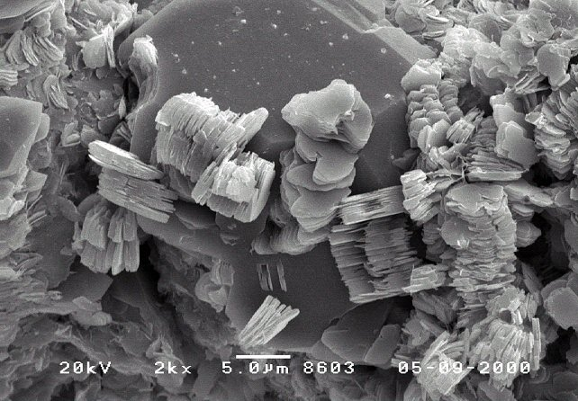
Kaolinite produced by weathering qtz diorite, Luquillo, PR (White et al., 1998)

Slide 23
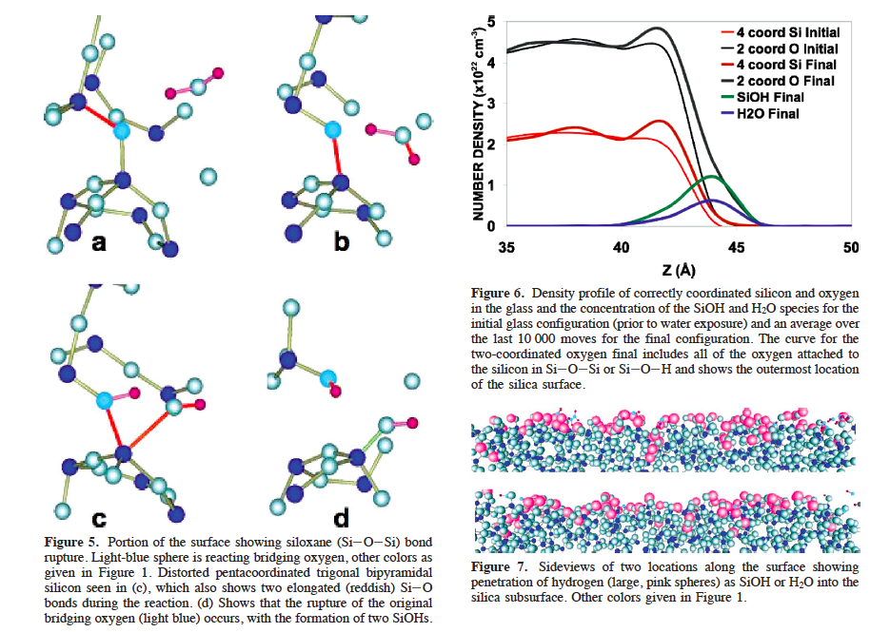
Notes:
Madadevan and Garofalini (2008) Jour. Phys. Chem. C

Slide 24
Rate “laws” for silicate weathering
hydrogen ion activity
Saturation index
(distance from equilibrium)
Rate constant
f(T)
reactive surface area:
evolves with reaction,
tectonics, erosion rate
This one place where the hydrology comes in. If the system is very wet, it can be strongly undersaturated, and that promotes faster reaction.
This is the main place where temperature comes in. Arrhenius dependence on T:

Slide 25
For silicate weathering reactions, E_{a} is usually 50 - 60 kJ/mol.
That implies an increase in reaction rate of about 2.5 for a 10˚C increase in temperature.
This is the “Walker thermostat” or “BLAG model” (in fact 19th C roots
But we have seen that water flux matters too (the saturation or affinity term), and that tectonics and erosion matter (generating reactive surface area). So this is not simple.
Temperature matters
Water matters
Erosion/transport rate matters
  How much does each, and why, and how does it vary?

Slide 26
Some controls on weathering reactions rates:
Distance from equilibrium (degree of undersaturation)
Diffusive transport to/from interface
Surface site occupancy (reversible/irreversible)
Defect density in crystal structure
Mineral surface area (evolves with reaction)
Complexation, ligands (esp. organic ligands)
Temperature
Coatings of secondary minerals
pH
Strain rate from ∆V of secondary mineral formation
Permeability of weathering zone
  You get the idea …
It is not easy to begin with microscopic properties/processes and predict behavior at the scale of a soil profile or watershed. Reactive transport modeling tries to do that at a continuum scale, but many kinetic parameters must be specified and are often poorly known.

Slide 27
Climate – weathering feedback
Solar luminosity has increased 25 – 30% over Earth history
But liquid water continuously present since > 4 Ga
Goldilocks solution – not too hot, not too cold
Continuous CO₂ release from interior, greenhouse
Tau_{CO2} ≈ 50 ka
What regulates T over time if CO₂ response time is < 0.1 Ma?
Let’s imagine that atmospheric CO₂ increases. Then :
  T increases
  Reaction rate increases as f(T)
  Water cycle accelerates (Sat H₂O P of atm is exponential in T)
  CO₂ consumption is enhanced by 2, 3
  CO₂ decreases
  T decreases
Voila!
But does this actually work? What exactly are mechanisms in play?

Slide 28
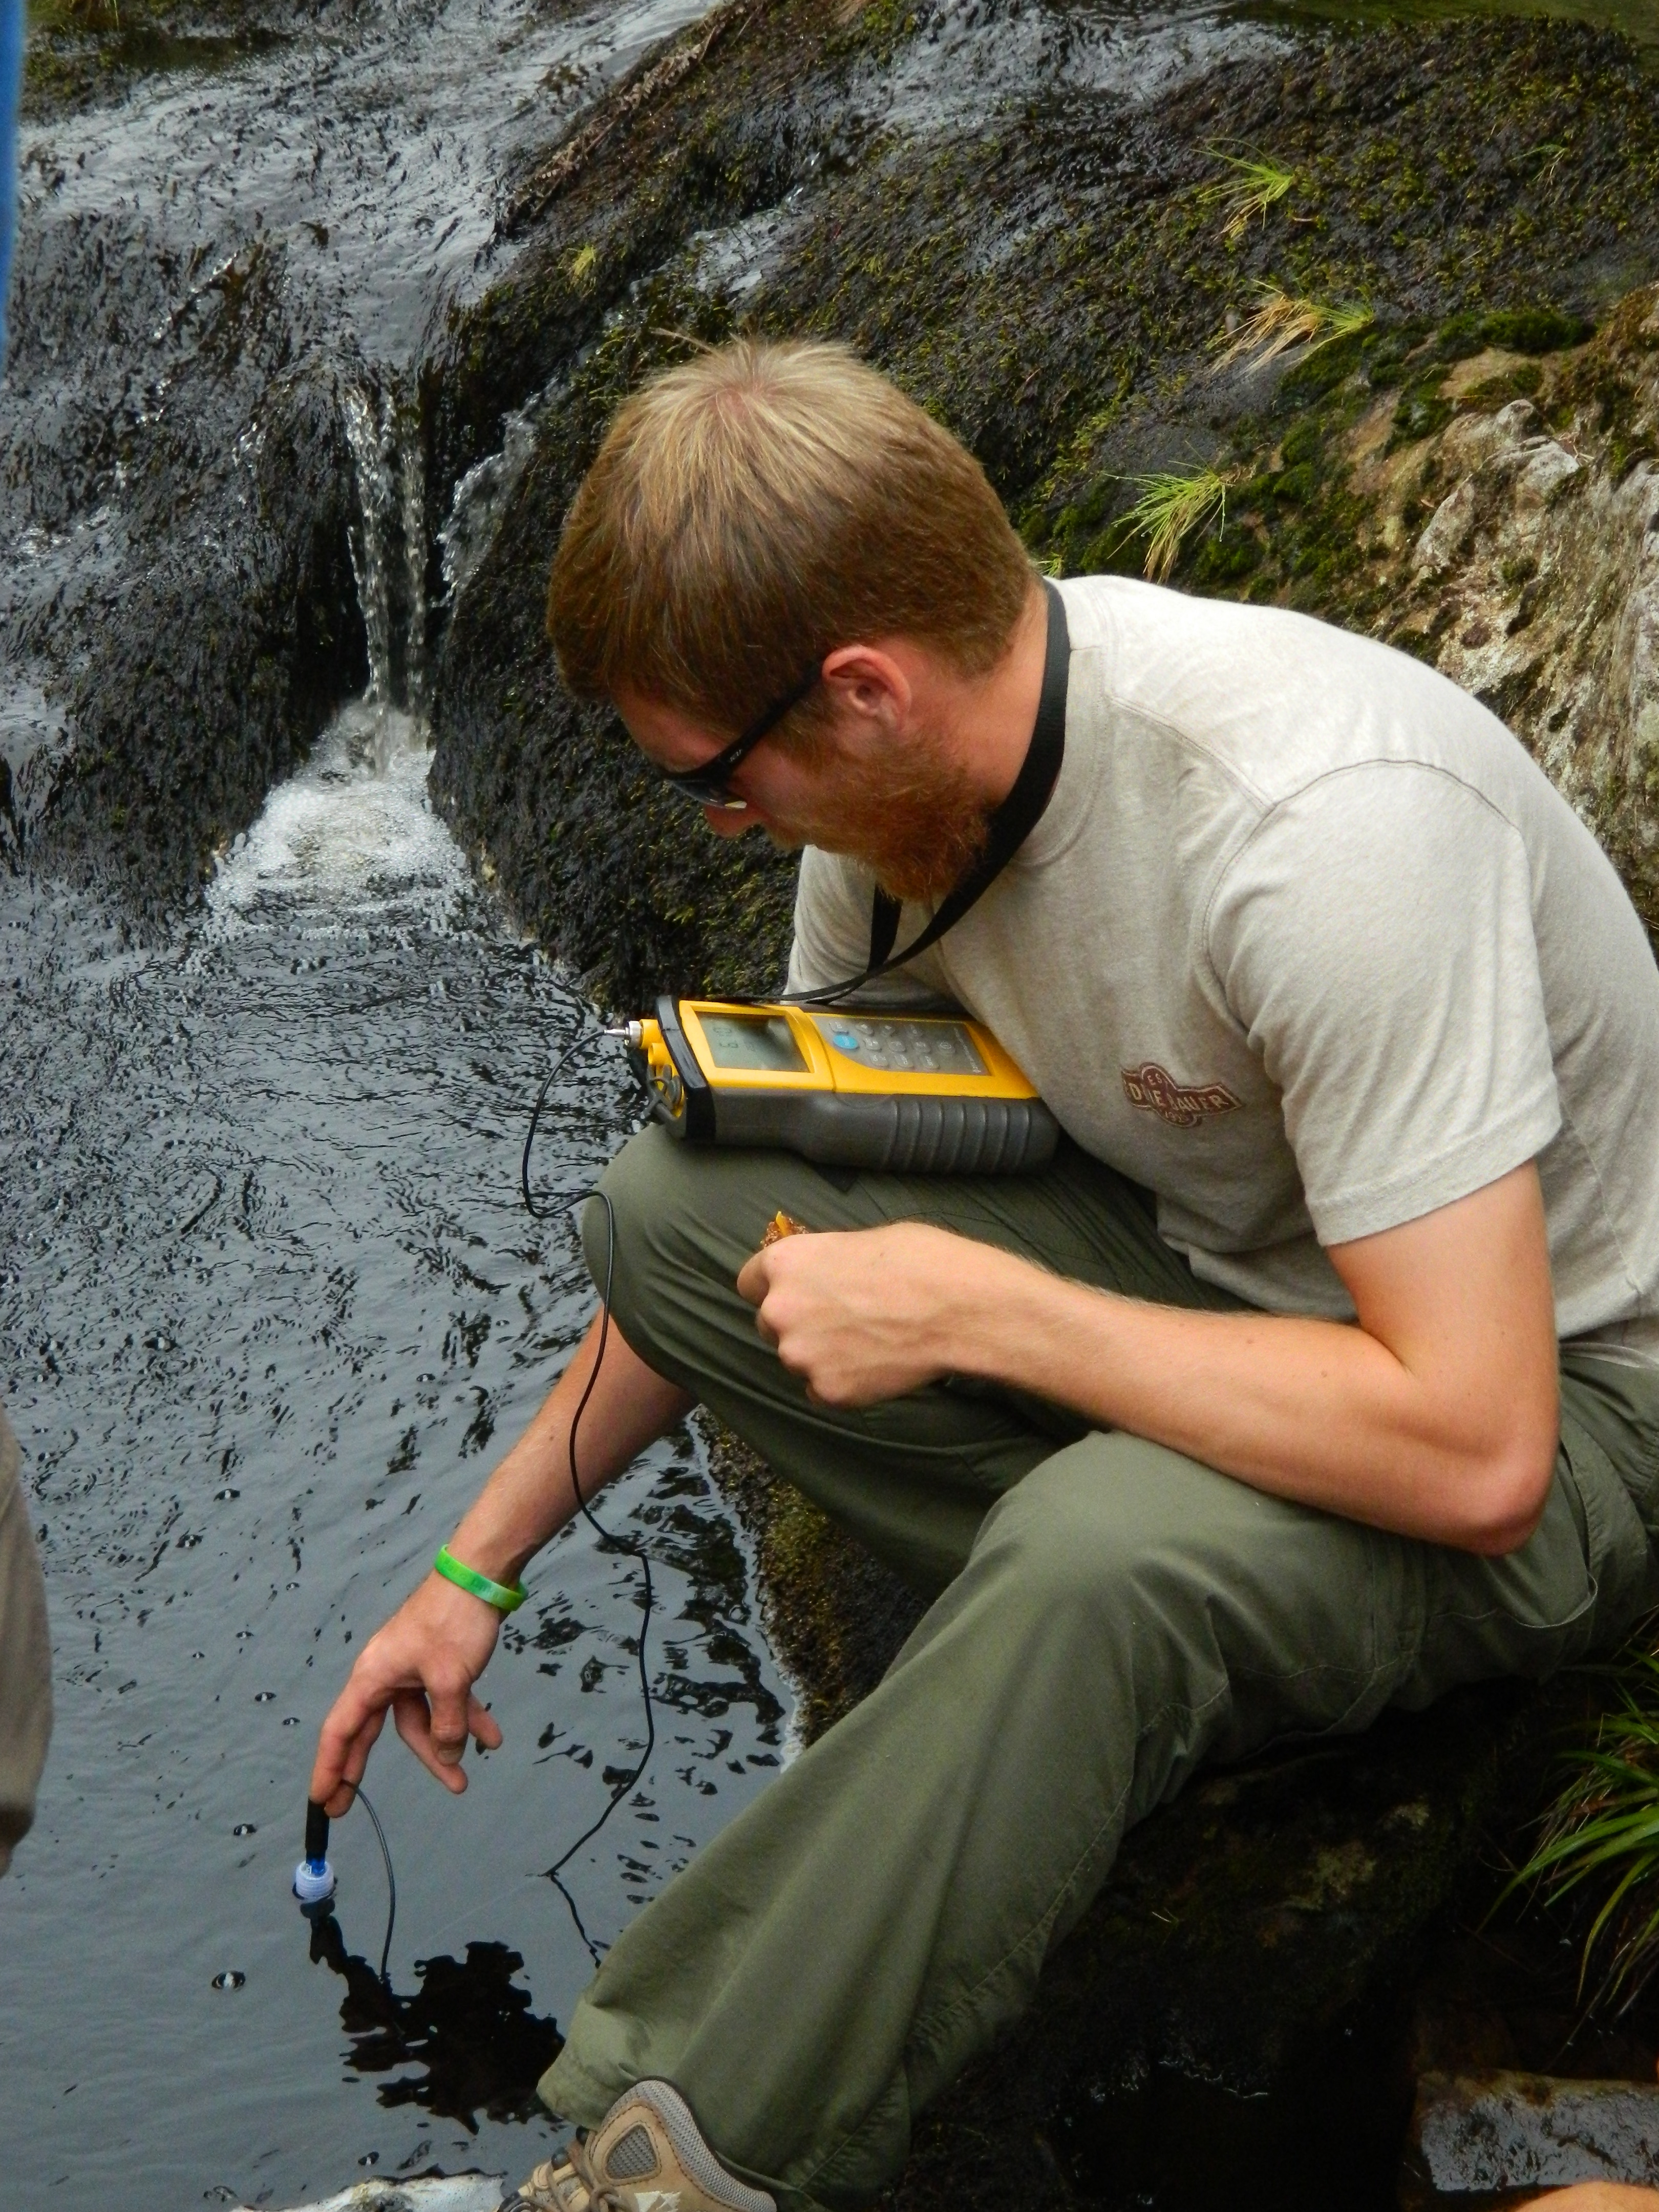
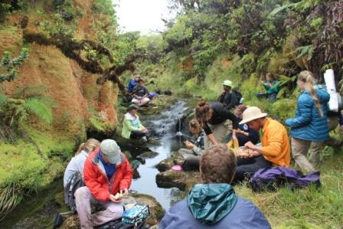
How do we study weathering rates and process at large scales?
One way is to measure the dissolved flux exported by rivers
In principle, this should integrate chemical processes over wide areas and highly heterogeneous geology. Give me one bottle of Amazon water …
Wait, isn’t that a problem if you have different kinds of processes operating whose effects you’d like to separate?

Slide 29
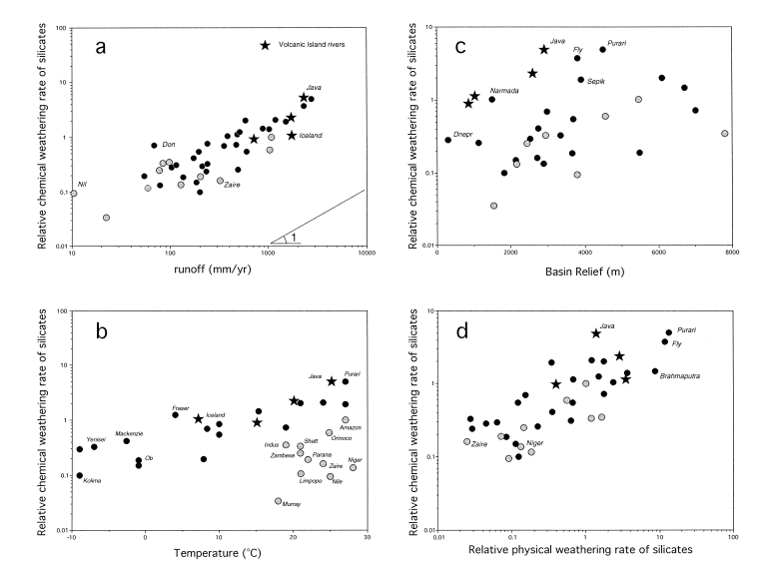
Weathering as f(Temp, runoff, erosion) in large rivers
climate sensitivity there but not as strong as expected
erosion rate plays an important role (tectonics + climate)
runoff
relief
Temperature
erosion
Gailardet et al., 1999

Slide 30
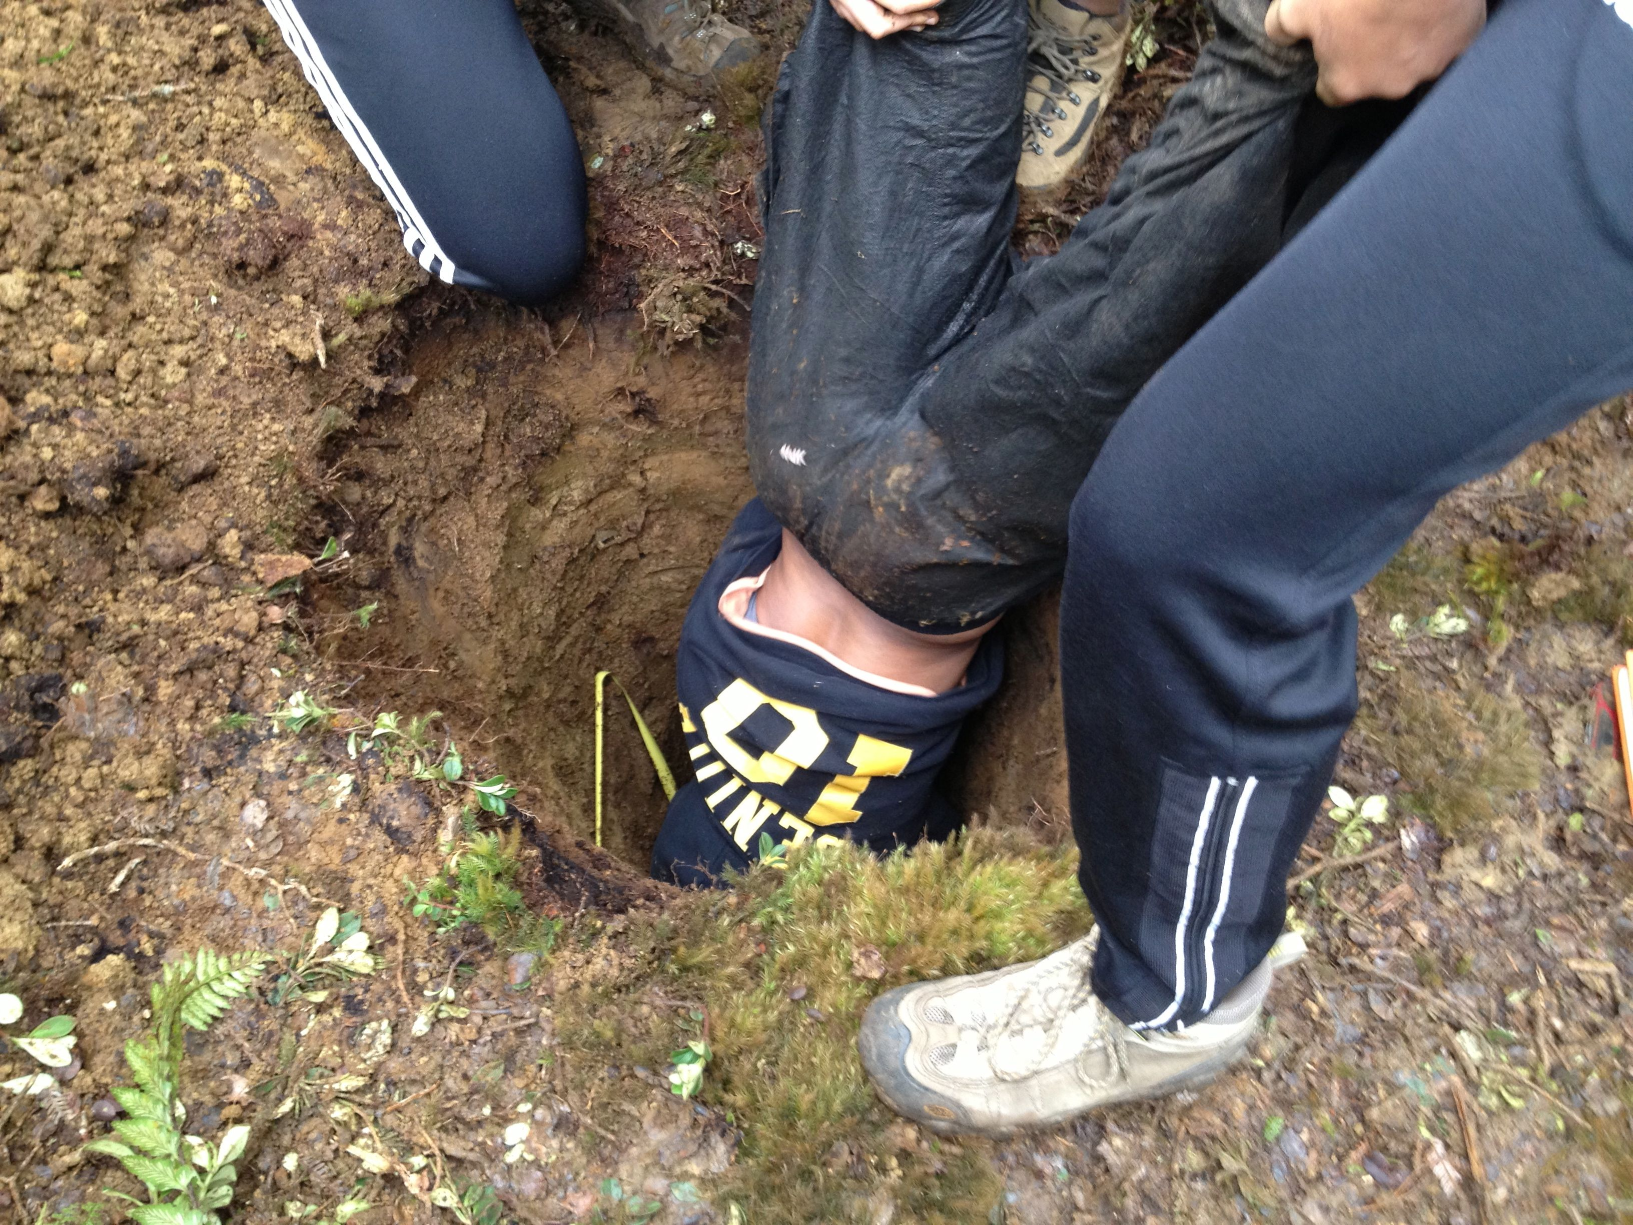
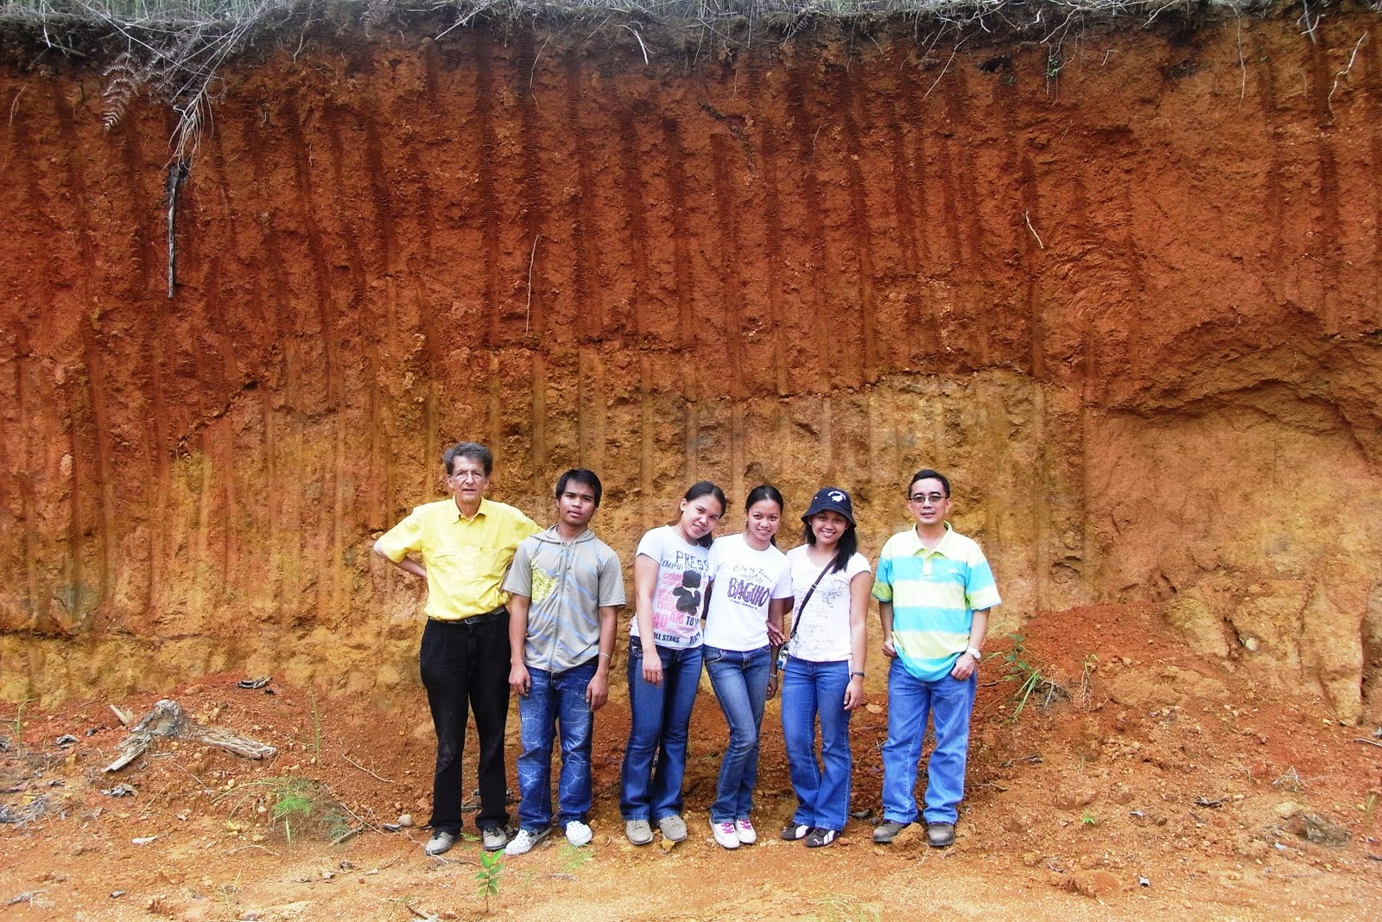
Another way is to sample the regolith (e.g. the boundary layer between the atmosphere and lithosphere, and where “everything” lives. We can look at compositional change as a function of chemistry/lithology/climate etc/

Slide 31
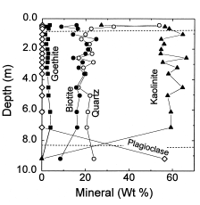
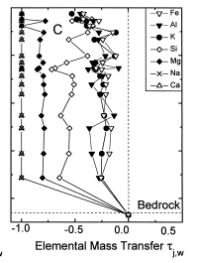
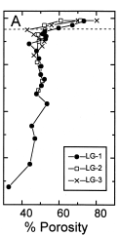
Soil profile from Luquillo, Puerto Rico, figure from White et al 1998 (GCA)
Normalized change
Integrate soil horizon density, thickness, elemental depletion to estimate
mass transfer. If we can add time we get a rate (cosmogenics).

Slide 32
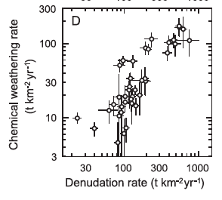
Studies based on chemical depletion indices of soil and cosmogenic nuclides
Riebe et al EPSL 2004

Slide 33
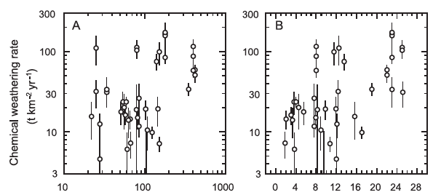
MAP, cm yr⁻¹
MAT, ˚C
E_{a} modeled 17 – 24 kJ mol⁻¹
Riebe et al EPSL 2004

Slide 34
Possible erosion control on weathering rates – is tectonics the first order control?
Paleocean tracer chemistry appears to support that, but (there’s always a but) ….
What is it, exactly, that the tracers are tracing?

Slide 35
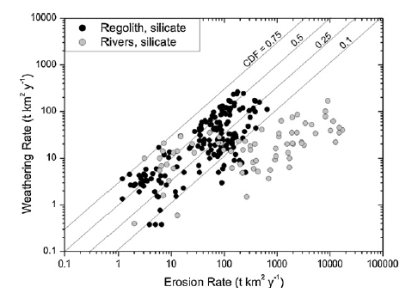
In continental settings R(wea) increases with R(erosion), to a point. At higher R(erosion) R(wea) “plateaus”, i.e. kinetics limit chemical reaction progress.
Dixon & von Blankenburg 2012 C.R. Geosci.

Slide 36
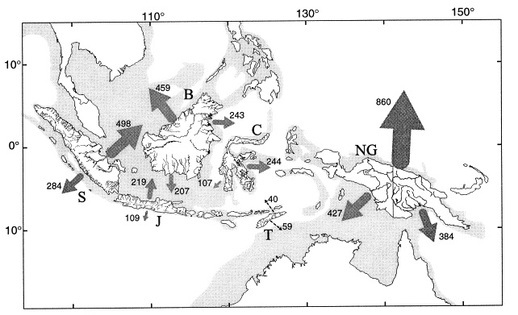
Arcs – a critical sink in the global C cycle?
Underrepresented in our data and our thinking
No big rivers
Large groundwater fluxes (unmeasured!)
Interesting features
Ca, Mg rich compositions
Fast kinetics in volcanic rocks
Tectonically active
Wet
High erosion rates
Frequent resurfacing
Climate sensitivity?
Milliman: sed yields are ≈10x global average

Slide 37
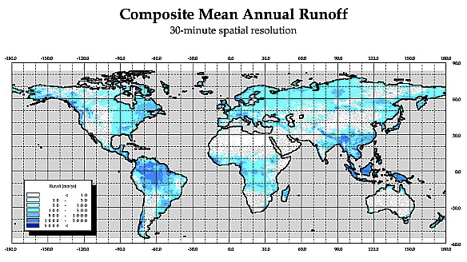

Slide 38
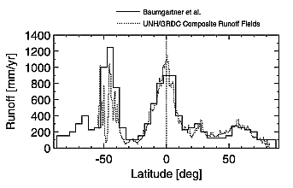
Are the fluxes from arcs and OIBs large enough to matter?
Global mean runoff ≈ 299 mm (Fekete et al., 2002)
Arcs and OIBs much wetter

Slide 39
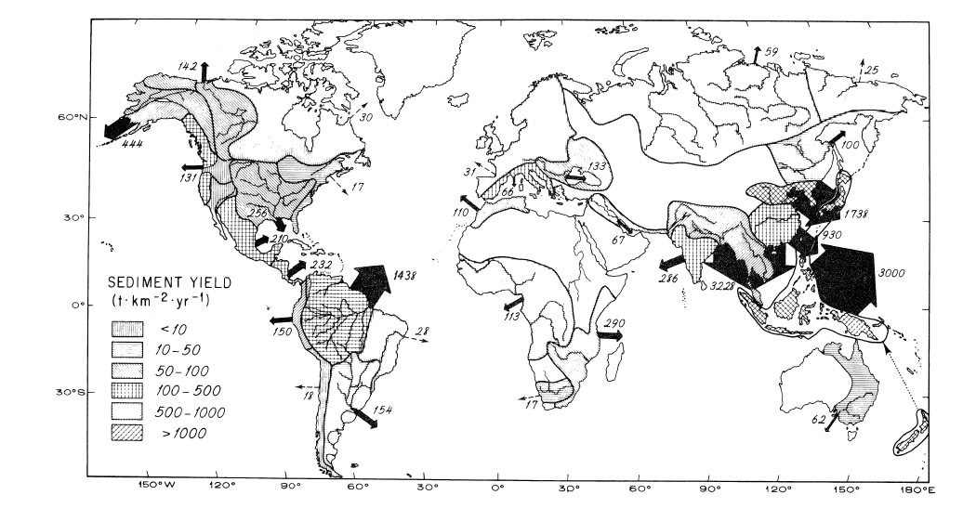
Global annual sediment delivery to oceans
Milliman 1983 J. Geol.

Slide 40
Arc and OIB rivers are different ….
Hawaii
Philippines

Slide 41
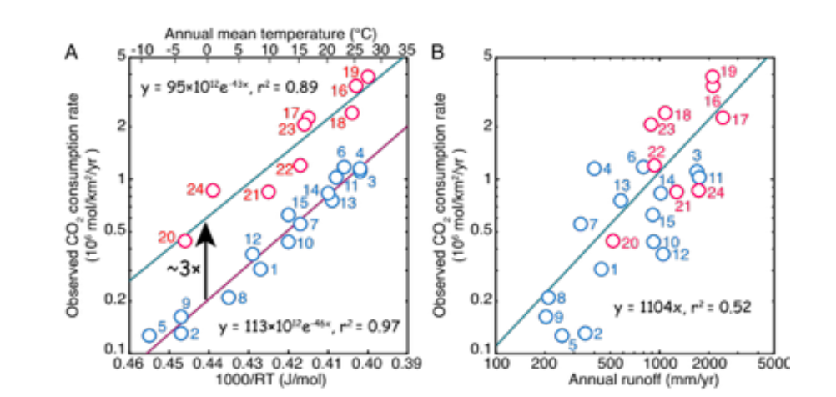
Basalt weathering rates from globally distributed sites
(Li et al, submitted)
active provinces
inactive provinces
Exponential T dependence
Hydrologic dependence

Slide 42
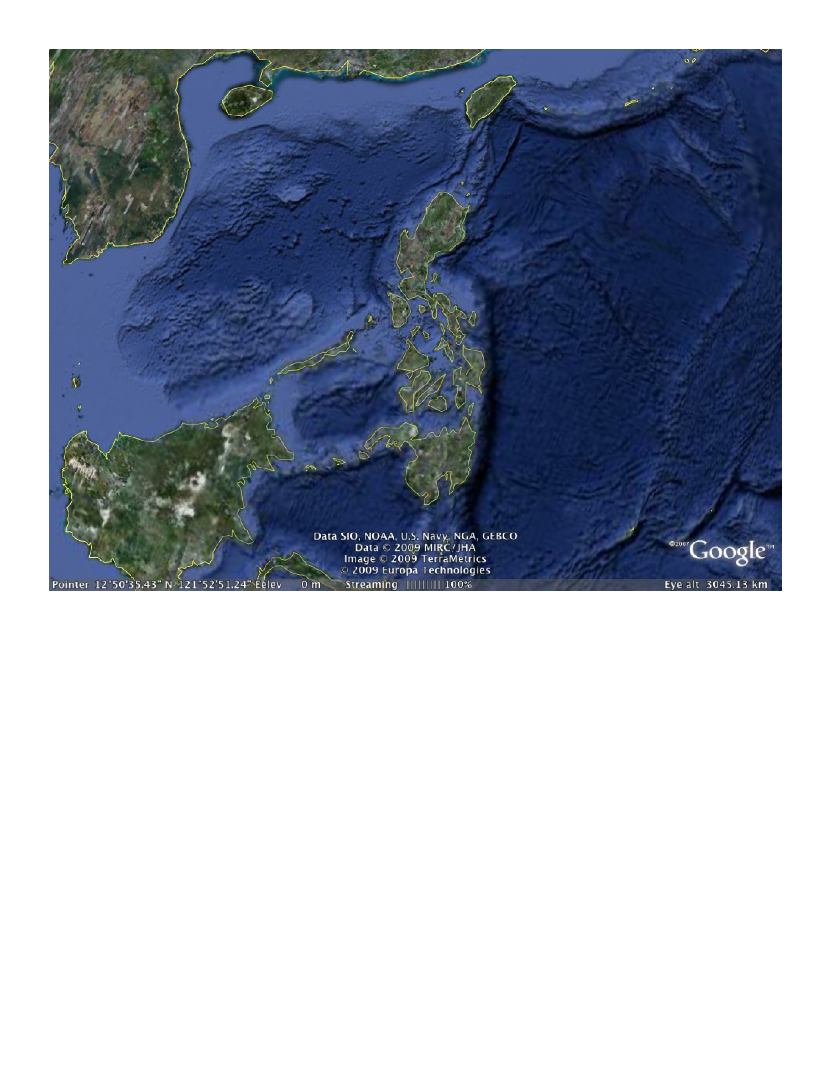
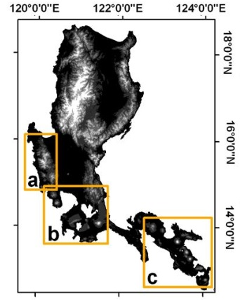
Luzon, Philippines
active arcs
ophiolites
typhoons

Slide 43
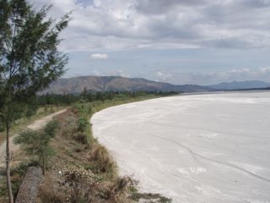
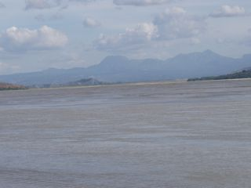
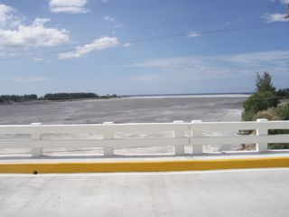
Rivers draining W side of Pinatubo
Big, full of fresh pumice, and completely uncharacterized
Large groundwater discharge directly to ocean
Pumice fills river channels
Pinatubo
S. China Sea

Slide 44
A function that estimates the impact of river input on oceanic ⁸⁷Sr/Sr:
Volcanic-hosted rivers contribute Sr with low ⁸⁷Sr/⁸⁶Sr to the oceans, typically 0.704 to 0.705 vs. seawater currently at 0.7092.

Slide 45
High CO₂ consumption associated with negative forcing on SW ⁸⁷Sr/⁸⁶Sr
increase (⁸⁷Sr/⁸⁶Sr)_{sw}
CO₂ consumption, 10³ mole km⁻² yr⁻¹
volcanics
Other major rivers
Ψ_{Sr}
Data from Gaillardet et al., 1999
Dessert et al, 2003
Schopka et al., 2010

Slide 46
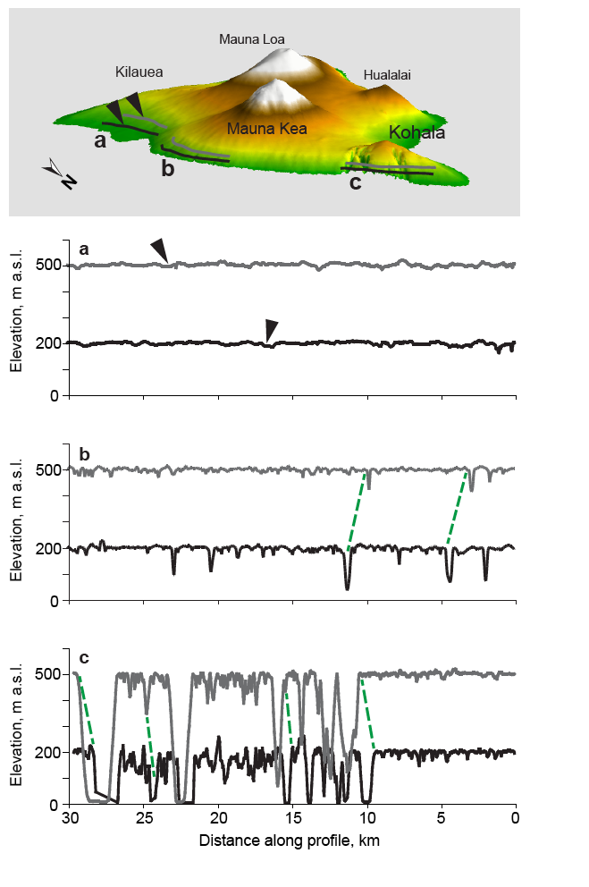
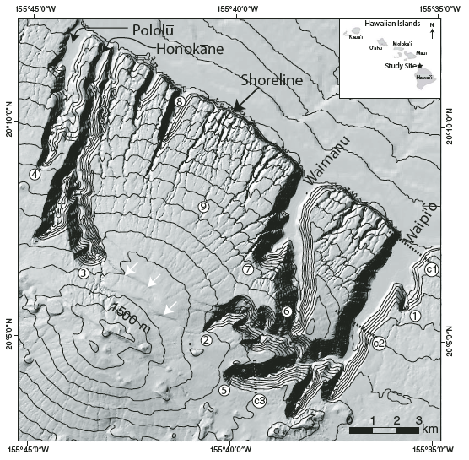
Strong coupling between weathering/pedogenesis, hydrologic pathways, and landform evolution
Kilauea/Mauna Loa (young)
Mauna Kea (intermediate)
Kohala (old, flank collapse)

Slide 47
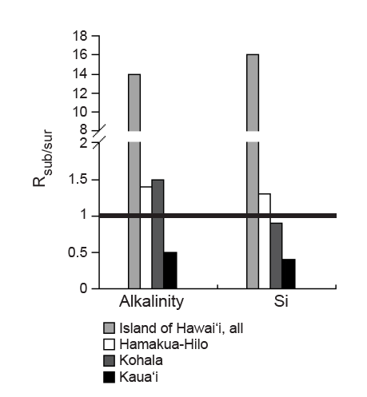
Ratio of weathering fluxes delivered via GW vs runoff

Slide 48
A few important notions:
Tropical arcs ≈ 1% of terrestrial surface, with 15-20% of CO₂ consumption, with apparently strong climate sensitivity.
C fluxes in rivers – focus here, but also
geothermal fluxes
ground water fluxes (in Hawaii 15x!)
Hypothesis: Arcs (± LIPs) are the locus of the climate-weathering feedback.
Cratonic settings less sensitive to climate but also to tectonics via erosion rate effects.

Slide 49
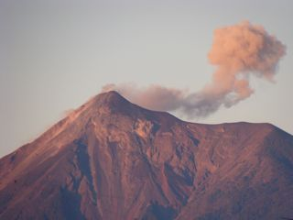
Oh, by the way, arcs are a source of CO₂ too.
Hmm, where does that get us?
Fuego, Christmas Day 2010 (Antigua, Guatemala)
Notes:
Fuego, Christmas Day 2010, Antigua Guatemala (Derry photo)

Slide 50
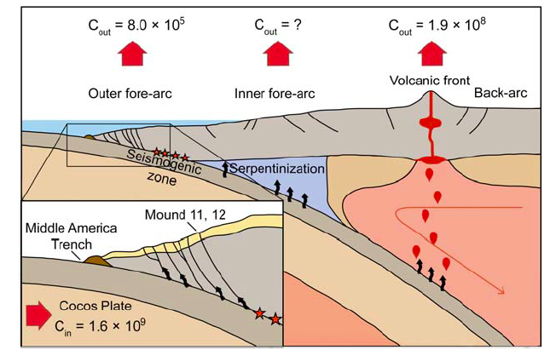
Costa Rica margin C balance (Furi et al, G3, 2010)
Input > 1.6×10⁹ g C km⁻¹ yr⁻¹ Output ≈ 2×10⁸ g C km⁻¹ yr⁻¹
i.e. ≤ 12%
Implication: most C introduced to subduction zone is recycled to mantle.
Should help maintain “steady state” surface C reservoir over long time scales
Notes:
Furi et al., Geochem. Geophys. Geosyst. 2010

