Slide 1

Inverse Theory
CIDER seismology lecture IV
July 14, 2014
Mark Panning, University of Florida
Notes:
Happy Bastille Day.

Slide 2
Outline
The basics (forward and inverse, linear and non-linear)
Classic discrete, linear approach
Resolution, error, and null spaces
Thinking more probabilistically
Non-linear problems and model space exploration
The takeaway – what are the important ingredients to setting up an inverse problem and to evaluate inverse models?

Slide 3
What is inverse theory?
A combination of approaches for determination and evaluation of physical models from observed data when we have an approach to calculate data from a known model (the “forward problem”)
  Physics – defines the forward problem and the theories to predict the data
  Linear algebra – to supply many of the mathematical tools to link model and data “vector spaces”
  Probability and statistics – all data is uncertain, so how does data (and theory) uncertainty map into the evaluation of our final model? How can we also take advantage of randomness to deal with practical limitations of classical approaches?
Notes:
Not just physics, of course… can come from chemistry or any other field

Slide 4
The forward problem – an example
Gravity survey over an unknown buried mass distribution
Continuous integral expression:
Gravity measurements
x
x
x
x
x
x
x
x
x
x
x
x
x
x
x
x
?
Unknown mass at depth
The anomalous mass at depth
The data along the surface
The physics linking mass and gravity (Newton’s Universal Gravitation), sometimes called the kernel of the integral

Slide 5
Make it a discrete problem
Data is sampled (in time and/or space)
Model is expressed as a finite set of parameters
Data vector
Model vector

Slide 6
Linear vs. non-linear – parameterization matters!
Modeling our unknown anomaly as a sphere of unknown radius R, density anomaly Δρ, and depth b.
Modeling it as a series of density anomalies in fixed pixels, Δρ_{j}
Non-linear in R and b
Linear in all Δρ_{j}
Notes:
Draw pictures on whiteboard for this bit to explain all the terms

Slide 7
The discrete linear forward problem
A matrix equation!
d_{i} – the gravity anomaly measured at x_{i}
m_{j} – the density anomaly at pixel j
G_{ij} – the geometric terms linking pixel j to observation i –
Generally we say we have N data measurements, M model parameters, and therefore G is an N x M matrix
Notes:
Gij is actually the derivative of the ith data value with respect to the jth model parameter

Slide 8
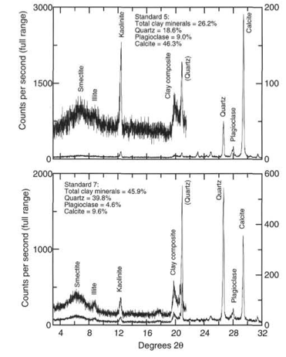
Some other examples of linear discrete problems
Acoustic tomography with pixels parameterized as acoustic slowness
Curve fitting (e.g. linear regression)
X-ray diffraction determination of mineral abundances (basically a very specific type of curve fitting!)
Notes:
Ti=dij uj

Slide 9
Takeaway #1
The physics goes into setting up the forward problem
Depending on the theoretical choices you make, and the way you choose to parameterize your model, the problem can be linear or non-linear

Slide 10
Classical linear algebra
Even-determined, N=M
  m_{est}=G⁻¹d
  In practice, G is almost always singular (true if any of the data can be expressed as a linear combination of other data)
Purely underdetermined, N<M
  Can always find model to match data exactly, but many models are possible
Purely overdetermined, M>N
  Impossible to match data exactly
  In theory, possible to exactly resolve all model parameters for a model that minimizes misfit to error
The real world: Mixed-determined problems
  Impossible to satisfy data exactly
  Some combinations of model parameters are not independently sampled and cannot be resolved
Notes:
Do some examples on board
Even-determined (fitting a line to 2 points)
Under-determined – classic 2-d tomography on 3 by 3 grid with only vertical and horizontal shots (leaving one vertical or horizontal out)
Over-determined – add in diagonals
Mixed-determined – add in last row of 3 x 3 (no longer possible to satisfy data exactly) or over sampling one block and not sampling another

Slide 11
Chalkboard interlude!
Takeaway #2: recipes
Overdetermined:
Minimize error
“Least squares”
Underdetermined:
Minimize model size
“Minimum length”
Mixed-determined:
Minimize both
“Damped least squares”
Notes:
On chalkboard, go quickly through a few examples of under, over, and mixed
Define the minimizationsand the basic procedures to do it: e=d-Gm, minimize eTe, mTm, or eTe+epsilon^2mTm

Slide 12
Data Weight
The previous solutions assumed all data misfits were equally important, but what if some data is better resolved than others?
If we know (or can estimate) the variance of each measurement, σ_{i}², we can simply weight each data by 1/σ_{i}²
Diagonal matrix with elements 1/σ_{i}²

Slide 13
Model weight (regularization)
Simply minimizing model size may not be sufficient
May want to find a model close to some reference model
  minimize (m-<m>)^{T}(m-<m>)
May want to minimize roughness or some other characteristic of the model
Regularization like this is often necessary to stabilize inversion, and it allows us to include a priori expectations on model characteristics

Slide 14
Minimizing roughness
Combined with being close to reference model

Slide 15
Damped weighted least squares
Data weighting
Misfit of reference model
Model weighting
Perturbation to reference model

Slide 16
Regularization tradeoffs
Changing the weighting of the regularization terms affects the balance between minimizing model size and data misfit
Too large values lead to simple models biased to reference model with poor fit to the data
Small values lead to overly complex models that may offer only marginal improvement to misfit
The L curve

Slide 17
Takeaway #3
In order to get more reliable and robust answers, we need to weight the data appropriately to make sure we focus on fitting the most reliable data
We also need to specify a priori characteristics of the model through model weighting or regularization
These are often not necessarily constrained well by the data, and so are “tuneable” parameters in our inversions

Slide 18
Now we have an answer, right?
With some combination of the previous equations, nearly every dataset can give us an “answer” for an inverted model
  This is only halfway there, though!
How certain are we in our results?
How well is the dataset able to resolve the chosen model parameterization?
Are there model parameters or combinations of model parameters that we can’t resolve?

Slide 19
Model evaluation
Model resolution – Given the geometry of data collection and the choices of model parameterization and regularization, how well are we able to image target structures?
Model error – Given the errors in our measurements and the a priori model constraints (regularization), what is the uncertainty of the resolved model?

Slide 20
The resolution matrix
For any solution type, we can define a “generalized inverse” G^{-g}, where m_{est}=G^{-g}d
We can predict the data for any target “true” model
And then see what model we’d estimate for that data
For least squares

Slide 21
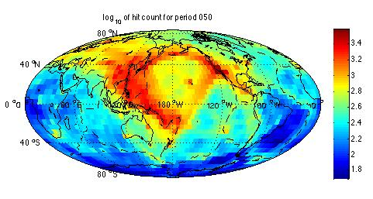
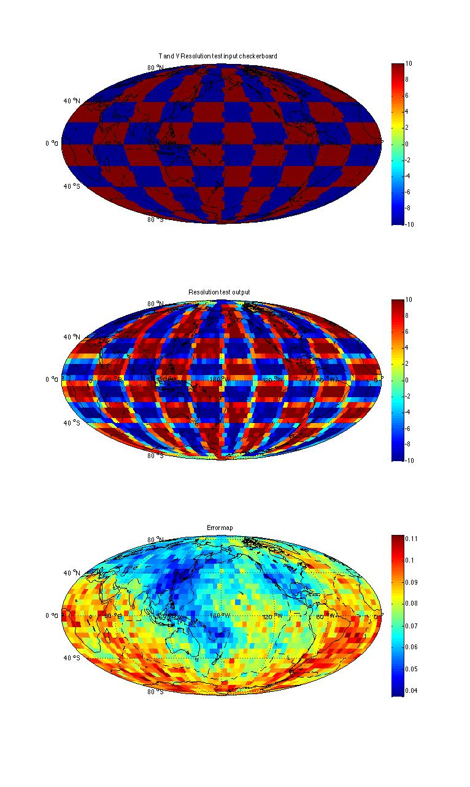
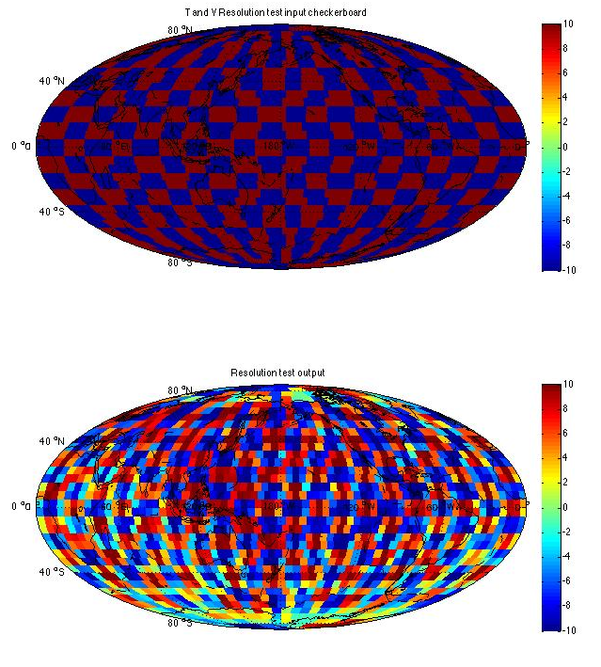
The resolution matrix
Think of it as a filter that runs a target model through the data geometry and regularization to see how your inversion can see different kinds of structure
Does not account for errors in theory or noise in data
Figures from this afternoon’s tutorial!
Notes:
Throw in some matlab figures here from the tutorial

Slide 22
Beware the checkerboard!
Checkerboard tests really only reveal how well the experiment can resolve checkerboards of various length scales
For example, if the study is interpreting vertically or laterally continuous features, it might make more sense to use input models which test the ability of the inversion to resolve continuous or separated features
From Allen and Tromp, 2005

Slide 23
What about model error?
Resolution matrix tests ignore effects of data error
Very good apparent resolution can often be obtained by decreasing damping/regularization
If we assume a linear problem with Gaussian errors, we can propagate the data errors directly to model error

Slide 24
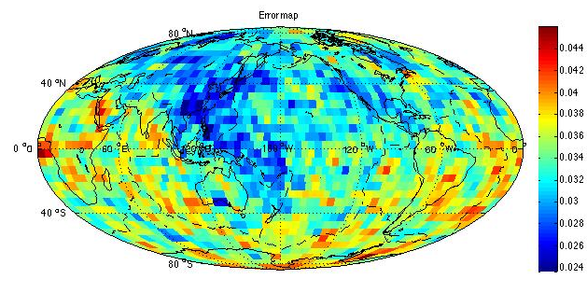
Linear estimations of model error
a posteriori model covariance
data covariance
Alternatively, the diagonal elements of the model covariance can be estimated using bootstrap or other random realization approaches
Note that this estimate depends on choice of regularization
Two more figures from this afternoon’s tutorial

Slide 25
Linear approaches: resolution/error tradeoff
Bootstrap error map (Panning and Romanowicz, 2006)
Checkerboard resolution map

Slide 26
Takeaway #4
In order to understand a model produced by an inversion, we need to consider resolution and error
Both of these are affected by the choices of regularization
  More highly constrained models will have lower error, but also poorer resolution, as well as being biased towards the reference model
Ideally, one should explore a wide range of possible regularization parameters

Slide 27
Null spaces
d=Gm
Model null space
Data null space
M
D
m=G^{T}d
Notes:
Not just googly eyes

Slide 28
The data null space
Linear combinations of data that cannot be predicted by any possible model vector m
For example, no simple linear theory could predict different values for a repeated measurement, but real repeated measurements will usually differ due to measurement error
If a data null space exists, it is generally impossible to match the data exactly

Slide 29
The model null space
A model null vector is any solution to the homogenous problem
This means we can add in an arbitrary constant times any model null vector and not affect the data misfit
The existence of a model null space implies non-uniqueness of any inverse solution

Slide 30
Quantify null space with Singular Value Decomposition
SVD breaks down G matrix into a series of vectors weighted by singular values that quantify the sampling of the data and model spaces
N x N matrix with columns representing vectors that span the data space
M x M matrix with columns representing vectors that span the model space
If M<N, this is a M x M square diagonal matrix of the singular values of the problem

Slide 31
Null space from SVD
Column vectors of U associated with 0 (or very near-zero) singular values are in the data null space
Column vectors of V associated with 0 singular values are in the model null space

Slide 32
Getting a model solution from SVD
Given this, we can define a “natural” solution to the inverse problem that
  Minimizes the model size by ensuring that we have no component from the model null space
  Minimizes data error by ensuring all remaining error is in the data null space

Slide 33
Refining the SVD solution
Columns of V associated with small singular values represent portions of the model poorly constrained by the data
Model error is proportional to the inverse square of the singular values
Truncating small singular values can therefore reduce amplitudes in poorly constrained portions of the model and strongly reduce error

Slide 34
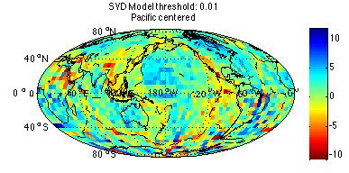
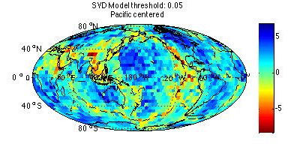
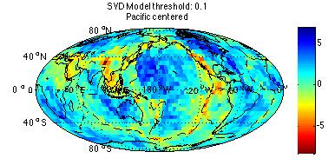
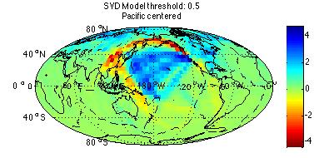
Truncated SVD
More from this afternoon!

Slide 35
Takeaway #5
Singular Value Decompositions allow us to quantify data and model null spaces
Using this, we can define a “natural” inverse model
Truncation of singular values is another form of regularization
Notes:
Note here that other types of regularization can be included as well

Slide 36
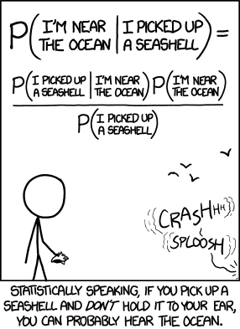
Thinking statistically – Bayes’ Theorem
Probability of the model – the a priori model covariance
Probability of the data given the model – related to the data misfit
Probability of the model given the observed data – i.e. the answer we’re looking for in an inverse problem!
Probability of the data – a normalization factor from integrating over all possible models

Slide 37
Evaluating P(m)
This is our a priori expectation of the probability of any particular model being true before we make our data observations
Generally we can think of this as being a function of some reasonable variance of model parameters around an expected reference model and some “covariance” related to correlation of parameters

Slide 38
Evaluating P(d|m)
The probability that we observe the data if model m is true… high if the misfit is low and vice versa

Slide 39
Putting it together
Minimize this to get the most probable model, given the data
Notes:
This is the Tarantola and Valette style inversion we’ll do this afternoon.
We’ll learn a little more about how to assemble Cm then.

Slide 40
Takeaway #6
We can view the inverse problem as an exercise in probability using Bayes’ Theorem
Finding the most probable model can lead us to an equivalent expression to our damped and weighted least squares, with the weighting explicitly defined as the inverse data and model covariance matrices

Slide 41
What about non-linear problems?

Slide 42
sample inverse problem
d_{i}(x_{i}) = sin(ω₀m₁x_{i}) + m₁m₂
with ω₀=20
true solution
m₁= 1.21, m₂ =1.54
N=40 noisy data
Notes:
This is the simple non-linear inverse problem that we will solve by a variety of ways.

Slide 43
(A)
Grid search
(B)
Example from Menke, 2012
Notes:
Note that the error surface is fairly complicated, even though the inverse problem looks fairly simple.
Note that the estimated solution is very close to the true solution, discrepancy due to grid spacing.
Fig. 9.5. A grid search is used to solve the non-linear curve fitting problem, d_{i}(x_{i}) = sin(ω₀m₁x_{i}) + m₁m₂, . (A) The true data (black curve) are for m₁= 1.21, m₂ =1.54. The observed data (black circles) have additive noise with variance, s²_{d}=(0.4)². The predicted data (red curve) are based results of the grid search. (B) Error surface (colors), showing true solution (green circle) and estimated solution (white circle) MatLab script gda09_07.

Slide 44
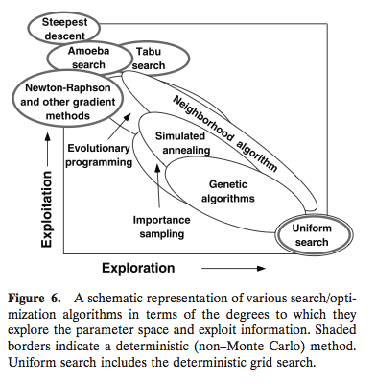
Exploit vs. explore?
Markov Chain Monte Carlo and various Bayesian approaches
Grid search, Monte Carlo search
From Sambridge, 2002

Slide 45
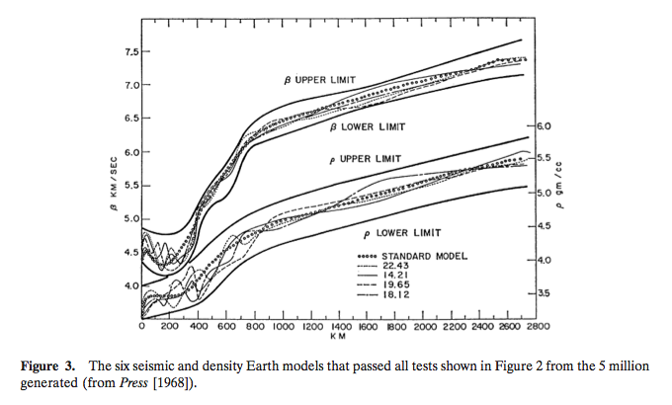
Press, 1968 Monte Carlo inversion

Slide 46
Markov Chain Monte Carlo (and other Bayesian approaches)
Many derived from Metropolis-Hastings algorithm which uses randomly sampled models that are accepted or rejected based on the relative change in misfit from previous model
End result is many (often millions) of models with sample density proportional to the probability of the various models

Slide 47
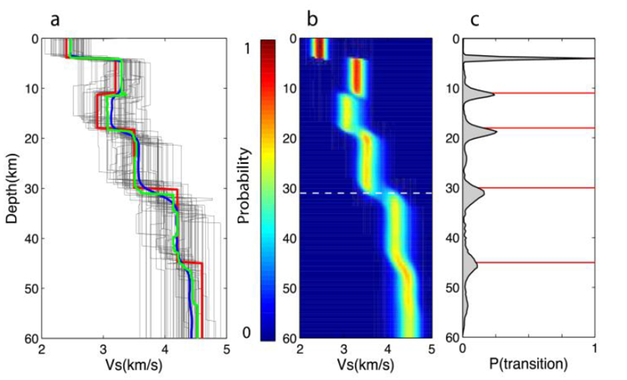
Some model or another from Ved

Slide 48
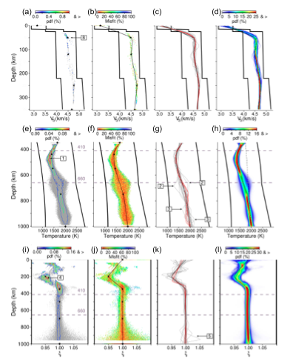
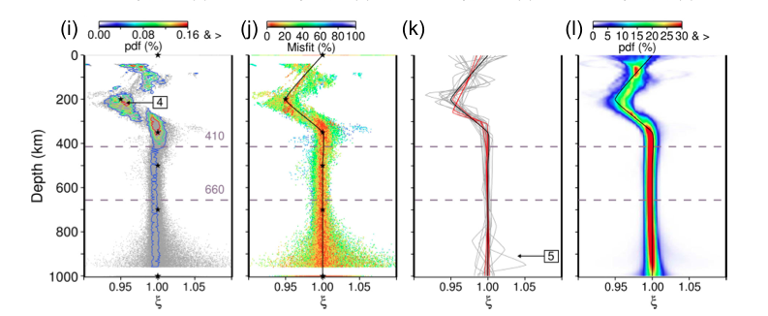
Bayesian inversion
From Drilleau et al., 2013

Slide 49
Takeaway #7
When dealing with non-linear problems, linear approaches can be inadequate (stuck in local minima and underestimating model error)
Many current approaches focus on exploration of the model space and making lots of forward calculations rather than calculating and inverting matrices

Slide 50
Evaluating an inverse model paper
How well does the data sample the region being modeled? Is the data any good to begin with?
Is the problem linear or not? Can it be linearized? Should it?
What kind of theory are they using for the forward problem?
What inverse technique are they using? Does it make sense for the problem?
What’s the model resolution and error? Did they explain what regularization choices they made and what effect it has on the model?

Slide 51
For further reference
Textbooks
  Gubbins, “Time Series Analysis and Inverse Theory for Geophysicists”, 2004
  Menke, “Geophysical Data Analysis: Discrete Inverse Theory” 3rd ed., 2012
  Parker, “Geophysical Inverse Theory”, 1994
  Scales, Smith, and Treitel, “Introductory Geophysical Inverse Theory”, 2001
  Tarantola, “Inverse Problem Theory and Methods for Model Parameter Estimation”, 2005

