Slide 1
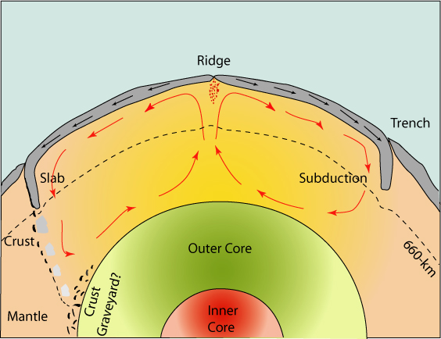
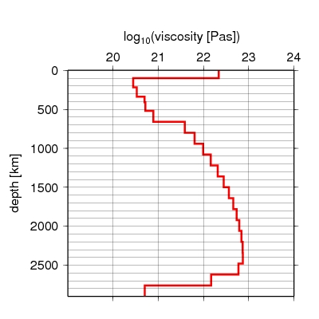
Flow in the Earth—A Catholic Theme
S. Rost
Things that flow—Glib answer: Probably everything except the lithosphere, and even that kind of does.
Slightly less glib: Solids at high T, core (both inner and outer), mantle, fluids, melts.
Steinberger
All-encompassing Nature Dovetails with CIDER Interdisciplinarity…

Slide 2
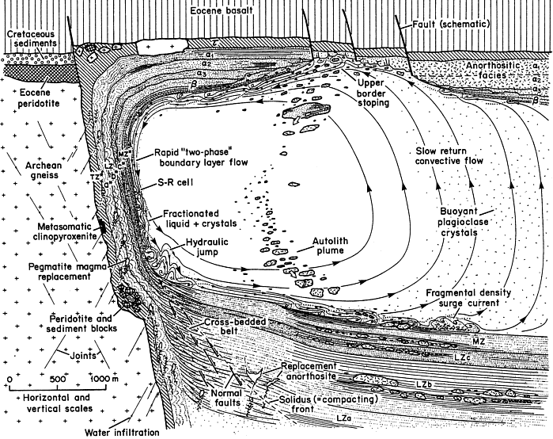
Flow in the Earth—A Catholic Theme
Interdisciplinary (CIDER) Styles of Deep Earth Flow Problems Include:
Mixing between Materials with Contrasts in Viscosity/Phase*
Coupling of Flow and Chemistry*
Competition between Convective and Conductive Heat Flow*
Skaergaard Intrusion
(Irvine et al., GSA Bull., 1998)

Slide 3
Things that drive material flow
1) Density Differences (Thermal and/or Compositional and/or Phase): Ubiquitous in Earth Sciences
Drivers: Thermal Expansion: α = -1/ρ(dρ/dT); Heavier Element Enrichment (Fe, etc.); ΔV_{melting, transition}
Thermal Expansion—Robustly dependent on both P and T
Al₂O₃
Erbe et al., PCCP, 2015

Slide 4
Other Things that can Drive (or Impede) Flow
2) Externally Imposed Stresses
3) Surface Tension/Energy (minimize surface energy per volume)
4) Variations in Chemical Potential
Lithosphere-Asthenosphere Boundary from Unextractable Melt? (Holtzmann, G³, 2016)

Slide 5
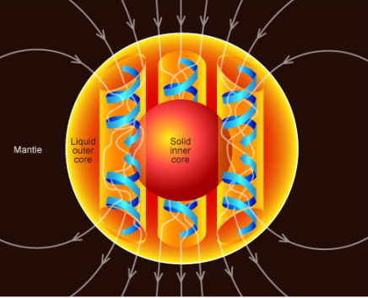
3 Illustrative Examples (of many)
Core Evolution (dQ_{cond} ~ dQ_{conv}?)
Flow and Composition of LLSVP’s
Slabs/Hydration of the Mid-Mantle (TZ/LM)

Slide 6
A First-Order Question: When Did the Inner Core Form?
State-of-the-Art in the 90’s: Total Heat Flow Across CMB; Conductive Flow ~2 x 10¹² W, Energy Release from Core Crystallization from ~2.5-3 B.Y.,
No Problem….
Buffett et al., JGR, 1996
Mostly Kaapvaal Craton
Aubert, Tarduno,
Johnson, Space Sci.
Rev., 2010

Slide 7
Since the 90’s, Core Temperatures got Hotter, T Gradients at the Top of the Core Got Bigger
Implies a Markedly Different Thermal State of the Core (+ ca. 1000 K)---
And Higher Heat Flow out the Top.
Gen. 3
Gen. 1
Generation 2
Anzellini et al., Science, 2013
Melting Curve of Iron: Notable Shifts in
T and Slope at High Pressures (Esp. at ICB)
Anzellini et al., Science, 2013

Slide 8
An Illustration of the Core Thermal Regime Today and at ICN
Melting Curve of Iron: Notable Shifts in
T and Slope at High Pressures
Olson et al., PEPI, 2015

Slide 9
Iron Thermal Conductivity Estimates Also Went up (factor of 2-3-ish)…
High Thermal Conductivity of Liquid Iron implies:
(1) Heat transport in/out of the core is larger;
(2) power for the dynamo is less;
(3) the inner core forms late, and
(4) stable stratification might be necessitated at the top of the outer core.
Theory
~40 W/m/K is Canonical Low Value
Pozzo et al., Nature, 2012

Slide 10
With high T-conductivity: conductive heat flow is comparable to convective heat transport—Dramatic Implications for Inner Core!
Inner Core is Recent: 1.7 to 0.4 Ga---Goodness!!
Here, thermal conductivity of ~80-110 W/m/K is used
Pre-IC entropy Production
Nimmo, TOGP, 2015

Slide 11
The Experimental Situation: Muddy…
Electrical Resistivity Scales Inversely with Thermal Conductivity…
Wiedemann-Franz Law: LT = kρ, where L is viewed as a constant for metals, k is thermal conductivity and ρ is electrical resistivity.
Rough Trajectory for K ~ 40 W/m/K
Net Result: k ~ 88 (+29/-13) W/m/K for Liquid Alloy at top of CMB
Ohta et al., Nature, 2016

Slide 12
The Experimental Thermal Conductivity Situation: Muddy…
Young
Inner
Core
Ohta et al. 2016: 136 GPa
Old I.C.
Hard Experiments on Solid Iron; There is a Modeling Dependence, but they should be actual Thermal Conductivity Measurements…
Konopkova et al., Nature, 2016

Slide 13
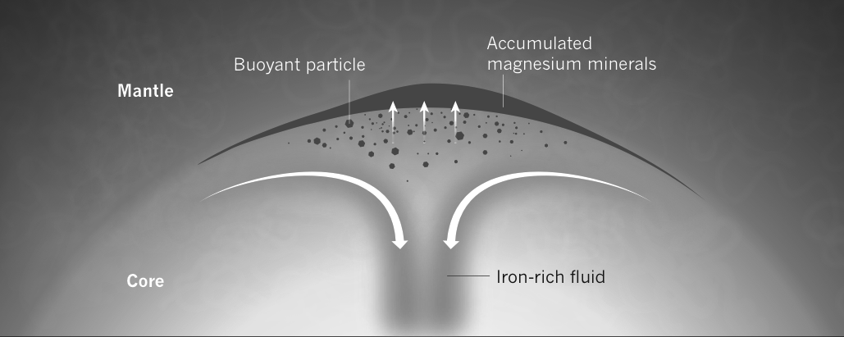
There are Possible Solutions…
Easier than we think to run a geodynamo absent an inner core?;
Different boundary conditions at the top of the core/base of mantle?
Can we lower the temperature of the outer core (Hydrogen (?), with its associated accretionary problems)
An unrecognized energy source in the outer core
Possibility of unrecognized radiogenic sources (Long-standing discussion…)
Exsolution of other components (e.g. Mg: O’Rourke and Stevenson, Nature, 2016)
(5) Perhaps thermal conductivity of the core is not that high, and there is less of a problem here (a minority opinion)…
Advantage for CIDER: This is the Domain of Creative Interdisciplinary Ideas…
Buffett, after O’Rourke and Stevenson, 2016

Slide 14
3 Illustrative Examples (of many)
Core Evolution (dQ_{cond} ~ dQ_{conv}?)
Flow and Composition of LLSVP’s
Hydration of the Mantle

Slide 15
Origins of LLSVPs
Garnero
Primordial X
Fe/Si enriched
(unknown mechanism)
Subducted MORB Graveyard
Low Fraction Silicate Melt
Low Fraction Iron-alloy Melt (CIDER-Result!!)
With Varying Amounts of Enhanced Temperature
Observations: Basal; Low Seismic Shear Velocity (1-3%); Possibly Elevated Density (~1%); Sharp Edges; General Correlation with LIPS and Hotspots

Slide 16
One Set of Simulations---Starting with Unspecified 3.5% Density Anomaly in 100 km Layer at Bottom
Net Result: Coupled Flow, Vigorous Internal Motion, Some Entrainment; Sharp Edges Not so Clear (Contour is 75% density Anomaly).
Questions: To what Degree Can Geodynamics Resolve Between Differing Origins of LLSVPs? To what Degree might LLSVPs have Internal Structure?
Hassan, Flament, Gurnis et al. G³, 2015

Slide 17
A Basaltic Consolidation at the Base of the Mantle: Basalt with 1.8-3.6% Density Anomaly
Key Features: Renewable and Entrainable; Long-Lived; Mixed with “Normal” Mantle; Depends on low viscosity near CMB; Thermal Edges Separate from Compositional Edges; Unclear how “Sharp” (near Resolution of 1-30 km).
Mulyukova, Steinberger et al., JGR, 2015

Slide 18
Temperature Composition Viscosity
Strong ppv (‘Normal’)
Weak ppv
(1000 x weaker)
3% Dense Layer--Features: Long-lasting Layer, Entirely underlain by PV (!!), Some apparent entrainment; Not clear that it is sharp…Doesn’t care about basal viscosity
Li, Deschamps, Tackley, GRL, 2014

Slide 19
But, There are things that could add a *lot* of dynamic complexity to LLSVPs-e.g.,:
Basalt May Remelt at 50-100 km above the CMB…
Pradhan, Fiquet et al. EPSL, 2015

Slide 20
Net Modeling Observations for LLSVPs
LLSVP’s may be long-lived.
It seems a bit hard to get sharp edges
They are uniformly hot
Role of basal viscosity unclear
They may leak and exchange
Outcome-- The Bridge has not been fully built between the composition, structure, formation and dynamics of LLSVPs: Ongoing CIDER Prospects
French and Romanowicz,
Nature, 2015

Slide 21
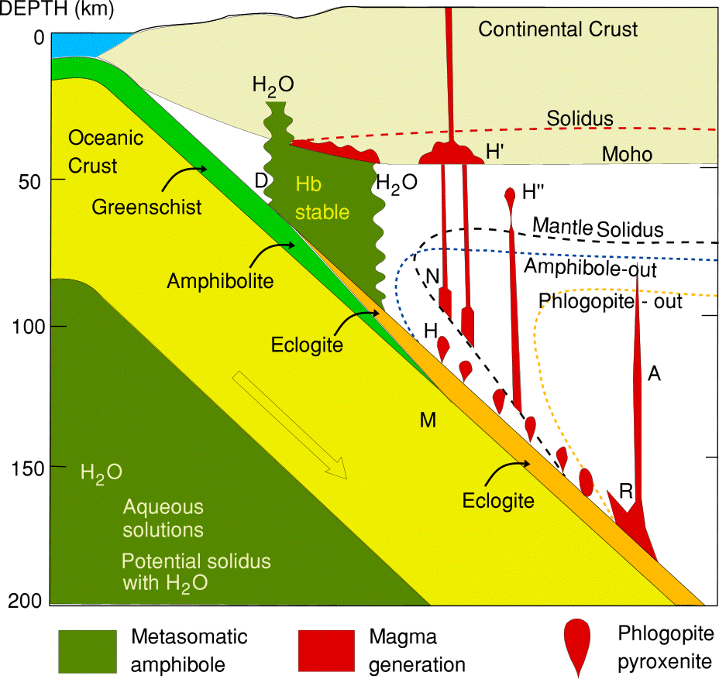
3 Illustrative Examples (of many)
Core Evolution (dQ_{cond} ~ dQ_{conv}?)
Convection in and Composition of LLSVP’s
Slabs/Hydration of the Mantle

Slide 22
Slabs: One Example of Flow Coupling to Chemistry
Standard Subduction + Deeper Hydrous Phases
E
Phase
D
Ridiculously Complicated Phase Diagram of Hydrous Phases in Peridotite + Water system from Ohtani. All you really need to know is gray is anhydrous, bluish is hydrous…
Hebert and Montesi, JGR, 2013

Slide 23
The Water Storage Capacity of the Mantle
At High T’s, Water is Stored in Nominally Anhydrous Minerals (NAMs): Mostly
(Mg,Fe)₂SiO₄-polymorphs
Marked Shift in Water Solubility at Top of Lower Mantle:
a Water Barrier
Hebert and Montesi, JGR, 2013

Slide 24
Slabs: What Happens to Hydration of the Mantle Lithosphere?
Slab Dehydration at Deep Depths, with Water Into Overlying Mantle---
Secondary Water Release Can Concentrate Water away from Slab
Hebert and Montesi, JGR, 2013

Slide 25
Slabs: An Emphasis here on Chemical Effects
Water Content
Fluid Velocity ~ 25 cm/yr
Can Produce Water-rich Low Viscosity Channels Running Parallel to the Slab in TZ…An Odd (and Maybe Unexpected) Result
Hebert and Montesi, JGR, 2013

Slide 26
This is solely for Water---Other aspects involving chemical interplays with Deep Slabs (carbon, deep melt) might be amenable to coupled approaches…
Heterogeneous Water-Rich Upwellings (well away from the arc) could be Generated---Water-driven Upwellings?
Vertical Velocities (Scale from -15.7 to 31.4 cm/yr
CIDER: Regional Chemical Effects Producing Local Inhomogeneities
Hebert and Montesi, JGR, 2013

Slide 27
Flow---Lots of CIDER Opportunities, including…
Core Evolution: Low Conduction, or Alternate Heat Sources?
LLSVP’s: The Enigmatic Role of the Interplay between their Composition and Dynamics (and maybe their relation with ULVZ’s)
Volatiles, the Mid/Deep Mantle, and Slabs: Heterogeneous Viscosities, Varying Densities, Rapid Transport (?), Messy Chemistry

