Slide 1
Some definitions
Primordial (or non-radiogenic) noble gases (³He, ²²Ne, ³⁶Ar, ¹³⁰Xe): isotopes not produced on Earth through radioactive decay
Radiogenic noble gases: produced from radioactive decay (⁴He, ⁴⁰Ar, ¹³⁶Xe) or through nuclear reactions (²¹Ne)
Report noble gas isotopes ratios as radiogenic/primordial

Slide 2
²⁰Ne/²²Ne
⁴⁰Ar/³⁶Ar
³He/²²Ne
³He/³⁶Ar
Mukhopadhyay, 2012
Plumes cannot supply all of the primordial noble gases to the MORB source.

Slide 3
How does one explain the ³He/²²Ne of the mantle?
Honda and Macdougall (1997) suggested magma ocean degassing
to explain the ³He/²²Ne difference
Post magma ocean the whole mantle was not homogenized with respect to its He/Ne ratio

Slide 4
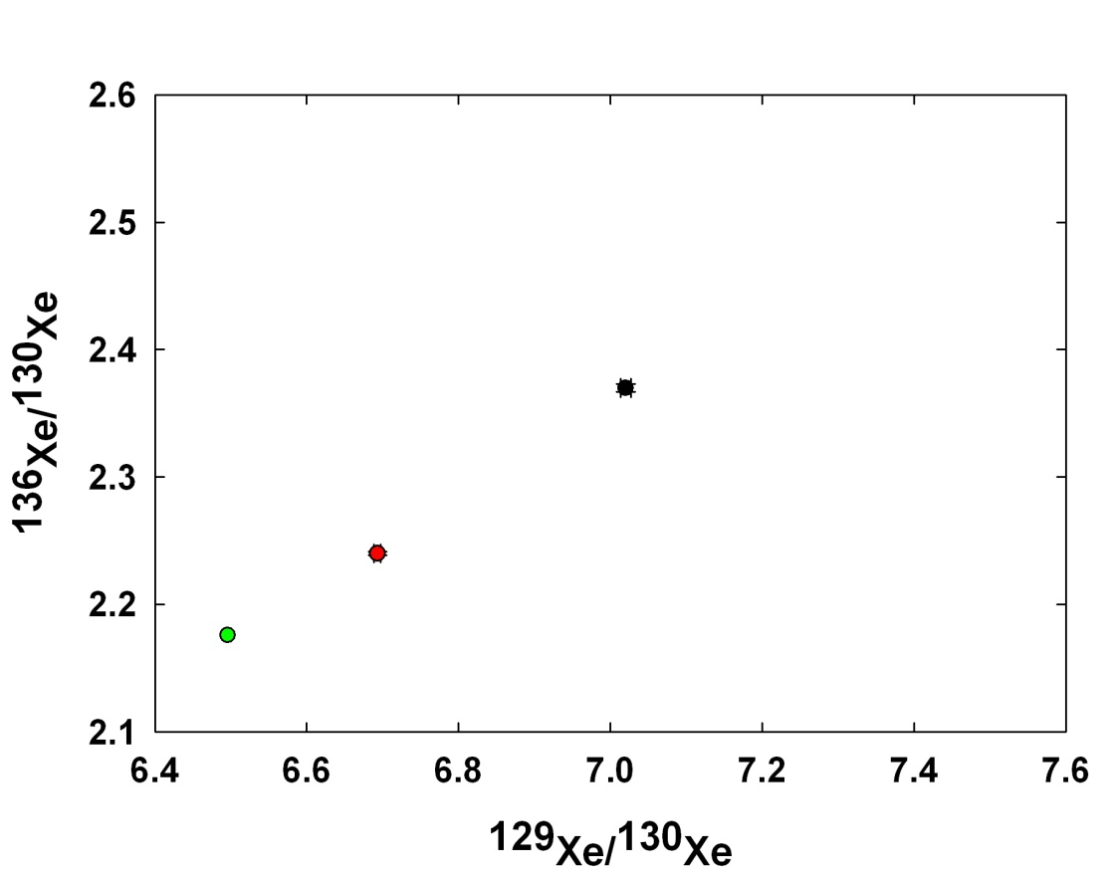
¹²⁹I → ¹²⁹Xe; t_{1/2}=15.7 My ²⁴⁴Pu → ¹³⁶Xe; t_{1/2} = 80 My; ¹³⁶Xe also produced from ²³⁸U spontaneous fission
Popping rock
(MORB)
Iceland?
(OIB)
Black squares
Iceland
Air
Lower xenon excesses in OIBs
More shallow level air contamination for OIBs compared to MORBs
Preferential subduction of air or air saturated seawater into the OIB source
MORBs and OIBs have different I/Xe and (Pu+U)/Xe ratios

Slide 5
MORB source ¹²⁹Xe/¹³⁰Xe is 7.9 ±0.14 from continental well gases.
¹³⁶Xe/¹³⁰Xe
¹²⁹Xe/¹³⁰Xe
Holland and Ballentine, 2006

Slide 6
Ar-Xe mixing constrains Iceland mantle ¹²⁹Xe/¹³⁰Xe
¹²⁹Xe/¹³⁰Xe
Mukhopadhyay, 2012
Iceland mantle source ¹²⁹Xe/¹³⁰Xe constrained for the first time = 6.98±0.07 (MORBs = 7.9±0.14)
Lower values in OIBs compared to MORBs are not related to shallow level air-contamination.

Slide 7
¹²⁹I → ¹²⁹Xe; t_{1/2}=15.7 My ²⁴⁴Pu → ¹³⁶Xe; t_{1/2} = 80 My; ¹³⁶Xe also produced from ²³⁸U spontaneous fission
Popping rock
(MORB)
Iceland
(OIB)
Black squares
Iceland
Air
Lower xenon excesses in OIBs
More shallow level air contamination for OIBs compared to MORBs X
Preferential subduction of air or air saturated seawater into the OIB source
MORBs and OIBs have different I/Xe and (Pu+U)/Xe ratios.

Slide 8
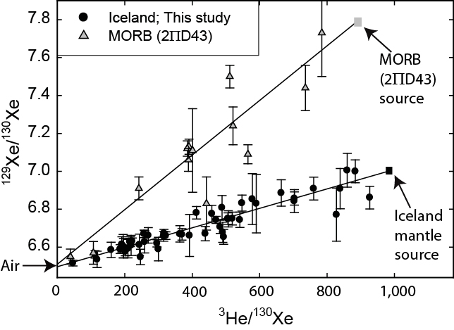
Lower ¹²⁹Xe/¹³⁰Xe in Iceland compared to MORBs is not a result
of preferential recycling of Air
Air
OIBs and MORBs separated by 4.45 Ga; subsequently mixing between MORBs and OIBs have to be limited.

Slide 9
¹²⁹Xe -¹³⁶Xe differences between Iceland and depleted MORB
Iceland
n=51
Air subduction
N. Lau
plume
SWIR MORB
n=83
Eq. Atlantic
MORB
n=25
Air subduction
OIBs and MORBs separated by 4.45 Ga; subsequent mixing between MORBs and OIBs has to be limited.
Mukhopadhyay, 2012; Parai, Mukhopadhyay & Standish, In review;
Tucker, Mukhopadhyay & Schilling, In review

Slide 10
Torsvik et al., 2010
(Also see Dziewonski et al., 2010)
If plumes are derived from the LLSVPs then these are ancient and have persisted through most of Earth’s history (older then 4.4 Ga).

Slide 11
Torsvik et al., 2010
(Also see Dziewonski et al., 2010)
If plumes are derived from the LLSVPs then these are ancient and have persisted through most of Earth’s history (older then 4.4 Ga).
Plume flux 1-2 10¹⁴ kg/yr,
primordial material constitutes ~10-20% of total plume
➔ LLSVPs material could have constituted ~3-7% of mantle mass.

Slide 12
Conclusions
He/Ne ratios in the mantle remembers a magma ocean
¹²⁹Xe/¹³⁰Xe in OIBs reflect two reservoirs that evolved with different I/Xe ratios → MORB and OIB sources were separated by 4.45 Ga and subsequent direct mixing between MORB and plume sources must have been limited over entire Earth history
If LLSVPs are the source of OIB material, they are at least as old as 4.45 Ga.
Moon forming impact did not homogenize the entire mantle

Slide 13
The first billion year history of the atmosphere (and hydrosphere)
Primary Atmosphere
Capture of Solar Nebular gases
Secondary Atmosphere
Impact degassing
Delivery from icy meteorites and comets
Outgassing of the Earth’s mantle

Slide 14
Composition of the earliest atmosphere
Reducing atmosphere: CH₄, NH₃, H₂O (e.g., Urey 1951 – led to the famous Urey-Miller experiments on prebiotic chemistry)
Oxidizing atmosphere through volcanic outgassing: CO₂, H₂O (e.g., Rubey 1951)
Why is the early atmosphere important?
The composition of the early atmosphere sets the boundary condition for surface chemistry → prebiotic chemistry

Slide 15
Deep mantle Neon says yes to incorporation of nebular gases
Atmosphere depleted in lighter isotope (²⁰Ne)

Slide 16
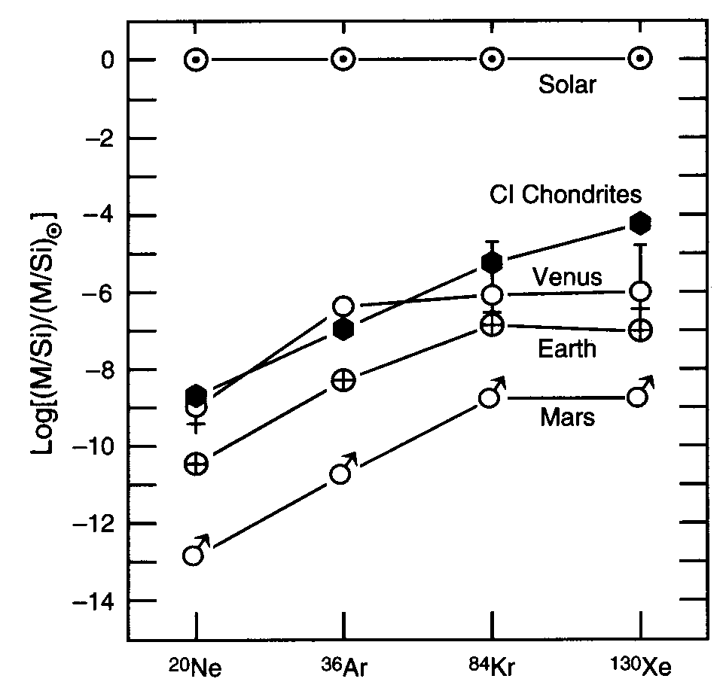
Noble gases in the atmosphere of terrestrial planets
Massive depletion of volatiles from Earth
Abundance pattern looks like carbonaceous meteorites
Atmosphere does not remember the primary atmosphere
Solar N/Ne ~1; terrestrial N/Ne ~86,000 =>most of the nitrogen delivered in condensed form.

Slide 17
Formation of Early Atmosphere
Primary Atmosphere
Capture of Solar Nebular gases
Present day atmospheric noble gases do not remember the presence of a primary atmosphere
Secondary Atmosphere
Impact degassing (while accreting)
Outgassing of the Earth’s mantle
Delivery from icy meteorites and comets (late veneer)

Slide 18
Noble gases in the atmosphere of terrestrial planets
Massive depletion of volatiles from Earth
Abundance pattern looks like carbonaceous meteorites
Atmosphere does not remember the primary atmosphere
So can chondrites deliver the noble gases and hence the other volatiles to
Earth?

Slide 19
Co-variation of D/H with N isotopes Earth volatiles: Signature of comets? Meteorites?
Marty, 2012

Slide 20
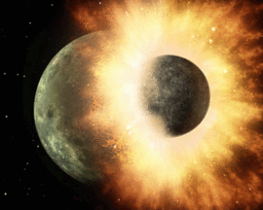
What happened during the Moon-forming giant impact
Likely led to majority of the volatiles being in near-surface environments
Magma ocean degassing: Atmospheric C-O-H species controlled by magma ocean fugacity
Zonation in fO₂ in the magma
ocean but surface likely to be
in equilibrium with H₂O-CO₂
Hirschmann, EPSL, 2012

Slide 21
Earth atmosphere depleted in lighter isotopes compared to sun but enriched compared to chondrites

Slide 22
Earth atmosphere depleted in lighter isotopes

Slide 23
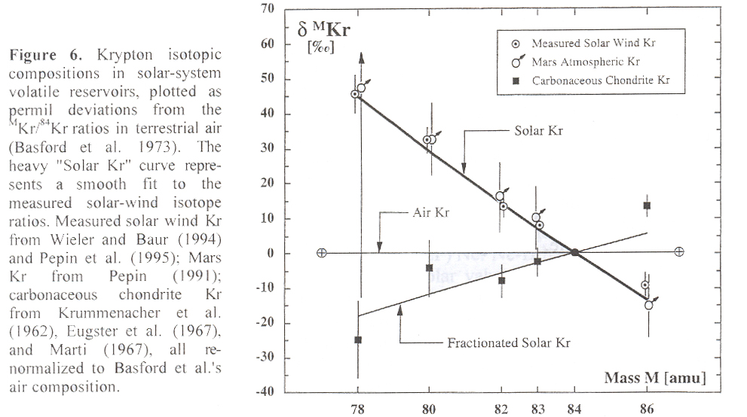
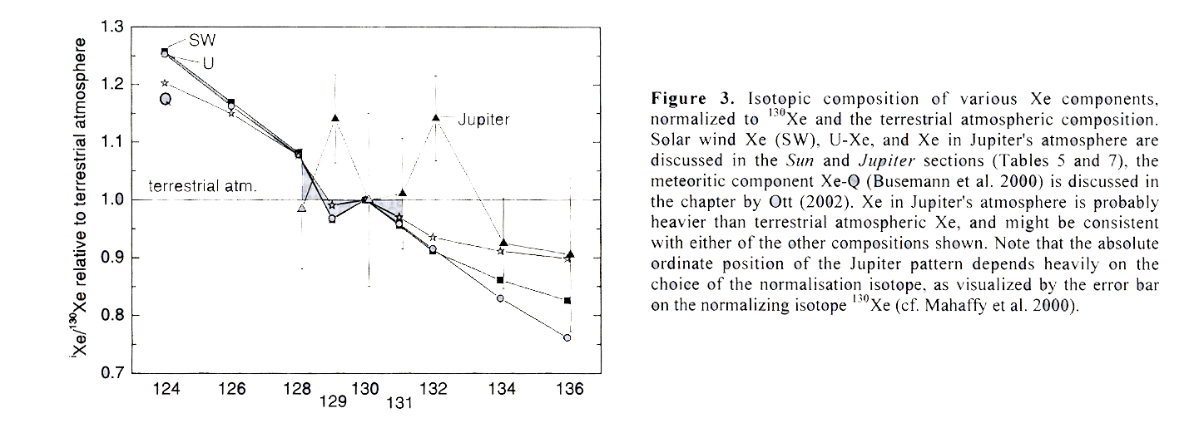
Hmmmm……

Slide 24
Observation: Atmosphere is enriched in the heavier isotope compared to the mantle
Explanations
Outgas the mantle followed by hydrodynamic escape of a H₂ rich atmosphere (e.g., Pepin, 1991)
Atmosphere is a mixture of outgassed mantle gases and later accreting material (late veneer)

Slide 25
Atmospheric noble gases: Mantle outgassing or late veneer?
Iceland, max measured
Marty, 2012

Slide 26
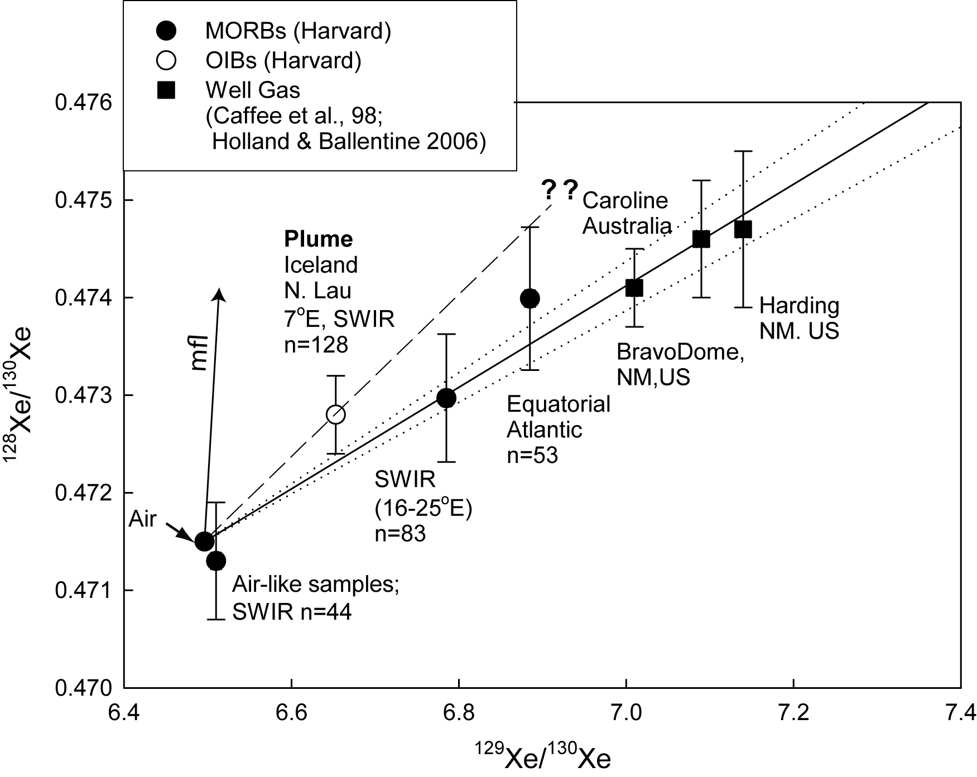
MORBs and OIBs have non-atmospheric primordial Xe isotopes
¹²⁸Xe/¹³⁰Xe
¹²⁹Xe/¹³⁰Xe
Well gas data from Caffee et al., 1999; Holland and Ballentine, 2006
Mukhopadhyay et al.,
In prep

Slide 27
Kr in the mantle and the atmosphere
Fractionated residual gas
Holland et al., 2009

Slide 28
Evidence that the atmosphere cannot form through mantle outgassing i.e. its from a late veneer after the giant impact
Mantle outgassing followed
by mass fractionation
Atmosphere
Mantle
Increasing ¹²⁸Xe/¹³⁰Xe
Mantle
Atmosphere
Increasing ⁸²Kr/⁸⁴Kr

Slide 29
But late veneer is NOT carbonaceous chondrites
Earth atmosphere looks neither like sun nor like chondrites

Slide 30
What happened next (and during)?
During end of accretion, heavy bombardment likely maintained hot, steam atmosphere
Oldest zircons (possibly 4.3-4.4 Ga) indicate very early formation of a continental crust
Measurements of oxygen isotope ratios in zircons indicate liquid water at the earth’s surface
“Impact frustration” on the development of life immediately after accretion
- How long did this period last?
Impacts can help and hurt atmosphere formation and prebiotic chemistry
Only a few impacts could deliver the Earth’s ocean water
Large impacts could have blown off several generations of early atmospheres
Impact degassing can produce reducing atmosphere

Slide 31
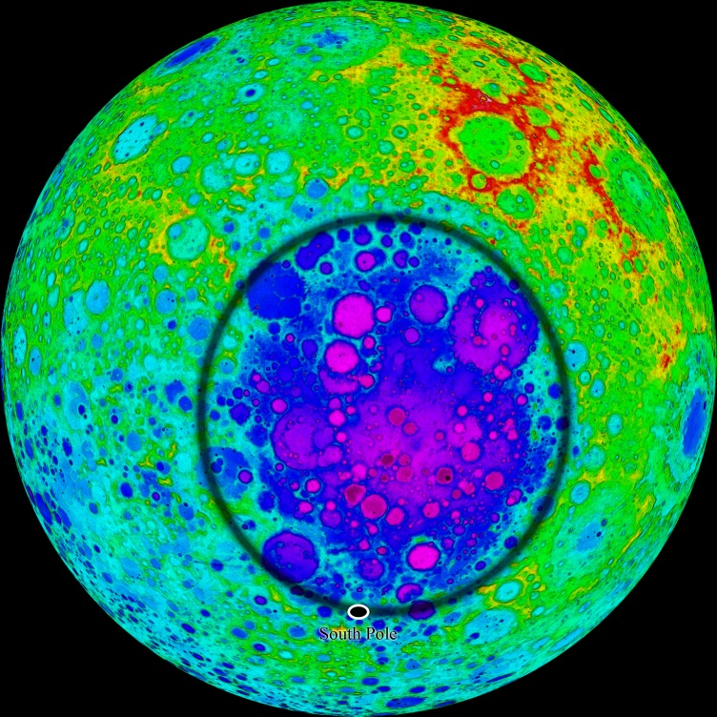
Basin scale impacts can produce steam atmospheres
Zahnle et al., 2011
2500 km diameter

Slide 32
Basin scale impacts can produce steam atmospheres
Zahnle et al., 2011

Slide 33
Atmospheric composition produced through impact degassing of ordinary chondrites: Quite reducing
Schaefer and Fegley, 2010
Also see Hashimoto et al., 2007 and Schaefer and Fegley 2007

Slide 34
Atmospheric composition produced through impact degassing of carbonaceous (CI) chondrites: Substantial amounts of reducing gases
Schaefer and Fegley, 2010
Also see Hashimoto et al., 2007 and Schaefer and Fegley 2007

Slide 35
Metamorphosed pillow basalts at Isua
Banded iron formation in 3.6-3.8 Ga Isua metasediments
3.8 Ga Akila metasediemnts
Sedimentary (water-lain) rocks by
3.8 Ga → oceans established by 3.8 Ga

Slide 36
The faint young sun paradox
High concentration of greenhouse gases required to keep the planet above freezing
Kasting, 2010

Slide 37
Mass independent fractionation in sulfur isotopes:
Interaction of the mantle with the surface reservoir?
Halevy et al., 2010

Slide 38
Summary
Nebular gas signature present in deep mantle
Transition from solar (nebular) gases to more ‘chondritic’ gases
Atmosphere and mantle have not been completely homogeneized
Atmosphere likely related to late veneer; BUT no known meteorite can match the noble gas pattern
Post giant impact atmosphere could have been reducing or oxidizing.
Liquid water at surface by 4.3 Ga; impacts may have prevented stable ocean for the first few hundred million years; stable oceans likely by 3.8 Ga
High concentrations of greenhouse gases required to keep the planet above freezing in the Archean.

