Slide 1

The Formation and Evolution of Cratonic Lithospheric Mantle
Seismic characteristics – what’s causing them
Samples of cratonic lithospheric mantle
Constraints from xenolith composition on tectonic setting of lithosphere production and temporal variability
Metasomatism: An indicator of formation mechanism and the ultimate “terminator” for lithosphere survival?
Richard Carlson
Carnegie Institution of Washington, DTM

Slide 2
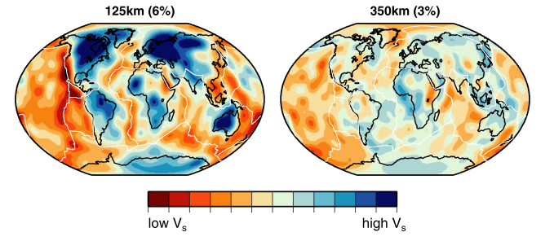
Continents are Not Just the Crust
s20rts seismic velocity model from Ritsema et al. (2004)
Notes:
The continent-ocean distinction continues to depths of 100-200 km as indicated by high shear wave velocities of continental lithospheric mantle.

Slide 3
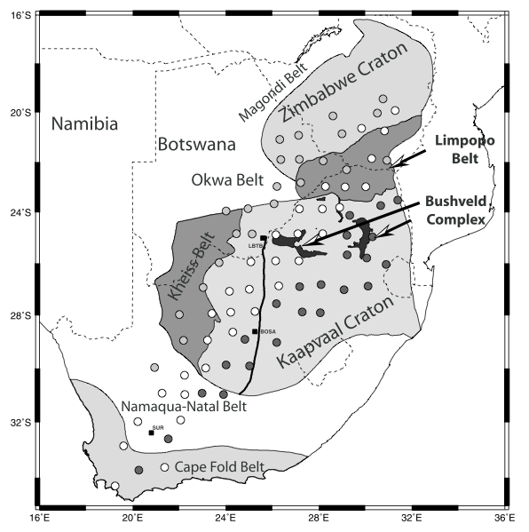
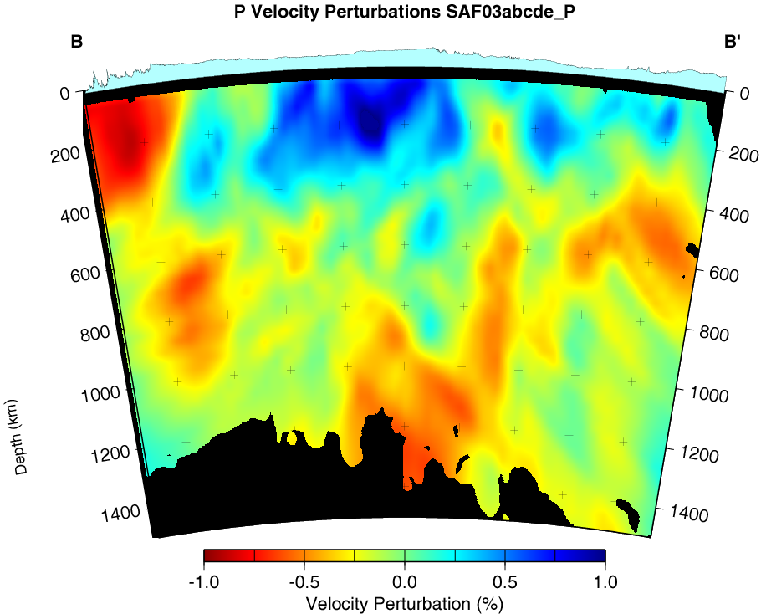
Kaapvaal Craton: High seismic velocities to depths of 200-250 km, layering not obvious. High velocities disrupted at Bushveld, high again to the North in the Zimbabwe Craton. Jump to low velocities at Cape Fold belt, intermediate beneath Proterozoic Namaqua-Natal belt.
km
James et al., 2001, GRL

Slide 4
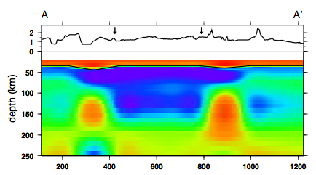

Tanzanian Craton: High velocities, but bounded sharply by low velocities beneath the two arms of the African Rift
Labait
Lashaine
Usagaran Belt
Slide courtesy of Roberta Rudnick
From Weeraratna et al., 2003, JGR
Notes:
Thick, cold lithosphere to ~150 km beneath Labait – hint of cold thick lithosphere beneath Lasahine

Slide 5
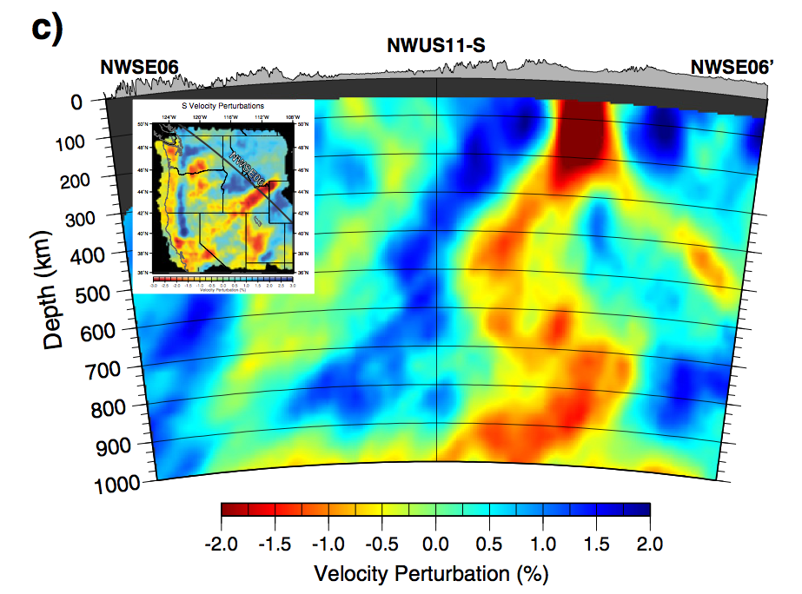
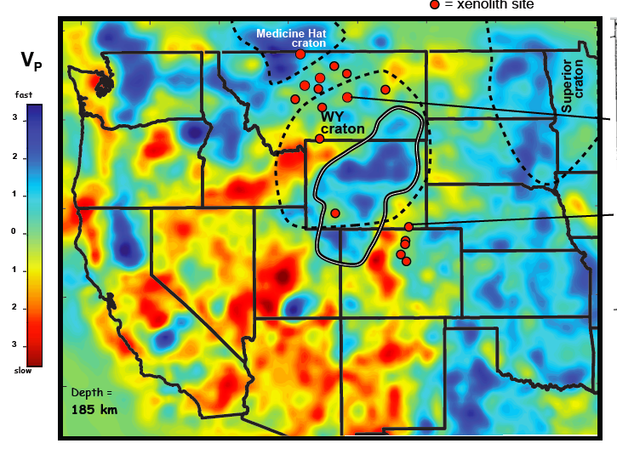
Wyoming Craton: Still there, but under assault from all the Cenozoic magmatic/tectonic activity in the western U.S. One of several high velocity bodies in the mantle beneath the western U.S.
James et al., EPSL, 2011
Humphreys, CIDER, 2013
Notes:
Yellowstone – Snake River Plain path has cut into western edge of Wyoming Craton removing the characteristic fast velocities from the mantle section.

Slide 6
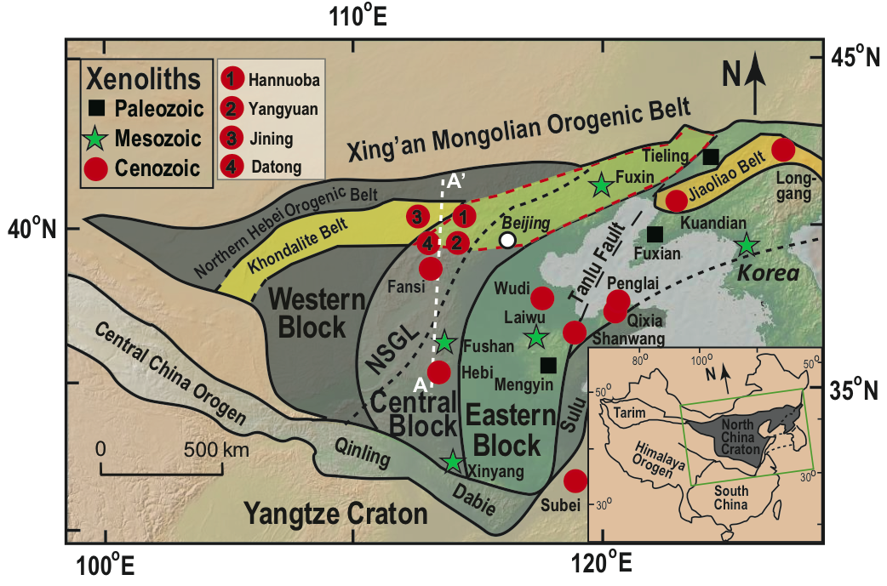
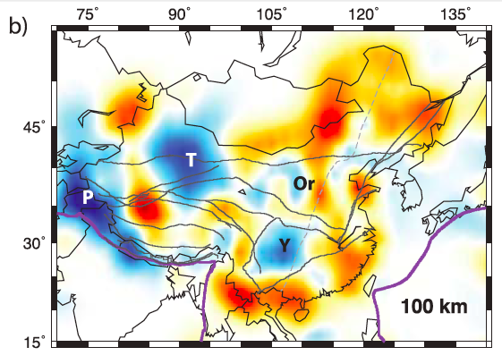

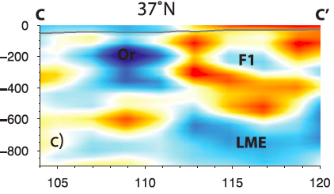
North China Craton: High velocities only beneath western block, slower to the east beneath an area where the crust is still Archean, but the lithospheric mantle is Proterozoic to modern (Liu et al., GCA, 2011).
S-wave tomography from Obrebski et al., JGR, 2012

Slide 7
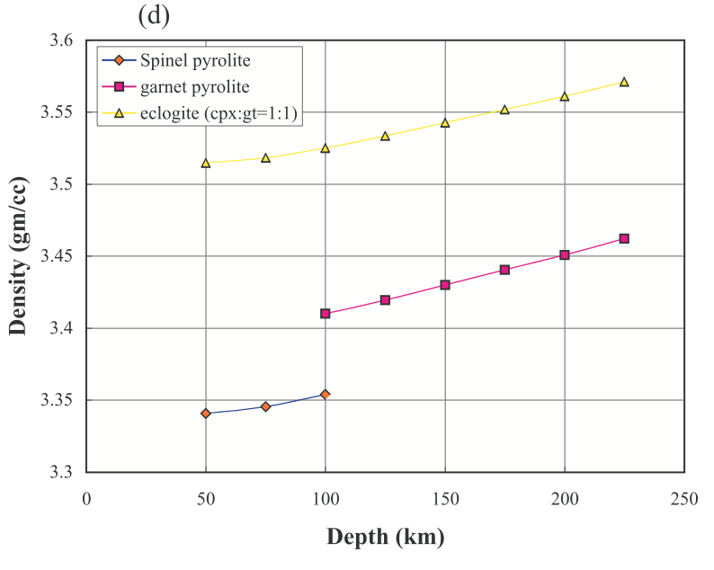
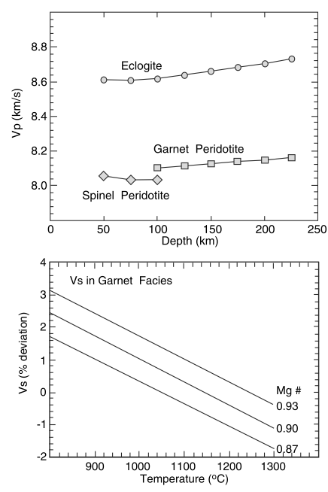
James et al., G-cubed, 2004
James et al., G-cubed, 2004
Two Ways to Get Fast Seismic Velocities in the Lithospheric Mantle:
Make it cold
Add eclogite
Lee, JGR, 2003
Notes:
At constant composition the s-velocity of peridotite increases by about 1% for every 100oC temperature drop. The appearance of garnet in peridotite raises its P velocity by about 1%, but the transition from basalt to eclogite is a step up in density by 20%. Eclogite in the lithosphere would increase seismic velocities in the right direction, but would also result in major increases in density of the lithosphere.

Slide 8
Residues of Continent Formation Persist for as Long as the Continent
Re-Os Model Ages for Continental Mantle Xenoliths
(Carlson et al., ROG, 2005)

Slide 9
The Tectosphere Hypothesis
Jordan, Nature 1978
Jordan, J. Pet. 1988
Density increase due to cold temperatures is offset by density decrease due to chemical buoyancy
Cratonic keels are “isopycnic”

Slide 10
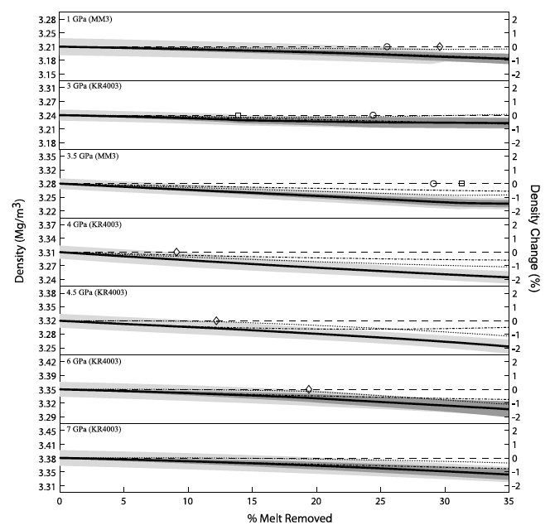
Partial Melt Extraction Lowers the Density of the Mantle Residue.
Figure from Schutt and Lesher, JGR, 2006
Notes:
Decrease in density of a melt-depleted peridotite due to increase in Mg/Fe, thereby lowering the mean atomic number of the rock, but much more important is the removal of garnet because the aluminum that resides in garnet in the mantle selectively partitions into the melt, thus leaving melt-depleted peridotite garnet deficient. As a result, melting in the shallow mantle where garnet is not present lowers the restite density by only about 1% after 30% partial melt removal, while the same amount of melt removal at ~4 GPs lowers the restite density by 2%

Slide 11
Density is NOT Conserved During Partial Melting
Basalt
(2.97 g/cc)
Eclogite
(3.57 g/cc)
Melt
Fertile
Garnet
Lherzolite
(3.4 g/cc)
Ol – 9% - 3.38 g/cc
Cpx – 31% - 3.4
Plag – 60% - 2.7
Omphacite – 50% - 3.33 g/cc
Garnet – 50% - 3.81 g/cc
Residue
Melt-depleted
Garnet
Harzburgite
(3.32 g/cc)
Ol – 61% - 3.36 g/cc
Opx – 10% - 3.29
Cpx – 14% - 3.31
Ga – 15% - 3.7
Ol – 71.5% - 3.32 g/cc
Opx – 24% - 3.26
Cpx – 1.8% - 3.29
Ga – 2.7% - 3.7
Notes:
Mass is conserved during melting, but volume is not, so neither is density. The abundance of garnet strongly influences the density of mantle rocks.

Slide 12
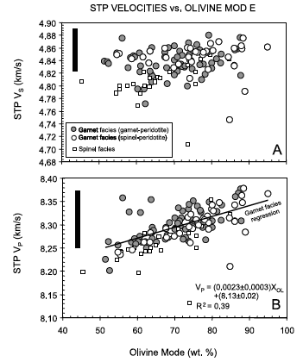
Partial melt extraction has only a minor effect on S seismic velocity, a bit more (~1%) on P:
High cratonic seismic velocities mostly due to low temperature, buoyancy due to melt depletion.
Figure from Lee, JGR 2003

Slide 13
The Formation and Evolution of Cratonic Lithospheric Mantle
Seismic characteristics – what’s causing them
Samples of cratonic lithospheric mantle
Constraints from xenolith composition on tectonic setting of lithosphere production and temporal variability
Metasomatism: An indicator of formation mechanism and the ultimate “terminator” for lithosphere survival?

Slide 14
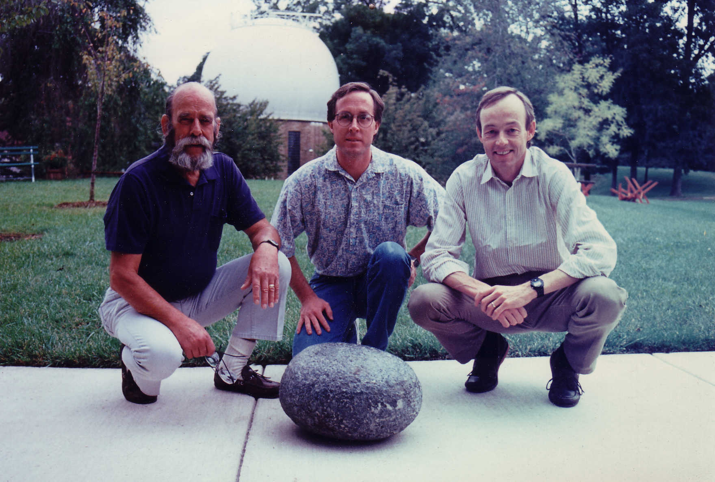
Xenoliths can be Large and Abundant
Notes:
Joe Boyd, Steve Shirey and the speaker with a peridotite xenolith from ~150 km beneath the surface – sampled by the Premier kimberlite, South Africa

Slide 15
Xenolith Availability Good, In Some Places
Notes:
A selection of large kimberlite pipes in southern Africa. Many more localities are available if one considers smaller dike rather than diatreme facies kimberlites.

Slide 16
Mineral Thermobarometry Allows Reconstruction of Xenolith Stratigraphy in the Mantle
Reviews: Brey and Kohler, J. Pet. 1990; Carswell and Gibb, CMP 1987; Finnerty and Boyd (in Nixon, P.H., “Mantle Xenoliths”, 1987)
Thermometers
  Fe-Mg-Ca exchange between opx and cpx (B&K; Wells, CMP 1977; Finnerty and Boyd, GCA 1984; Carlson and Lindsley, Am. Min.1988)
  Ca in opx (Nickle and Brey, CMP 1984)
  Na partitioning between opx and cpx (B&K)
  Exchange of Fe and Mg between garnet and cpx (Ellis and Green, CMP 1979; Krogh, CMP 1988) or opx (Harley, CMP, 1984; Lee and Ganguly, J. Pet. 1988) or olivine (O’Neill CMP 1980)
Barometers (don’t work for eclogites!)
  Al-in-opx barometer (MacGregor, Am. Min. 1974; Harley, J. Pet. 1984; Bertrand et al., CMP 1986; Finnerty and Boyd, 1987)
  Tschermak’s molecule in opx coexisting with garnet (Nickle and Green,EPSL 1985)
  Exchange of Ca between olivine and cpx (Kohler and Brey, GCA 1990)

Slide 17
Mantle Lithosphere of Archean Cratons is:
Thick: ~200 km based on xenoliths, not the same everywhere
Cold: average surface heat flow is 40 mW m⁻², not the same everywhere
0
Kalihari
Slave
50
2
100
4
Pressure (GPa)
150
Depth (km)
6
Lesotho
Jericho
Kimberley
Lac de Gras
200
Best Fit
Torrie
Kalihari
8
Letlhakane
250
Grizzly
10
300
0
200
400
600
800
1000
1200
1400
1600
200
400
600
800
1000
1200
1400
1600
Temperature (ºC)
Temperature (ºC)
Rudnick & Nyblade, 1999
Notes:
Mineral thermobarometry allows reconstruction of the stratigraphic position of xenoliths sampled randomly by the host kimberlite. The reconstructed xenolith stratigraphy creates cold (35-50 mW/m2) geotherms that intersect a mantle adiabat with potential temperature of 1350C near 200 km depth

Slide 18
Things to Note in Cratonic Geotherms:
Intersect adiabats at 5-7 Gpa (150-250 km)
Slave very cold above 150 km
Magmatically active areas (Tanzania, Vitim) offset to higher geotherms
Only limited penetration into the diamond stability field
Geotherm data from the compilation of Rudnick et al., Chem. Geol, 1998

Slide 19
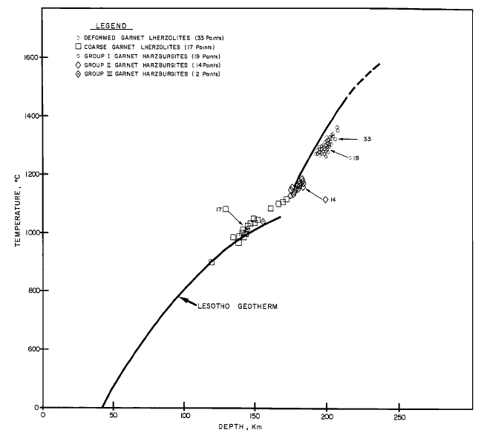
Geotherm for low-T Peridotite Xenoliths from the 1200 Ma Premier Kimberlite, South Africa, Define a Geotherm Similar to those of the Xenolith Suites from Cretaceous Kimberlites
(~ 1000ºC at 150 km)
Danchin, in “The Mantle Sample: Inclusions in Kimberlites and Other Volcanics”, AGU, Spec. Pub. V. 16, 1979
Notes:
The geotherms recorded by kimberlite xenoliths are a snapshot of mantle lithosphere temperatures at the time of kimberlite eruption. There is no clear temporal change in the geotherms derived from kimberlites of different ages, at least back to the 1200 Ma Premier kimberlite or 1600 Ma Kuruman kimberlite of South Africa

Slide 20
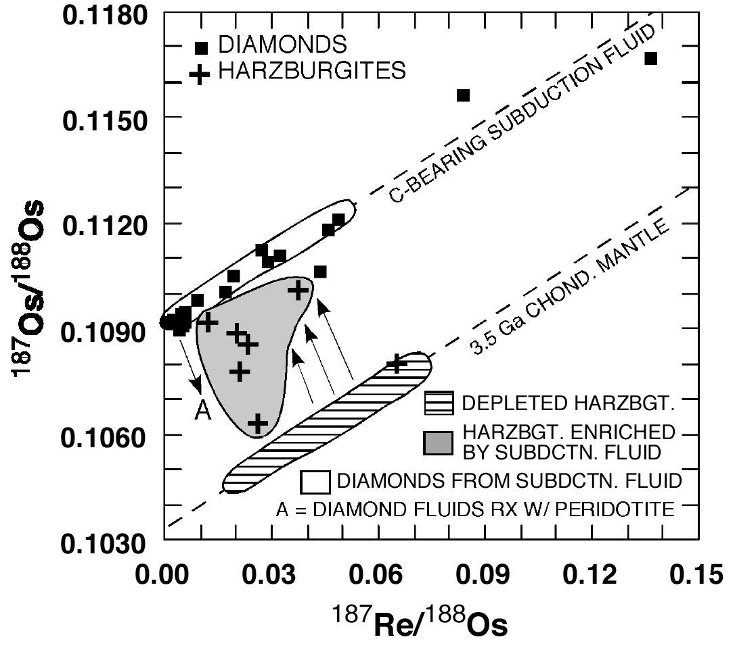
Evidence for Diamond Formation as Old as 3.56 Ga
Not likely if the base of the lithospheric mantle were >200 ºC hotter than present day
Squares are measurements of sulfides included in diamonds from the Panda kimberlite pipe, Slave Craton, Canada.
Age = 3.56 ± 0.15 billion years
(Westerlund et al., CMP 2006)
Notes:
The diamond surrounding the sulfide inclusion keeps the inclusion from exchanging Re and Os with surrounding mantle. In essence, even though sulfide has a low Re-Os closure temperature, the diamond surrounding the sulfides imposes its very high closure temperature on the included sulfide. This is an example from the Slave Craton of northern Canada, where diamond inclusions define a 3.56 Ga Re-Os isochron age, with an initial 187Os/188Os substantially higher than expected for the mantle a that time (the lined balloon). The crosses represent peridotite xenoliths that appear to be mixtures between 3.5 Ga mantle, and the fluids with high 187Os/188Os from which the diamond inclusion sulfides crystallized. High 187Os/188Os is a characteristic of crustal rocks, perhaps implying that this diamond isochron reflects diamond formation in the relatively deep (> 150 km) upper mantle due to subduction and dewatering of crustal materials.

Slide 21
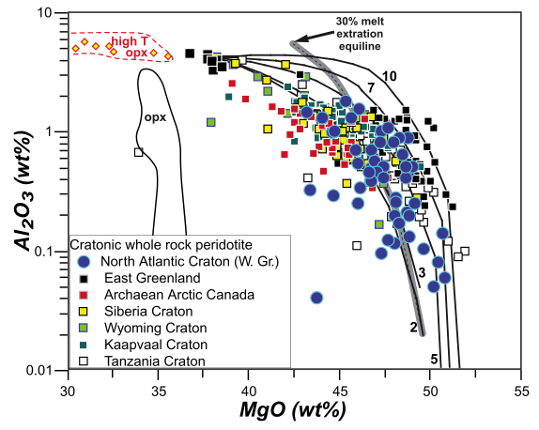
Lithospheric Mantle Xenoliths are Dominated by Melt-depleted Peridotite
Pearson et al., EPSL 1995
Degrees of melt extraction = 25-45% at pressures of 3-7 GPa
Pearson & Wittig, J. Geol.Soc. Lond., 2008
Notes:
The majority of lithospheric peridotite xenoliths have compositions consistent with them being the residues of large amounts of partial melt extraction.

Slide 22
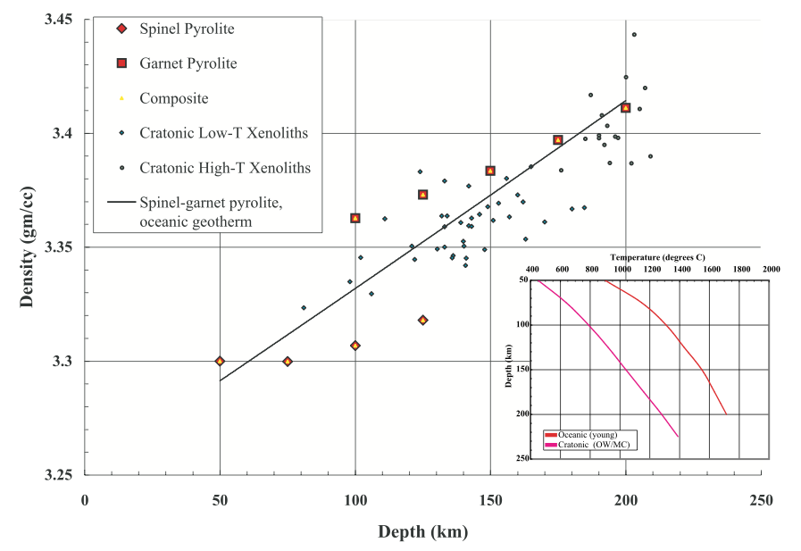
Degree of Melt Depletion Results in Isopycnic Lithosphere
(more or less…)
Densities calculated for both fertile mantle (pyrolite) and depleted lithospheric peridotites along Kaapvaal geotherm
Pyrolite densities calculated along oceanic geotherm, lithospheric densities along cratonic geotherm
Notes:
At the same temperature, fertile mantle (pyrolite) is about 2% denser at 150 km depth than garnet harzburgite xenoliths from the Kaapvaal Craton. This compositional density difference requires of order 400-500oC colder lithospheric mantle at 150 km depth in order for lithospheric mantle to be isopycnic with pyrolite. Note large density jump in pyrolite going from spinel to garnet facies.

Slide 23
The Formation and Evolution of Cratonic Lithospheric Mantle
Seismic characteristics – what’s causing them
Samples of cratonic lithospheric mantle
Constraints from xenolith composition on tectonic setting of lithosphere production and temporal variability
Metasomatism: An indicator of formation mechanism and the ultimate “terminator” for lithosphere survival?

Slide 24
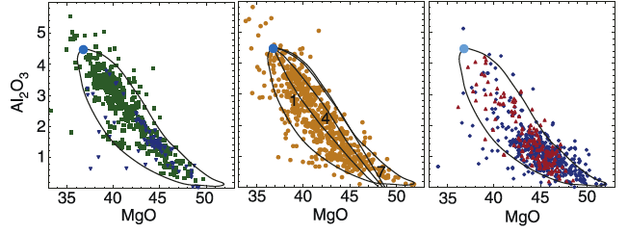
Is the High Average Degree of Melt-depletion of Cratonic Mantle an Indication of Higher Mantle Potential Temperatures, the Tectonic Setting of Melting, or Tectonic “Winnowing” of Dense/Fertile Components?
Blue = Abyssal
Green = Massif
Off-Craton Spinel
Peridotites
Blue = Cratonic Low-T
Red = High-T
Figure from Carlson et al., ROG 2005 with data from the compilation of Bill McDonough
Notes:
The thing about this slide that intrigues me is that the difference between the different settings is not so much in the maximum degree of depletion, but that the cratonic sample does not preserve many fertile components. Is this because the melting was so extensive that there was no fertile stuff left, or does the more fertile stuff eventually get eliminated either because it is the first to melt during later heating events or because it is dense enough to eventually sink out of the lithosphere? The field shown in each plot are simply duplicates of the field from the center figure drawn to encompass the majority of data points. The curves in the middle panel show the expected trajectories of melts at different pressures (numbers along curves in GPa – from Walter, TOG, 2003).

Slide 25
The Melt Removed from the Lithospheric Mantle is NOT the Continental Crust
Element | Fertile Mantle | Depleted Mantle | Picrite (20% melt) | Average Cont. Crust
SiO₂ (wt%) | 45 | 44 | 45.8 | 60.6
Al₂O₃ | 4.45 | 0.6 | 13.4 | 15.9
FeO | 8.05 | 7.7 | 8.5 | 6.7
MgO | 37.8 | 46.3 | 18.9 | 4.66
CaO | 3.55 | 0.8 | 10.8 | 6.41
Ba (ppm) | 6.6 | 0 | 40 | 456
Mass Balance:
[A]_{PM}*M_{PM} = [A]_{DM}*M_{DM} + [A]_{CC}*M_{CC}: M_{PM} = M_{DM} + M_{CC}
Then:
For Al₂O₃, M_{DM} = 3 x M_{CC}, but for Ba M_{DM} = 68 x M_{CC}
Notes:
The degree of melt-depletion observed for cratonic peridotites is of order 20-40%. This high degree melting would produce a picrite or komatiite, but the continental crust is andesite. To turn a picrite into an andesite requires A LOT of additional processing (extreme fractional crystallization, wet remelting, or extreme weathering of the mafic component of the picrite) in order to make siliceous continental crust. On the basis of an incompatible major element like aluminum, the residue to the continental crust COULD be a residue similar in size to the lithospheric mantle. This will not work for highly incompatible trace elements like Ba, for example, as the continents contain something like 30-50% of all the Earth’s Ba. Ba is one of the fluid-mobile trace elements selectively transferred to the crust during convergent margin volcanism. Convergent margin volcanism provides an easy way to decouple trace element transfer from a large volume of subducted crust/sediment into the continental crust while limiting the degree of major element transfer that most likely occurs by fluid-flux melting in a convergent margin.

Slide 26
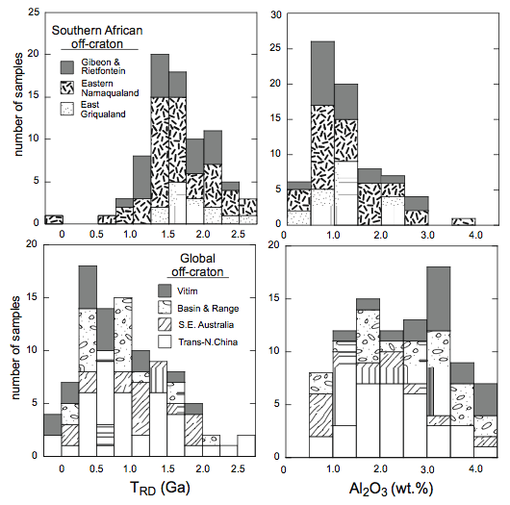
Is there a secular trend in degree of depletion?
From Janney et al., J. Pet. 2010
Notes:
If the mantle is cooling with time, then the degree of lithosphere depletion should decrease with time. The evidence for/against a secular change in the degree of mantle depletion is not convincing either way.

Slide 27
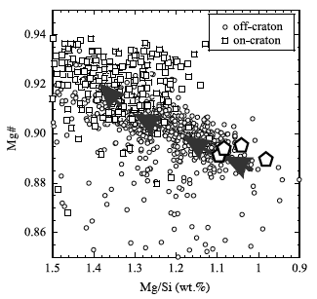
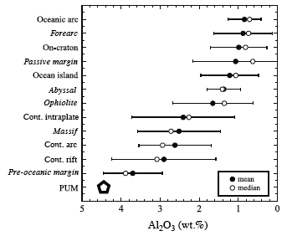
Do High Degrees of Lithosphere Melting Reflect High Temperature Mantle or Water-flux Melting?
Pearson et al., TOG, 2003
Notes:
On the basis of Al, its hard to tell cratonic from either arc or OIB mantle. Cratonic mantle could be plume, could be arc.

Slide 28
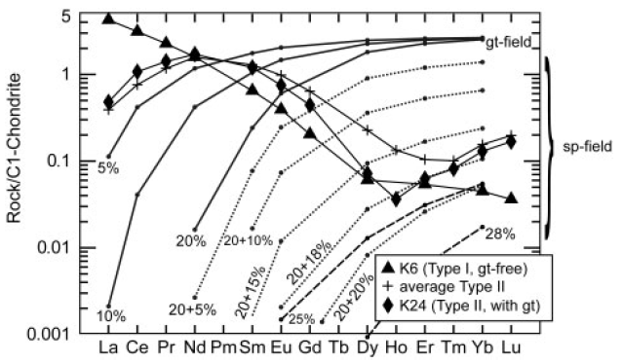
Low HREE Concentrations Indicative of Melting Past the Point of Garnet Exhaustion → Shallow Melting?
Garnet
Spinel
Simon et al., J. Pet., 2007
Notes:
Lithospheric peridotites are quite depleted in heavy rare earth elements (REE), like Lu. Garnet strongly concentrates the heavy REE, so if garnet were residual during the partial melting event that produced lithospheric peridotites, they should have high, not low, Lu contents. This result suggests that the melting event producing lithospheric peridotites was relatively shallow, above the garnet stability field.

Slide 29
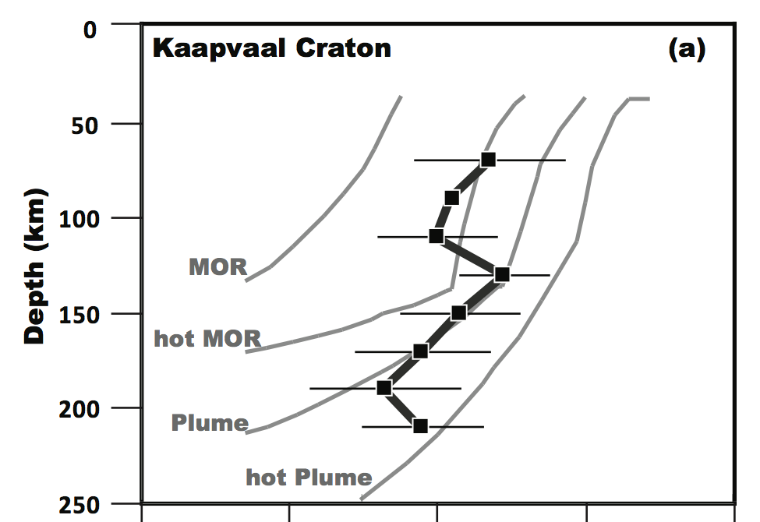
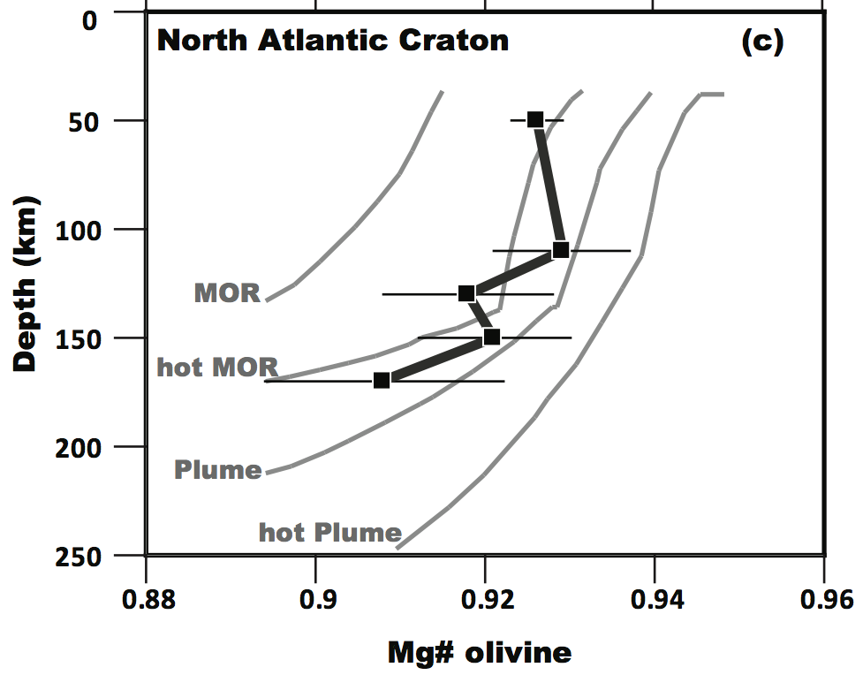
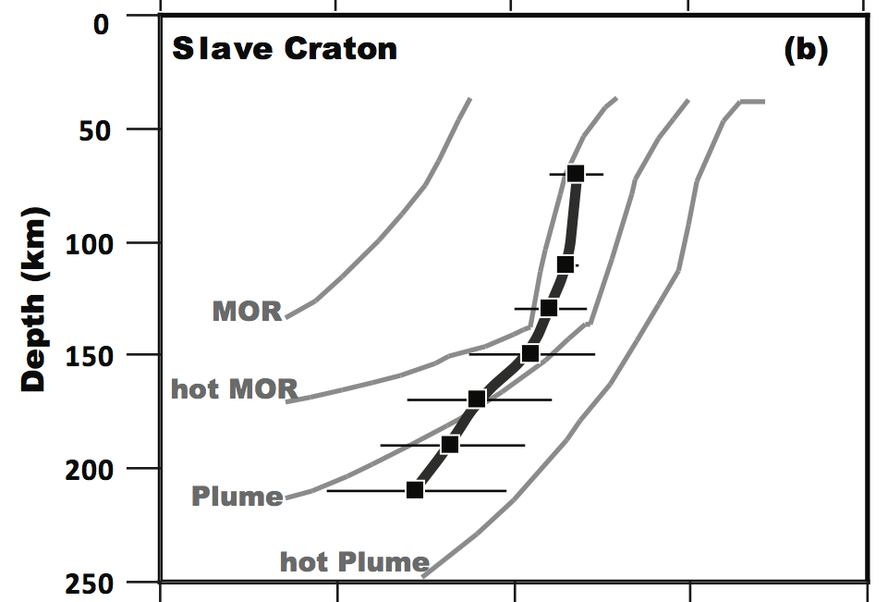
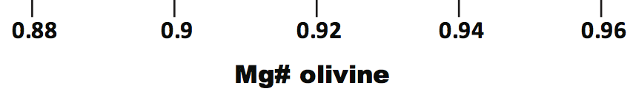
Residues of melting of MOR (1350 Tp), hot MOR (1550 Tp), Plume (1650 Tp) and hot plume (1750 Tp). Kaapvaal shows little change with depth, Slave and NA more fertile with depth. (Figures from Pearson and Wittiq, TOG, 2013, based on melting models of Herzberg, J. Pet. 2004 and Herzberg and Rudnick, Lithos 2012)
Notes:
Comparison of the expected Mg# of olivines left after melting of mantle at potential temperatures of 1350C (modern mid ocean ridges – MOR), 1550C as might be expected for ocean ridge mantle in the Archean (hot MOR), 1650C an Archean plume, or 1750C as suggested by some of the higher temperature estimates for komatiites. The dark lines show the average Mg# of olivines from cratonic peridotites averaged over depth bins.

Slide 30
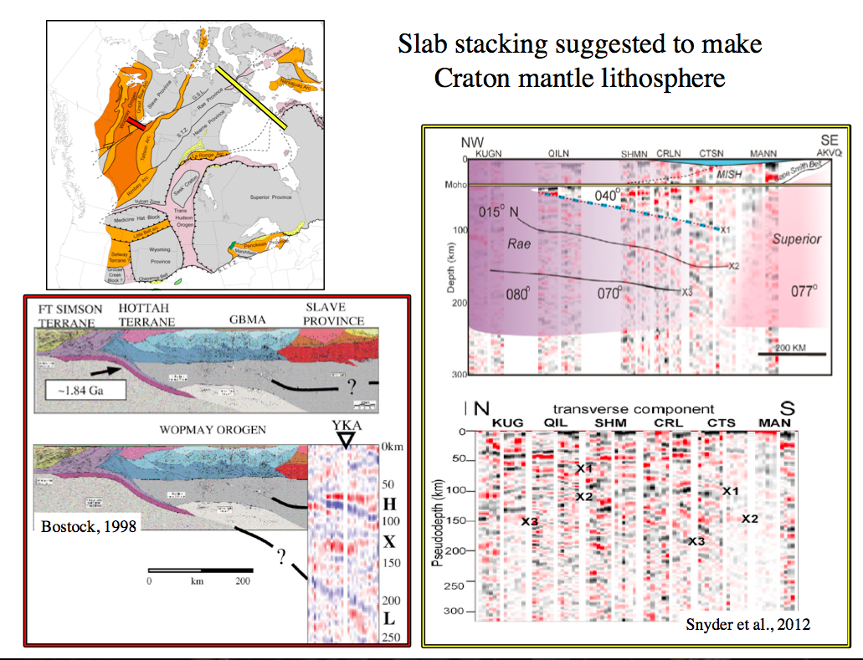
Slide from Humphreys, CIDER 2013
Notes:
The Slave Craton shows many “layered”” characteristics to its lithosphere including tomography, EM, anisotropy, receiver functions, and xenolith compositions.

Slide 31
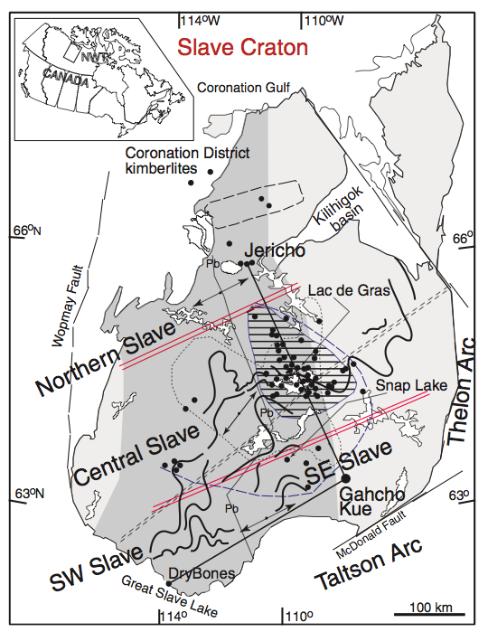
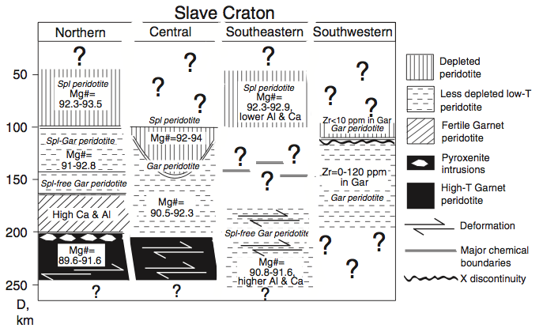
Petrologic Data for Xenoliths from Slave Indicate a Compositionally Layered Lithosphere
Figures from Kopylova and Russell, EPSL 2000 and Kopylova and Caro, J. Pet. 2004

Slide 32
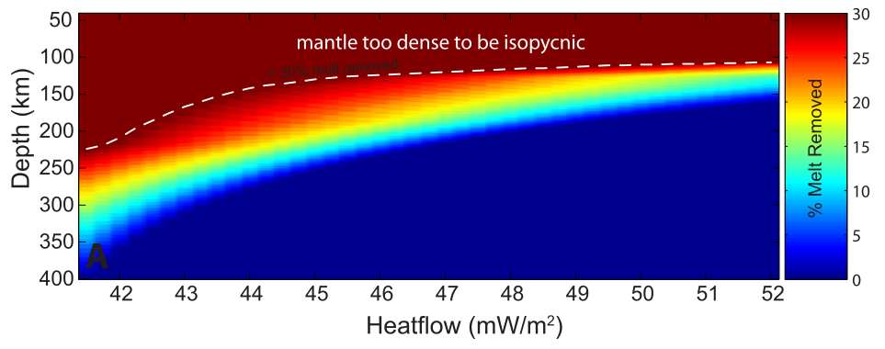
The Buoyancy Created by Melt Depletion is Greater at Greater Depth
To be isopycnic, the lower sections of the lithosphere can have lost less melt than more shallow lithosphere
Figure from Schutt and Lesher, JGR 2006

Slide 33
The Formation and Evolution of Cratonic Lithospheric Mantle
Seismic characteristics – what’s causing them
Samples of cratonic lithospheric mantle
Constraints from xenolith composition on tectonic setting of lithosphere production and temporal variability
Metasomatism: An indicator of formation mechanism and the ultimate “terminator” for lithosphere survival?

Slide 34
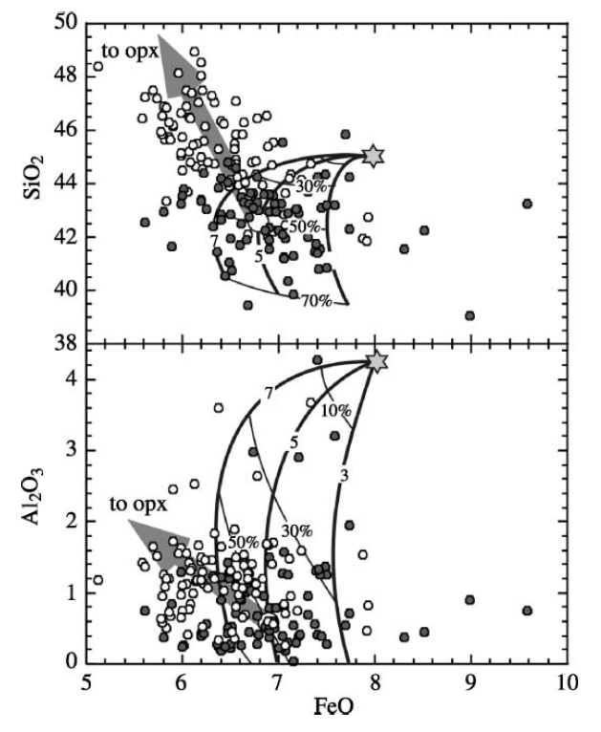
Distinguishing “Secondary” Compositional Effects
Can they can be used to infer the setting of melt depletion?
Si-enrichment, once thought to be a ubiquitous characteristic of lithospheric mantle, now seen as an unusual characteristic of the Kaapvaal Craton
From Walter, TOG, 2003
Notes:
Some lithospheric peridotites, particularly those from the Kaapvaal craton, have higher Si concentrations than expected for residues of melt extraction. When the Kaapvaal Craton was about the only well-studied craton, the silica-enrichment was viewed as some special process necessary for the creation of lithospheric mantle. As more cratonic data were added, the Kaapvaal began to stand out as anonymously Si enriched and is now viewed as being caused by a secondary, i.e. post melt extraction, process. The Si enrichment is expressed as unusually high modal orthopyroxene abundances.

Slide 35
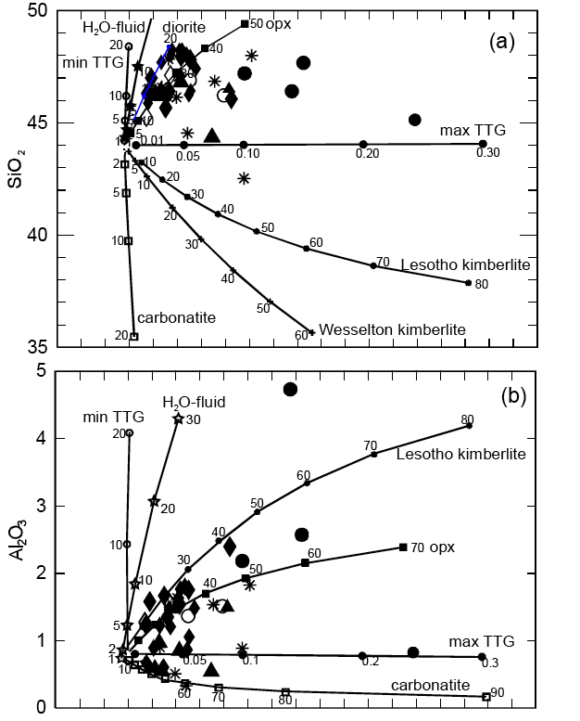
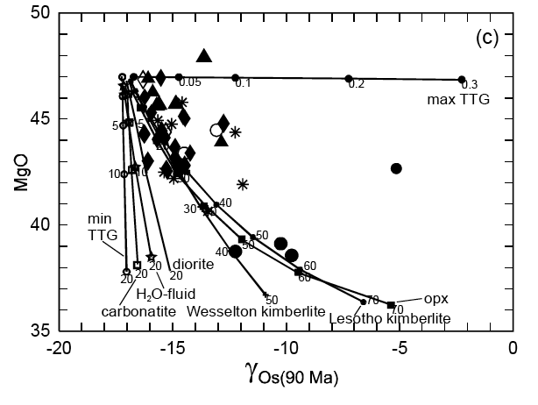
Si-addition best explained by orthopyroxene addition, not by addition of any obvious melt composition. Opx addition as a reaction with a passing Si-rich, Al-poor, ¹⁸⁷Os-rich fluid in a subduction zone?
-15
-10
-5
γOs (90 Ma)
From Simon et al., J. Pet, 2007
Notes:
Si enrichment is not due to host rock contamination, but its cause is not clear. One option is the precipitation of opx as Si-rich magmas originating from a subducting, underlying, slab pass through the lithosphere. Another involves opx crystallization from passing basaltic melts.

Slide 36
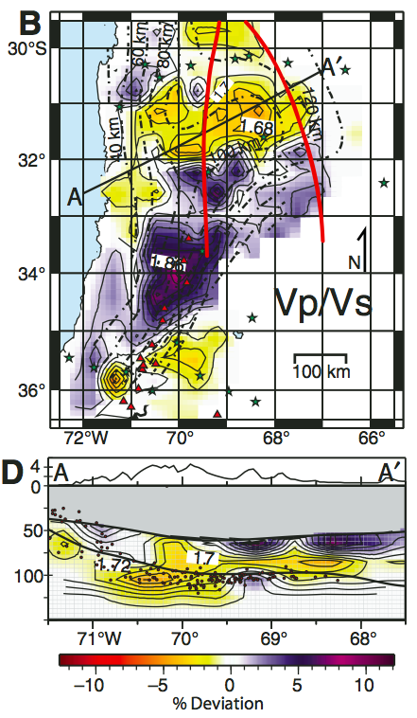
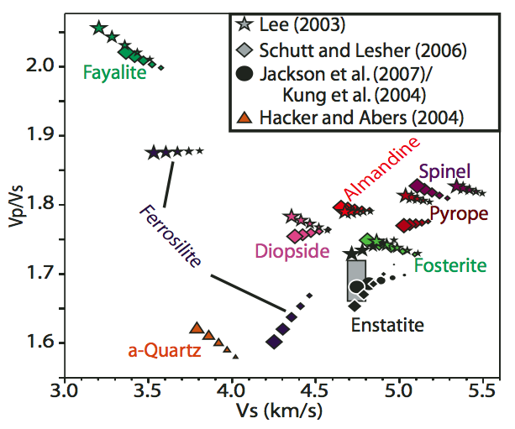
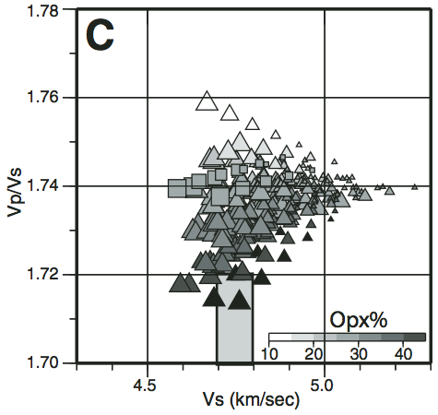
Opx Enrichment Expressed as Low Vp/Vs in Chile-Argentina Upper Mantle
Opx enrichment a characteristic of mantle wedges in convergent margins?
Figures from Wagner et al., Geology 2008
Notes:
Possible connection of opx enrichment with convergent margin processes from tomography of mantle above the flat slab subduction in Chile-Argentina.

Slide 37
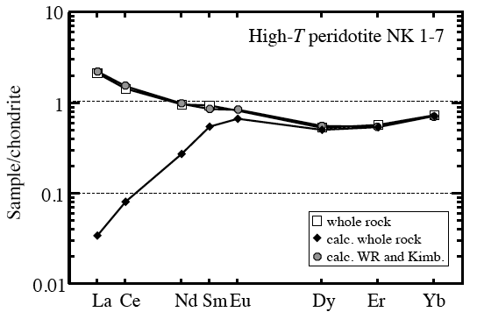
Carlson et al., ROG 2005
Distinguishing Primary from Secondary Compositional Characteristics
Somerset Island, Canada, xenolith REE pattern,
measured compared to reconstructed from mineral analyses (Schmidberger and Francis, J. Pet., 2001)
Notes:
Mantle xenoliths are carried to Earth’s surface in some of the most incompatible element rich magmas known. As a result, even a fraction of a percent infiltration of the host magma into the xenolith can completely overwhelm its abundance of highly incompatible elements.

Slide 38
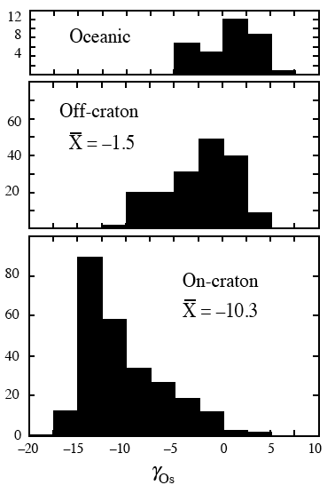
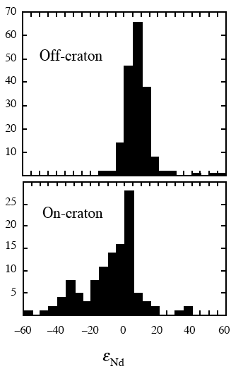
Contamination by Host Magma a BIG Problem, but Clear Evidence also Exists for Ancient Metasomatism
Depletion
Enrichment
Enrichment
Depletion
Number
Number
γ_{Os}
Pearson et al., TOG, 2003
Notes:
Re is more incompatible than Os. Sm is more incompatible than Nd. A residue of melting should have low Re/Os and high Sm/Nd. As a result, an old residue should have low 187Os/188Os (negative gamma Os) and high 143Nd/144Nd (positive epsilon Nd). Cratonic lithosphere peridotites indeed have negative gamma Os, but often also negative epsilon Nd. Nd is strongly incompatible and so very low in abundance in depleted peridotite, but strongly enriched in most melts. As a result, even small amounts of melt introduced into depleted peridotite will overwhelm preexisting Sm and Nd abundances leaving a metasomatized residue with low Sm/Nd that will evolve to negative epsilon Nd with time. In contrast, Os is compatible in the mantle and is present at concentrations some 30 to 1000 times higher than most magmas. Thus, small amounts of melt metasomatism will raise the Re/Os ratio of the metasomatized mantle a bit, but the Re/Os ratio will remain low enough, at low degrees of metasomatism, to continue to evolve negative gamma Os.

Slide 39
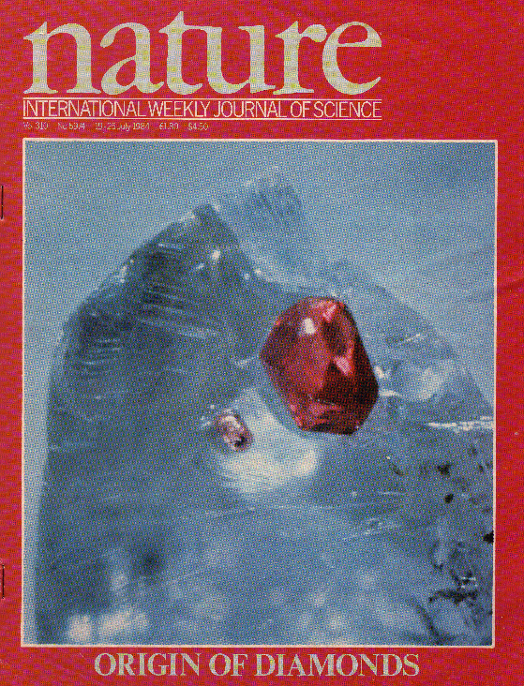
Diamond as an Indicator of Deep Mantle Metasomatism
Richardson et al., Nature, 1984
Notes:
Garnets included in diamond also are strongly enriched in light REE, which means they formed from a fluid that was tremendously light REE enriched. Once encapsulated in diamond, their low Sm/Nd ratios allow them to evolve very low 143Nd/144Nd. The Sm-Nd model age is Archean in this example, but the age is dating the time of garnet formation from the metasomatic fluid/melt, not the melt depletion that created lithospheric peridotites. This is perhaps the clearest evidence that metasomatism of the lithospheric mantle was occurring during or shortly after the event that caused its melt depletion.

Slide 40
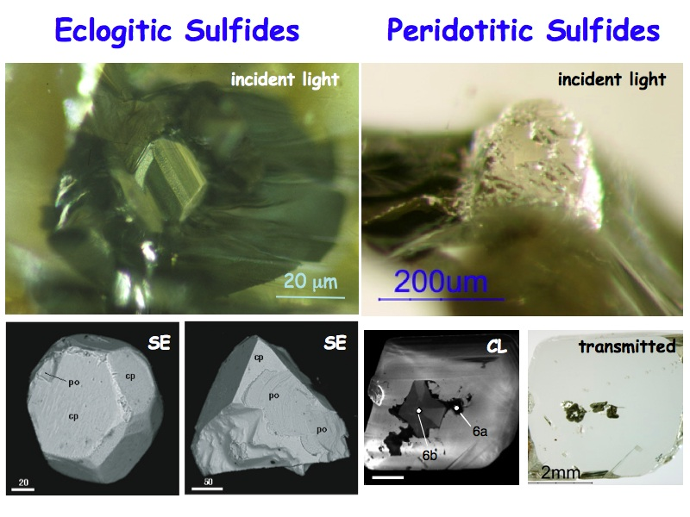
Another Indicator of the Role of Subduction:
Similar Re-Os Evolution of Sulfides and Eclogites in the Lithospheric Mantle
Kaapvaal Craton
Carlson et al., ROG 2005
Sulfide data from Griffin et al., Chem. Geol. 2004, eclogites from Pearson et al., Nature 1995 and Menzies et al., Lithos 2003
Notes:
Both sulfides metasomatically added to depleted peridotites and eclogite xenoliths in the mantle lithosphere likely got there by the subduction of crustal materials. Their circa 3 Ga age in this example suggests that subduction of crustal material into the mantle was already ongoing by 3 Ga.

Slide 41
Strong, Laramide, Metasomatic Overprint in the Wyoming Craton Lithosphere
Carlson et al., Lithos 2004
Notes:
Mantle xenoliths are available from the ~50 Ma Williams and Homestead kimberlites erupted through the Wyoming Craton and from the circa 380 Ma Sloan kimberlite erupted through Proterozoic crust south of the Wyoming Craton. The Sloan xenoliths record a cold mantle geotherm typical of cratonic lithosphere and show slight depletion in incompatible elements suggestive of minimal metasomatic enrichment. In contrast, the Wyoming Craton xenoliths also show a cold geotherm down to ~150 km then a steep step up in temperature documented by a very limited number of samples. Cpx from the Williams and Homestead xenoliths show “U” shaped incompatible element patterns typical of strongly metasomatized peridotites.

Slide 42
Sudden Transition to Warm, Younger, Mantle at 4.5 GPa Beneath the Wyoming Craton?
Sloan
Homestead
Williams Low-T
Williams High-T
Carlson et al., Lithos 2004
Notes:
Re-Os data support a Proterozoic age for Sloan lithosphere to depths of ~200 km (one sample not on this plot has an equilibration pressure of 6 GPa and a TRD age of 1.57 Ga). Data for Homestead support an Archean lithosphere to the greatest depth sampled (~140 km), but Williams shows a step to high-T peridotites with younger Re-Os ages at about 150 km depth. Whether this reflects the bottom of the Wyoming lithosphere awaits more definitive data.

Slide 43
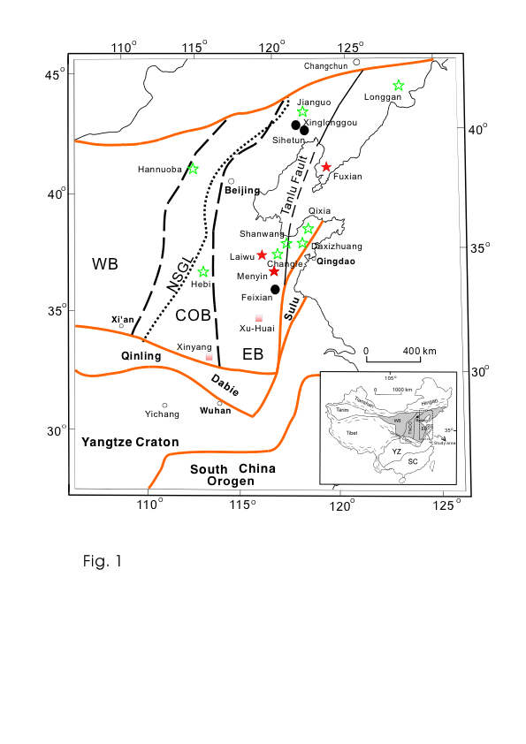
North China Craton: The Poster-Child for Lithosphere Removal
1: ~250 Ma
Jiaoliao Belt
North: Solonker Suture
Yinshan
Khondalite Belt
2. East: Paleo-pacific Subduction
Ordos
Western
Block
Eastern
Block
2: 100-200 Ma
3. South: Yangtze Craton Collision
Central
In all three cases, NCC is on hanging wall.
3: 220 Ma
Slide courtesy of
Roberta Rudnick
Map after Zhao et al., 2010; events after Windley et al., 2010
Notes:
The NCC has seen 3 Phanerozoic tectonic events along its margins, and has served as the hanging wall in all three events.

Slide 44
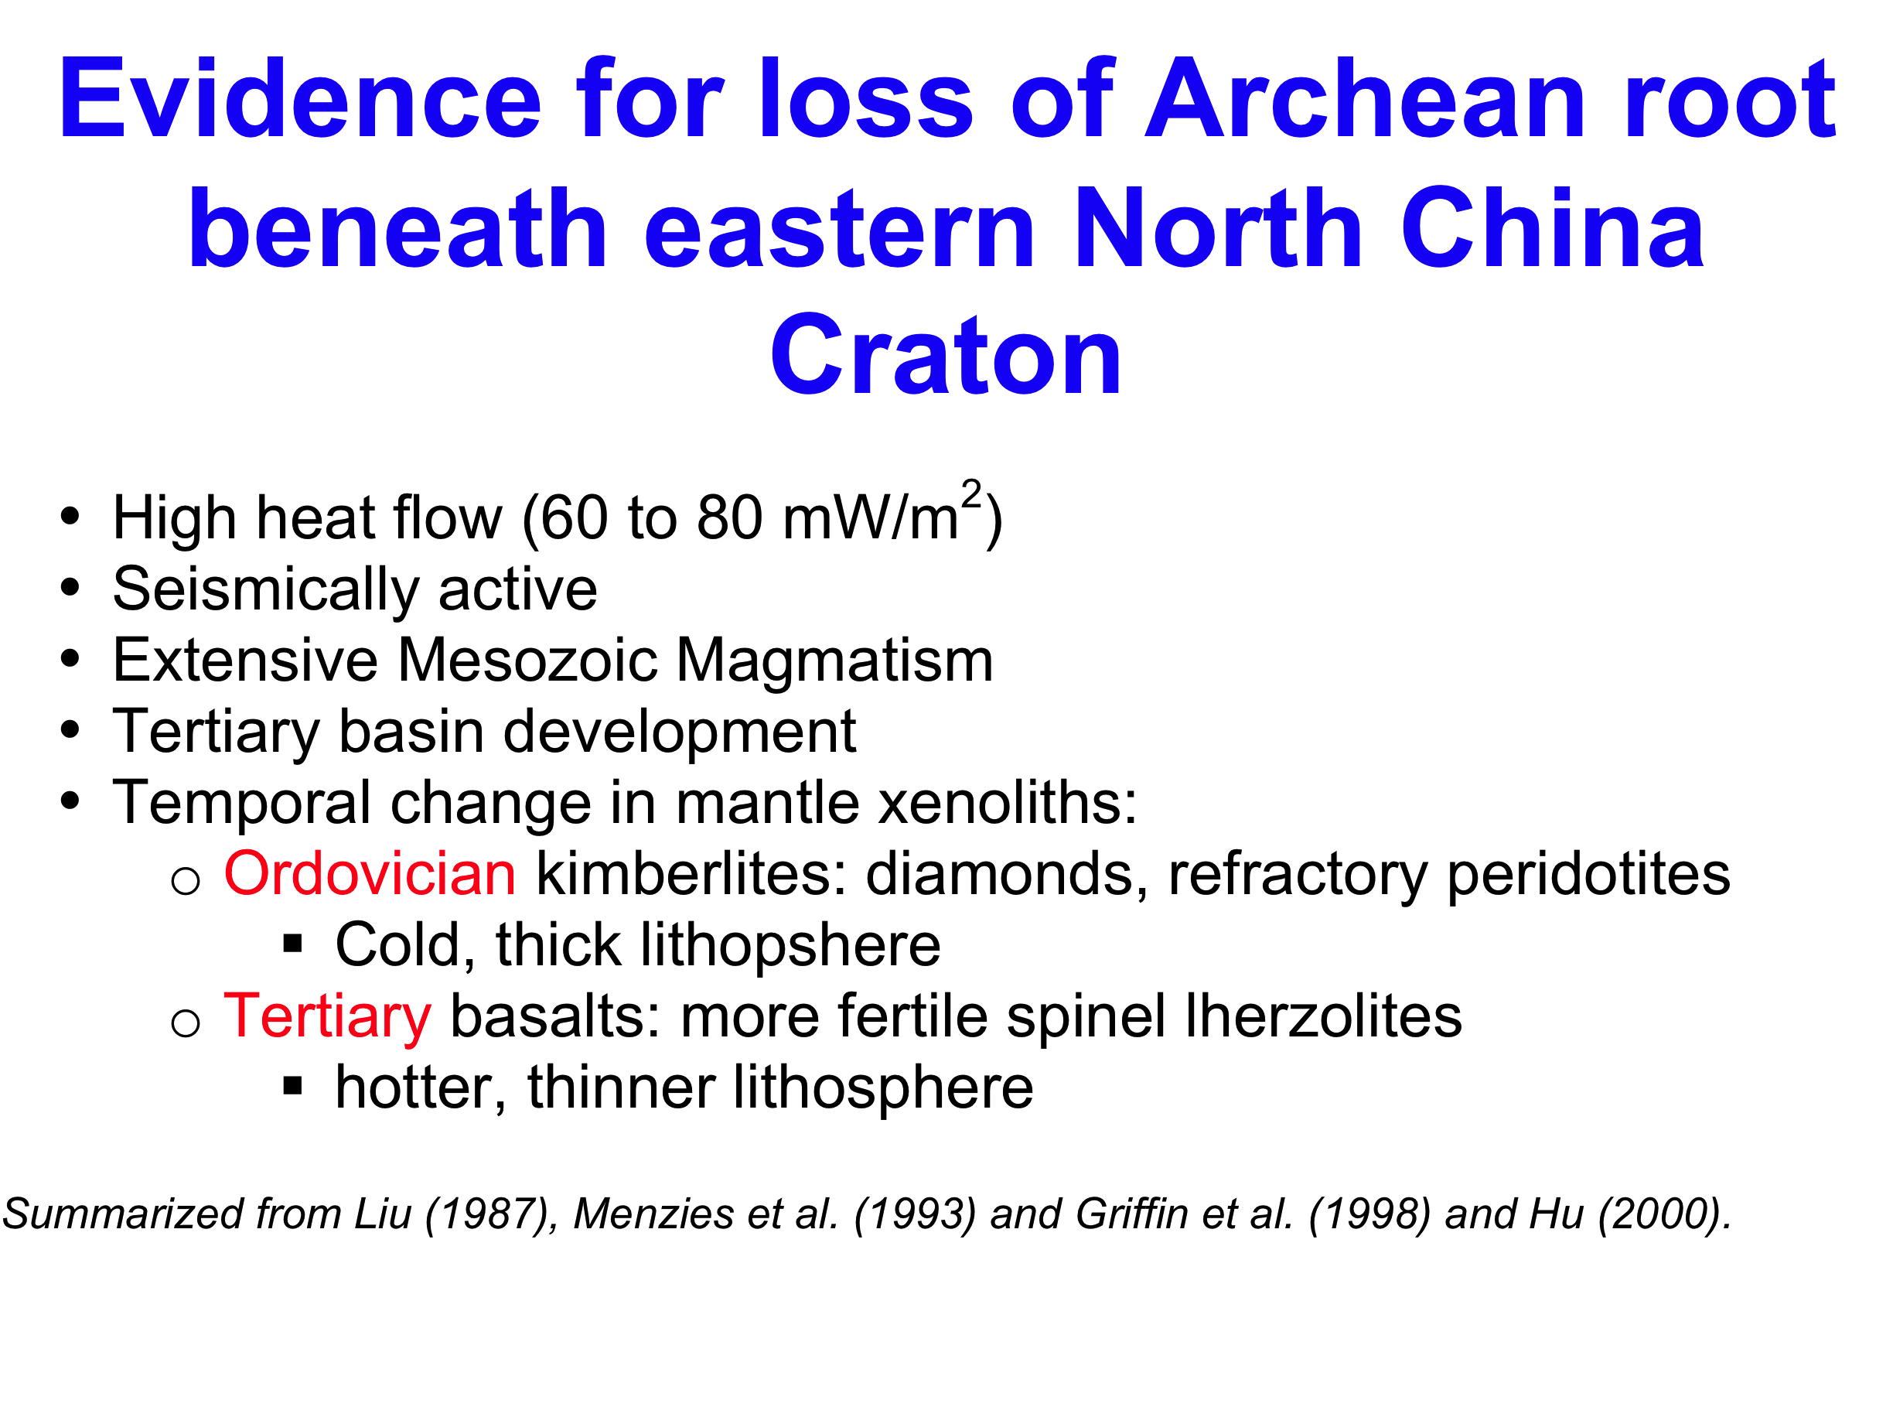
Slide courtesy of Roberta Rudnick

Slide 45
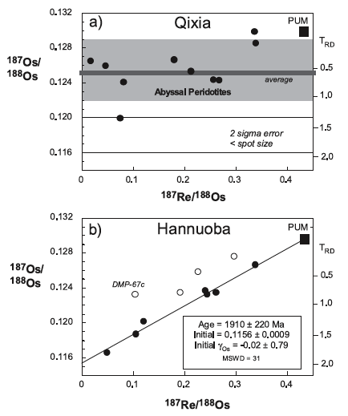
Archean Lithosphere in East Replaced by Modern Asthenospheric Mantle. Mantle Beneath Archean Crust of TNCO is 1.9 Ga
Gao et al., EPSL, 2002;
Liu et al., GCA 2011;
Liu et al., Chem. Geol. 2012

Slide 46
Conclusions
Melt depletion of lithospheric peridotites leaves them chemically buoyant, strong, and with little capacity for heat generation so they get cold, fast
Tectonic setting of lithosphere creation not entirely clear – shallow melting either under a hot ridge or water-flux melting in a convergent margin wedge are implicated
If left undisturbed, highly depleted lithospheric mantle is stable beneath continents for billions of years
If subjected to melt metasomatism, all the characteristics that make lithospheric mantle stable can be eliminated, allowing its removal

