Slide 2
Plan
Fluxes and why the mantle matters
Earth’s buffer – ocean
Earth’s buffer – weathering
A question

Slide 3
Crust = 8.5 X 10²¹ moles C
Total mantle flux
2.2 X 10¹² moles C/yr
1 X 10¹² moles C/yr
1 X 10¹² moles C/yr
0.2 X 10¹² moles C/yr
Total flux is
1.6 X10¹² but only 20
20% is from mantle
Plumes/Oceanic Islands
Mid- ocean ridges
Arcs
Mantle = 2.2 to 10 X 10²³ moles C
Estimates summarized in Hayes and Waldbauer (2006) and Dasgupta and Hirschmann (2010)

Slide 4
atmosphere = 7.2 X 10¹⁶ moles C
Fossil fuel and cement flux = 10¹⁶ to 10¹⁷
moles C/yr
Crust = 8.5 X 10²¹ moles C
Total mantle flux
2.2 X 10¹² moles C/yr

Slide 5
Crust = 8.5 X 10²¹ moles C
=
3.86 byr
Flux = 2.2 X 10¹² moles C/yr
Crust = 8.5 X 10²¹ moles C
Total mantle flux
2.2 X 10¹² moles C/yr
1 X 10¹² moles C/yr
1 X 10¹² moles C/yr
0.2 X 10¹² moles C/yr
Total flux is
1.6 X10¹² but only 20
20% is from mantle
Arcs

Slide 6
Crust = 8.5 X 10²¹ moles C
8.5 X 10²¹ moles C
0
4.0
0
Age (byr)

Slide 7
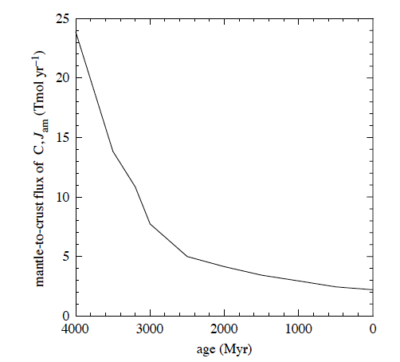
Assumes higher early flux
Hayes and Waldbauer (2006)

Slide 8
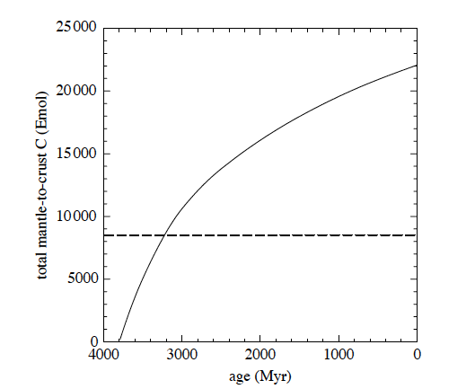
Assumes higher early flux
High return flux
3. Crustal inventory in 1 byr
Only takes 30,000 yrs to
400 ppm in atm with current mantle
flux (1012). Thus, crustal system
must modulate perturbations
Current crustal inventory
Hayes and Waldbauer (2006)

Slide 9
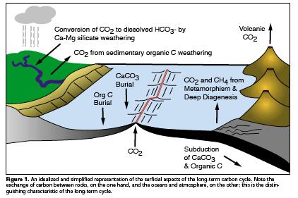
Berner, 1999

Slide 10
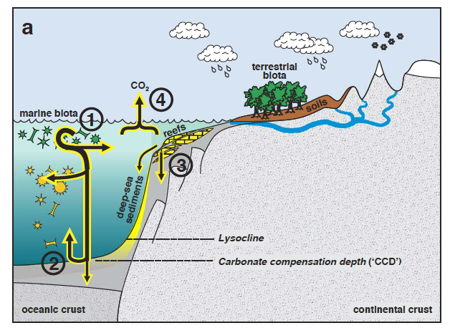
Open ocean carbonate: Ca²⁺ + 2HCO₃- = CaCO₃ + CO₂ + H₂O (Coccolithophores, forams)
- mid Mesozoic revolution
3) Shallow water – reefs – formation returns CO2 to atmosphere
2) CCD buffer CO2 increase shallows – Ca increase deepens – e folding 10kyr
Ridgewell and Zeebe 2005 EPSL

Slide 11
Pre-biogenic carbonate - >500 myr
Ca⁺⁺
Higher saturation state
All ocean inorganic carbonate precipitation

Slide 12
Shallow water biogenic carbonate – 500 to mid Mesozoic
Ca⁺⁺
Shallow water biogenic carbonate
Open ocean carbonate
CCD

Slide 13
Open ocean biogenic carbonate – Mid Mesozoic to Recent
Ca⁺⁺
Lower saturation state
Open ocean biogenic carbonate
Shallow water biogenic carbonate
CCD
CCD buffer
Reaction 1:
Ca⁺⁺ + 2HCO₃ = CaCO₃ + CO₂ + H₂O.

Slide 14
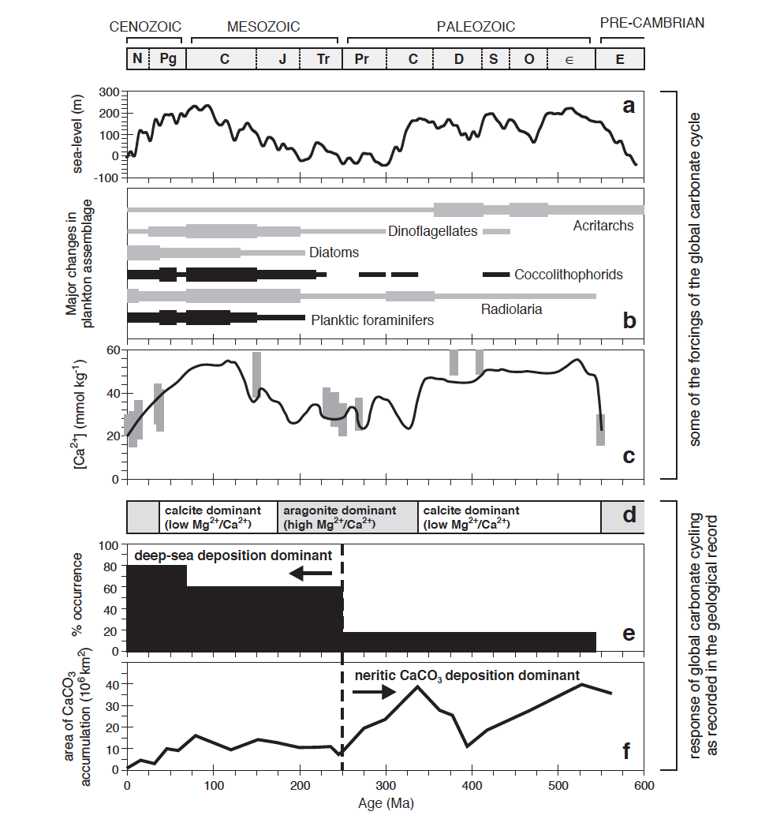
Cretan
Neritan
Strangelove
Strangelove – supersaturation, abiotic,
highly sensitive to perturbations
Neritan – biotic, less sensitive to
perturbations, shallow environments
Cretan – Mid-Mesozoic revolution,
Much less sensitive to perturbations,
Full ocean deposition.
Lower saturation
Ridgewell and Zeebe, 2005;
Zeebe and Zeebe and Westbroek, 2003

Slide 15
Organic Burial
P and N (nutrients)
CO₂ + H₂O = CH₂O + O₂
sunlight
53% land
47% in ocean

Slide 16
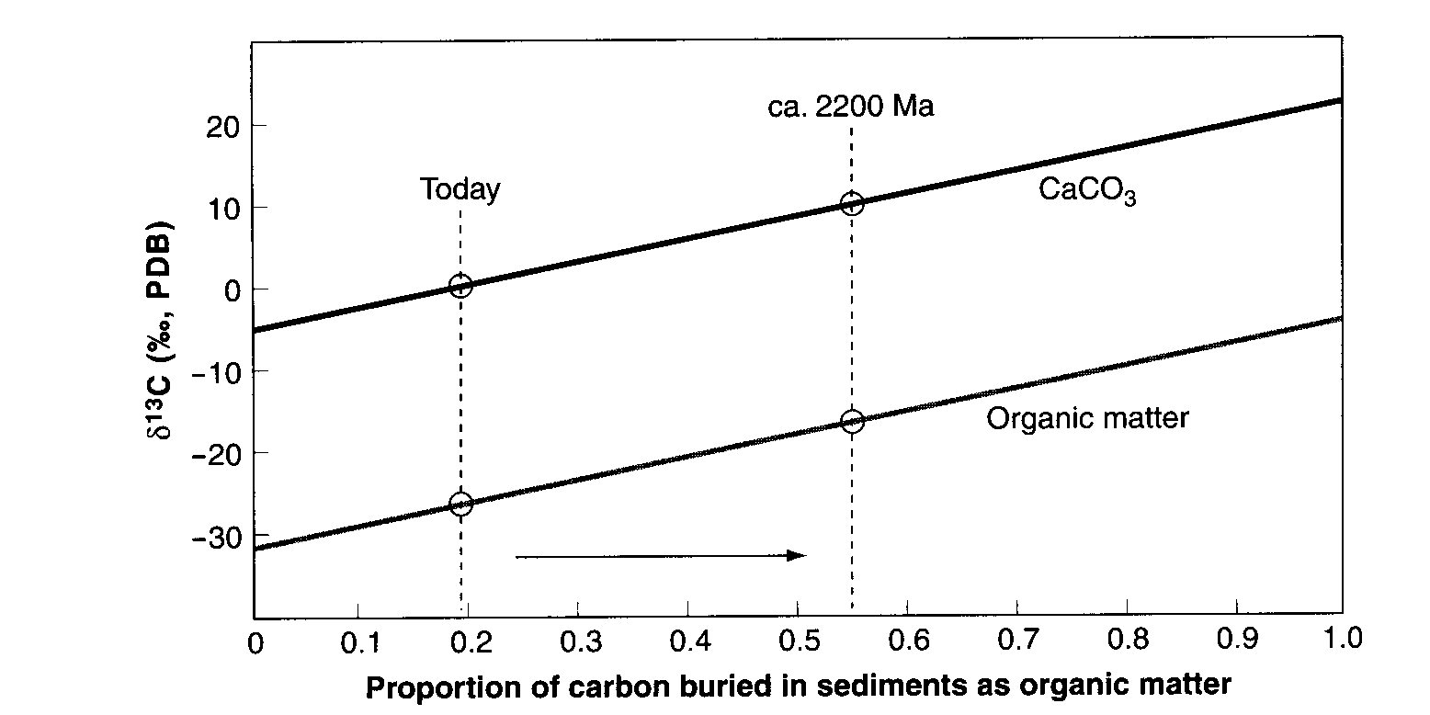
Total carbon should be fixed and isotopic
composition should vary dependent upon how
much of each component through time
Mantle
Increase
in inorganic
carbonate deposition
Increase
in burial of
organic matter

Slide 17
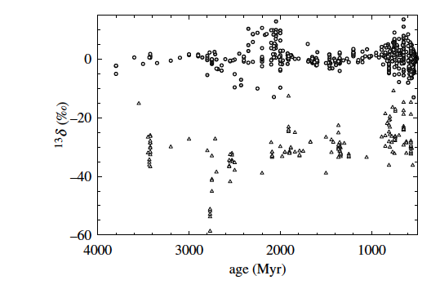
Compiled in Hayes and Waldbauer 2006

Slide 18
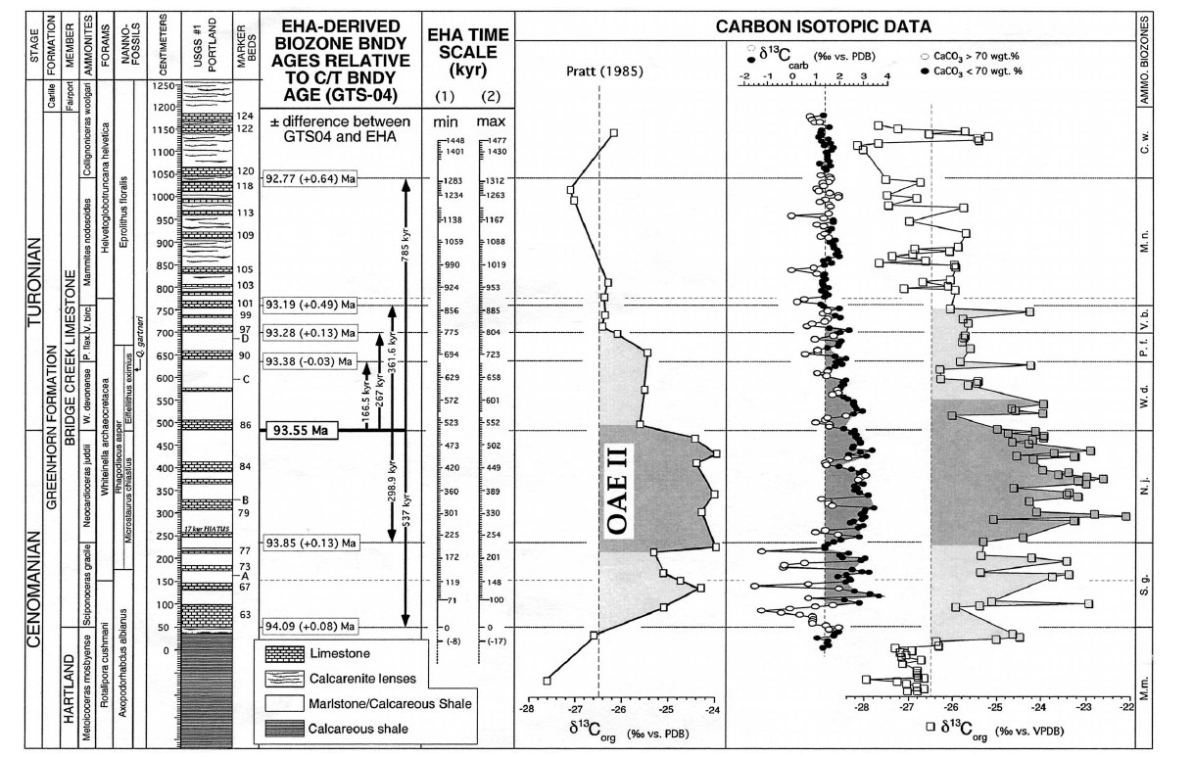
Ocean Anoxic Even 2
Sageman et al., 2006, Geology

Slide 19
Berner, 1999

Slide 20
2 CO₂ + H₂O + CaSiO₃ = 2 HCO₃- + SiO₂
Ca⁺⁺ + 2 HCO₃- = CaCO₃ + 1 CO₂ + H₂O
Urey Reaction
CO₂ + CaSiO₃ = CaCO₃ + SiO₂

Slide 21
1. Increased temp and hydrologic cycle
2. Increased weathering
Release CO₂
P (nutrients)
3. CO₂ + H₂O = CH₂O + O₂
0. LIP
Massive Organic Burial

Slide 22
Ocean Anoxic Even 2
Sageman et al., 2006, Geology

Slide 23
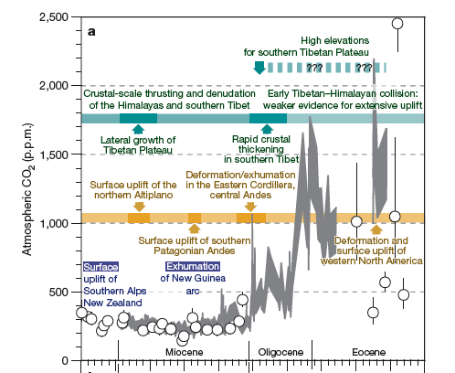

Slide 24
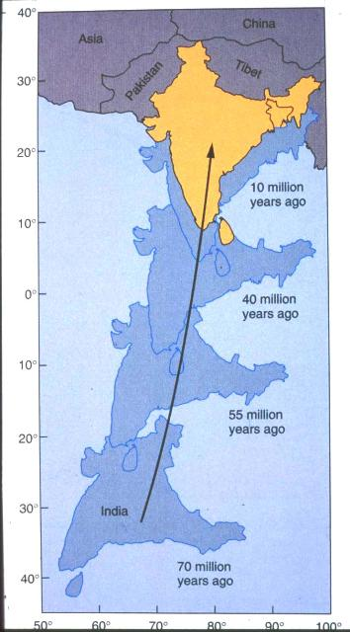
Starts to collide at
~40 myr

Slide 25
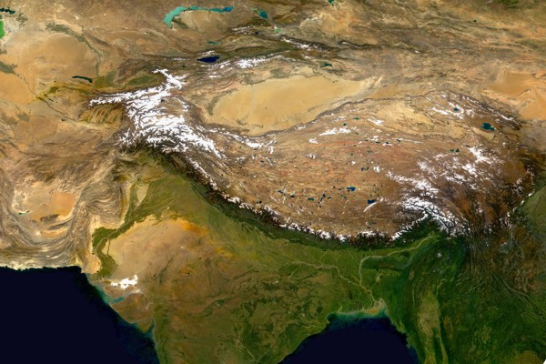
Some of the worlds largest rivers drain the
worlds largest mountain belt

Slide 26
Steady State chemical weathering
Waldbauer and Chamberlain, 2005
Hilley et al., 2010

Slide 27
Chemical Weathering Model
Rate of mineral concentration (q_{i}) change due to chemical weathering:
In steady state, composition of the weathering profile is constant:
In a state of steady uplift at a velocity u, z=ut where z=t=0 at the bottom of the weathering zone. Thus dz/dt=u and :

Slide 28
Uplift and Effective Surface Age
The total chemical weathering rate is found by integrating over the depth of the weathering profile Z:
This result can be parameterized in terms of the ‘effective surface age’ τ:
We define R_{i}=R_{i}’/Z (normalize to volume of weathering profile) and express the weathering rate as a function of effective surface age:

Slide 29
Effective Surface Age
Active Collisional Orogen
e.g. New Zealand, Himalayas, Andes
u=10mm/yr Z=5m
τ=Z/u=500 years
Stable Tropical Craton
e.g. Amazon, Congo Basins
u=.01mm/yr Z=30m
τ=Z/u=3,000,000 years
Equivalent to residence time defined by
Anderson et al., 2002

Slide 30
Chemical Weathering Rate of Granitic Minerals

Slide 31
Exposure of fresh
rock through
tectonic processes
dominant control on
chemical weathering
See also Riebe et al. 2001
Eastern Syntaxis
Himalaya
Western Syntaxis
Himalaya
New Zealand

Slide 33
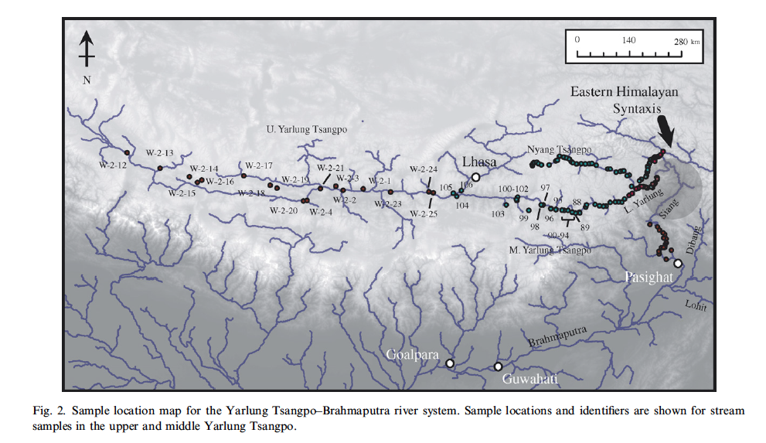
Hren et al., 2007

Slide 34
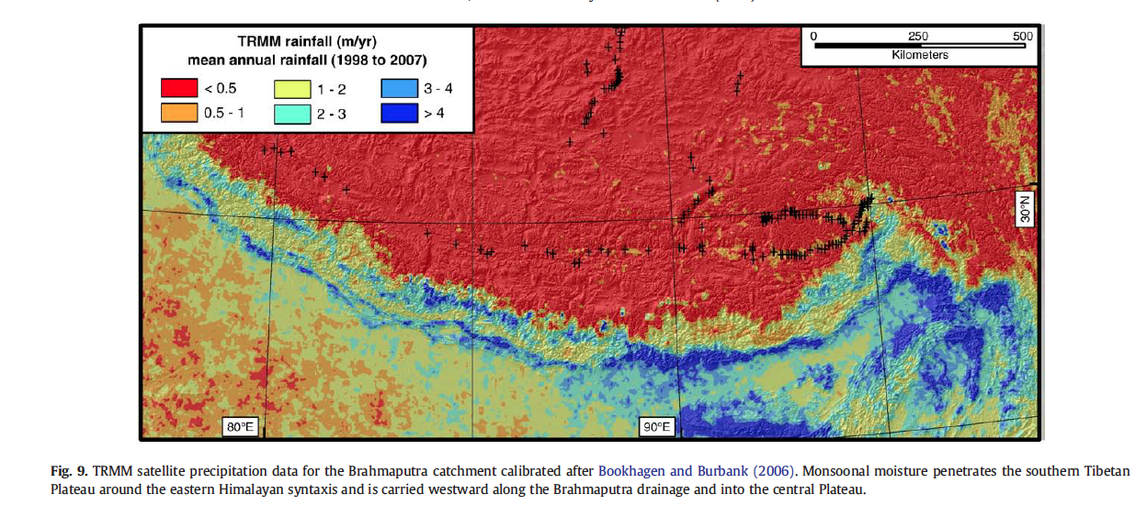
Precipitation in Himalaya/Tibet
Hren et al., 2009

Slide 35
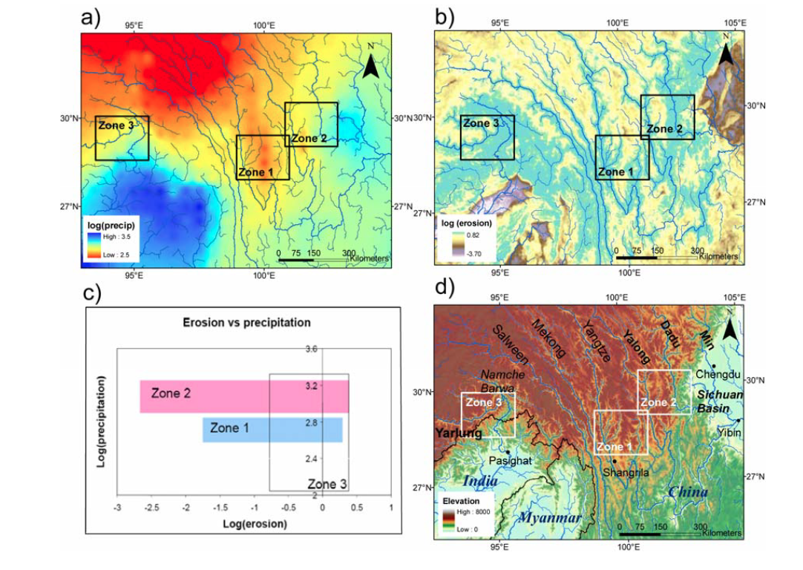
Precip and erosion gradients
Zone 3 is Yarlung

Slide 36
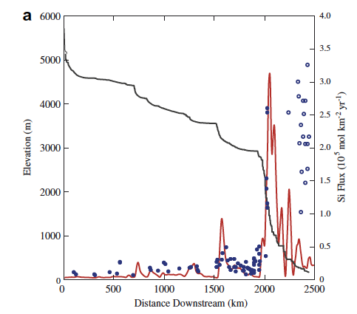

Slide 37
Problems in Approach
No hydrology
Little thermodynamics
Can runaway

Slide 38
Two equations
Reactive transport
Erosion soil model
Reactive flow paths
Uplift
Maher and Chamberlain, 2014, Science

Slide 39
Solute Production
Higher Dw higher solutes
Reactive flowpath length
Fraction on fresh
Minerals in soil
Reaction rate and
Maximum concentration

Slide 40
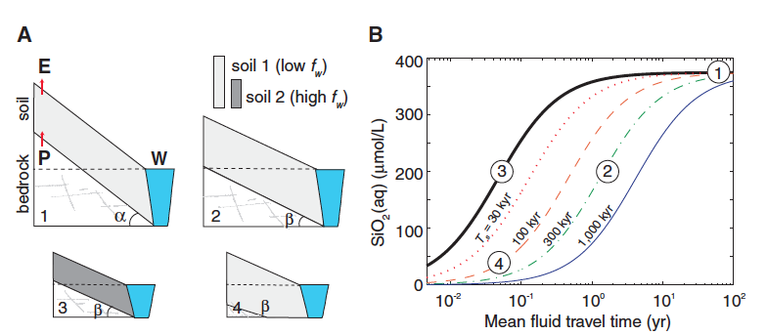

Slide 41
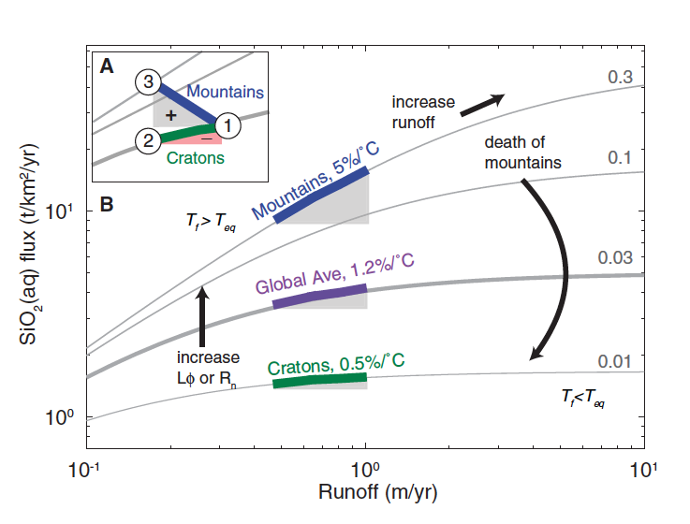
Mountains matter the most in climate regulation

Slide 42
What is the optimal size ?

