Slide 1
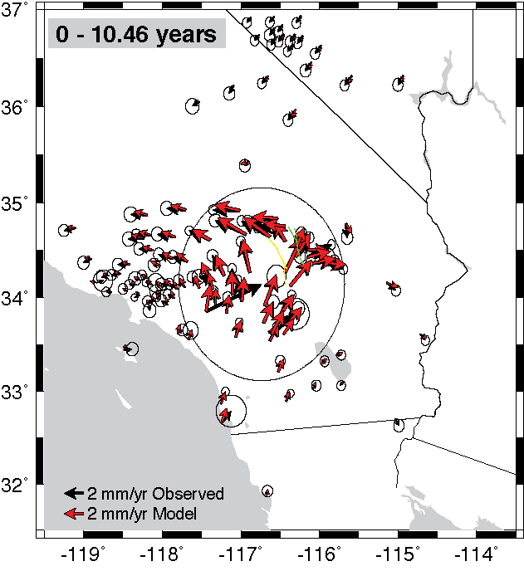

VISCO2.5D: Post-Earthquake Relaxation Using a Spectral Element Method
2015 CIDER
Summer Program
Fred Pollitz
USGS Menlo Park

Slide 2
Acknowledgements
Brad Aagaard USGS
Andrew Bradley Stanford University
Bill Broadley CIG
Jeff Freymueller University of Alaska
Kaj Johnson Indiana University
Laurent Montesi University of Maryland
Christina Morency LLNL
Kaiqing Yuan UC Berkeley

Slide 3
Tutorial available at
VISCO2.5D/DOC directory
or
2015 Summer Program Agenda site:
http://www.deep-earth.org/wiki_cider/2015_Summer_Program_Agenda

Slide 4
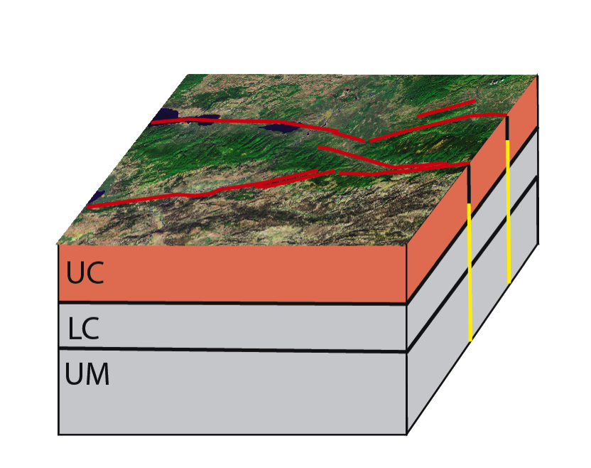
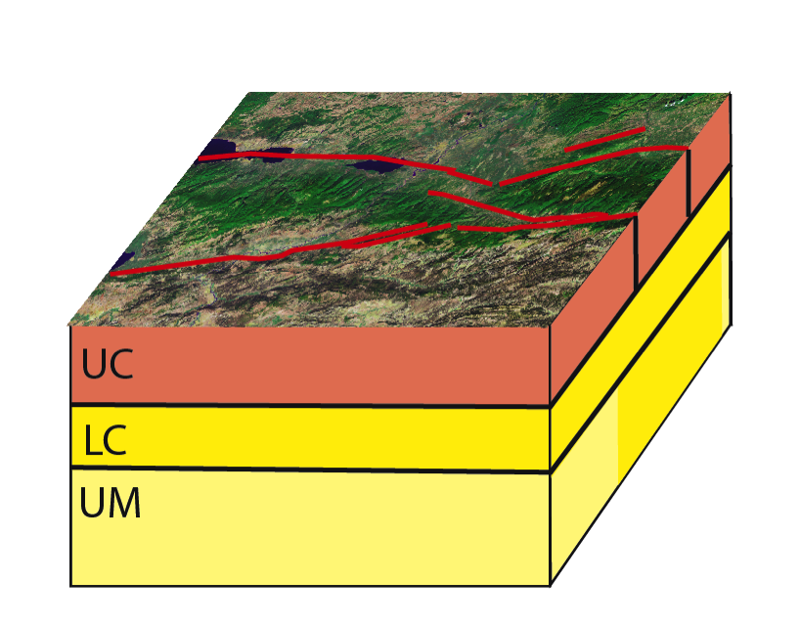
Lower crust/mantle
relaxation
Afterslip
Upper crust
Upper crust
Lower crust
Lower crust
Upper mantle
Upper mantle
Figures courtesy of Liz Hearn
Notes:
VISCO2.5D is for quasi-static (static and post-earthquake) relaxation applications. Figures illustrate typical rheology that controls this relaxation.
Can be simplified at `short’ timescale as elastic lithosphere (upper + lower crust + mantle lithosphere) over mantle asthenosphere.
Code is particularly suited for 2D structures, e.g. depth-dependent structure that varies with distance from a straignt strike-slip fault.

Slide 5
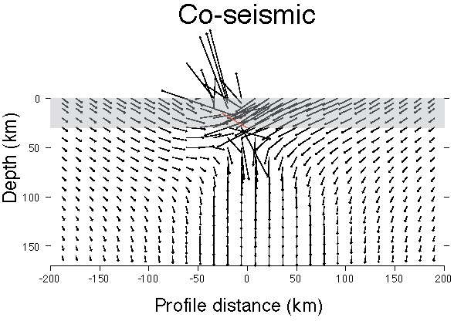
crust
mantle (asthenosphere)

Slide 6
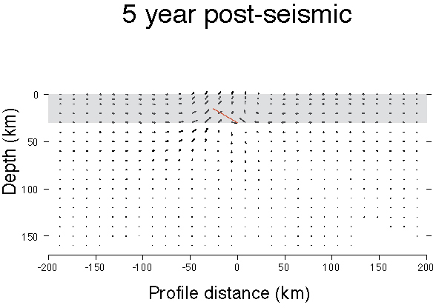
crust
mantle (asthenosphere)
Notes:
Elastic lithosphere above a viscoelastic asthenosphere

Slide 7
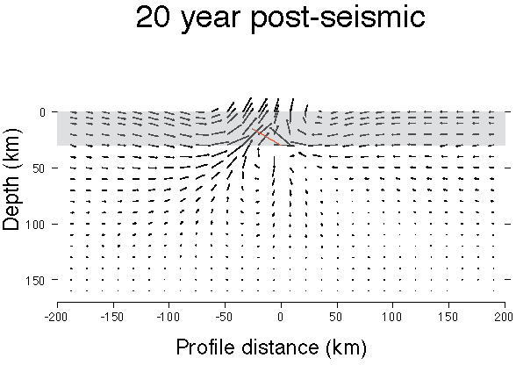
crust
mantle (asthenosphere)

Slide 8
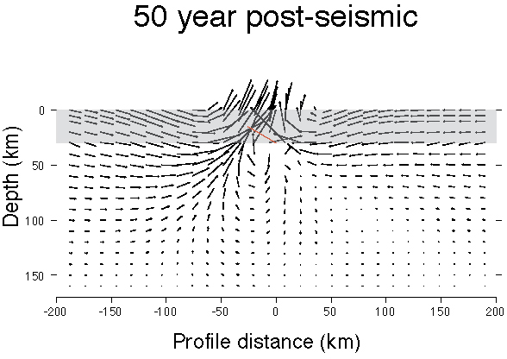
crust
mantle (asthenosphere)

Slide 9
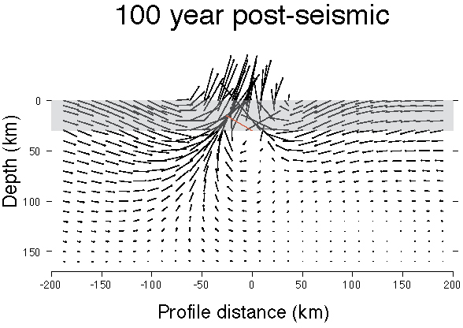
crust
mantle (asthenosphere)
Notes:
The time-dependent surface response is sensitive to the material properties of the ductile mantle asthenosphere.
Hence surface observations (GPS, InSAR) or other observations (e.g. GRACE gravity) can constrain depth-dependent material properties.

Slide 10
Tutorial objectives
Learn why post-earthquake relaxation is important
Compile and run the code
Become familiar with what the code is solving
Visualize results

Slide 11
Compiling the code
Change directory to VISCO2.5D/MAINPROG
Compile libraries
$ make umf4_f77zwrapper64.o
$ make libs
Compile main program
$ make visco2pt5d
Notes:
Here is the place to go to the EXAMPLES directory and start a simplified Example 1 (and Exampe 2).
– with 1200. 300. in place of 1200 30. in simulation-spherical.infoEX1 or simulation-spherical.infoEX2
Also $ cp source-spherical.paramEX1 source-spherical.paramEX2
This leads to much less computational effort because fewer wavenumber components (equivalently, azimuthal order numbers) are used.

Slide 12
Faster version of Example 1
$ cd VISCO2.5D/EXAMPLES
Edit `simulation-spherical.infoEX1’
Change
30.
to
300.
$ ./example1.x &
Notes:
This will run Example 1 in 37 minutes instead of 3 hours.

Slide 13
Model domain
r = radius
θ = angular distance from
prescribed pole P
φ = azimuth
Spherical geometry
Displacements depend on r, θ, φ
Viscoelastic structure depends on r, θ
Notes:
We’re working in a spherical coordinate system. Global variables are colatitude θ and radius r.
The third dimension in phi is handled by solving 2D problems with different wavelengths.

Slide 14
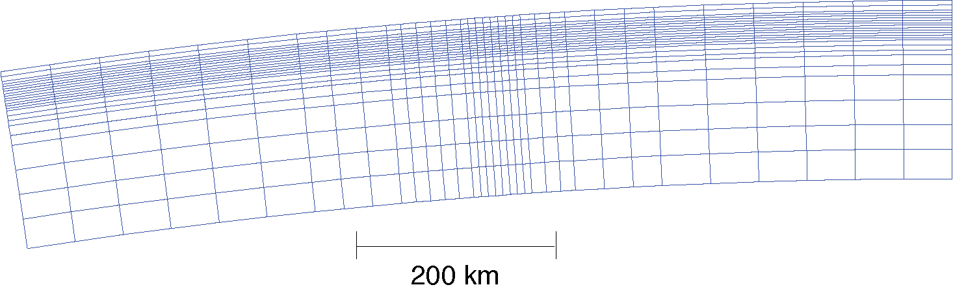
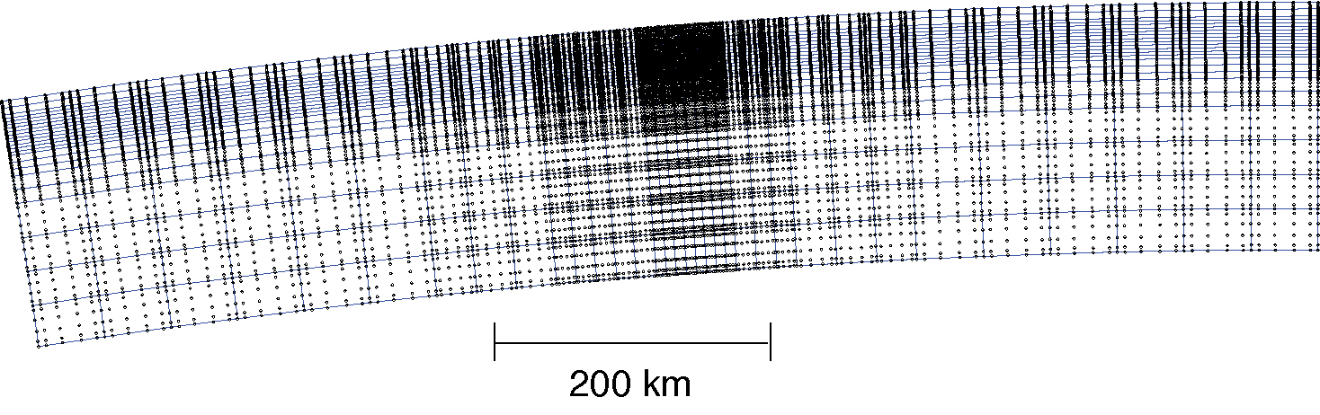
What is visco2pt5d solving for?
NX = number of cells in horizontal dimension
NZ = number of cells in radial dimension
N = number of GLL points on side of cell
Examples 1 and 2: NX=34, NZ=23, N=6
Total number of 2D global GLL gridpoints = [N*NX-(NX-1)]*[N*NZ-(NZ-1)] = 19836
For given wavelength, total number of displacement parameters = 3*19836 = 59508
Notes:
Note that all examples involve several hundred inversions for ~60000 parameters. (12 Laplace transform parameters and ~50 azimuthal order numbers).
The simplified example that we’ve started (after editing simulation-spherical.infoEX1) involves much fewer inversions.

Slide 15
Outline
Difference between seismic and quasi-static governing equations
SEM for quasi-static deformation
Constraining mantle asthenosphere rheology with GPS and GRACE gravity
Description of VISCO2.5D with examples

Slide 16
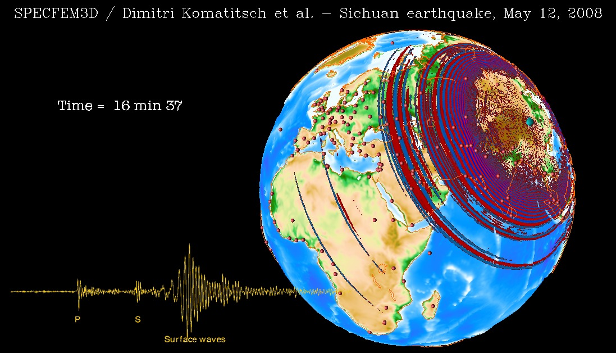
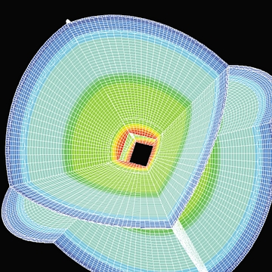
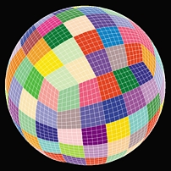
Seismic wave propagation
2008 Sichuan earthquake
(Komatitsch et al. --
http://komatitsch.free.fr/)
Komatitsch and
Tromp (Linux Journal,
2001)

Slide 17
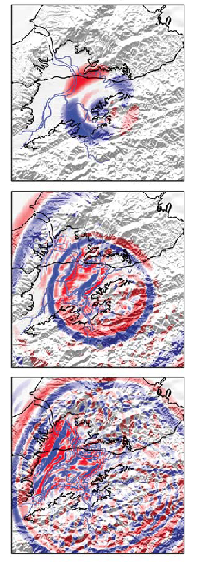
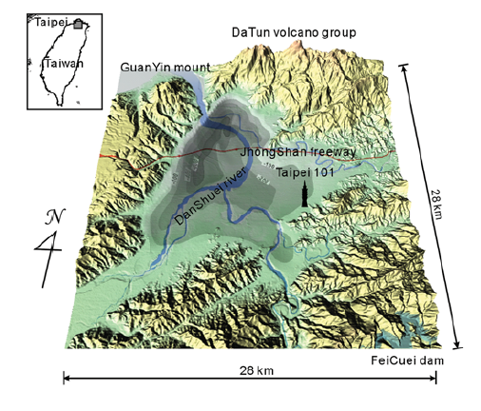
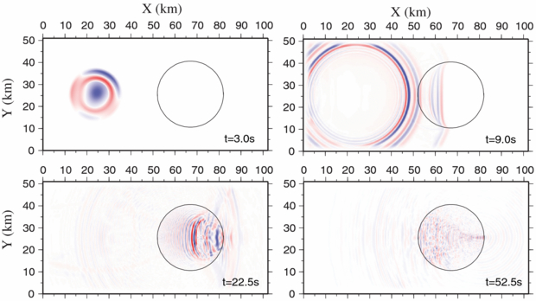
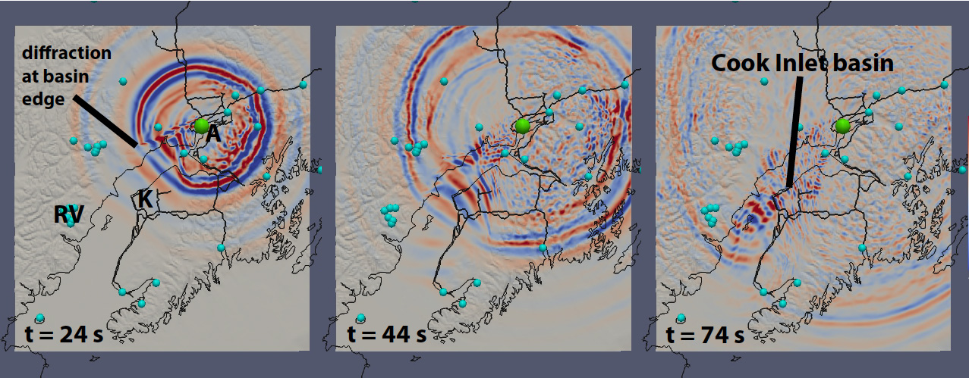
Seismic wave propagation
Taipai Basin
(Lee et al., 2008)
Sedimentary basin amplification
(Qin et al., 2012)
Cook Inlet Basin (Tape and Silwal, 2014 SSA Mtg)

Slide 18


Seismic wave propagation
Quasi-static deformation
u = displacement; σ = stress tensor; f = source term
c = elastic tensor
r = position vector; s = Laplace transform variable

Slide 19
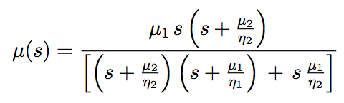
Viscoelasticity
Implemented in the Laplace transform domain
Burgers body:
Notes:
Can realize a Maxwell solid by having either \mu_2 or \eta_2 approach infinity.
A standard linear solid would have \eta_1 approach infinity.

Slide 20
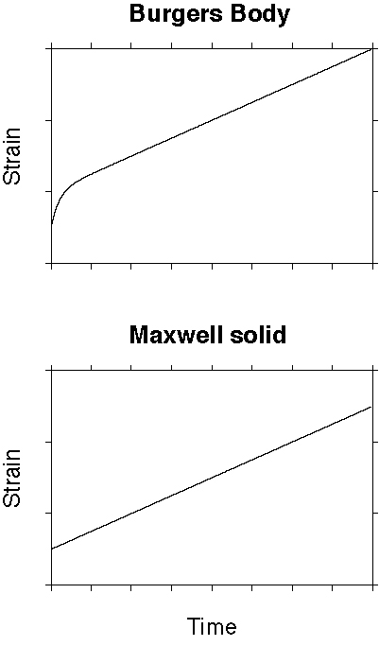
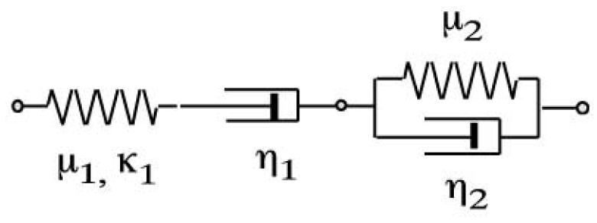
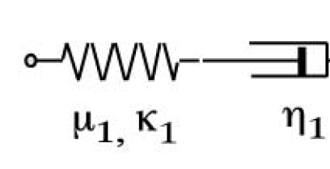
Notes:
Response to constant stress step.

Slide 21
SEM for quasi-static deformation
Equations of quasi-static → Strong form
equilibrium Weak form
Model discretization → Mesh of elements
→ Transformation between physical
and local elemental coordinates
= Mapping
Interpolation of functions → Lagrange polynomials
on the elements Gauss-Lobatto-Legendre (GLL) points
Integration over the → GLL integration quadrature
element GLL points and weights
Mass matrix → Quasi-static problem
Stiffness matrix
Assembly of global linear system
----------------------
Notes:
The reason the method works so well – with high spatial accuracy – is because we’re using interpolation and quadrature points defined with GLL points.

Slide 22
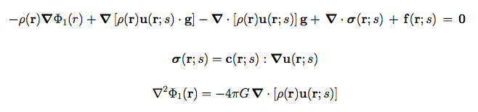

Equations of quasi-static equilibrium
where ρ is density, Φ₁ is perturbed gravitational potential, c is the elastic tensor, and g
is the reference gravitational acceleration vector
Ignore coupling of the elastic deformation field with Φ₁ →
r = position vector; s = Laplace transform variable

Slide 23
Equations of quasi-static equilibrium
For a reference structure that is in hydrostatic equilibrium
∇ρ ×∇g = 0
This enables us to re-write the equation of quasi-static equilibrium in a form
which does not depend on the gradient of density:

Slide 24
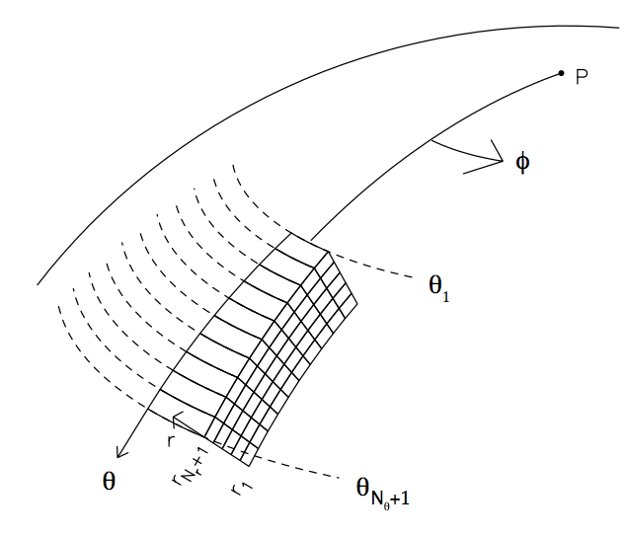
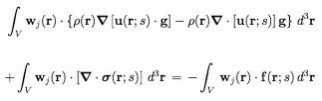

Weak form of equation of quasi-static equilibrium
Take the vector product with w_{j}(r) and integrate over a
volume V , the annulus swept out by an elemental area over
the azimuth range from 0 to 2π about the pole of symmetry
Apply the divergence theorem to the ∇ · σ term to obtain the weak form:

Slide 25
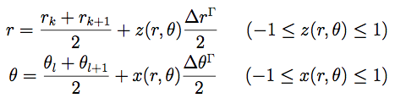
Model discretization
A general mapping of local to global coordinates in element Γ is
element Γ
In the Laplace transform domain, let the local
3D displacement field be expanded as
ψ_{αβ} are 2D Gauss-Legendre-Lobatto basis functions
m = azimuthal order number

Slide 26
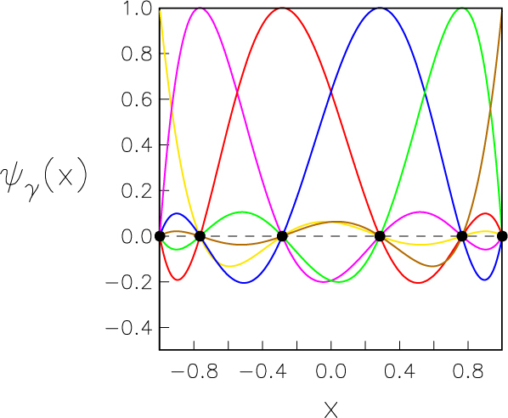

Gauss-Legendre-Lobatto basis functions
Example with N=5
Interpolation points
1D GLL basis functions
Notes:
1D GLL functions are Lagrangian interpolation polynomials

Slide 27

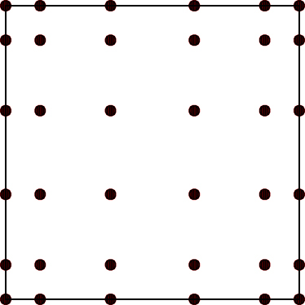
Gauss-Legendre-Lobatto basis functions
2D GLL basis functions
z
x
Notes:
N=5 used in the examples and the Hector Mine application. Total of 36 GLL points.

Slide 28
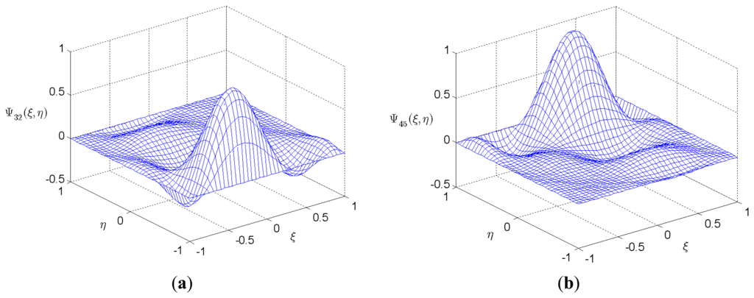
Gauss-Legendre-Lobatto basis functions

Slide 29

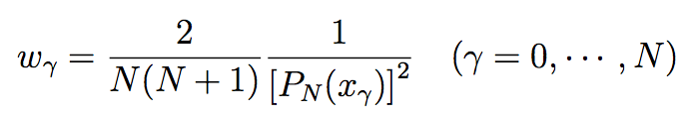
Integration over the elements
Quadrature points
2D Legendre-Gauss-Lobatto
integration rule
Weights
Extremely high spatial accuracy -- 2D integration rule exact for polynomial
functions up to degree 2N-1 in each dimension
Quadrature points are identical to the interpolation points
Notes:
For infinitely differentiable functions f(x,z), the integration rule exhibit spectral convergence, i.e. the error in the approximation with increasing N diminishes faster than any power of N.

Slide 30

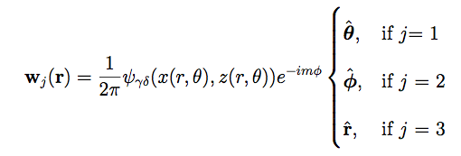
Linear system of simultaneous equations
Weak form of
eqns of static
equilibrium
Stress-strain relation
Expansion of displacement field in terms of Gauss-Legendre-Lobatto basis functions
Test functions defined using GLL basis functions
2D Gauss-Lobatto integration rule
Notes:
The representation of the displacement field is a pseudospectral approximation.

Slide 31
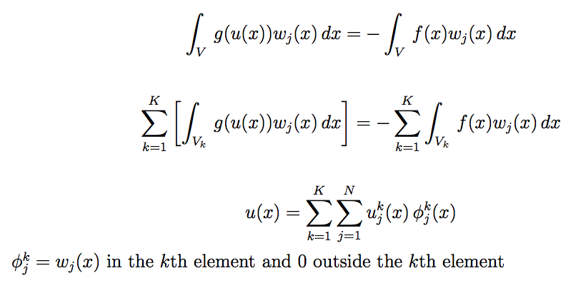
Assembly of global linear system
Weak form of eqns of
static equilibrium
Domain V divided into
K non-overlapping
subdomains V_{k}
Global interpolant
Notes:
Spectral element method combines Galerkin spectral methods with finite element method. Like the finite element method, V is divided into K non-overlapping sibdomains. The Galerkin spectral method is applied within each element V_k. With this implementation, the elements are coupled only at the elemental boundaries, resulting in a simple implementation and a relatively sparse matrix.

Slide 32




Linear system of simultaneous equations
(Stiffness matrix) (Displacement coefficients) = Source vector
The vector of unknowns U contains the expansion coefficients of the
displacement components , three for each of the
nodes of the global grid
At the 2D GLL interpolation points
Displacement field at points (r_{γν},θ_{γν}) and arbitrary φ is

Slide 33
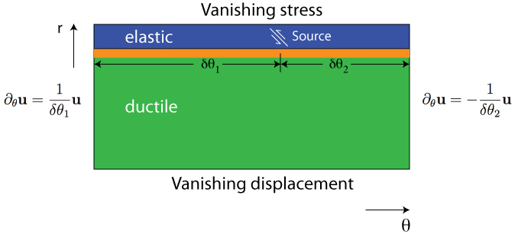
Boundary Conditions
Notes:
For a medium that is bounded in one dimension, e.g., in the r direction, then the far field displacements decay with horizontal distance from the source as the reciprocal of the horizontal distance. That is embodied in the BC on the sides of the 2D domain.

Slide 34
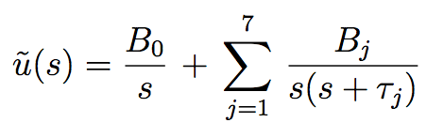
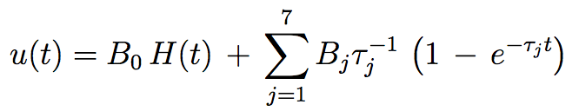
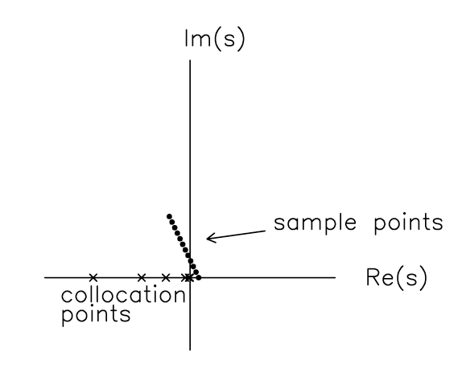
Time domain results
Laplace transform domain
Time domain
τ_{j}
Notes:
The value of smax for a specific earth model equals the reciprocal of the minimum inverse material decay time, i.e. the ratio of viscosity to rigidity.
In actual computations, I use 12 sample points (which is sufficient to determine the eight B-coefficients).

Slide 35
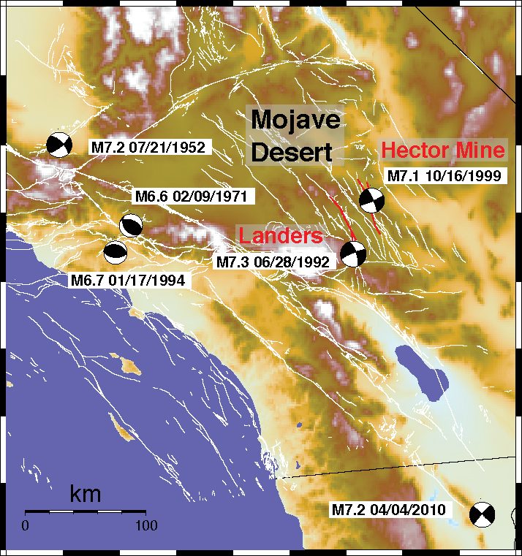
Constraining mantle asthenosphere rheology using GPS data
Pollitz (2015)
Notes:
Landers and Hector Mine quakes were the largest to strike southern California since the 1952 Kern County quake.

Slide 36
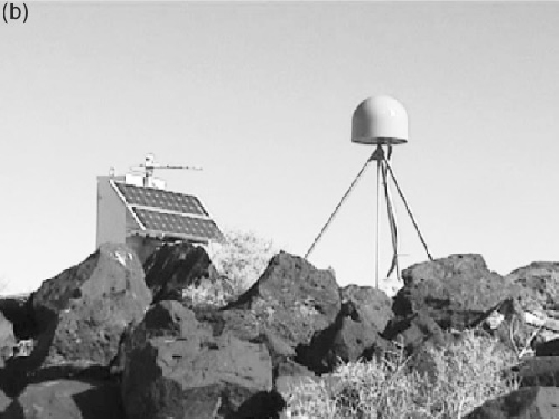
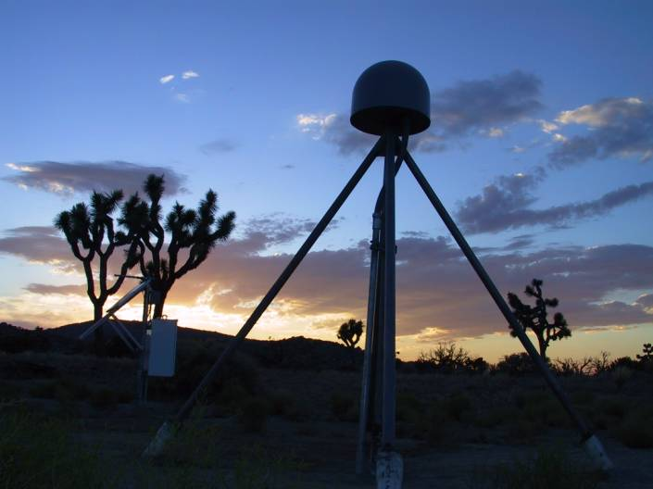
Continuous GPS observations
AGMT
KYVW
Hudnut et al. (2002)
250th SCIGN station, installed
July 2, 2001
Notes:
AGMT is Argos Mountain; KYVW is Key’s View

Slide 37
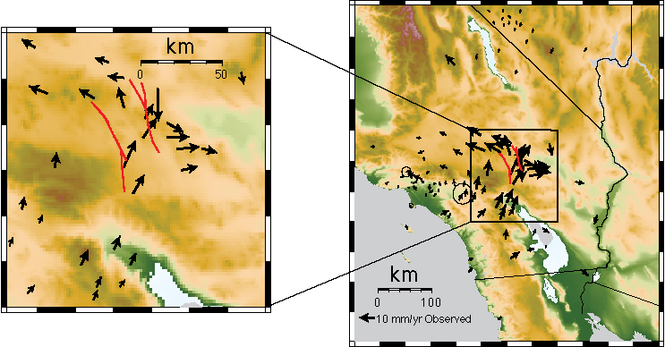
Transient motions – first 6 months after 10/16/1999
Notes:
Transient motions (i.e., over and above background motions) after the Hector Mine quake were more than 1 cm/yr. The background velocity field
has been subtracted in this slide.

Slide 38

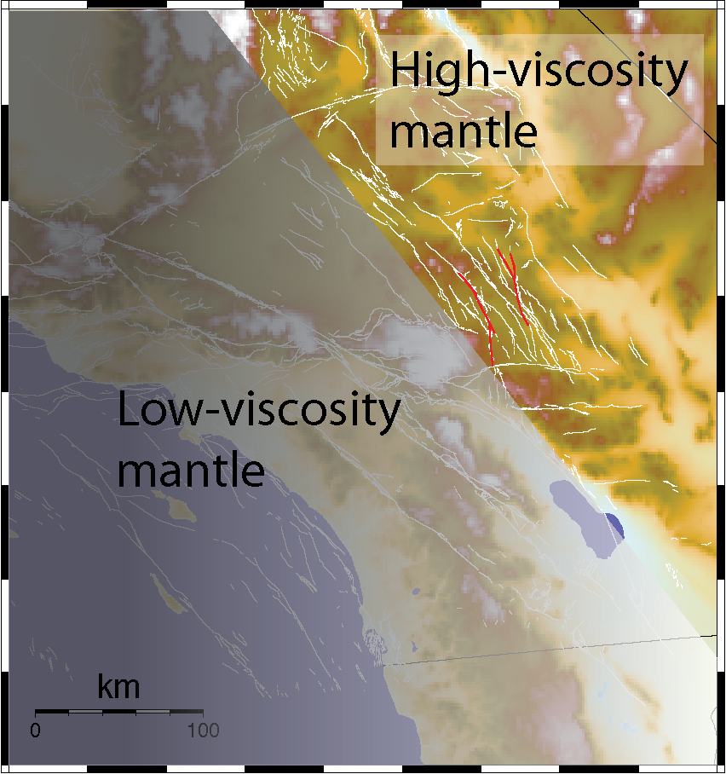

Afterslip
Lower crust/mantle
relaxation
Notes:
What’s new?
Joint afterslip /lower crust + upper mantle viscoelastic relaxation modeling
Laterally variable effective viscosity structure (mantle asthenosphere)
Afterslip → plastic deformation
Relaxation → ductile flow

Slide 39
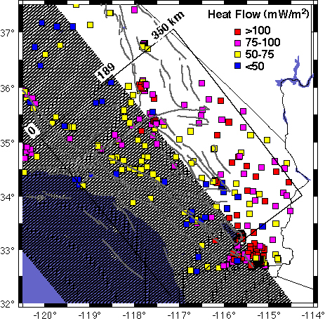
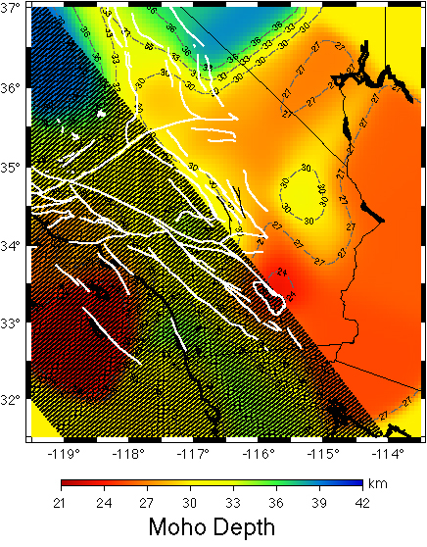
Joint afterslip + lower crust and mantle relaxation model
Spectral element method for calculating quasi-static motions
-- 3D time-dependent displacements
-- 2D viscoelastic structure
Afterslip rate has assumed temporal dependence ~exp[-t/0.25 yr]
cGPS time series up to 10.5 years post-Hector Mine quake
Search over trial viscoelastic structures in two separate domains
Pollitz (2015)
Notes:
Using 109 regional stations

Slide 40
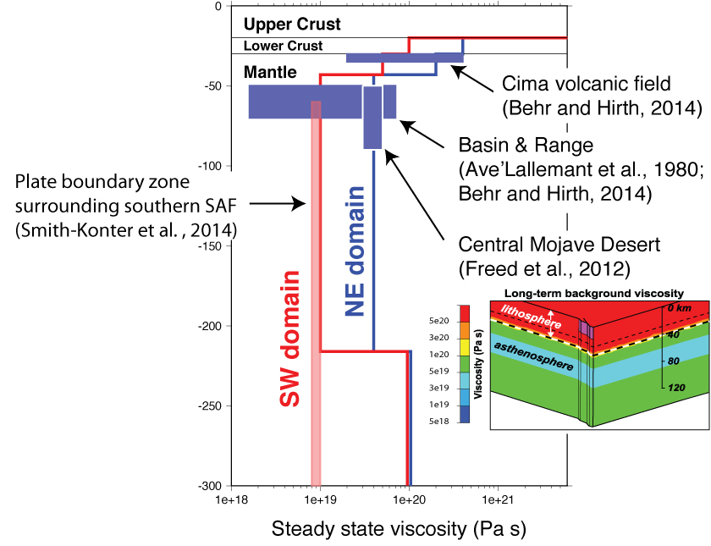

Slide 41
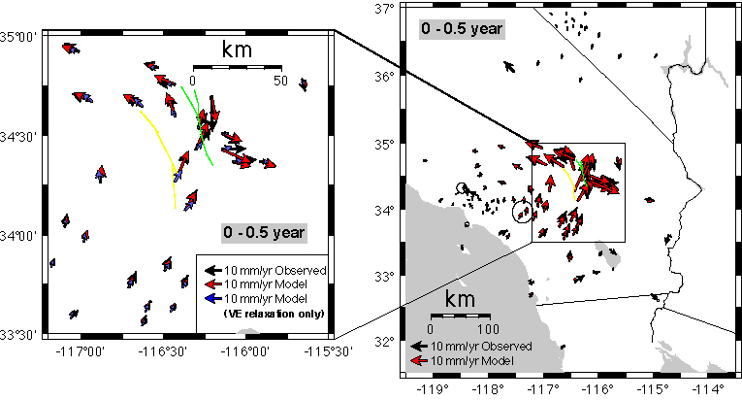
Contributions of afterslip and mantle relaxation
Notes:
Sites within ~25 km of the Hector mine rupture are dominated by afterslip in the first 0.5 years post-Hector Mine.
Studies that interpret the near-field postseismic deformation with only relaxation (e.g., Pollitz, 2003) may underestimate the transient viscosity because of this.

Slide 42
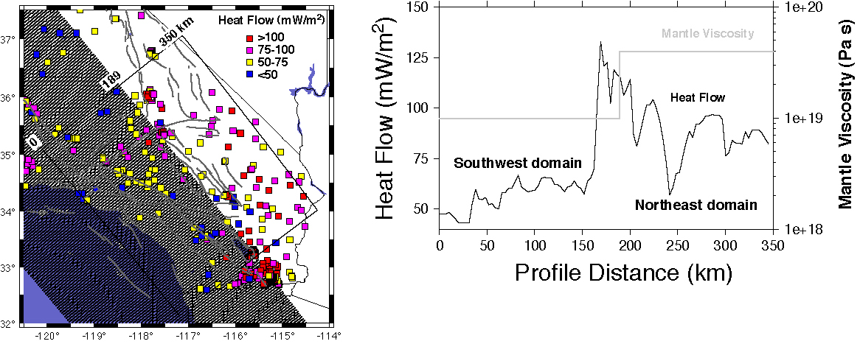
Implications of southern California rheology structure
Factors other than temperature strongly control mantle rheology
Notes:
There are interesting implications of the inferred rheology structrure, as it is counter to what’s expected based on heat flow alone…

Slide 43
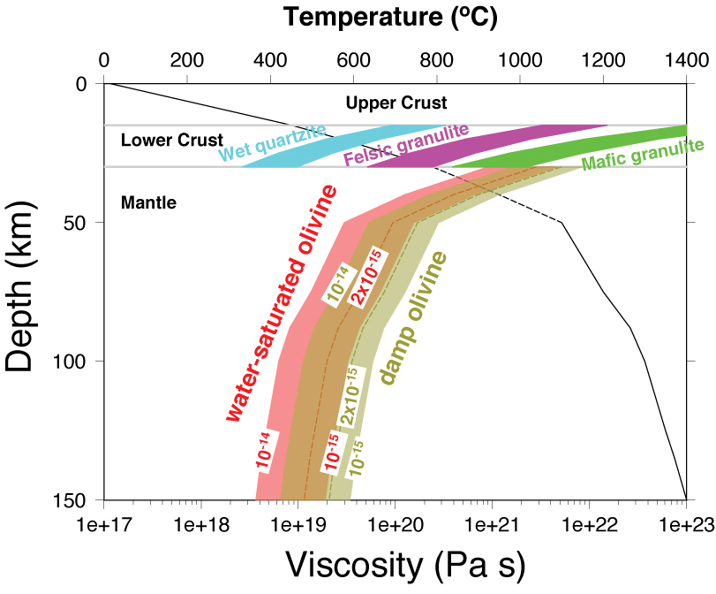
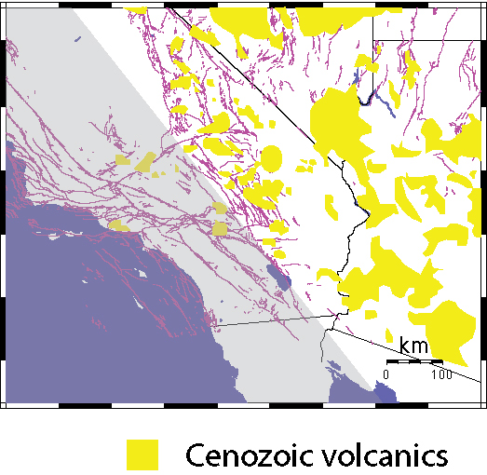
Water content strongly controls mantle rheology
Notes:
Water-saturated olivine mantle rheology is consistent with SW domain viscosity structure from GPS; `damp’ olivine rheology rheology is consistent with NE domain viscosity structure.
The NE domain has lesser water content in the mantle asthenosphere (factor of 5 reduction compared with NE domain) because of the extraction of water during the past ~20 Ma associated with Basin & Range opening.

Slide 44
Post-earthquake motions are explained with joint afterslip and mantle relaxation
Mantle viscosity structure is laterally variable and anti-correlated with heat flow
Lateral variation in viscosity is consistent with reduced water content beneath the ECSZ /Basin & Range part of southern California

Slide 45
Constraining seismic slip and mantle asthenosphere rheology using GRACE gravity data
(a) Observed gravity change
(b) Seismic model
two-year mean difference
before and after the earthquake
Mw 8.6 (main) + Mw 8.2 (aftershock)
Han, Sauber, and Pollitz (2015)
(c) Postseismic gravity change
(d) Background data noise
(a) subtracted by (b)
two-year mean difference
(2010-2011) minus (2008-2009)
Notes:
Various forms of observed GRACE gravity change (parts a, c, d) and modeled coseismic gravity change (part b). The April 11, 2012 off-Sumatra (Wharton Basin) M8.6 quake was easily large enough to produce a strong coseismic gravity signal (part a). It also produced a measurable postseismic gravity signal (part c).
Part a is mostly the coseismic gravity change but has two years worth of postseismic gravity signal as well; this is estimated in part c where the gravity change predicted from a coseismic model has been subtracted.

Slide 46
Constraining seismic slip and mantle asthenosphere rheology using GRACE gravity data
Free air
Gravity from seafloor vertical motionrtical motion
graviBouguer
Coseismic slip
Viscoelastic relaxation
Notes:
MODELS: (Upper panels) - coseismic gravity change (free-air, seafloor vertical motion, Bouguer); seismic source model for 04/11/2012 M8.6 off-Sumatra quake.
(Lower panels) - VE gravity change (snapshot at 2014; free-air, seafloor vertical motion, Bouguer); Burgers body mantle asthenosphere.
Lower left panel is comparable with part c of previous slide.
Quake-induced gravity change is generally due to the sum of volumetric density change and vertical motions of seafloor (or internal discontinuities in density).
The coseismic gravity change is atrributed to primarily the density change, whereas the postseismic gravity change is attributed to primarily the vertical motions.

Slide 47
GRACE gravity has detected the coseismic and postseismic deformation associated with several M>=8.5 quakes over the past decade
Coseismic gravity change provides an independent constraint on large-quake magnitude
Postseismic gravity constrains mantle rheology
GRACE Follow-on Mission in 2017 (NASA and German Space Program collaboration) has the potential to improve sensitivity to M>=7.5
Notes:
http://grace.anu.edu.au/about.php
GRACE, for Gravity Recovery and Climate Experiment, is a joint American-German project that has been an incredibly successful satellite mission. In the GRACE mission, the distance between two spacecraft is measured using a microwave ranging system. Temporal estimates of the Earth's gravity field are inferred from changes in this distance and it has provided new and unexpected insights into the natural processes of the Earth. This mission will not extend beyond 2013 and a GRACE Follow-on mission is scheduled to launch in 2017.

Slide 48
VISCO2.5D
3D quasi-static displacement field on 2D viscoelastic structures
-- solves a series of 2D problems, each with a different
azimuthal order number
Limited to linear rheologies
Currently implements simple elements – bounded by
spherical shells and vertical interfaces
Simple to run in parallel

Slide 49
Checklist of input parameters
Earth model
• Viscoelastic structure as a function of depth and one lateral distance:
density ρ,
seismic wavespeeds Vp and Vs (equivalent to bulk modulus κ and shear modulus
of Maxwell element μ₁),
shear modulus of Kelvin element μ₂,
Maxwellian viscosity η₁,
and Kelvin viscosity η₂ as a function of radius.
μ₂ is prescribed indirectly through the strength construct μ’= μ₁ μ₂ / (μ₁ + μ₂ )
• Radius of Earth

Slide 50
Checklist of input parameters
Source model
• Number of fault planes
• Strike, dip, rake, slip, length, depths of upper and lower fault edges,
latitude and longitude of one fault corner
• Earthquake origin time;
start and end times of cumulative postseismic displacements
(Optional) Observation points to output displacements - in addition to GLL points
• Number of observation points
• Latitude, longitude, and depth of these observation points
Model domain
• Number of elements in horizontal and radial directions
• Dimensions of elements
• Spacing of `fictitious’ sources; minimum wavelength in azimuthal coordinate

Slide 51
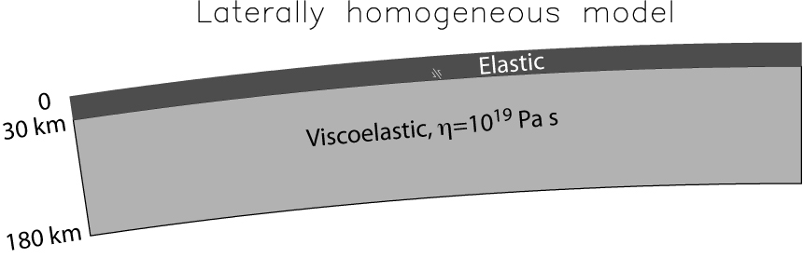
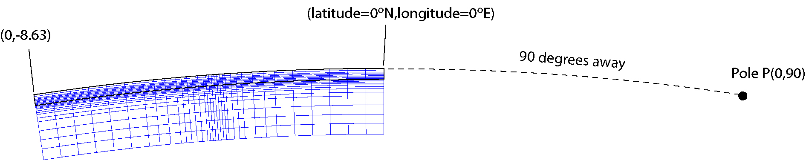
Example 1

Slide 52
input file elastic.paramEX1-Maxwell
theta r-6371. Vp Vs Rho \mu' \eta_2 \eta_1
(deg.) (km) (km/s) (km/s) (g/cm^3) (10^{10} Pa) (10^{18} Pa s) (10^{18} Pa s)
4.1872 -31.4096 5.4772 3.1623 3.0000 0.100000E+02
4.1872 -30.0100 5.4772 3.1623 3.0000 0.100000E+02
4.1872 -29.9900 5.4772 3.1623 3.0000 0.100000E+12
4.1872 -29.3902 5.4772 3.1623 3.0000 0.100000E+12
Notes:
Note that theta is measured positive from the point (0,0) towards the other end of the model domain, i.e. towards the left.
Maxwell rheology cvan be implemented by specifying the viscosity

Slide 53
input file simulation-spherical.infoEX1
# geographic coordinates of (theta,phi)=(theta_ref,0.) of spherical geometry in (deg.,deg.)
0. 0.
# Angular distance theta_ref (geocentric deg.) and azimuth (deg. CW from due N) of pole from the above point
90. 90.
# number of cells in theta^-direction
34
# theta-length of each cell (radians)
7.8480615e-3 7.8480615e-3 7.8480615e-3 7.8480615e-3 7.8480615e-3 7.8480615e-3 4.7088369e-3 4.7088369e-3 4.7088369e-3 2.354418e-3 ……
# number of cells in z-direction
23
# z-length of each cell (km)
30. 25. 25. 25. 10. 10. 5. 5. 5. 2.5 2.5 2.5 2.5 2.5 2.5 2.5 2.5 2.5 2.5 2.5 2.5 5.0 5.0
# Effective width of third (i.e. phi) dimension (km); minimum wavelength in third dimension (km)
1200. 30.
# input file with elastic parameters
elastic.param
# gravitational acceleration at earth's surface (m/s) (0 for non-gravitational case)
0.

Slide 54
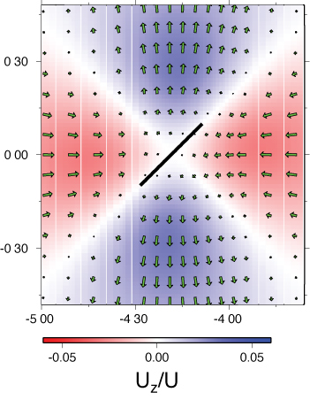
input file source-spherical.paramEX1
# year of earthquake, year obs.#1, year obs.#2 (yrs),
viscosity multiplier
1975. 1975. 1996.164 1.
# finite fault with # segments
1
# max depth, min depth (km), dip(deg.)
# lat,lon(deg.),length(km),strike(deg.),rake(deg.),
slip(cm) for each segment
29.00 15.00 90.
0.1589861 -4.15000 50. 45. 180. 100.
# along-strike discretization
17
# down-dip discretization
25
Notes:
T0=1975. and t1=1996.164 correspond to 1tau time period (tau = material relaxation time = 2*viscosity/shear modulus).
The given lat,lon is the lower edge point closest to the strike direction.
The viscosity multiplier has the effect multiplying all viscosities in the prescribed viscoelastic model by the given number. It is set to unity in these examples

Slide 55
Post-earthquake displacements: output file visco2pt5d-post-phival-EX1.gmt
Cumulative displacements
up to 5τ for post-strike-
slip relaxation
t₁(years) t₂ (years) long(deg.) lat(deg.) E-displ (meters) N-displ Up-displ
0.0000000000000000 21.163999999999987 -3.9120479 0.10884094 -1.28795677173707563E-002 -1.67004069474830383E-003 -9.64602455E-03
0.0000000000000000 42.327999999999975 -3.9120479 0.10884094 -1.77491487605508820E-002 -2.64450441218149661E-003 -1.62272304E-02
0.0000000000000000 63.491999999999962 -3.9120479 0.10884094 -1.95342406197510227E-002 -3.29256088298801640E-003 -2.08724756E-02
0.0000000000000000 84.655999999999949 -3.9120479 0.10884094 -2.00349968886317023E-002 -3.76547095871732941E-003 -2.42824778E-02
0.0000000000000000 105.81999999999995 -3.9120479 0.10884094 -2.00202674074643865E-002 -4.13324276688831725E-003 -2.68790703E-02
(results at 1 of 8364 points on earth’s surface)
5τ
Notes:
To make the plot, I extracted every line with “0.0000000000000000 105.81999999999995”

Slide 56
Cumulative displacements
up to 5τ for post-strike-
slip relaxation

Slide 57
Post-earthquake displacements: output file visco2pt5d-post-phival-EX1.gmt
Cumulative displacements along the equator for post-strike-slip relaxation
t₁(years) t₂ (years) long(deg.) lat(deg.) E-displ (meters) N-displ Up-displ
0.0000000000000000 21.163999999999987 -3.9120409 0.0000000 -1.40114610019168861E-002 -3.21903869600829724E-004 -1.03409067E-02
0.0000000000000000 42.327999999999975 -3.9120409 0.0000000 -1.93915367178731889E-002 -3.76323788120289159E-004 -1.74560752E-02
0.0000000000000000 63.491999999999962 -3.9120409 0.0000000 -2.14185802850651343E-002 -3.53884765603142625E-004 -2.25025583E-02
0.0000000000000000 84.655999999999949 -3.9120409 0.0000000 -2.20443113440669698E-002 -3.18266479829585345E-004 -2.62226015E-02
0.0000000000000000 105.81999999999995 -3.9120409 0.0000000 -2.21005678579361611E-002 -2.86158206573032016E-004 -2.90630031E-02
(results at 1 of 8364 points on earth’s surface)
1τ, 2τ, 5τ
Notes:
This example specifies non-gravitational case in simulation-spherical.infoEX1. Exercise: Make gnuplot of U_x (E displacement)

Slide 58

Example 2

Slide 59
input file elastic.paramEX2
theta r-6371. Vp Vs Rho \mu' \eta_2 \eta_1
(deg.) (km) (km/s) (km/s) (g/cm^3) (10^{10} Pa) (10^{18} Pa s) (10^{18} Pa s)
4.1000 -101.6098 5.4772 3.1623 3.0000 0.100000E+02
4.1000 -100.0100 5.4772 3.1623 3.0000 0.100000E+02
4.1000 -99.9900 5.4772 3.1623 3.0000 0.100000E+12
4.1000 -98.5904 5.4772 3.1623 3.0000 0.100000E+12
..
..
4.1872 -31.4096 5.4772 3.1623 3.0000 0.100000E+02
4.1872 -30.0100 5.4772 3.1623 3.0000 0.100000E+02
4.1872 -29.9900 5.4772 3.1623 3.0000 0.100000E+12
4.1872 -29.3902 5.4772 3.1623 3.0000 0.100000E+12
Notes:
Between 4.1000 and 4.1872 degrees from the edge of the model domain, the lithosphere thickness jumps from 100 km to 30 km (see the viscosity column)

Slide 60
input file simulation-spherical.infoEX2
# geographic coordinates of (theta,phi)=(theta_ref,0.) of spherical geometry in (deg.,deg.)
0. 0.
# Angular distance theta_ref (geocentric deg.) and azimuth (deg. CW from due N) of pole from the above point
90. 90.
# number of cells in theta^-direction
34
# theta-length of each cell (radians)
7.8480615e-3 7.8480615e-3 7.8480615e-3 7.8480615e-3 7.8480615e-3 7.8480615e-3 4.7088369e-3 4.7088369e-3 4.7088369e-3 2.354418e-3 ……
# number of cells in z-direction
23
# z-length of each cell (km)
30. 25. 25. 25. 10. 10. 5. 5. 5. 2.5 2.5 2.5 2.5 2.5 2.5 2.5 2.5 2.5 2.5 2.5 2.5 5.0 5.0
# Effective width of third (i.e. phi) dimension (km); minimum wavelength in third dimension (km)
1200. 30.
# input file with elastic parameters
elastic.param
# gravitational acceleration at earth's surface (m/s) (0 for non-gravitational case)
0.

Slide 61

input file source-spherical.paramEX2
# year of earthquake, year obs.#1, year obs.#2 (yrs),
viscosity multiplier
1975. 1975. 1996.164 1.
# finite fault with # segments
1
# max depth, min depth (km), dip(deg.)
# lat,lon(deg.),length(km),strike(deg.),rake(deg.),
slip(cm) for each segment
29.00 15.00 90.
0.1589861 -4.15000 50. 45. 180. 100.
# along-strike discretization
17
# down-dip discretization
25
Notes:
Identical to source-spherical.paramEX1 in previous eample

Slide 62
Post-earthquake displacements: output file visco2pt5d-post-phival-EX2.gmt
t₁(years) t₂ (years) long(deg.) lat(deg.) E-displ (meters) N-displ Up-displ
0.0000000000000000 21.163999999999987 -3.9120479 0.10884094 -1.28795677173707563E-002 -1.67004069474830383E-003 -9.64602455E-03
0.0000000000000000 42.327999999999975 -3.9120479 0.10884094 -1.77491487605508820E-002 -2.64450441218149661E-003 -1.62272304E-02
0.0000000000000000 63.491999999999962 -3.9120479 0.10884094 -1.95342406197510227E-002 -3.29256088298801640E-003 -2.08724756E-02
0.0000000000000000 84.655999999999949 -3.9120479 0.10884094 -2.00349968886317023E-002 -3.76547095871732941E-003 -2.42824778E-02
0.0000000000000000 105.81999999999995 -3.9120479 0.10884094 -2.00202674074643865E-002 -4.13324276688831725E-003 -2.68790703E-02
5τ
Cumulative displacements
up to 5τ for post-strike-
slip relaxation
Notes:
[ NOTE. This needs to be updated with the output file from the actual EX2 run.]

Slide 63
Cumulative displacements
up to 5τ for post-strike-
slip relaxation
Notes:
Comparison beween Example 1 and Example 2 results

Slide 64
Cumulative displacements along the equator for post-strike-slip relaxation

Slide 65

Example 3

Slide 66


input file elastic.paramEX3
theta r-6371. Vp Vs Rho \mu' \eta_2 \eta_1
(deg.) (km) (km/s) (km/s) (g/cm^3) (10^{10} Pa) (10^{18} Pa s) (10^{18} Pa s)
3.2277 -218.5601 8.4573 4.5361 3.4020 0.0000 0.100000E+03 0.100000E+14
3.2277 -216.0000 8.4573 4.5361 3.4020 0.0000 0.100000E+03 0.100000E+14
3.2277 -216.0000 8.4685 4.5421 3.3930 3.5000 0.240000E+01 0.100000E+02
3.2277 -213.4399 8.4685 4.5421 3.3930 3.5000 0.240000E+01 0.100000E+02
..
..
3.4021 -218.5601 8.4573 4.5361 3.4020 0.0000 0.100000E+03 0.100000E+14
3.4021 -216.0000 8.4573 4.5361 3.4020 0.0000 0.100000E+03 0.100000E+14
3.4021 -216.0000 8.4685 4.5421 3.3930 3.5000 0.400000E+01 0.400000E+02
3.4021 -213.4399 8.4685 4.5421 3.3930 3.5000 0.400000E+01 0.400000E+02
Notes:
This goes beyond previous examples and specifies a Burgers body uppermost mantle.
Transition from low-viscosity to high-viscosity mantle takes place between 3.2277 and 3.4021 deg. away from the reference point (32.5N,-120.0E).

Slide 67
input file simulation-spherical.infoEX3
# geographic coordinates of (theta,phi)=(theta_ref,0.) of spherical geometry in (deg.,deg.)
32.5 -120.0
# Angular distance theta_ref (geocentric deg.) and azimuth (deg. CW from due N) of pole from the above point
90. 230.
# number of cells in theta^-direction
34
# theta-length of each cell (radians)
7.8480615e-3 7.8480615e-3 7.8480615e-3 7.8480615e-3 7.8480615e-3 7.8480615e-3 4.7088369e-3 4.7088369e-3 …
# number of cells in z-direction
27
# z-length of each cell (km)
30. 30. 30. 30. 30. 25. 25. 25. 10. 10. 5. 5. 5. 2.5 2.5 2.5 2.5 2.5 2.5 2.5 2.5 2.5 2.5 2.5 2.5 5.0 5.0
# Effective width of third (i.e. phi) dimension (km); minimum wavelength in third dimension (km)
1200. 20.
# input file with elastic parameters
elastic.param
# gravitational acceleration at earth's surface (m/s^2) (0 for non-gravitational case)
0.
Notes:
Kai Johnson made this figure, which actually goes down to 210 km (older example that he ran) rather than 300 km…

Slide 68

Static displacements: output file visco2pt5d-stat-rec-EX3.gmt
t₁ t₂ (years) long(deg.) lat(deg.) -depth(km) E-displ (meters) N-displ Up-displ
0.0 0.0 -116.42899 34.594006 0.0000000 -0.23851041874420995 0.55857079248884034 -9.96864773E-03
0.0 0.0 -114.93200 36.319000 0.0000000 -1.36367536345956449E-003 -2.46052410852053323E-003 6.97492680E-04
0.0 0.0 -117.52200 36.050003 0.0000000 -3.81506943952817984E-003 4.42968748650607292E-004 -1.16505136E-03
0.0 0.0 -116.63000 33.540005 0.0000000 4.46783087680648928E-003 1.20152162065534640E-002 2.74178735E-03
0.0 0.0 -117.89701 34.126003 0.0000000 -7.66989636246788475E-004 1.87106110293406929E-003 -2.67727000E-06
0.0 0.0 -116.88400 34.264004 0.0000000 1.87129267475715719E-002 2.58959332847727534E-002 3.38370260E-03
Notes:
[NOTE Add a layer with annotated lines from that output file]

Slide 69

Post-earthquake displacements: output file visco2pt5d-post-rec-EX3.gmt
t₁ t₂ (years) long(deg.) lat(deg.) -depth(km) E-displ (meters) N-displ Up-displ
0.0 0.149 -116.42899 34.594006 0.0000000 -3.76309046015517587E-004 9.07945510420315994E-004 5.89608499E-05
0.0 0.250 -116.42899 34.594006 0.0000000 -6.01410084655171033E-004 1.45248113118394764E-003 9.41972903E-05
……
0.0 5.390 -116.42899 34.594006 0.0000000 -5.06644020730585582E-003 1.17908516102857245E-002 4.60011855E-04
0.0 8.992 -116.42899 34.594006 0.0000000 -6.48493467948441527E-003 1.55905654279113442E-002 8.13763589E-04
0.0 14.999 -116.42899 34.594006 0.0000000 -8.17769131917874328E-003 2.05945479430972959E-002 1.46980165E-03
Notes:
Post-seismic time intervals are computed at times t2 = 0.15*(obs_yr_#2 – obs_yr_#1) to 15*(obs_yr_#2 – obs_yr_#1) , where the observation times are those input in source-spherical.param

Slide 70
Future improvements
Topography
Output strain (v1.0 has only displacement)
Transverse isotropy
More complicated linear rheology
Notes:
Topography is a particular case of implementing more general quadrilateral shapes.
Another improvement is the use of additional linear algebra libraries when compiling

Slide 71
Following slides:
Notes on plotting results of Example 1 or Example 2 runs with gnuplot on the ubunto hard drive

Slide 72
Example 1: plot profile of visco2pt5d-post-phival-EX1.gmt E-component displacement
Extract latitude=0 results from output file containing postseismic motions at earth’s surface
$ sed -n 20401,21420p visco2pt5d-post-phival-EX1.gmt > tmp0
Extract cumulative 1-tau (21.163999 year) displacement lines
$ grep “ 21.163999” tmp0 > tmp1
Make gnuplot of E-displacement as a function of longitude
$ gnuplot
gnuplot > plot “tmp1” using 3:5 title ‘1-tau displacement’
Can do same thing for 2-tau (42.327999 year)and 5-tau (105.819999 year)displacements
$ grep “ 42.327999” tmp0 > tmp2
$ grep “ 105.819999” tmp0 > tmp3
$ gnuplot
gnuplot> plot “tmp1” using 3:5 title ‘1-tau displacement’, \
“tmp2” using 3:5 title ‘2-tau displacement, \
“tmp3” using 3:5 title ‘5-tau displacement

Slide 73

Notes:
These displacement profiles are similar to those shown on slide 5,7 but they are of lower amplitude because we specified 300 km minimum wavelength for the phi (out of plane) component in place of 30 km in simulation-spherical.infoEX1

Slide 74
Example 2: plot profile of visco2pt5d-post-phival-EX2.gmt E-component displacement
Extract latitude=0 results from output file containing postseismic motions at earth’s surface
$ sed -n 20401,21420p visco2pt5d-post-phival-EX2.gmt > tmp0
Extract cumulative 1-tau (21.163999 year) displacement lines
$ grep “ 21.163999” tmp0 > tmp1
Make gnuplot of E-displacement as a function of longitude
$ gnuplot
gnuplot > plot “tmp1” using 3:5 title ‘1-tau displacement’
Can do same thing for 2-tau (42.327999 year)and 5-tau (105.819999 year)displacements
$ grep “ 42.327999” tmp0 > tmp2
$ grep “ 105.819999” tmp0 > tmp3
$ gnuplot
gnuplot> plot “tmp1” using 3:5 title ‘1-tau displacement’, \
“tmp2” using 3:5 title ‘2-tau displacement, \
“tmp3” using 3:5 title ‘5-tau displacement

Slide 75

Notes:
These displacement profiles are similar to the “laterally heterogeneous” curves shown on slide 64, but they are of lower amplitude because we specified 300 km minimum wavelength for the phi (out of plane) component in place of 30 km in simulation-spherical.infoEX1

