Slide 1

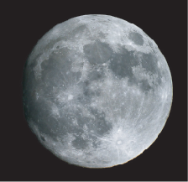
Modification of Earth’s Composition Before and During Earth Formation
Richard Carlson
CIDER, July 2012

Slide 2
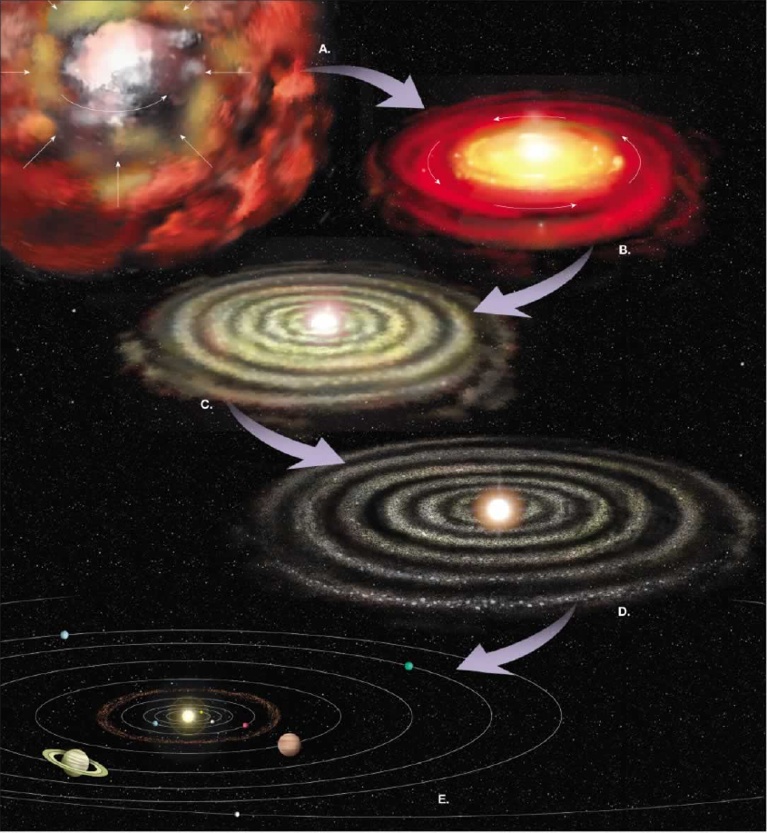
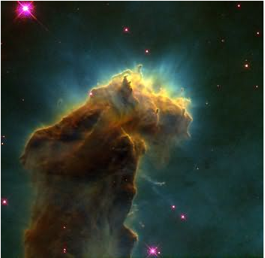
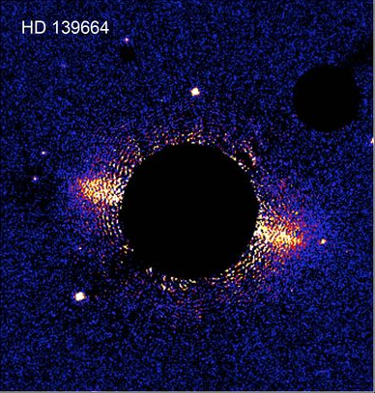
Molecular Cloud, M16
NASA/ESA
Protoplanetary Disk,
Hubble Telescope
When did planetary chemical differentiation begin?
Before there were planets!
Notes:
We will push this back one step farther and consider the chemical fractionation processes that could occur before planet formation. Collapse of the Solar molecular cloud leads to a central mass concentration which results in high temperatures, at least within the inner Solar system. The survival of presolar grains show that temperatures did not get sufficiently hot throughout the nebula to volatilize everything, but a hot gaseous, well-mixed, inner solar system is at least a good place to start this story.

Slide 3
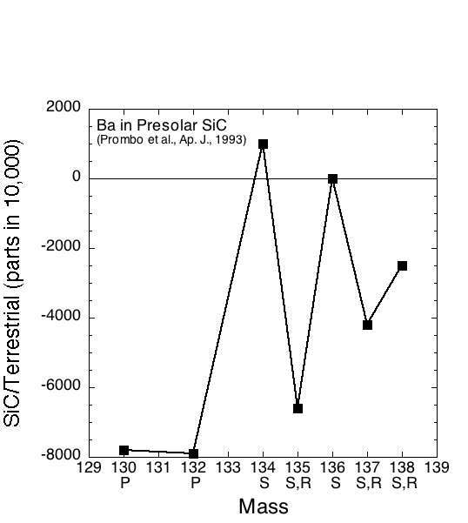
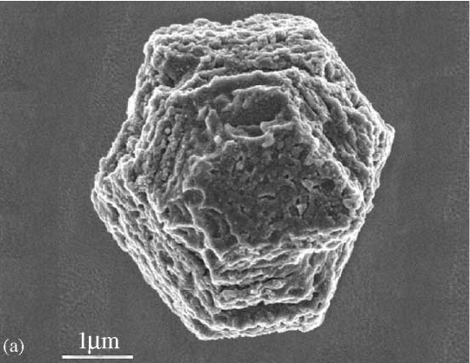
Not Everything was Volatilized!
Small Grains from Other Stars Survived
Photo of presolar SiC grain from Zinner, TOG 2003
Varying the whole rock presolar SiC abundance by less than a ppm would create the magnitude of anomalies seen in the whole rock C-chondrites
Notes:
A wide variety of grains have been found in meteorites that have stable isotope compositions dramatically different than Solar compositions. In the example above, the SiC grain is strongly depleted in r- and p-process Ba isotopes and consequently enriched is s-process isotopes. These processes refer to whether the elements are made at relatively low neutron density (s-process) in large stars (AGB – Asymptotic Giant Branch – stars) or at very high neutron densities and very high temperatures in supernova (r-process, p-process). The r-process adds neutrons so quickly that it bypasses the normal decay back to the stable ratio of neutrons to protons for a given element and ends up making very neutron-rich isotopes that end up decaying back to the neutron-rich side of the stable isotopes of a given element. P-process occurs at such high temperatures that neutrons in the nucleus emit electrons and move to the proton-rich side of the neutron/proton ratio of stable isotopes. Although such grains have huge isotope anomalies compared to solar material, they were apparently well enough mixed in the solar nebula that at the whole rock (meteorite) size scale, the anomalies they contain are balanced by other grains containing complimentary anomalies that produce a mixture – the whole rock – that has isotopic compositions often not analytically resolvable from that of average solar system material.

Slide 4
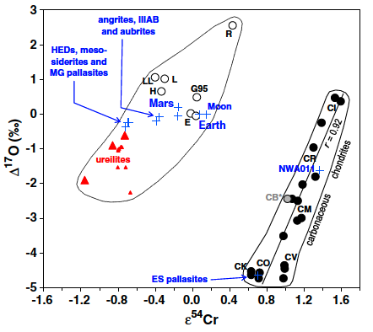
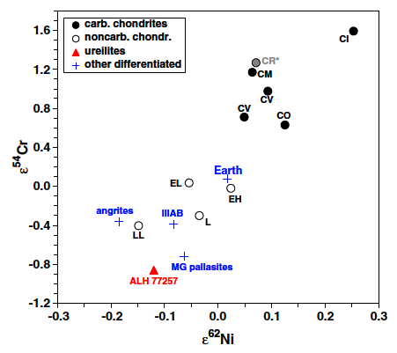
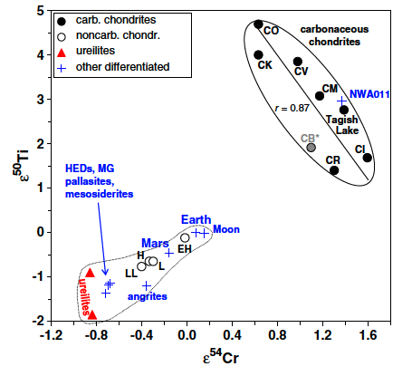
Isotopic studies are revealing an ever increasing number of elements where Earth is isotopically distinct from most meteorites, particularly C-chondrites
Figures from Warren (EPSL, 2011)
Notes:
A group of elements – Ca, Ti, Cr, Ni – that are made by what is known as the equilibrium process. In a supernova at high temperatures, there is a competition between neutron addition and the free energy release by decaying back to 56Fe, the most stable nuclei. The equilibrium process ends up by enriching the neutron-rich end of the stable isotopes of elements near iron’s mass. Carbonaceous chondrites show an excess of these neutron-rich isotopes, providing one of the few, along with oxygen, Mo and Ru, isotopic tracers that correlate with meteorite type. What this represents is not yet clear, but one possibility is that these neutron-rich isotopes were injected into the Solar nebula by the supernova that instigated its collapse, and thus did not have enough time to get perfectly mixed with the elements that were already present in the Solar molecular cloud. What this means for which meteorite best represents Earth’s building blocks also is unclear as these small isotope anomalies don’t necessarily have to correlate with composition, but they do show that the Earth and Moon are different from essentially every type of meteorite, thus opening up the question of whether the available meteorites provide an adequate compositional representation of what Earth may have been made from.

Slide 5
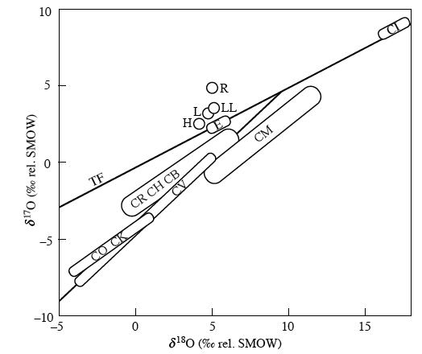
Isotopically, Earth is Distinct from Most Meteorite Groups – Most Similar to E-Chondrites
Only E and CI chondrites lie on the same oxygen mass fractionation line as does Earth
(Figure from Clayton, TOG, 2004)
Notes:
Most chemical reactions cause isotope fractionation whose magnitude is mass dependent, so, in the case of oxygen, the 18O/16O ratio will change by twice as much as the 17O/16O in a given reaction (slope = 0.5 on this diagram). Some UV-induced reactions cause the same magnitude of fractionation for both 17O and 18O, leading to a slope 1 correlation on the above diagram. Most used to think that the oxygen isotopic composition of the Sun, and hence Solar system, lay somewhere on the slope 0.5 “terrestrial fractionaion – TF” line. Recent measurements of Solar wind oxygen implanted into collector plates on the Genesis spacecraft show instead that the Sun has oxygen isotopic composition well down the slope 1 line, well off the TF. A known complement to Solar isotopic composition are meteoritic reaction products that are interpreted as interacting with ices in the outer solar system that have very heavy (18O, 17O enriched) water. Whether Earth is a mixture of Solar and the ices remains to be proven, but what is clear is that Earth ended up with an oxygen isotope composition very different from the Sun.

Slide 6
Isotopically, Earth is not Solar!
Heavy Water
(+180, +180)
Only E and CI chondrites lie on the same oxygen mass fractionation line as does Earth
(Figure from Clayton, TOG, 2004, with the addition of Solar oxygen from McKeegan et al., Science 2011)
Sun (-60, -60)
Notes:
Most chemical reactions cause isotope fractionation whose magnitude is mass dependent, so, in the case of oxygen, the 18O/16O ratio will change by twice as much as the 17O/16O in a given reaction (slope = 0.5 on this diagram). Some UV-induced reactions cause the same magnitude of fractionation for both 17O and 18O, leading to a slope 1 correlation on the above diagram. Most used to think that the oxygen isotopic composition of the Sun, and hence Solar system, lay somewhere on the slope 0.5 “terrestrial fractionaion – TF” line. Recent measurements of Solar wind oxygen implanted into collector plates on the Genesis spacecraft show instead that the Sun has oxygen isotopic composition well down the slope 1 line, well off the TF. A known complement to Solar isotopic composition are meteoritic reaction products that are interpreted as interacting with ices in the outer solar system that have very heavy (18O, 17O enriched) water. Whether Earth is a mixture of Solar and the ices remains to be proven, but what is clear is that Earth ended up with an oxygen isotope composition very different from the Sun.

Slide 7
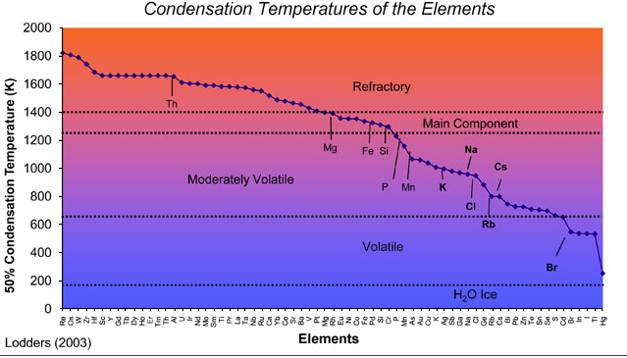
Cooling of a Hot, Gaseous, Solar Nebula Can Cause Element Fractionation According to Condensation Temperature
Notes:
As the Solar nebula cools, different elements condense out of the gas at different temperatures. One means of chemical fractionation thus is any physical mechanism that can mechanically separate dust from gas during this cooling phase.

Slide 8
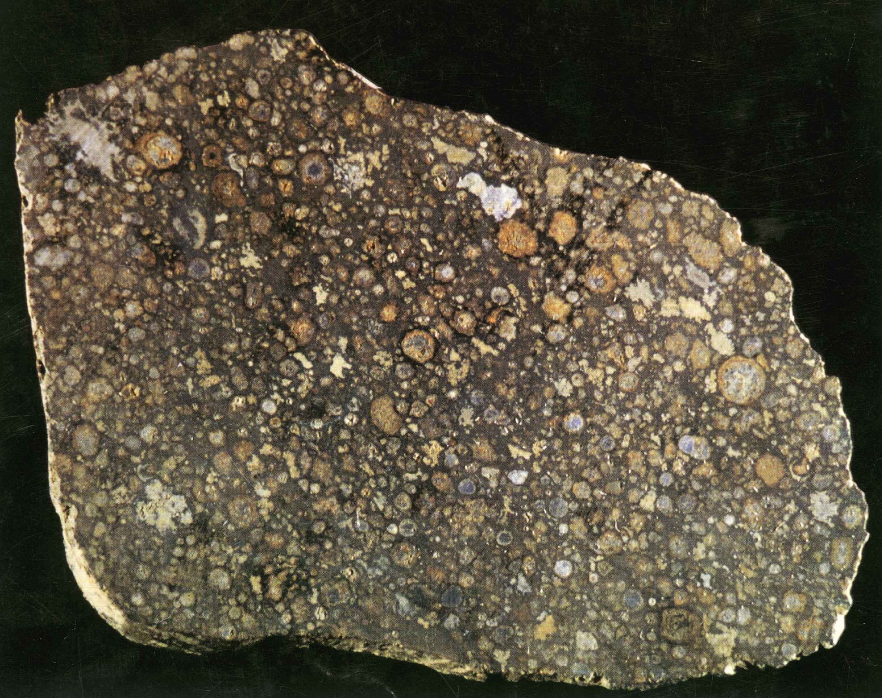
Condense Mineral Grains from a Cooling Disk of Gas Around the Proto-Sun
Chondritic Meteorite as a Sample of Primitive Solar System Material
CAI = Calcium-Aluminum-rich Inclusion. Composed of the minerals that would condense from a hot solar nebula at the highest temperature.
Uranium-Lead Age of CAI’s from the Allende chondrite:
4.5686 ± 0.0002 billion years.
(Bouvier et al., 2009)
CAI
Notes:
Meteorites provide a reasonable argument in favor of the condensation sequence. The most refractory components (CAIs) provide the oldest ages and provide the starting point for Solar system formation. These meteorites managed to assemble a mixture of high temperature and low temperature condensates in a nearly equal proportion and thus ended up with a composition approaching that of the Sun, except for the most volatile elements. Not all meteorites, or planets were so efficient in collecting the low and high temperature condensates.

Slide 9
Some Meteorites have a Composition Similar to that of the Average Solar System, i.e. the Sun
N
For most elements, CI chondrites provide a good approximation of solar composition
CI-chondrites a good approximation for the building blocks of the terrestrial planets…at least to start with
C
In?
Li
Solar and CI compositions from Palme and O’Neill, Treatise on Geochemistry, 2003
Notes:
The Sun is highly enriched in H, He and other noble gases compared to Earth and is enriched in C and N as well. The Sun is depleted in Li because it is consumed during nuclear fusion.

Slide 10
Dating the Processes that Modified Earth Composition
Actively-used short-lived radioactive isotopes
Parent Isotope | Atom % | Half-life (Myr) | Daughter Isotope
²⁶Al | 0.005 | 0.73 | ²⁶Mg
⁶⁰Fe | 3.7 x 10⁻⁷ | 1.5 | ⁶⁰Ni
⁵³Mn | 0.00063 | 3.7 | ⁵³Cr
¹⁰⁷Pd | 0.0015 | 6.5 | ¹⁰⁷Ag
¹⁸²Hf | 0.0037 | 9 | ¹⁸²W
¹²⁹I | 0.011 | 15.7 | ¹²⁹Xe
²⁴⁴Pu | ²⁴⁴Pu/²³⁸U = 0.0068 | 80 | Fission Xe
¹⁴⁶Sm | 0.026 | 103 | ¹⁴²Nd
Condensation – Volatile Loss: Al-Mg, Mn-Cr, Pd-Ag, Pb-Tl, I-Xe
Metal – Silicate Separation: Fe-Ni, Pd-Ag, Hf-W, Pb-Tl
Silicate Differentiation: Al-Mg, Fe-Ni, Mn-Cr, Hf-W, Sm-Nd
Notes:
The supernova that instigated collapse of the Solar molecular cloud and started Solar system formation deposited a large number of newly synthesized short-lived radioactive elements.
Short-lived systems more than double the number of chronometers available and have a wide range of chemical properties that allow the investigation of numerous processes important in solar system evolution

Slide 11
Radioactive Decay:
P_{t} = P₀e^{-λt}
P = # of parent atoms
the decay constant (half-life = ln(2)/λ)
t = time
Looking at it from ingrowth of the daughter isotope “D”:
D_{t} = D₀ + (P₀-P_{t}) = D₀ + P_{t}(P₀/P_{t}-1) = D₀ + P_{t}(e^{λt}-1)
For the decay of ⁸⁷Rb to ⁸⁶Sr (50 Ga half-life)
(⁸⁷Sr/⁸⁶Sr)_{t} = (⁸⁷Sr/⁸⁶Sr)₀ + (⁸⁷Rb/⁸⁶Sr)_{t}(e^{λt}-1)

Slide 12
For an extinct isotope the parent is gone!
²⁶Al decays to ²⁶Mg with a 730,000 yr half-life:
(²⁶Mg/²⁴Mg)_{t} = (²⁶Mg/²⁴Mg)₀ +(²⁶Al/²⁴Mg)₀ e^{-λt}
(²⁶Mg/²⁴Mg)_{t} = (²⁶Mg/²⁴Mg)₀ + (²⁶Al/²⁷Al)₀(²⁷Al/²⁴Mg)_{t}e^{-λt}
A plot of measured ²⁶Mg/²⁴Mg vs. ²⁷Al/²⁴Mg yields a slope that corresponds to (²⁶Al/²⁷Al)₀e^{-λt}, but
(²⁶Al/²⁷Al)_{t} = (²⁶Al/²⁷Al)_{REF} x e^{-λ(t}_{REF}^{-t)}
To get an age from ²⁶Al, you need to know its abundance (²⁶Al/²⁷Al)_{REF} at some time, and you need to assume that its abundance was homogeneous across the Solar nebula at that time. Extinct nuclides thus give only relative ages – relative to a chronological reference point from an absolute age provided by a long-lived radiometric system

Slide 13
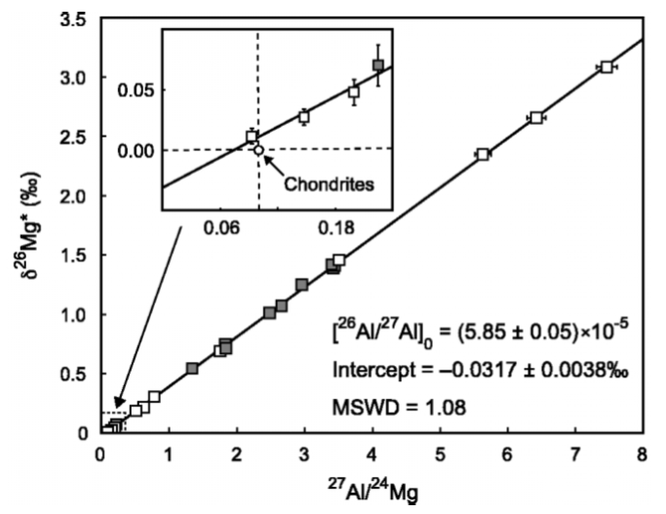
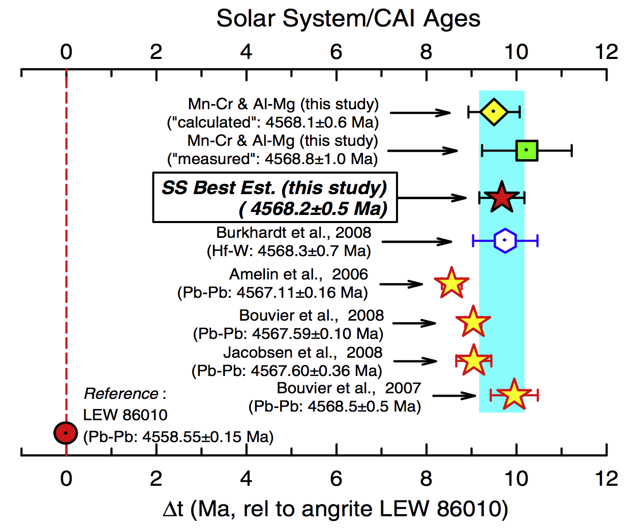
High Chronological Resolution
(Nyquist et al., 2009)
Al-Mg systematics for calcium-aluminum-rich inclusions from various carbonaceous chondrites (Thrane et al., Astrophys. J., 2006) provide a potential age precision of ± 9000 years. Accuracy, however, is of the order 1 Ma due to remaining questions of extinct nuclide calibrations.
Notes:
Short half lives allow very high chronological precision, if all goes well. Metamorphic disturbance can affect all radiometric ages, sometimes to different degrees, so when discrepancies in ages are found, understanding their cause can be difficult. Such disturbance may explain the variable U-Pb ages determined for CAIs, but another contributor is that just a couple of years ago, it was discovered that the U isotopic composition in these early Solar system materials is not constant, and this will affect U-Pb ages as well.

Slide 14
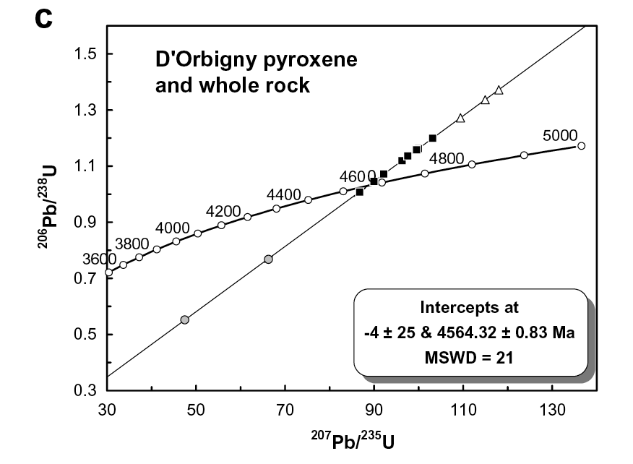
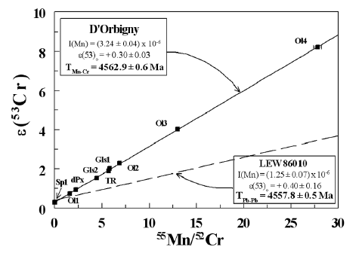
Planetesimal Differentiation Started Within 2 to 6 Ma of Solar System Formation
Markowski et al., 2007
Amelin, 2008
Glavin et al., 2004
Angrite D’Orbigny:
U-Pb = 4564.3 ± 0.8 Ma
Mn-Cr = 4562.9 ± 0.6 Ma
Hf-W = 4562.4 ± 1.5 Ma
Al-Mg = 4562.8 ± 0.5 Ma
Notes:
Short-lived systems provide only relative ages. Need a reference absolute chronometer like U-Pb. An example like the angrites provide an argument that the parent isotopes were initially homogeneously distributed in the solar nebula given that the ages shown in the slide are variably referenced either to CAI or LEW (a different angrite meteorite with a precisely determined U-Pb) ages, depending on the system. This type of work shows clearly that silicate melting on planetesimals was already underway within just a couple of million years of Solar system formation.

Slide 15
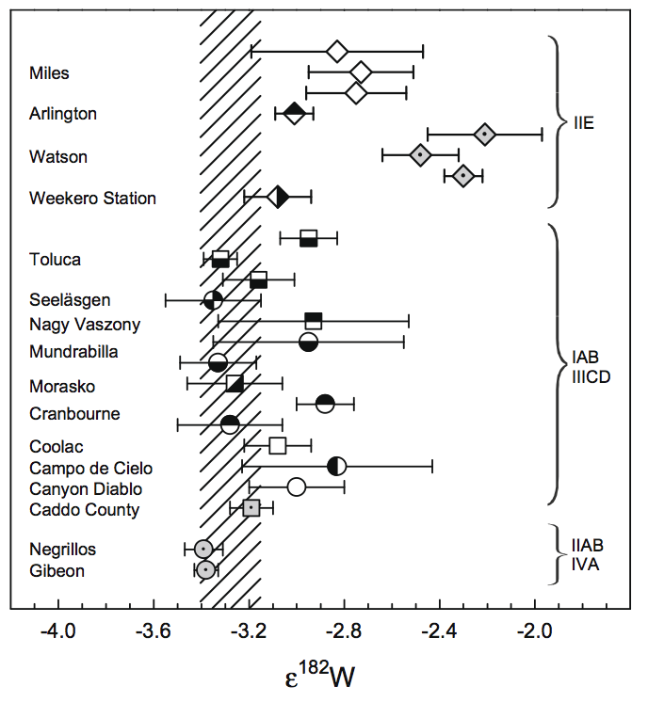
Iron Meteorite Tungsten Shows that Metal-Silicate Separation Happened Quickly, Even on Small Planetesimals
ΔT (CAI) Ma
0
5
10
20
¹⁸²Hf decays to ¹⁸²W with a half life of 9 Ma. W is soluble in iron metal, but Hf is not. When metal-silicate separation occurs, Hf and W are separated. In the metal, radiogenic ingrowth of ¹⁸²W stops. Many iron meteorites have ¹⁸²W /¹⁸⁴W ratios similar to the Solar system initial value determined from CAIs. Others have higher ¹⁸²W/¹⁸⁴W consistent with iron-metal separation times of 20 Ma. The implication here is that Earth grew from already differentiated planetesimals, not primitive chondrites.
(Kleine et al., EPSL, 2009)
Notes:
The short-lived decay of 182Hf to 182W (9 Ma half life) allows precise dating of iron-silicate separation on planetesimals. Many iron meteorites provide Hf-W formation ages within a couple million years or less of solar system formation. These likely represent the result of early planetesimal melting due to heating by short-lived radioactive nuclides like 26Al (730,000 year half life) and possibly 60Fe (1.5 Ma half life). Some iron meteorites give significantly younger ages (~20 Ma after Solar system formation) that are too young to be fueled by 26Al decay. These likely represent the result of planetary differentiation fueled by another abundant energy source – high velocity collisions between planetesimals.

Slide 16
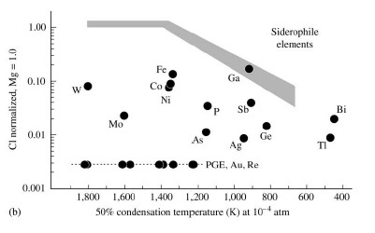
Extraction of Iron to the Core took with it all the Elements that are More Soluble in Iron than in Silicate (Siderophile Elements)
Hf
Cr
Mn
Volatility
Trend
Pd
Figure from Palme and O’Neil, TOG, 2003
Notes:
Iron-silicate separation likely occurred at the grain-size scale in the Solar nebula, but it would also occur during core formation. When the core forms, it will take with it all the elements that are more soluble in iron (the siderophile elements) than in silicate (lithophile) melts. Mantle abundances of siderophile elements are displaced below the volatile-loss trend (the shaded field) for Earth, because these elements were removed to the core. We can use the Hf-W, Pd-Ag and Mn-Cr short-lived isotope systems to constrain both the timing and the process of Earth’s volatile loss and core formation.

Slide 17
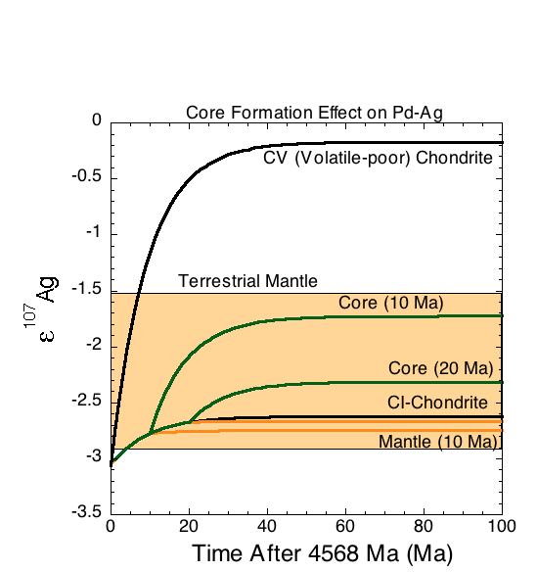
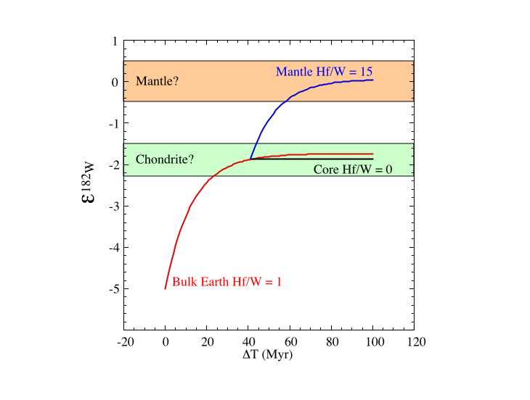
The Use of Hf-W, Mn-Cr and Pd-Ag to Constrain the Timing and Process of Earth Formation
Hf-W sensitive only to core formation
Pd-Ag sensitive to both core formation and volatile depletion
Mn-Cr sensitive primarily to volatile depletion
Core Formation Effect on Hf-W
Notes:
Pd-Ag works in a similar way as Hf-W during metal-silicate separation, but in the opposite direction. In Hf-W, the parent 182Hf (9 Ma half life) is lithophile whereas the daughter 182W is siderophile, therefore when core formation occurs, the metal will have a Hf/W ratio near zero and the ingrowth of 182W will stop. In contrast, core formation raises the Hf/W ratio of the mantle, causing the mantle’s 182W/184W to rise more rapidly. For Pd-Ag, the parent, 107Pd is more siderophile than the daughter 107Ag, so the mantle ends up with a low Pd/Ag and low 107Ag/109Ag and the core with a high Pd/Ag and high 107Ag/109Ag if the core forms while 107Pd is still alive (6.5 Ma half life). Both Hf and W are refractory, so the Hf-W system is not affected by volatile fractionation. Ag is more volatile than Pd, and hence is sensitive to the degree of volatile loss, even within different groups of primitive meteorites. Neither Mn nor Cr are particularly siderophilic, so they mostly will be fractionated by volatile fractionation.

Slide 18
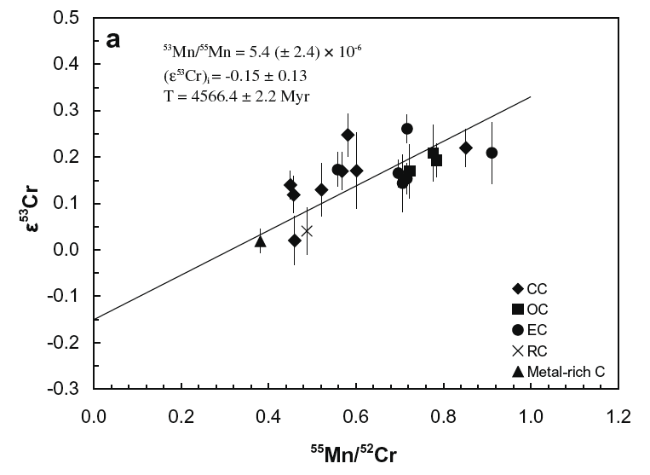
Earth Formed Volatile Depleted
Chondrite Mn/Cr variation correlates with ⁵³Cr/⁵²Cr.
Earth has a lower ⁵³Cr/⁵²Cr than almost all chondrites. Mn more volatile than Cr.
Earth’s volatile depletion occurred while ⁵³Mn was alive (t_{1/2} = 3.7 Myr)
Earth
From Qin et al., GCA 2010
Notes:
Tighter constraints can be put on the time of volatile depletion with the Mn-Cr system. Different types of meteorites show a range in 53Cr/52Cr (the deviations are small so e53Cr is the difference in measured 53Cr/52Cr in parts in 10,000 compared to a terrestrial standard) that correlates with Mn/Cr ratio. Mn/Cr ratio is measure of volatile abundance as Mn is moderately volatile, but Cr is significantly less volatile. The best fit line to the meteorite data provides an age indistinguishable from the age of the Solar system. We know Earth’s 53Cr/52Cr – its by definition e53Cr = 0 – and various estimates of the bulk Earth Mn/Cr ratio would put it on the meteorite isochron at lower Mn/Cr, as expected from Earth’s volatile depleted nature. This suggests that Earth formed volatile depleted, or at least it acquired this characteristic in less than 4 Ma after the beginning of Solar system formation.

Slide 19
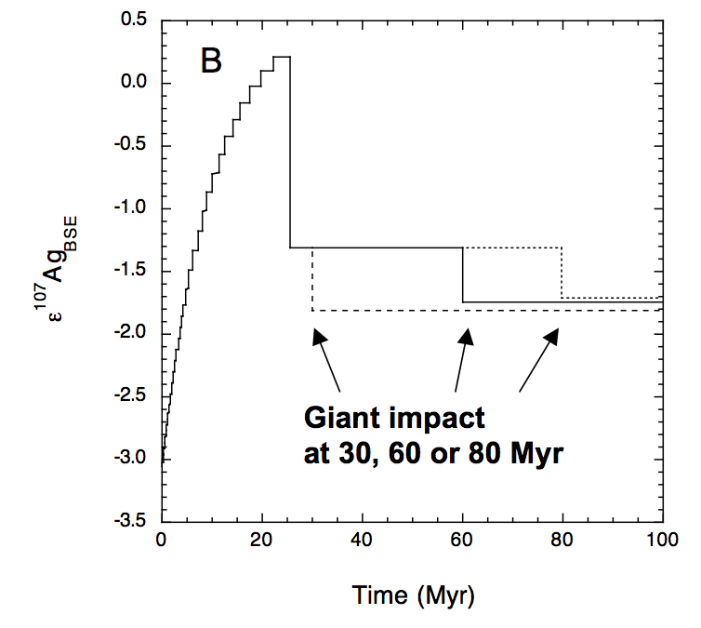
Reconciling Mn-Cr, Pd-Ag, and Hf-W Constraints on the Timescale of Earth Volatile-Depletion and Core Formation
26 Myr accretion of volatile-poor material (86% of Earth mass)
4% CI added at 26 Myr
Earth’s
Mantle
(Adds another 9% of Earth Mass)
(Schonbachler et al., Science, 2010)
Notes:
The inventory of Earth’s mantle’s volatile and siderophile is thus a function of what actually was accreting to form the Earth along with the time scale over which Earth accretion and core formation occurred. Three short-lived isotope systems can be used to provide constraints on the nature and timescale of Earth’s growth and core formation. 53Mn-53Cr (3.7 Ma half life) is sensitive primarily to volatile-refractory element separation because Mn is moderately volatile while Cr is moderately refractory and neither are particularly siderophilic. 182Hf-182W (9 Ma half life) is sensitive only to metal-silicate separation because both elements are highly refractory, but W is moderately siderophile while Hf is strongly lithophile. 107Pd-107Ag (6.5 Ma half life) is sensitive to both – Pd is refractory, Ag is moderately volatile. Pd is strongly siderophile, Ag is not, but is soluble in sulfides which might accompany core formation. Combining the 3 systems can provide the types of non-unique constraints illustrated in the figure.

Slide 20
The Evidence Against Chemical Exchange Between Core and Mantle AFTER the Completion of Core Formation
Interaction of core with mantle will change the ratio of siderophile (Ni) to lithophile (Mg) elements.
A variety of lithophile/siderophile element ratios show little or no change in the mantle over Earth history --> implies limited, if any, core-mantle exchange.
After the arguments of McDonough and Sun, Chem. Geol., 1995
Notes:
Both Pd-Ag and Hf-W thus indicate that the major portion of core segregation occurred within the first ~100 Ma of Earth history. Has there been significant mantle-core exchange since then? Doesn’t look like it. Many examples have been shown of the ratio of a siderophile to a lithophile element (Mg/Ni shown above) in mantle-derived rocks of different ages that do not convincingly resolve variability in these ratios with time. The sensitivity of these ratios is such that not more than about 1% of core could have been added back into the mantle over the last 3 Ga. But there is evidence that accretion did not stop after core formation.

Slide 21
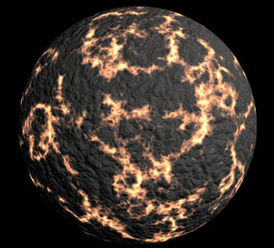
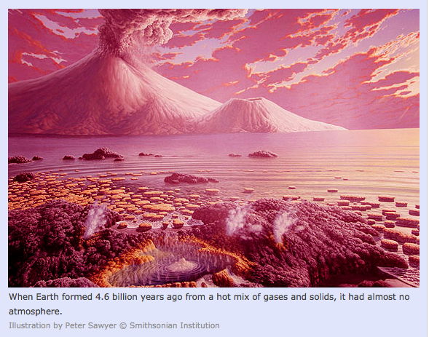
To this point we have formed an Earth that is depleted in volatile elements, probably because it formed from volatile-depleted planetesimals. We have seen that core formation occurred within the first 50-100 Ma of Earth history. What we haven’t talked about is whether these processes have had any effect on the main mass/volume of Earth – the mantle.

Slide 22
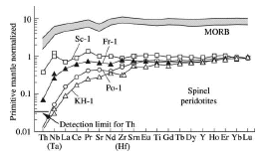
Elements that are Neither Volatile, nor Siderophile, the Refractory Lithophile Elements, SHOULD be Present in the Silicate Earth in Chondritic Relative Abundances
(but are not in most terrestrial rocks!)
“Fertile” mantle xenoliths (from Palme and O’Neill, TOG, 2004, after Jagoutz et al., 1979)
Element order reflects the degree of incompatibility during melting in the shallow mantle
Notes:
Refractory lithophile elements often are assumed to be present in chondritic relative abundances in Earth because there is no easy way to fractionate these elements in the nebula. When we look at terrestrial rocks, however, very few indeed have chondritic relative abundances of these elements. Is this because the Earth is not chondritic or is it because the Earth we sample experienced some form of igneous differentiation that fractionated these elements. The process of continent formation has transferred highly incompatible elements to the crust and stored them there for a good portion of Earth history, leaving behind in the residual mantle a complementary depletion in these elements. The conventional wisdom is that adding continental crust back in the right amounts to the incompatible element depleted mantle source of oceanic crust takes one back to a “primitive” mantle with chondritic relative abundances of refractory lithophile elements, but does it?

Slide 23
^{146,147}Sm-^{142,143}Nd Systematics
Short-lived chronometer:
¹⁴⁶Sm ¹⁴²Nd (T_{1/2}= 68 Ma)
¹⁴⁶Sm exists only in
the first ~500 Ma of
Solar system history
Coupled to the long-lived chronometer:
¹⁴⁷Sm ¹⁴³Nd (T_{1/2} = 106 Ga)
¹⁴⁷Sm abundance decreased by only 3% in 4.56 Ga
Zircon
4.4 Ga
Isua
3.8 Ga
Notes:
The Sm-Nd radiometric system is particularly useful for tracking this problem because both are refractory lithophile elements and are fractionated primarily by partial melting of silicate rocks. Embedded in Sm-Nd are two separate radiometric systems, one short-lived (146Sm-142Nd) that is sensitive to Earth differentiation over about the first 200-300 Ma of Solar system history and one long-lived (147Sm-143Nd) system that still responds to differentiation events today.

Slide 24
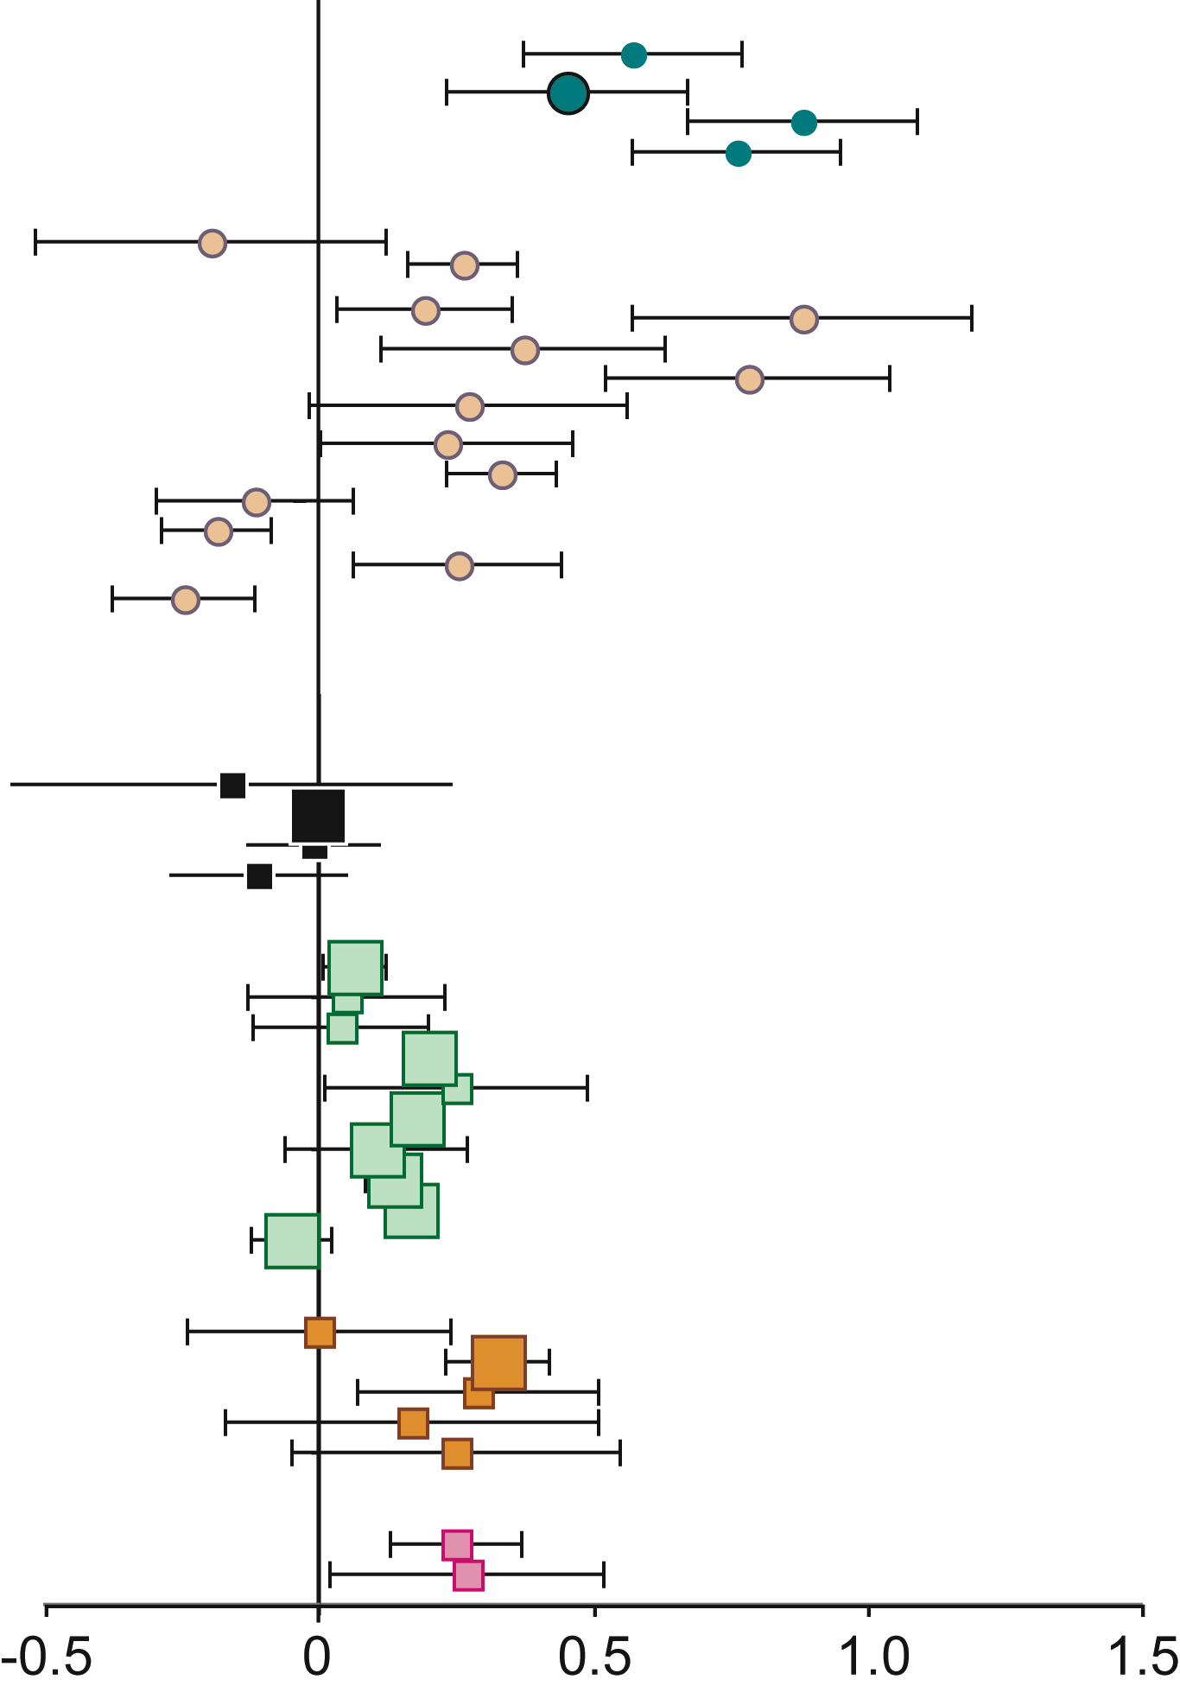
Why Search for ¹⁴²Nd Anomalies in Terrestrial Samples?
Because ¹⁴²Nd anomalies have been
measured in meteorites (eucrites, angrites),
SNC meteorites (Mars) and lunar samples.
Evidence for very early Sm/Nd fractionation
Interpretation: Fractionation produced during
the crystallization of a magma ocean
A magma ocean stage has wide support :
  - Accretion model (large impacts in late stages)
  - Very short-lived extinct radioactivity (²⁶Al, ⁶⁰Fe)
  - Core formation liberates lots of gravitational potential energy
MARS
Borg et al., 1999; Boyet and Carlson 2007;
Foley et al., 2005; Harper et al., 1995;
Nyquist et al., 1995; Brandon et al. 2009.
MOON
ε142Nd
Notes:
Other planets – Mars, Moon – show quite large variations in 142Nd, particularly Mars, that shows clearly that Sm and Nd were fractionated from one another very early in the history of these planets. Such early, global, differentiation often is explained by a magma ocean episode – where a good fraction, or all, of the planet is molten. Magma oceans are most likely when there is enough energy available for such large scale melting, and in the early Solar system, this includes the energy of short-lived radioactive systems, particularly 26Al, but also the energy of large planetesimal impacts and the gravitational potential energy released as the metal in the planet sinks to the center.

Slide 25
¹⁴²Nd Variation in Earth Materials is
Limited and Restricted Only to Rocks Older than 2.7 Ga
¹⁴²Nd excesses measured in 3.8 Ga samples from SW Greenland and Anshan, China (up to 0.15ε). ¹⁴²Nd deficiencies in Nuvvuagittuq, Quebec, Canada
Evidence for early differentiation, but not seen in all old rocks
No heterogeneities in ¹⁴²Nd/¹⁴⁴Nd preserved after 2.7 Ga in Earth’s convecting mantle
Notes:
The only variation in 142Nd/144Nd seen in Earth rocks occurs in rocks older than 3.5 Ga including rocks from Isua Greenland and Anshan China, both of which have 142Nd/144Nd roughly 15 ppm higher than most other Earth rocks. This variation in 142Nd/144Nd does not correlate with the rocks Sm/Nd ratio and thus probably reflects a characteristic of their mantle source. In contrast, rocks from the Nuvvuagittuq greenstone belt in northern Quebec show low 142Nd/144Nd that does correlate with Sm/Nd providing a 146Sm-142Nd isochron of age near 4.3 Ga making these the oldest crustal rocks on Earth. An important point about this isochron, however, is that the initial 142Nd/144Nd at the time of formation of these rocks is the same as that the mantle source of all modern igneous rocks would have had at 4.3 Ga.

Slide 26
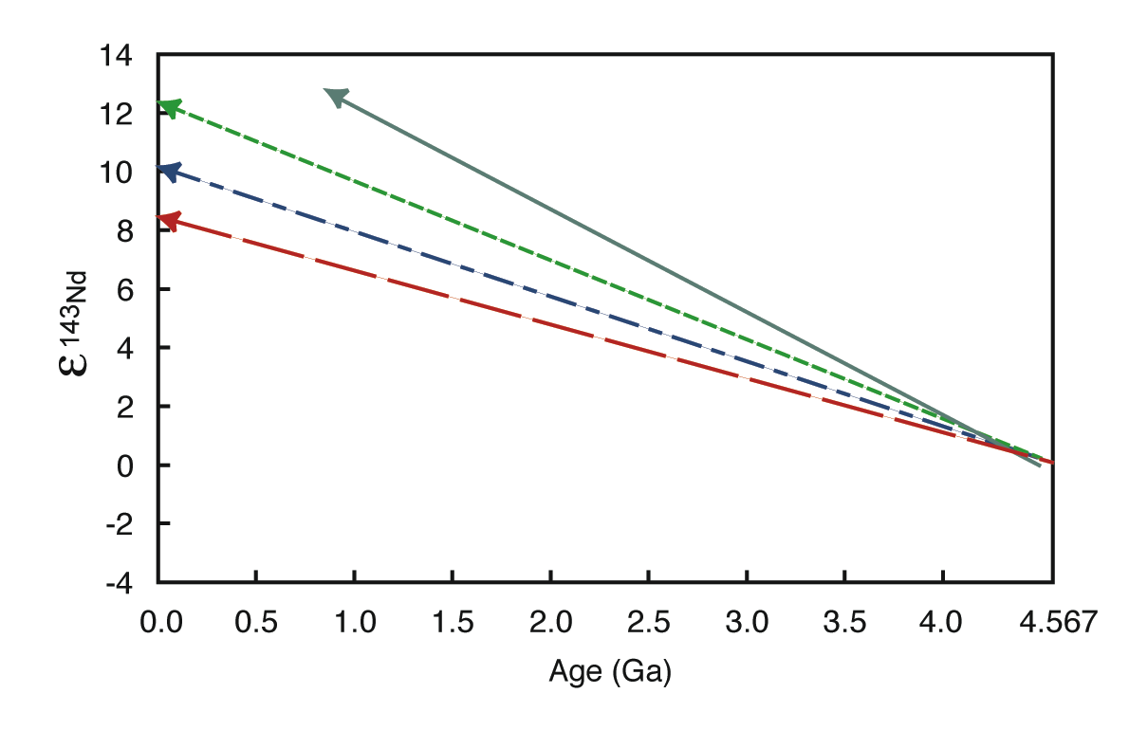
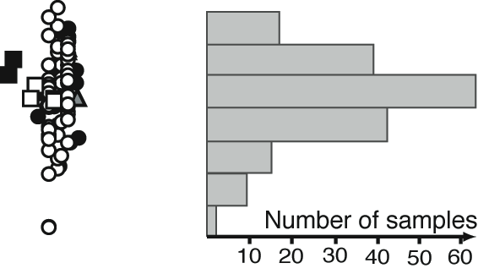
¹⁴²Nd Excess Implies a Higher than Chondritic ¹⁴³Nd/¹⁴⁴Nd for the “Primitive” Mantle if the Sm/Nd Ratio Responsible
for the Excess ¹⁴²Nd is Maintained Over Earth History
Mid-ocean ridge basalts
5 Ma, ¹⁴⁷Sm/¹⁴⁴Nd=0.209
30 Ma, ¹⁴⁷Sm/¹⁴⁴Nd=0.212
60 Ma, ¹⁴⁷Sm/¹⁴⁴Nd=0.216
100 Ma, ¹⁴⁷Sm/¹⁴⁴Nd=0.222
chondritic evolution
Archean samples
Notes:
Whatever affects 146Sm-142Nd will have consequences for 147Sm-143Nd, but the consequences will depend on when the Sm/Nd fractionation occurs. In the example above, each of the 4 cases shown provide a combination of Sm-Nd fractionation and age that will lead to the observed 20 ppm difference between chondrites and Earth. The sooner this happens, the less Sm and Nd need be fractionated because 146Sm is still present, but the later this occurs, the less 146Sm is available, so one has to increase the Sm/Nd ratio to make up for the lack of 146Sm. Waiting 100 Ma requires a Sm/Nd ratio so high that this reservoir would today have a 143Nd/144Nd higher than observed in the highest large-volume reservoir on Earth, the source of mid-ocean ridge basalts. If the Earth formed with a Sm/Nd ratio greater than chondritic, then the Sm/Nd ratio need be only about 6% higher than chondritic, and such a reservoir would today have 143Nd/144Nd about 6-8 parts in 10,000 (e143Nd) higher than chondritic (e143Nd = 0).

Slide 27
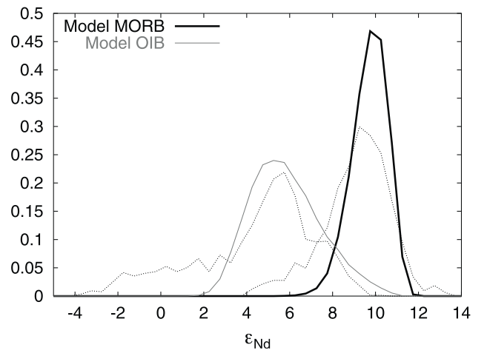
“Chondritic” mantle is a very muted component in intraplate volcanism
One explanation – regulate mass transfer rates between depleted upper mantle and primitive lower mantle to match erupted compositions, e.g. Kellogg et al., EPSL, 2002
Notes:
Most mantle-derived rocks have 143Nd/144Nd higher than chondritic. One can construct transport models between a lower mantle with e143Nd = 0 and an upper mantle with e143Nd = +10 that will mimic the distribution of 143Nd/144Nd in ocean island basalts, but an alternative simply is that the “primitive” mantle has an eNd of about +6 instead of zero. This would satisfy the 142Nd/144Nd difference between chondrites and Earth.

Slide 28
Predicted Parental Mantle Reservoir from ¹⁴²Nd Overlaps with high ³He/⁴He Reservoir
(Ra)
Reservoir parental to terrestrial mantle
“primordial” chondrite reservoir
Notes:
A mantle reservoir with a Sm/Nd ratio 6% higher than chondritic would today have a 143Nd/144Nd ratio (0.5130) about 6 parts in 10,000 higher than chondritic (0.51263). The predicted 143Nd/144Nd of the reservoir parental to modern terrestrial lavas overlaps with the 143Nd/144Nd of the highest 3He/4He lavas, another tracer of “primitive” mantle.

Slide 29
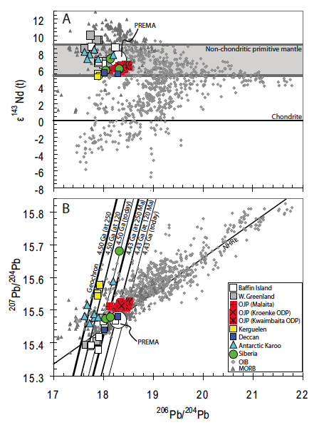
Though there are complexities (age corrections, crustal contamination), the Pb isotopic composition of many flood basalt parental magmas plot near circa 4.5 Ga geochrons.
All the colored symbols on this figure have ε¹⁴³Nd between +5.3 and +8 and were selected as those samples least affected by crustal contamination.
Jackson & Carlson, Nature, 2011
Notes:
Selecting through flood basalts for those free from crustal contamination,which is easy for oceanic flood basalts (e.g. Ontong-Java), but not for most, and then choosing those that have 143Nd isotopic compositions within the range suggested by the excess in 142Nd in Earth compared to chondrites, leaves of group that have Pb isotope compositions consistent with a source that is some 4.5 to 4.4 Ga old as opposed to the majority of ocean island basalts that head out to higher 206Pb/204Pb along a shallow slope that corresponds to an age of 1.8 Ga.

Slide 30
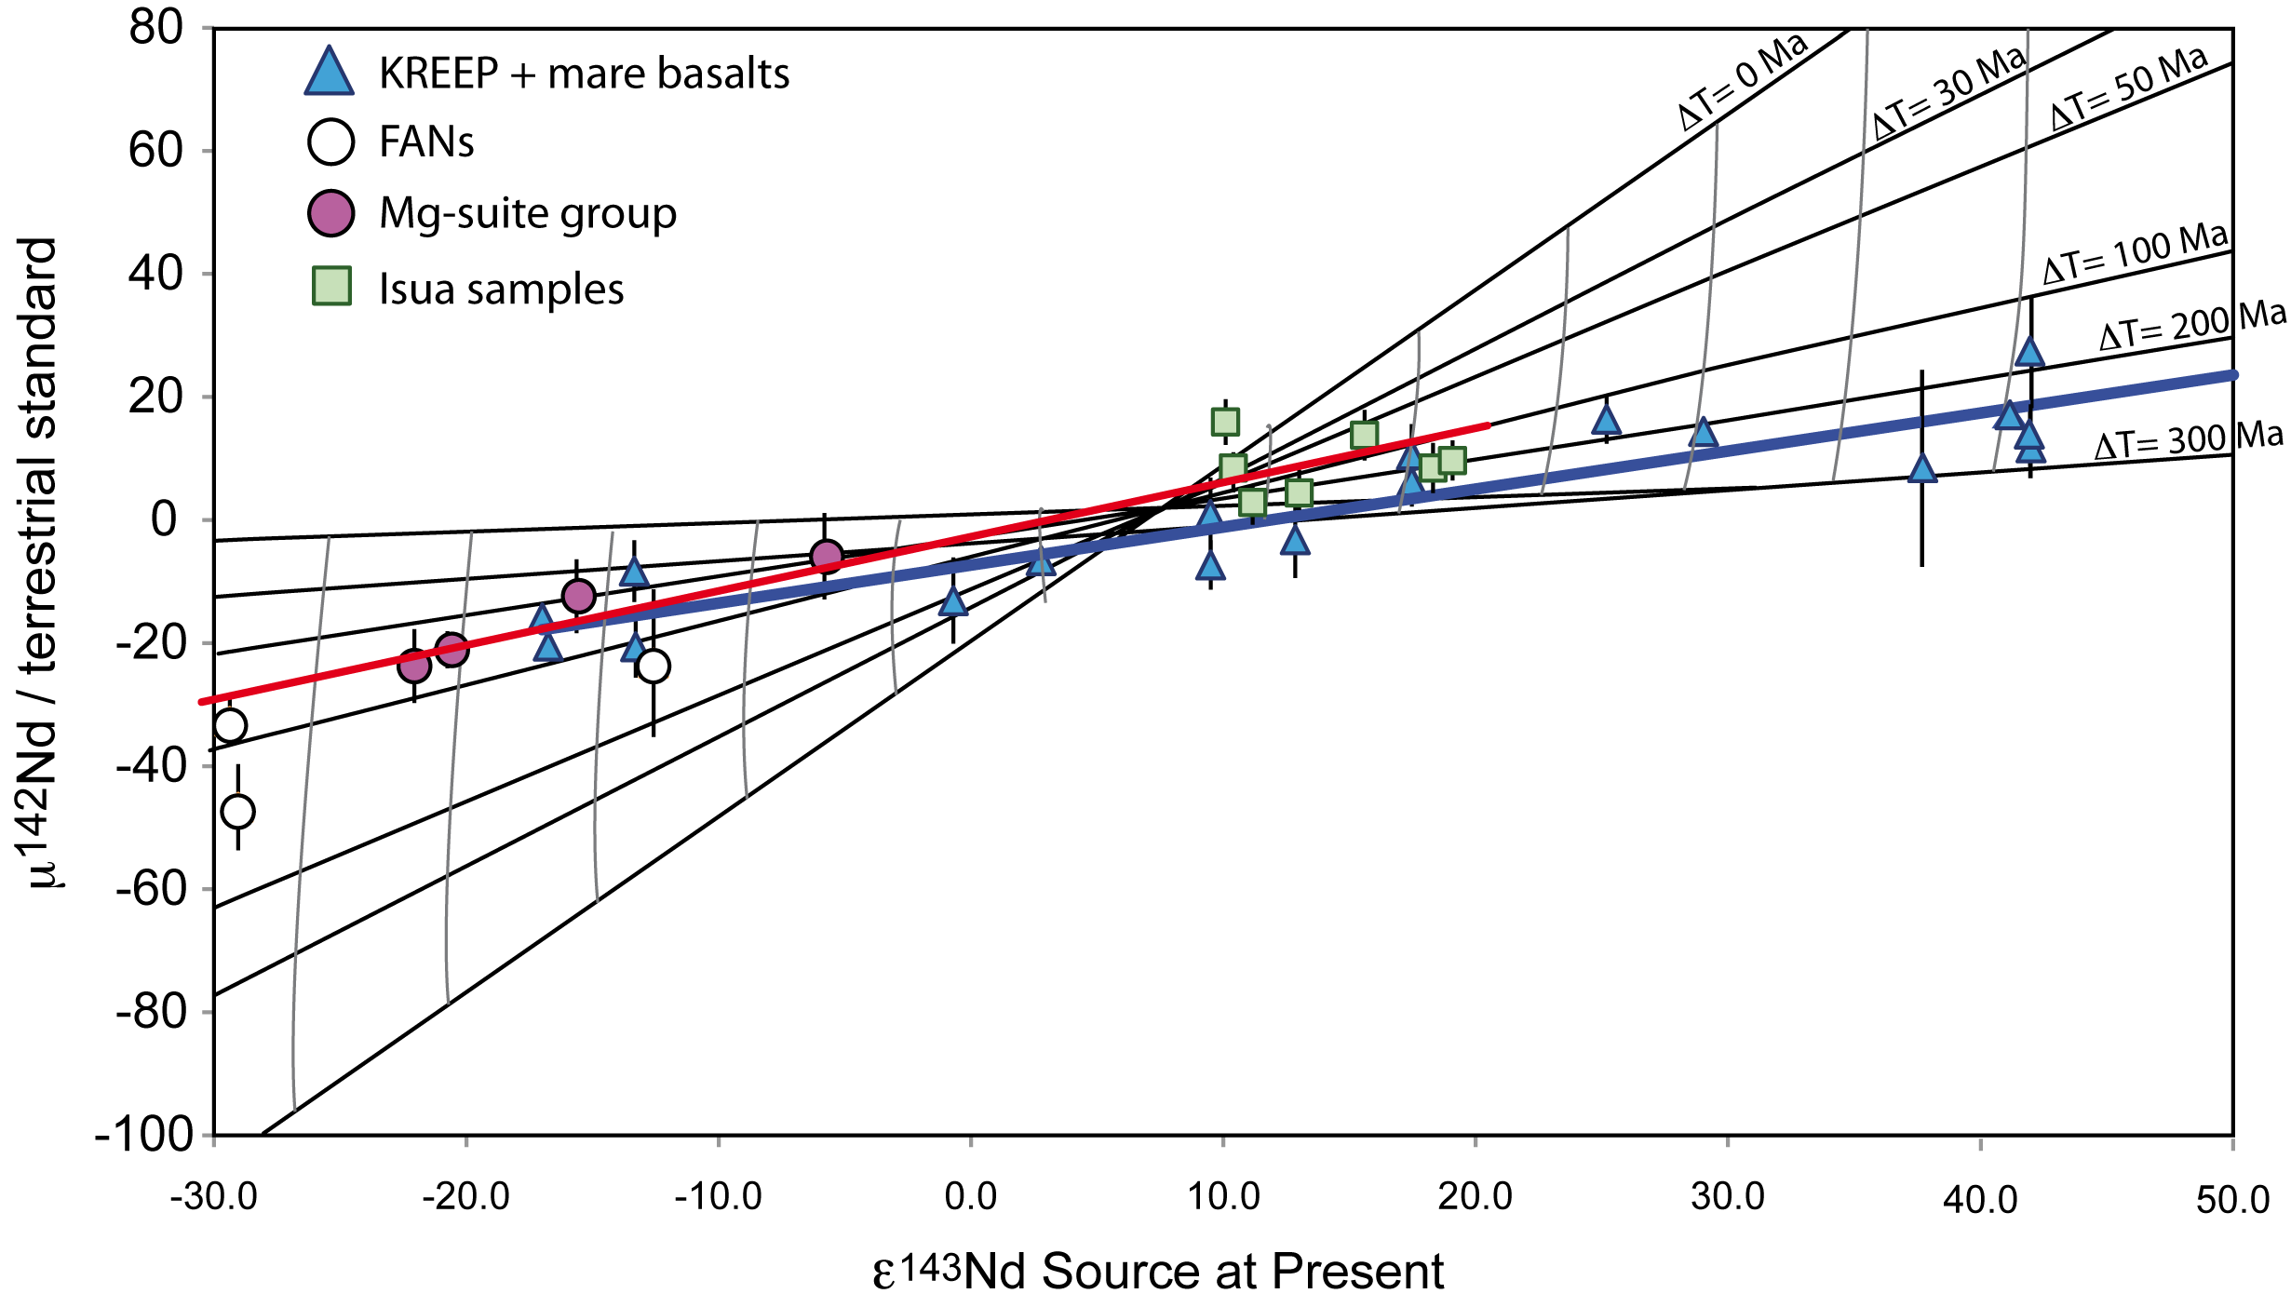
Evidence of a “late”Global Terrestrial Differentiation
Modern
Terrestrial
Mantle
Chondritic
+28
Magma ocean crystallization = 120 Ma
-22
Both the Moon and Earth show little lithophile evidence for 4.56 Ga differentiation. Instead, the ¹⁴⁶Sm-¹⁴²Nd data for lunar crustal rocks, mare basalts, and the Isua rocks with positive ¹⁴²Nd anomalies suggest a global differentiation age in the circa 4.45 Ga range – similar to Pb ages for Earth. Is this the time of the giant impact and Moon formation?
Notes:
146Sm-142Nd data for lunar and the rocks from Isua lie along a similar evolution line that suggests that Earth and Moon differentiated something like 100+ Ma after Solar system formation. On the Moon, this is conveniently interpreted as the magma ocean, but why does Earth also show a similar age in both Sm-Nd and Pb? Perhaps this is the age of Moon formation by giant impact into Earth?

Slide 31
Superchondritic ¹⁴³Nd/¹⁴⁴Nd of Mantle Throughout Earth History
Early differentiation coupled with a short period of mixing between enriched and depleted reservoirs can explain both ¹⁴²Nd and ¹⁴³Nd variation in mantle-derived rocks through time. Complementary enriched reservoir may no longer exist if BSE is non-chondritic.
¹⁴²Nd/¹⁴⁴Nd in Archean Mantle-Derived Rocks
Initial ε¹⁴³Nd in Mantle-Derived Rocks
Figure after Shirey et al., 2007 with data from numerous literature sources
From Carlson & Boyet, Phil. Trans. 2008
Notes:
Mantle-derived rocks through Earth history have had e143Nd higher than chondritic. Traditionally this has been interpreted as a sign that continent formation began early – which may still be true. The variable 142Nd/144Nd in 3.5 to 3.8 Ga rocks, however, requires differentiation circa 4.45 Ga, and more depleted (higher Sm/Nd ratio) mantle than at present. One option is that the Archean-Hadean mantle preserves the memory of the initial differentiation of the silicate Earth, that was erased by the mixing associated with mantle convection by 2.5 to 3 Ga. The left panel above shows a simple, and non-unique, two-stage evolution model starting with a highly depleted mantle at Earth formation (the depleted component of the magma ocean?) which evolves unto 4 Ga at which point it begins to mix with its enriched (low Sm/Nd ratio) compliment to drag the 142Nd/144Nd ratios of mantle-derived rocks back to the modern value. This model independently results in the 143Nd/144Nd evolution shown in the right panel, which does a reasonable job of matching the initial e143Nd of mantle-derived rocks throughout Earth history with the exception of the increasing deviation to higher e143Nd in recent times likely due to the effects of continental crust formation over Earth history.

Slide 32
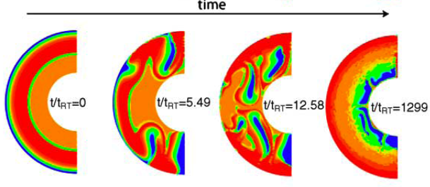
The Post Magma Ocean Overturn, and a Period of Quiescence
Magma ocean crystallization leaves a buoyantly unstable cumulate pile. Overturn leaves cold, dense, material at the base, and hot, buoyant, material near the surface. Large-scale mantle convection impeded until radioactive heating reestablishes a thermal gradient sufficient to overwhelm compositional density.
Density
Elkins-Tanton et al., EPSL, 2005

Slide 33
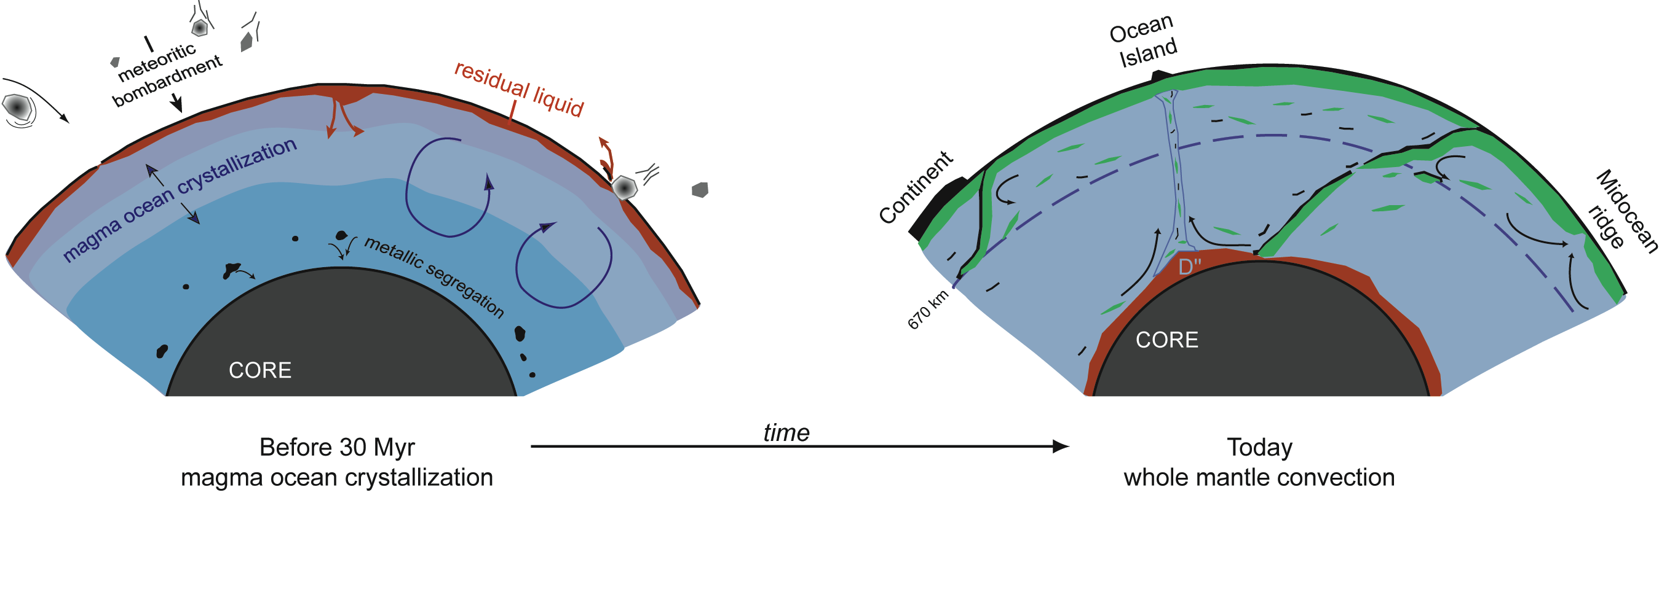
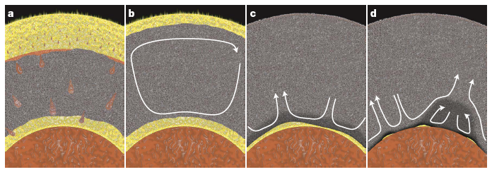
Two Ways to Create an EDR – EER Pair
Magma Ocean Overturn
Basal Magma Ocean (Labrosse et al., Nature 2007)
Notes:
If the bulk silicate Earth has chondritic relative abundances of the refractory lithophile elements, then the 142Nd imply an early differentiation event and complementary incompatible element enriched and depleted mantle reservoirs. Only the depleted reservoir has been sampled by surface igneous rocks. Two ways to do this are illustrated above, one a lunar-analog magma ocean that evolves to an iron-rich, and hence dense, silicate liquid at the top that eventually sinks to the base of the mantle and stays there. Another option here is that this early crust is removed by impact, in which case the bulk Earth would no longer be chondritic, and hence the need for a complementary incompatible element enriched reservoir goes away. The other option considers the possibility that at high pressure, silicate liquids are more dense than solids and hence would sink to the bottom of the mantle to form a basal magma ocean.

Slide 34
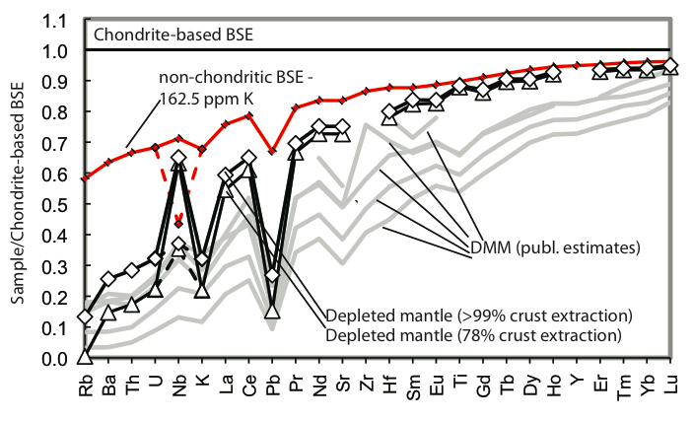
Calculated Lithophile Trace Element Pattern for Early Depleted Reservoir Calculated from ¹⁴²Nd/¹⁴⁴Nd Mass Balance Modeling
Jackson and Jellinek, in prep.
Notes:
One way to decide between these options takes advantage of the different styles of chemical fractionation that will occur during melting/crystallization as a result of the different mineral phases that will be involved at different pressures and temperature of melting/crystallization. The current best estimate for the early incompatible element depleted source shows a smooth chondrite-normalized incompatible element pattern. When looking at such patterns, it is critical to recognize that the order of the elements on the x-axis is based on their incompatibility during the melting the produces MORB and ocean island basalts, and this melting is in the shallowest upper mantle where clinopyoxene primarily controls the abundance of these elements in the melt.

Slide 35
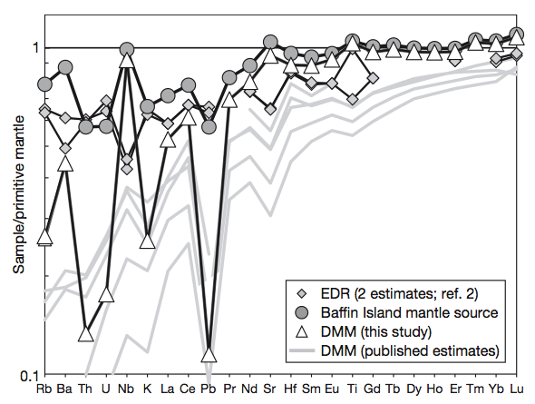
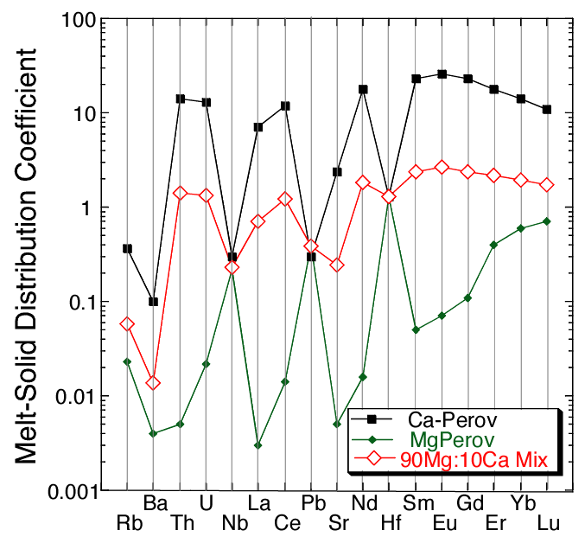
How Did the Non-Chondritic Mantle Form?
Melting is the easiest way to fractionate the lithophile elements, but what were the conditions of melting?
Notes:
The incompatible element fractionation of the depleted mantle source will be imprinted by the minerals that fractionated to produce it. If in the shallow mantle, this will be clinopyroxene, and indeed the clinopyroxene distribution coefficients look a lot like the calculated mantle composition. If deeper melting/fractionation were involved, garnet and/or majorite might be important crystallizing phases, but these strongly fractionate the middle elements from the right hand elements leading to a strongly sloped pattern from e.g. Nd to Lu, but this is not inferred for the mantle. If either Ca- or Mg-perovskite fractionation by themselves is involved, both minerals strongly fractionate high-charged cations (Nb, Pb, Hf) from other lithophile elements (e.g. Ba, U, Nd, etc.). Some, but not huge, spikes in these elements are calculated for the mantle source. Because of their complementary distribution coefficient patterns, combining Ca- and Mg-perovskite in the right portion can lead to a bulk distribution coefficient pattern not too different from clinopyroxene, so at this point, this path cannot resolve whether the “primitive” mantle was formed by clinopyroxene fractionation in the uppermost mantle, or from a combination of Ca- and Mg-perovskite fractionation in the lower mantle.

Slide 36
Conclusions
  Earth inherited compositional variation present the nebula
    Volatile depletion (present by 4564 Ma), high Fe content
    Isotopic distinction, particularly from C-chondrites
  Global differentiation of Earth and Moon occurred at ~4.45 Ga, not ~4.56 Ga
    120-150 Ma lunar crust and mare basalt isochrons consistent with ¹⁴²Nd excess in Isua and Pb “Age of the Earth”
  3) Accessible Earth slightly depleted in highly incompatible lithophile elements
    Explains:
      The most common Nd isotopic composition seen in OIB
      The positive εNd seen even in the oldest mantle-derived rocks
      Association of high ³He/⁴He mantle with positive εNd
      The ⁴⁰Ar “paradox”
        U, Th, and K abundances in the non-chondritic BSE are 60% those generally assumed
      Flood basalts preferentially sample the non-chondritic primitive mantle

Slide 37
¹⁴²Nd Variations - Radiogenic or Nucleogenic
Half-life
> 10⁹ yr
Days to 10⁸ yr
Minutes to Days
< Minutes
Number of
Protons
Number of Neutrons
S-Process
Slow Neutron Addition
R-Process
Fast Neutron Addition
P-Process
Proton-rich Nuclei

Slide 38
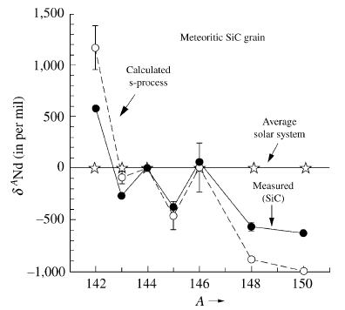
¹⁴²Nd Variations - Radiogenic or Nucleogenic?
Pre-Solar grains in meteorites preserve massive Nd isotope anomalies including huge enrichments in ¹⁴²Nd
Data from Richter et al., 1992

Slide 39
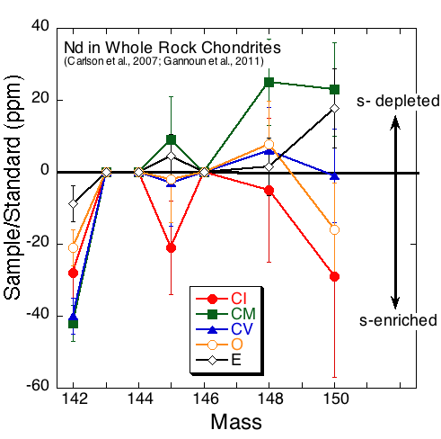
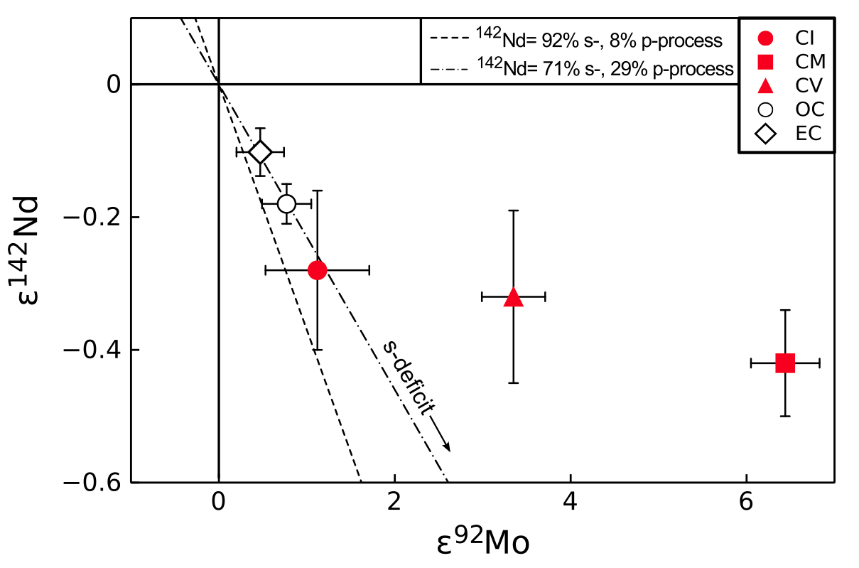
Nd is Nucleosynthetically Variable, but is that the Answer to the
Chondrite – Earth ¹⁴²Nd Difference?
⁹²Mo anomalies may correlate with ¹⁴²Nd anomalies
(Burkhardt et al., 2011)
Angrite
NWA
4801
Nd displays small nucleosynthetic anomalies in C-chondrites at the whole rock scale. CM are s-process depleted, CI are s-process enriched. Both have negative ¹⁴²Nd anomalies compared to Earth. Angrites, with no measureable Mo isotope anomaly have μ¹⁴²Nd = +3 (NWA 4590), -7 (NWA 4801) and +3 (D’Orbigny) (Sanborn et al., LPSC 2010) relative to chondrites, in other words, 15 to 25 ppm lower than Earth.

Slide 40
Few meteorites have both ¹⁴²Nd/¹⁴⁴Nd and ¹⁴⁸Nd/¹⁴⁴Nd that simultaneously overlap terrestrial values. E-chondrites come closest, but even they show a range of isotopic compositions
(Qin et al., GCA 2011)

Slide 41
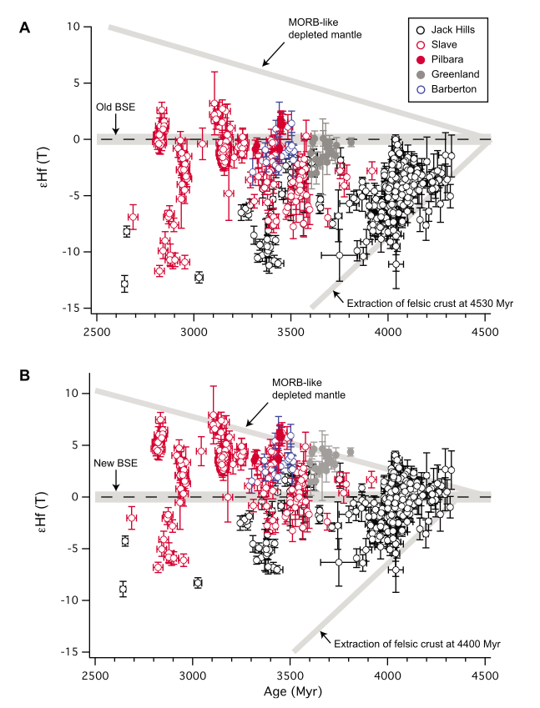
Nd Suggests an Incompatible Element Depleted BSE. Why do Hadean and Eoarchean Zircons Show Negative εHf?
(Bizzarro et al., G³ 2012)
Age (Ma)

Slide 42
⁵³Mn → ⁵³Cr (3.7 million years)
Element Condensation T [CI Chondrite] [Mantle] [Core]
Mn 1158 ºK 1920 ppm 1045 ppm 300 ppm
Cr 1296 2650 2625 9000
Mn/Cr 0.72 0.40 0.033
¹⁰⁷Pd → ¹⁰⁷Ag (6.5 million years)
Element Condensation T [CI Chondrite] [Mantle] [Core]
Pd 1324 ºK 550 ppb 3.9 ppb 3100 ppb
Ag 996 200 8.0 150
Pd/Ag 2.8 0.5 21
¹⁸²Hf → ¹⁸²W (9 million years)
Element Condensation T [CI Chondrite] [Mantle] [Core]
Hf 1684 ºK 103 ppb 283ppb 0 ppb
W 1789 93 29 470
Hf/W 1.1 10 0

Slide 43
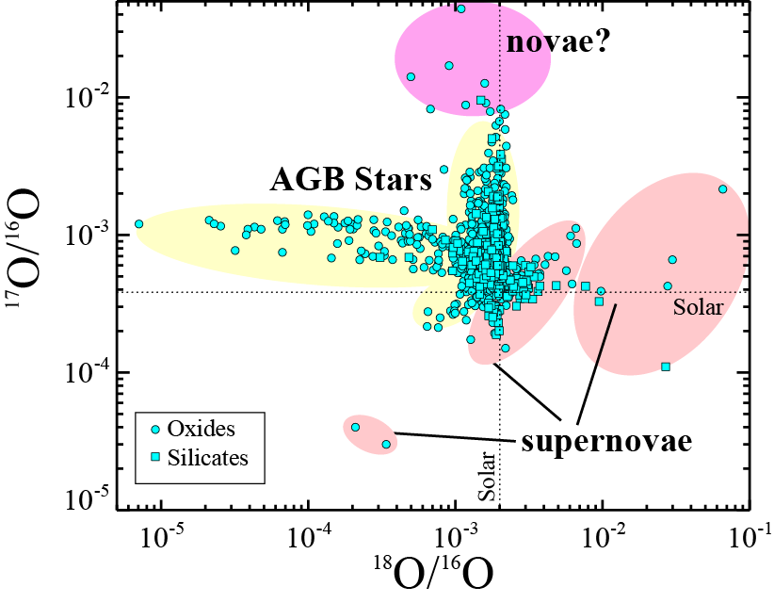
Oxygen: A Clear Indication that the Solar Nebula was not Compositionally Homogeneous
Nucleosynthetic
Or Chemical?
Nucleosynthetic
Variations
(Figure courtesy
of Larry Nittler)
Notes:
Most Solar system studies of oxygen isotope report 18O/16O and 17O/16O ratios in parts per thousand – delta – differences from some terrestrial standard. In contrast, presolar grains display a range in oxygen isotope composition of up to 5 orders of magnitude. The presolar grain compositions are clearly due to nucleosynthetic processes. The range of values for Solar system materials, however, may be caused by isotope fractionation accompanying chemical reactions in the Solar nebula, particularly interaction of UV light emitted from the Sun with various gaseous oxygen-bearing compounds (CO, CO2, H2O, etc).

Slide 44
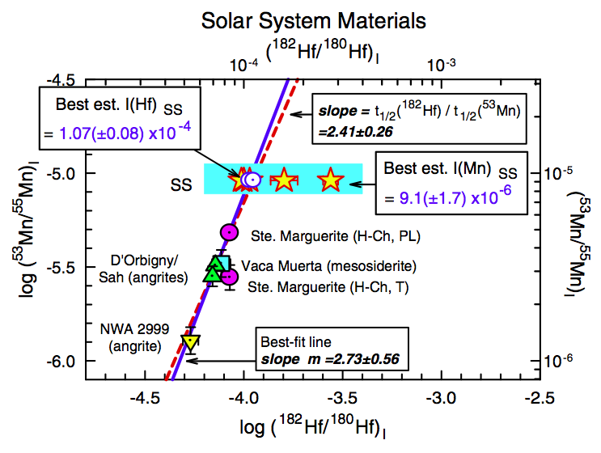
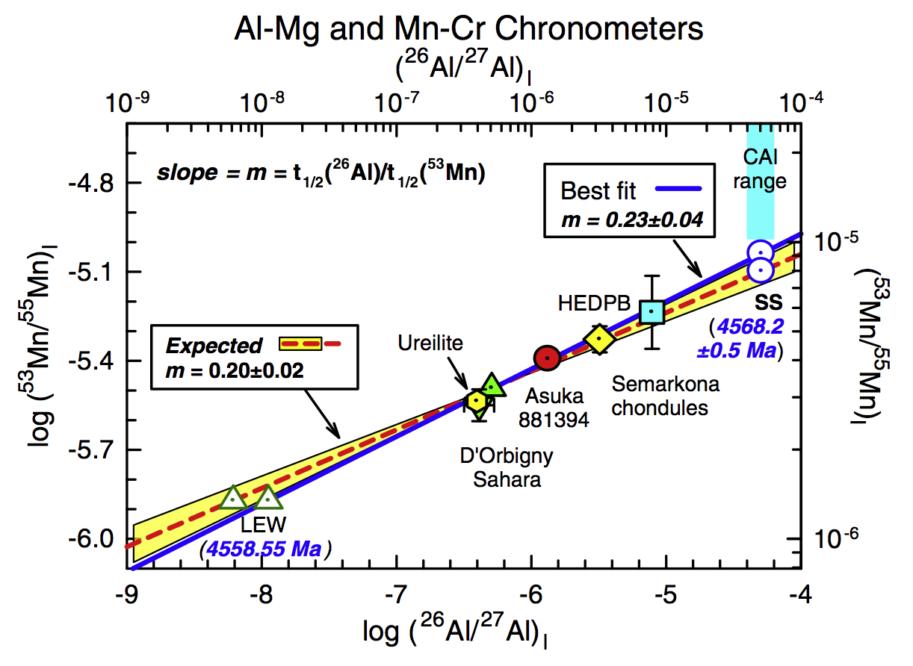
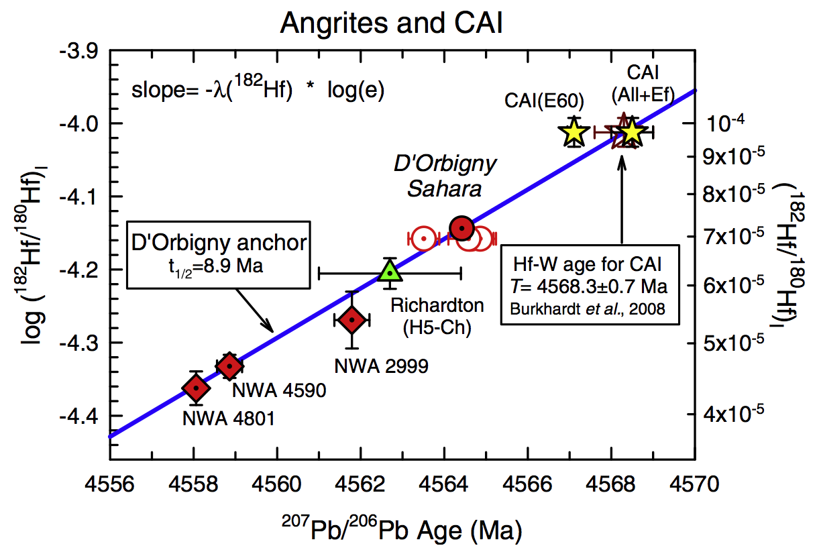
U-Pb ages provide a suitable absolute reference age for rocks that can be dated by U-Pb. One can also compare one extinct system against another.
Nyquist et al., 2009
Notes:
To turn a parent nuclide abundance for a now extinct radionuclide into an age requires anchoring the relative time scale provided by extinct radionuclides to an absolute time scale, usually provided by U-Pb. In this case, the Hf-W system is calibrated by comparing the 182Hf/180Hf ratios inferred from isochrons from meteorites of various ages with their U-Pb ages. The agreement of Hf-W ages with U-Pb ages, pinned from just one of the meteorites shown in the lower left figure (the D’Orbigny anchor) across a range in U-Pb ages suggests that the 182Hf/180Hf ratio in the Solar nebula was initially homogeneous and the variation in this ratio measured in the different meteorites is due simply to the decay of 182Hf. The upper right figures shows a comparison of Hf-W ages with Mn-Cr (53Mn decays to 53Cr with a half life of 3.7 Ma), and the upper right continues this approach by intercalibration of Mn-Cr and Al-Mg systems. There remains enough variability about these lines to keep the question of whether they provide accurate ages or measures of initial Solar system heterogeneity alive, but the evidence is increasingly strong that these systems can provide accurate age resolution at the 0.5 to 1 Ma time scale at 4568 Ma ago.

Slide 45
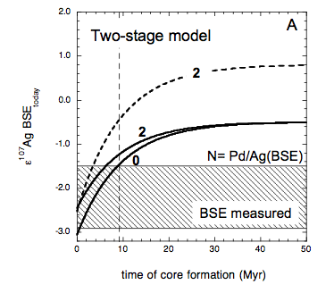
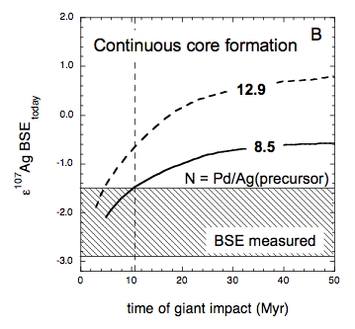
Pd-Ag Core Formation Timescale Too Fast for Hf-W!
Accrete volatile-rich material – volatiles lost in later event
Dashed curves are for accumulation of material as volatile-depleted as Earth today (Pd/Ag = 13). Solid curves are for accumulation of CV3 chondrites (Pd/Ag = 8.5). Numbers along the curves in A give the mantle Pd/Ag ratio after core formation. If Earth accumulated from volatile-rich material, then Pd-Ag offers no constraints on the timing of core formation. (From Schonbachler et al., Science 2010)
Notes:
Using the estimated Pd/Ag ratio of the bulk Earth, which is higher than chondritic because of the volatile depletion of Earth, the 107Ag/109Ag of the mantle would evolve to higher values than measured for mantle-derived rocks within about 9 Ma unless core formation lowers the mantle Pd/Ag before then, but this is too fast for the ~30+ Ma suggested for core formation by Hf-W. Pd-Ag is not as sensitive to the actual mechanism of core formation (one step vs. a core forming event with every impact) because the Pd and Ag abundances in meteorites, compared to a post-core formation mantle, are so high that the Pd-Ag of the mantle mostly tracks the Ag isotope evolution of the incoming material.

Slide 46
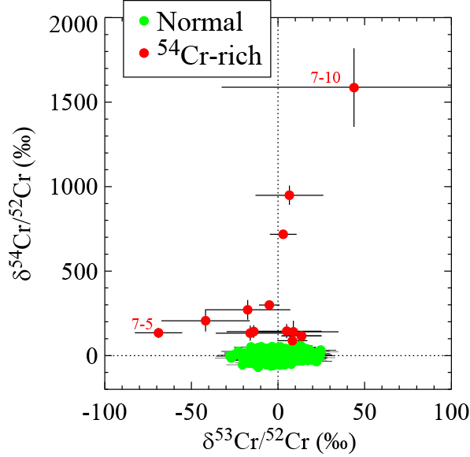
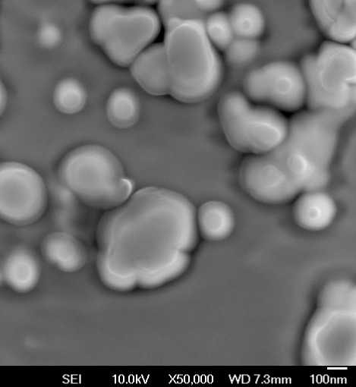
Isotopic Compositions Influenced by Presolar Grains
(Qin et al., GCA 2011)
Grains with anomalies of this magnitude may influence isotopic composition, but do they influence elemental composition?

Slide 47
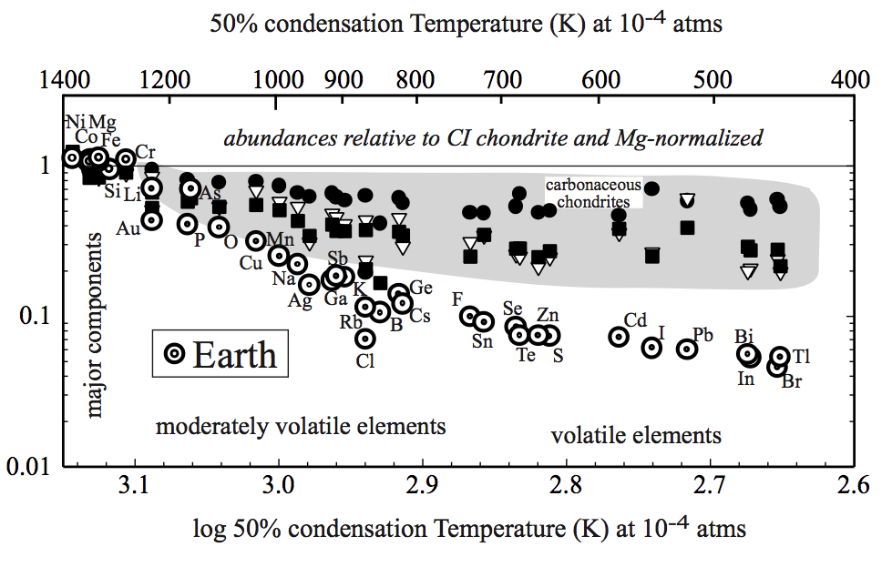
Ice-Rock Separation:
Volatile depletion (never enrichment) is a characteristic of many Solar system objects, including Earth
From McDonough
TOG, 2003
CI-normalized terrestrial volatile element abundances decrease with decreasing condensation temperature. Same pattern, though less extreme, is seen in “primitive” meteorites. Volatile depletion of Earth is a “pre-accretion” phenomena
Notes:
A most obvious chemical separation mechanism is temperature and volatility as one would expect a significant temperature gradient across the Solar nebula. Earth clearly shows a depletion in the moderately volatile elements (those with condensation temperatures i<~1100C) as do many meteorites.

Slide 48

Timing of Planetary Volatile Depletion via Rb-Sr
Notes:
We have known of Earth’s volatile depletion for a long time through simple approaches like this one using Rb-Sr isotope evolution. 87Rb decays to 87Sr with a 50 billion year half life, so it is still working today. Rb is moderately volatile while Sr is refractory. Volatile-rich chondrites (CI) have high Rb/Sr ratios, similar to the Sun, so their 87Sr/86Sr ratios increase rapidly. Determinations of the initial Sr isotopic composition of both angrite meteorites and lunar rocks show that their low Rb/Sr ratios were established within about 3 Ma of Solar system formation. The lowest 87Sr/86Sr measured in a terrestrial rock is for a 3.4 Ga old barite from Australia. This would suggest that Earth’s low Rb/Sr was established by 4449 Ma. The present day 87Sr/86Sr of the MORB source is of order 0.702 to 0.703, which would be reached by 4200 Ma if Earth had a chondritic Rb/Sr ratio. These ages could all be made younger, however, if the portion of the Solar nebula in which Earth formed had a lower than Solar Rb/Sr.

Slide 49
The Importance of that Last 1% of Accretion
Earth = 6 x 10²⁴ Kg
Ocean = 1.4 x 10²¹ Kg
CI Chondrite = 18 wt% H₂O
1% Earth Mass of CI Chondrite contains 10²¹ Kg water
Notes:
The so-called highly siderophile elements – called that because they have metal-silicate distribution coefficients of 10^4 or above, and hence should be depleted in the mantle by a similar amount, are instead found in the mantle at nearly chondritic relative abundances at a bit less than 1% of chondritic abundances. One way to do this is to add about 1% of the mass of the Earth after core-mantle exchange stopped – a so-called “late veneer”. If the later veneer were made of volatile-rich chondrites, then this material would have brought in an amount of water similar to that currently present in the ocean. The siderophile element abundances in the mantle don’t require a volatile-rich late veneer, however.

Slide 50
¹⁴²Nd Difference Between Earth and Chondrites
¹⁴²Nd/¹⁴⁴Nd ratios measured in carbonaceous and ordinary chondrites and basaltic eucrites are lower than all modern terrestrial rocks. Enstatite chondrites (Gannoun et al., PNAS, 2011) overlap both O-chondrite and terrestrial mantle values.
Explanation :
  BSE has a Sm/Nd ratio ~6% higher than O-chondrites. High Sm/Nd ratio results in excess ¹⁴²Nd from the decay of ¹⁴⁶Sm.
Data from Nyquist et al., 1995; Boyet and Carlson, 2005; Andreasen and Sharma, 2006; Rankenburg et al., 2006. Carlson et al., 2007; Gannoun et al., 2011.
Notes:
Although there is only very limited variation in 142Nd/144Nd in any group of Earth’s rocks, and none in any post-2.5 Ga rocks, the modern Earth does have a 142Nd/144Nd about 20 ppm higher than ordinary chondrites. If this difference is due to 146Sm decay (an alternative is nucleosynthetic heterogeneity – see Carlson and Boyet, 2008 and Qin et al. 2011 for example) then it implies that the accessible Earth has a Sm/Nd ratio higher than chondritic.

