Slide 1
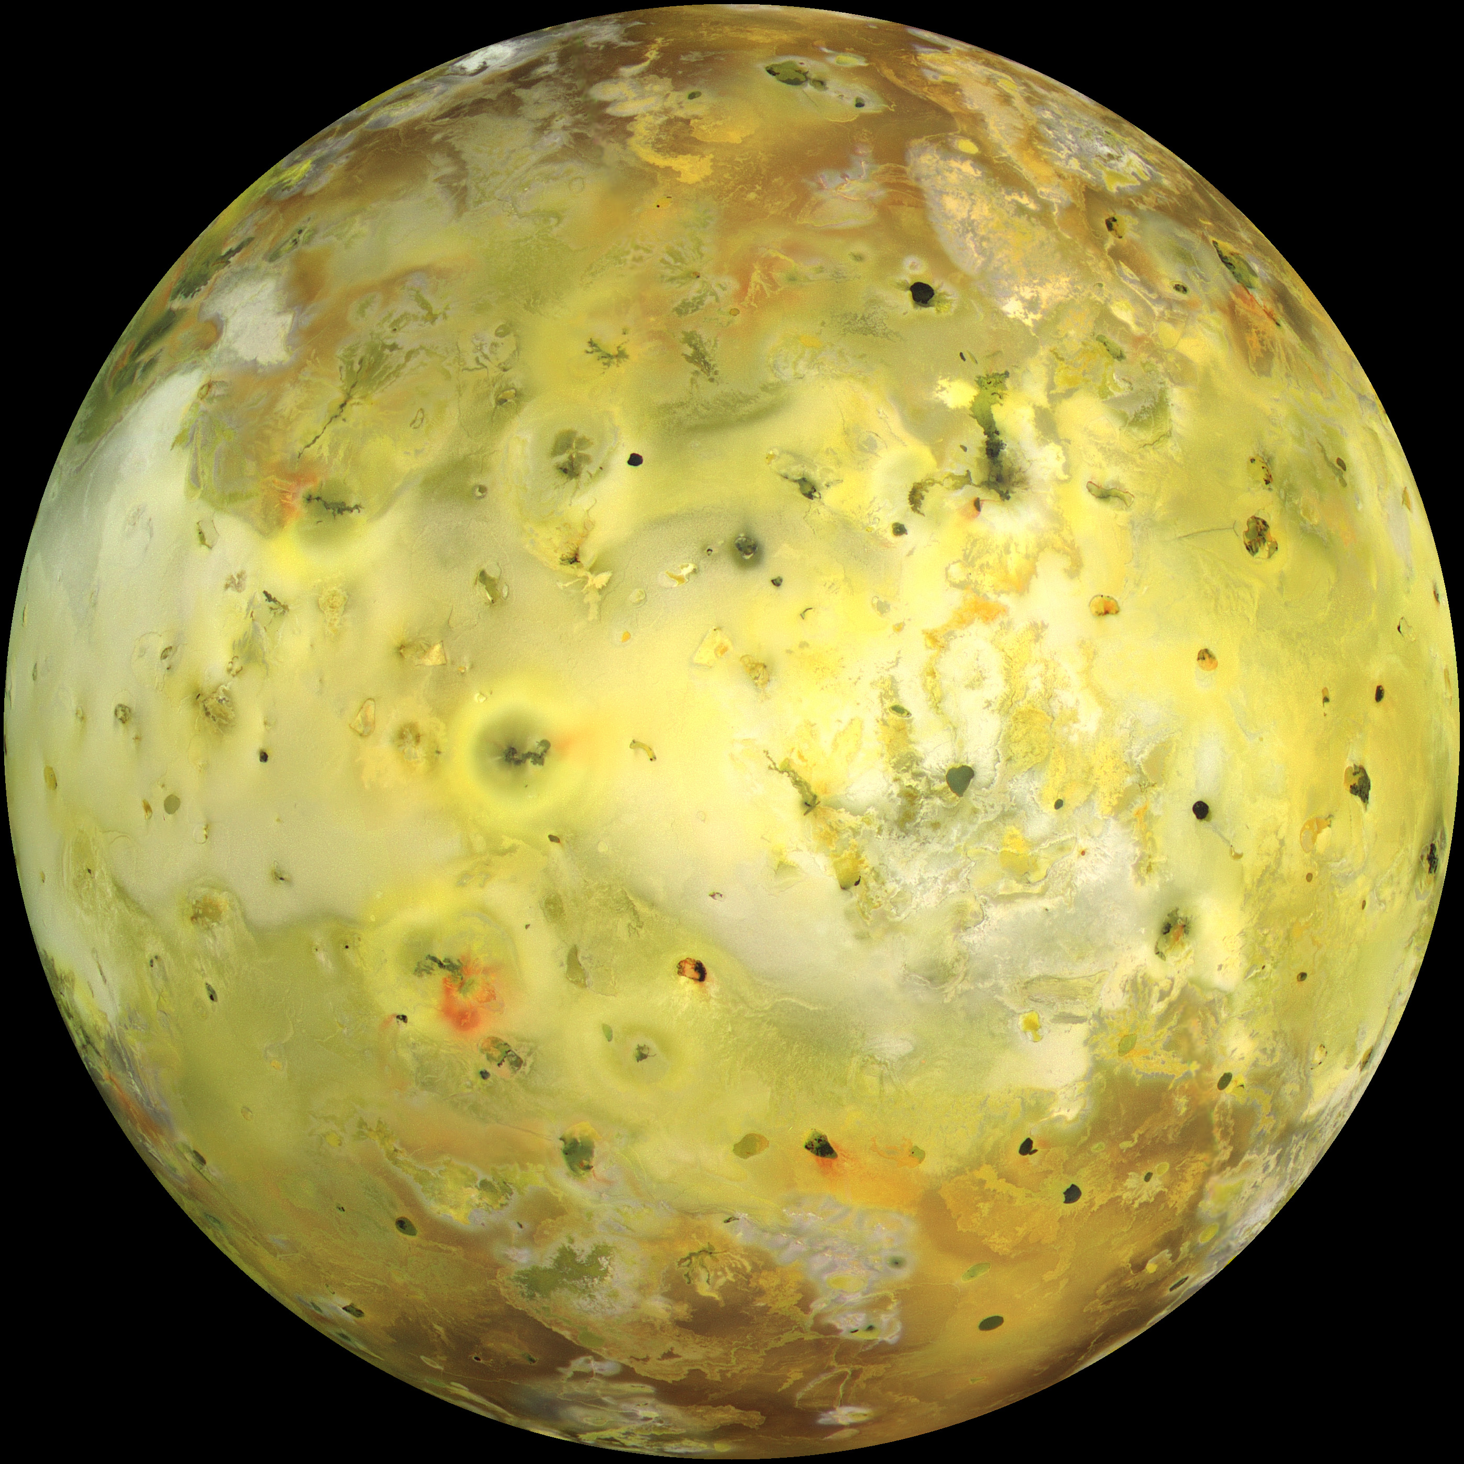
Dynamics of Planetary Interiors
Io (NASA)
Notes:
Io – a geologically active moon of Jupiter. The geological activity of a planet is often expressed by volcanism or a particular type of tectonics. Inevitably, this activity is related to transport of heat from the interior by convection. This heat may be primordial or due to radiogenic heat sources. It can also be due to tidal forces.

Slide 2
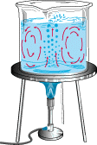
Convection
Predictions
D
1. Heat flow ~ Ra^{1/3}
(USGS)
2. Velocity ~ Ra^{2/3}
3. Horizontal Length L ~ D
Rayleigh Number
Notes:
The process of convection is relatively well understood when the properties of the fluid are constant. In this case we can define a dimensionless number which describes the vigor of convection. The Rayleigh number depends on the depth of the fluid, the temperature difference, the strength of gravity and coefficient of thermal expansion. It also depends on the viscosity and thermal diffusivity. The theory of convection makes predictions for the heat flow, or the velocity of flow. We can also predict the horizontal scale of the upwellings and downwellings, which are comparable to D.

Slide 3
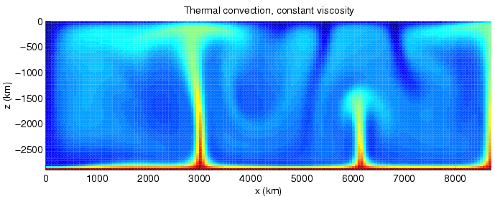
Numerical Models
Quelle & Schmelling (2002)
Notes:
This is an example of a numerical model. You will run similar models in the tutorial to confirm some of the predictions we just mentioned. You can see thermal plumes rising from the hot lower boundary, and downwellings from the cold, top boundary. The horizontal scale is comparable to D.

Slide 4
Complications
Rheology (stress-strain relationship)
Melting (alters composition and volatiles)
Geometry
Rotation
Turbulence
Notes:
Many of the lectures will deal with complications in the standard theory.

Slide 5
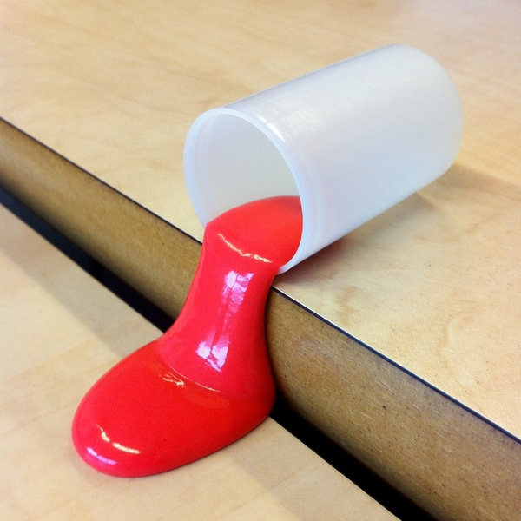
Rheology
Newtonian
Silicates & Oxides
Other variables: grain size, volatiles, partial melt, deformation history
Notes:
Rheology defines the relationship between stress and strain, particularly the time derivative of strain. For simple fluids there is a simple linear relationship. When we apply a stress we produce a deformation, but the rate of deformation depends on the viscosity. This is perfectly reasonable for a fluid, but the behavior of a solid that creeps under stress is more complicated. The relationship between stress and strain rate can be a strong function of temperature T. It can also depend on stress. For example a flow model called dislocation creep depends on the density of dislocations. In the solid, which in turn depend on the stress.

Slide 6
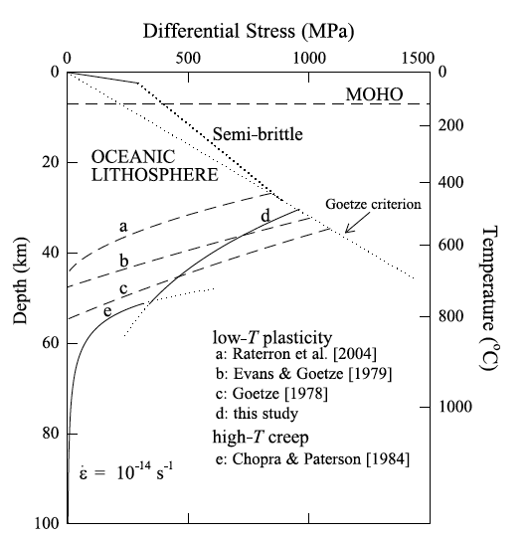
Example
Strength of Oceanic Lithosphere
a composite model including
- brittle failure
- low-T plasticity
- high-T creep
Mei et al. (2010)

Slide 7
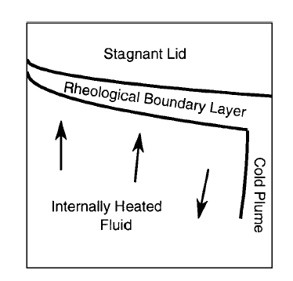
Expectations?
Notes:
Simple expectations suggest that the strong lithosphere should resist deformation. You would get an immobile or stagnant lid at the top and confine convection to the underlying region. This may be representative of convection on Venus. On Earth the strong lid has been broken to permit subduction.

Slide 8
Plate Tectonics
When did plate tectonics begin?
Notes:
Plate tectonic is a very efficient form of convection because we take the cold lithosphere and recycle it into the interior. Of course, this requires subduction zones to form.

Slide 9
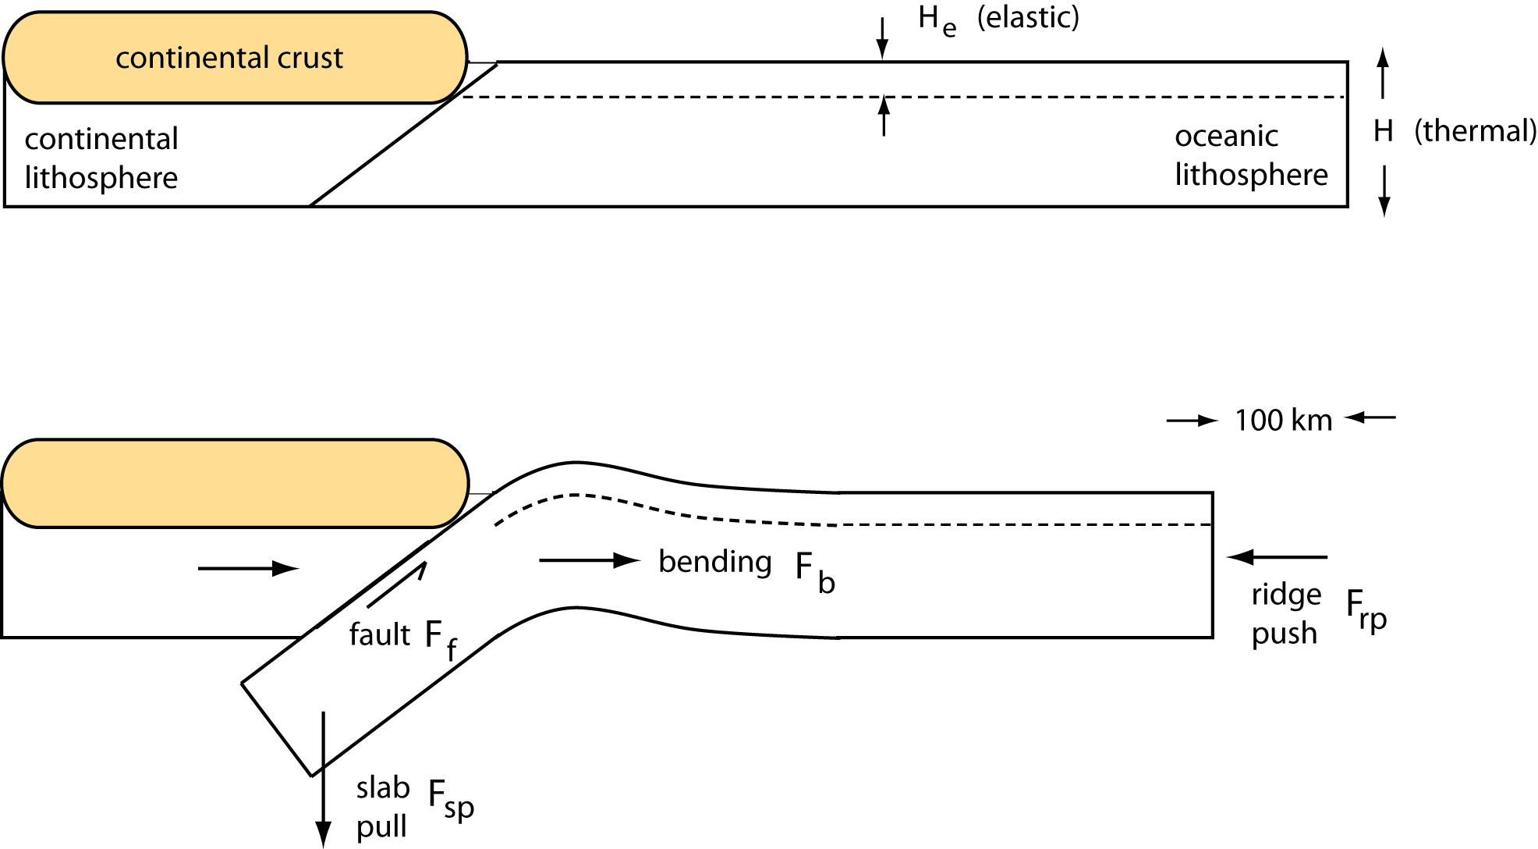
Initiation of Subduction
ΔX
Subduction
F_{sp} + F_{rp} > F_{f} + F_{b}
u > 1.3 cm/yr
McKenzie (1977)
Notes:
A closely related problem is the initiation of subduction on the present-day Earth. The first quantitative treatment of the problem was given by Dan McKenzie in an obsure AGU monograph. The idea is illustrated here. McKenize described the process as a finite amplitude instability because you need a critical size perturbation to kick start the process. Elastic stresses saturate after ~20km of convergence; convergence rate of 1.3 cm/yr; fault stress 10 MPa

Slide 10
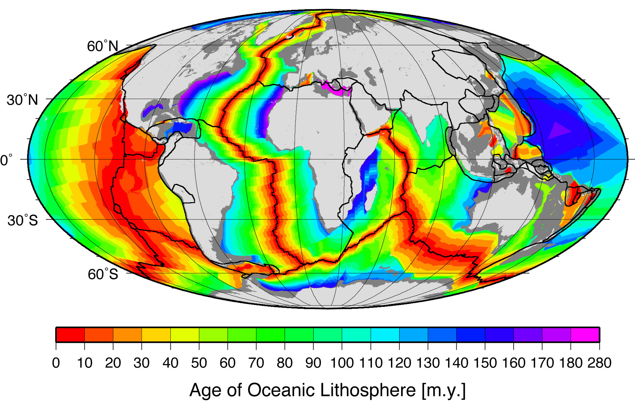
Plate Ages
Assuming 75% passive and 25% active margins
Methane carbon in gas hydrate 3000 Gton C
Methane carbon in bubbles 2000 Gton C
Total 5000 Gton C
Muller et al. 2008
Notes:
This is a map of the plate ages to illustrate the point. On the east coast of the US we have old oceanic lithosphere, but this arrangement is not unstable. Only by introducing a finite amplitude disturbance (100 km of convergence) do we expect to initiate subduction. Presumably this will happen any day now.

Slide 11
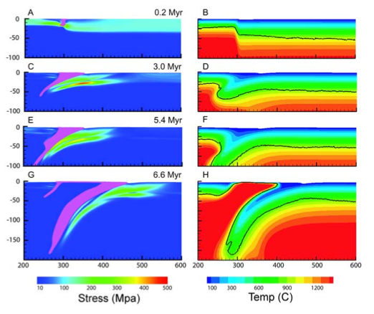
Initiation of Subduction
2cm/yr
ΔX
109 km
Gurnis et al. (2004)
Notes:
Elastic stresses saturate after ~20km of convergence; convergence rate of 1.3 cm/yr

Slide 12
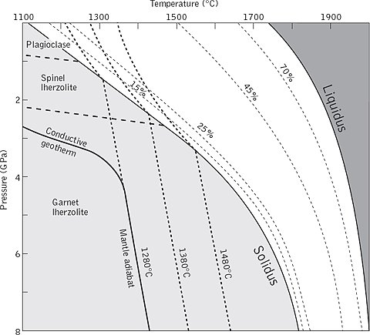
Melting
Decompression Melting
Melting forms oceanic crust (basalt)
and depleted residuum (harzburgite)
Densities
basalt ~ 2.9 g/cm³
harzburgite ~ 3.2 g/cm³
lherzolite ~ 3.3 g/cm³
Oxburgh & Parmentier (1977)

Slide 13
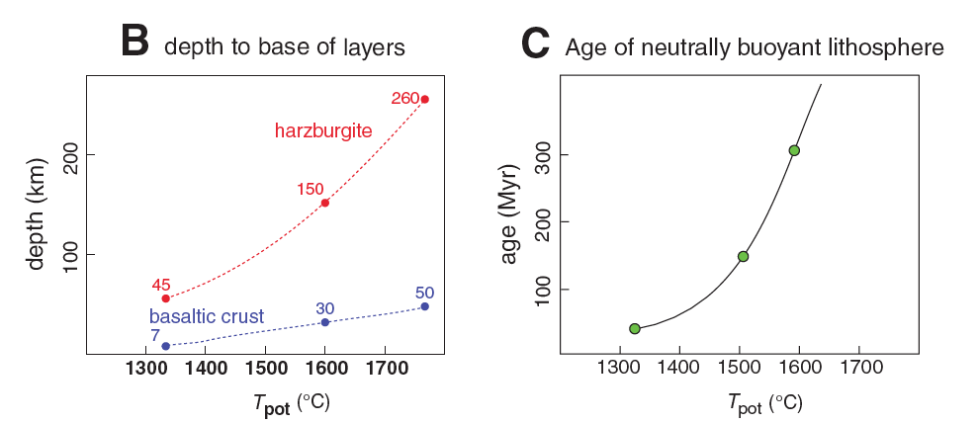
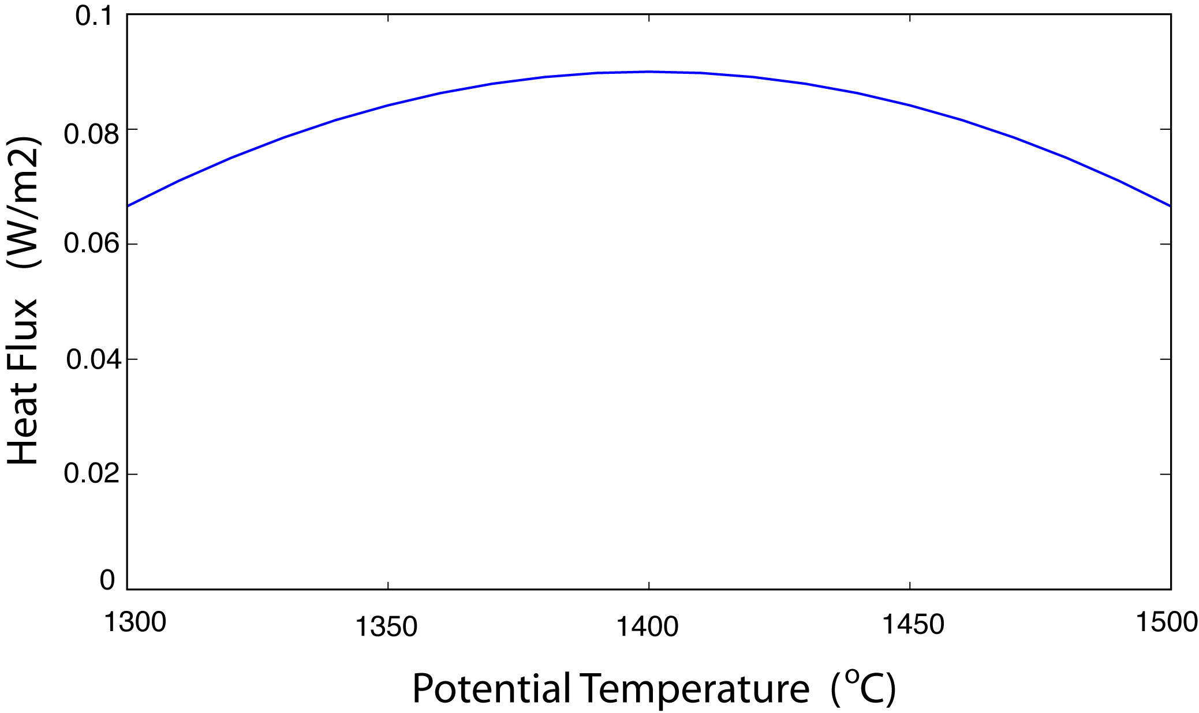
Buoyancy of Lithosphere
van Hunen et al. (2008)
average heat flux
Sleep (2007)

Slide 14
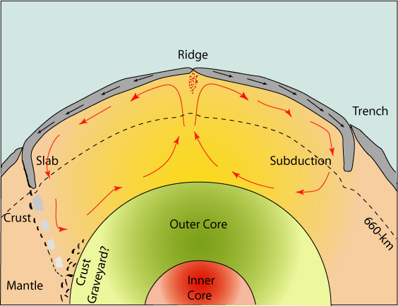
Mantle Mixing
(S. Rost)
How quickly are chemical anomalies and volatiles mixed?

Slide 15
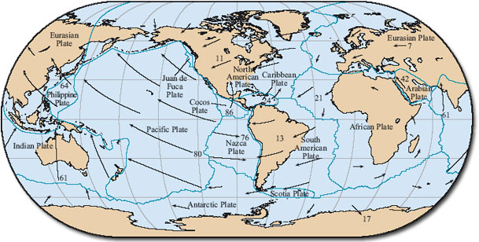
Geometry
The Open University
Notes:
Geometry is another interesting issue that arises with plate tectonics. There are constraints on the motion by virtue of the fact that plate behave as coherence, rigid plates. For example, there are places where very young lithosphere is subducted. You wouldn’t expect this behavior in the standard theory of convection, so it is a complication of Earth’s style of mantle convection.

Slide 16
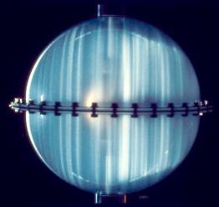
Rotation
P. Olson
Notes:
Rotation is another important complication. It can give rise to true polar wander in the mantle. But in the core where the viscosity is low and the stresses are small, we expect rotation to have a very important influence on the dynamics. This is an experiment of Peter Olson which shows the effects of rotation on convection. You see columnar structures, which are characteristic of rotating convection.

Slide 17
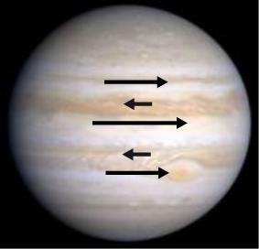
Rotation
Zonal winds
Notes:
Another property of rotating fluids is the presence of zonal winds. A KITP program that ended just as our program was starting was largely devoted to understand how these zonal flows emerge when the fluid is randomly forced by small-scale convection columns deeper in the fluid.

Slide 18
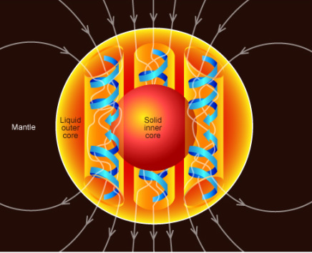
Geodynamo
Presence of magnetic field can affect the pattern of convection

Slide 19
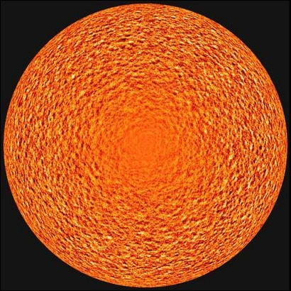
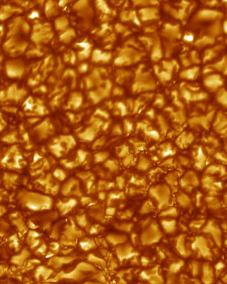
Turbulent Convection
Solar Convection
granulation
Our Initial Condition?
Notes:
SOHO doppler measurements. This style convection is fundamentally different from the types of convection that presently occur in the mantle or the core, for that matter. It is relevant because we might expect this type of convection in a magma ocean. The added complexities include the crystallization and the interplay between convection and solid crystals.

Slide 20
Summary
Geological activity is ultimately connected with convection in the interior
mantle convection
- complexities in rheology
- influence of melting
core convection
- achieve realistic properties
magma ocean convection
(S. Rost)
- two-phase with crystallization

