Slide 1


Mass, Isotopic, and Redox Balance Constraints on Carbon Cycling
Louis A. Derry
Cornell University

Slide 2
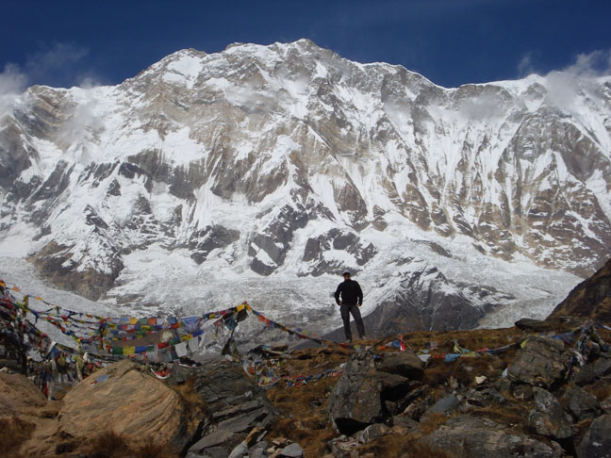
Snapshot of modern/recent data: impact of Himalaya on C cycle

Slide 3
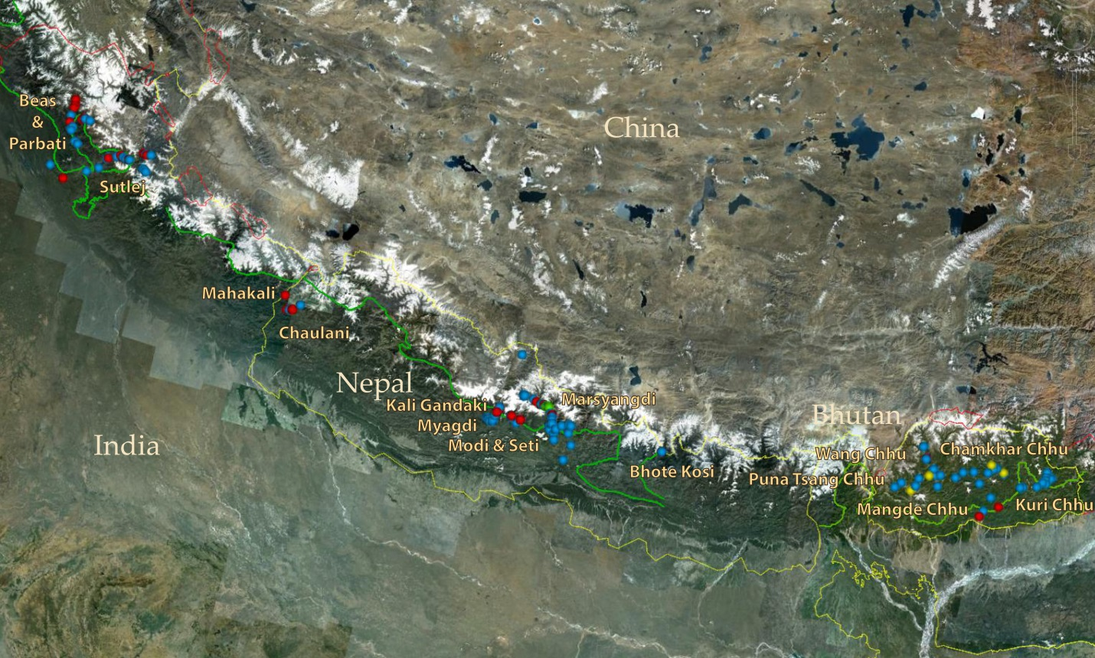
Hundreds of hot springs along Himalayan front, “MCT zone” (Oldham, J Geol Soc India 1883)
Important for stream chemistry, heat f flow and CO2 flux (Evans 04, 08; Perrier 09; Derry 10)

Slide 4
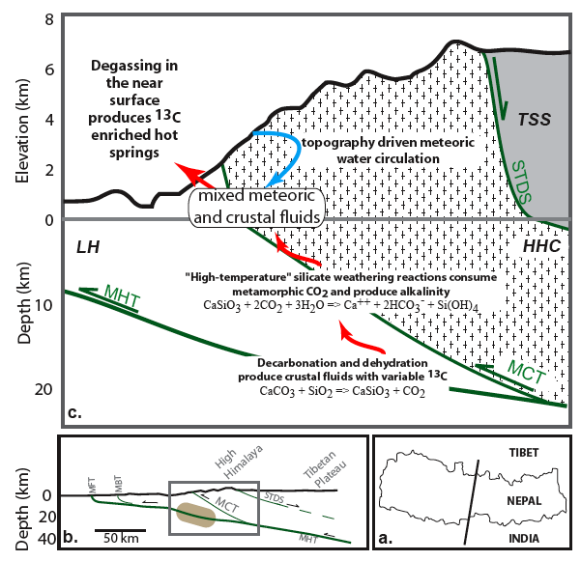
Exhumation
≈ 5 mm/yr

Slide 5
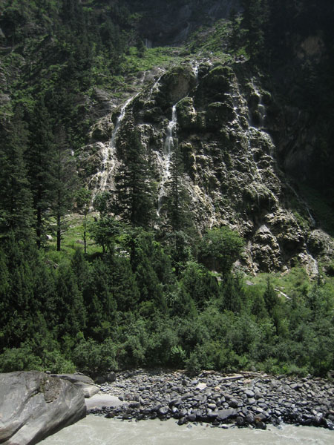
Travertine
CaCO₃
Steaming travertine spring
Sutlej River, NW India
Photo by Rasmus Thiede

Slide 6
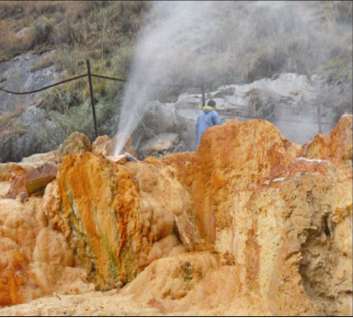
Tapoban geothermal field, NW India
travertine (“solid CO₂”), CO₂ and water
S.K. Rai et al., 2014

Slide 7
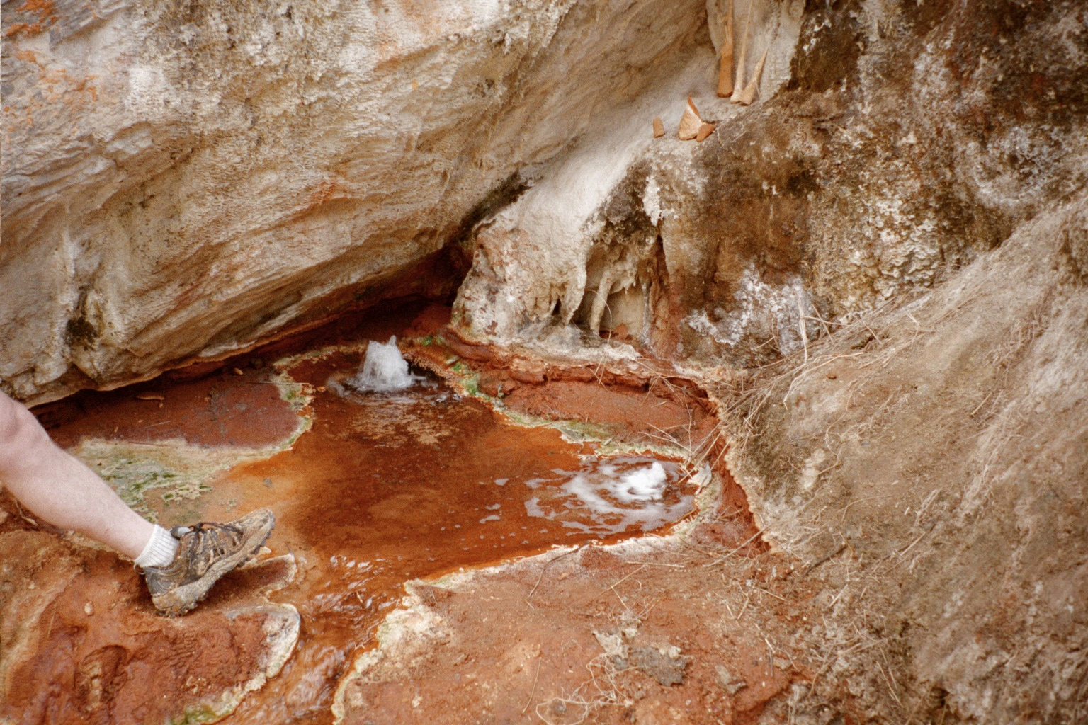
3) CO₂ sources and fluxes
(Aggrandisement de zone d’AOC du Champagne)
Champagne bubbler, Marsyandi
pCO₂ > 1 bar, T = 55˚C
Notes:
Bubbler photo

Slide 8
Bengal Fan - Himalaya cross section
Erosion of C_{org} poor rocks
Deposition of C_{org} “rich” sediments
Net result is large increase in mass of stored C_{org} over last 20 Ma or so

Slide 9
Preliminary Himalayan C budget
Silicate-carbonate cycle net source
Organic carbon subcycle net sink
Sinks
Sources
Silicate weathering
decarbonation
C_{org} burial

Slide 10
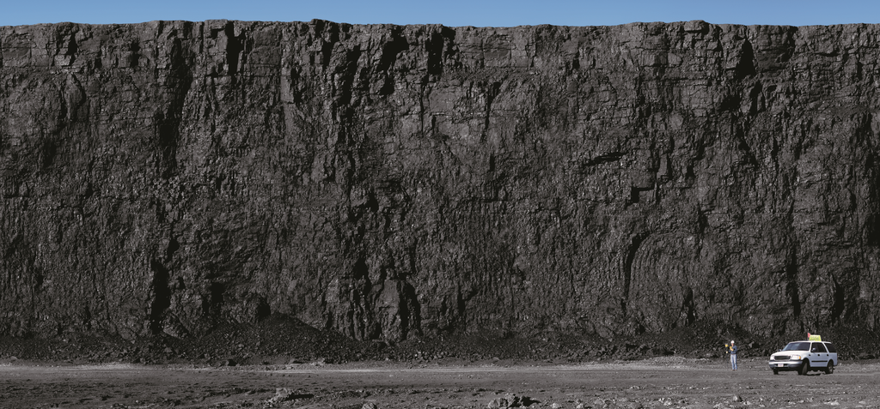
Organic carbon cycle and coupling to mantle
Synthesis and evolution of C_{org}
Behavior of C_{org} during erosion/weathering
Isotope mass balances
Alteration of oceanic crust (OC)
Can we come up with a self consistent view?

Slide 11
Hydrogen escape
Outline of a global redox balance
Degassing via volcanism, metamorphism
Oxidation of CC:
Fe²⁺, S⁻
Oxidation of C_{red}, S_{red}
via weathering
Photosynthesis and burial of C_{org}
Oxidation of basin gas CH₄
Alteration of OC:
Fe²⁺, S²⁻ (includes serpentinization)
Subduction of C_{red}
Estimate redox sinks via oxidation of reduced Fe and S in the oceanic crust (OC) and continental crust (CC).
Trace evolution of organic matter (C_{red}) from photosynthesis to burial, and through maturation/metamorphism.
Model C cycle fluxes and redox balance “embracing uncertainty”
Fig. modified from S. Petsch

Slide 12
Processes that result in oxidation of the ocean-atmosphere
Hydrogen escape - ∆O₂ ≈ 0.01 Tmol yr⁻¹ (Catling et al, 2001)
Not currently important, but significant for early Earth.
Photosynthesis and burial of C_{reduced} in sediments
CO₂ + H₂O ➔ CH₂O + O₂
Subduction return of C_{reduced} to mantle.
C_{reduced} added to the oceanic crust and returned to the mantle via subducted removes reducing potential from the surface environment, and results in net oxidation (in much the same way as H escape oxidizes the atmosphere).

Slide 13
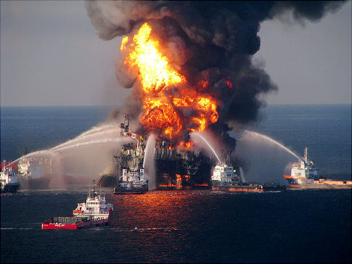
Processes that result in reduction of the ocean-atmosphere
Oxidation of Fe_{red} and S_{red} in oceanic and continental crust. Large Fe_{red} reservoir sets the redox budget for the OC.
2. Oxidative weathering of (meta)sedimentary organic carbon, i.e. “kerogen”.
Oxidation of sedimentary basin methane (“basin gas”). Methane is strongly reduced but oxidation kinetics are rapid, so this can be an important term.

Slide 14
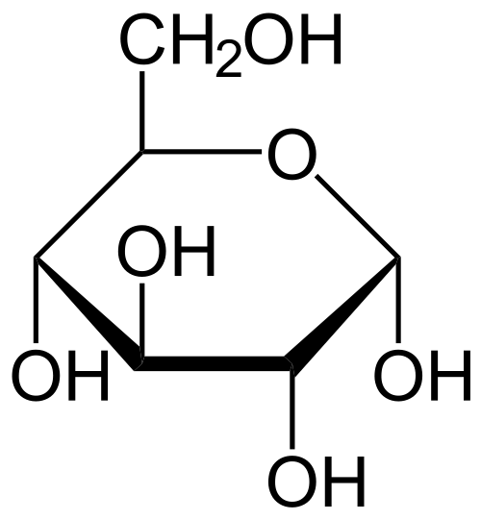
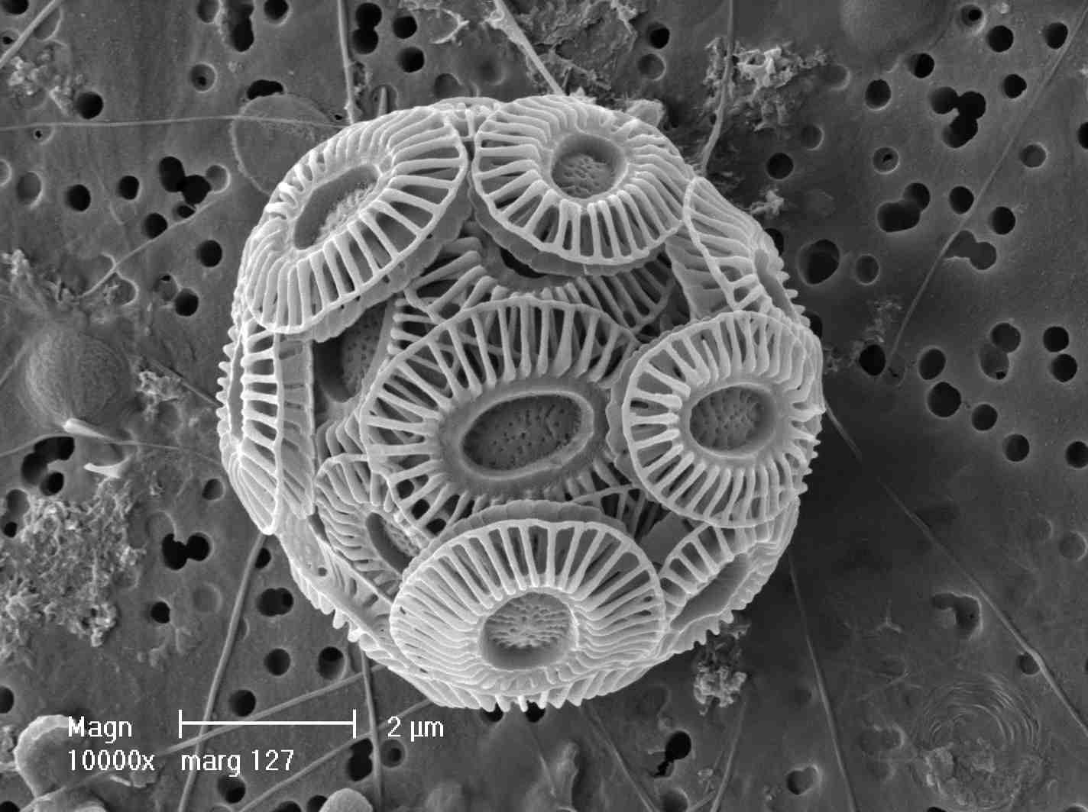
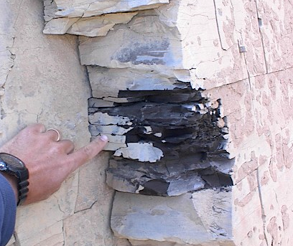
How does composition of OM vary from?:
primary photosythate (hexose sugars)
Coccolithophorid alga
to biomass
to sedimentary organic carbon
(kerogens, bitumens, etc)
Cenomanian black shale (10-15% TOC)
Petroleum source rock

Slide 15
Basic photosynthesis reaction
where some small fraction of the product reduced C can be buried, generating sedimentary C_{org}
And we usually shorthand it as a fully reversible reaction
But of course neither biomass nor sedimentary C_{org} look or behave like this …

Slide 17
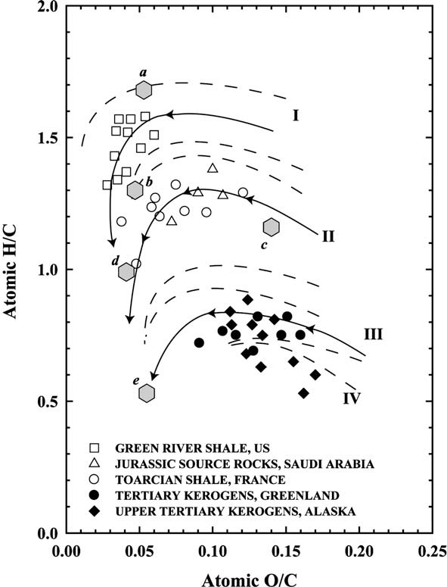
after Hunt 1996, Helgeson et al. 2010
H/C_{photo} = 2, O/C_{photo} = 1
Diagenesis proceeds in a similar direction, so that kerogen compositions are poor in O and H relative to marine OM.
O/C_{kerogen} < 0.2
H/C_{kerogen} ≤ 1.5
Oxidation of kerogens requires more O₂ than produced by its synthesis.
The result is kerogens that are more reduced and more refractory than fresh organic matter – harder to oxidize.

Slide 18
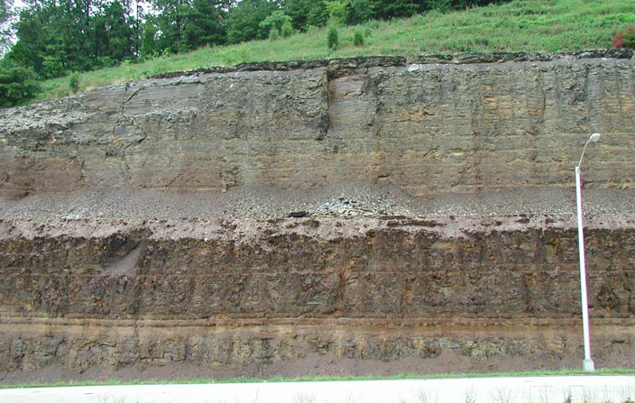
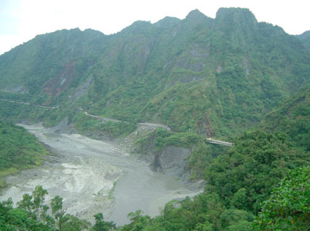
New Albany shale - Devonian
photo by J. Scheiber
Increasing evidence for recycling of sedimentary kerogen ,
i.e. incomplete oxidation during erosion
Erosion of metasediments, Taiwan
photo by C Stark

Slide 19

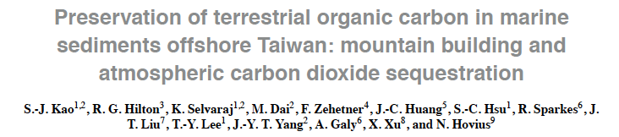
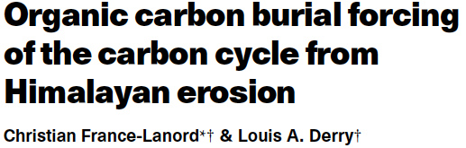
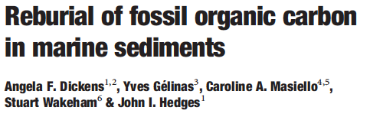
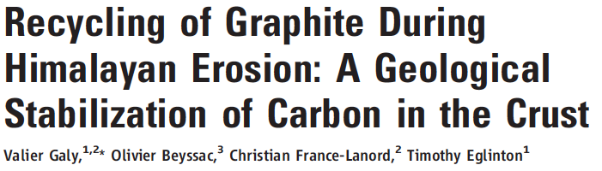
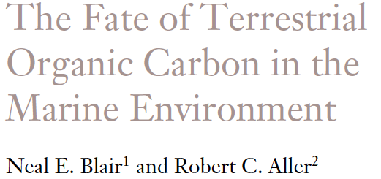
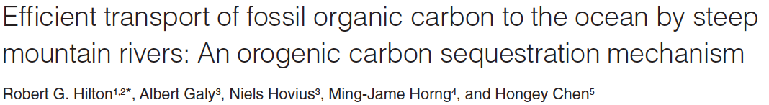

Slide 20
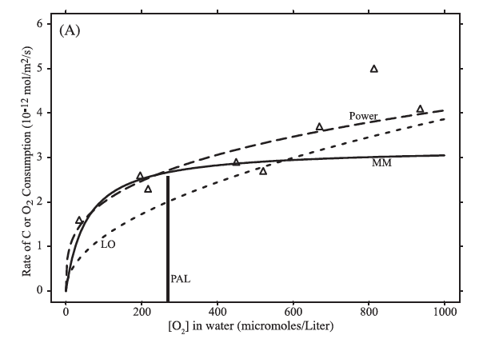
Oxidation experiments on coal (Chang & Berner 1999, Bolton et al 2006)
Strong sensitivity at low pO₂; surface saturation at high pO₂.

Slide 21
At sedimentary basin temperatures hydrocarbons can reduce water to produce methane and carbon dioxide (e.g. Seewald, 2003)
schematically: alkanes + H₂O + heat -> CH₄ + CO₂
Helgeson et al 2010 modeled “hydrolytic disproportionation” :
as thermodynamically favorable in the presence of water. CO₂ is largely consumed by mineral buffering reactions leading to gas with high CH₄/CO₂ ratios.
Recent estimates of this flux of “basin gas” or thermogenic CH₄ are large
J_{CH4} ≈ 2.6 – 4 Tmol yr⁻¹ Etiope et al., 2008
CH₄ oxidation is fast, complete,: CH₄ + 2O₂ = CO₂ + 2H₂O
  • oxidation of CH₄ is an efficient sink for O₂

Slide 22
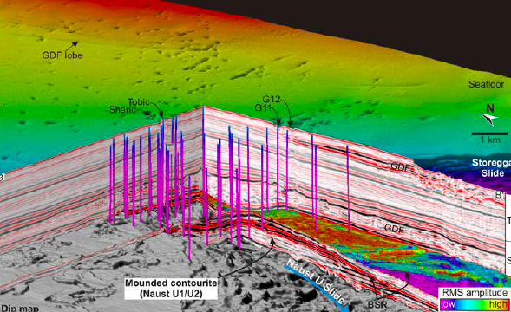
CH₄ escapes to surface or near-surface:
ex: Nyegga pockmark field, North Sea (Hustoft et al., 2009 G3)
Hundreds of CH₄ vent structures formed between 19 ka and 8.1 ka.
Gas expulsion is response to rapid loading by sedimentation and sea level.

Slide 23
Carbon isotope mass balance – the standard story
δ¹³C
δ_{in}
f_{org}

Slide 24
δ_{in} is for all inputs to the oceans
where J_{i} are the fluxes
δ_{in} = - 5.5‰ only if weathering is the exact reverse of sedimentation, i.e. no bias. This is unlikely for at least two reasons. But let’s ignore that for now …

Slide 25
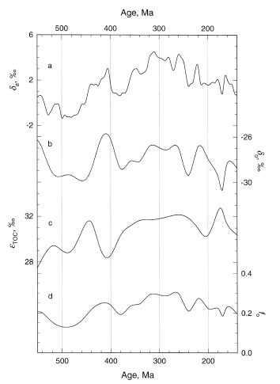
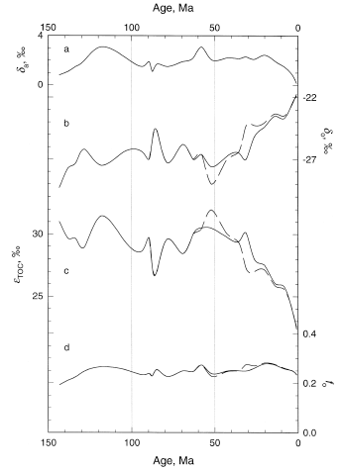
δ_{carb}
δ_{carb}
δ_{org}
δ_{org}
ε_{TOC}
ε_{TOC}
f_{org} = 0.25 ± 0.05
coal
Hayes et al. 1999

Slide 26
Isotopes say:
But what do crustal carbon inventories say? Holser (1988), Wedpohl (1995), Gao (1998) and Hartmann (2012) find, for upper crust and sediments:
f_{org} = 0.10 to 0.17 the difference is uncertain but likely real. Hmmm …
how can this discrepancy be resolved?
Two ideas so far
  δ_{in} > -5.5 because of preferential preservation of C_{org} (low δ¹³C)
  Basin gas (methane) is a significant flux – isotopically light, -40 to -50‰
δ¹³C:
-5.5‰
+2‰
-30‰
-45‰

Slide 27
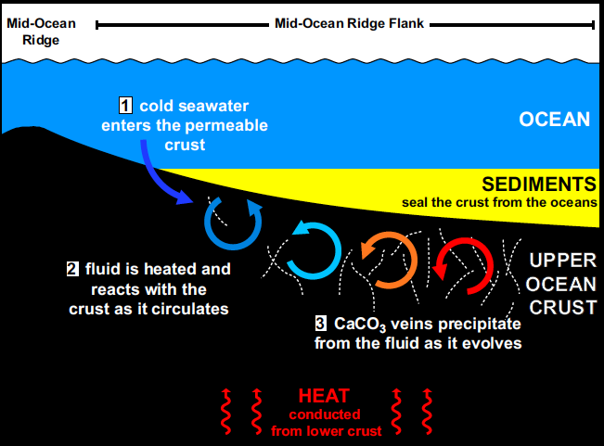
Alteration of oceanic crust is a redox sink
SO₄⁼ = 28 mM
O₂ = 0.25 mM
OC: 9 wt % Fe
0.1 wt % S
Modified from Coggan and Teagle 2011

Slide 28
α and β are stoichiometric coeffs for O2 equivalent reaction
(Fe3+/∑Fe)_{init} = 0.16
(Fe3+/∑Fe)_{alt} = 0.41
∆Fe3+/∑Fe = 0.25, 8 wt% Fe in OC
also S_{mantle} oxidation
∆S_{ox}/∑S = 0.34, 0.1 wt% S in OC
Total redox flux ≈ 3 Tmol yr⁻¹ O₂ equivalent (a lot!)
This depends on to what depth the OC is oxidatively altered. But oxidant consumption is nearly complete, implying that it’s the W/R that controls the amount of alteration, and therefore the depth and temperature dependent permeability κ(z, T) is a key parameter.

Slide 29
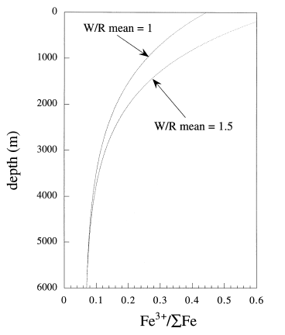
O₂ demand of OC alteration can range from ≈ 1 to 5 Tmol yr⁻¹ O₂ equiv depending on extent of reaction.
Compare to O₂ generation rate from δ¹³C and river fluxes:
Some significant fraction of O₂ produced by C_{org} burial is “taxed” by OC alteration.
Lecuyer & Ricard 1999

Slide 30
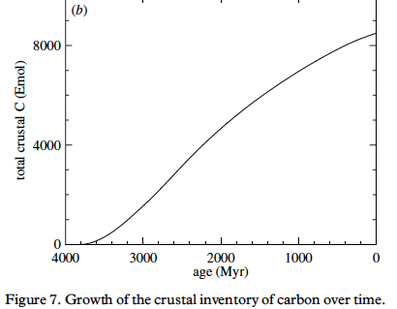
Consequence of mantle redox sink: must always add reduced C to crust (or subduct it).
Otherwise atm O₂ is lost on 10⁷ year time scale …
current inventory
Growth curve scaled by heat flow model
Hayes & Waldbauer 2006

Slide 31
Given that most of these terms have significant uncertainties, and vary in time, how can we construct a plausible set of mass balances?
Global constraints:
  Isotopic steady state:
  Redox steady state:

Slide 32
3. Define best estimates and plausible ranges for input variables.
These include fluxes (J_{i}), carbon isotopic compositions (δ_{i}), and λ_{ker}.
Goal is to explore the possible range of solution space, so we choose a set of uniform distributions with pdf:
Isotopic and redox balances are calculated in a Monte Carlo sense, and solutions that are inconsistent with the global constraints are discarded. Typically, ~600 viable solutions emerge from 50,000 trials (1%).

Slide 33
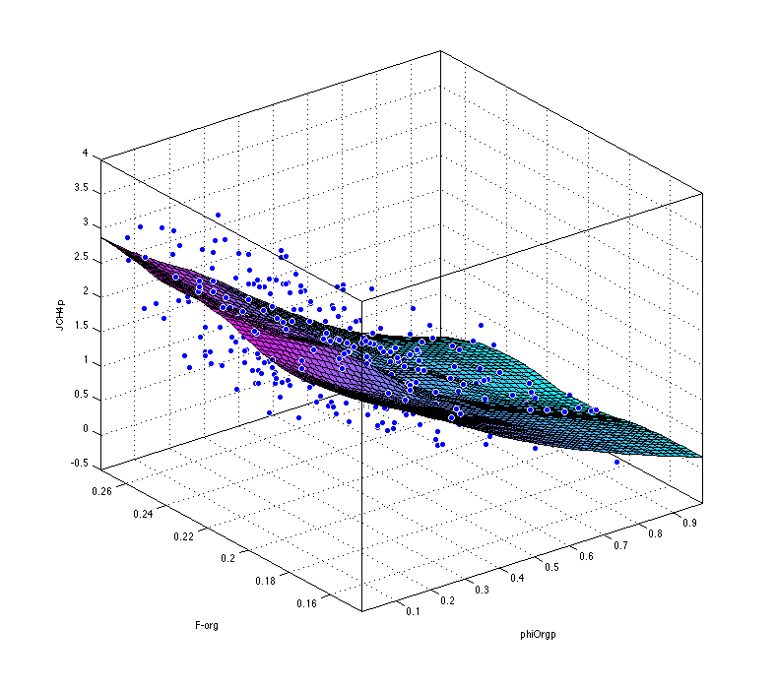
Simulation results
J_{CH4}
basin gas flux, Tmol yr⁻¹
f_{org}
C_{org} burial fraction
Φ_{org}
(weathering efficiency)

Slide 34
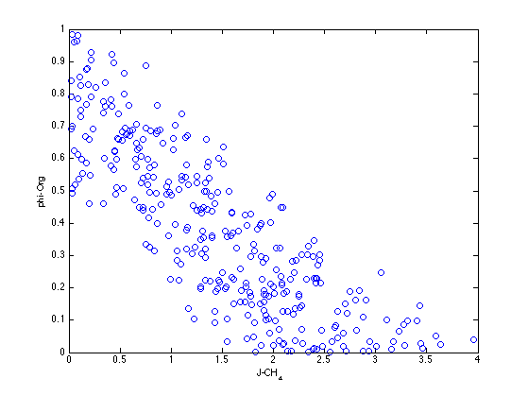
CH₄ fluxes only compatible with low weathering efficiency for sedimentary C_{org}
J_{CH4} ≈ 2.6 – 4 Tmol yr⁻¹
Etiope et al., 2008
Φ_{org}
(weathering efficiency)
J_{CH4} – basin gas flux, Tmol yr⁻¹

Slide 35
C_{org} evolves with biosynthesis, diagenesis and burial toward lower H/C and O/C and becomes less reactive.
Sedimentary C_{org} is incompletely oxidized even today (high O₂) . At low O₂ kerogen would have been recycled yet more efficiently.
Traditional isotope mass balance needs rethinking. Implies inefficient C_{org} oxidation and/or large CH₄ flux to close balance.
Oxidative weathering of sedimentary C_{org} (‘kerogen”) and of Fe²⁺ in the oceanic crust are the major redox sinks, and provides feedback on pO₂.
Oxidation of oceanic crust is
a) dependent on pO₂ – should have been low in Precambrian
b) represents major tax on O₂ production
c) requires that C_{org} reservoir grows and/or is subducted over time

Slide 36
A few more details
One way to approach this is to set up the full set of mass and isotope balance equations. This involves about 20 terms, not all of which are fully independent. Then for convenience I express the oxidation/reduction in terms of “O₂ equivalents” via the appropriate stoichiometry. I assign uncertainties by gazing at the data – sometimes we understand the uncertainty structure pretty well, in other cases it’s a best guess. The I impose two steady state constraints and run many Monte Carlo trials of all possible combinations. Most fail, and the subset that work form arrays in N dimensional space. 3D is about all I can see. I’m working on understanding the covariance structure better, and on how to project results. See a few details below.

Slide 37
1. Steady state assumption for masses and isotopes:
2. Inputs to ocean-atmosphere
3. Outputs to sediments and altered oceanic crust
{
A fraction of carbon in OC is returned to mantle (f^{sub})

Slide 38
4. Redox balance (assume steady state as a starting point)
where λ_{i} are the oxidation (reduction) coefficients for each sink (or source).
For example,
CH₄ oxidation
Photosynthesis and burial
Fe oxidation
Sulfide oxidation
H escape

