Slide 1
A set of different elements that behave coherently and a whole zoo of isotopes
Not useful
for Earth
history

Slide 2
Some definitions
Primordial (or non-radiogenic) noble gases (³He, ²²Ne, ³⁶Ar, ¹³⁰Xe): isotopes not produced on Earth through radioactive decay
Radiogenic noble gases: produced from radioactive decay (⁴He, ⁴⁰Ar, ¹³⁶Xe) or through nuclear reactions (²¹Ne)
Report noble gas isotopes ratios as radiogenic/primordial

Slide 3
A set of different elements that behave coherently and a whole zoo of isotopes
He → ³He and ⁴He
⁴He produced by radioactive decay of U and Th
Ne → ²⁰Ne, ²¹Ne, ²²Ne
²¹Ne is manufactured in abundance by nucleogenic reactions in the mantle: ¹⁸O(α, n)²¹Ne and ²⁴Mg(n, α)²¹Ne
Ar → ³⁶Ar, ³⁸Ar, ⁴⁰Ar
⁴⁰Ar produced by radioactive decay of ⁴⁰K
Kr → 78, 80, 82, 83, 84, 86
Xe → 124, 126, 128, 129, 130, 131, 132, 134, 136
131-136 produced by now extinct ²⁴⁴Pu and fission of U
129 produced by decay of now extinct ¹²⁹I

Slide 4
Geochemical Behavior
Solubility in melt
He>Ne>Ar>Kr>Xe
He/Ne ≈2
He/Ar ≈ 10
(Lux 1987; Jambon et al., 1986)
Degassing
He/Ne, He/Ar ratio increases
Partitioning during melting
Incompatible
He: 10⁻⁴-10⁻³; Ne: 10⁻⁴
(Heber et al., 2007; Parman et al., 2005)
Melting will not significantly fractionate He from Ne i.e., melt and original mantle have same He/Ne

Slide 5
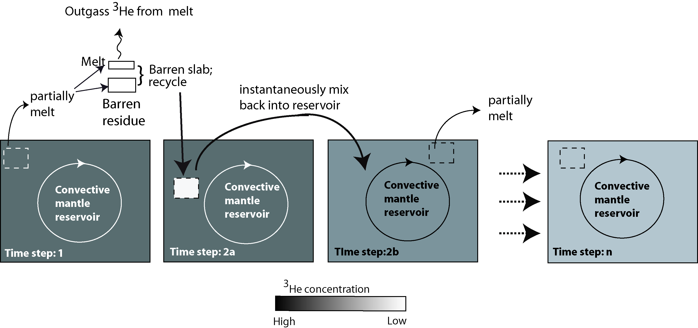
Outgass ³He, ²²Ne from melt
Gonnermann and Mukhopadhyay (2009)

Slide 6
Outgass ³He, ²²Ne from melt
He partition coefficient: 2 10⁻⁴
Ne partition coefficient: 4 10⁻⁴
(Heber et al., 2007)
Does not significantly fractionate
³He from ²²Ne

Slide 7
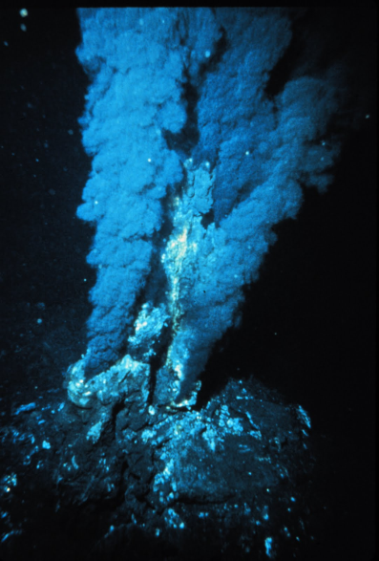
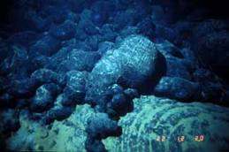
OIBs vs. MORBs
Low ⁴He/³He
Low ⁴⁰Ar/³⁶Ar
Low ¹²⁹Xe/¹³⁰Xe
High ⁴He/³He
High ⁴⁰Ar/³⁶Ar
High¹²⁹Xe/¹³⁰Xe
OIBs
MORBs

Slide 8
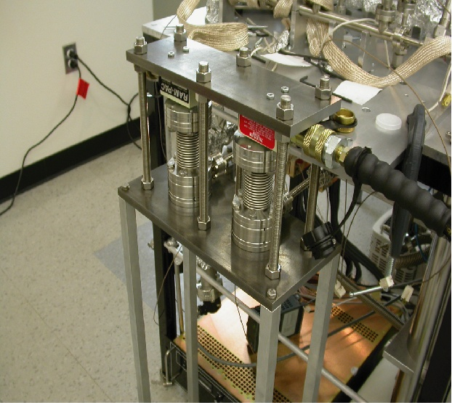

Slide 9
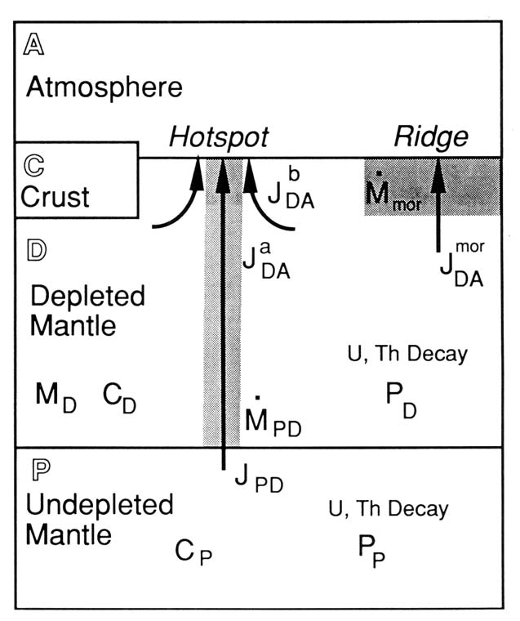
Interpreting mantle noble gases
A steady-state upper mantle
Primordial noble gases
(³He/²²Ne, ³He/³⁶Ar) and
¹²⁹Xe/¹³⁰Xe in the upper mantle
derived from the lower mantle
(e.g., Kellogg and
Wasserburg,1990; Porcelli and
Wasserburg, 1995; O’Nions
and Tolstikhin, 1996; Tolstikhin
and Hofmann, 2005)
Entire lower mantle

Slide 10
Interpreting mantle noble gases
A steady-state upper mantle
Primordial noble gases
(³He/²²Ne, ³He/³⁶Ar) and
¹²⁹Xe/¹³⁰Xe in the upper mantle
derived from the lower mantle
(e.g., Kellogg and
Wasserburg,1990; Porcelli and
Wasserburg, 1995; O’Nions
and Tolstikhin, 1996; Tolstikhin
and Hofmann, 2005)
D” layer at base of
lower mantle

Slide 11
Interpreting mantle noble gases Non-primordial explanations for low ⁴He/³He ratio
Lee et al. Nature 2010

Slide 12
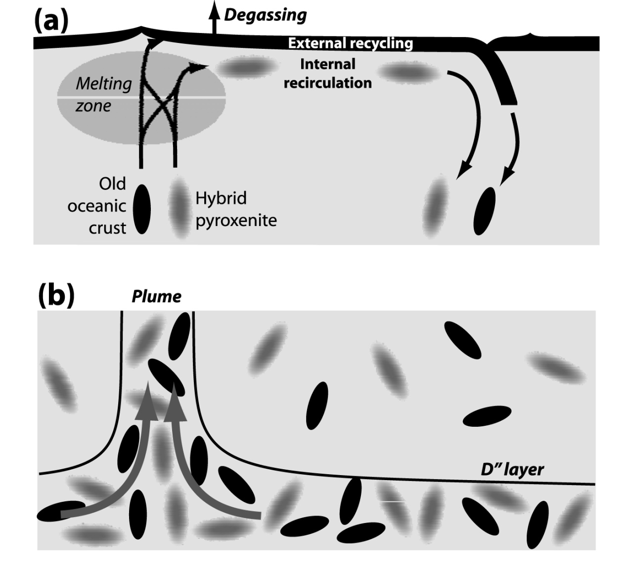
Interpreting noble gases in the mantle Non-primordial explanations for high ³He/⁴He ratio
Davies, 2010

Slide 13
²⁰Ne/²²Ne
⁴⁰Ar/³⁶Ar
³He/²²Ne
³He/³⁶Ar
Mukhopadhyay, 2012
Plumes cannot supply all of the primordial noble gases to the MORB source.

Slide 14
³He/²²Ne ratio in the mantle

Slide 16
How does one explain the ³He/²²Ne of the mantle?

Slide 17
How does one explain the ³He/²²Ne of the mantle?
Honda and Macdougall (1997) suggested magma ocean degassing
to explain the ³He/²²Ne difference
Post magma ocean the whole mantle was not homogenized with respect to its He/Ne ratio

