Slide 1
Inverse Theory
CIDER 2016
Ved Lekic, Univ. of Maryland.
(some slides courtesy of Mark Panning)

Slide 2

Inverse Theory
Happy Birthday Sanne!
CIDER 2016
Ved Lekic, Univ. of Maryland.

Slide 3
What is Inverse Theory?
A combination of approaches for determining and evaluating physical models from observed data
An approach to calculate data from known model must be possible → forward problem
Ingredients:
  Physics (usually) to define forward problem
  Linear algebra (usually) to map between model and data spaces
  Probability and statistics (sometimes) to quantify uncertainty of our physical model determinations

Slide 4


Types of forward problems
Linear
Non-linear
$y\left(x\right)=m_{1}x+m_{2}$
e.g. predict gravity given density of an object at known location
$y\left(x\right)= \sin\left(xm_{1}\right)+m_{1}m_{2}$
e.g. predict seismic waveform given 3D velocity structure of the Earth
y
y
x
x

Slide 5
Typical formulation
Observations are sampled in time and/or space and lumped into a data vector (d)
Physical quantities of interest are expressed as a finite set of parameters that are lumped into a model vector (m)
g
Model (m)
Data (d)
Data vector
Model vector
???

Slide 6
Parameterization
What quantities (parameters) should we consider?
Consider pairs of quantities, such as measurements (y) made at conditions (x)
Measurements (data)
Conditions (independent variable)

Slide 7
Parameterization
Physical model may provide insight into how to parameterize a problem
Sometimes we seek “simplest” model (fewest parameters) that can fit data
Measurements (data)
Conditions (independent variable)

Slide 8
Law of parsimony – a useful heuristic
Preference for “simpler” models is often justified by invoking “Occam’s Razor”.
  e.g. “It is vain to do more with what you can do with less.” – some 13th century monk
Karl Popper argues that simplest models are preferable because they can be more easily falsified
"I remember my friend Johnny von Neumann used to say, with four parameters I can fit an elephant, and with five I can make him wiggle his trunk.“
  -- Enrico Fermi, Nature (2004).
Measurements (data)
Conditions (independent variable)

Slide 9
Under-determined problem
With 1 data point, we cannot uniquely determine slope and y-intercept
Complete trade-off between m₁ and m₂!
Geochemical discovery → Nature paper!
Measurements (data)
Conditions (independent variable)

Slide 10
Even-determined problem
When we have 2 data points, we can uniquely determine m₁ and m₂
Measurements (data)
Conditions (independent variable)

Slide 11
Over-determined problem
With >2 points, the line is not guaranteed to pass through all points.
What do we choose?
What’s the BEST line … objectively speaking?
Measurements (data)
Conditions (independent variable)

Slide 12
The “objective” function
We introduce an objective (a.k.a. cost, misfit) function that is minimum when our line provides the “best” fit
i.e. we minimize ε_{j}
ε₄
ε₃
Measurements (data)
ε₂
ε₁
Conditions (independent variable)

Slide 13


Choices of objective functions
L-1
  Sum of absolute values of residuals
  Tends to ignore outliers
  “LAR”,”LAD”,”LAE”,”LAV”
L-2
  Sum of squared residuals
  Tries to fit outliers
  “Least-squares”
L-∞
  Maximum residual
  Fit is “never terrible” but usually not good, either
  “Minimax”
$$φ\left(m\right)=\sum_{j=1}^{N_{d}}{\left|d_{j}−g_{j}(m)\right|}$$
$$φ\left(m\right)=\sum_{j=1}^{N_{d}}{{\left(d_{j}−g_{j}(m)\right)}^{2}}$$
$$φ\left(m\right)=max\left|d_{j}−g_{j}(m)\right|$$

Slide 14
What about data uncertainty?
If error of one measurement is expected to be larger than that of another, then the line need not pass close to it, nor should the objective function count it as much as more accurate measurements
Measurements (data)
Conditions (independent variable)

Slide 15

What about data uncertainty?
If data error is normally distributed with variance σ_{j}² then the correct objective function is L-2
Each squared residual gets weighted by variance:
Measurements (data)
$$φ\left(m\right)=\sum_{j=1}^{N_{d}}{\frac{{\left(d_{j}−g_{j}(m)\right)}^{2}}{{σ_{j}}^{2}}}$$
Conditions (independent variable)

Slide 16




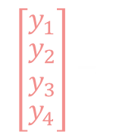


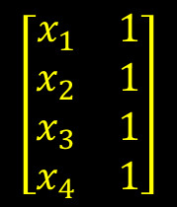

Fitting a line to some points
Linear problem:
$y_{j}=m_{1}x_{j}+m_{2}$
Matrix notation:
$$C_{D}^{−1}d=C_{D}^{−1}Gm$$
$\left[\begin{matrix}\begin{matrix}σ_{1}^{2} & 0 \\ 0 & σ_{2}^{2}\end{matrix} & \begin{matrix}0 & 0 \\ 0 & 0\end{matrix} \\ \begin{matrix}0 & 0 \\ 0 & 0\end{matrix} & \begin{matrix}σ_{3}^{2} & 0 \\ 0 & σ_{4}^{2}\end{matrix}\end{matrix}\right]$
$$\left[\begin{matrix}y_{1} \\ \begin{aligned}\begin{aligned}y_{2} \\ y_{3}\end{aligned} \\ y_{4}\end{aligned}\end{matrix}\right]=$$
$\left[\begin{matrix}\begin{matrix}σ_{1}^{2} & 0 \\ 0 & σ_{2}^{2}\end{matrix} & \begin{matrix}0 & 0 \\ 0 & 0\end{matrix} \\ \begin{matrix}0 & 0 \\ 0 & 0\end{matrix} & \begin{matrix}σ_{3}^{2} & 0 \\ 0 & σ_{4}^{2}\end{matrix}\end{matrix}\right]$
$$\left[\begin{aligned}\begin{matrix}x_{1} & 1 \\ x_{2} & 1\end{matrix} \\ \begin{matrix}x_{3} & 1 \\ x_{4} & 1\end{matrix}\end{aligned}\right]$$
$$\left[\begin{matrix}m_{1} \\ m_{2}\end{matrix}\right]$$
Y - Measurements (data)
$$φ\left(m\right)=\sum_{j=1}^{N_{d}}{\frac{{\left(d_{j}−g_{j}(m)\right)}^{2}}{{σ_{j}}^{2}}}$$
$$φ={{(d−Gm)}^{T}C}_{D}^{−1}(d−Gm)$$
X - Conditions (independent variable)

Slide 17



Fitting a line to some points
Linear problem:
$y_{j}=m_{1}x_{j}+m_{2}$
Matrix notation:
Minimize φ with respect to m
Condition is satisfied when:
“Least squares” estimate of model parameters: m_{est}
$$C_{D}^{−1}d=C_{D}^{−1}Gm$$
$$φ={{(d−Gm)}^{T}C}_{D}^{−1}(d−Gm)$$
$\frac{∂φ}{∂m}$ = 0
Y - Measurements (data)
$$m_{est}={{(G^{T}C}_{D}^{−1}G)}^{−1} {G^{T}C}_{D}^{−1}d$$
$$φ\left(m\right)=\sum_{j=1}^{N_{d}}{\frac{{\left(d_{j}−g_{j}(m)\right)}^{2}}{{σ_{j}}^{2}}}$$
X - Conditions (independent variable)

Slide 18

How confident are we in m_{est}?
We can evaluate the uncertainty of model parameters using the posterior model covariance matrix:${ \tilde{C}}_{M}$
But first, let’s build some intuition…
Which scenario – left or right – will yield a less uncertain estimate of slope?
Measurements
Measurements
Conditions
Conditions

Slide 19
How confident are we in m_{est}?
We can evaluate the uncertainty of model parameters using the posterior model covariance matrix:${ \tilde{C}}_{M}$
But first, let’s build some intuition…
Objective function is more affected by slope variations when data uncertainty is small
→ more accurate data tends to yield more reliable estimates of parameters
BETTER!
Measurements
Measurements
Conditions
Conditions

Slide 20
How confident are we in m_{est}?
We can evaluate the uncertainty of model parameters using the posterior model covariance matrix:${ \tilde{C}}_{M}$
But first, let’s build some intuition…
Which scenario – left or right – will yield a less uncertain estimate of slope?
Measurements
Measurements
Conditions
Conditions

Slide 21
How confident are we in m_{est}?
We can evaluate the uncertainty of model parameters using the posterior model covariance matrix:${ \tilde{C}}_{M}$
But first, let’s build some intuition…
Predictions of widely spaced (in x) points are more sensitive to slope variations
→ estimates of parameters to which you are more sensitive tend to be better!
BETTER!
Measurements
Measurements
Conditions
Conditions

Slide 22


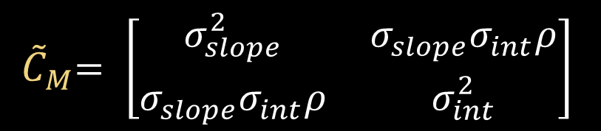

How confident are we in m_{est}?
We can evaluate the uncertainty of model parameters using the posterior model covariance matrix:${ \tilde{C}}_{M}$
Variance of slope estimate
$$m_{est}={{(G^{T}C}_{D}^{−1}G)}^{−1} {G^{T}C}_{D}^{−1}d$$
Correlation between estimates of slope and y-intercept → how much parameters trade-off!
$${ \tilde{C}}_{M}={{(G^{T}C}_{D}^{−1}G)}^{−1}$$
${ \tilde{C}}_{M}= \left[\begin{matrix}σ_{slope}^{2} & σ_{slope}σ_{int}ρ \\ σ_{slope}σ_{int}ρ & σ_{int}^{2}\end{matrix}\right]$
Variance of y-intercept estimate

Slide 23

Limitation of ${\tilde{C}}_{M}$
Posterior model covariance matrix only describes the generalized Gaussian distribution around the optimal model
Variance of slope estimate
$$m_{est}={{(G^{T}C}_{D}^{−1}G)}^{−1} {G^{T}C}_{D}^{−1}d$$
Correlation between estimates of slope and y-intercept → how much parameters trade-off!
$${ \tilde{C}}_{M}={{(G^{T}C}_{D}^{−1}G)}^{−1}$$
${ \tilde{C}}_{M}= \left[\begin{matrix}σ_{slope}^{2} & σ_{slope}σ_{int}ρ \\ σ_{slope}σ_{int}ρ & σ_{int}^{2}\end{matrix}\right]$
Variance of y-intercept estimate

Slide 24
Schematic representation
data
d = Gm
LINEAR PROBLEM
Low
High
Low
Likelihood
m_{est}
model
after Tarantola, 2005

Slide 25

Common complication…
Often, real-world problems are mixed-determined
  Some parameters are well constrained
  Other parameters are poorly or completely un-constrained
Sometimes it happens that $det{(G^{T}C}_{D}^{−1}G)=0$and therefore ${{(G^{T}C}_{D}^{−1}G)}^{−1}$ – a.k.a. G^{-g} – does NOT exist (i.e. there are an insufficient number of linearly independent constraints to determine the unknowns)
What do we do in that case?

Slide 26
…Use explicit regularization
Regularization is the procedure by which we modify our problem to ensure that G^{-g} exists
Our parameterization constitutes “implicit” regularization
  By decreasing the number of parameters we can often ensure G^{-g} exists
  e.g. If we only seek long wavelength variations in seismic wavespeed, then we don’t need as much data to obtain a model
Explicit regularization involves introducing additional equations based on prior knowledge

Slide 27
Two common forms
We may want to find a model close to some reference model
  minimize (m-<m>)^{T}(m-<m>) in addition to minimizing (d - Gm)^{T}(d - Gm)
  Norm damping
May want to minimize roughness – size of first or second spatial derivatives of m – of the model:
  Minimize (Dm)^{T}(Dm) in addition to minimizing (d - Gm)^{T}(d - Gm)
  Smoothing

Slide 28
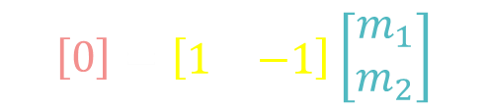


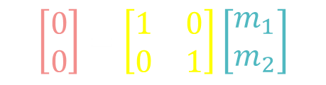

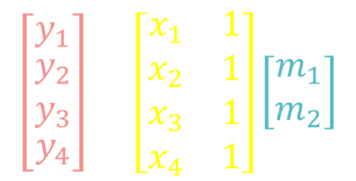
Prior model covariance matrix $C_{M}$
Alternative but conceptually similar form of explicit regularization is by introducing $C_{M}$
$$\left[\begin{matrix}y_{1} \\ \begin{aligned}\begin{aligned}y_{2} \\ y_{3}\end{aligned} \\ y_{4}\end{aligned}\end{matrix}\right]=\left[\begin{aligned}\begin{matrix}x_{1} & 1 \\ x_{2} & 1\end{matrix} \\ \begin{matrix}x_{3} & 1 \\ x_{4} & 1\end{matrix}\end{aligned}\right]\left[\begin{matrix}m_{1} \\ m_{2}\end{matrix}\right]$$
$$d=Gm$$
$$0=Im$$
$$0=Dm$$
$$\left[\begin{matrix}0 \\ 0\end{matrix}\right]=\left[\begin{matrix}1 & 0 \\ 0 & 1\end{matrix}\right]\left[\begin{matrix}m_{1} \\ m_{2}\end{matrix}\right]$$
$$\left[0\right]=\left[\begin{matrix}1 & −1\end{matrix}\right]\left[\begin{matrix}m_{1} \\ m_{2}\end{matrix}\right]$$
$$m_{est}={{(G^{T}C}_{D}^{−1}G+λ_{1}I{+ λ}_{2}D^{T}D)}^{−1} {G^{T}C}_{D}^{−1}d$$

Slide 29
How much to regularize?
More regularization →
  more data misfit
  more smoothness / smaller model
A “sweet spot” can sometimes be determined
“L-curve”
model size or roughness
data misfit (d-Gm)
λ₁,λ₂ (regularization)

Slide 30


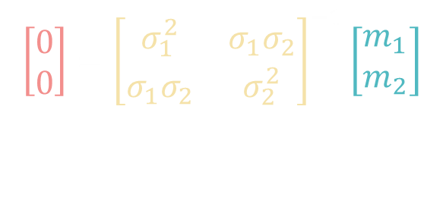

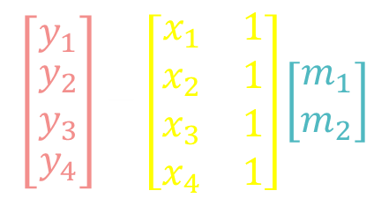
Prior model covariance matrix $C_{M}$
Alternative but conceptually similar form of explicit regularization is by introducing $C_{M}$ (the ignorant cousin of ${ \tilde{C}}_{M}$).
$$\left[\begin{matrix}y_{1} \\ \begin{aligned}\begin{aligned}y_{2} \\ y_{3}\end{aligned} \\ y_{4}\end{aligned}\end{matrix}\right]=\left[\begin{aligned}\begin{matrix}x_{1} & 1 \\ x_{2} & 1\end{matrix} \\ \begin{matrix}x_{3} & 1 \\ x_{4} & 1\end{matrix}\end{aligned}\right]\left[\begin{matrix}m_{1} \\ m_{2}\end{matrix}\right]$$
$$d=Gm$$
$$0=C_{M}^{−1}m$$
$$\left[\begin{matrix}0 \\ 0\end{matrix}\right]={\left[\begin{matrix}σ_{1}^{2} & σ_{1}σ_{2} \\ σ_{1}σ_{2} & σ_{2}^{2}\end{matrix}\right]}^{−1}\left[\begin{matrix}m_{1} \\ m_{2}\end{matrix}\right]$$
$$m_{est}={{(G^{T}C}_{D}^{−1}G+C_{M}^{−1})}^{−1} {G^{T}C}_{D}^{−1}d$$
$${ \tilde{C}}_{M}={{(G^{T}C}_{D}^{−1}G+C_{M}^{−1})}^{−1}$$

Slide 31
Effect of regularization
data
d = Gm
Model estimate obtained after addition of prior constraints (regularization)
m_{est}
Previous model estimate (obtained without regularization)
Prior m constraint
model

Slide 32
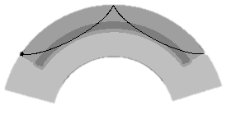
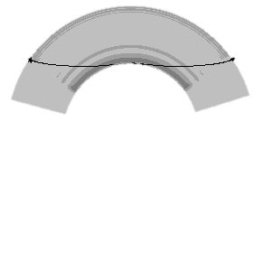
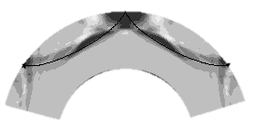
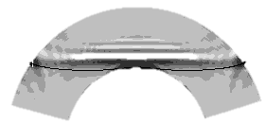
Effect of forward modeling error
Sometimes, we cannot (or choose not to) compute the forward problem g(m) exactly, e.g.:
  Consider only coupling along a normal mode branch (PAVA) not across branches (NACT)
  Use perturbation theory instead of spectral element method
  Use rays computed for 1D Earth in 3D imaging
PAVA
SS
Sdiff
NACT
Li and Romanowicz, 1995

Slide 33

Effect of forward modeling error
Consequences of incorrectly computing g(m) can be significant:
$${ \tilde{C}}_{M}={(G^{T}{\left(C_{D}+C_{T}\right)}^{−1}G)}^{−1}$$
  Equivalent to errors to data thereby increasing model estimate uncertainty
  Can systematically bias the model estimate
Lekic and Romanowicz, 2011

Slide 34
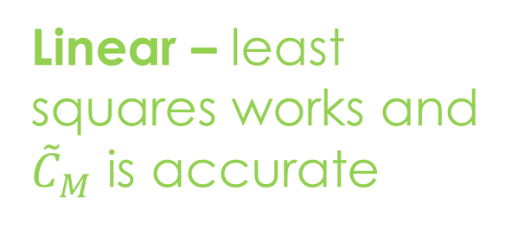
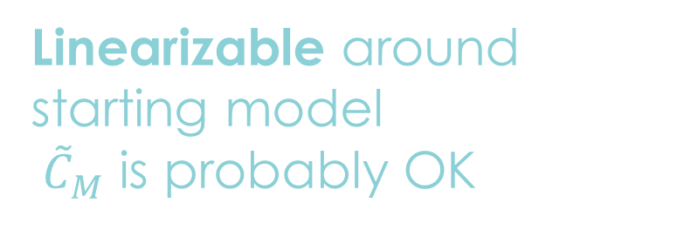
Types of inverse problems
Linear – least squares works and ${\tilde{C}}_{M}$ is accurate
Linearizable around starting model
${ \tilde{C}}_{M}$ is probably OK
Tarantola, 2005

Slide 35

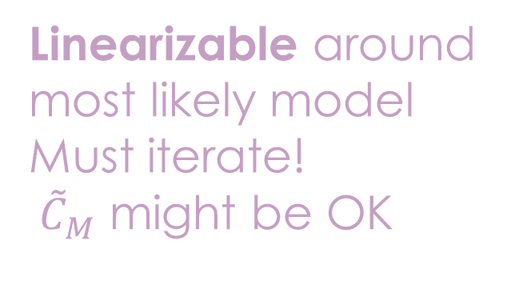
Linearizable around most likely model
Must iterate!
${ \tilde{C}}_{M}$ might be OK
Non-linear → multi-modal posterior on m, ${\tilde{C}}_{M}$ is woefully invalid!
Don’t use least-squares! rjMcMC ☺
Tarantola, 2005

Slide 36

Trumpian / Brexistential
nothing will work! $Good luck!$
Give up and get a drink
Tarantola, 2005

Slide 37
Model space search approaches
When the relationship between data and model – i.e. g(m) – is non-linear, linear approaches can be inadequate, i.e. stuck in local minima and underestimating model error.
Many current approaches focus on exploration of the model space (talk to Chao Gao and Tolu Olugboji)
  Eliminate need for regularization → less biased estimates of model parameters
  Some have flexible parameterization: “transdimensional”
  Some estimate data uncertainty: “hierarchical”
  Yield ensemble of models that can be analyzed to map uncertainty and non-uniqueness

Slide 38
Tomographic Problem
Pull travel-times into data vector d with N entries
neutral
fast
SLOW
FAST
neutral
fast
neutral
neutral
neutral
slow
fastest
slow
slow

Slide 39
How to compute g(m)?
Pull travel-times into data vector d_{j} with N entries
Parameterize into 17x17 grid = 289 boxes
Model vector m_{k} has 289 entries corresponding to slowness (inverse of velocity) in each box
d_{j} = G_{jk}m_{k} where Gjk is the path distance spent by wave j within box k.

Slide 40
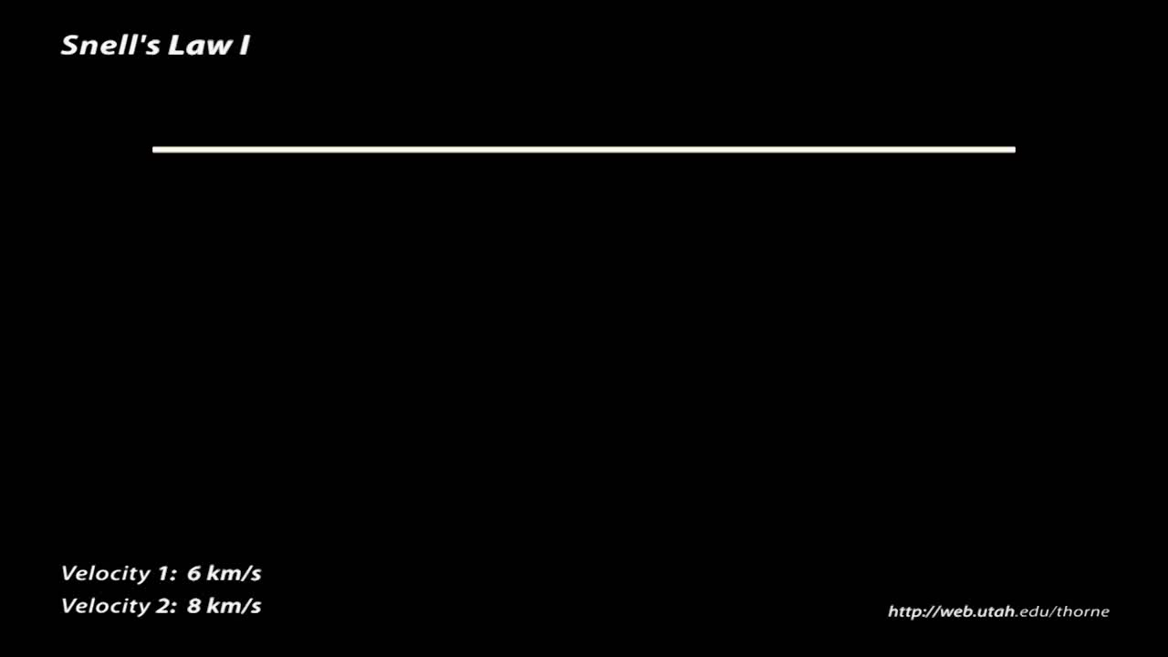
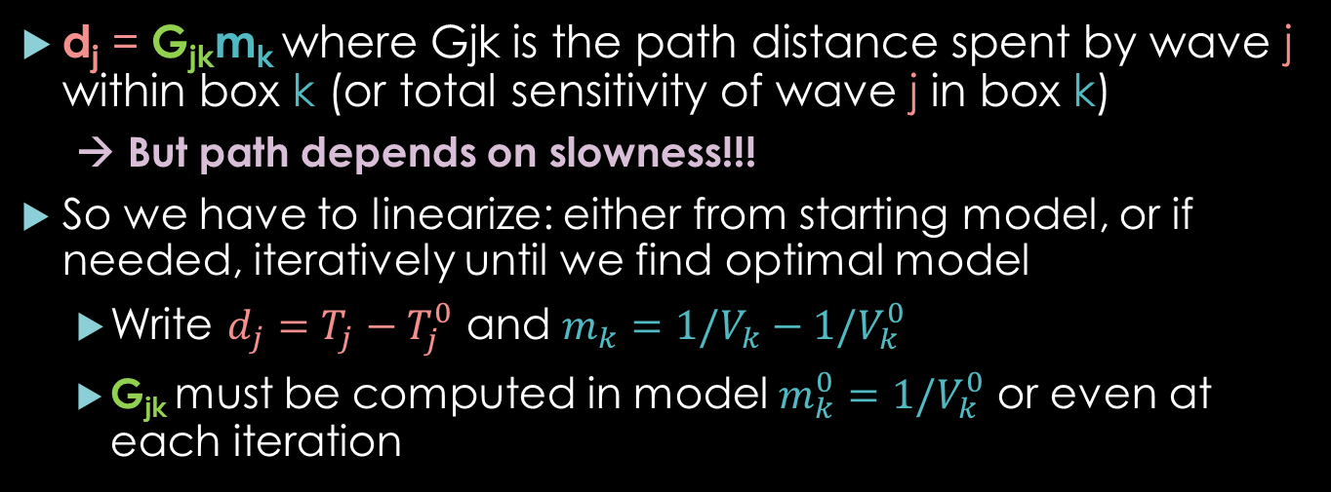
Linearize from starting model
For wavefield to remain continuous along interface between regions with different velocities, waves will change direction in addition to their speed.
d_{j} = G_{jk}m_{k} where Gjk is the path distance spent by wave j within box k (or total sensitivity of wave j in box k)
  → But path depends on slowness!!!
So we have to linearize: either from starting model, or if needed, iteratively until we find optimal model
  Write $d_{j}=T_{j}−T_{j}^{0}$ and $m_{k}={1/V}_{k}−{1/V}_{k}^{0}$
  G_{jk} must be computed in model ${m_{k}^{0}=1/V}_{k}^{0}$ or even at each iteration

Slide 41


Resolution analysis
To solve the mixed-determined tomographic problem, we usually need to introduce prior information (i.e. smoothing, damping,${ C}_{M}$)
We can see how well we would image input structures $m_{test}$ by feeding predicted data d_{test} = Gm_{test} into the inversion:
  $m_{est}={{(G^{T}C}_{D}^{−1}G+C_{M}^{−1})}^{−1}{G^{T}C}_{D}^{−1}Gm_{test}=Rm_{test}$
  R is called the “resolution” operator (or matrix)
$$m ={{(G^{T}C}_{D}^{−1}G+C_{M}^{−1})}^{−1} {G^{T}C}_{D}^{−1}d$$
$${ \tilde{C}}_{M}={{(G^{T}C}_{D}^{−1}G+C_{M}^{−1})}^{−1}$$

Slide 42
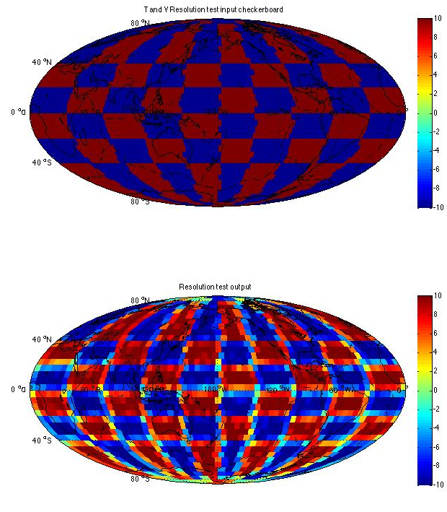
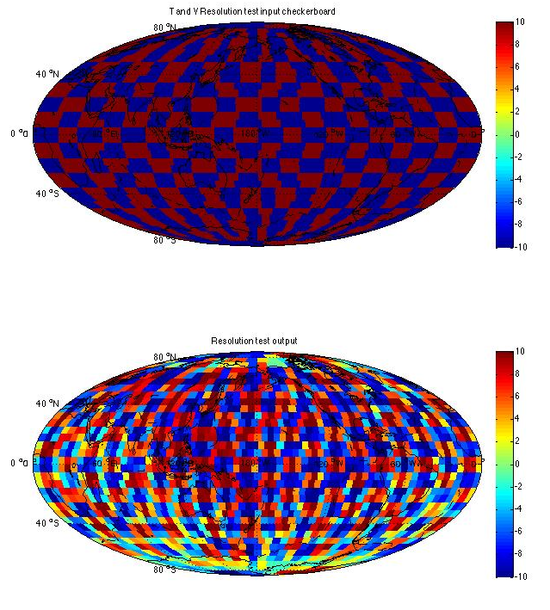
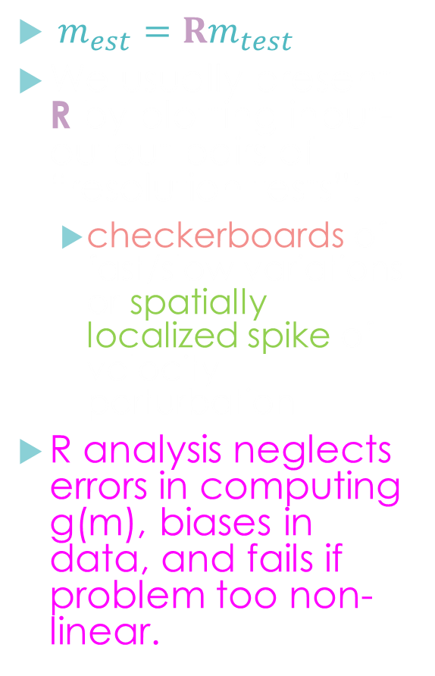
Resolution analysis, continued.
$m_{est}=Rm_{test}$
We usually present R by plotting input-output pairs of “resolution tests”:
  checkerboards of fast/slow variations or spatially localized spike of velocity perturbation
R analysis neglects errors in computing g(m), biases in data, and fails if problem too non-linear.
Above figures from this afternoon’s tutorial!
Ritsema et al. 2004

Slide 43

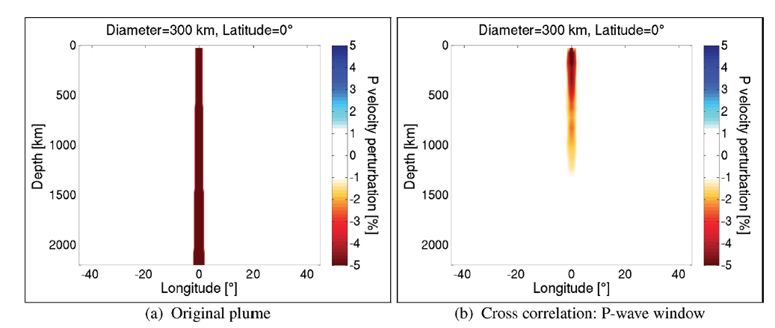
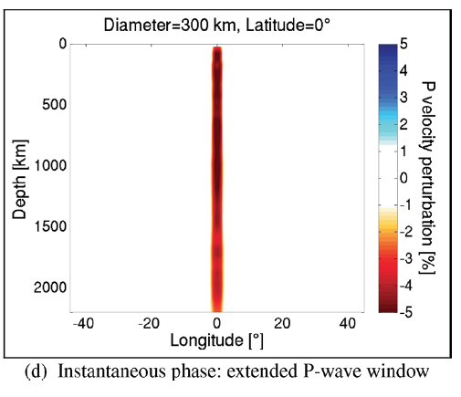
Are all data created equal?
Traditional tomography relies on travel-time (phase velocity) measurements of body (surface) waves
This data is ill-suited – has low sensitivity – for imaging structures that are small, far away, or have weak velocity anomalies (e.g. plume conduits)
Input structure (plume)
Imaged using traveltimes
Imaged using waveforms
Rickers et al. 2012

Slide 44
Null spaces
d=Gm
Data null space
Model null space
M
D
m=G^{T}d
Notes:
Not just googly eyes

Slide 45
The data null space
Linear combinations of data that cannot be predicted by any possible model vector m
  For example, no simple linear theory could predict different values for a repeated measurement, but real repeated measurements will usually differ due to measurement error
If a data null space exists, it is generally impossible to match the data exactly

Slide 46
The model null space
A model null vector is any solution to the homogenous problem
This means we can add in an arbitrary constant times any model null vector and not affect the data misfit
The existence of a model null space implies non-uniqueness of any inverse solution
We can use linear algebra to map out model null space

Slide 47
Quantifying null space with Singular Value Decomposition
SVD breaks down G matrix into a series of vectors weighted by singular values that quantify the sampling of the data and model spaces
  Column vectors of U associated with 0 (or very near-zero) singular values are in the data null space
  Column vectors of V associated with 0 singular values are in the model null space
N x N matrix with columns representing vectors that span the data space
M x M matrix with columns representing vectors that span the model space
If M<N, this is a M x M square diagonal matrix of the singular values of the problem

Slide 48

How to evaluate tomography?
Consider data + modeling uncertainty:
  quality of recordings / processing
  ray theory vs. wave equation solver
Consider how sensitive data is to quantity of interest:
  waveforms contain more information than travel-times
  density is tough compared to velocity
Posterior model covariance matrix ${\tilde{C}}_{M}$ can tell you about trade-offs and uncertainty
  but be mindful of limitations!

Slide 49
Evaluating an inverse model paper
How well does the data sample the region being modeled? How sensitive is it to parameters of interest? Is the data any good to begin with?
Is the problem linear or not? Can it be linearized? Should it?
What kind of theory are they using for the forward problem?
What inverse technique are they using? Does it make sense for the problem?
What’s the model resolution and error? Did they explain both implicit and explicit regularization choices they made and what effect they have on the model?

Slide 50
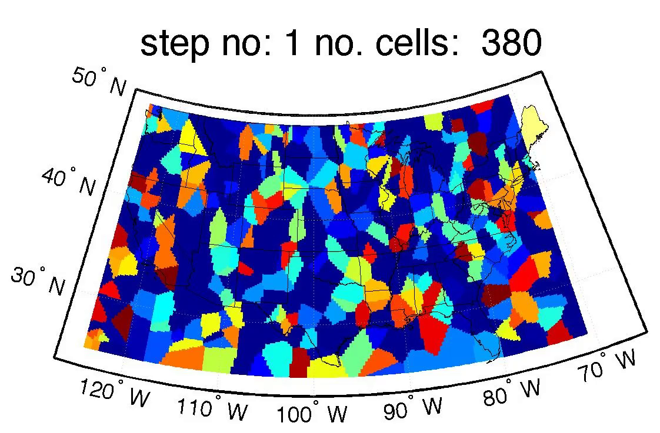
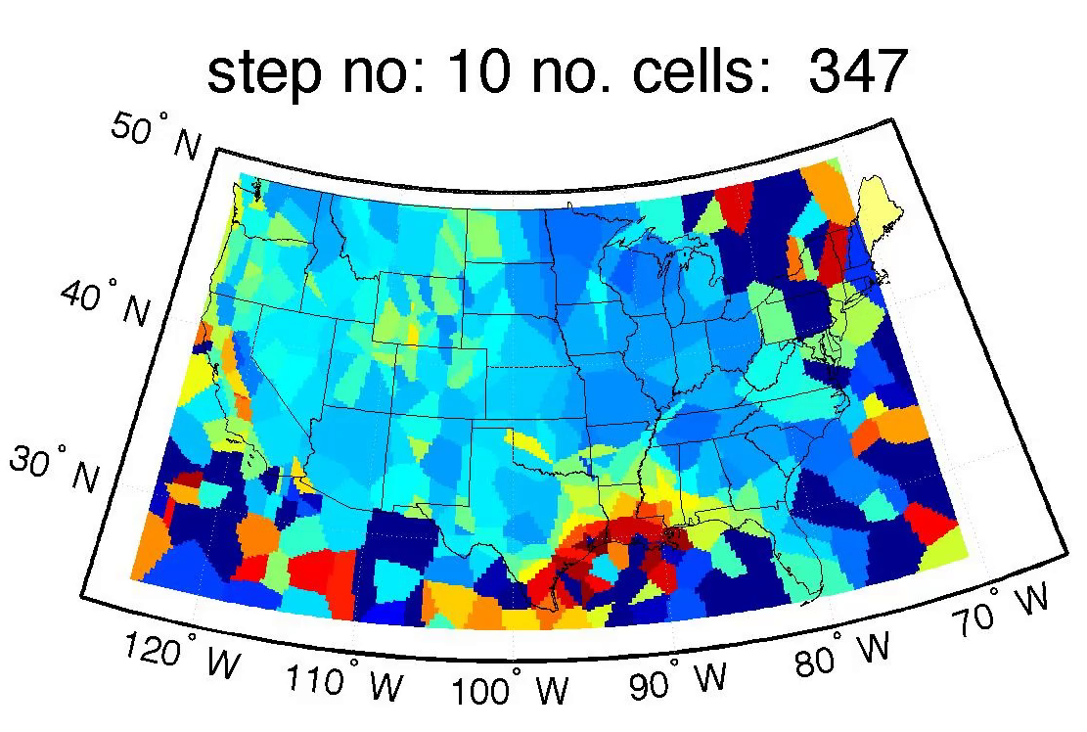
Q&A + Discussion
Any questions?
Any comments?
Any heckles?

