Slide 2
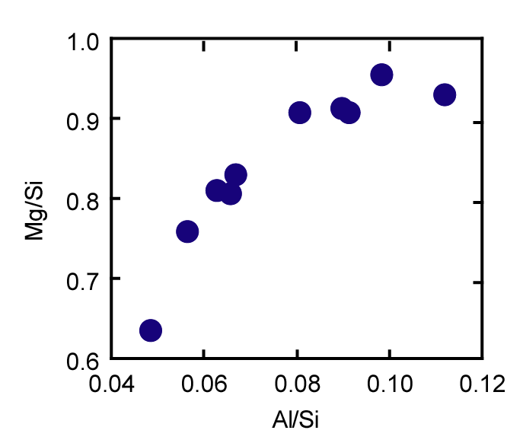
Olivine
McD & Sun
EARTH
Javoy et al ‘10
EARTH
Carbonaceous
chondrites
(kg/kg)
Gradient in olivine/pyroxene
Ordinary chondrites
Enstatite chondrites
Pyroxene
(kg/kg)

Slide 3
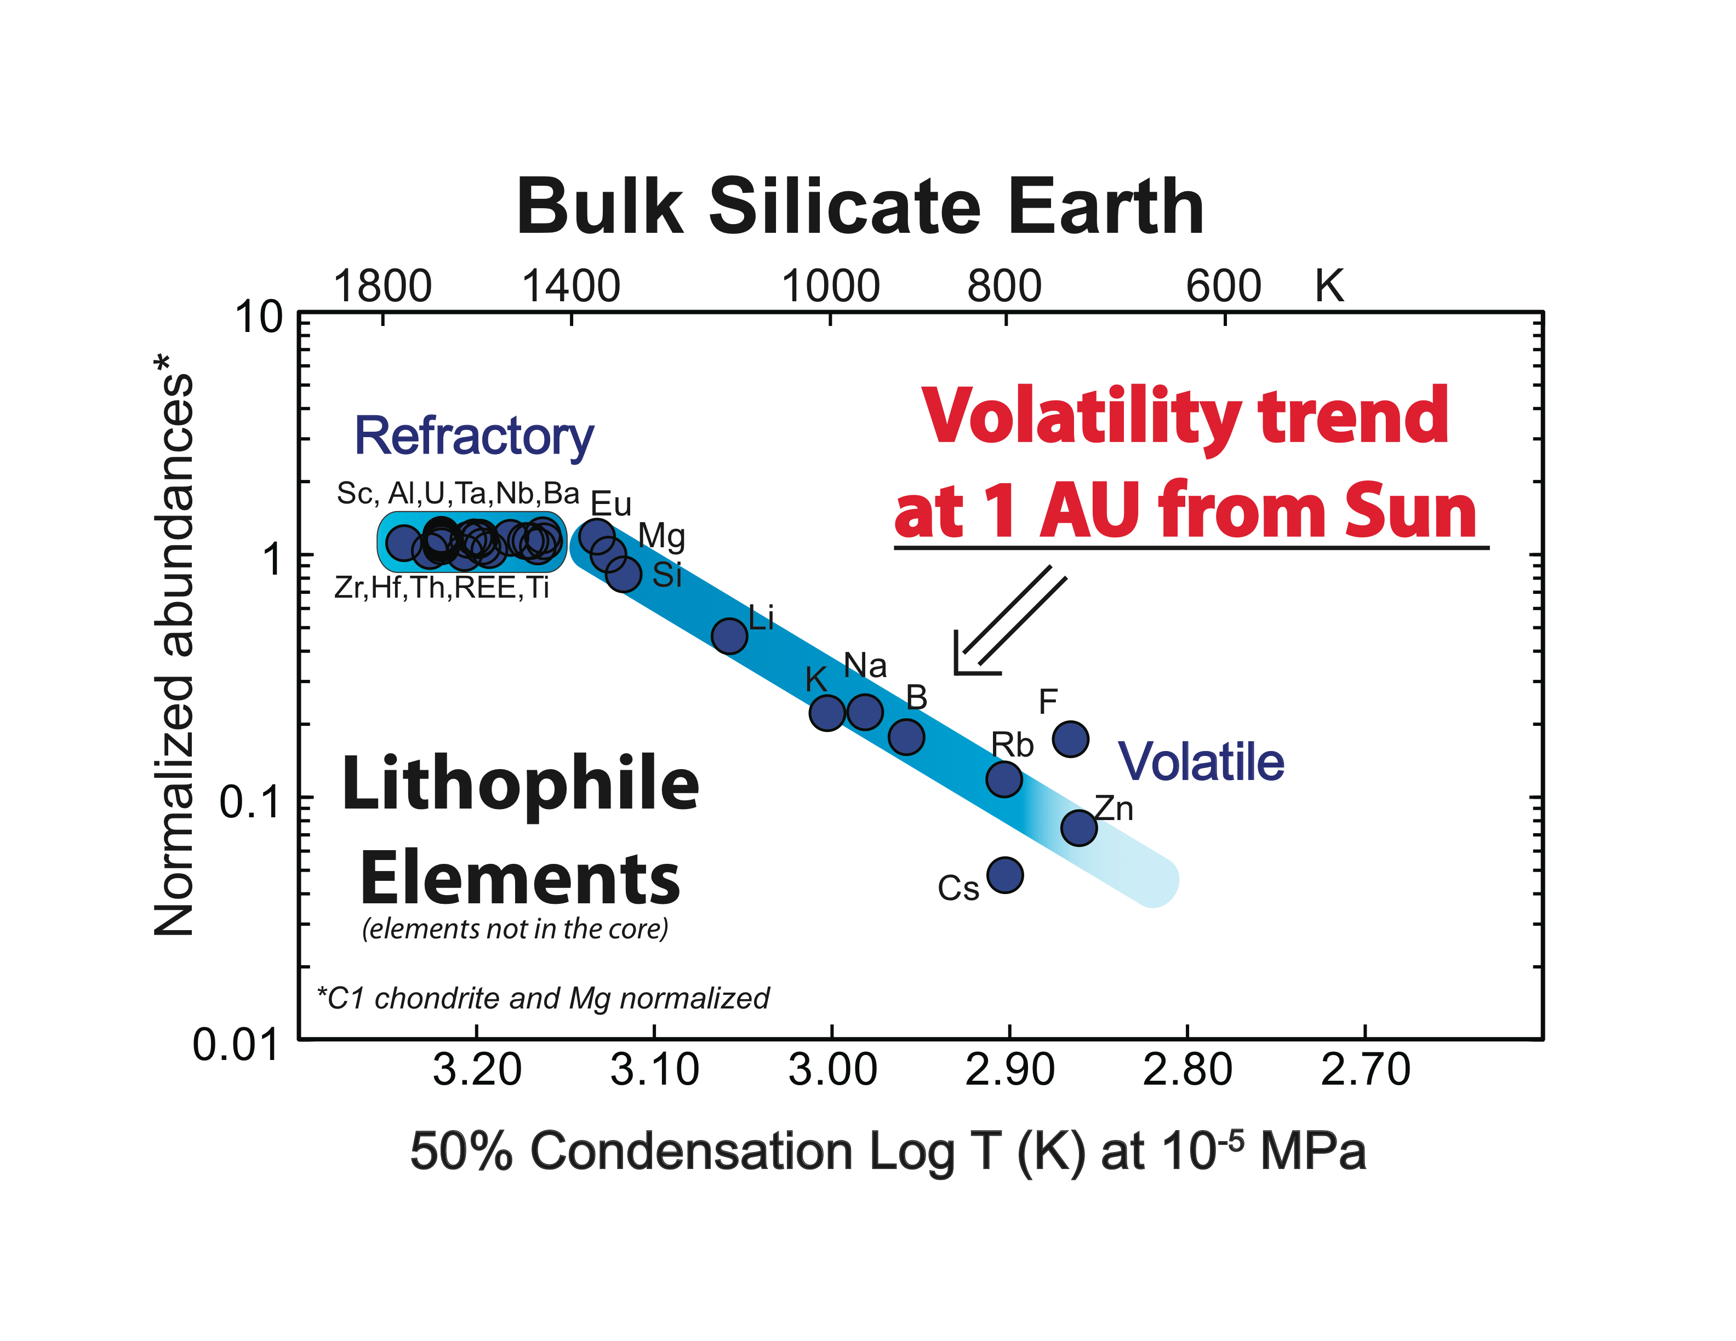
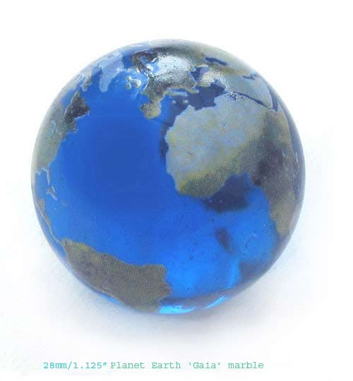
Th & U
K
from McDonough & Sun, 1995

Slide 4
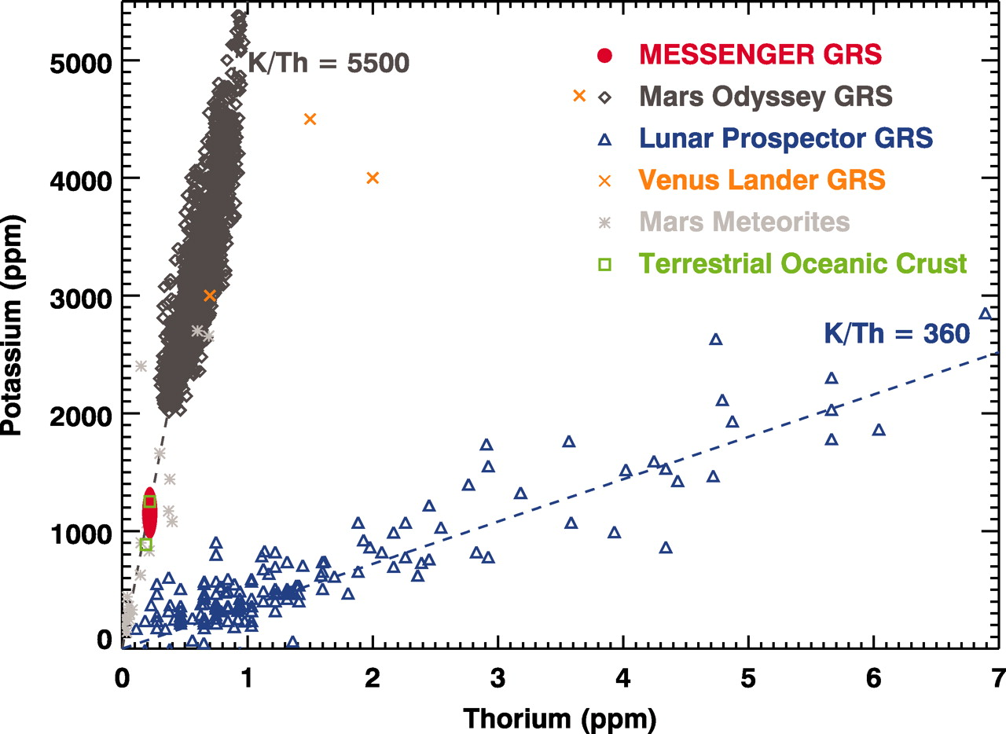
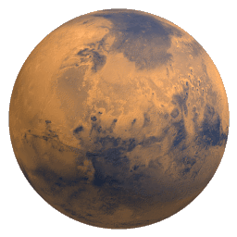
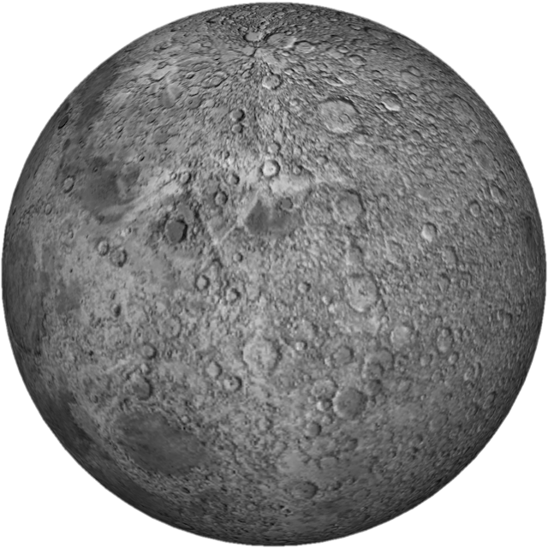
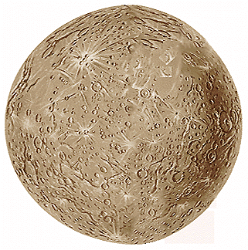
K/U K/Th
Mercury 20,000 5,000
Earth 14,000 3,600
Moon 2,500 500
Mars 19,000 5,000
C1 70,000 18,000
En. Chond 90,000 23,000
Mars
Moon
Mercury
Volatile element
Peplowski et al (Science, 2011)
Refractory element

Slide 5
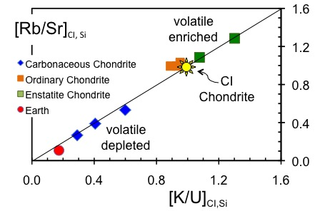
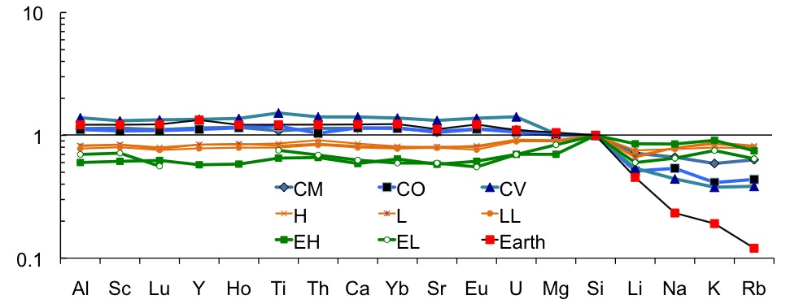
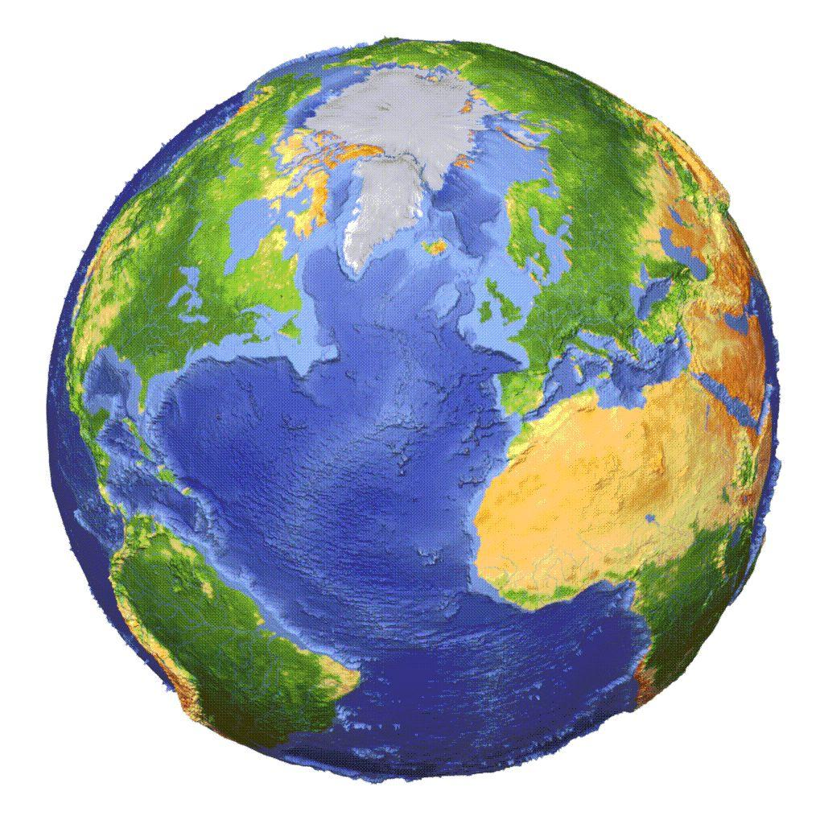
Volatiles
(alkali metals)
in Chondrites
Enstatite Chondrites
enriched in volatile elements
High ⁸⁷Sr/⁸⁶Sr [c.f. Earth]
⁴⁰Ar enriched [c.f. Earth]
CI and Si Normalized

Slide 7
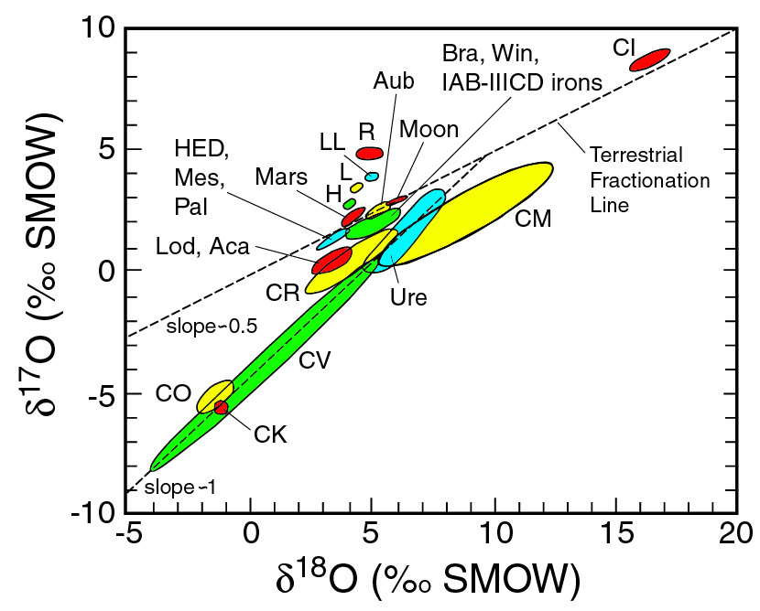
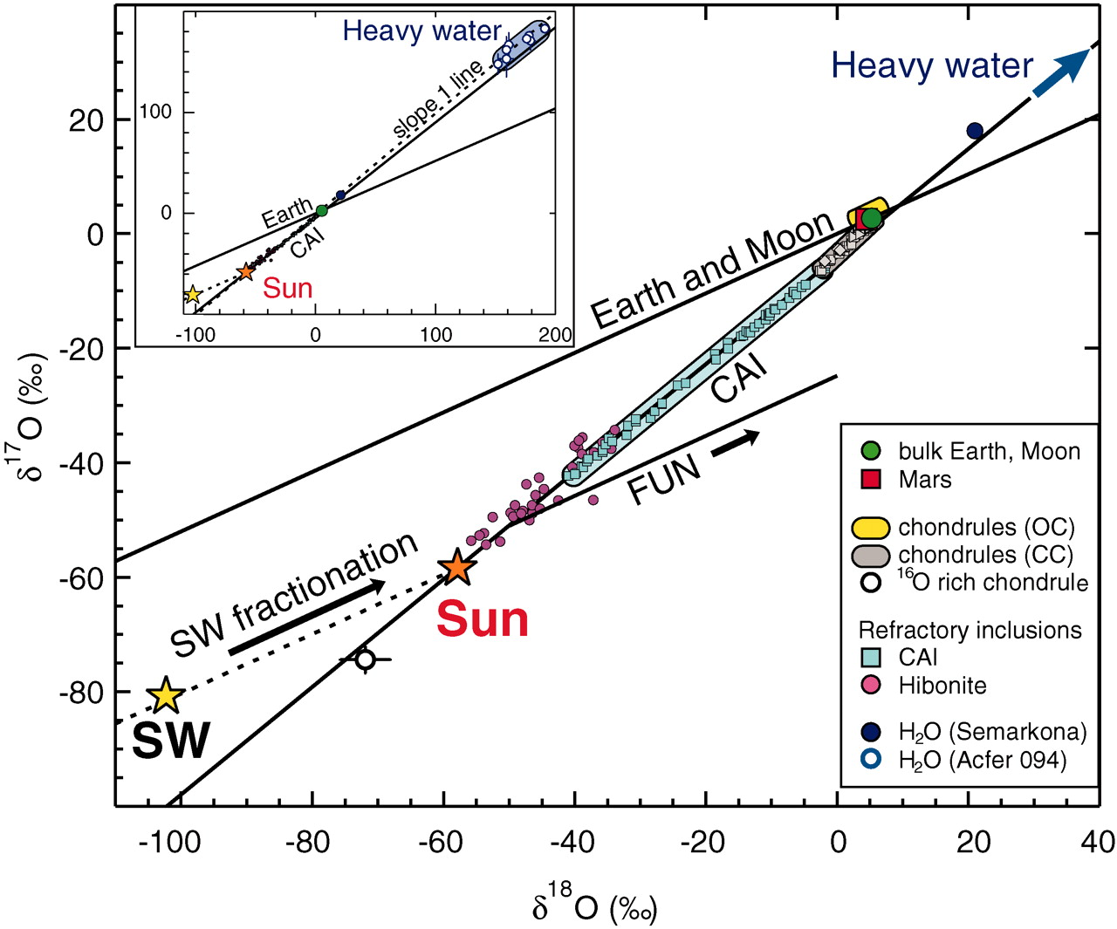
What does Oxygen isotopes tell us?
McKeegan et al. Science 2011

Slide 8
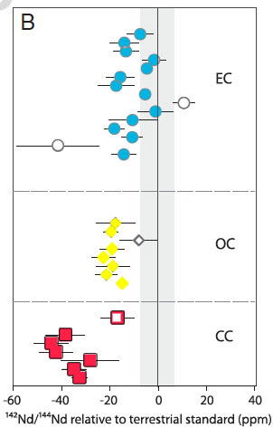
Earth
¹⁴²μ_{Nd}
What does this Nd data mean for the Earth?
Solar S heterogeneous
Chondrites are a guide
Planets ≠ chondrites ?
Enstatite
chondrites
Ordinary
chondrites
Carbonaceous
chondrites
Data from:
Gannoun et al (2011, PNAS)
Carlson et al (Science, 2007)
Andreasen & Sharma (Science, 2006)
Boyet and Carlson (2005, Science)
Jacobsen & Wasserburg (EPSL, 1984)

Slide 9
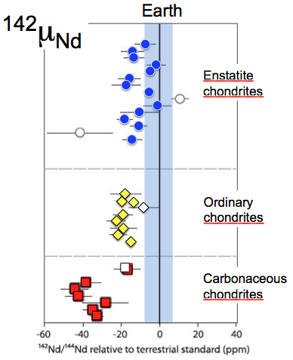
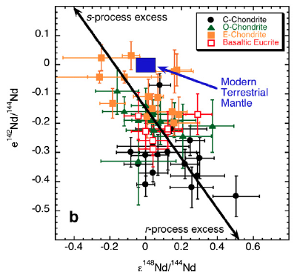
¹⁴²Nd: what does it tell us about the
Earth and chondrites?
Please stop saying that the ε¹⁴²Nd = 18 ± 5 ppm for chondrites
☺
Data from:
Gannoun et al (2011, PNAS); Carlson et al (Science, 2007)
Andreasen & Sharma (Science, 2006); Boyet and Carlson (2005, Science); Jacobsen & Wasserburg (EPSL, 1984); Qin et al (GCA, 2011)

Slide 10
Models for the ¹⁴²Nd observation
2 solutions
There is no problem
The ¹⁴²Nd data record the efficiency of mixing in the nebular (r and s product from the SN)
Assume mantle has a specific ¹⁴²Nd chondritic composition
2 solutions: (store it deep or lose it)
EER: early enriched mantle at the CMB
Boyet and Carlson (2005, EPSL)
Collisional erosion
O’Neill and Palme (2008, PTRSL)

Slide 11
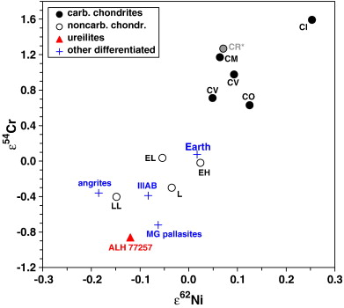
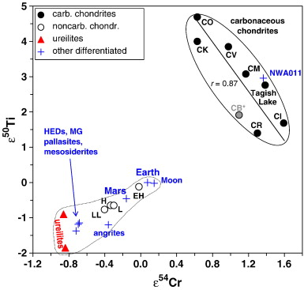
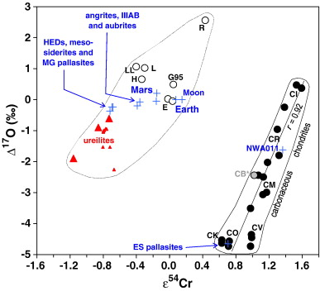
Enstatite chondrite
vs
Earth
Carbonaceous
chondrites
diagrams from Warren (2011, EPSL)
Carbonaceous
chondrites
Carbonaceous
chondrites

Slide 12
Earth is “like” an Enstatite Chondrite!
Mg/Si -- is VERY different
Shared isotopic: O, Ti, Ni, Cr, Ca, Nd,..
Shared origins – unlikely
Core composition -- no K, Th, U in core
“Chondritic Earth” – useful concept
Javoy’s model – needs modifications

Slide 13
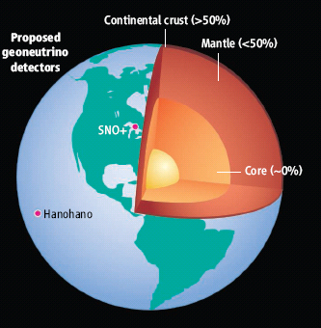
U in the Earth:
~13 ng/g U in the Earth
Metallic sphere (core)
<<<1 ng/g U
Silicate sphere
20* ng/g U
*O’Neill & Palme (2008) 10 ng/g
*Turcotte & Schubert (2002) 31 ng/g
Continental Crust
1300 ng/g U
Mantle
~12 ng/g U
“Differentiation”
Chromatographic separation
Mantle melting & crust formation

Slide 14
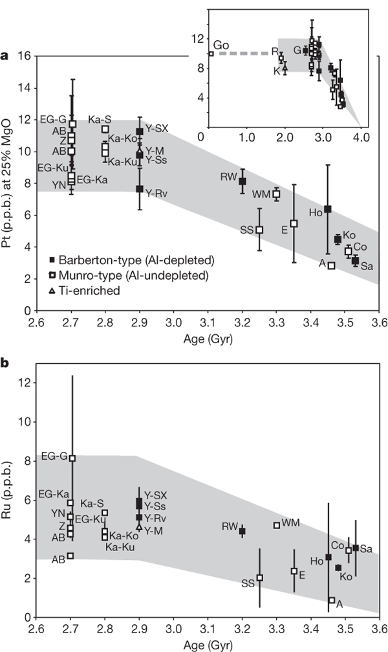
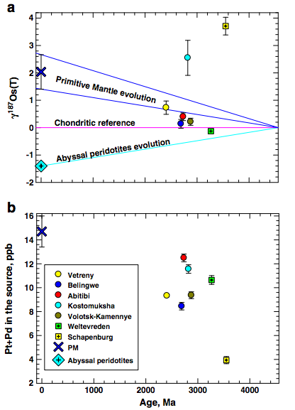
secular evolution of the mantle
Observations from komatiites
Models of Late Accretion
When was the Late Accretion added?
When was it mixed in to the BSE?
Connolly et al (2011, EPSL)
timing & duration of Late Accretion
HSE (PGE) added
after core fm
- before ~ 3 Ga
Maier et al (2009, Nature)
A measure of efficiency of mantle mixing?

Slide 15
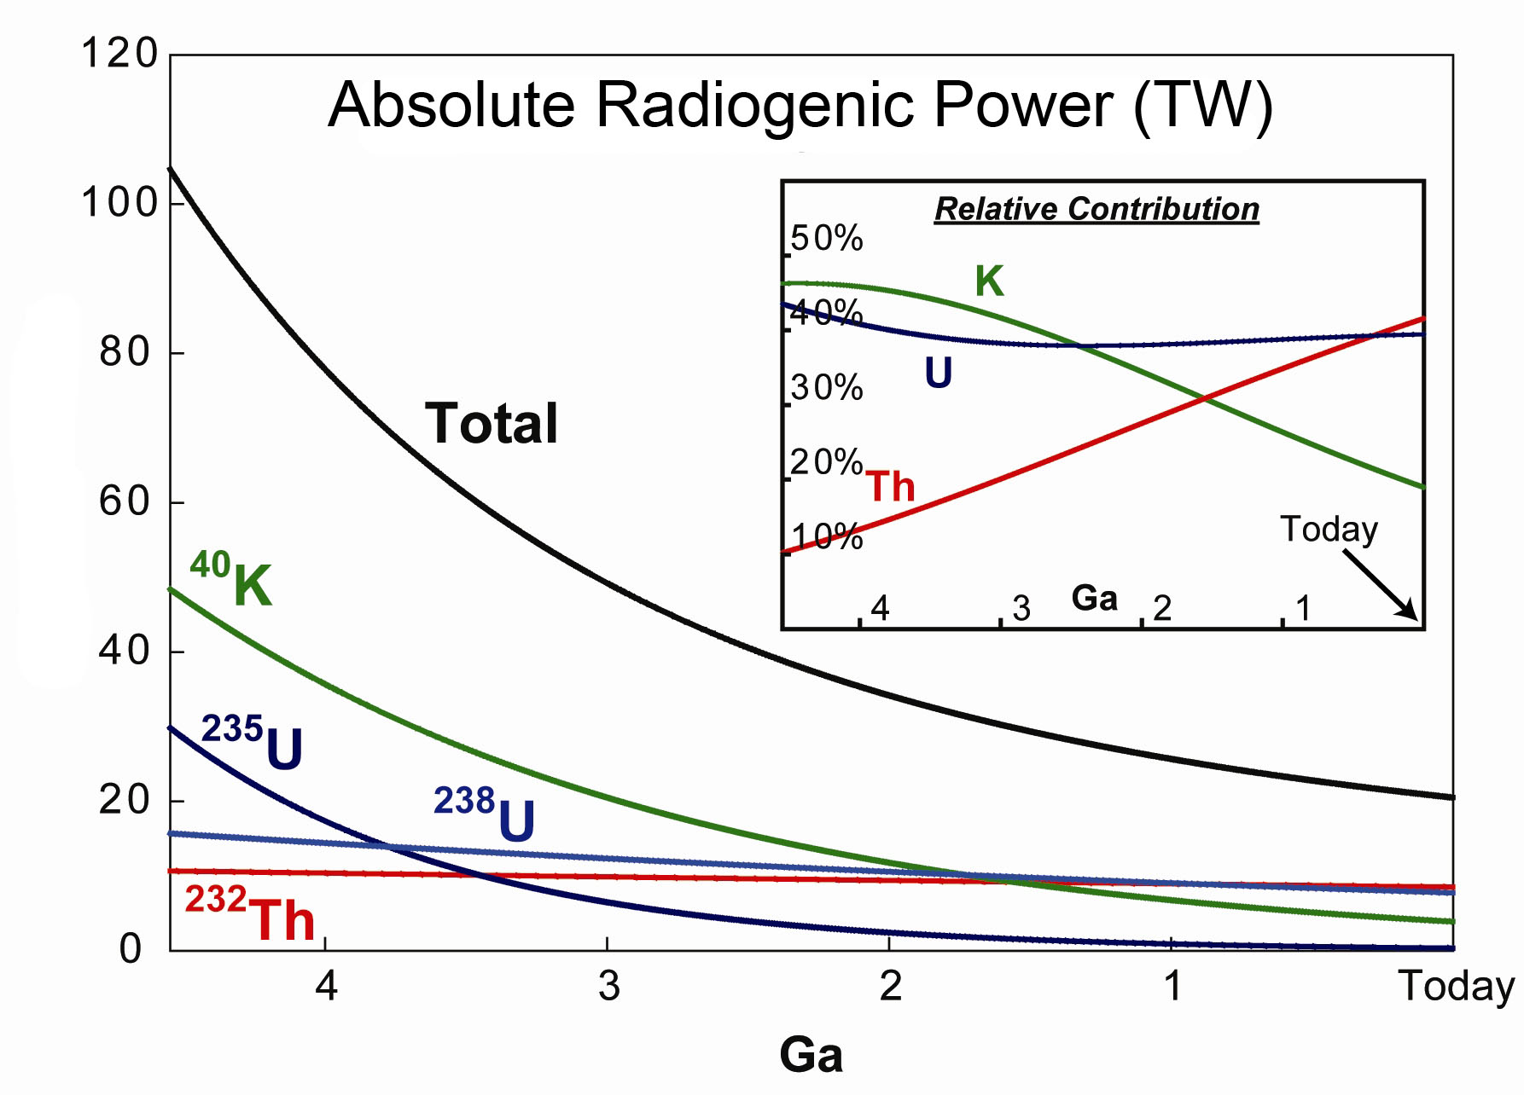
Earth’s thermal evolution: role of K, Th & U
Archean boundary
Power (TW)
Arevalo, McDonough, Luong (2009) EPSL

Slide 16
Earth’s surface heat flow 46 ± 3 (47 ± 1)
± 1σ
Mantle cooling
(18 TW)
Crust R*
(8 ± 1 TW)
Core
(~9 TW)
-
(4-15 TW)
Mantle R*
(12 ± 4 TW)
total R*
20 ± 4
*R radiogenic heat
(0.4 TW) Tidal dissipation
Chemical differentiation
after Jaupart et al 2008 Treatise of Geophysics

Slide 17
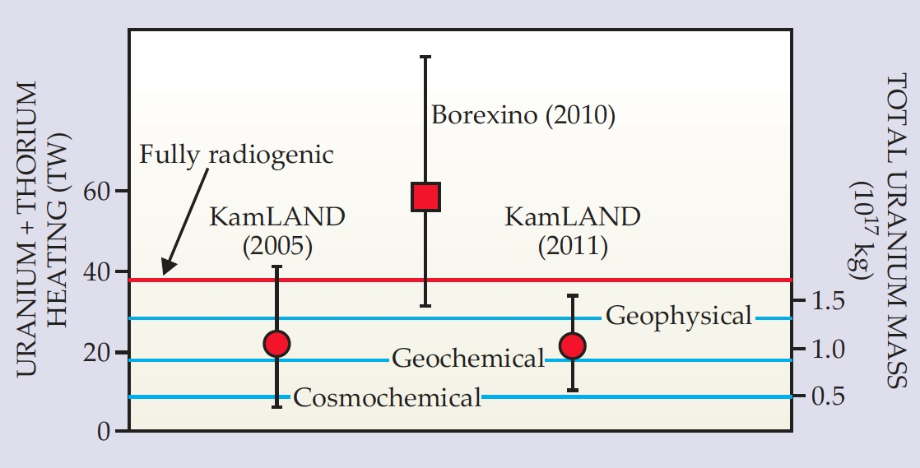
Summary of geoneutrino results
Constrainting U & Th in the Earth
MODELS
Cosmochemical: uses meteorites – Javoy et al (2010); Warren (2011)
Geochemical: uses terrestrial rocks – McD & Sun, Palme & O’Neil, Allegre et al
Geophysical: parameterized convection – Schubert et al; Davies; Turcotte et al; Anderson

Slide 18
Conclusions
The CHONDRITE concept is robust
Chondrites provide a guideline, not a set or rules
The present population of chondrites is LIKELY highly biased
Composition of the Earth is an unknown and big issues are:
- Mg/Si (ratio of olivine to pyroxene)
- BSE:10-30 ppb U, ~ 10 to 30 TW, Cont. Crust 7 to 8 TW
Differences in isotopic and chemical ratios in chondrite groups (i.e., enstatite, carbonaceous, ordinary) reflect nebular mixing phenomena

