Slide 1
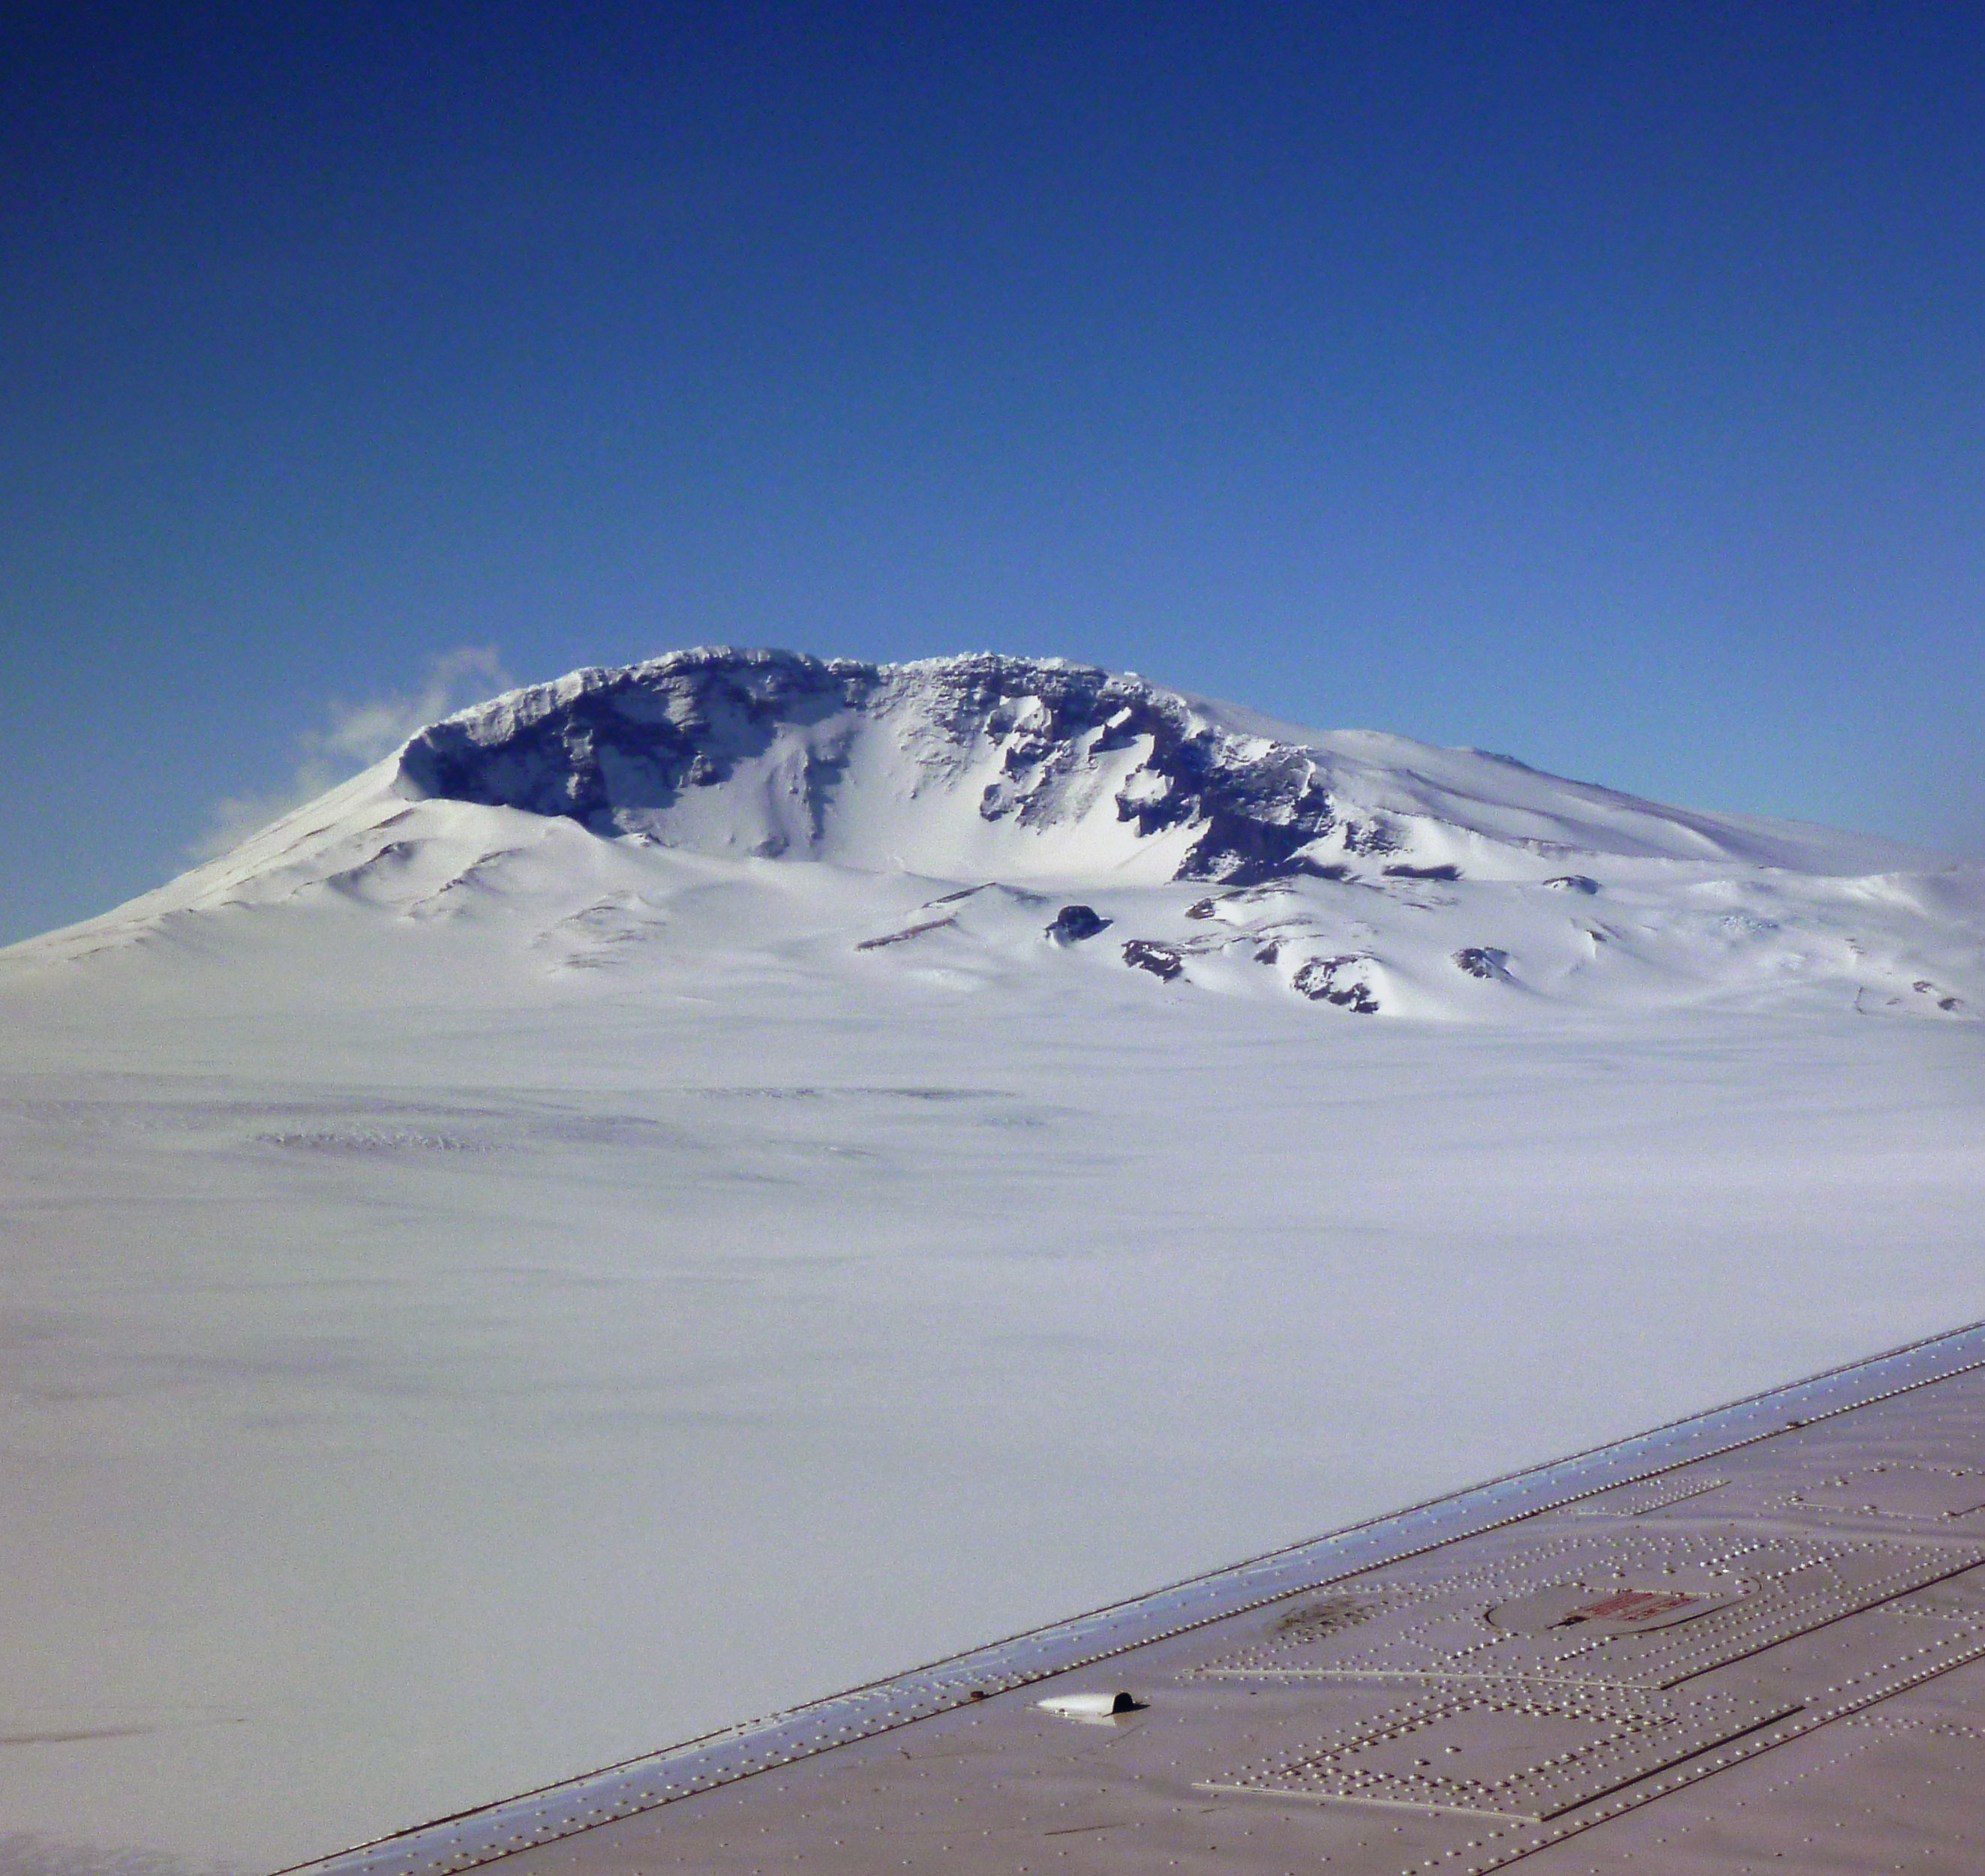





Seismic imaging of Earth structure, and application to volcanic arc and glacial problems
Mt. Sidley volcano
Marie Byrd Land
Antarctica
Douglas Wiens

Slide 2
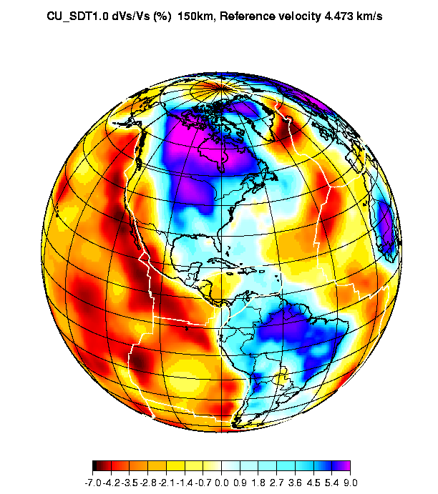
Seismic imaging of the Earth’s Interior
Highest resolution method for
imaging the earth’s interior

Slide 3
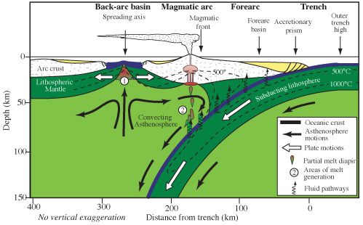
Imaging pathways of water and melt through arc/backarc systems
Figure credit:
Wikipedia
Seismology provides constraints on:
Amount of water coming into the system in the subducting plate
Depth and configuration of the melting region beneath the arc and backarc
Relationship of arc and backarc melt production systems
Effect of water on the melting system when water varies along strike

Slide 4
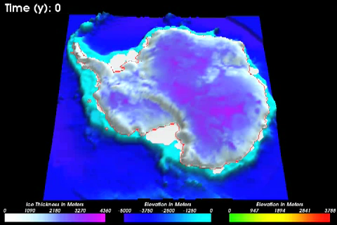
Solid Earth influence on the instability of the West Antarctic Ice Sheet
Pollard & Deconto
[2009]9]
This movie shows a model of the Antarctic Ice sheet through a interglacial
West Antarctic Ice Sheet melting will raise global sea level by about 6 meters
Major questions remain about the interaction between the solid earth & ice sheet
Earth structure controls heat flow at the base of the ice as well as isostatic adjustment

Slide 5
Outline
Seismology basics – what can we measure?
-- P, S velocity, attenuation
-- Relationship to temperature, composition, volatiles -- Instrumentation
Mantle melting and the effect of water beneath arcs and backarcs
Solid-earth controls on glacial movement and isostatic response

Slide 6
Seismic velocities
k = Bulk modulus
μ
= Shear modulus
ρ = density
λ
= Lame’s lambda constant

Slide 7
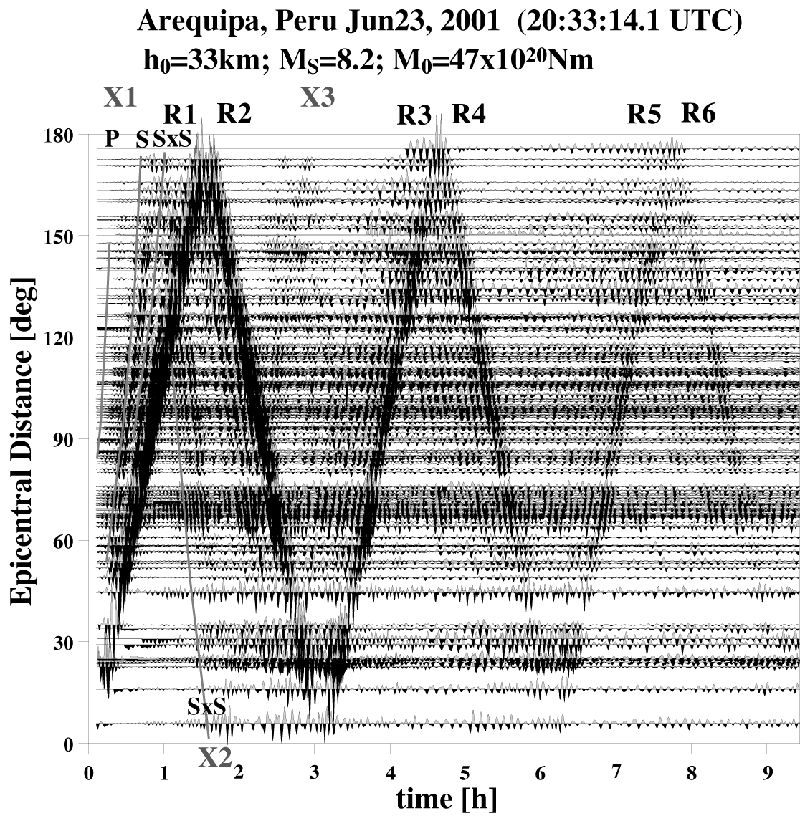
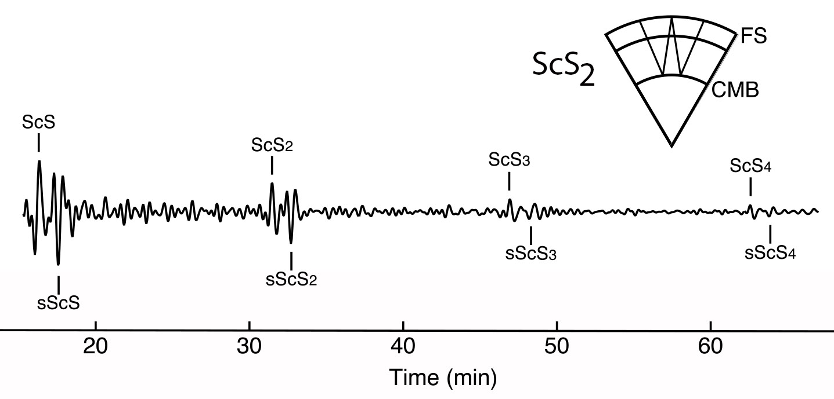
Seismic Attenuation
In a perfectly elastic medium, the total energy of the wavefield is conserved
Seismic attenuation is the absorption of seismic energy, or the deviation from perfect elasticity
Surface waves
Body waves
Coutier & Revenaugh [2006]
Widmer & Laske [2007]

Slide 8
Q – Quality Factor
Attenuation is quantified by 1/Q, in analogy to the damped harmonic oscillator (underdamped)
Smaller Q results in faster damping (greater deviation from elastic case)
Frequency-independent Q damps high frequencies more than low frequencies
Q = 2π (total energy/energy lost during one cycle)

Slide 9
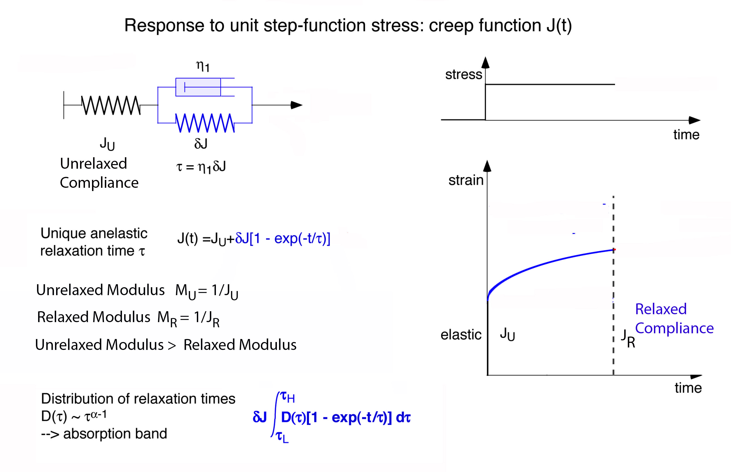
Anelasticity (Attenuation)
Makes the shear modulus frequency dependent
Figure from Uli Faul

Slide 10
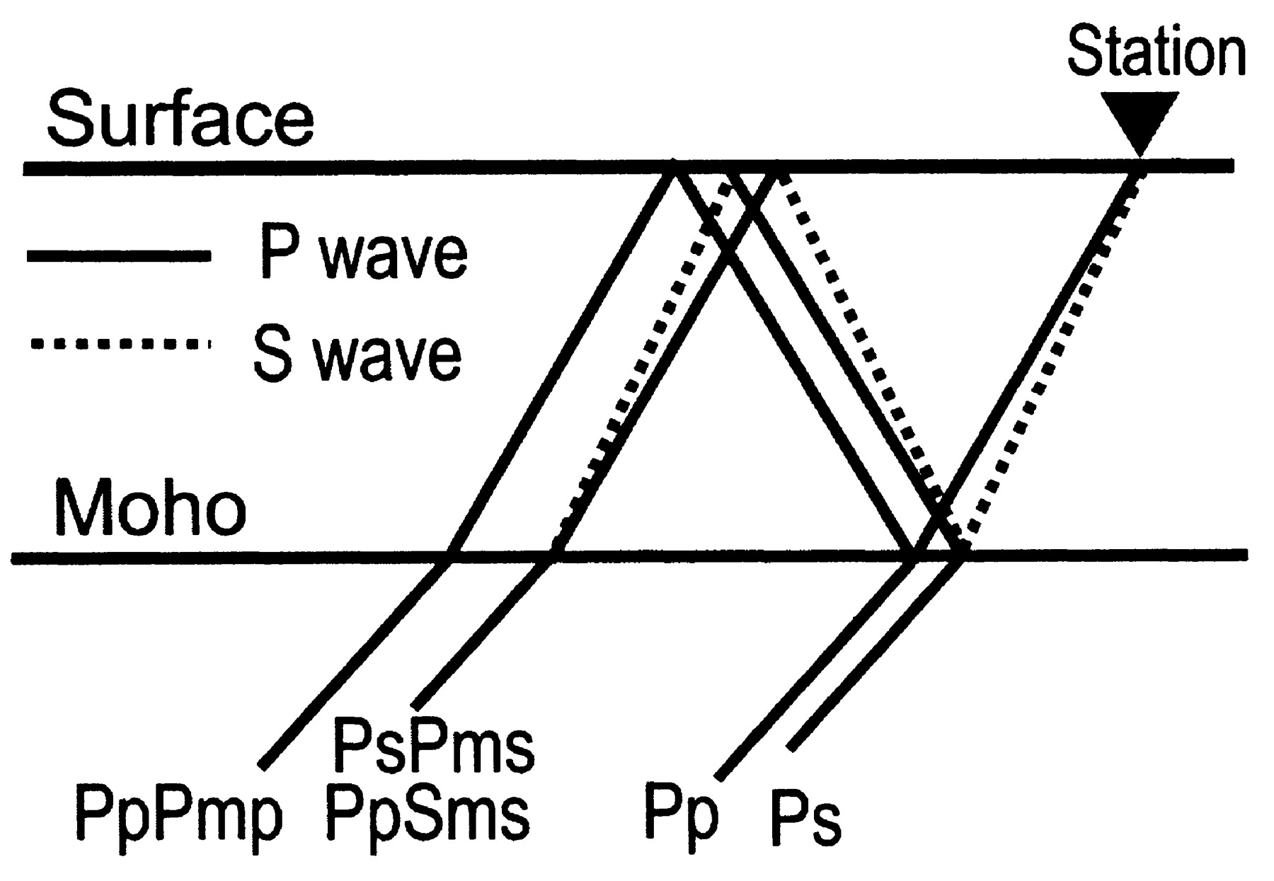
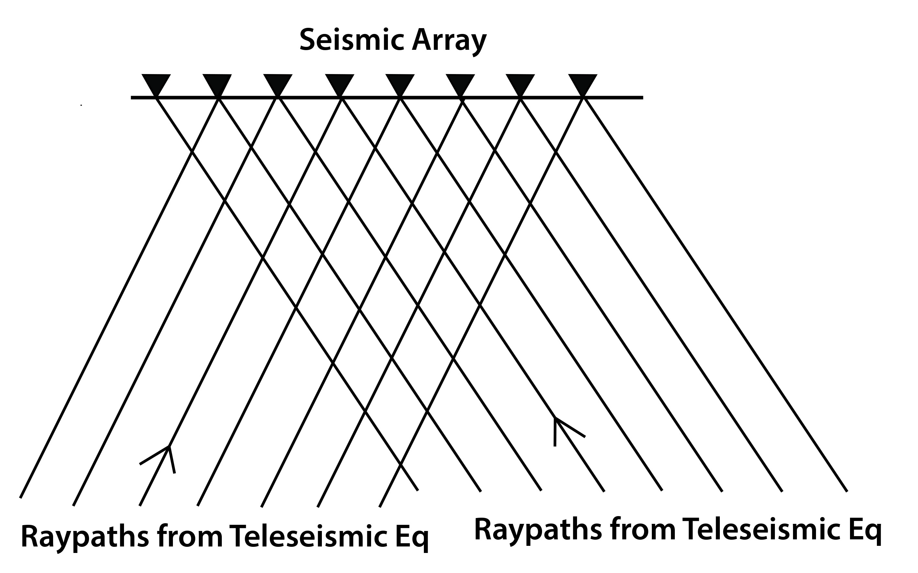
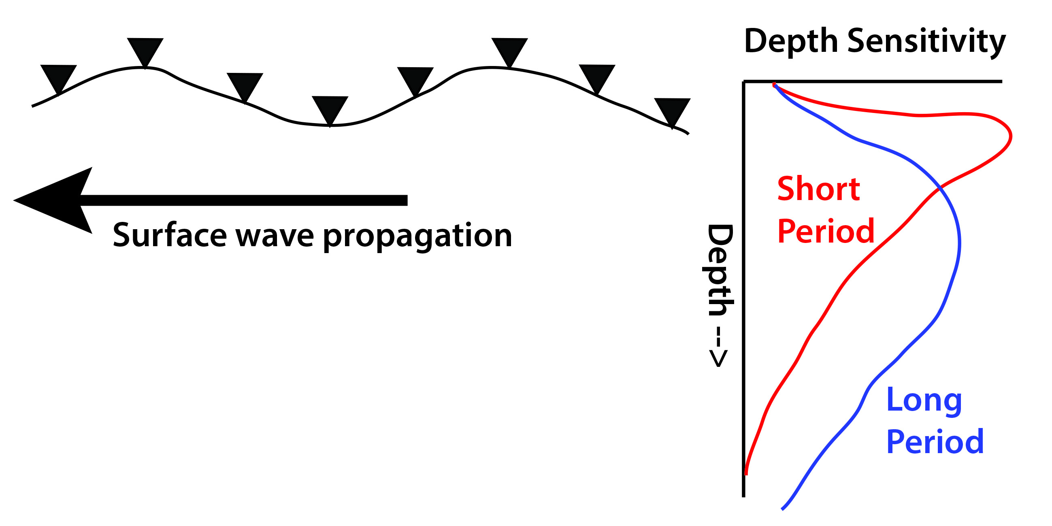
Seismological Analysis Methods
Receiver Functions
Body Wave Tomography
Good for: Imaging discontinuities
(Moho, sed/rock interface, 410)
Weakness: can’t see gradients
can’t constrain velocities well
results limited to immediately below station
Good for: lateral variations
Structure in 100-600 km depth range
Weakness: need close station spacing,
often poor depth resolution
velocities are relative, not absolute
Surface (Rayleigh) wave tomography
Good for: depth variations
gives absolute velocities
Weaknesses: often poor lateral resolution
limited to upper 300 km

Slide 11
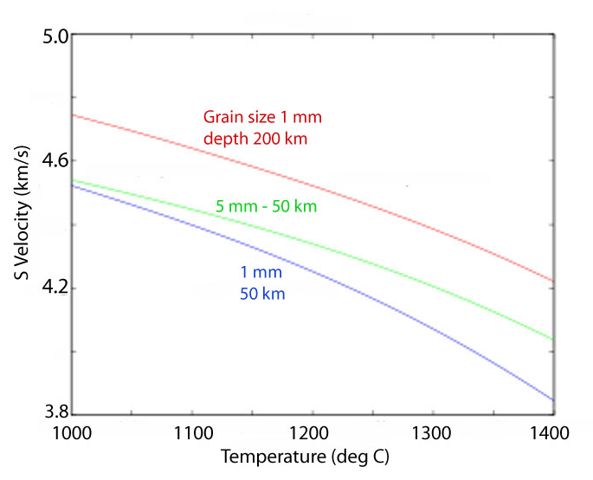
How do material properties affect mantle seismic observables?
Temperature effect on seismic velocity and attenuation -- no melt
P and S velocities are controlled by anharmonic temperature derivatives at
temperatures below about 900°C --- relatively linear
Above 900°C attenuation increases rapidly and the velocity derivatives are non-linear
Both attenuation and velocity are also a function of frequency, grain size, and depth (Faul and Jackson, 2005; Jackson et al., 2010; McCarthy & Takei, 2011)
Nonetheless, it is impossible to get extremely low shear velocities (< 3.8 km/s) even with small grain size and high mantle temperature
Shear Velocity vs Temp
Calculated using
Faul & Jackson [2005]

Slide 12
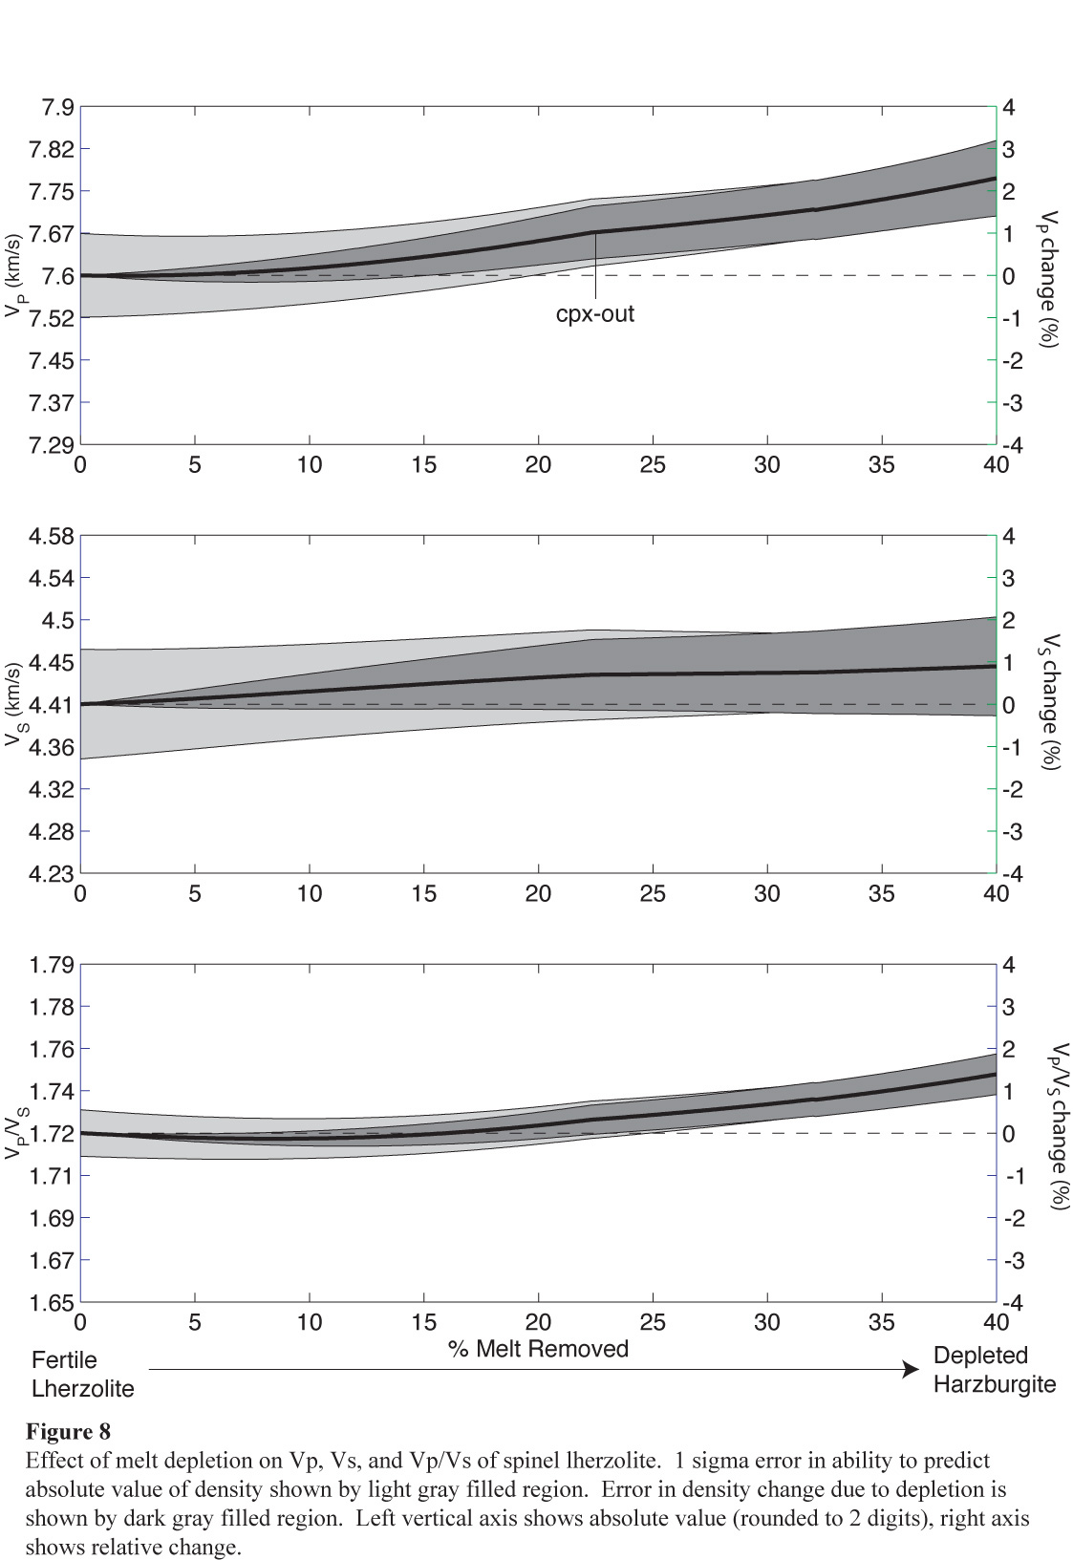
The effect of mantle composition on seismic velocity
Modeling the effect of
melt depletion on mantle
velocity (Schutt & Lesher, 2006)

Slide 13
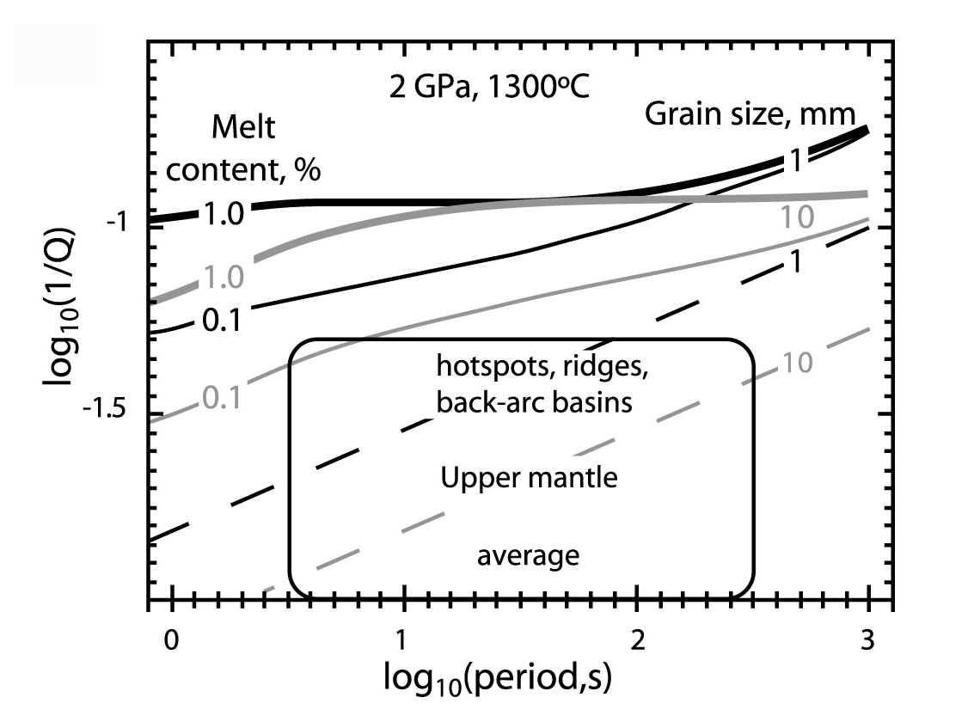
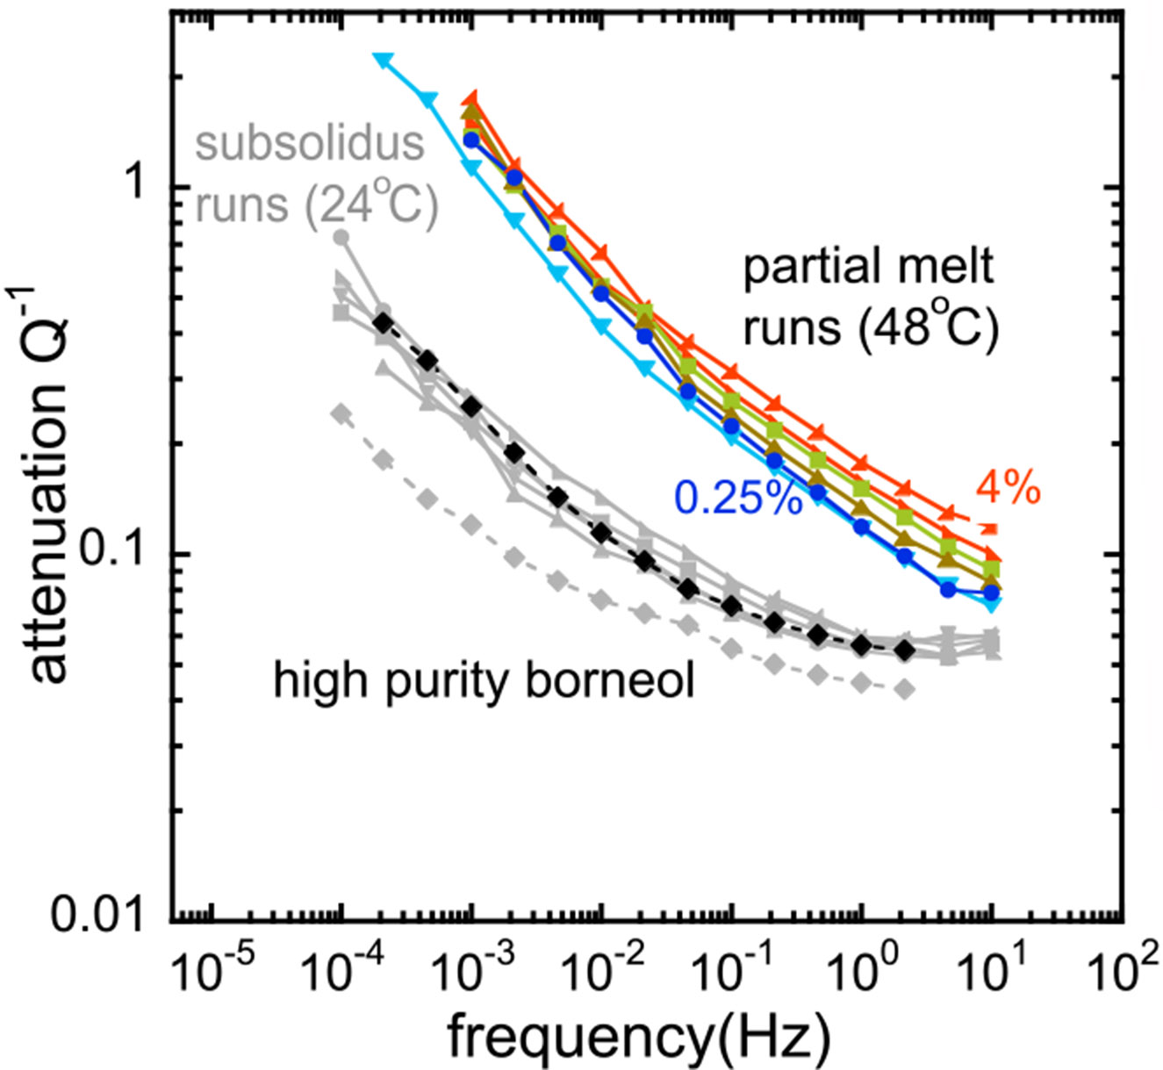
Effect of melt on seismic velocity and attenuation
Experiments on Olivine
Faul et al., 2004
Experiments with an Analog Material
McCarthy and Takei [2011]
Both experiments indicate melt produces an anelastic effect
Effect of melt is extremely strong at very small melt porosity
Less than 1% melt can produce nearly an order of magnitude increase in attenuation
Strong attenuation will also produce a large velocity decrease due to dispersion

Slide 14
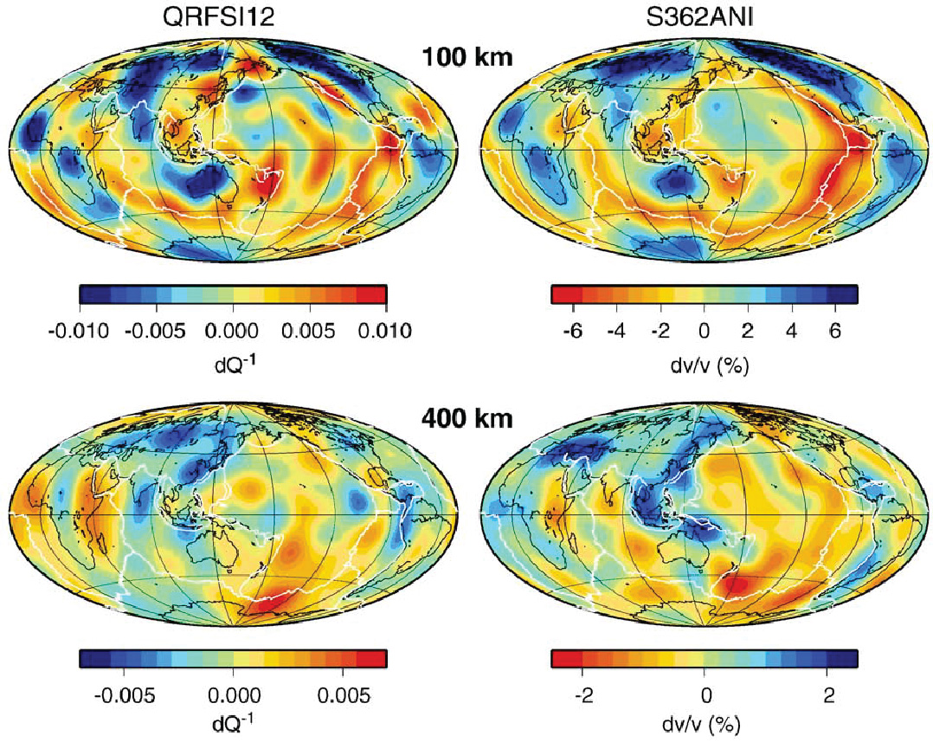
Attenuation and Velocity Anomalies are Highly Correlated
Indicates a Thermal Origin
Q model
S Velocity Model
Dalton et al. [2009]

Slide 15
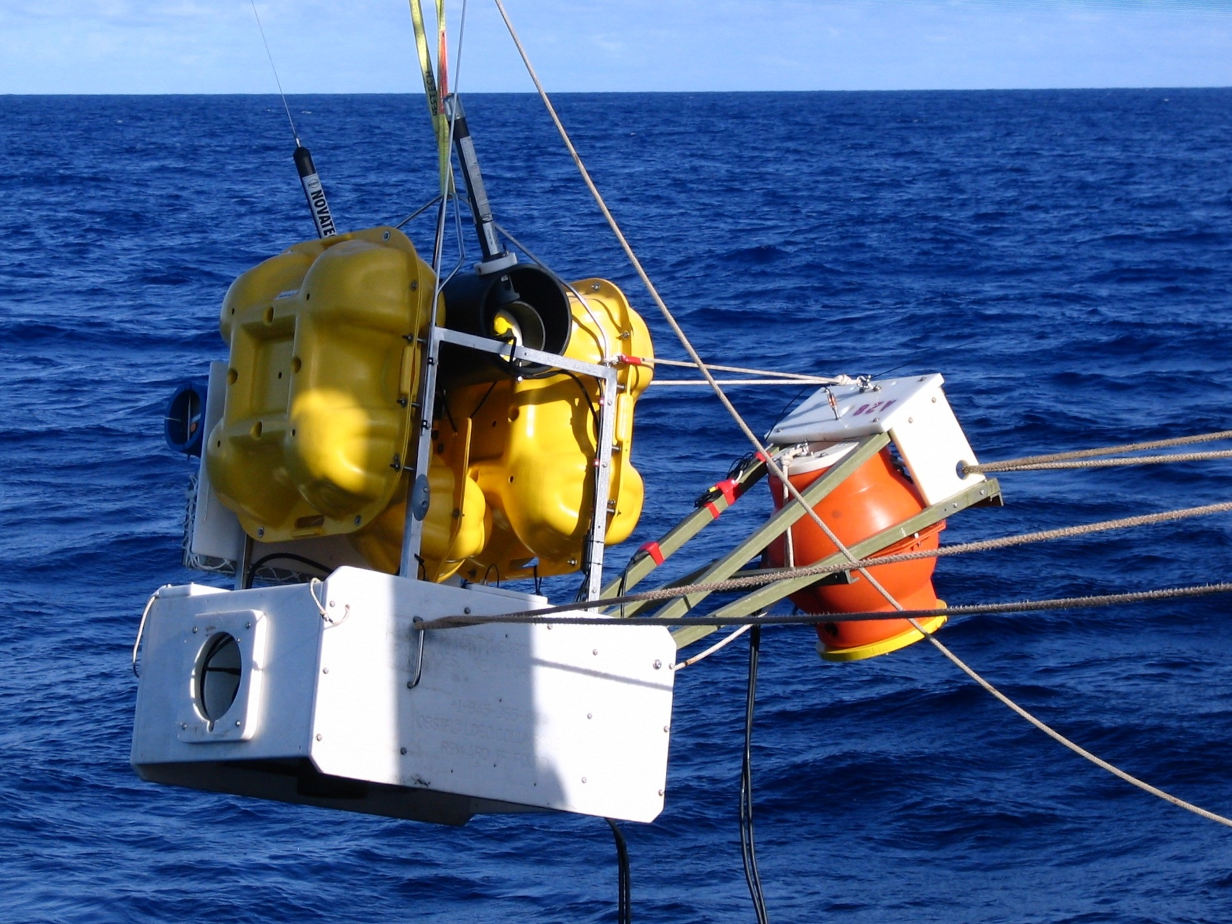
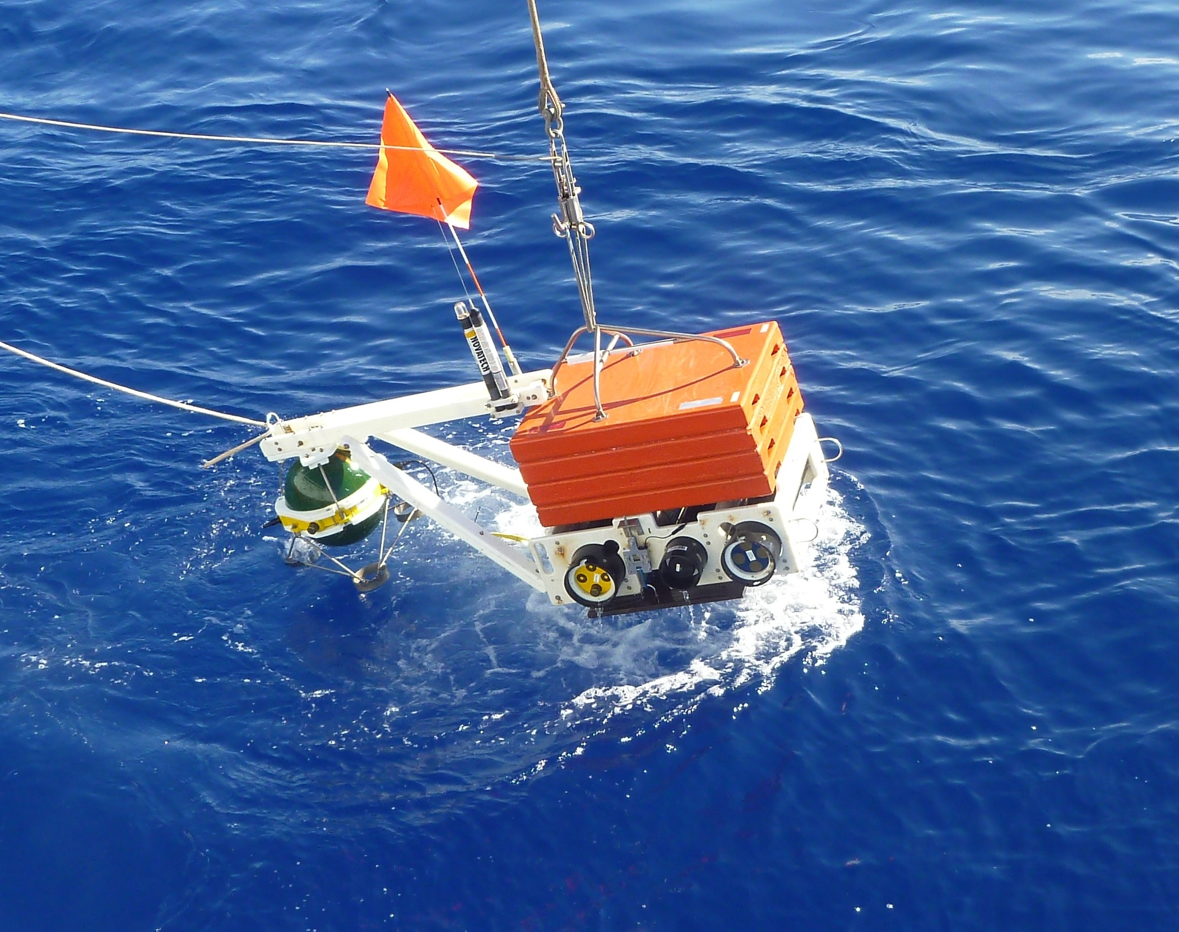
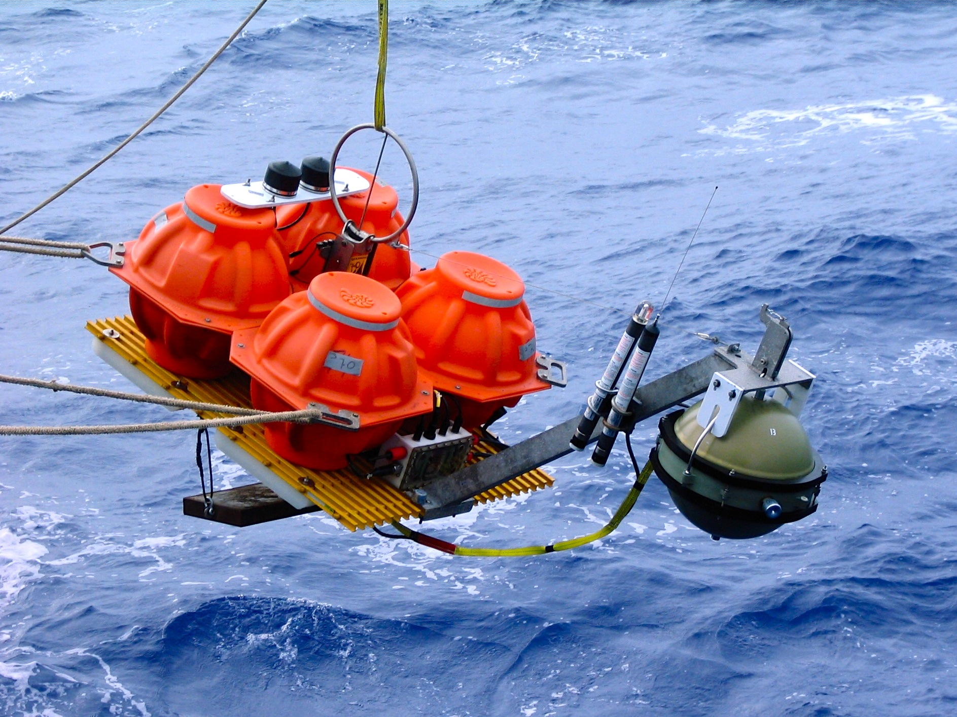
Broadband Ocean Bottom Seismographs (OBS)
Lamont-Doherty
Scripps
Woods Hole

Slide 16
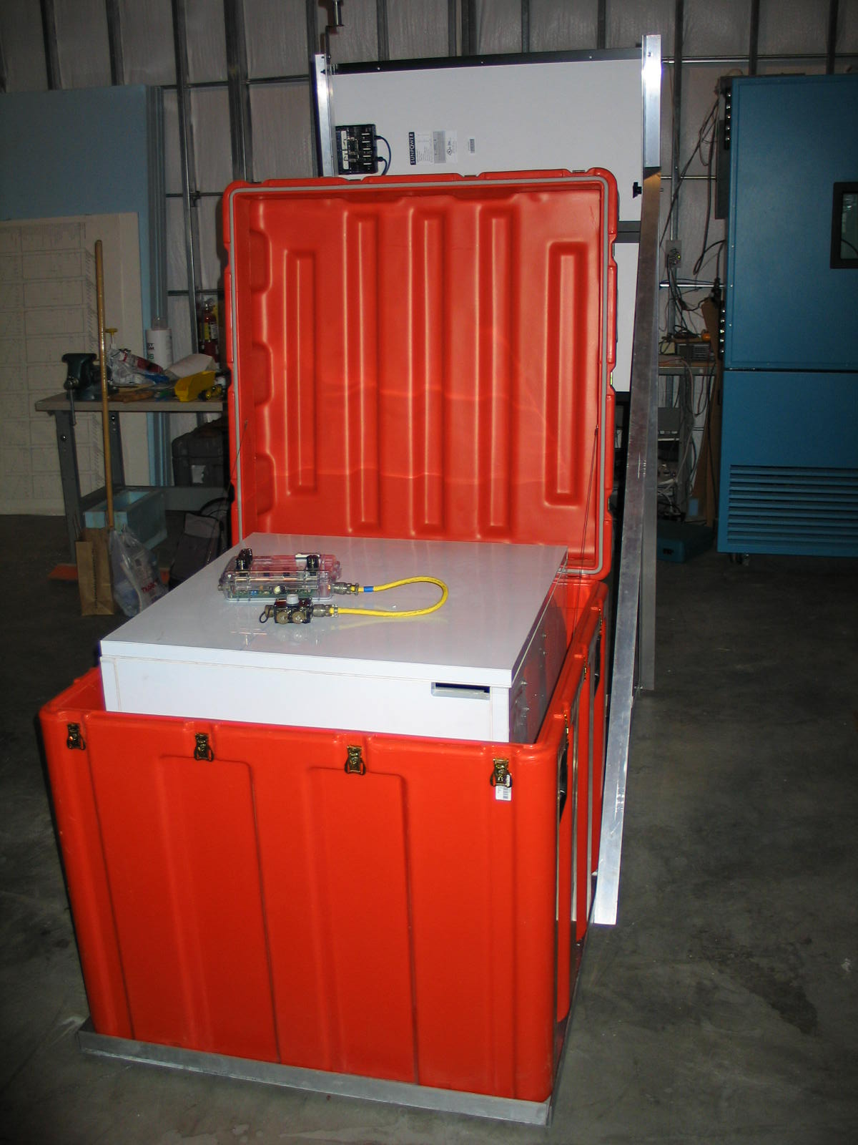
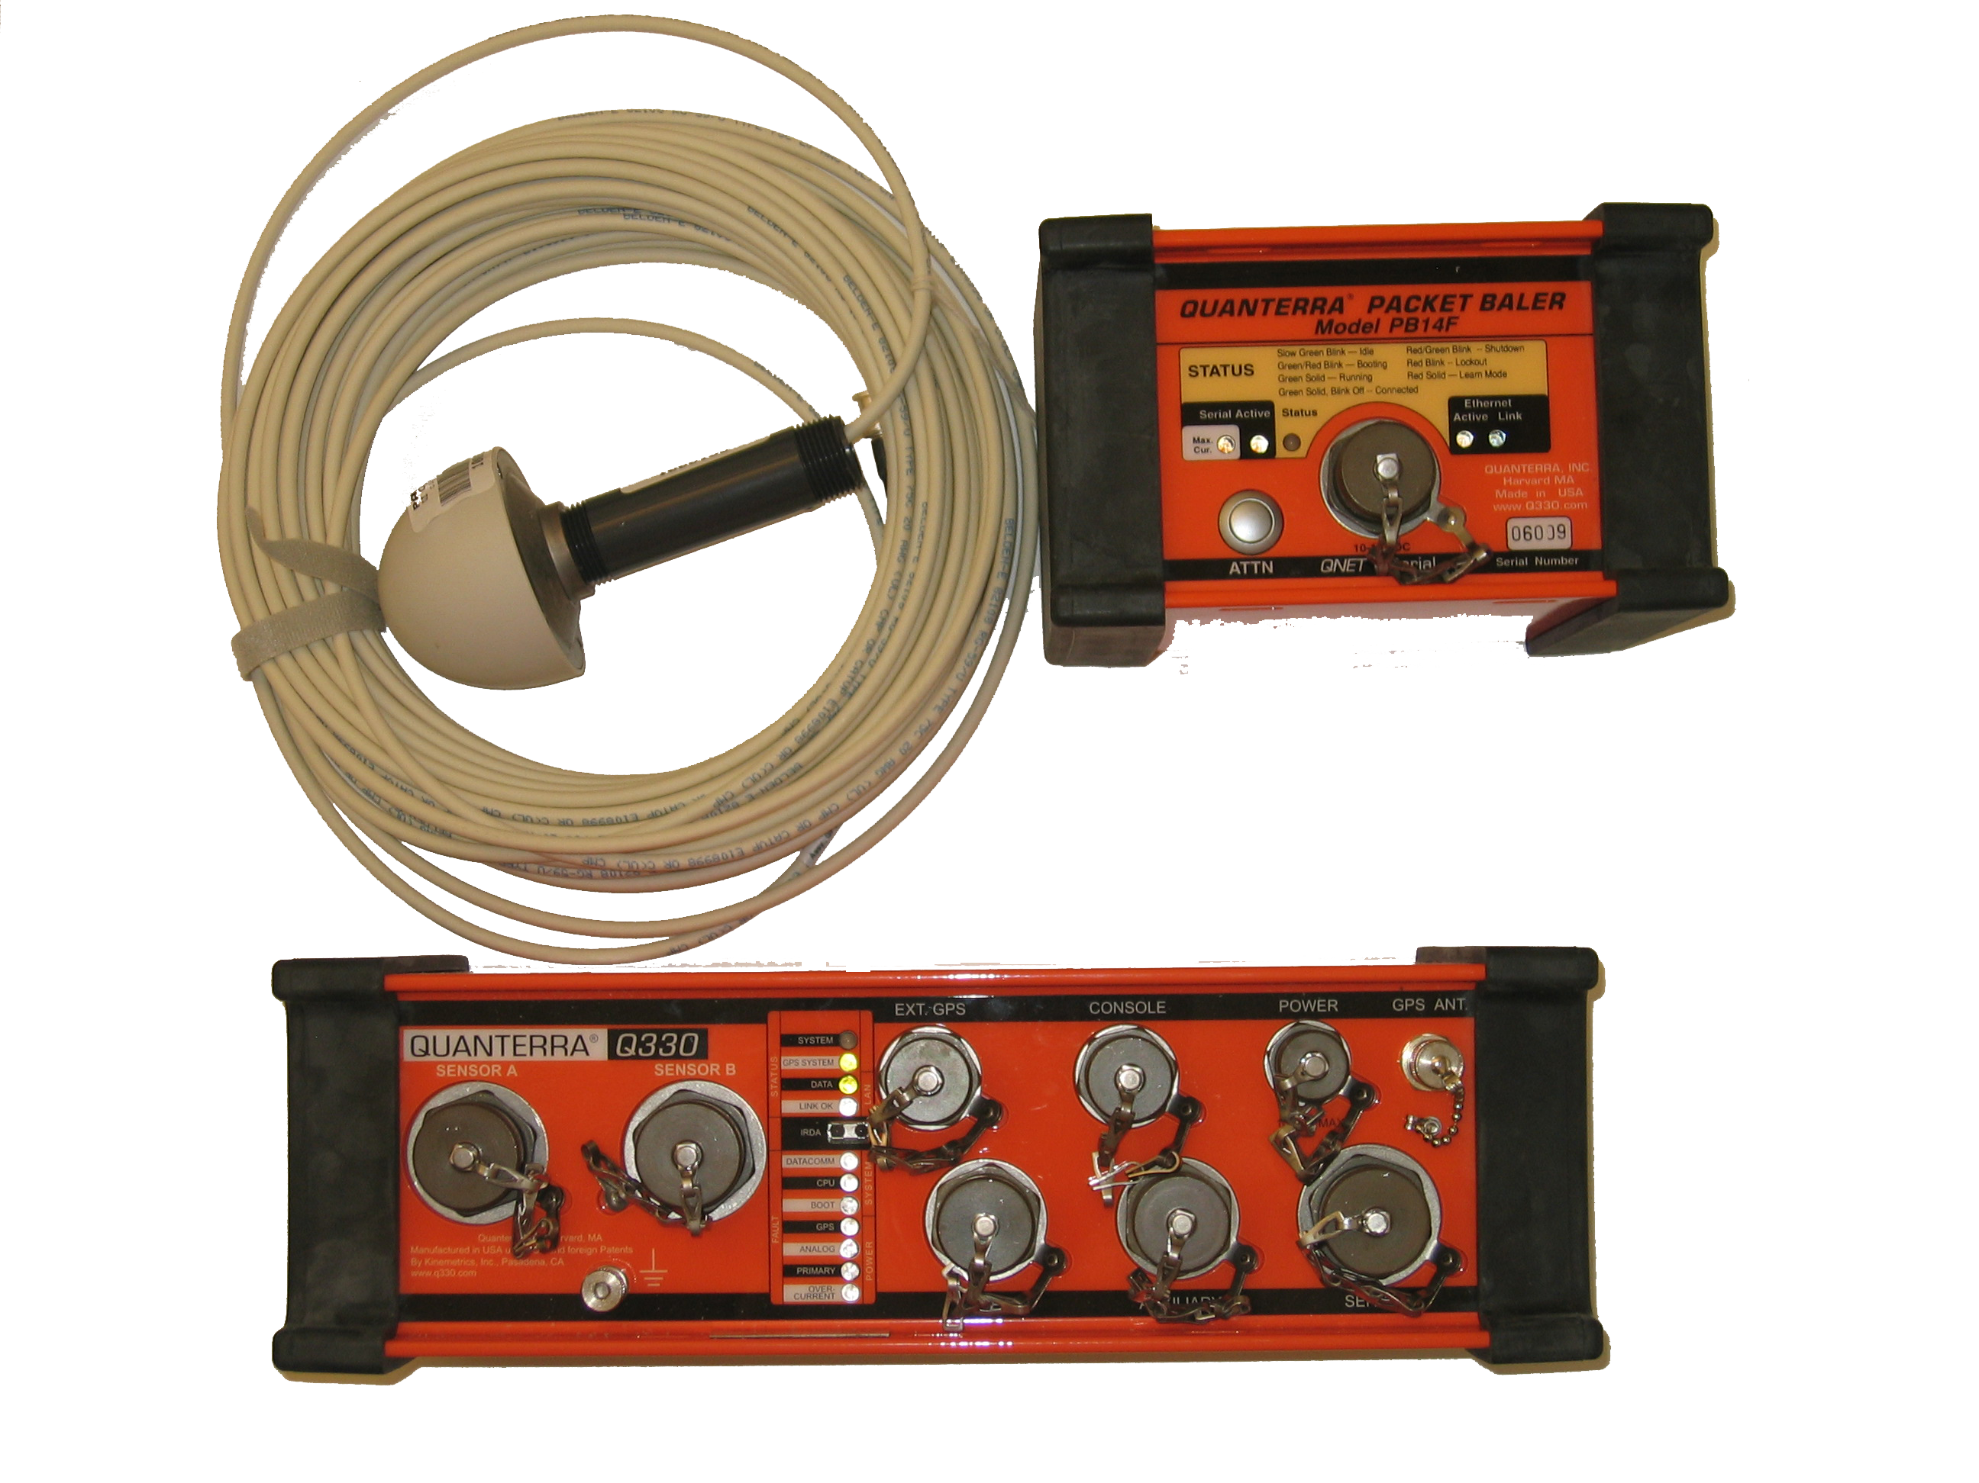
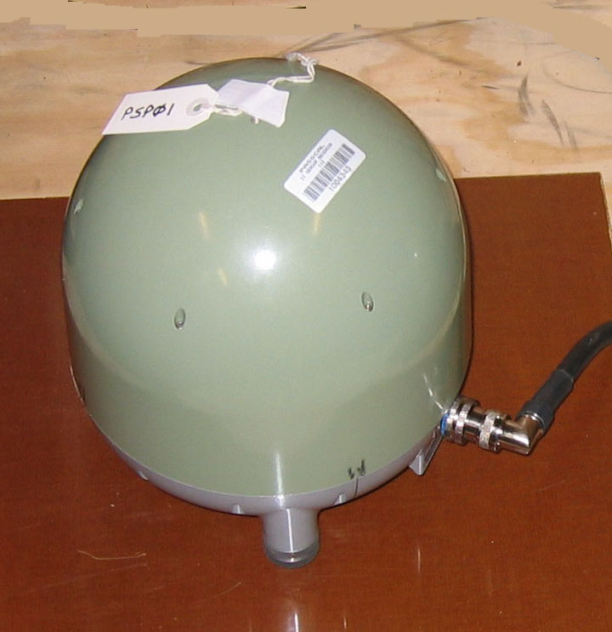
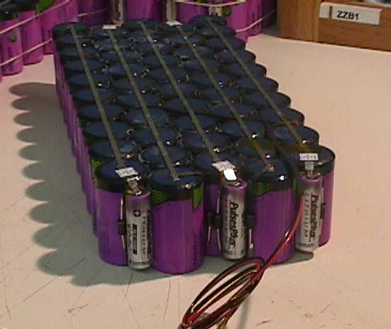
Polar Seismic Instrumentation
Problems – 6 months of darkness, winter temperatures to
-70°C (-95°F)
Sensor: Trillium 240 or modified Guralp 3T - operates to -55°C
Datalogger: Quanterra Q330 with solid state recording
operates to -45°C
power source is solar panels (summer) and primary
lithium batteries (winter)
total power required ~ 2 Watts
equipment is enclosed in buried insulated vaults
to maintain temperature 15-20° C above ambient

Slide 17
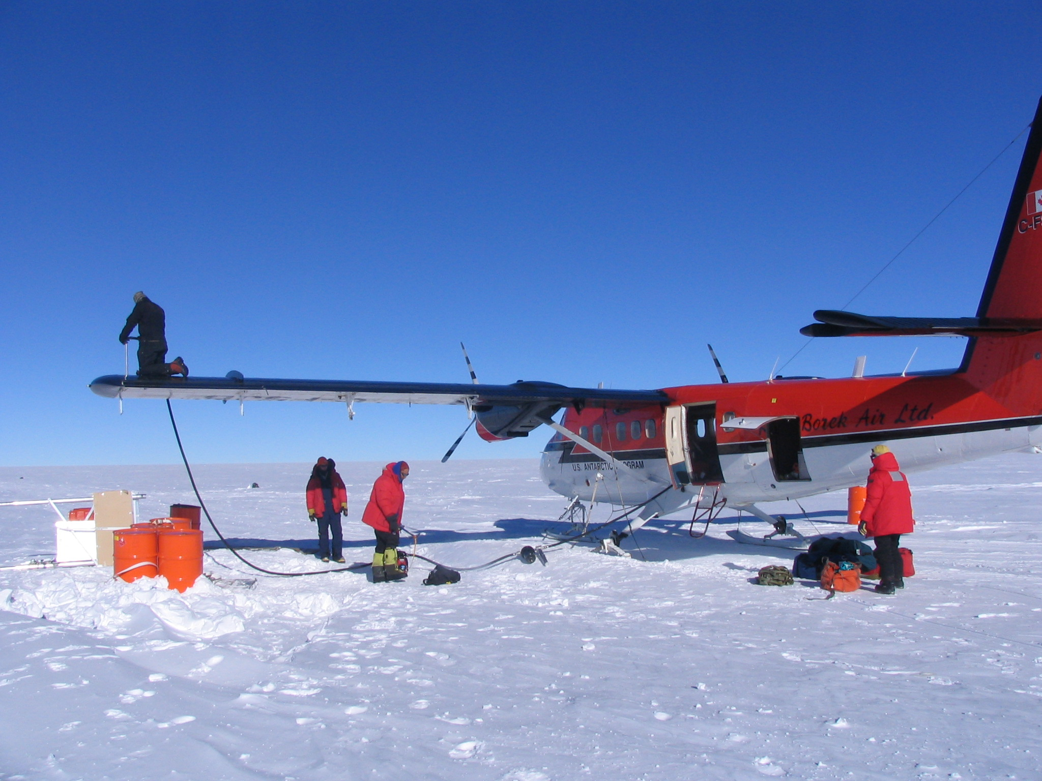
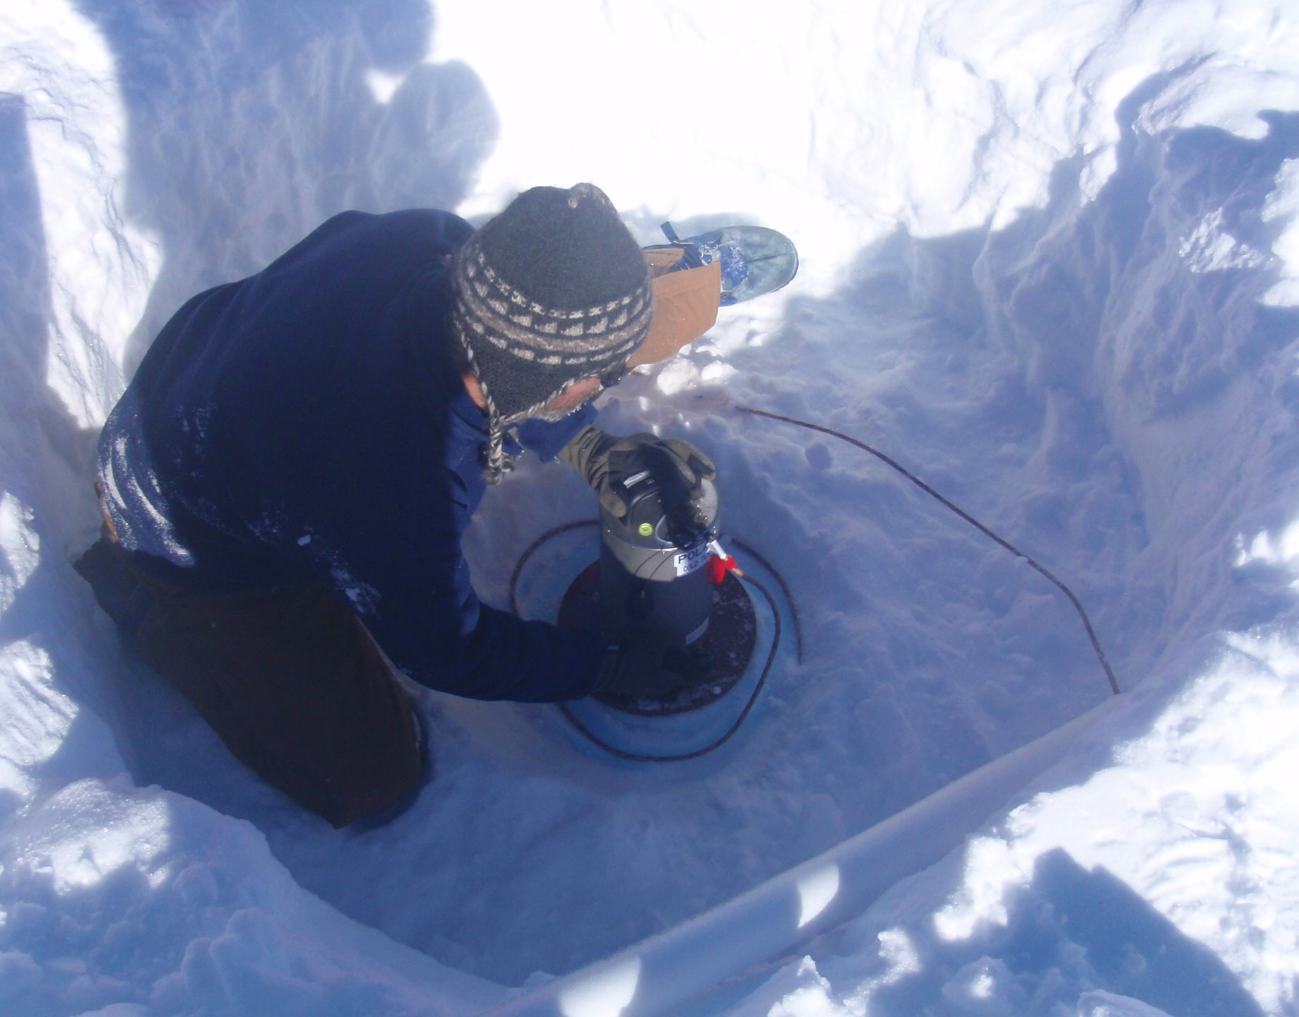
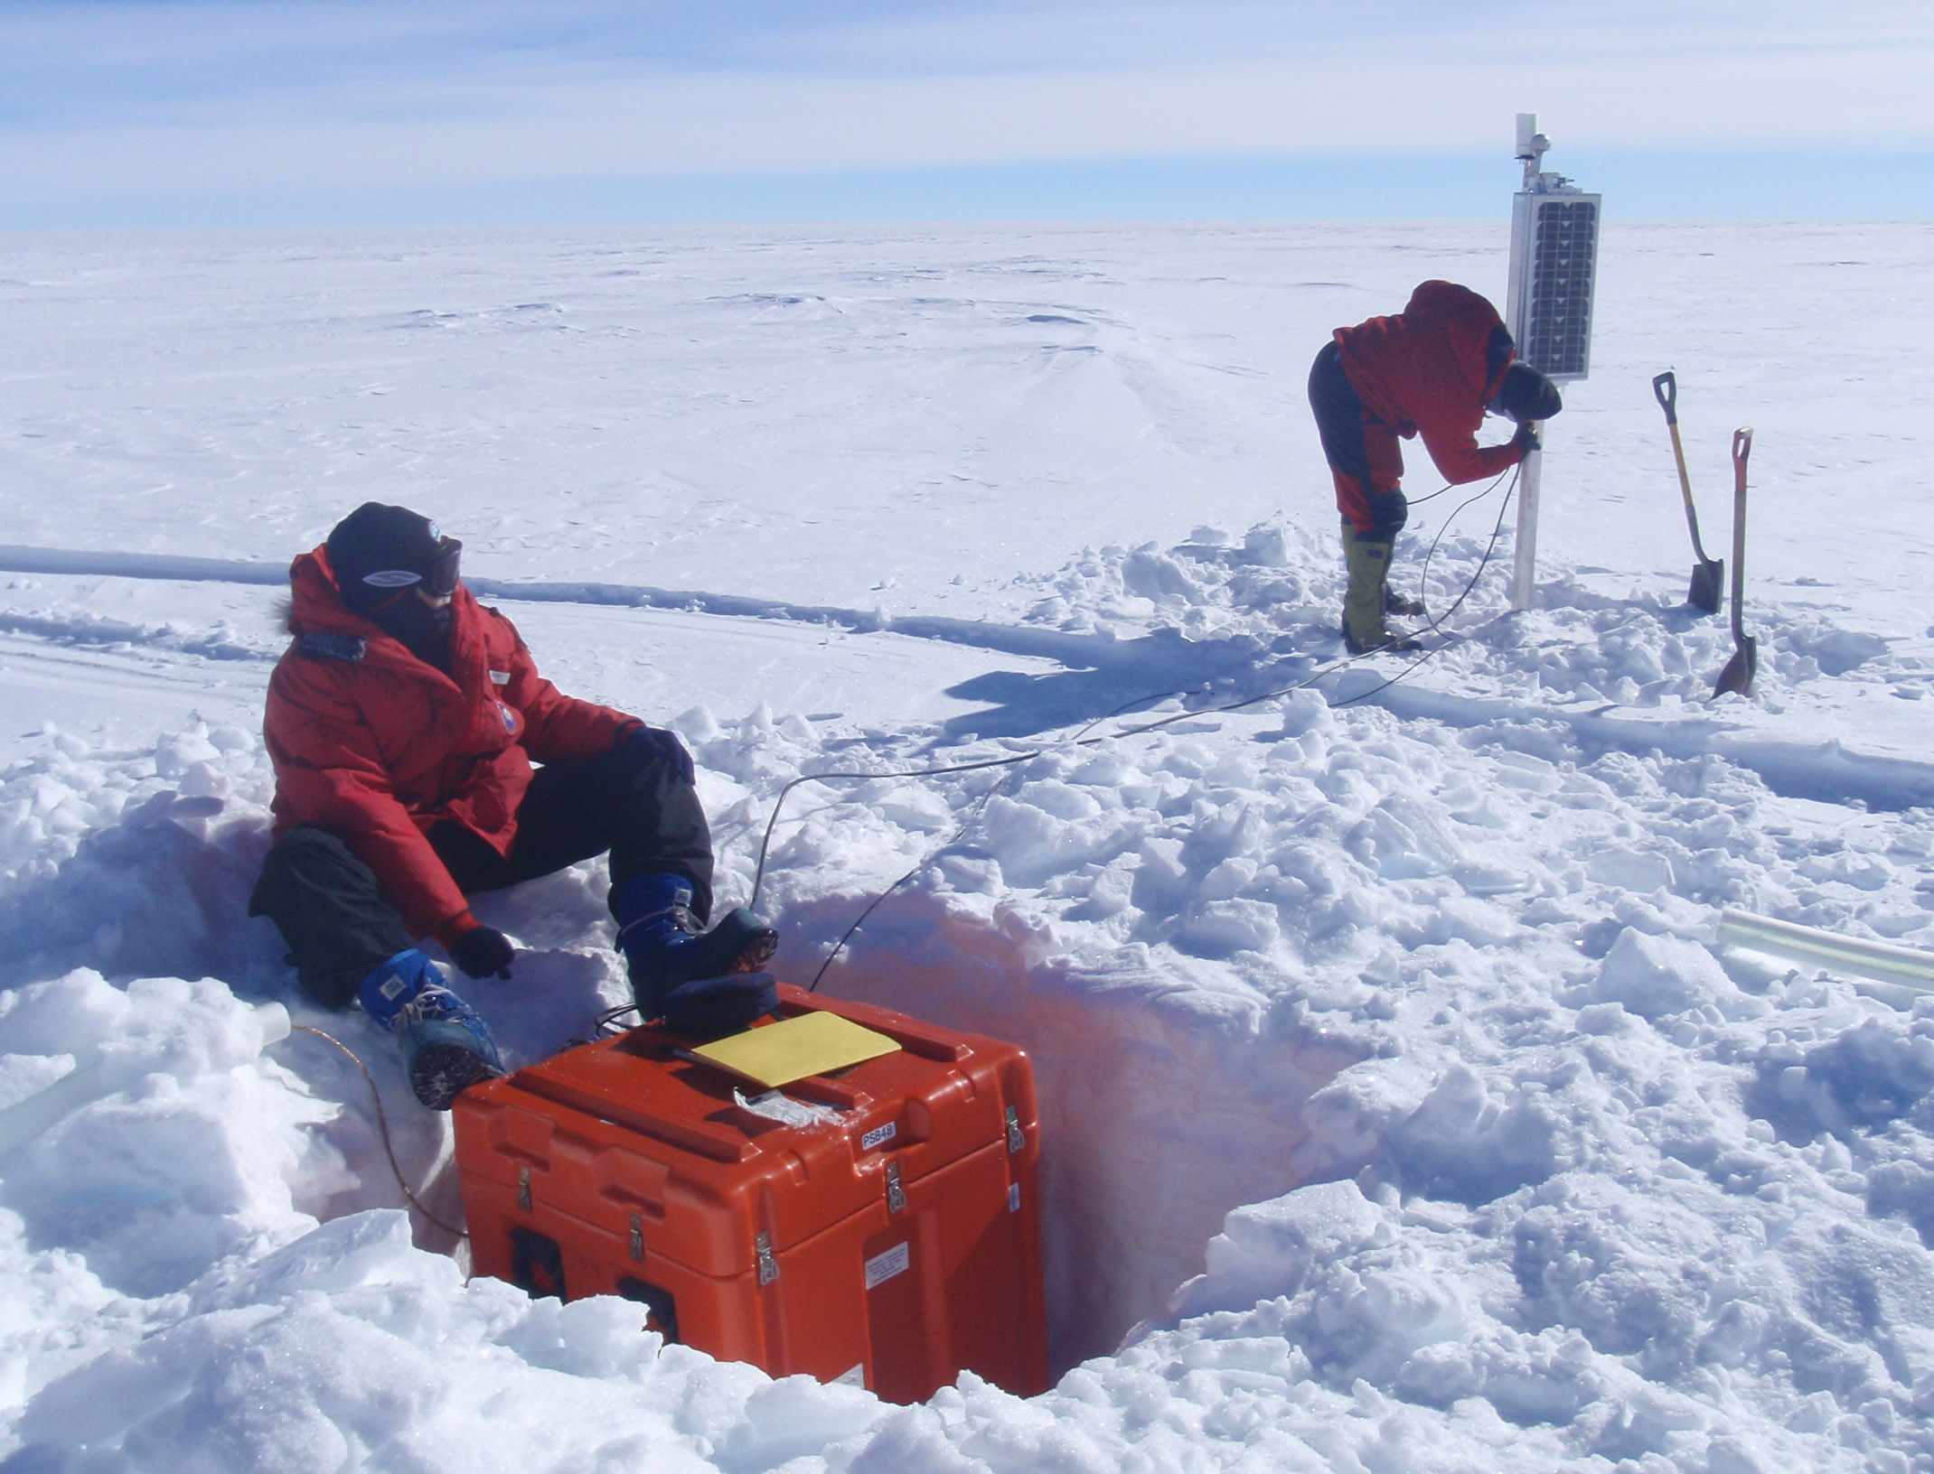
Polar Seismograph Installation

Slide 18
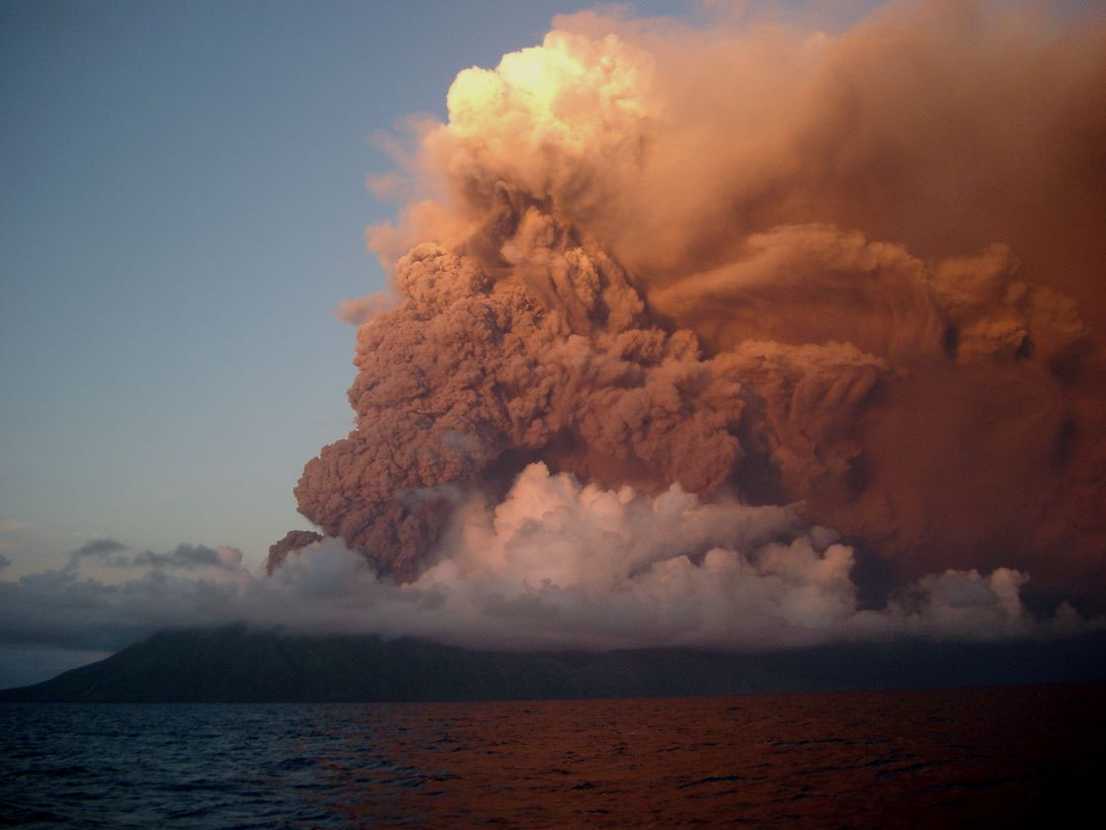
Imaging Mantle Melting and the Effect of Water beneath Arcs and Backarcs
Eruption of Anatahan Volcano,
Northern Mariana Is, June 10, 2003

Slide 19
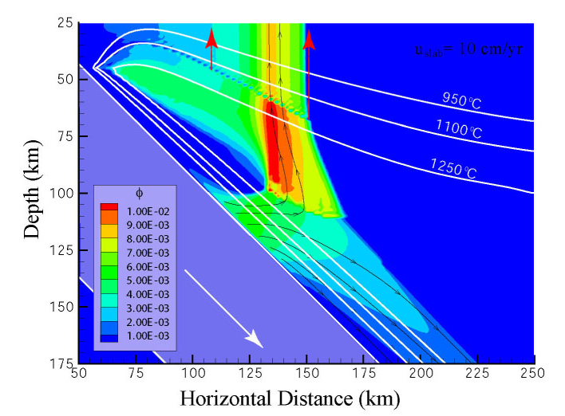
Imaging fluid transport and melt production beneath the arc
Model of melt/fluid production and transport
Cagniocle et al., 2007

Slide 20
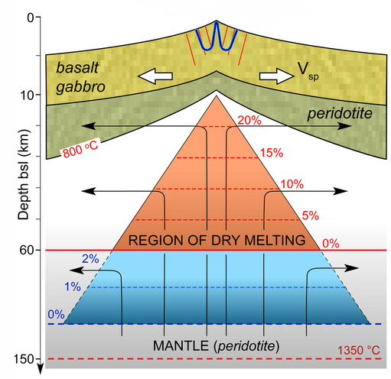
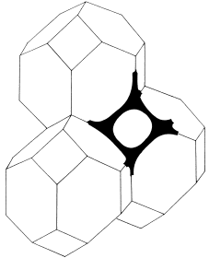
Melt production at spreading centers
Melt/fluid porosity and geometry
Decompression melting
Melt is buoyant and escapes
by porous flow
Many questions:
geographical extent of melt region
porosity and transport velocity
melt focusing mechanism
deep volatile-enhanced melting?
After Ligi et al. [2013]

Slide 21
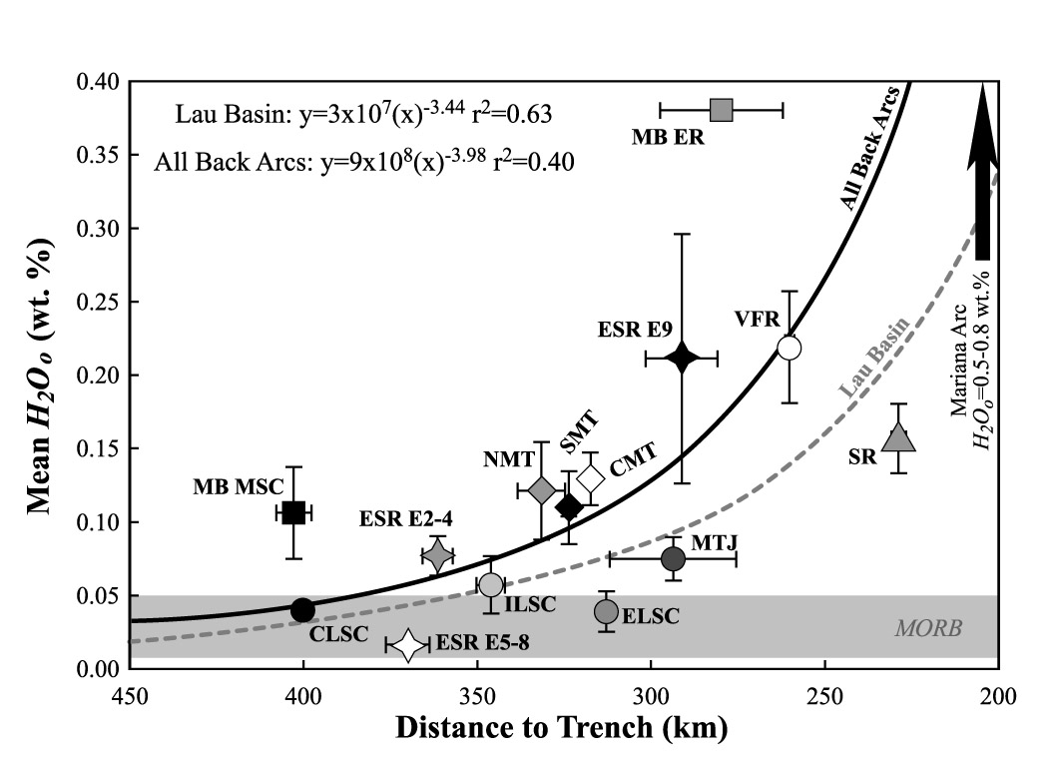
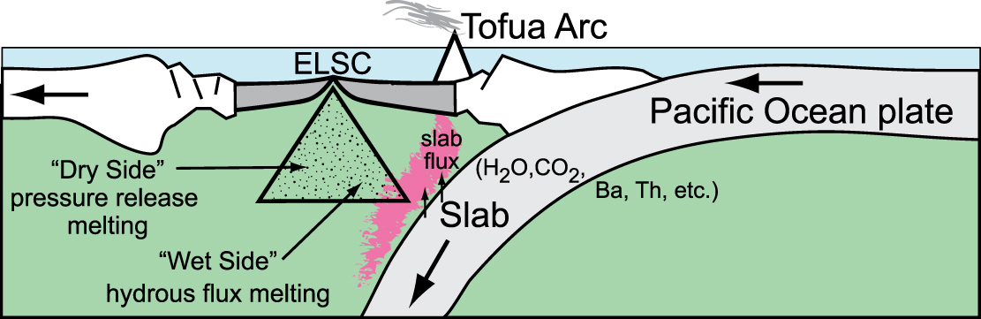
Arc/backarc systems:
Sampling the mantle with distance from the slab – variable water content
After Tivey et al. [2012]
Earthquakes in the slab provide a source
array allowing us to image the melting regions
beneath arc and backarc spreading center
Study the interaction between arc and backarc
magmatic systems in the mantle
Kelley et al. [2006]

Slide 22
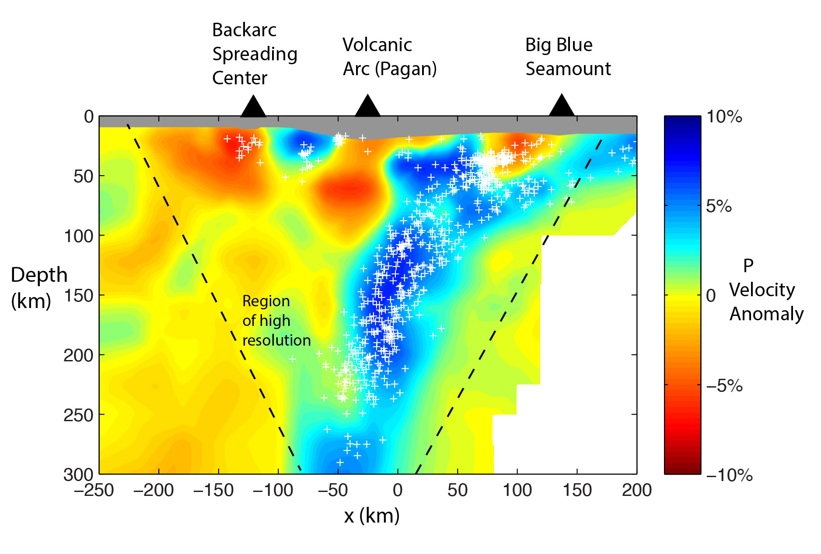
P wave velocity model – Mariana Arc
Barklage et al. [2015]
Slow mantle velocity anomalies of ~8% relative to average model beneath the arc and backarc spreading center
Fast velocities down to 50 km depth separate the arc and the backarc spreading center anomalies and represent cold refractory lithosphere.
Slow anomalies are possibly connected at about 75 km depth
Arc anomaly is centered at ~ 75 km depth whereas backarc anomaly is centered at 25 km
Slow velocities in outer forearc indicate mantle serpentinization

Slide 23
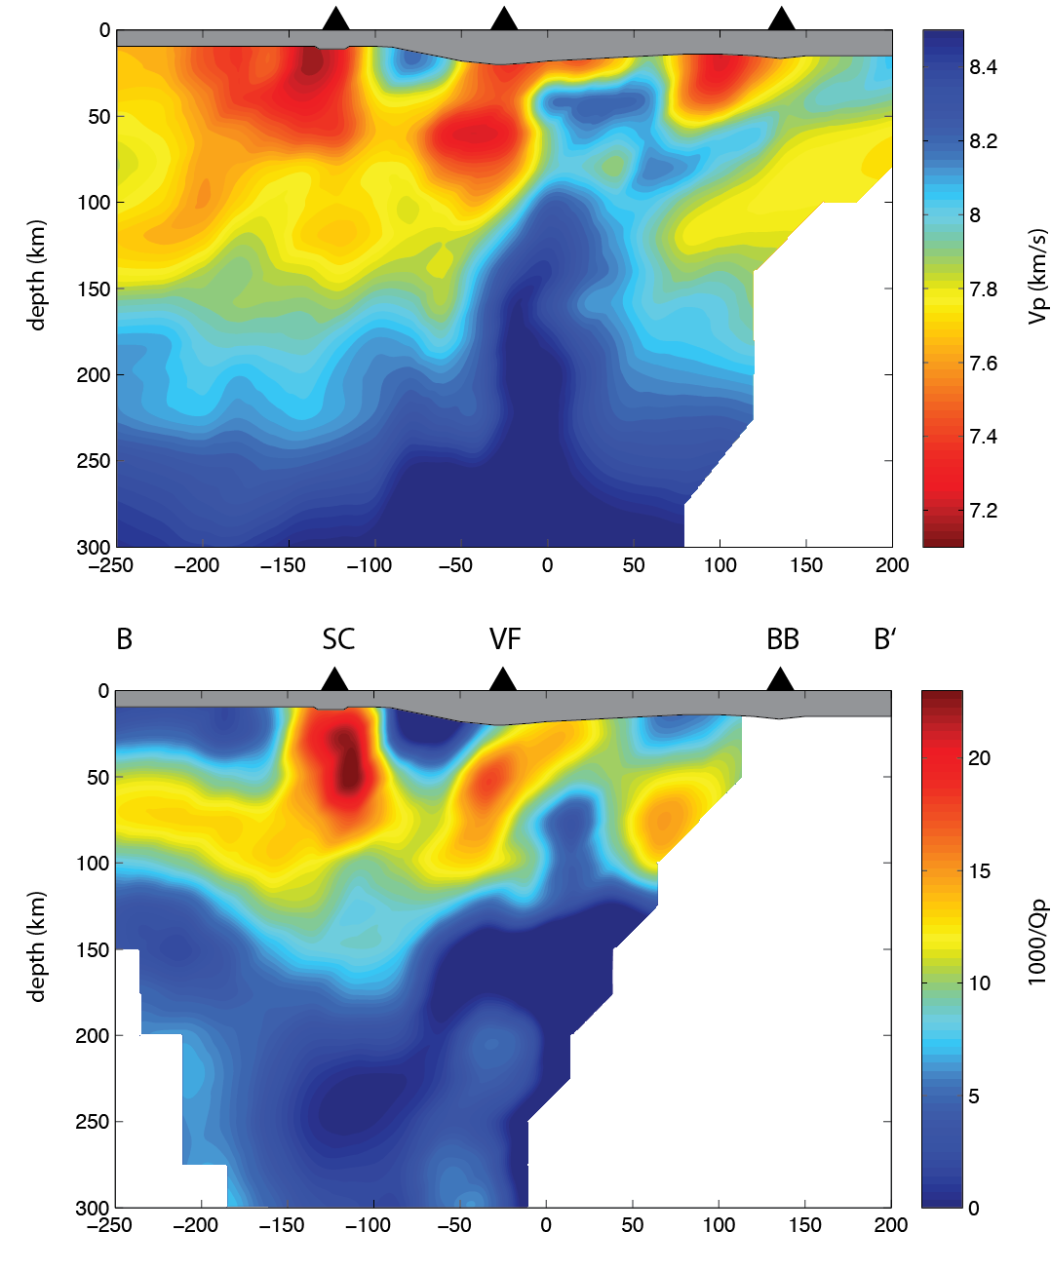
Comparison of P Velocity and Attenuation Anomalies
Spreading
Center
Volcanic
Front
Serpentinite
Seamount
Seismic attenuation image shows many
similar features to the velocity image
Slow velocity & high attenuation beneath
the arc at 40-90 km depth
Anomalies beneath the backarc are
slightly shallower (20-70 km)
Arc and spreading center anomalies
separated at shallow depths; join at
~ 75 km depth
P velocity
P attenuation
Pozgay et al [2009]

Slide 24
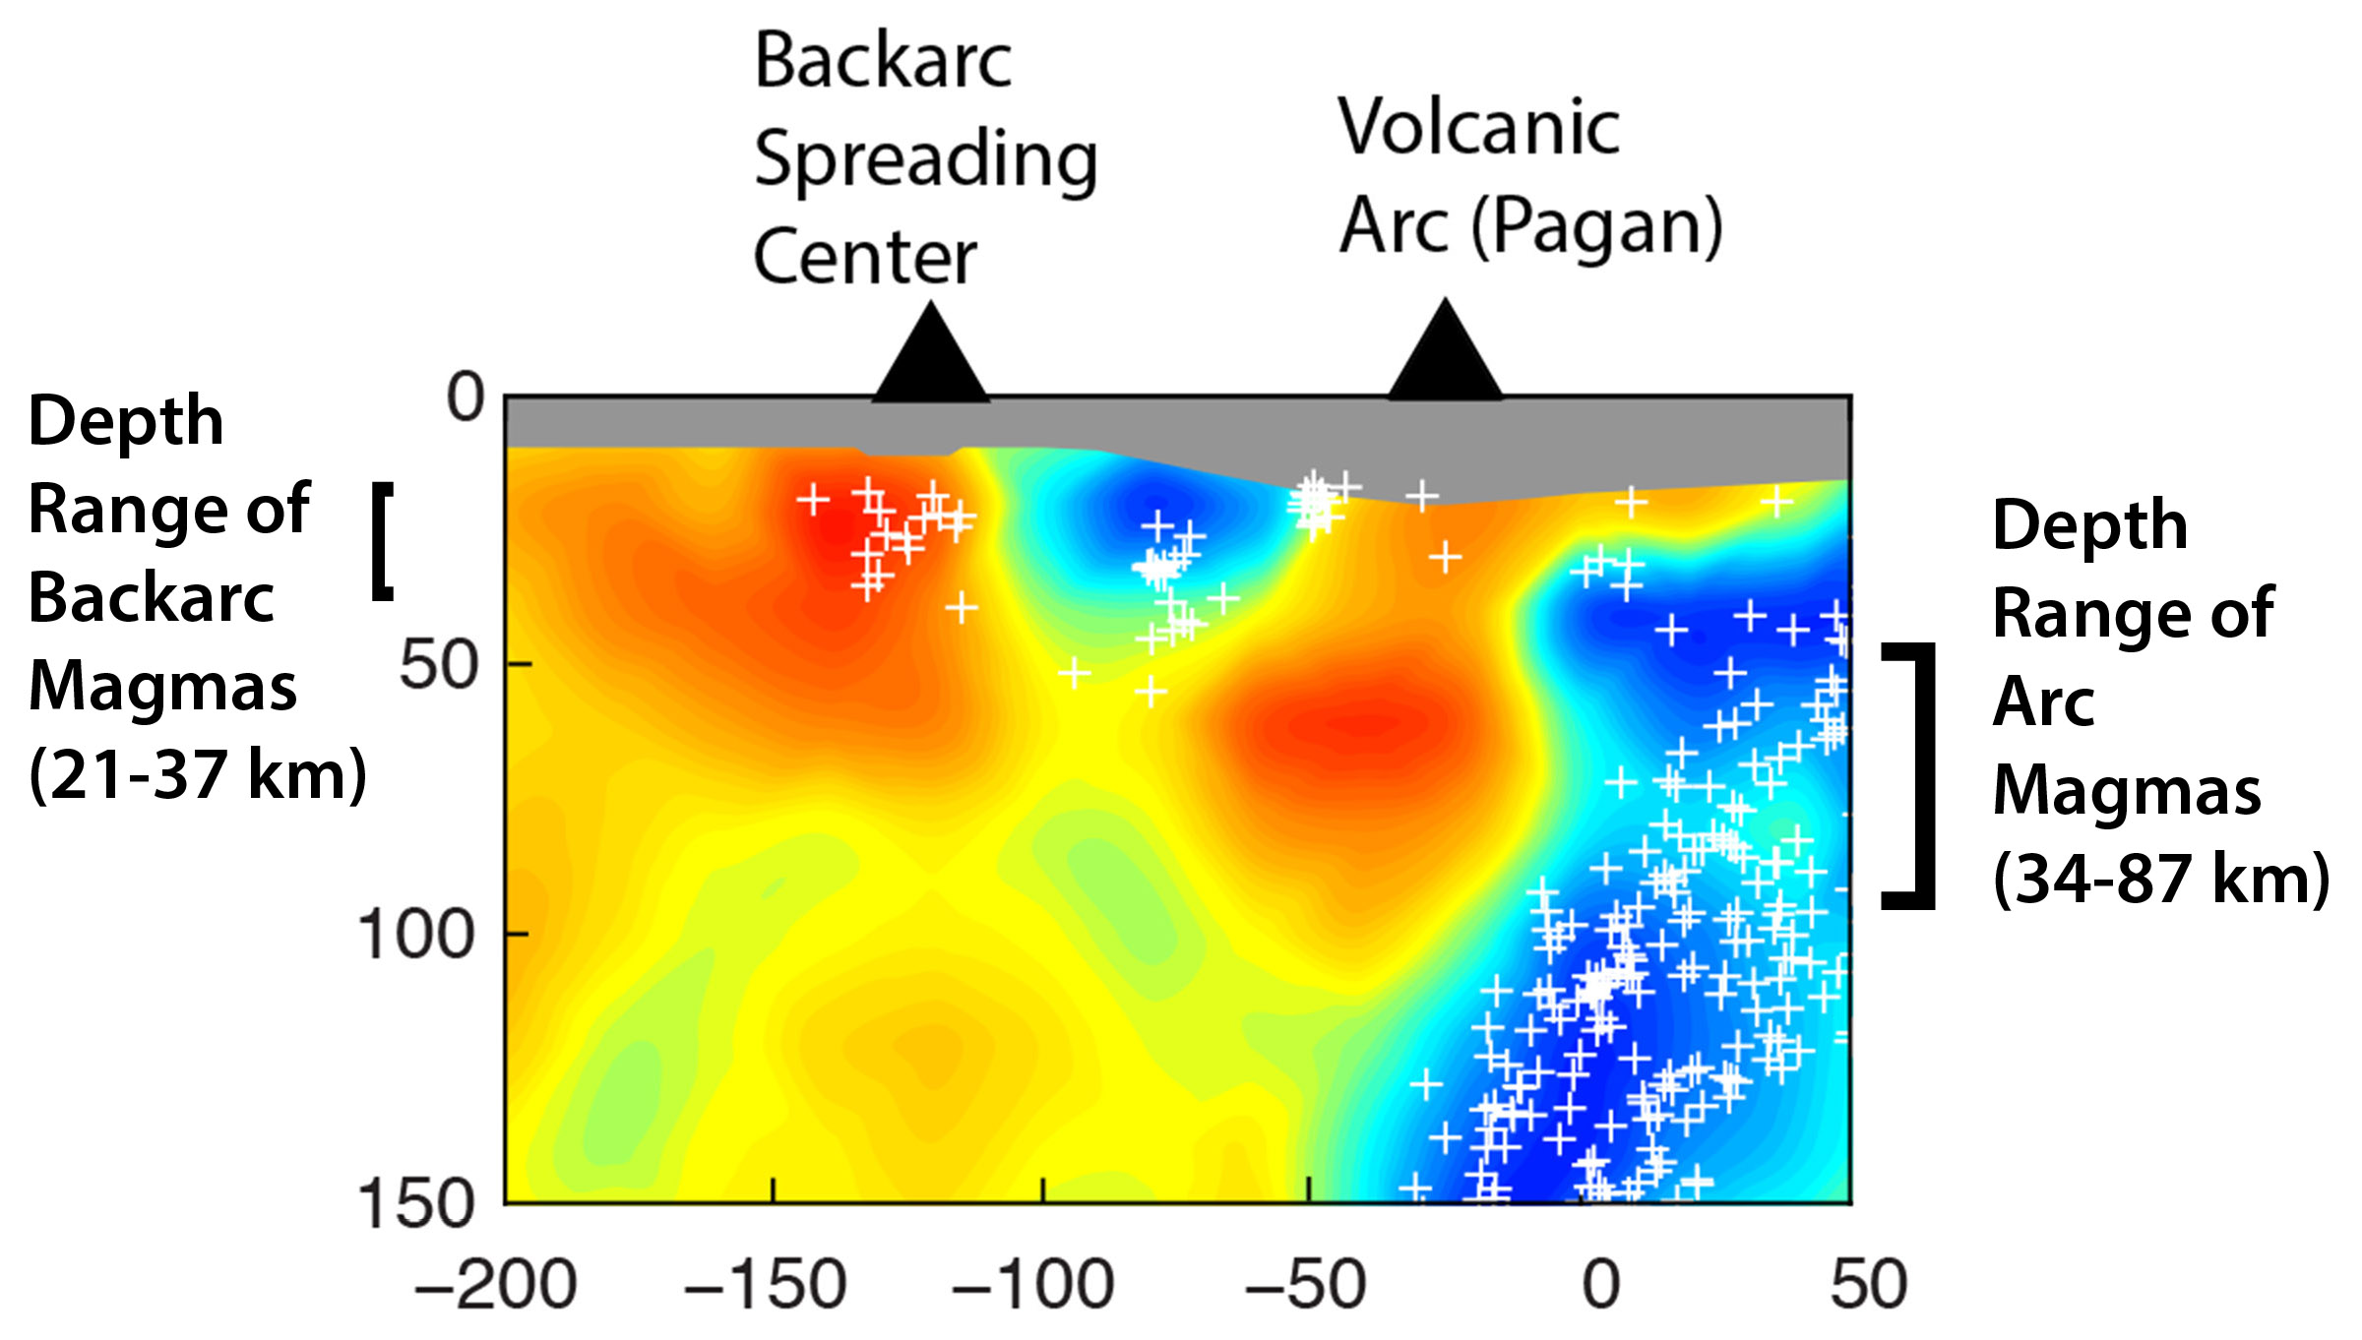
Comparison with Basalt Geobarometry
P wave velocity image;
Barklage et al. [2015]
= maximum
anomaly
Si & Mg thermobarometry suggest a final equilibration depth of magma: 21-34 km for the backarc spreading center
34-87 km for the volcanic arc [Kelley et al., 2010]
Corresponds perfectly with the strongest anomalies beneath the backarc and arc
Shows that velocity and Q anomalies delineate the melt production region
Anomalies result from small fractions of in-situ melt

Slide 25
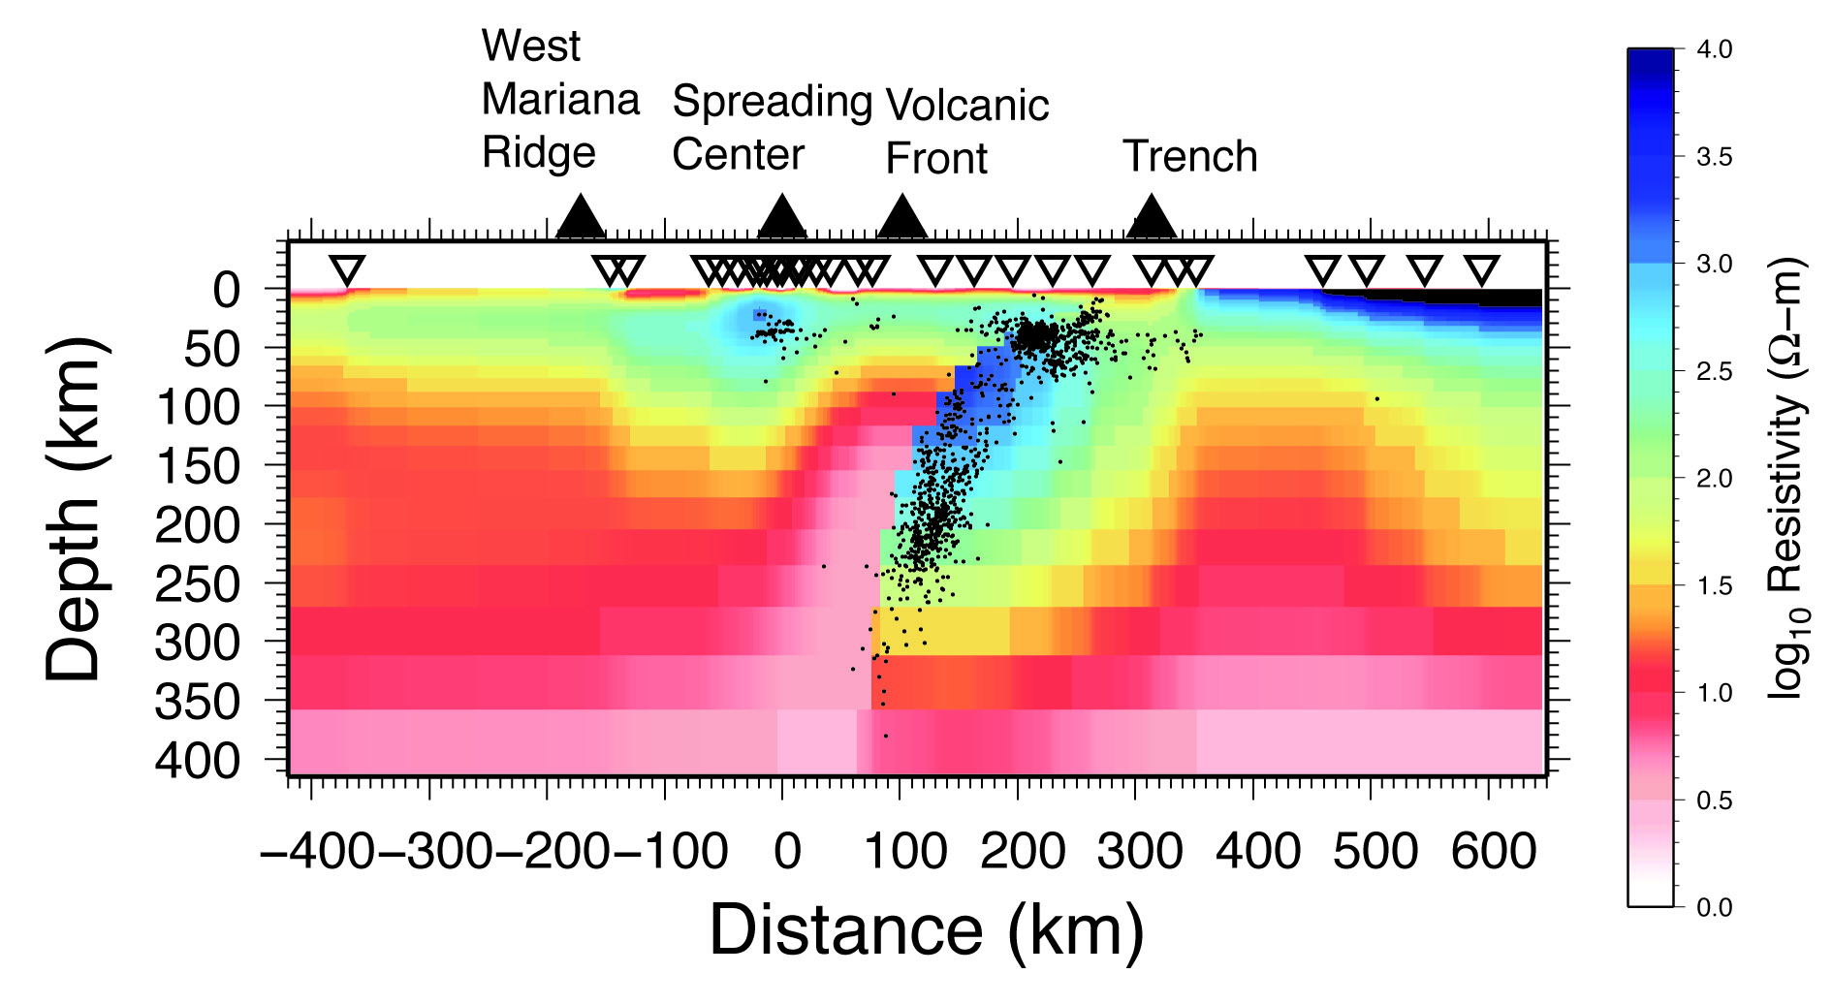
Comparison to Resistivity Structure from
Ocean Bottom MT Survey
Matsuno et al [2010]
High conductivity above the slab up to depths of 60 km beneath the arc
Suggests the presence of connected melt and/or other fluids
Low conductivity beneath the spreading center
Any melt beneath the spreading center is disconnected or distributed
discontinuously along the ridge

Slide 26
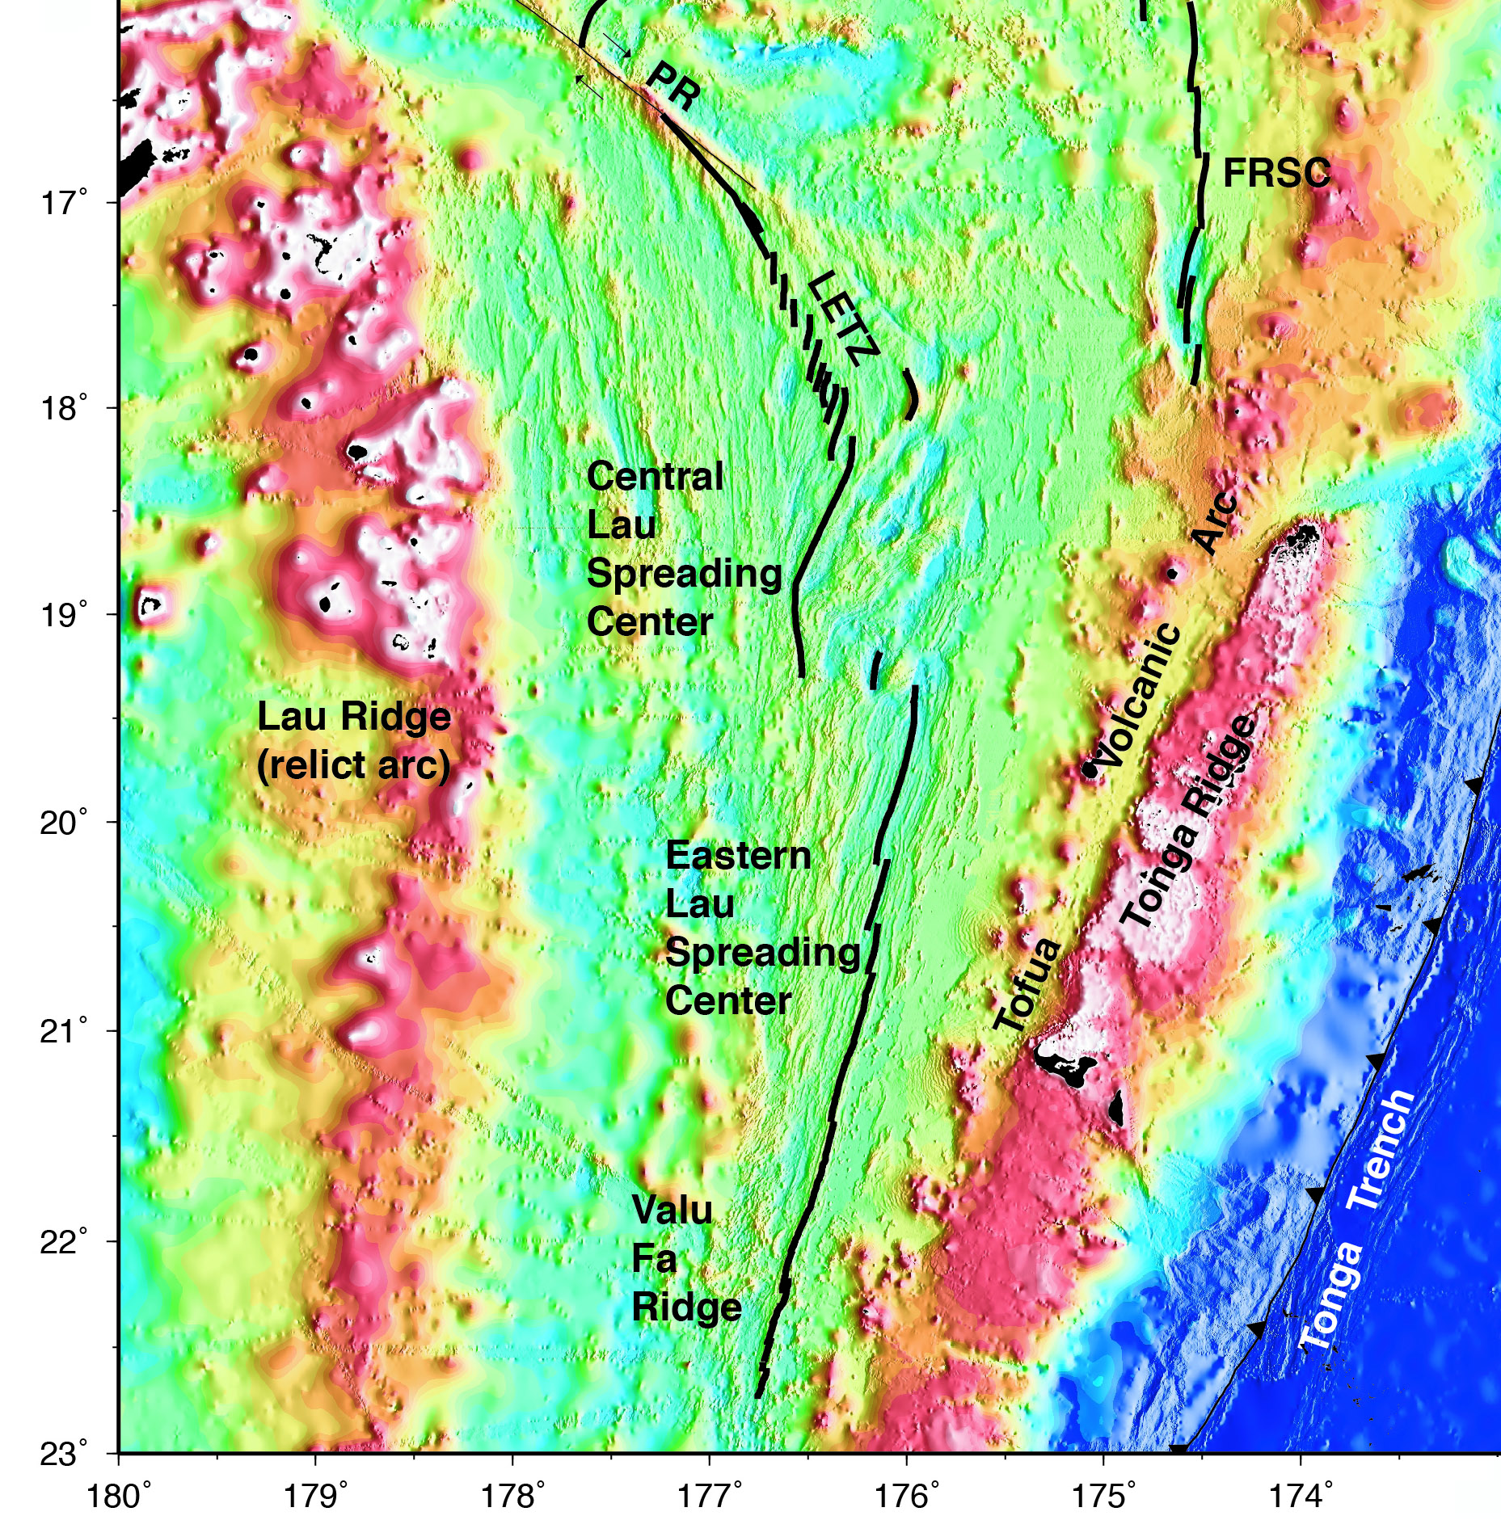
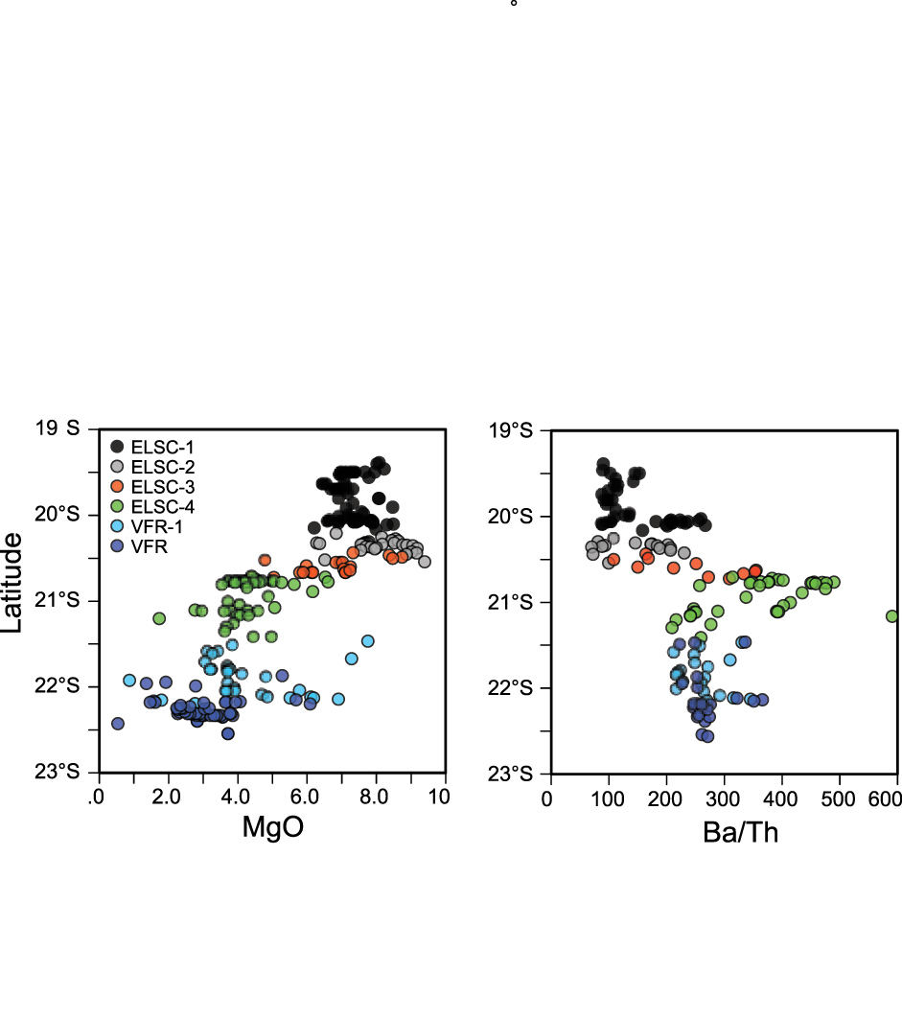
The Lau Basin: Subducted water signature in backarc spreading
Variable slab influence on backarc spreading centers
Eastern Lau Spreading Center
Tivey et al [2012]

Slide 27
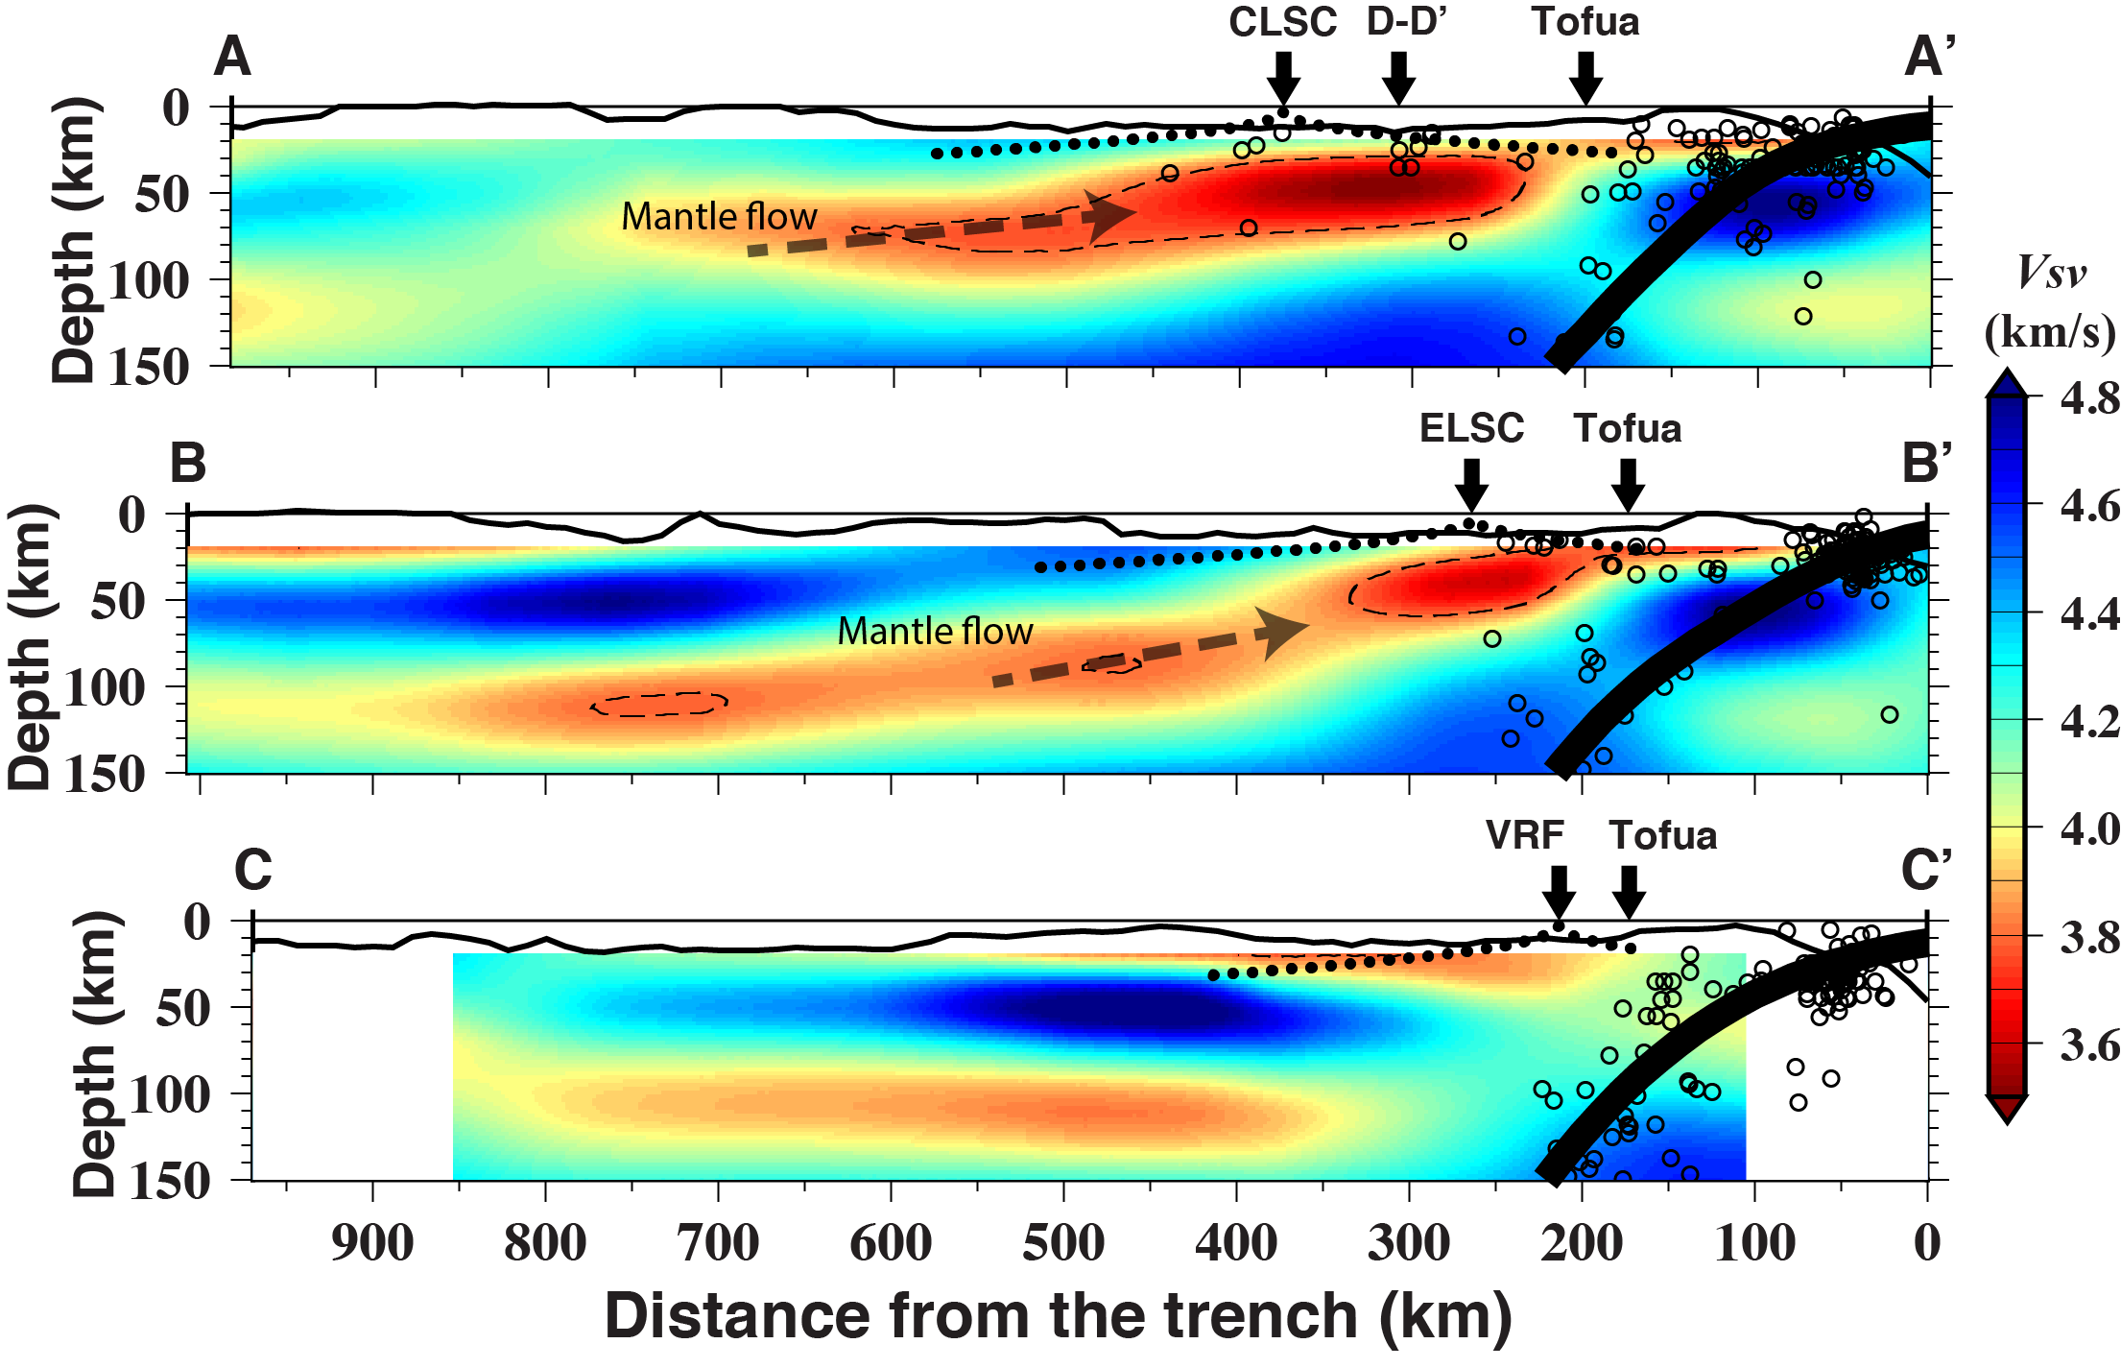
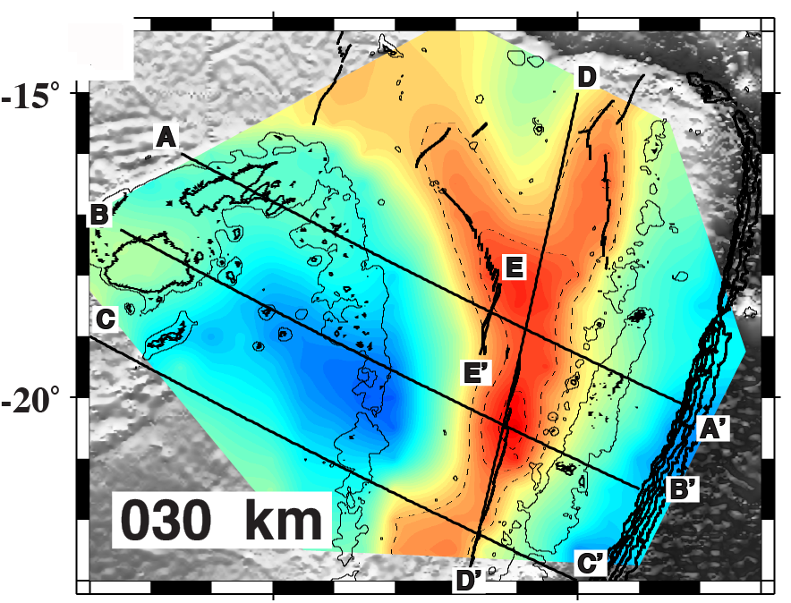
Backarc Geochemistry and Mantle Tomography
A-A’
B-B’
Wei et al., Nature, 2015
CLSC and Northern ELSC show ridges are fed by
decompression melting in upwelling to the west.
Valu Fa Ridge show no connection to the Upwelling to the
west, instead ridge samples only area above the slab
Explains sudden change of ridge geochemistry at 21°S
C-C’

Slide 28
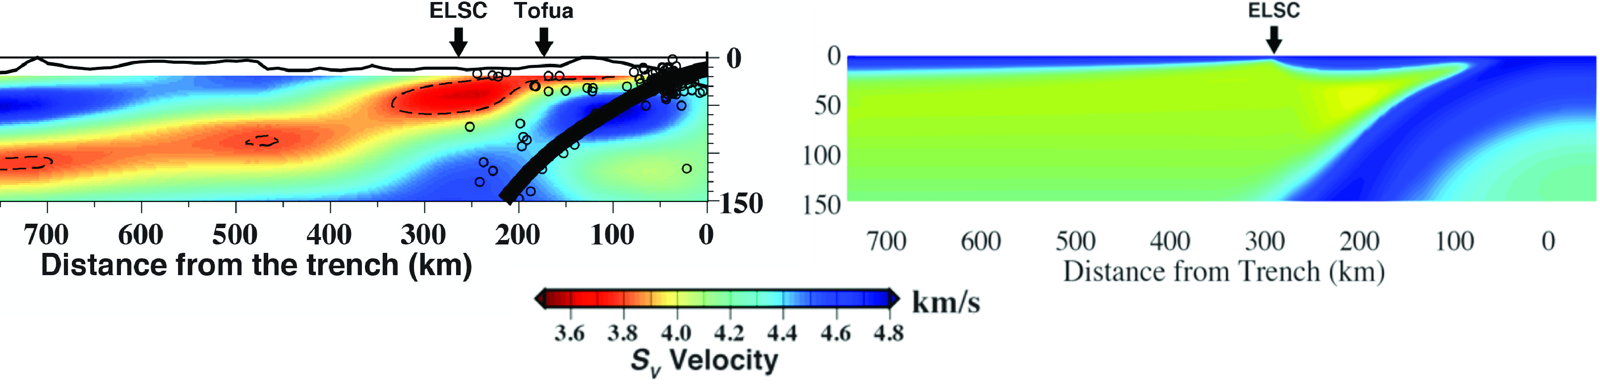
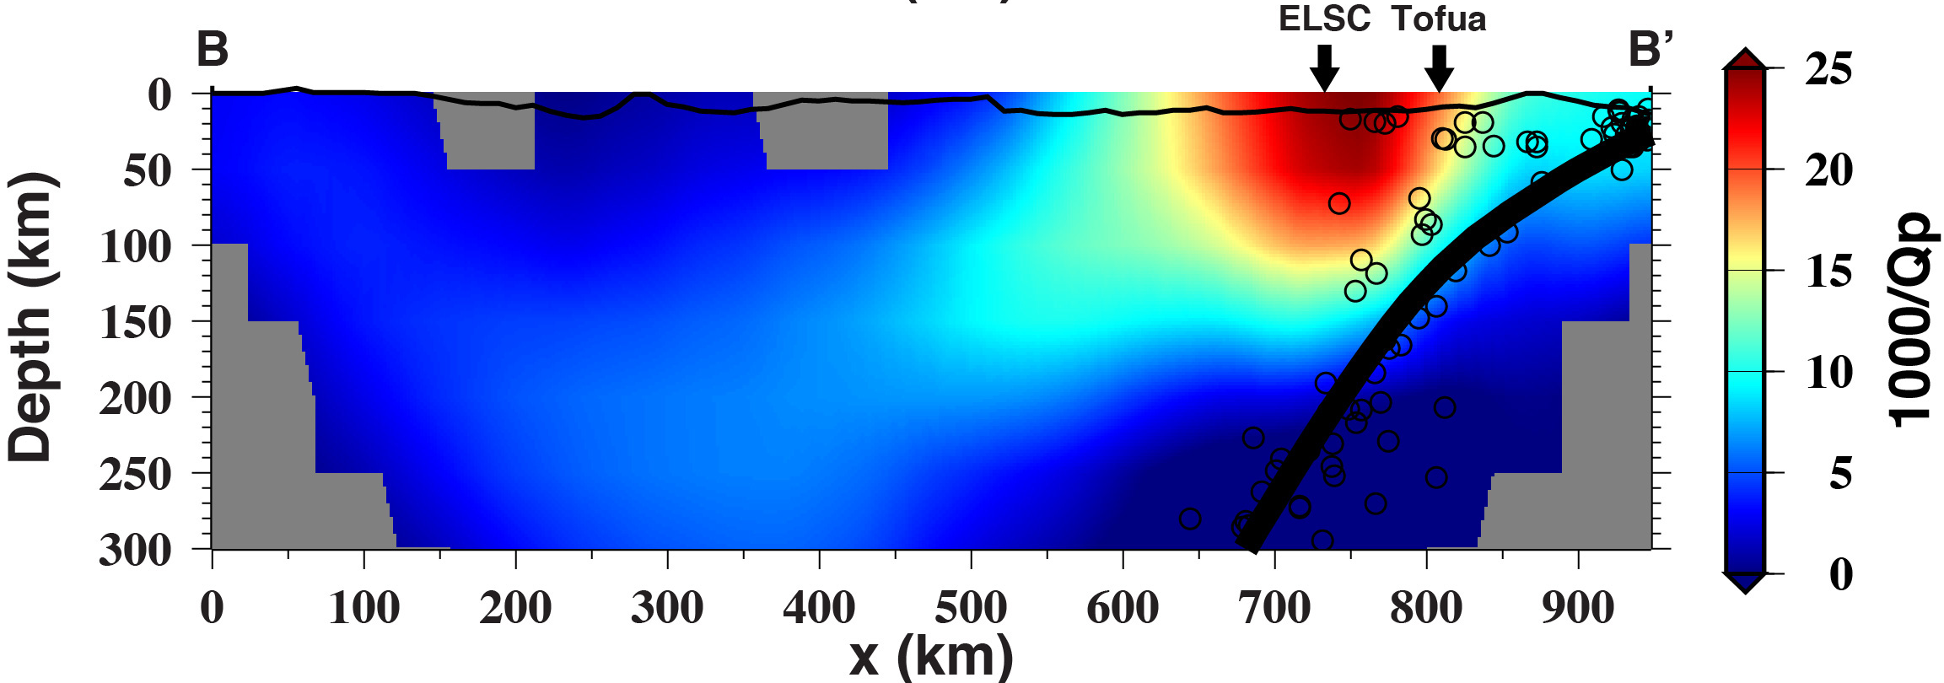
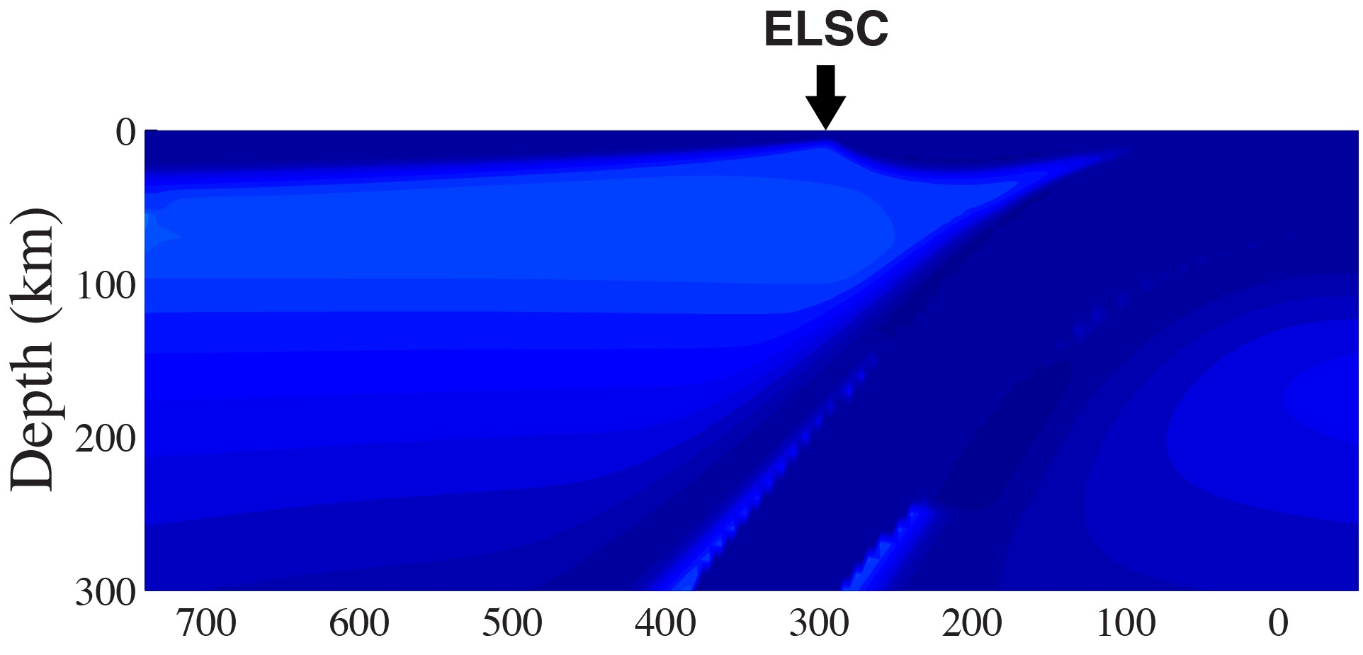
Observations cannot be matched with temperature and water effects
Observation
Model (Harmon & Blackman, 2010)
S_{v} Velocity
P-wave attenuation
Geodynamic model results (Harmon & Blackman, 2010) are converted to velocity and attenuation using Jackson et al (2010) for temperature and Karato (2012) for water content

Slide 29
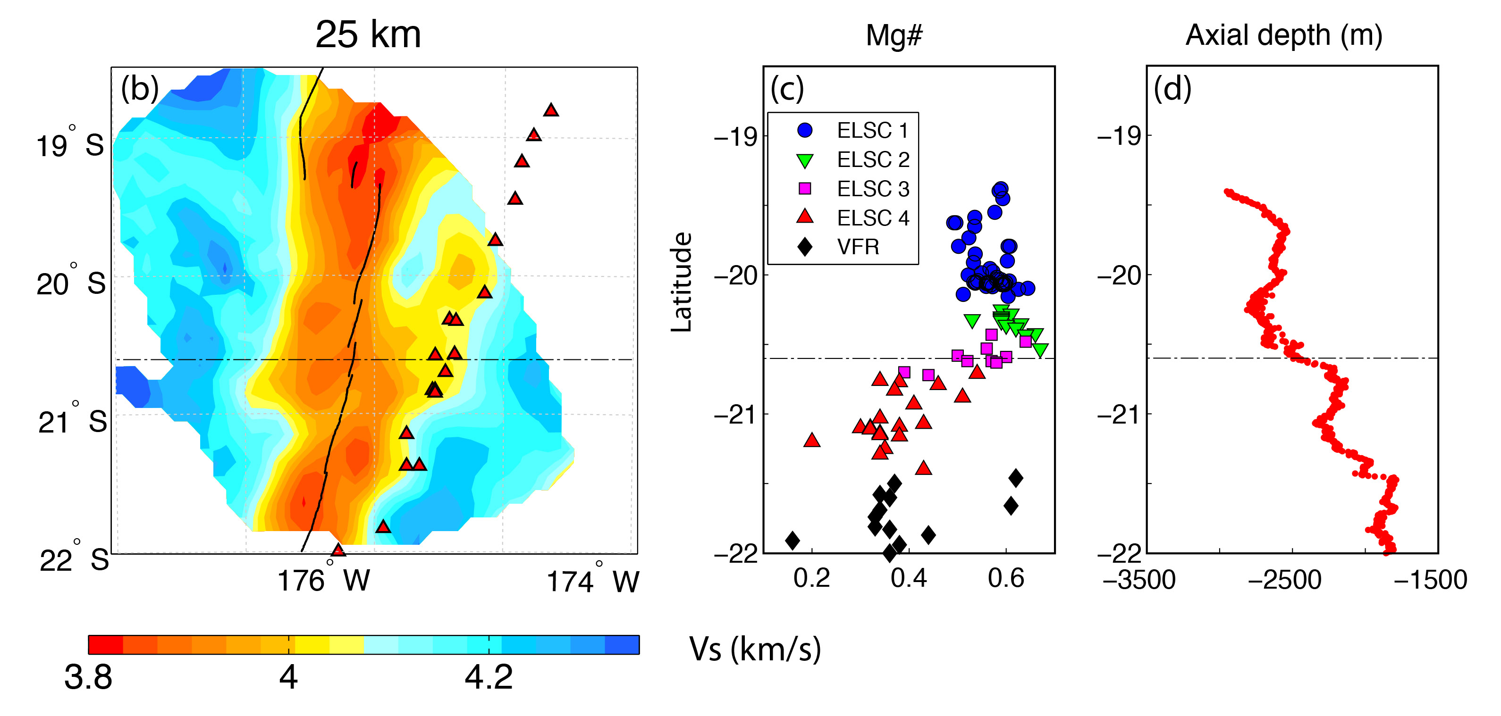
Backarc geochemical discontinuity
Tofua
Volcanic
Arc
Eastern
Lau
S C
Zha et al. [2014]
Seismic noise correlation gives higher resolution images at shallow depths
Melting region is offset to the west along northern ELSC, consistent with deeper images
Melt becomes offset to the east and extends to the volcanic arc at the chemical discontinuity
Geochemical discontinuity is where the backarc and arc melting regions begin to interact
South of the discontinuity slab water is provided to the backarc melt from the sub-arc mantle

Slide 30
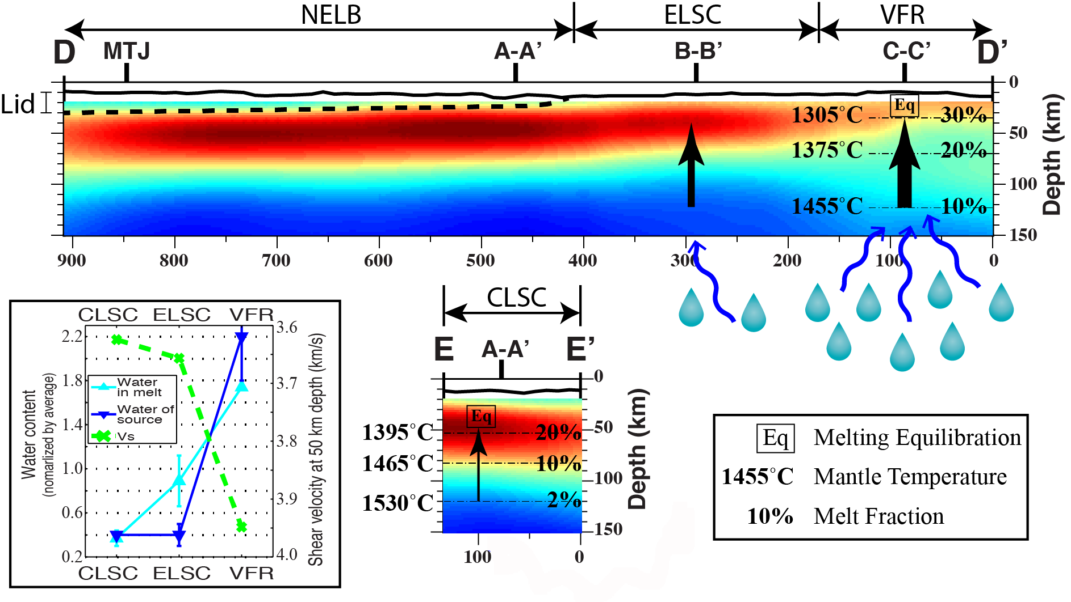
Backarc Geochemistry and Mantle Tomography
Wei et al., Nature, 2015
Temperatures and final equilibration
depths from Si + Mg thermobarometry
(Lee et al., 2009) provided by T. Plank
Images show great variation in the anomaly amplitude in the melting region (~50 km depth)
Largest anomaly is in the Northeast Lau Basin (with no spreading center) and CLSC
Anomaly beneath Northeast Lau basin could be a result of melt trapped beneath lithosphere?
Much smaller anomaly beneath the Valu Fa Ridge, with large water input from the slab
Seismic anomaly difference is too large to be caused by temperature differences
Anomaly amplitude is inversely correlated with water in the melt, suggesting decreased
melt porosity for aqueous melts

Slide 31
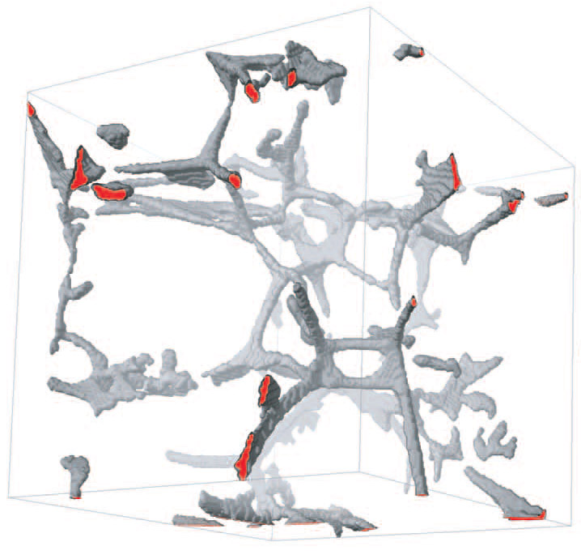
How does water affect melt porosity?
Melt Porosity
Assume the magnitude of the seismic
anomalies controlled by melt porosity
Results suggest melt porosity is reduced
in regions of high water content
If melt moves by equilibrium porous flow:
melt flux ∝ d²ϕ^{n}/μ
For similar melt flux, porosity decreases
with increasing grain size or decreasing
melt flux
Water increases grain growth rates
(Karato, 1989) and decreases melt
viscosity, both of which will decrease
melt porosity
Essentially water increases the efficiency
of melt extraction, reducing porosity
Node
Zhu et al
[2011]
Melt Flux ∝ d²ϕ^{n}/μ
Where: d = grain size
ϕ = porosity
μ = melt viscosity
n = between 2-3
Tubule

Slide 32
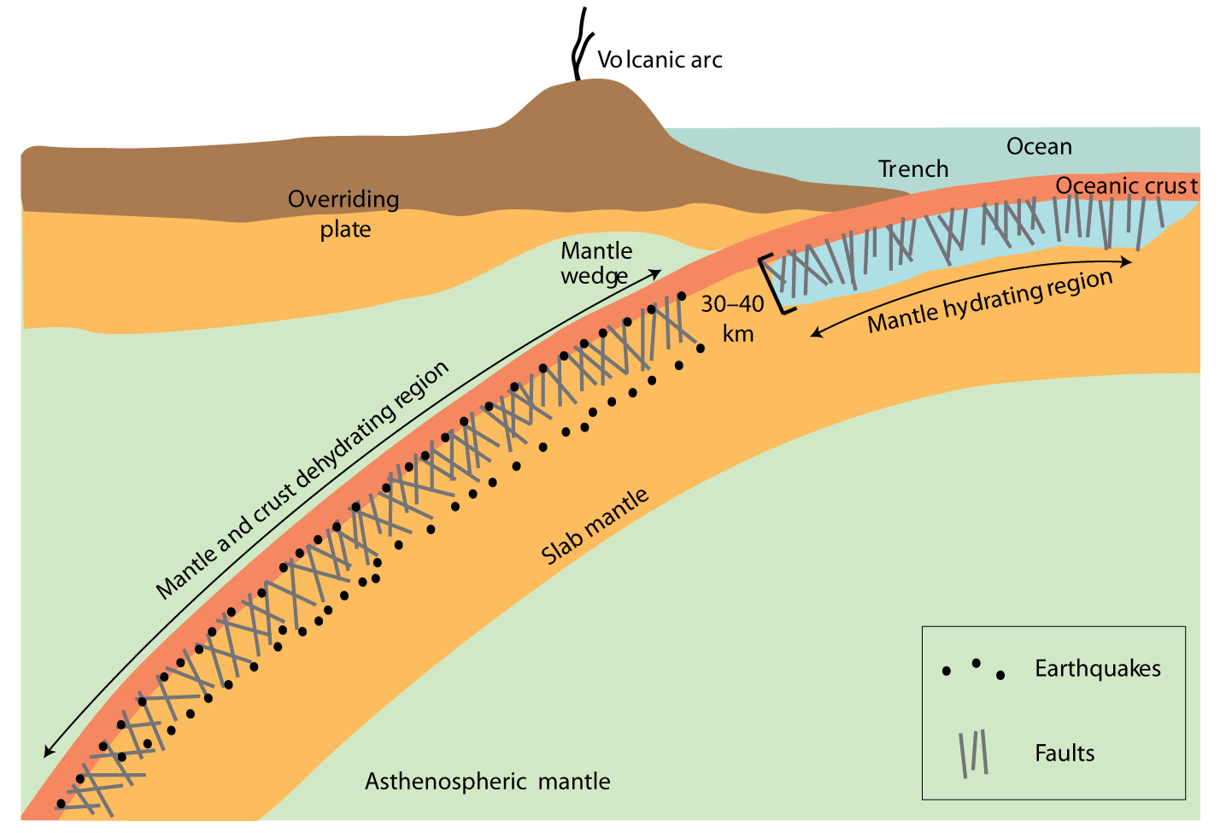
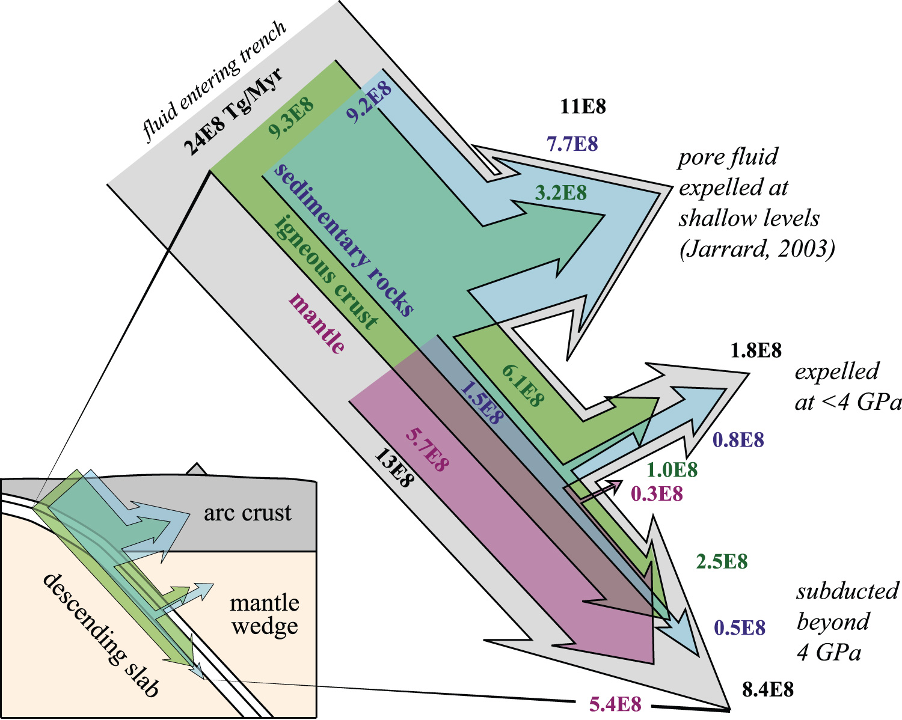
Subduction Input Water Budget
Estimated Water Budget
Model for Hydrating the Upper Mantle
Hacker [2008]
Billen [2009]

Slide 33
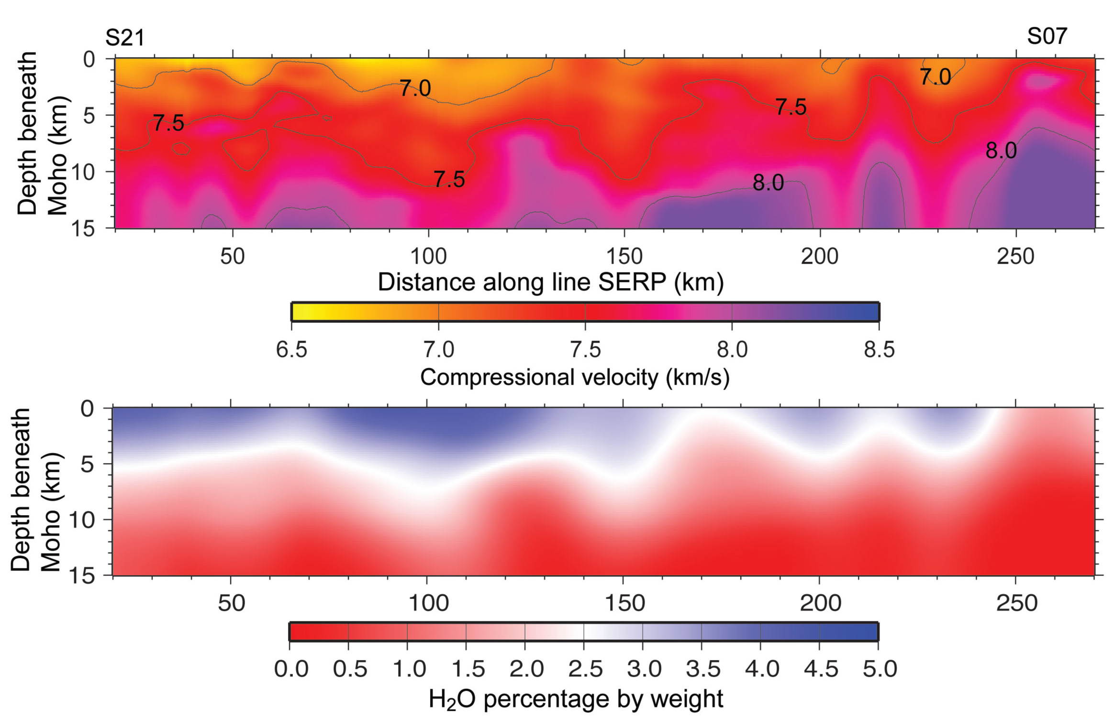
Upper Mantle Serpentinization: Central America
Nicaragua
Costa Rica
Sub-Moho seismic velocity in subducting Cocos plate
Maximum depth of extensional earthquakes
Lefeldt et al. [2009]
H2O distributed in mantle
van Avendonk et al. [2011]

Slide 34
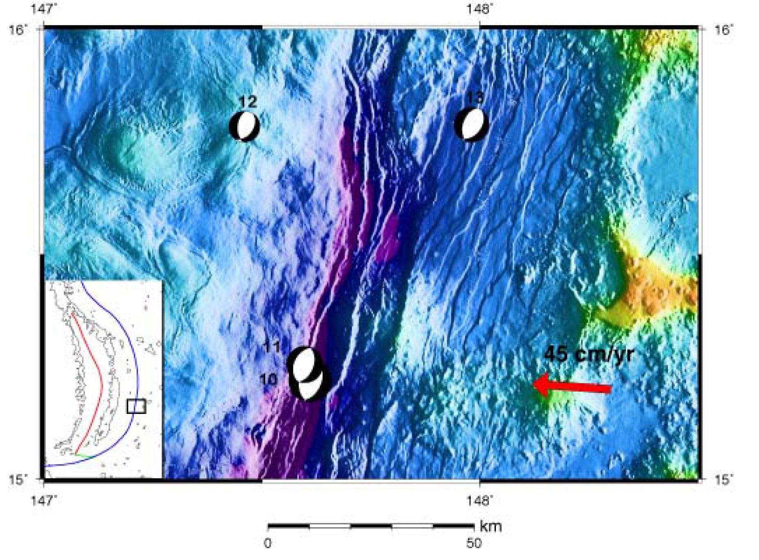
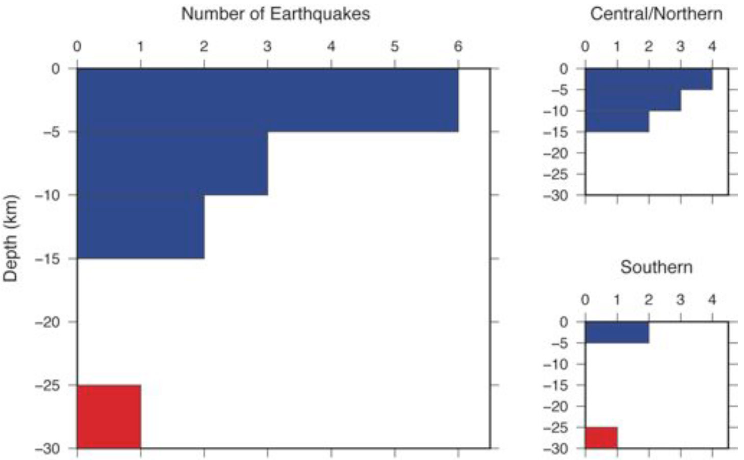

Plate-bending faults and the serpentinization of the Mariana incoming plate
Extensional
Compressional
Tensional earthquakes concentrated in
the upper 12 km of the mantle
Do tensional earthquake depths control
the depth of mantle serpentinization?
Does depth of faulting cause along
strike changes in subducted water?
Emry et al. [2014]

Slide 35



2012-2013 Mariana Trench OBS deployment
Investigating slab and forearc serpentinization
R/V Langseth
Deploying moored
hydrophones
near the Mariana
Trench axis
20 broadband OBS, 60 short period OBS,
5 tethered hydrophones

Slide 36

Solid-Earth Controls on Glacial Movement
and Isostatic Response
Byrd Glacier,
Antarctica

Slide 37



POLENET/ANET- Autonomous Seismic
and GPS stations in Antarctica
autonomous GPS & seismic instruments at remote sites
first continuous autonomous measurements in the interior
GPS
Seismic

Slide 38


Opening a new continent for seismic studies
Seismographs in 2006
Seismographs in 2010
Other Seismology PIs on the POLENET/ANET project: Sridhar Anandakrishnan & Andy Nyblade (Penn State),
Rick Aster (Colorado State), Audrey Huerta and Paul Winberry (Central Washington)

Slide 39


Solid-Earth Controls on Glacial Movement
Ice velocity from radar interferometry
Ice drained by vast ice streams
Mechanics of basal sliding:
why low friction?
what causes stick-slip?
heat flow is crucial for basal water
Rignot et al., [2011]

Slide 40


Antarctic Geothermal Heat Flow?
Heat flow controls melting and water at the base of ice sheets
May have a strong influence on ice sheet dynamics
Heat Flow estimated from magnetics
Maule et al. [2005]
Heat Flow estimated from seismic structure
Shapiro & Ritzwoller [2004]

Slide 41

Seismic velocity model for Antarctica
(Heeszel et al., 2015)
Based on array Rayleigh wave phase velocities recorded by arrays in Antarctica
High velocity cratonic lithosphere in East Antarctica down to ~ 250 km depth
Slow velocities in the Ross Sea and along the West Antarctic Rift System (WARS), suggesting low upper mantle viscosity
Evidence of a low velocity thermal plume beneath Marie Byrd Land

Slide 42


Sub-glacial Active Volcanoes in Marie Byrd Land
Deep (30 km) LP Volcanic Earthquakes
Satellite Image
Ongoing deep long-period volcanic
earthquakes discovered
Indicative of an active magma system
Demonstrates that active volcanism along
Executive Com. Range continues
southward migration
Volcanic eruption would melt many km³
of ice, lubricate the ice sheet
Subglacial Topography
Lough et al., Nature Geosciences [2013]

Slide 43

Glacial Isostatic Adjustment
The solid earth responds to changes
in ice mass
Part of the response is immediate –
Elastic response – allows us to
measure current ice mass change
But part of the response is longer
term, results from mantle flow
If we understand this part, we can
also determine ice mass history
Key observations:
elevation (from GPS)
gravity (from GRACE satellite)
also need some estimate of mantle
viscosity

Slide 44

Glacial Isostatic Adjustment is Dependent on Earth Structure
Computed GIA Uplift Rate for Different Mantle Viscosities
Low viscosity:
short-term memory
Sensitive only to Holocene
Computed uplift strongly dependent on viscosity
Larger viscosity gives much larger uplift
“Memory” is a strong function of viscosity
Viscosity is expected to be highly variable for the Antarctic continent
Seismology can provide constraints on 3D viscosity structure
High Viscosity:
long-term memory
Sensitive to LGM
Ivins & James 2005

Slide 45

Estimating Viscosity Structure from the Seismic Model
Convert S_{v} velocity to isotropic S velocity
Compute velocity anomaly with respect to a standard earth model (here we use PREM)
Use (Wu et al, 2013):
-- Temperature derivative from Karato (2008)
-- T₀ - reference temperature – assume 1315 °C adiabat
-- β - percent of seismic anomaly due to temperature
-- E* and V* - rheological constants

Slide 46

Estimated Mantle Viscosity Variations
Large viscosity variation between Marie Byrd Land and craton
Suggests that uplift in West Antarctica results from the last ~ 100-500 years, East Antarctica uplift sensitive to last glacial maximum

Slide 47


Glacial Isostatic Adjustment from POLENET GPS
Vertical motions from POLENET
Colors represent mantle viscosity at 180 km depth from seismology
West Antarctica is dominated
by uplift
Uplift is caused by reduction
in the weight of ice as it melts
The low viscosity shows that the
uplift is caused by recent ice loss
Coastal uplift of up to 42 mm/yr
is largest in the world
Caused by combined elastic and
viscous response to rapid ice mass
loss
Log η
Pa s
Figure from T. Wilson
Figure from Terry Wilson

Slide 48


Melting of West Antarctic Ice from Gravity Measurements
Ice Mass Loss in Antarctica from GRACE
Ice Mass in West Antarctica
Glacial Isostatic Adjustment uplift is needed
to correct gravity measurements to get another
measure of ice loss
GRACE satellite measures large ice loss along the
Amundsen Sea coast and the Antarctic Peninsula
Shows increasing rate of ice mass loss
Harig & Simons [2015]

Slide 49

Any
Questions?

