Slide 2
Uncertainties…
What do we mean, … mean age of the Earth?
Element classification
Classification of meteorites
What do we mean by “chondrite”?
Other topics….

Slide 3
Just a side note
There are several competing compositional models for the Earth
Someone must be right(?), but we all can be partially right, or we could all be wrong
We really do not know the composition of the lower mantle…
There may or may not be hidden reservoirs in the mantle
We lack a complete meteoritic record

Slide 4
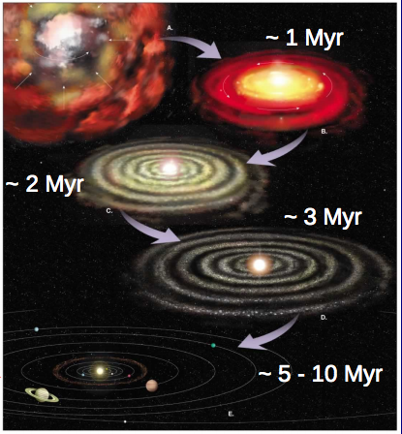
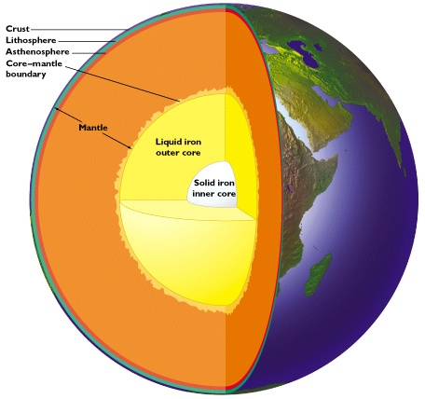
Compositional model of the Earth and early planetary evolution
Bill McDonough
Geology, U Maryland

Slide 5
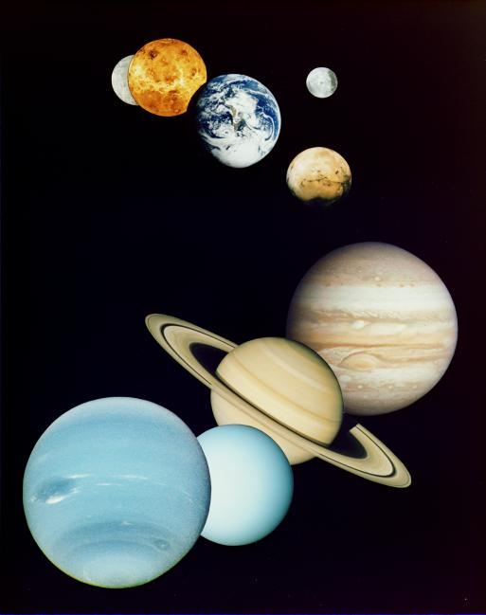
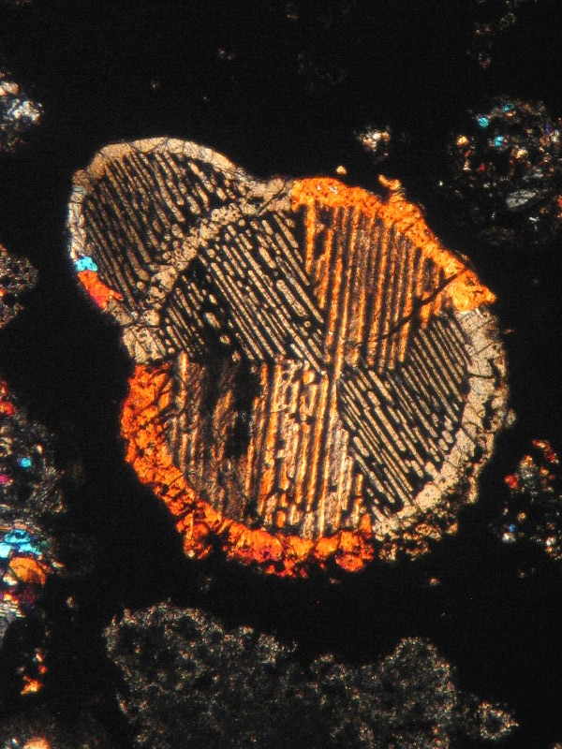
Solar Nebular Considerations
Space – Time – Temperature:
gradients and heterogeneity
Sorting:
size …CAI vs chondrules vs matrix
density …metals vs silicate
crystallinity …increases toward Sun
Redox conditions:
nebular vs parent-body
- Compositional models differ widely, implying a factor of three difference in the Ca, Al, U & Th content of the Earth

Slide 6
Earth Models Update: …just the last 9 months!
Murakami et al (May - 2012, Nature): “…the lower mantle is enriched in silicon … consistent with the [CI] chondritic Earth model.”
Campbell and O’Neill (March - 2012, Nature): “Evidence against a chondritic Earth”
Zhang et al (March - 2012, Nature Geoscience): The Ti isotopic composition of the Earth and Moon overlaps that of enstatite chondrites.
Fitoussi and Bourdon (March - 2012, Science): “Si isotopes support the conclusion that Earth was not built solely from enstatite chondrites.”
Warren (Nov - 2011, EPSL): “Among known chondrite groups, EH yields a relatively close fit to the stable-isotopic composition of Earth.”
- Compositional models differ widely, implying a factor of two difference in the U & Th content of the Earth

Slide 7
U content of BSE models
Nucelosynthesis: U/Si and Th/Si production probability
Heat flow: secular cooling vs radiogenic contribution… ?
Modeling composition: which chondrite should we use?
A brief (albeit biased) history of U estimates in BSE:
Urey (56) 16 ppb Turcotte & Schubert (82; 03) 31 ppb
Wasserburg et al (63) 33 ppb Hart & Zindler (86) 20.8 ppb
Ganapathy & Anders (74) 18 ppb McDonough & Sun (95) 20 ppb ± 4
Ringwood (75) 20 ppb Allegre et al (95) 21 ppb
Jagoutz et al (79) 26 ppb Palme & O’Neill (03) 22 ppb ± 3
Schubert et al (80) 31 ppb Lyubetskaya & Korenaga (05) 17 ppb±3
Davies (80) 12-23 ppb O’Neill & Palme (08) 10 ppb
Wanke (81) 21 ppb Javoy et al (10) 12 ppb

Slide 8
Nature & amount of Earth’s thermal power
radiogenic heating vs secular cooling
- abundance of heat producing elements (K, Th, U) in the Earth
- clues to planet formation processes
- amount of radiogenic power to drive mantle convection & plate tectonics
- is the mantle compositionally layered or have large structures?
estimates of BSE from 9TW to 36TW
constrains chondritic Earth models
estimates of mantle 1TW to 28TW
layers, LLSVP, superplume piles
the future… Geoneutrino studies

Slide 9
Ca, Al, REE, K, Th & U
Lithophile
elements
Atmophile elements
Core
Mantle
Fe, Ni,
P, Os
Siderophile
elements

Slide 10
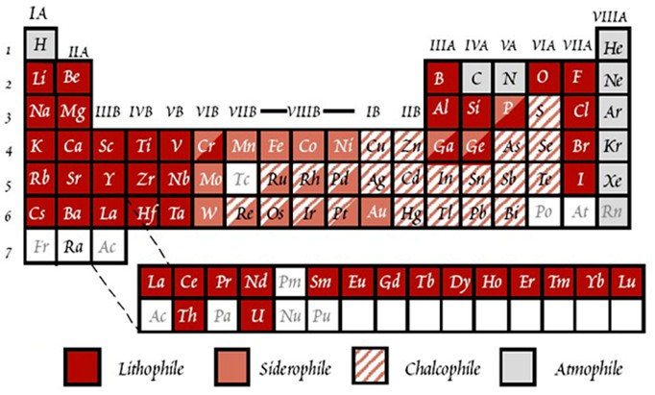
Goldschmidt’s Classification of Element

Slide 11
Classification of elements
nebular environment:
- condensation temperatures at which 50% the mass of an element precipitates out of a nebular gas (typical assumpution 10⁻⁴ atm of H)
refractory: Ca, Al, Ti, Th, U, REE, Re, Os
major components: Mg, Fe, Ni, Co, Si
moderately volatile: K, Pb, S, Rb, Au, Cd, halides
volatile: H, C, N, O, noble gases
planetary environment:
- what’s in the core, mantle and atmosphere/hydrosphere
lithophile: Mg, Ca, Al, Ti, Th, U, REE
siderophile: Ni, Fe, Co, Ir, Au, Os
chalcophile: S, Cu, Pb,
atmophile: N, H, C, O, noble gases
>1400 K
1350 – 1250 K
1250 – 800 K
<800 K
In the mantle
Mostly in the core
In the core & mantle
Mostly in the atm/hydro

Slide 12
Volatiles: defined
- H₂O, CO₂, N₂, CH₄, (i.e., H, C, N, O)
Noble gases (group 18 elements)
- elements with half-mass condensation T <1250 K
- elements readily degassed (e.g., Re, Cd, Pb…)
- chalcogens (group 16: i.e., O, S, Se and Te)
- halides (group 17: i.e., F, Cl, Br, I)?
alkali metals (group 1: Cs, Rb, K…)?

Slide 13
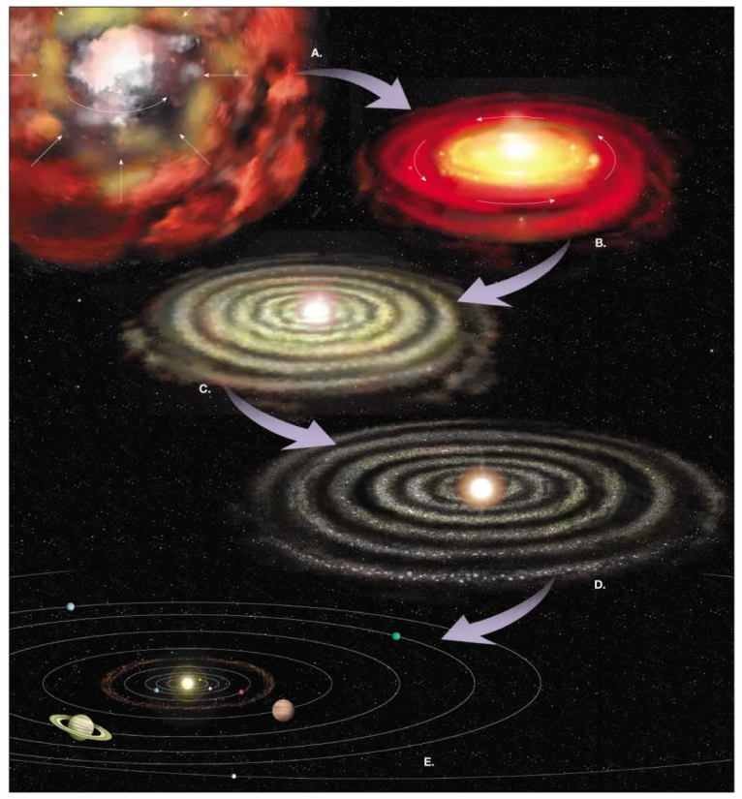
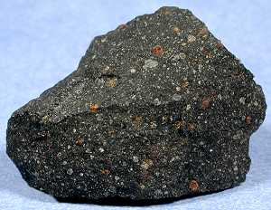
What is the composition of the Earth?
and where did this stuff come from?
Nebula
Meteorite
Heterogeneous mixtures of components with different formation temperatures and conditions
Planet:
mix of metal, silicate, volatiles

Slide 14
“Standard” Planetary Model
Orbital and seismic (if available) constraints
Chondrites, primitive meteorites, are key
So too, the composition of the solar photosphere
Refractory elements (RE) in chondritic proportions
Absolute abundances of RE – model dependent
Mg, Fe, Si & O are non-refractory elements
Chemical gradient in solar system
Non-refractory elements: model dependent
U & Th are RE, whereas K is moderately volatile

Slide 15
Classification of meteorites
chondrites:
- undifferentiated, chondrules, mixtures of metals and silicates, oldest material
- redox state, size of chondrules, degree of alteration and metamorphism
carbonaceous chondrites: oxidized, mostly FeO, less Fe
ordinary chondrites: intermediate redox state
enstatite chondrites: reduced (Si in metal)
rumuruti, kakangari, other: new families being found…
not chondrites:
- differentiated, irons, silicates, or mixtures of olivine and irons
irons: Fe and Ni >95% by mass
stony irons: disrupted fragments from CMB of planetismals
achondrites: mantle and crust (basalt) fragments
other: e.g., pieces of the Moon and Mars
attributes
taxonomy

Slide 16
** Bias **
Most studied meteorites
fell to the Earth ≤0.1 Ma ago

Slide 17
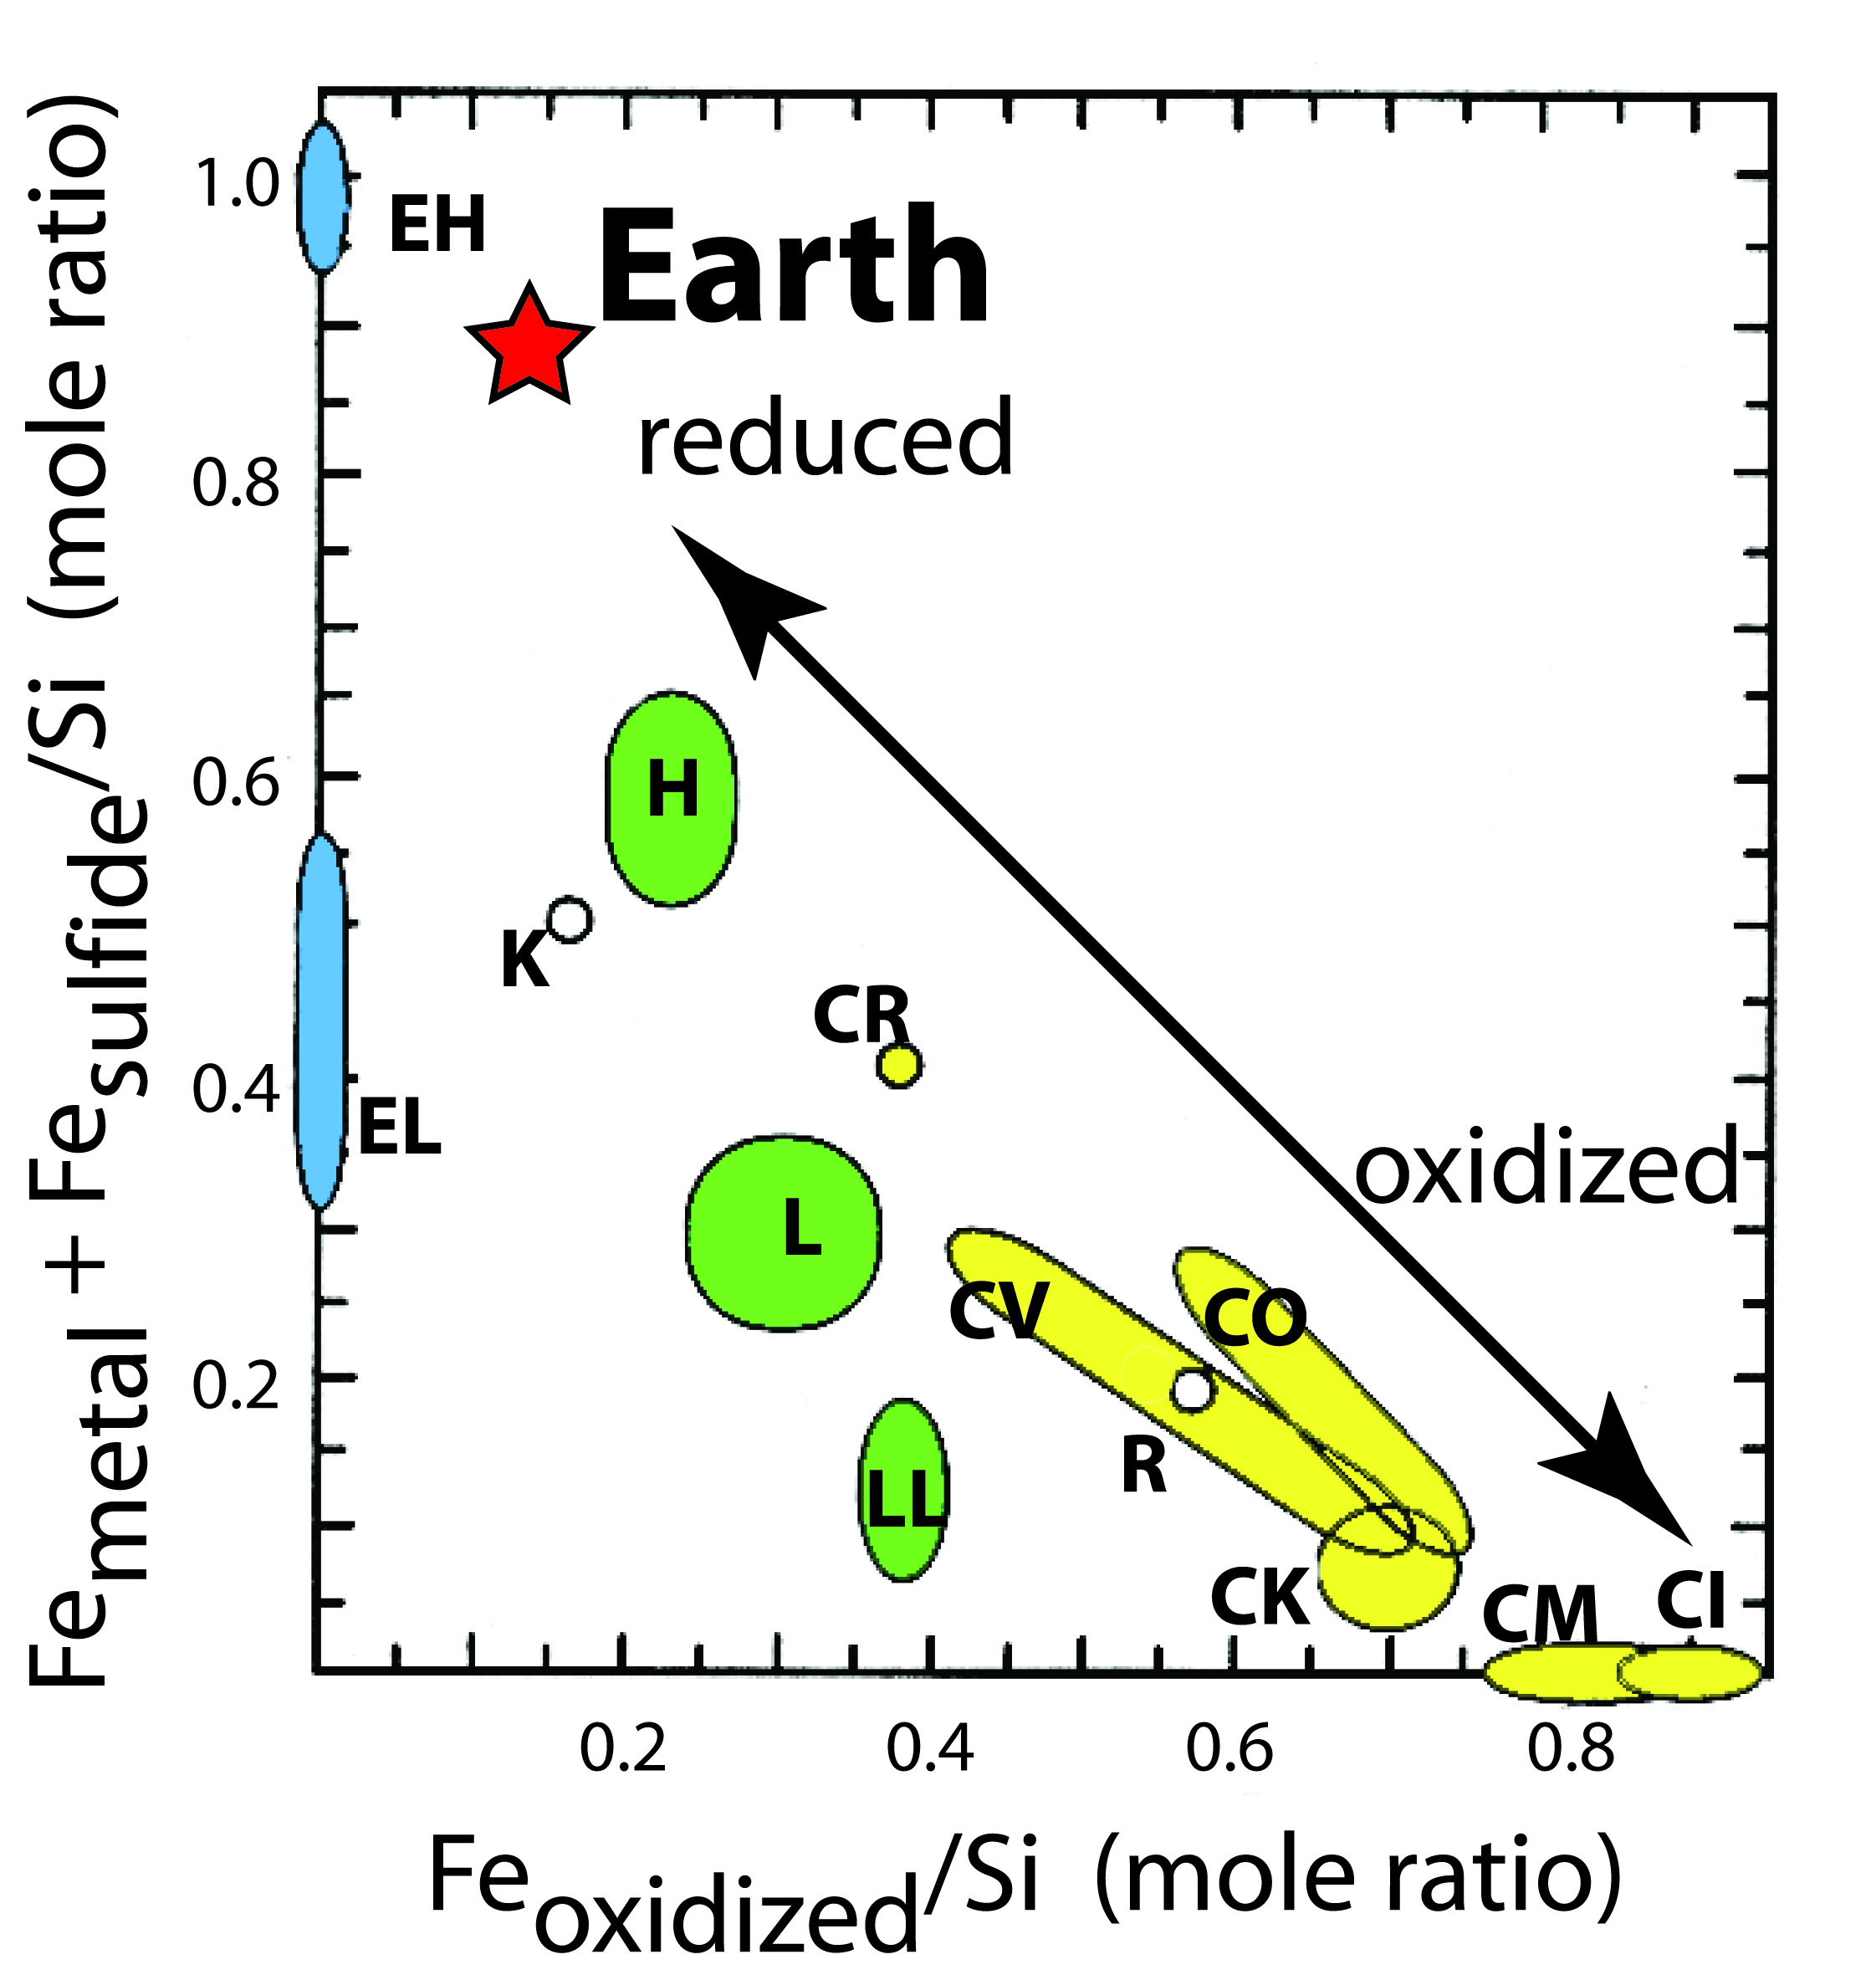

Slide 18
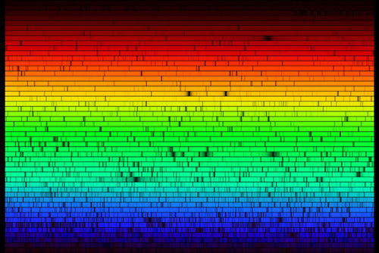
Absorption spectra of the Sun
Compositional analysis of the solar photosphere
Near infrared
Ultraviolet

Slide 19
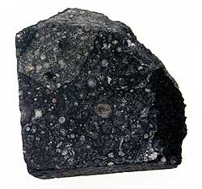

Slide 20
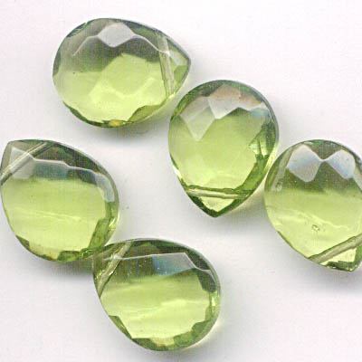
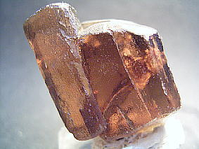
Mg/Si variation in the SS
Forsterite (Mg₂SiO₄)
- high temperature
- early crystallization
Mg/Si ~ 2
Enstatite (MgSiO₃)
- lower temperature
- later crystallization
Mg/Si ~1

Slide 21
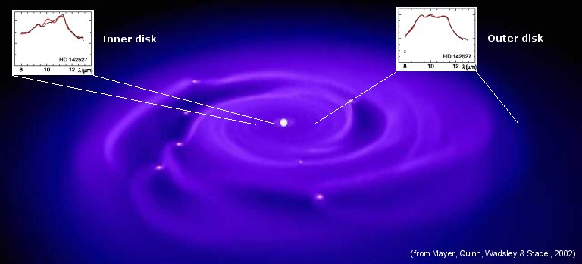
Inner nebular regions of dust to be highly crystallized,
Outer region of one star has
- equal amounts of pyroxene and olivine
- while the inner regions are dominated by olivine.
Boekel et al (2004; Nature)
Olivine-rich
Ol & Pyx

Slide 22
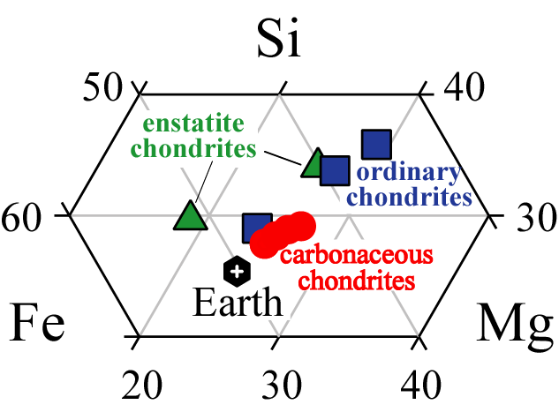
Si
Fe
Mg
weight % elements
Moles Fe + Si + Mg + O = ~93% Earth’s mass
(with Ni, Al and Ca its >98%)

Slide 23
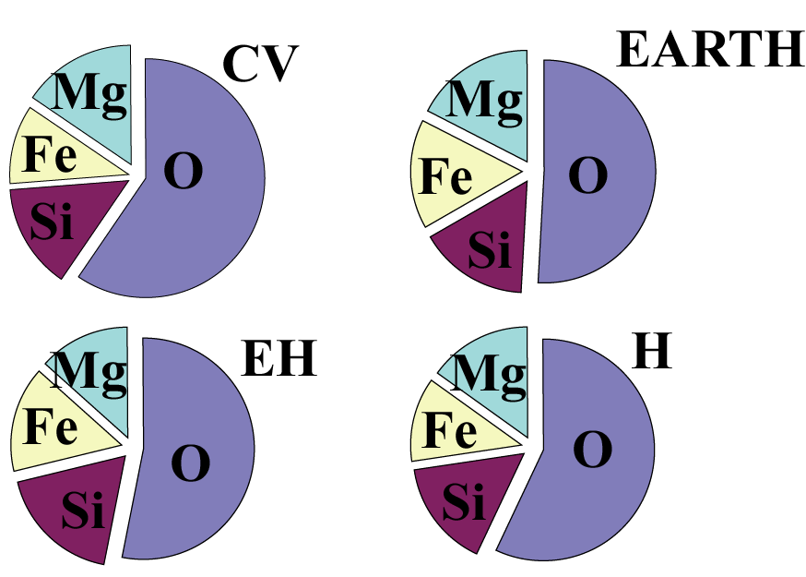
Atomic proportions of the elements

Slide 24
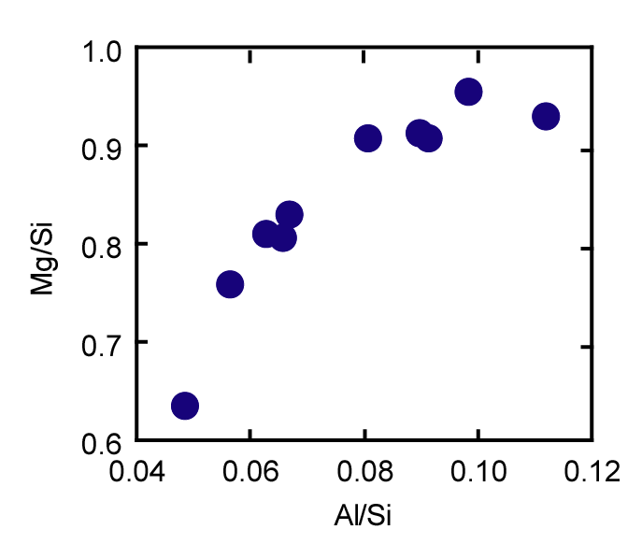
Olivine
McD & Sun
EARTH
Javoy’s
EARTH
Carbonaceous
chondrites
(kg/kg)
Gradient in olivine/pyroxene
Ordinary chondrites
Enstatite chondrites
Pyroxene
(kg/kg)

Slide 25
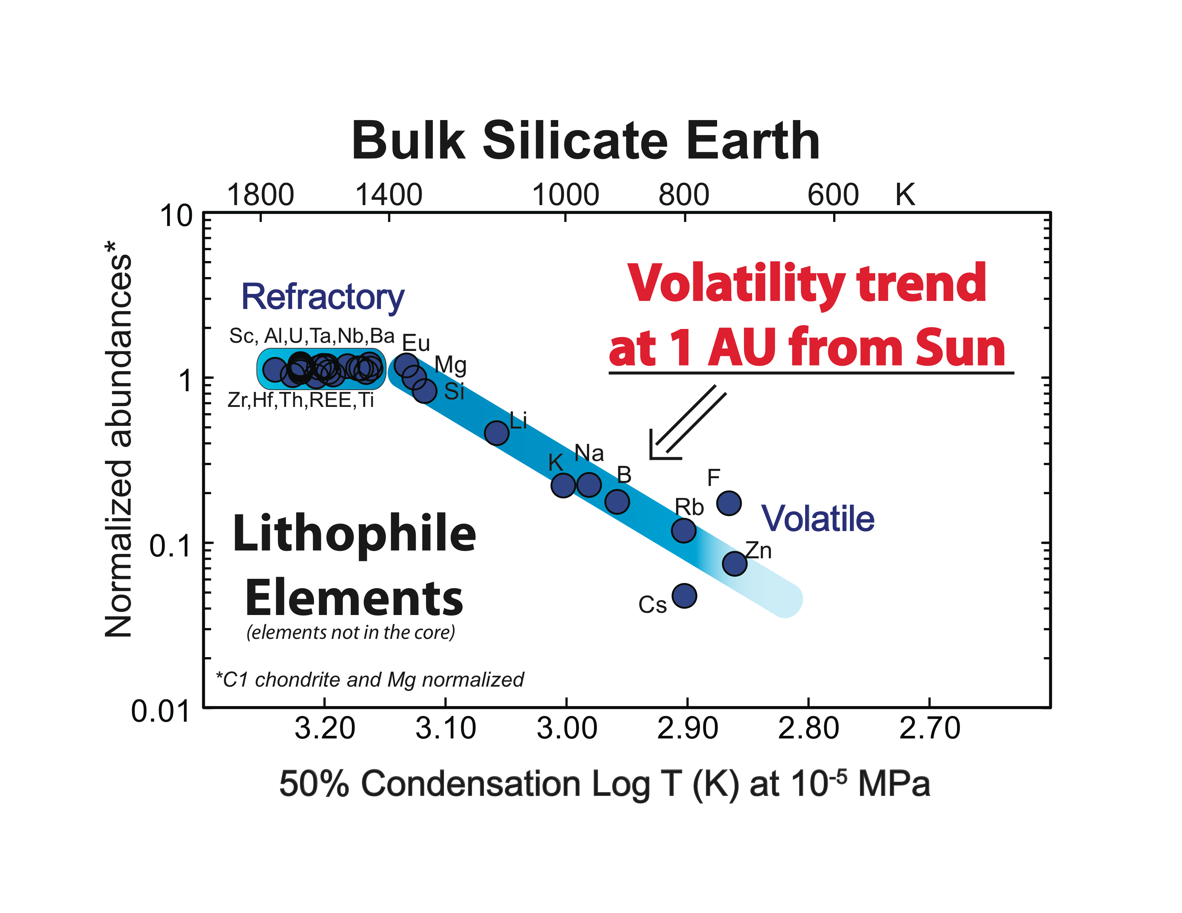
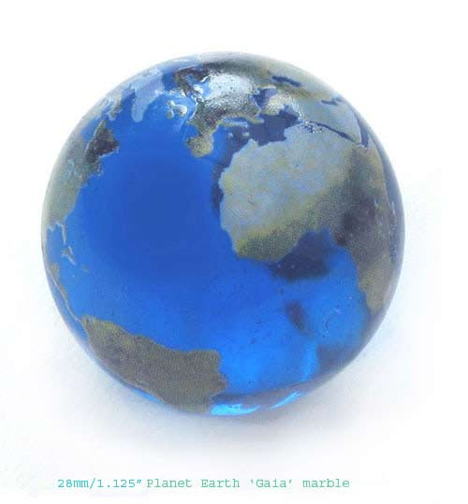
Th & U
K
from McDonough & Sun, 1995

Slide 26
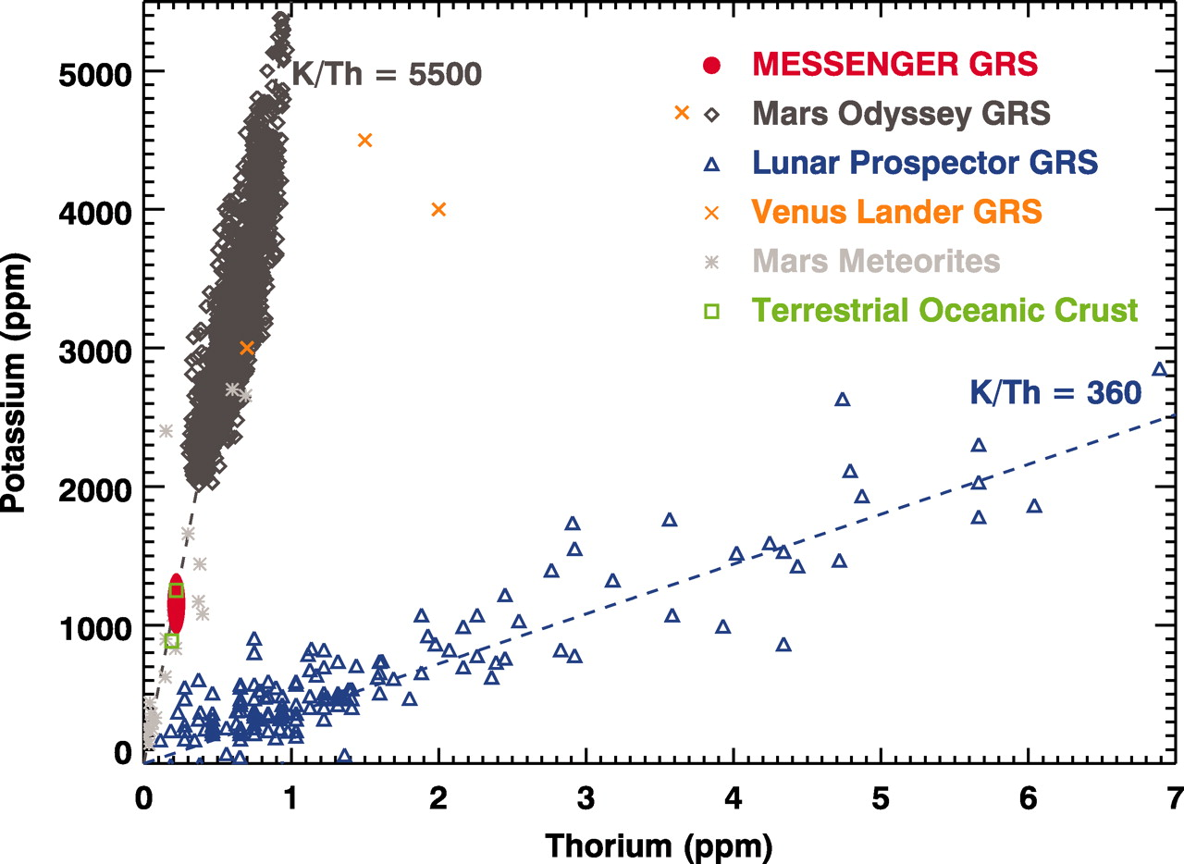
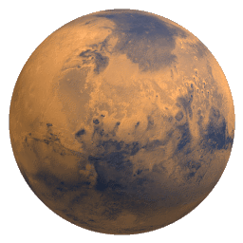
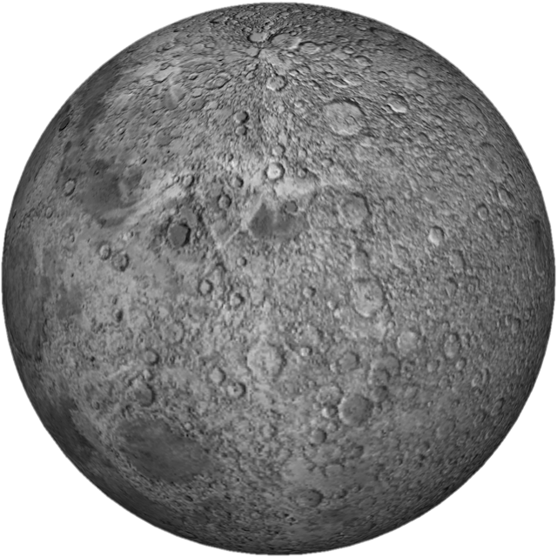
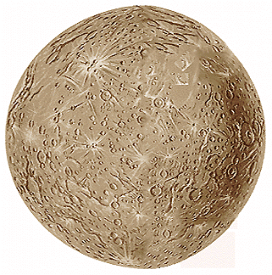
K/U K/Th
Mercury 20,000 5,000
Earth 14,000 3,600
Moon 2,500 500
Mars 19,000 5,000
C1 70,000 18,000
En. Chond 90,000 23,000
Mars
Moon
Mercury
Volatile element
Peplowski et al (Science, 2011)
Refractory element

Slide 27
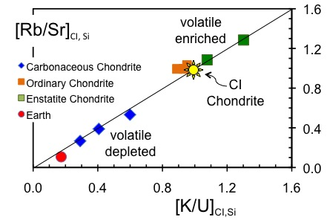
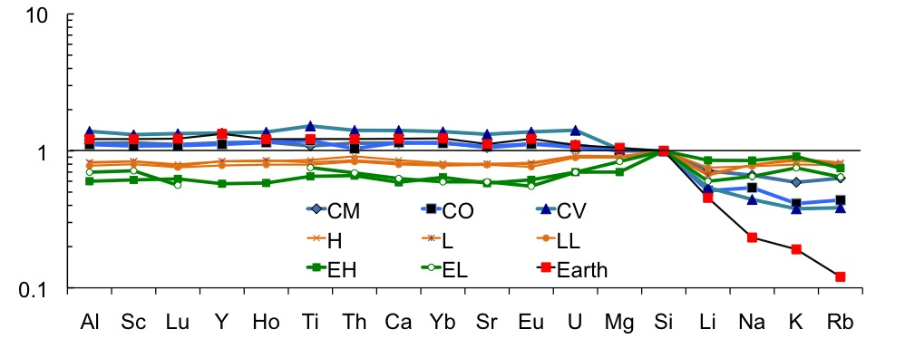
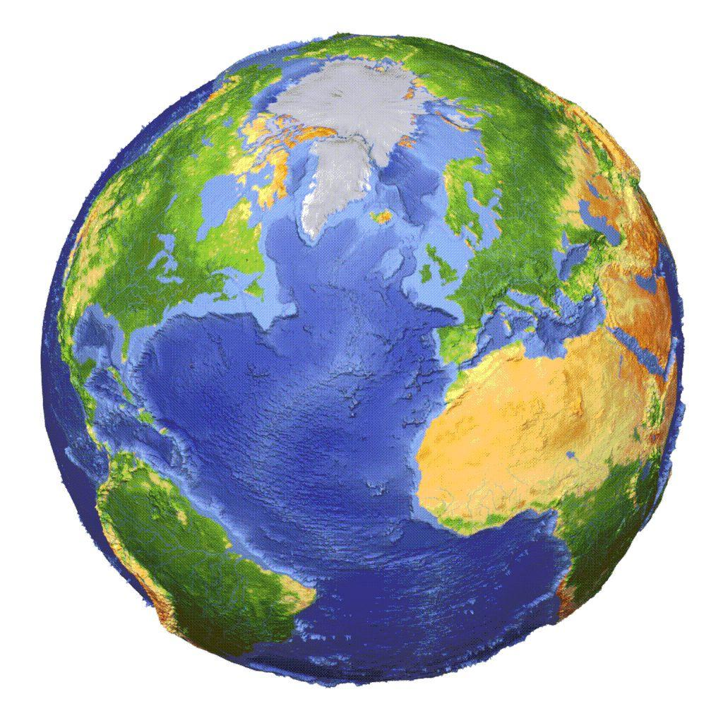
Volatiles
(alkali metals)
in Chondrites
Enstatite Chondrites
enriched in volatile elements
High ⁸⁷Sr/⁸⁶Sr [c.f. Earth]
⁴⁰Ar enriched [c.f. Earth]
CI and Si Normalized

Slide 29
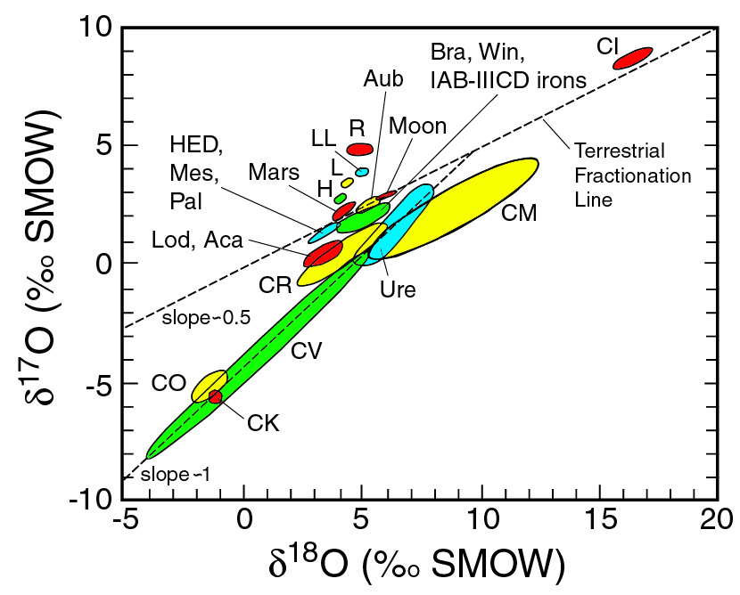
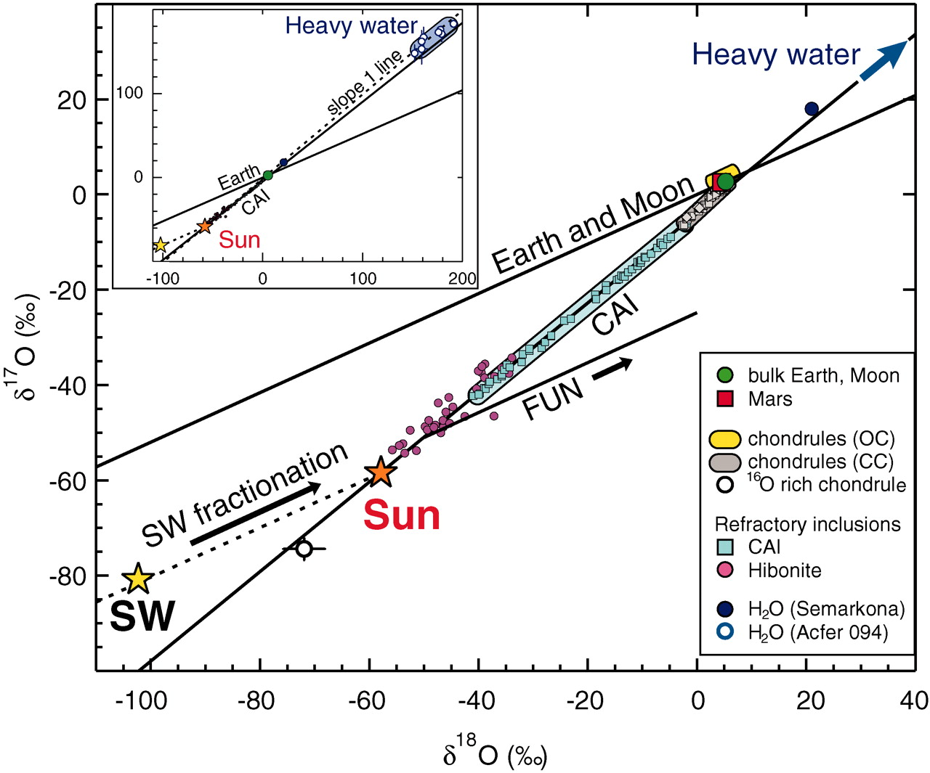
What does Oxygen isotopes tell us?
McKeegan et al. Science 2011

Slide 30
Philosophy and History
In the 1960s, as a result of going to the Moon, we greatly improved our analytical skills and our data for meteorites.
Consequently, in geochemistry and cosmochemistry you were “awarded” (i.e., stayed in the game) if you could measure precisely and accurately. Reduced uncertainties were the goal of the day.
The last 10-20 years, enormous instrumental improvements provided significant gains in precision and accuracy and thus wonderful resolution.
The problem: some scientists are over interpreting what is and isn’t a “chondritic” composition.

Slide 31
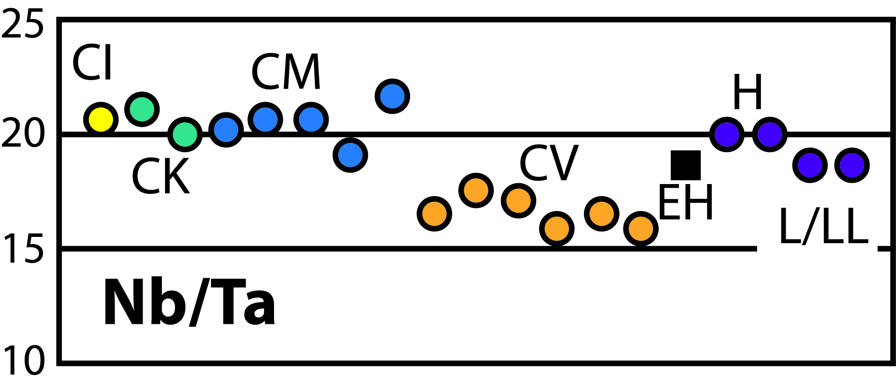
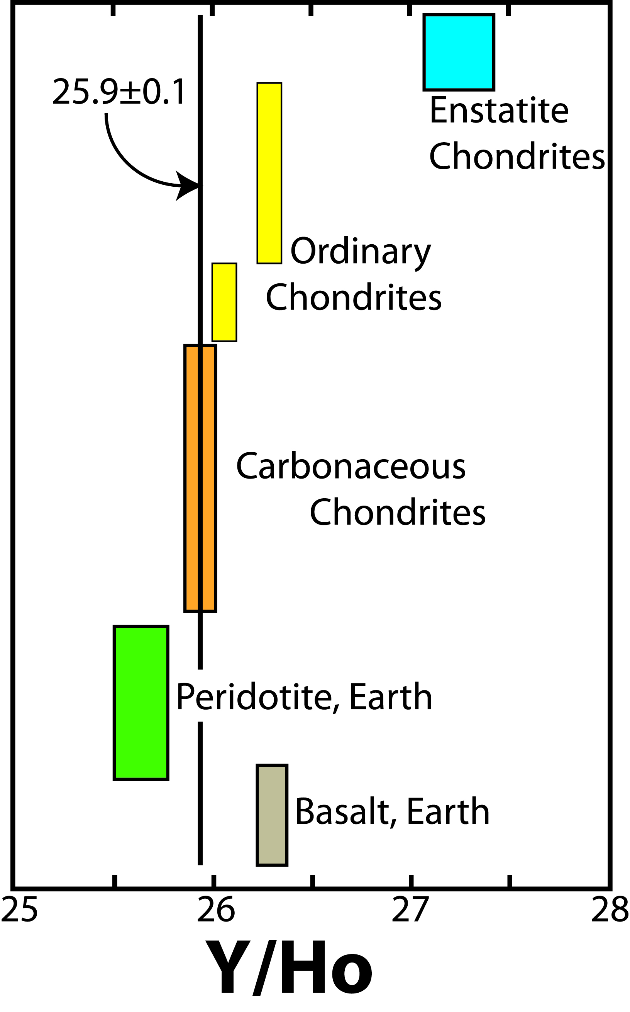
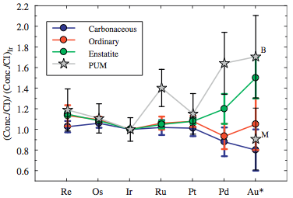
Super- & -refractory
element ratios
…in chondrites
Munker et al Science (2003)
Pack et al GCA (2007)
Chondrites 19.9 ± 0.6
Walker Chem Erde (2009)

Slide 32
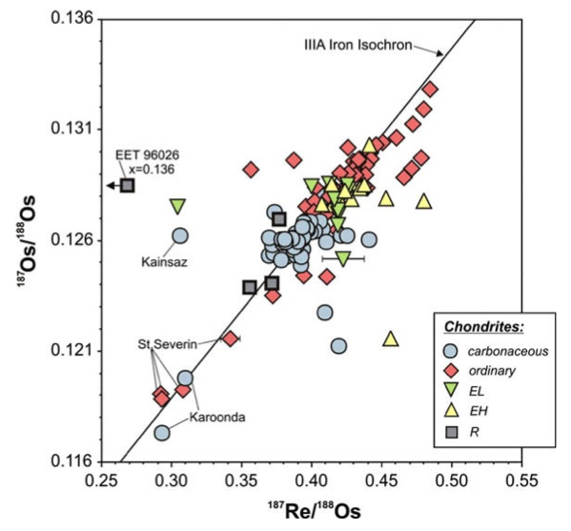
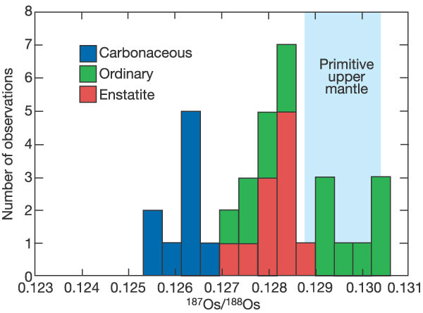
Isotopic differences between chondrites:
ultra-refractory elements
Re-Os system
What is the cause of the Re/Os fractionation?
~ X_{i} of BSE
From Drake and Righter2002;
Modified after Walker et al 2002
Fischer-Gödde et al (2010)

Slide 33
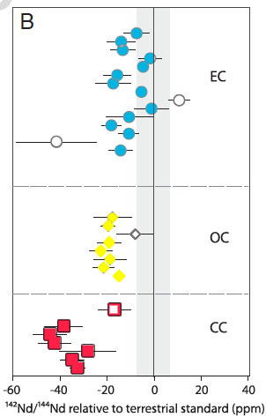
Earth
¹⁴²μ_{Nd}
What does this Nd data mean for the Earth?
Solar S heterogeneous
Chondrites are a guide
Planets ≠ chondrites ?
Enstatite
chondrites
Ordinary
chondrites
Carbonaceous
chondrites
Data from:
Gannoun et al (2011, PNAS)
Carlson et al (Science, 2007)
Andreasen & Sharma (Science, 2006)
Boyet and Carlson (2005, Science)
Jacobsen & Wasserburg (EPSL, 1984)

Slide 34
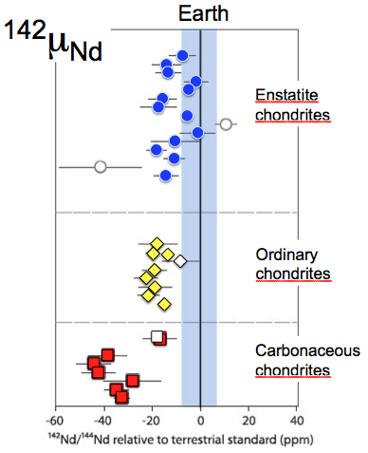
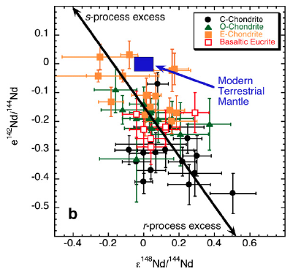
¹⁴²Nd: what does it tell us about the
Earth and chondrites?
Please stop saying that the ε¹⁴²Nd = 18 ± 5 ppm for chondrites
☺
Data from:
Gannoun et al (2011, PNAS); Carlson et al (Science, 2007)
Andreasen & Sharma (Science, 2006); Boyet and Carlson (2005, Science); Jacobsen & Wasserburg (EPSL, 1984); Qin et al (GCA, 2011)

Slide 35
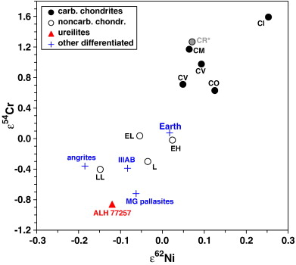
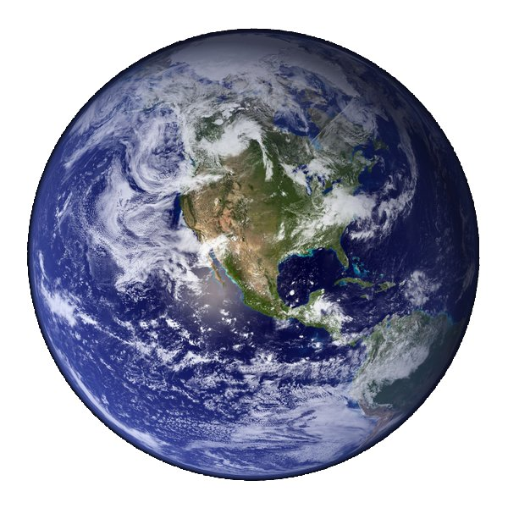
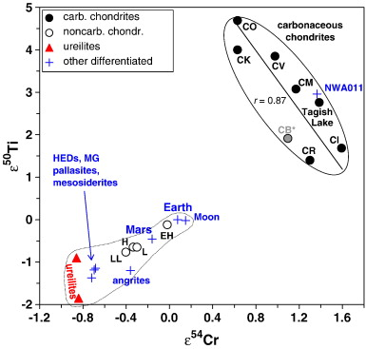
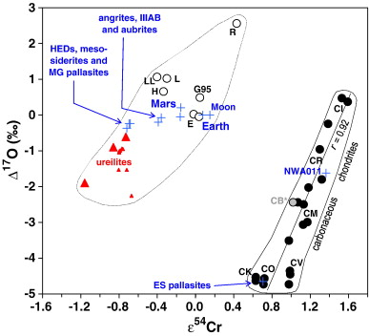
Enstatite chondrite
vs
Earth
Carbonaceous
chondrites
diagrams from Warren (2011, EPSL)
Carbonaceous
chondrites
Carbonaceous
chondrites

Slide 36
Earth is “like” an Enstatite Chondrite!
Mg/Si -- is VERY different
Shared isotopic: O, Ti, Ni, Cr, Nd,..
Shared origins – unlikely
Core composition -- no K, Th, U in core
“Chondritic Earth” – useful concept
Javoy’s model – needs modifications

Slide 37
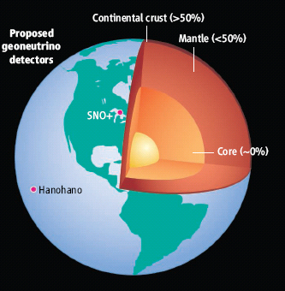
U in the Earth:
~13 ng/g U in the Earth
Metallic sphere (core)
<<<1 ng/g U
Silicate sphere
20* ng/g U
*O’Neill & Palme (2008) 10 ng/g
*Turcotte & Schubert (2002) 31 ng/g
Continental Crust
1300 ng/g U
Mantle
~12 ng/g U
“Differentiation”
Chromatographic separation
Mantle melting & crust formation

Slide 38
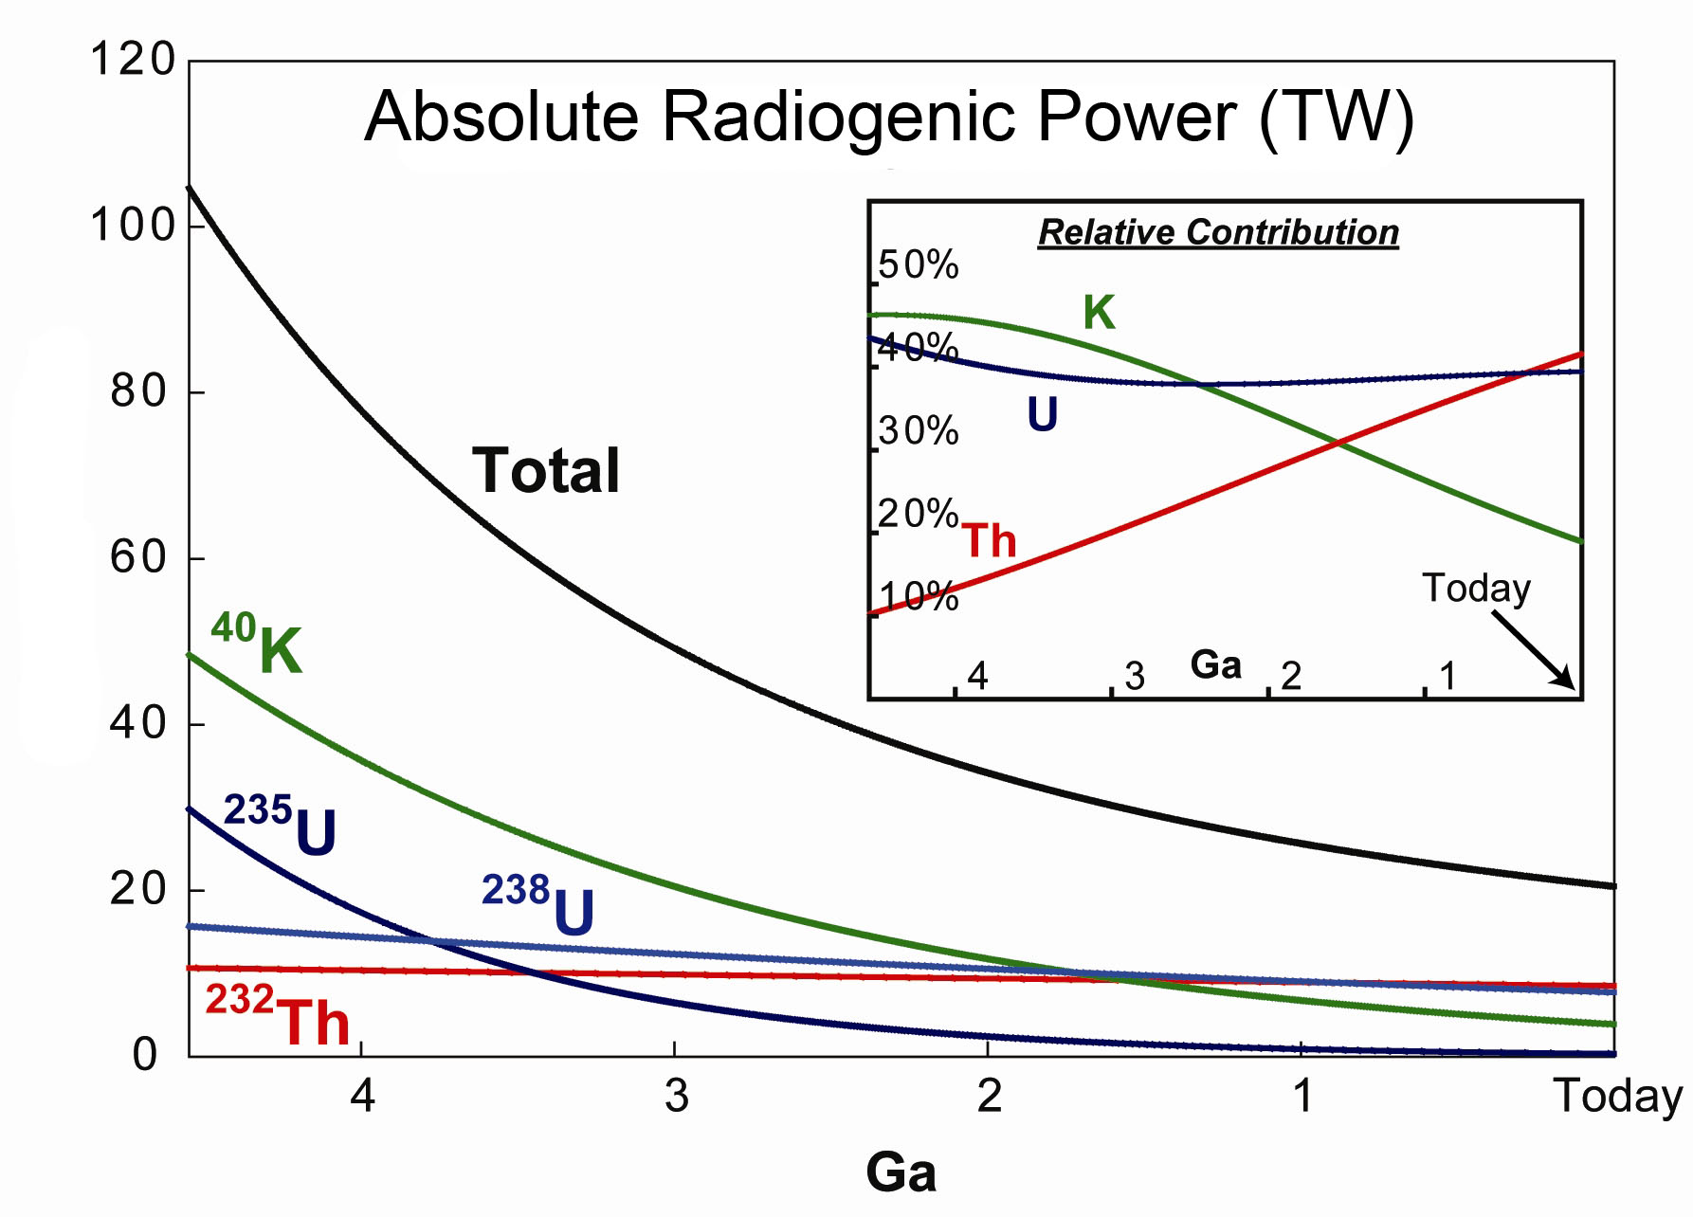
Earth’s thermal evolution: role of K, Th & U
Archean boundary
Power (TW)
Arevalo, McDonough, Luong (2009) EPSL

Slide 39
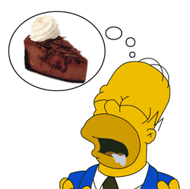
Earth’s surface heat flow 46 ± 3 (47 ± 1)
± 1σ
Mantle cooling
(18 TW)
Crust R*
(8 ± 1 TW)
Core
(~9 TW)
-
(4-15 TW)
Mantle R*
(12 ± 4 TW)
total R*
20 ± 4
*R radiogenic heat
(0.4 TW) Tidal dissipation
Chemical differentiation
after Jaupart et al 2008 Treatise of Geophysics

Slide 40
Conclusions (for the first talk)
The CHONDRITE concept is robust
Chondrites provide a guideline, not a set or rules
The present population of chondrites is LIKELY highly biased
Composition of the Earth is an unknown and big issues are:
- Mg/Si (ratio of olivine to pyroxene)
- amount of U (range 10-30 ppb U), ~ 10 TW to 30 TW
Differences in isotopic and chemical ratios in chondrite groups (i.e., enstatite, carbonaceous, ordinary) reflect nebular mixing phenomena
Next talk will review different BSE models, their origins and consequences…

Slide 41
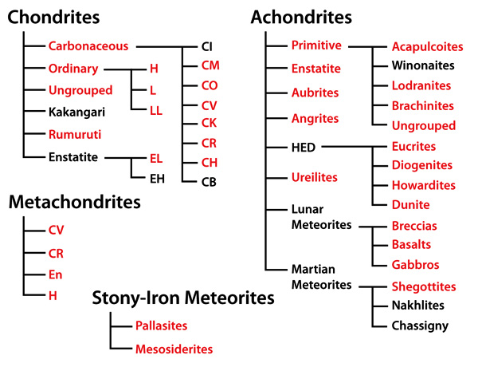
Irons
Northern Arizona Meteorite Laboratory
http://www4.nau.edu/meteorite/

Slide 42
Enstatite Chondrites, an example
Chondrules in E3 chondrites differ from those in other chondrite groups.
Endmember enstatite (MgSiO₃), some contain Si-bearing FeNi metal, sulfide
Cr-bearing troilite,
Mg, Mn- and Ca-sulfides
less common Olivine and more FeO-rich pyroxene
Chondrules in E-chondrites show a range of O isotope compositions demonstrating a mixing of components, similar to that seen in O and C chondrite groups. Therefore, in all of these chondrites there are similar chondrule-forming processes, solid–gas mixing and possibly similar ¹⁶O-rich precursors solids. However, E3 chondrules formed in a distinct oxygen reservoir from the other chondrite groups.
Calcium–aluminum-rich inclusions (CAIs) in E3 chondrites have petrologic characteristics and oxygen isotope ratios similar to those in other chondrite groups. However, chondrules from E3 chondrites differ markedly from those in other chondrite groups.

