Slide 1
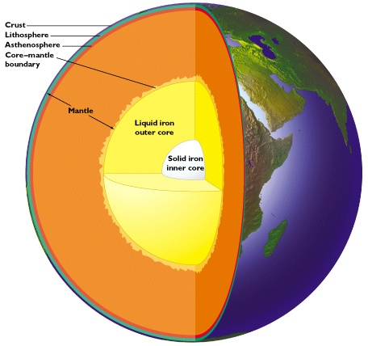
Geoneutrinos and heat production in the Earth
Bill McDonough, *Yu Huang ⁺Ondřej Šrámek and Roberta Rudnick
Geology, U Maryland
Steve Dye, Natural Science,
Hawaii Pacific U and Physics, U Hawaii
Shijie Zhong, Physics, U Colorado
Fabio Mantovani, Physics, U Ferrara, Italy
John Learned, Physics, U Hawaii
*graduate student
⁺post-doc

Slide 2
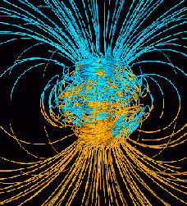
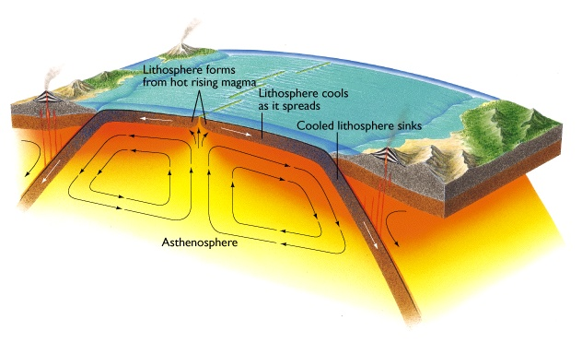
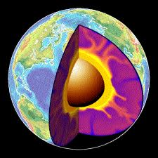
Plate Tectonics,
Convection,
Geodynamo
Does heat from radioactive decay drive the Earth’s engine?

Slide 3
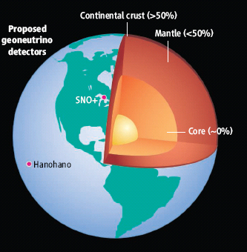
U in the Earth:
~13 ng/g U in the Earth
Metallic sphere (core)
<<<1 ng/g U
Silicate sphere
20* ng/g U
*O’Neill & Palme (2008) 10 ng/g
*Turcotte & Schubert (2002) 31 ng/g
Continental Crust
1300 ng/g U
Mantle
~12 ng/g U
“Differentiation”
Chromatographic separation
Mantle melting & crust formation

Slide 4
Earth’s surface heat flow 46 ± 3 TW
Mantle cooling
(18 TW)
Crust R*
(7 ± 1 TW)
(Rudnick and Gao ’03
Huang et al ‘13)
Core
(~9 TW)
-
(4-15 TW)
Mantle R*
(13 ± 4 TW)
total R*
20 ± 4
*R radiogenic heat
(after McDonough & Sun ’95)
(0.4 TW) Tidal dissipation
Chemical differentiation
after Jaupart et al 2008 Treatise of Geophysics

Slide 5
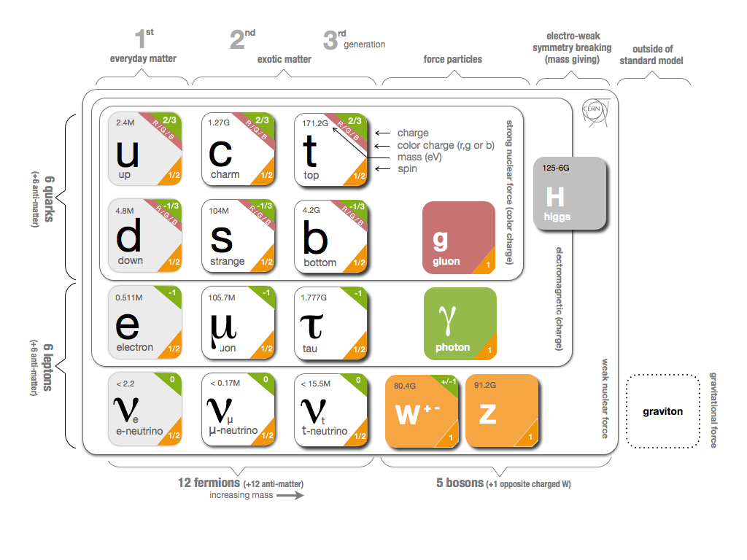
What are Geoneutrinos?
electron anti-neutrinos from the Earth, products of natural radioactivity
Geoneutrino flux
- typical flux 6*10⁶ cm⁻² s⁻¹
Force
carriers
Quarks
Leptons
Anti-neutrino
-vs- neutrino

Slide 6
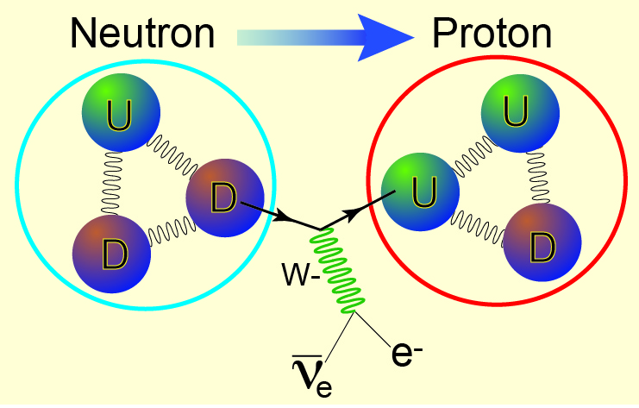
β ⁻ decay process (e.g., U, Th, K, Re, Lu, Rb)
up
quark
down
quark
electron
anti-neutrino

Slide 7
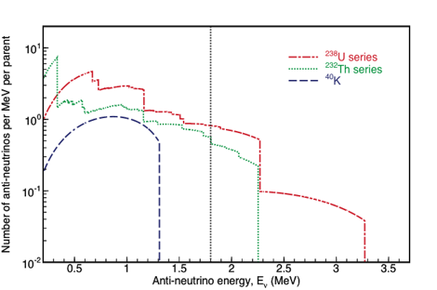
Geoneutrinos
²³⁸U
²³²Th
ν_{e} + p⁺ → n + e⁺
1.8 MeV Energy Threshold
1α, 1β
1α, 1β
ν_{e}
²³⁸U
²³²Th
⁴⁰K
ν_{e}
²³⁴Pa
²²⁸Ac
2.3 MeV
2.1 MeV
31%
1%
5α, 2β
4α, 2β
ν_{e}
ν_{e}
²¹⁴Bi
²¹²Bi
3.3 MeV
2.3 MeV
46%
20%
2α, 3β
⁴⁰K
⁴⁰Ca
1β
1α, 1β
²⁰⁶Pb
Only geoneutrinos from
U and Th are detectable
²⁰⁸Pb

Slide 8
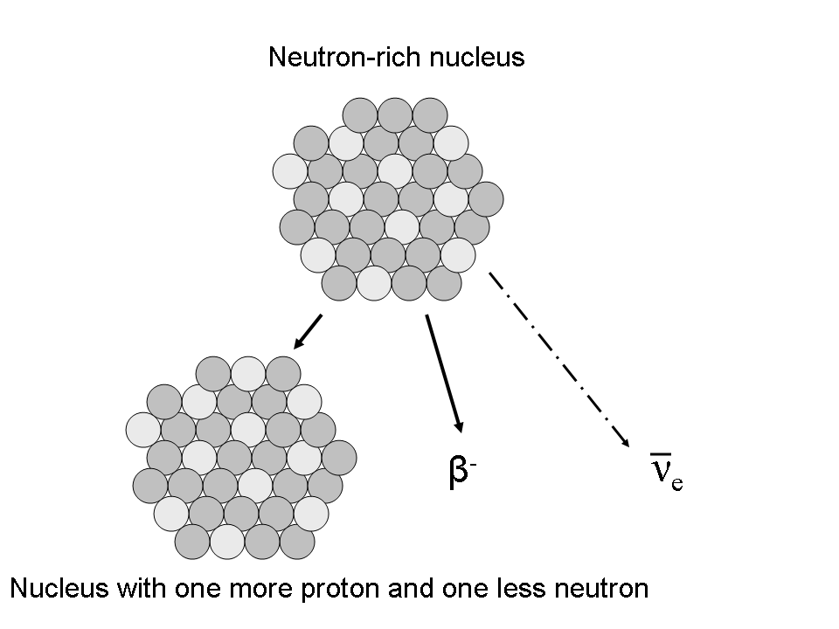
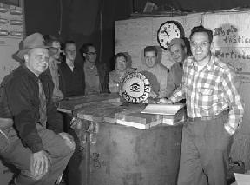
MeV-Scale Electron Anti-Neutrino Detection
Key: 2 flashes, close in space and time,
2nd of known energy, eliminate background
Production in reactors
and natural decays
Detection
E_{vis}=E_{ν}-0.8 MeV
prompt
delayed
E_{vis}=2.2 MeV
Standard inverse β-decay coincidence
E_{ν} > 1.8 MeV
Rate and spectrum - no direction
Reines & Cowan

Slide 10
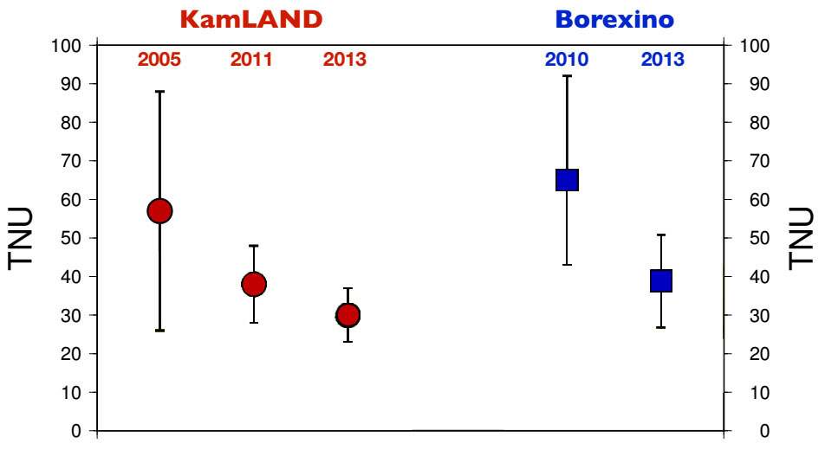
Can Physics Help Geoscience?
TNU: geo-nυ event seen by a kiloton detector in a year

Slide 11
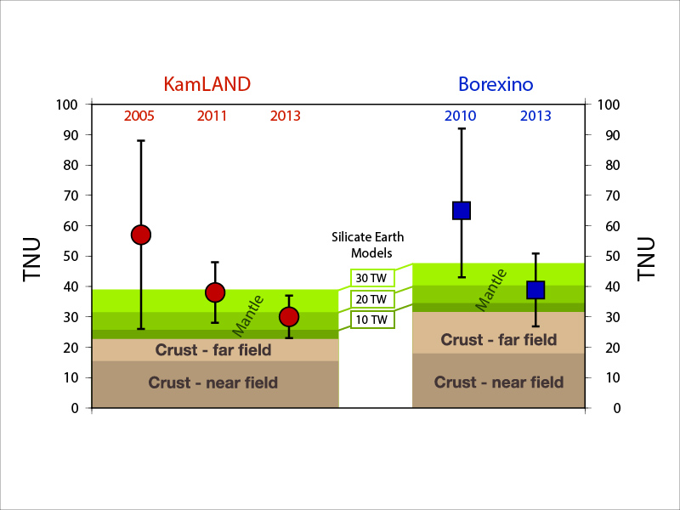
Summary of geoneutrino results
Silicate Earth MODELS
Cosmochemical: uses meteorites – 10 TW
Geochemical: uses terrestrial rocks –20 TW
Geodynamical: parameterized convection – 30 TW
TW scales relative to U
10, 20, 30 TW ≈ 10, 20, 30 ppb

Slide 12
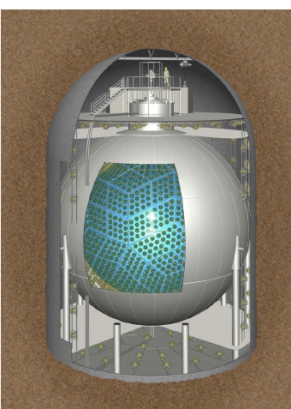
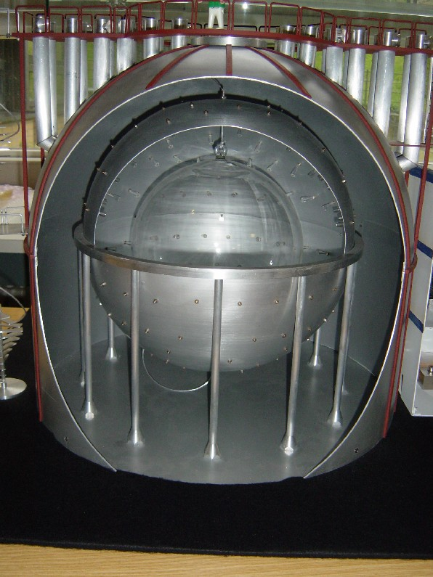
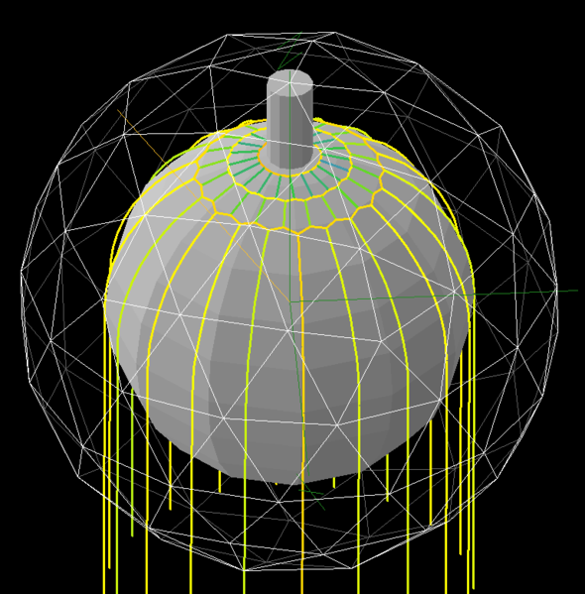
Present Liquid Scintillator Detectors
KamLAND, Japan (1kt)
SNO+, Canada (1kt)
Borexino, Italy (0.3kt)
under construction
(online 2014)
116
+28
14.3±4.4
-27
from Mar ‘02 to Nov ‘12
from Dec ‘07 to Aug ‘12

Slide 13
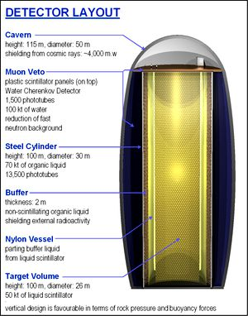
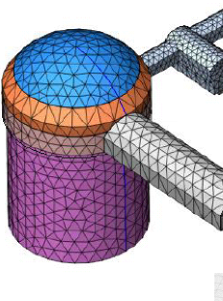
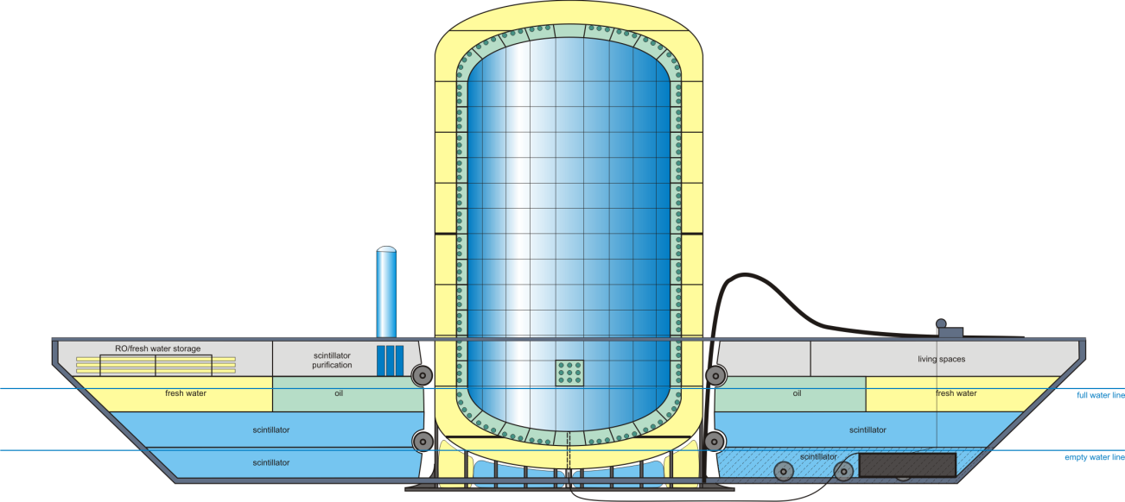
JUNO
China
(20kt)
LENA,
EU
(50kt)
Future
detectors?
Hanohano
International
ocean-based (50kt)

Slide 14
Geoneutrino Flux on Earth Surface
Activity and number of produced geoneutrinos
Volume of source unit
Survival probability function
Abundance and density of the source unit
Distance between source unit and detector
Earth structure (ρ and L) and chemical composition (a)

Slide 15
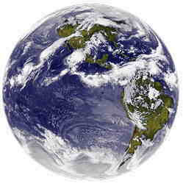
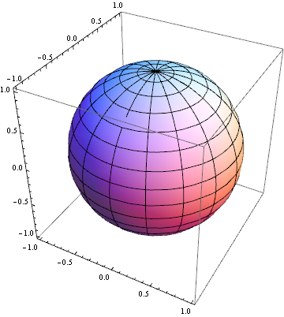
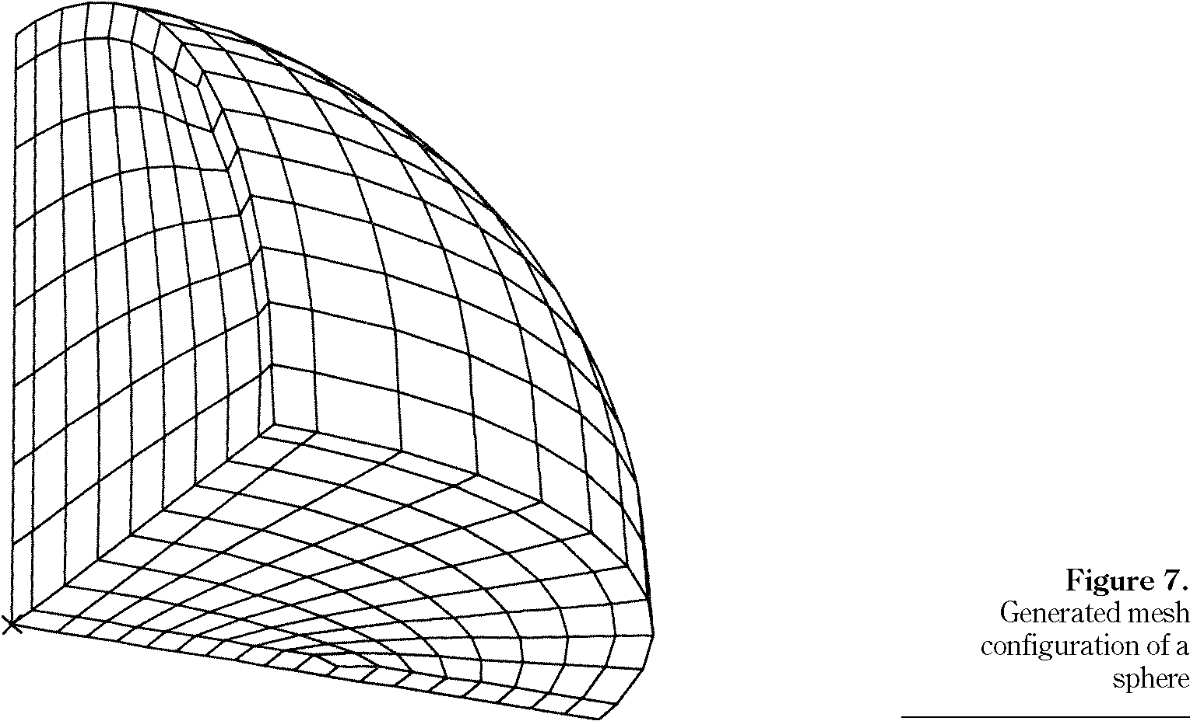
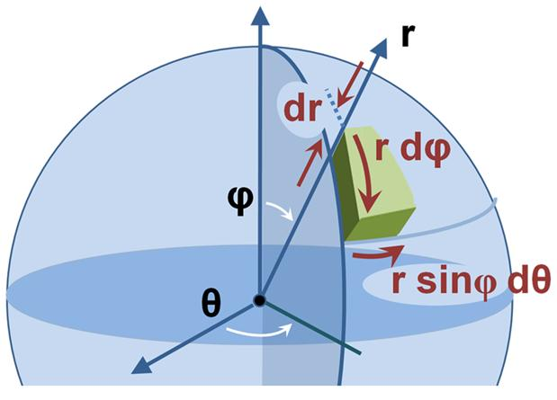
Constructing a 3-D reference model Earth
assigning chemical and physical states to Earth voxels
1º x 1º x “z” tile
mapping of elements
Huang et al (2013) G-cubed arXiv:1301.0365

Slide 16
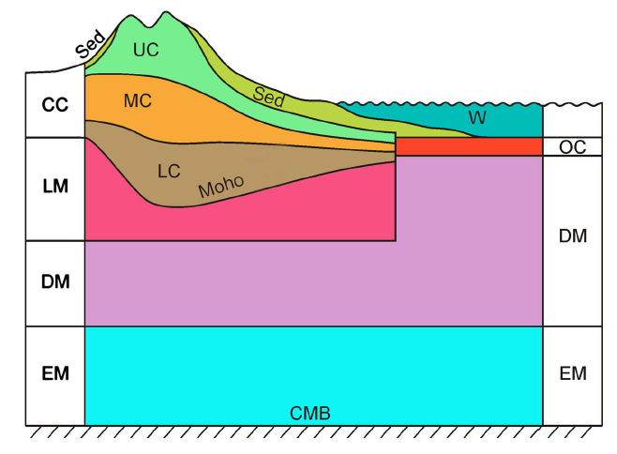
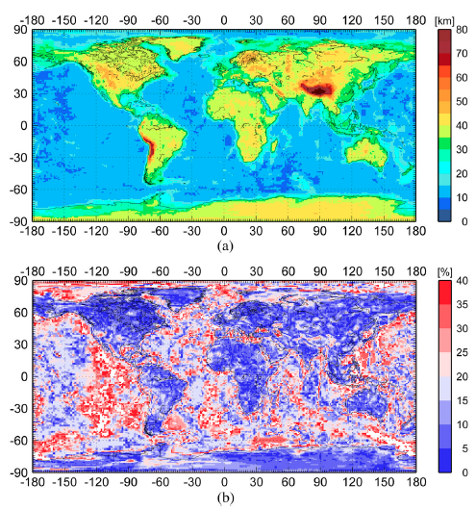
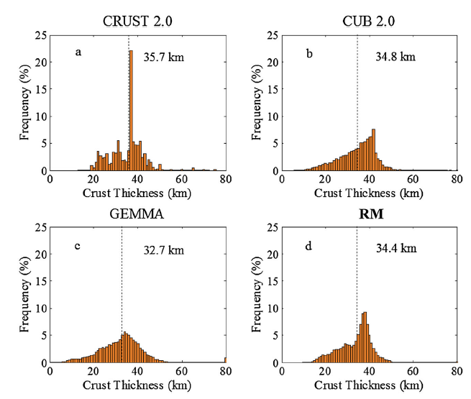
Huang et al (2013) G-cubed
Global Earth Reference Model
7 layers for the top 200 km
Integrate 3 global models for the crust
New crust model with uncertainties

Slide 17
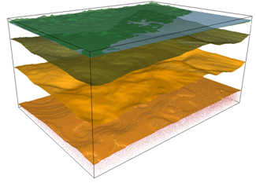
Geological model – Continental Crust
U
(ppm)
Upper crust
2.7
Middle crust
1.3
~35km
Lower crust
0.2
Upper mantle
Moho
0.01
crust – mantle
boundary
Surfaces of each layer is defined by geophysical data (i.e., gravity and seismic)

Slide 18
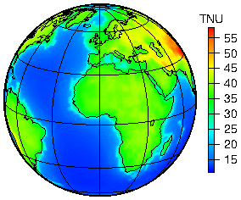
Predicted Global geoneutrino flux based on our new Reference Model
Geoneutrino detection rate
--TNU: Terrestrial Neutrino Unit
-- 1 TNU = one geoneutrino event
per 10³² free protons per year
Huang et al (2013) G-cubed arXiv:1301.0365

Slide 19
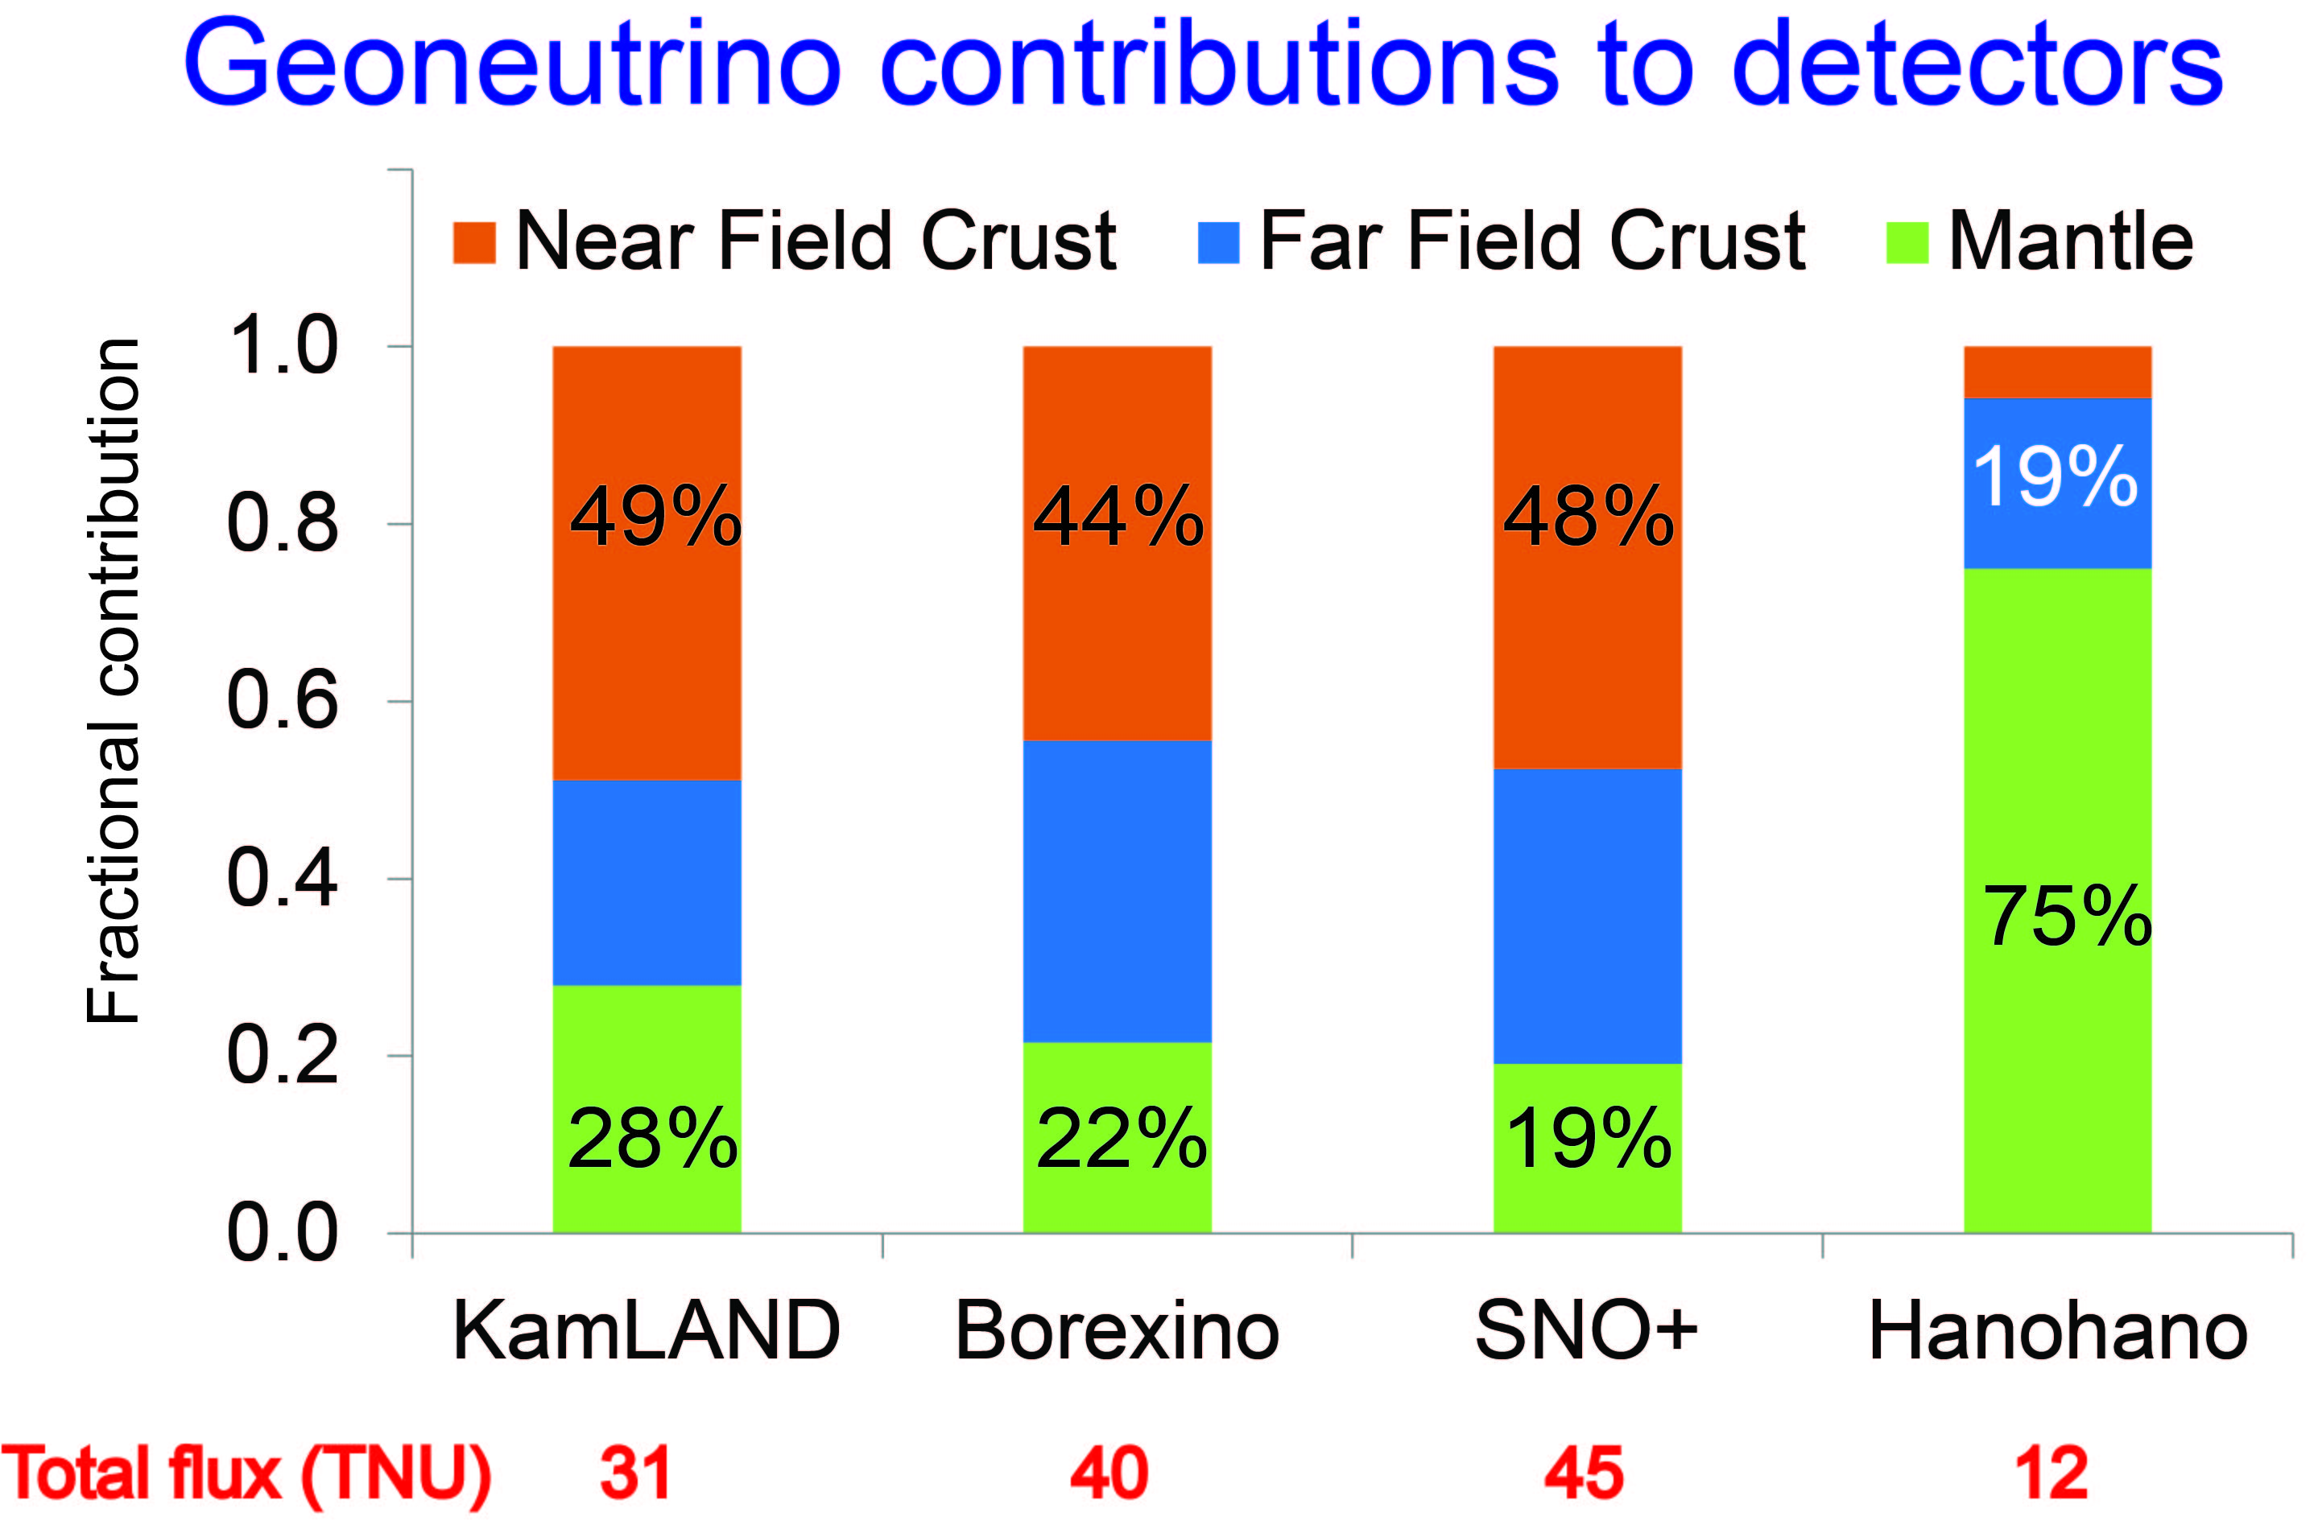
Near Field: six closest 2° × 2° crustal voxels
Far Field: bulk crust – near field crust

Slide 20
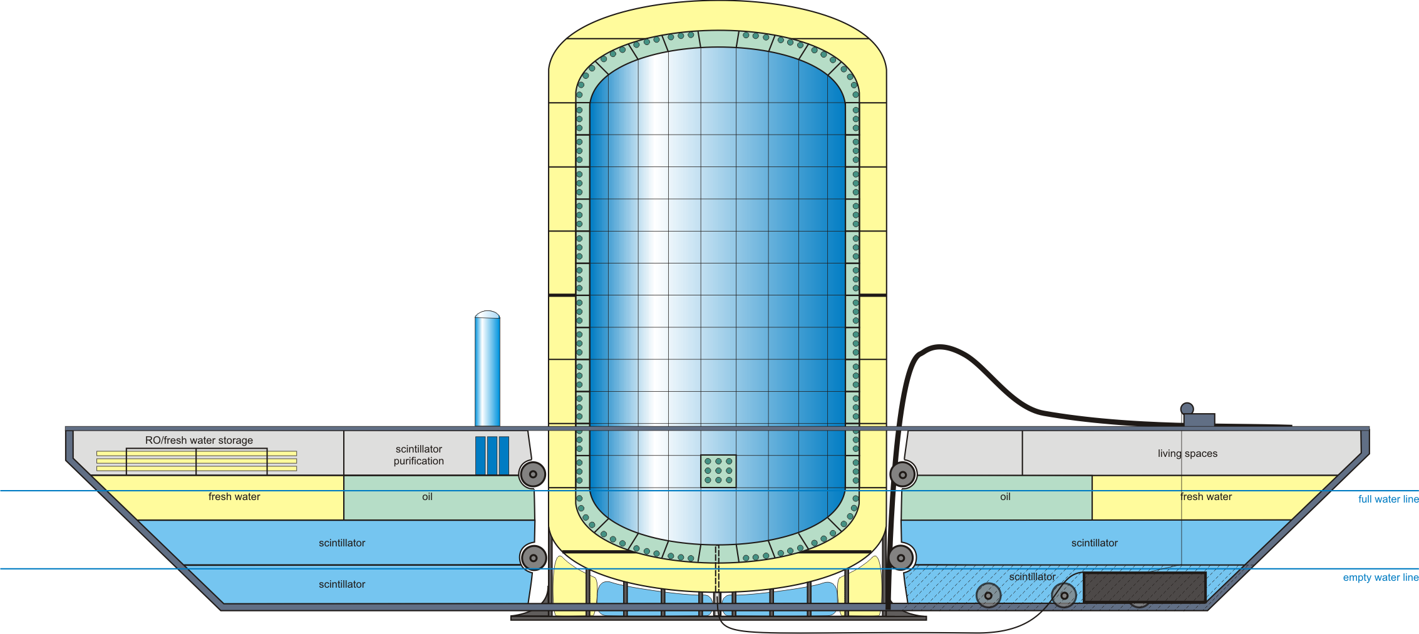
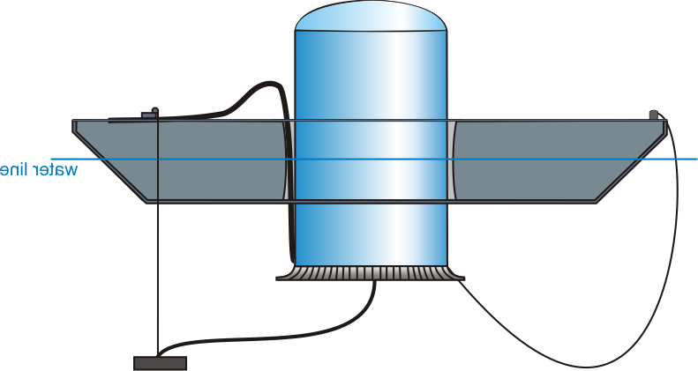
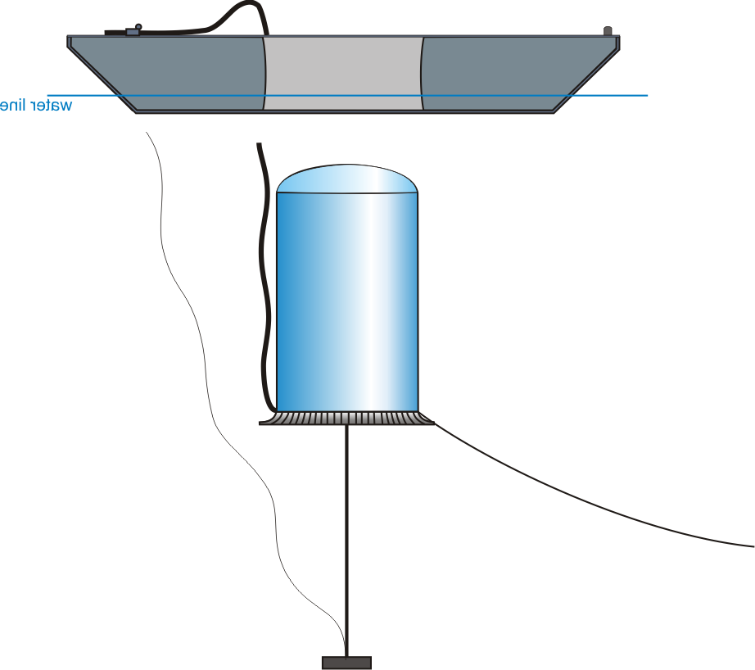
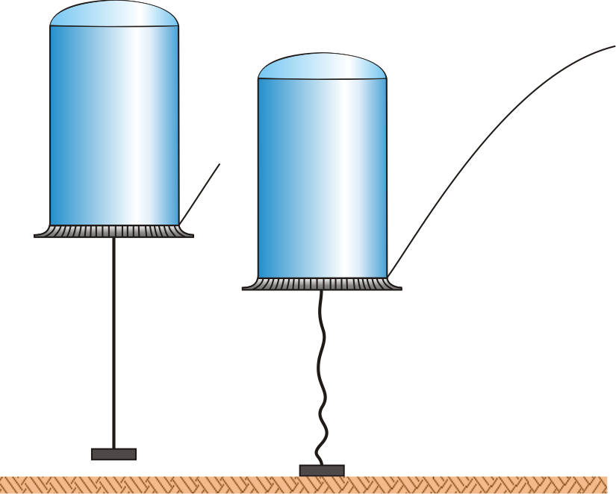
Hanohano
An experiment with joint interests in Physics, Geology, and Security
Size: scalable from 1 to 50 kT
10-yr cost est: $250M @ 10 kT
multiple deployments
deep water cosmic shield
control-able L/E detection
A Deep Ocean
ν_{e} Electron
Anti-Neutrino
Observatory
Deployment Sketch
Descent/ascent 39 min

Slide 21
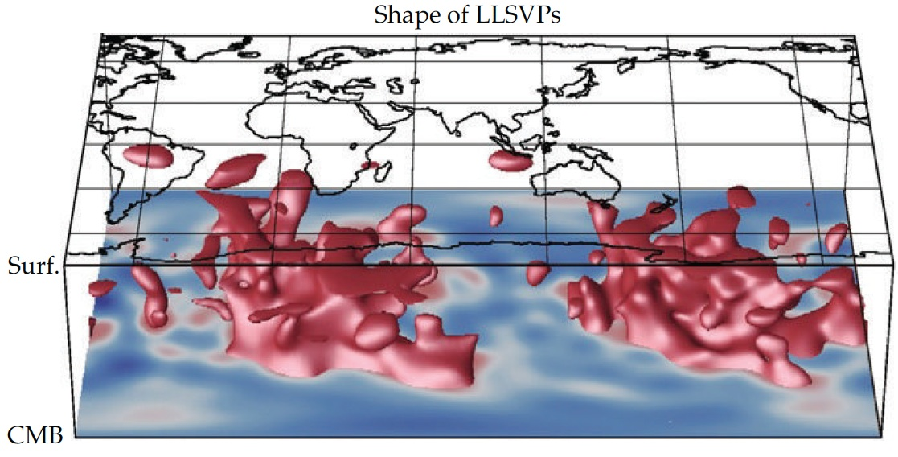
What’s hidden in the mantle?
Seismically slow “red” regions in the deep mantle
Can we image it
with geonus?
Ritsema et al (Science, 1999)

Slide 22
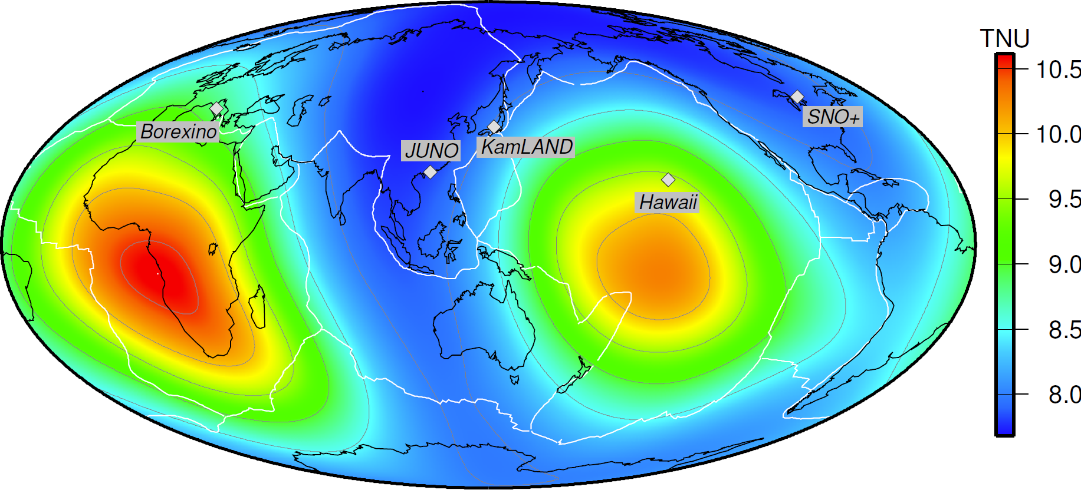
Testing Earth Models
Mantle geoneutrino flux (²³⁸U & ²³²Th)
Šrámek et al (2013) EPSL 10.1016/j.epsl.2012.11.001; arXiv:1207.0853

Slide 23
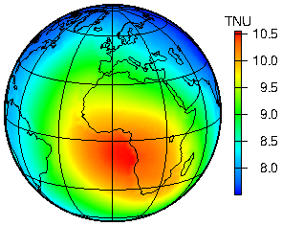
Predicted geoneutrino flux
Total flux at surface
dominated by Continental crust
Yu Huang et al (2013) G-cubed arXiv:1301.0365
Mantle flux at the Earth’s surface
dominated by
deep mantle structures
Šrámek et al (2013) EPSL 10.1016/j.epsl.2012.11.001; arXiv:1207.0853

Slide 24
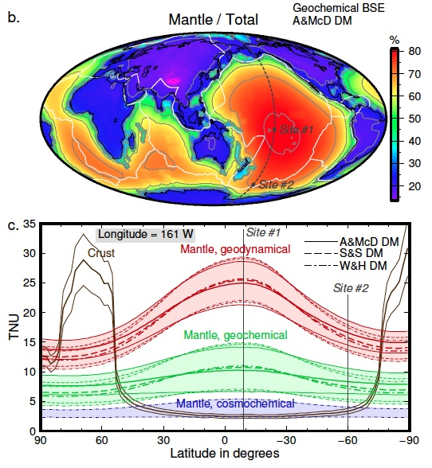
Ocean based experiment!
Neutrino Tomography… ☺
- Pacific Transect
Avoid continents
4 km depth deployments
Map out the Earth’s interior
Test the models
Šrámek et al (2013) EPSL arXiv:1207.0853

Slide 25
SUMMARY
Earth’s radiogenic (Th & U) power
22 ± 12 TW - Borexino 11.2 TW - KamLAND
Prediction: models range from 8 to 28 TW (for Th & U)
On-line and next generation experiments:
SNO+ online 2013/14 ☺
JUNO: good experiment, big bkgd, geonu application…
Hanohano: this is FUNDAMENTAL for geosciences
Geology must participate & contribute to the cost
Future:
Neutrino Tomography of the Earth’s deep interior ☺
+ 7.9
- 5.1

