Slide 1
Introduction to Seismology
CIDER 2014
Seismology Lecture #1
Ved Lekic
University of Maryland
geol.umd.edu/~ved

Slide 2
What is seismology?
Seismology is the study of the generation and propagation of elastic waves
Study of wave generation is termed source seismology:
  Earthquakes
  Tremor / micro-seismicity associated with hydrofracturing
  Explosions / mine collapses
  Ocean-solid-Earth interactions
Study of wave propagation can be used to infer properties of the inaccessible interior of objects – structural seismology:
  Oil / gas / mineral exploration
  Mantle tomography
  Converted wave imaging
  Waveform modeling

Slide 3
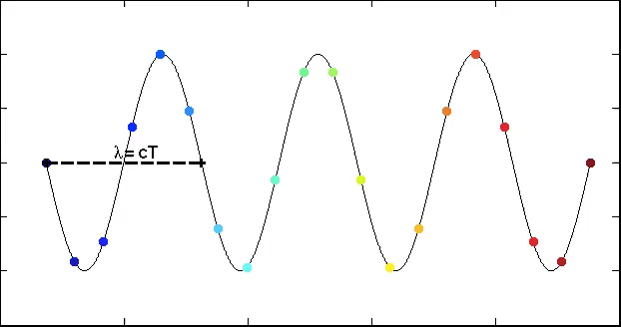
What are elastic waves?
Period =
Frequency ⁻¹
T = 1/f
Wavelength = Wavenumber⁻¹
λ= 1/k
Speed (c):
c = λf = f/k
Amplitude
Distance
In an elastic continuum, perturbing the position of one particle will result in a restoring force that will accelerate that particle back and past the equilibrium position
Perturbation in position of one particle will accelerate its neighbors

Slide 4
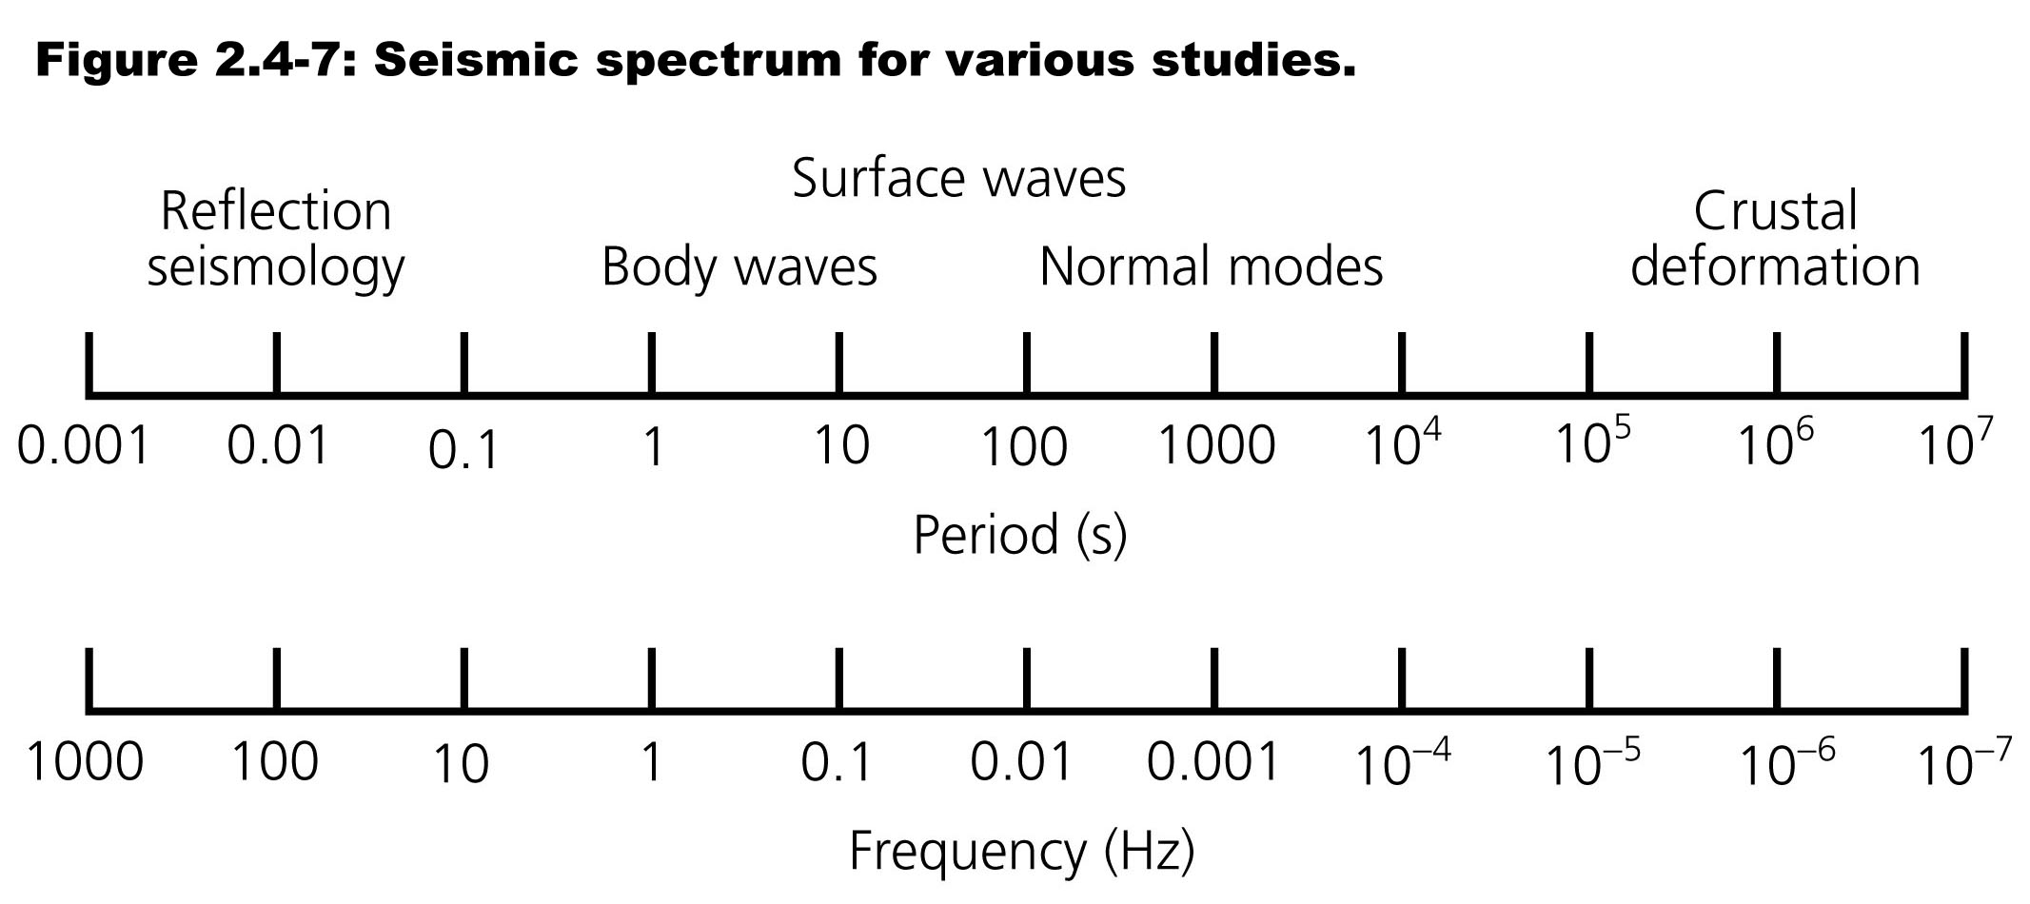
Frequencies / Periods of motion
From Stein and Wysession, 2003
Seismology spans ~6 orders of magnitude in frequency, from waves that oscillate >1000 times in a second, to those that take >1000 seconds to oscillate once

Slide 5
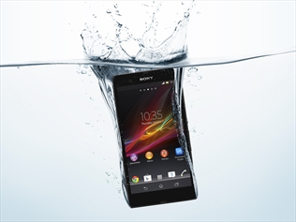

Tractions and the stress tensor
The stress tensor describes forces acting across infinitesimal planes within a continuum (i.e. tractions)
Its units are: N/m² a.k.a. Pa
Can vary with position, describes both compression / estension and shearing
Stress tensor is symmetric, in 3D has 6 independent components
Pressure:
direction depends on surface
Gravity:
direction always down

Slide 6
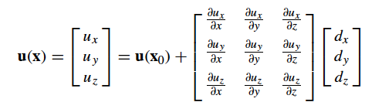
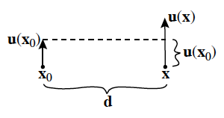
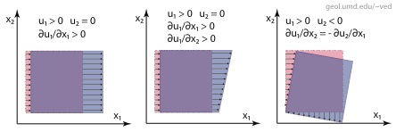
Internal deformation
How do we describe (small) internal deformations?

Slide 7
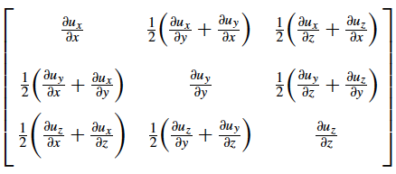
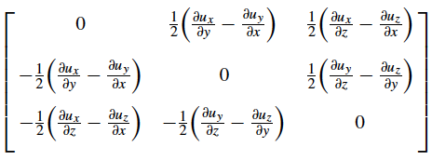
Strain and Rotation tensors
No net rotation only if ∂u_{i}/∂x_{j} – ∂u_{j}/∂x_{i} = 0
Decompose deformation into Strain and Rotation matrices:
                +
Strain is a dimensionless quantity (ΔL/L )
Strain due to passage of seismic waves are typically <10⁻⁵
Strain tensor is symmetric
Rotation tensor is anti-symmetric

Slide 8
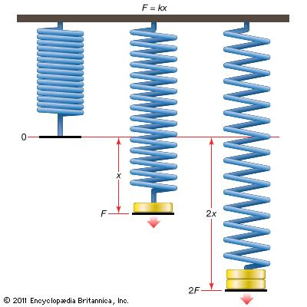
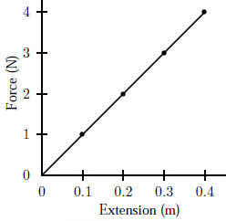
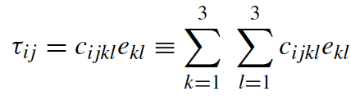
Constitutive relationship
In an elastic medium, stress and strain are linearly related (for small strains, and assuming perfect elasticity)
In 1D, this is the familiar Hooke’s Law:
F = - k x
The constant k is the spring stiffness
In 3D, x becomes the strain tensor, and F becomes the stress tensor:

Slide 9

Elastic tensor and anisotropy
The 4-th order tensor relating stress to strain has 81 components (3 × 3 × 3 × 3 = 81) with units of pressure (GPa)
Because of symmetry of stress and strain tensors internal deformation energy considerations, c_{ijkl} = c_{klij} = c_{lkij} = c_{klji}→ 21 independent components
Specifying all 21 at every point is needed in a medium with general anisotropy
To zeroth order, Earth is isotropic at large scales: only 2 independent components (Lamé parameters):

Slide 10









Isotropic medium representations
In an isotropic medium, wave speed depends on NEITHER the direction of propagation NOR polarization direction
Relationship between stress and strain is simple:
Shear modulus: measure of the resistance of material to shear.
Bulk modulus: measure of incompressibility of a material. Given by hydrostatic stress divided by fractional volume change.
Poisson’s ratio: lateral contraction of a cylinder divided by longitudinal extension.

Slide 11
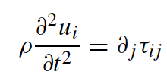


Momentum → Seismic Equation
Homogeneous momentum equation governs seismic waves outside of source regions
Summation convention: repeated index → summation, e.g. e_{kk} = e₁₁ + e₂₂ + e₃₃.
Constitutive relation for isotropic medium, where we used 2e_{jk} = (∂u_{k}/∂x_{j} + ∂u_{k}/∂x_{j})
+ manipulation and a vector identity:
Seismic Wave Equation for an isotropic medium

Slide 12
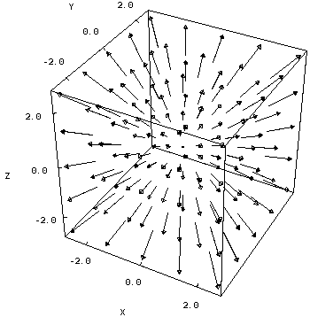
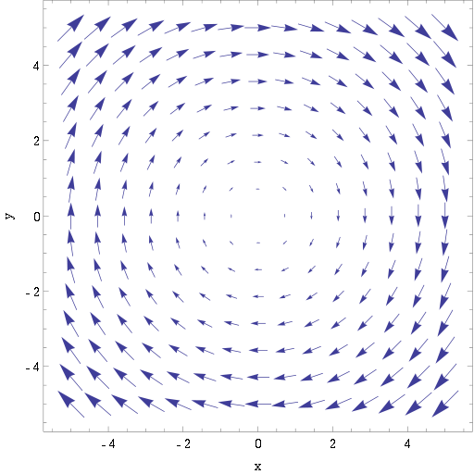
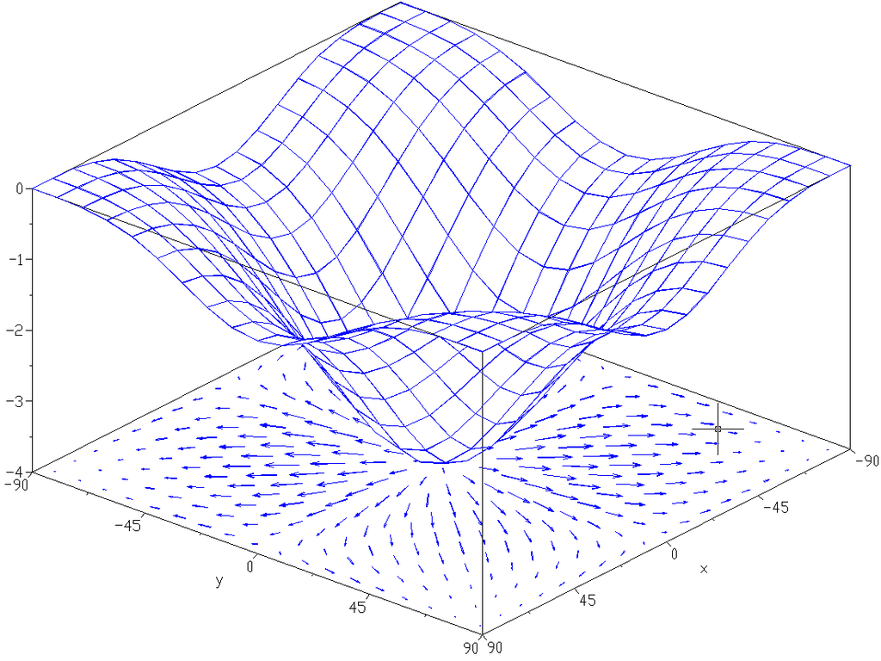
Seismic Wave Equation
Gradient: Vector describing the direction and magnitude of change in a quantity
Divergence: Scalar describing volume change
Curl: Vector describing infinitesimal rotation (think paddle wheel)

Slide 13


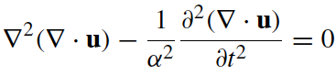





Homogeneous medium
In a homogeneous medium, or in the high-frequency approximation, the gradients of λ and μ can be neglected:
Taking the divergence of the equation (remember ):
Taking the curl of the equation (remember and ):
Compressional wave (P-wave) propagating at speed α
Shear wave (S-wave) involving no volume change propagating at speed β

Slide 14
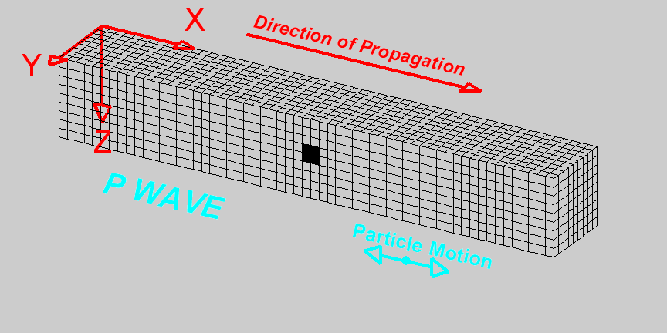
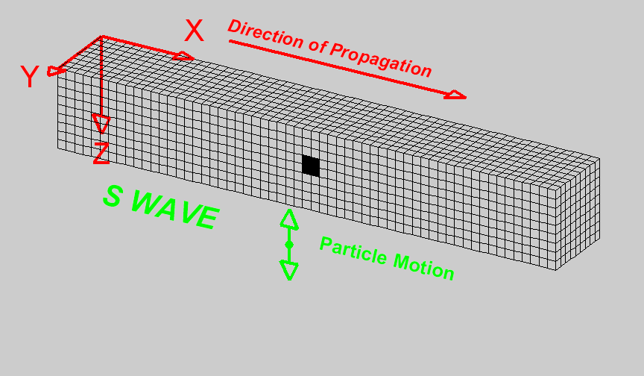


P and S waves
http://www.geo.mtu.edu/UPSeis/images/
P waves: volume & shape change, particle motion in the direction of propagation
S waves: only shape change (no volume change), particle motion perpendicular to direction of propagation
  SH – particle motion in the horizontal plane
  SV – particle motion in the vertical plane

Slide 15
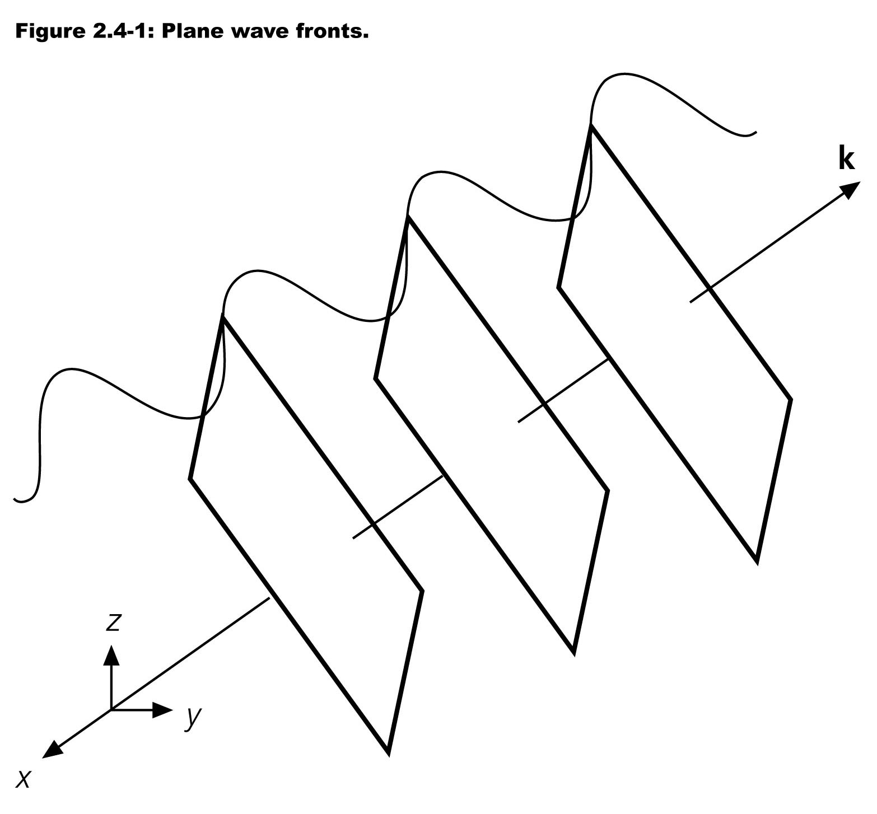
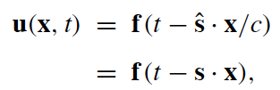
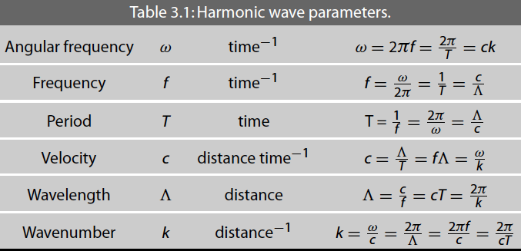
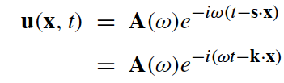
Plane waves
Solutions to the P and S equations are waves: u(x,t)= f(x ± vt), v = velocity
Plane waves:
  s is the slowness vector
Particle displacement at a frequency ω:
  k is the wavenumber vector
(Figure from Stein and
Wysession, 2003)

Slide 16
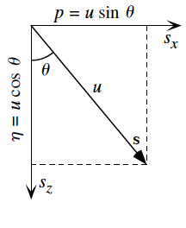
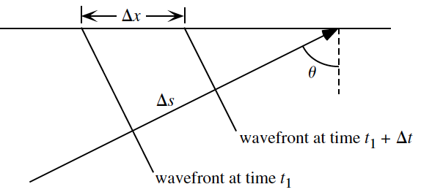

Horizontal & vertical slownesses
We can measure how quickly a wave sweeps across a small, dense array of seismometers
Slowness: u = 1 / c
Horizontal slowness: p = ΔT/ΔX
Vertical slowness:
figures from Shearer, 2009

Slide 17
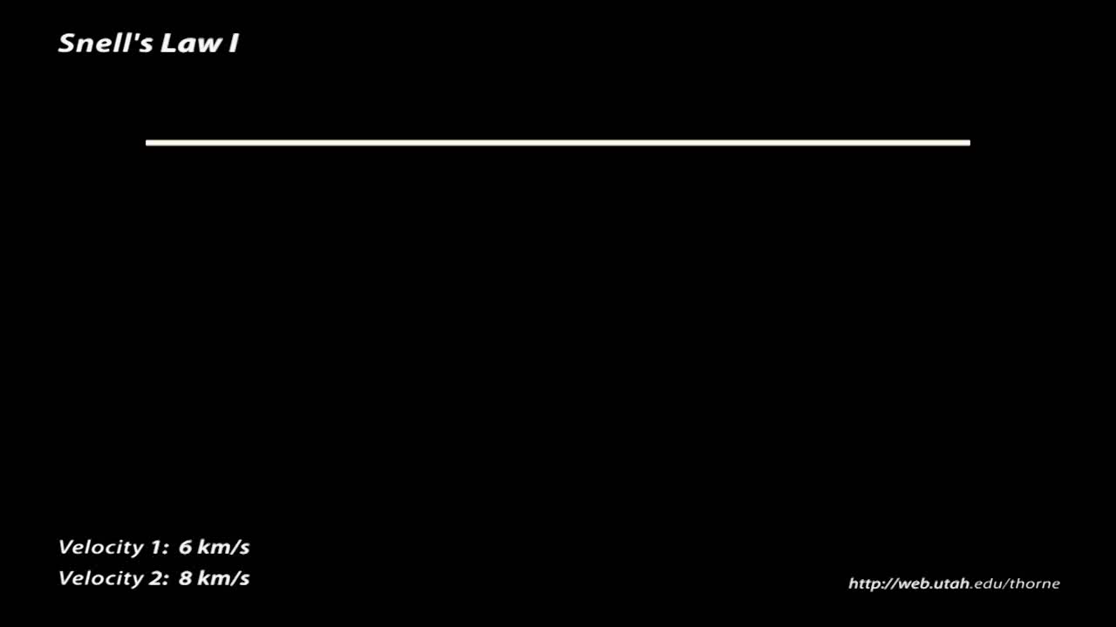
Snell’s Law – the ray parameter
For wavefield to remain continuous along interface between regions with different velocities, waves will change direction in addition to their speed.

Slide 18
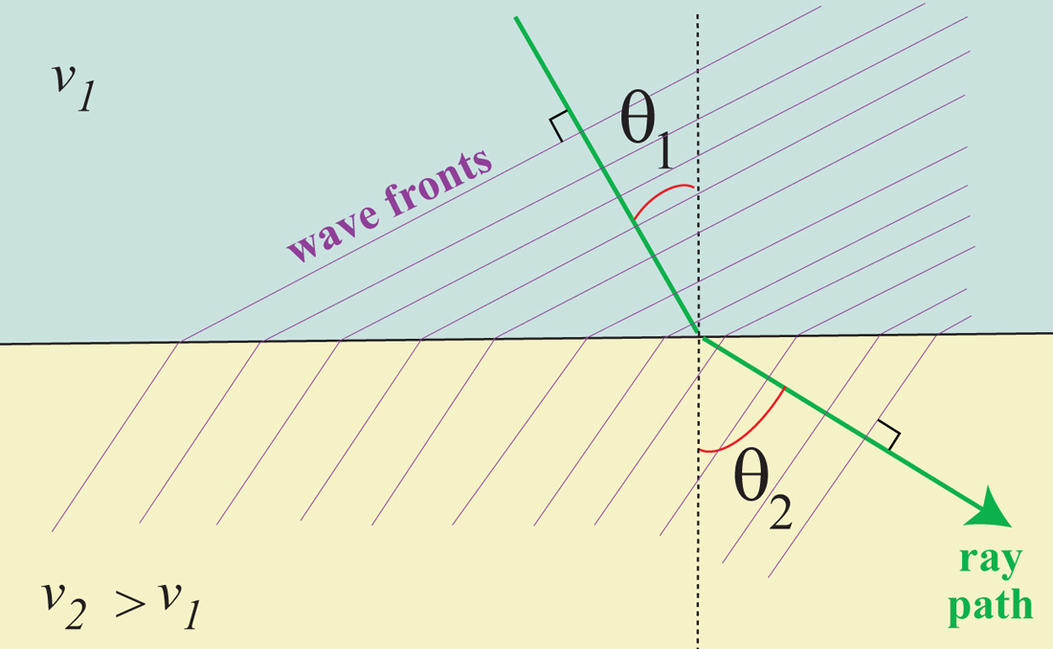
Snell’s Law – the ray parameter
For wavefield to remain continuous along interface between regions with different velocities, waves will change direction in addition to their speed.
Snell’s Law:
Ray parameter (horizontal slowness) remains the same along the ray path
figure from garnero.asu.edu

Slide 19
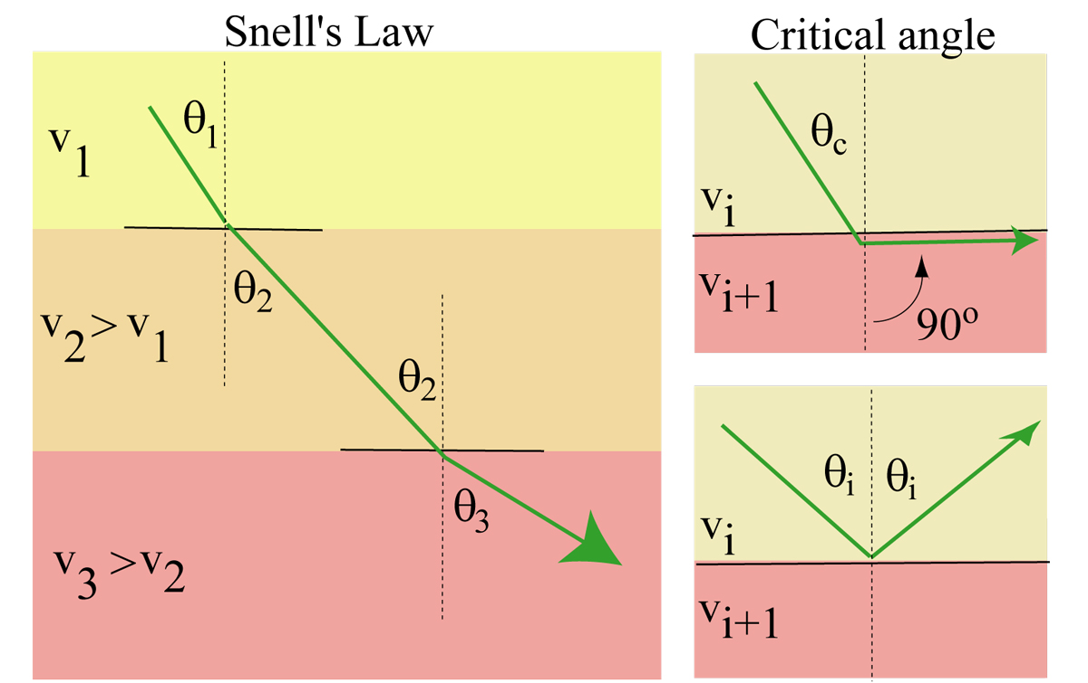
Layered / shell medium
By specifying a ray parameter and a starting location, we fix the ray-path through a layered or spherically-symmetric Earth
The deepest depth the ray can reach is one where:
figure from garnero.asu.edu

Slide 20
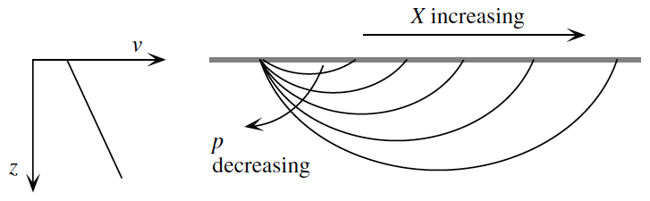
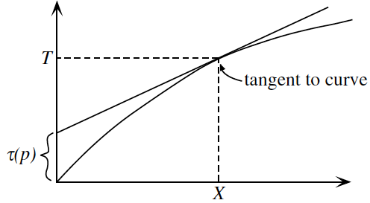
Travel-time curves
figures from Shearer, 2009
T(X) = τ(p) + pX
Ray parameter (horizontal slowness) is the slope of the travel-time curve
Different rays observed at different distances
Shallowing of slope dT/dX with distance → slowness decreases with depth

Slide 21
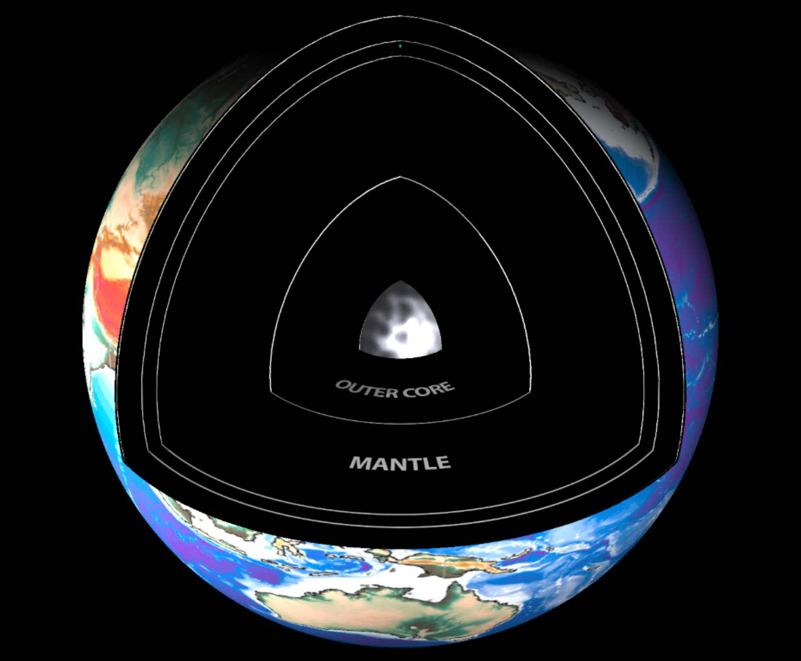
Seismic wavefield
P waves
S waves
Seismic waves take a variety of paths and sample all parts of the Earth
They provide most complete and direct information on present-day state of the deep interior

Slide 22
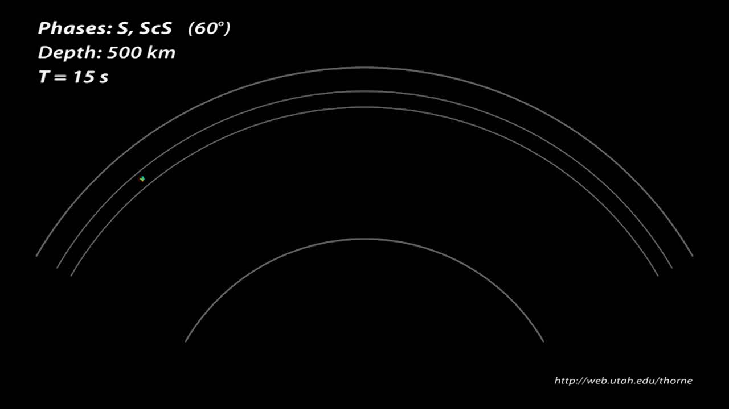
Wavefronts and raypaths

Slide 23
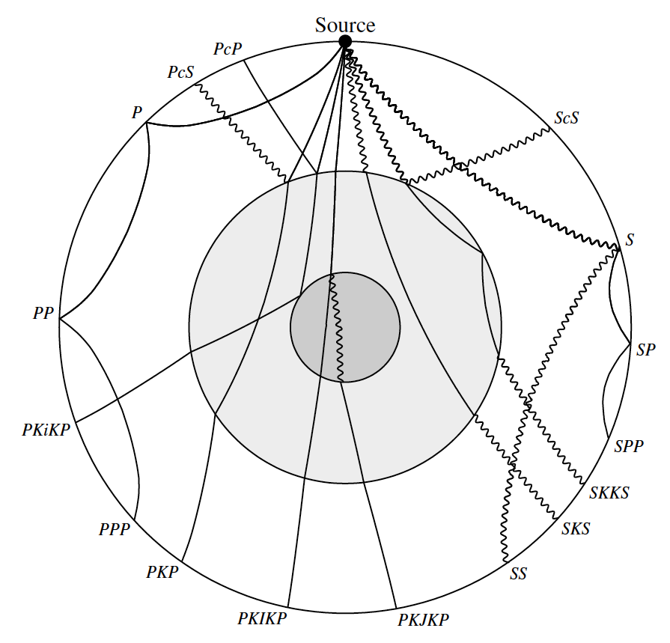
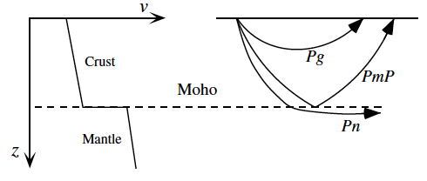
Ray nomenclature
figures from Shearer, 2009
Moho

Slide 24
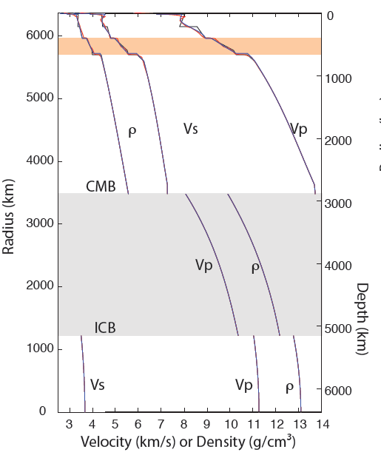
Earth’s 1D (radial) structure
A number of 1D Earth models have been developed: PREM (Dziewonski and Anderson, 1981), ak135 (Kennett et al., 1995), IASP91 (Kennett and Engdahl, 1991).
Seismically fast lithosphere
Seismically slow asthenosphere (LVZ)
Velocity jumps at 410 and 660 km define the transition zone from the upper and lower mantle
CMB is at ~2891 km depth
ICB is at ~5150 km depth

Slide 25
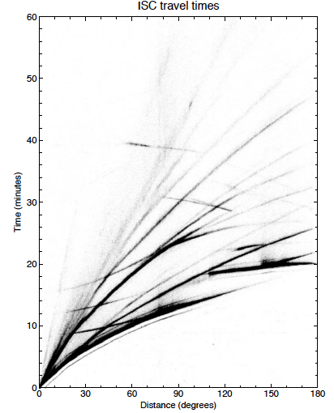
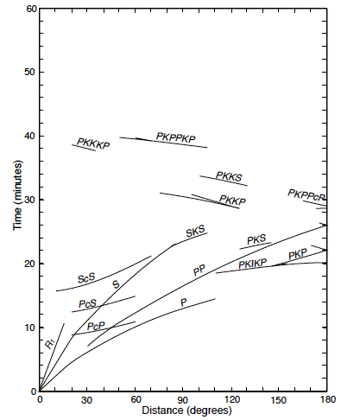
Body wave observations
figures from Shearer, 2009

Slide 26
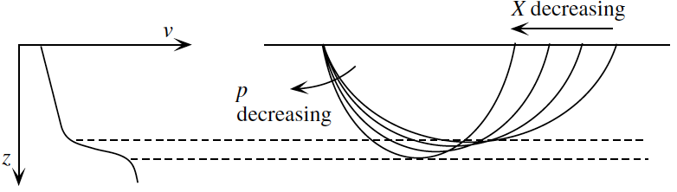
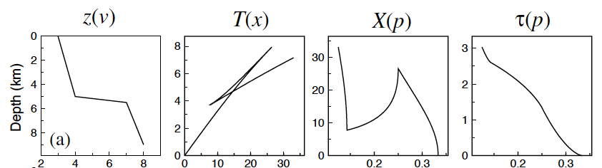
Triplications
figures from Shearer, 2009
Depth ranges in which velocity increases rapidly with depth can produce triplications: multiple rays (with different horizontal slownesses) arrive at the same time
Transition zone discontinuities produce triplications
At epicentral distances > 30° rays bottom in the lower mantle and no triplications are (typically) observed

Slide 27
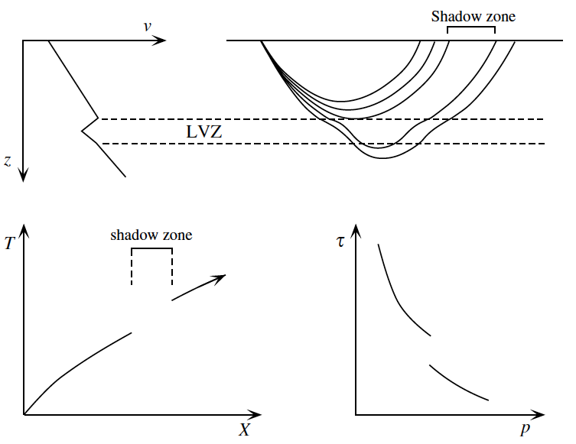
Shadow zones
Rays cannot bottom in a depth range where velocity decreases with depth*
Low-velocity zones produce shadow zones
Prominent shadow zone in PKP waves due to low velocities in the outer core
Shadow zones
figures from Shearer, 2009

Slide 28
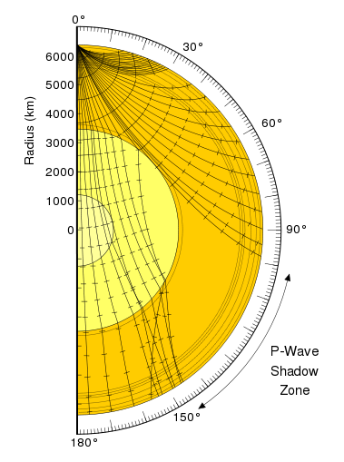
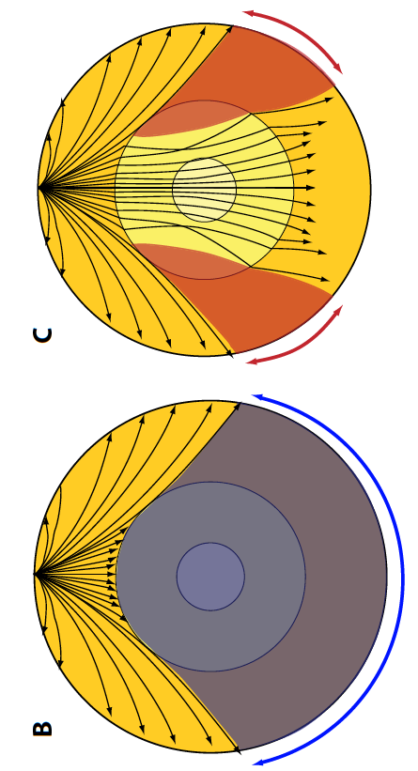
Shadow zones
Rays cannot bottom in a depth range where velocity decreases with depth*
Low-velocity zones produce shadow zones
Prominent shadow zones result from low velocities in the liquid outer core
Shadow zones
P waves
S waves

Slide 29
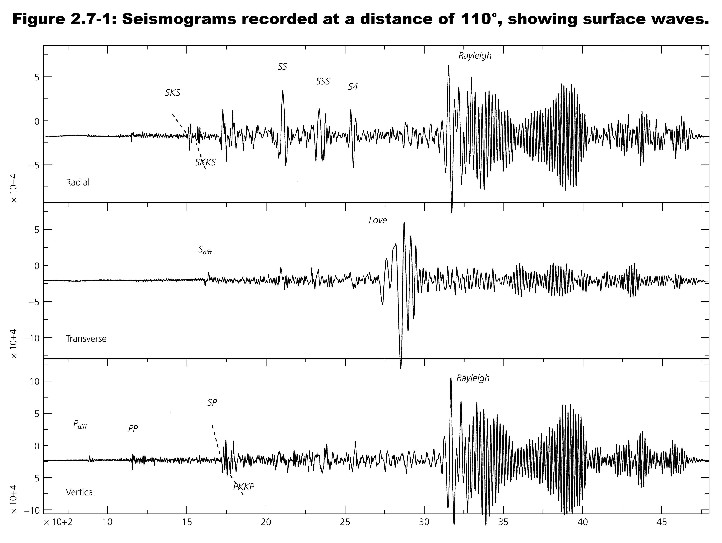
Surface wave observations
figure from Stein & Wyssession, 2003

Slide 30
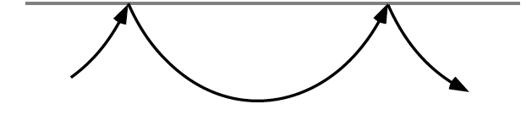
Relationship to body waves
Love waves
Rayleigh waves
Constructive interference between surface-bouncing SH waves
Constructive interference between post-critically reflected P and SV waves
figures from Shearer, 2009

Slide 31
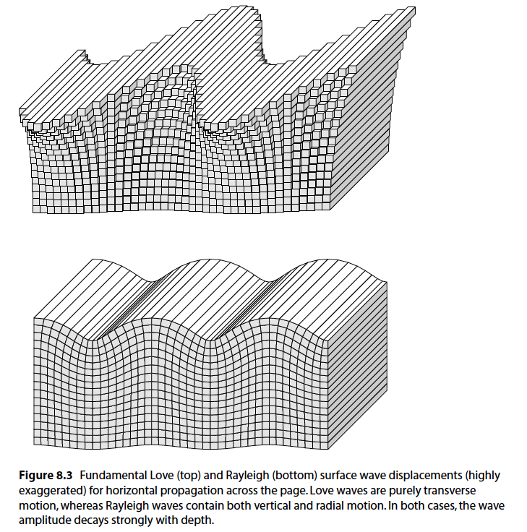
Surface waves
Love Waves
Particle motion is in the horizontal plane perpendicular to direction of propagation
Rayleigh Waves:
Particle motion is confined to the vertical plane joining source-receiver.
figures from Shearer, 2009

Slide 32
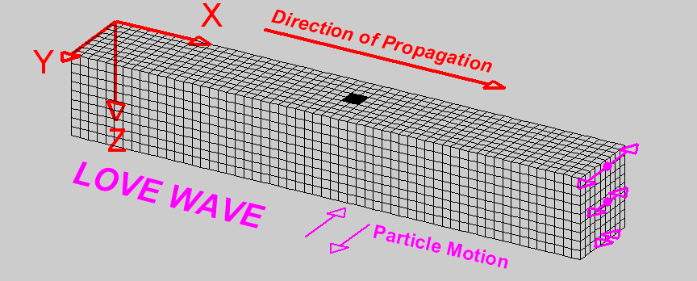
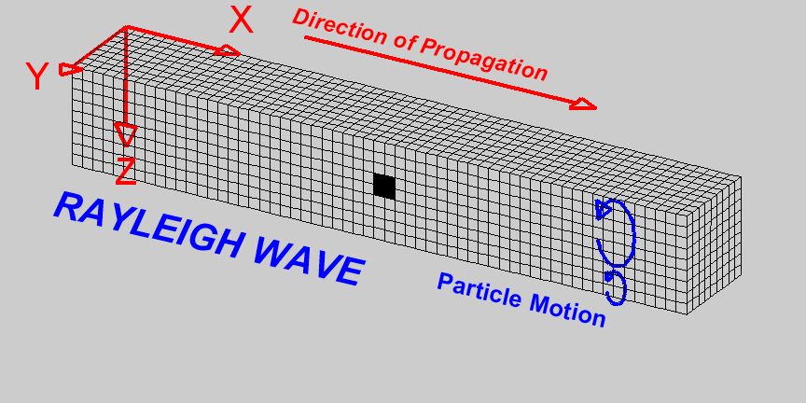


Surface waves
Love Waves
Particle motion is in the horizontal plane perpendicular to direction of propagation
Rayleigh Waves:
Particle motion is confined to the vertical plane joining source-receiver.
http://www.geo.mtu.edu/UPSeis/images/

Slide 33
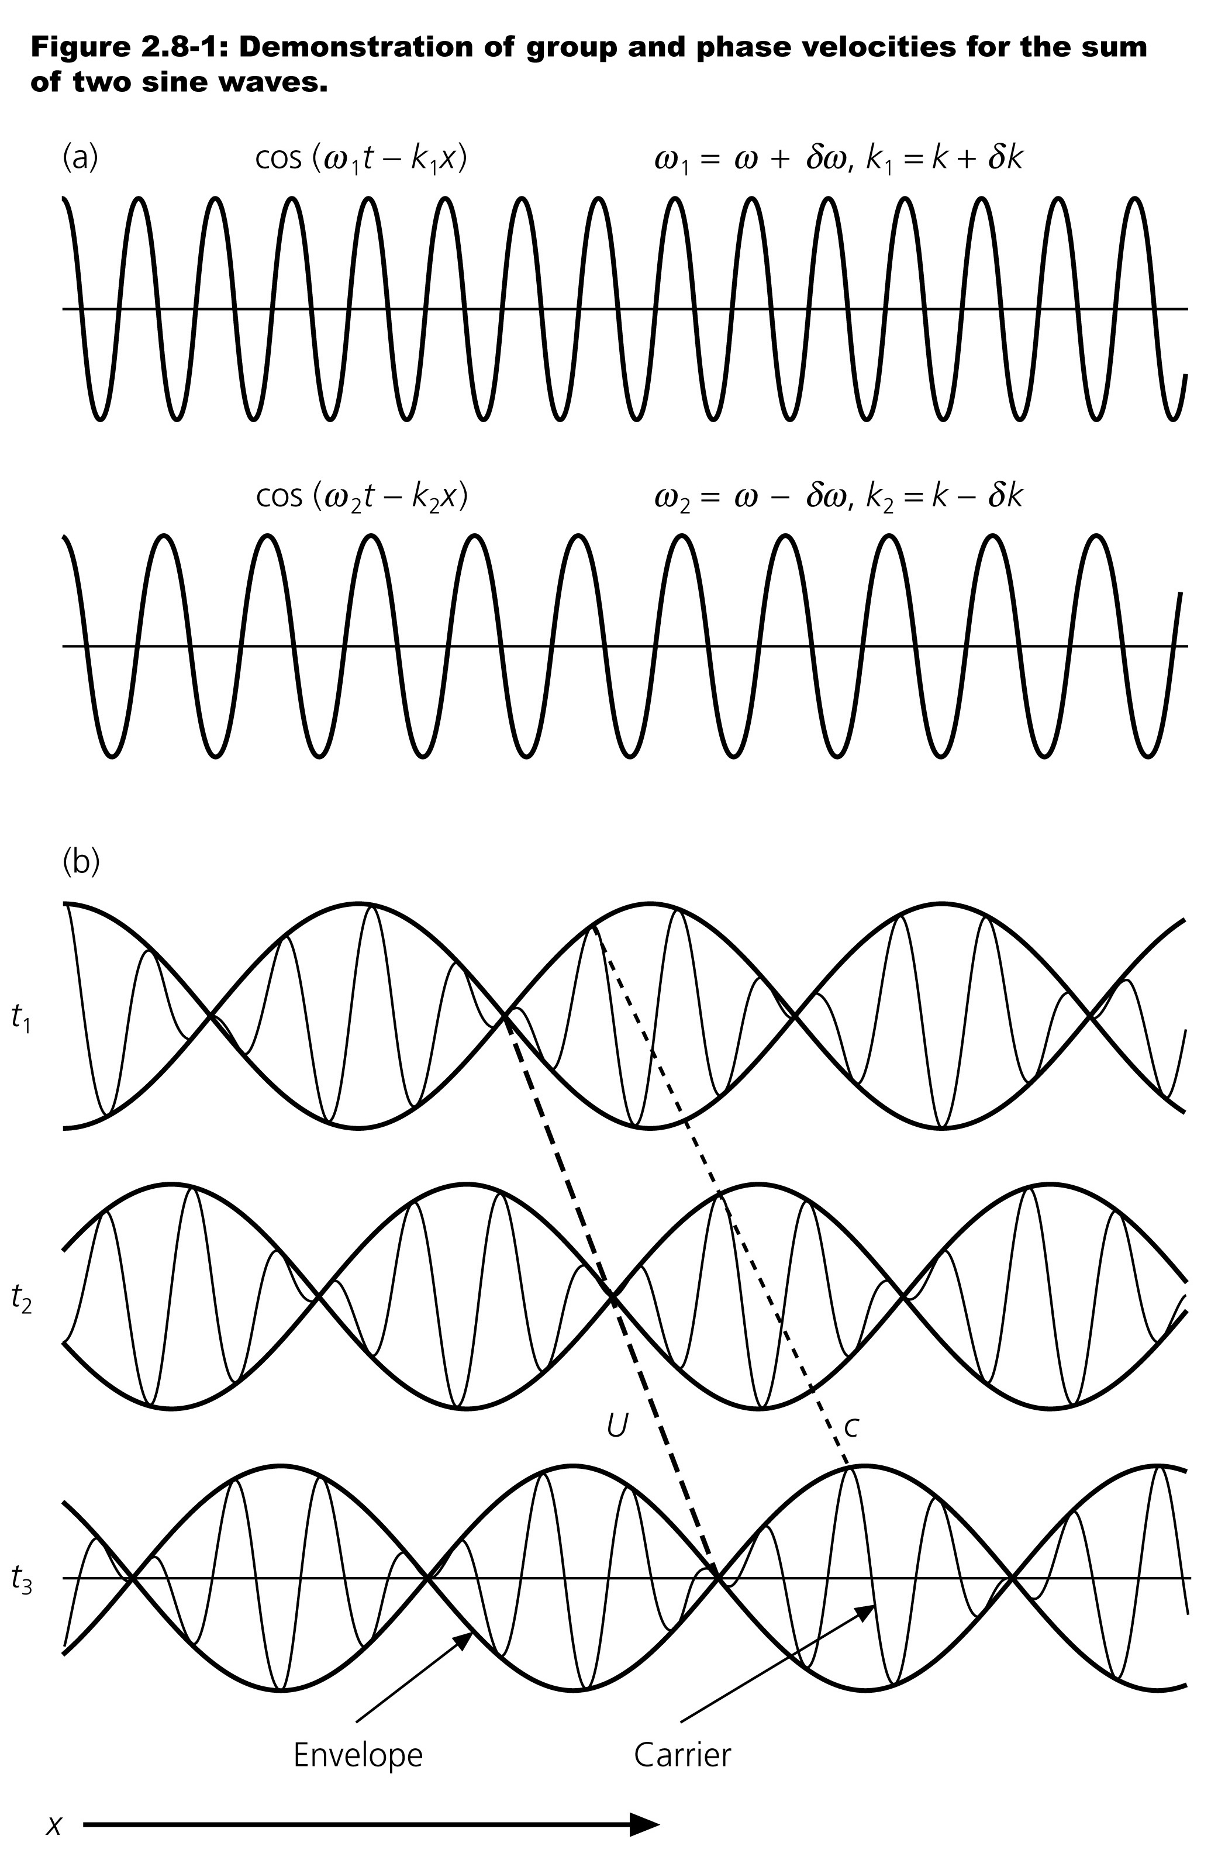
Phase vs Group velocity
When different frequencies propagate at different (phase) velocities, packets of seismic energy travel at a different velocity (group)
Phase velocity: c = ω/k
Group velocity: U = dω/dk
Group velocity is always slower than phase velocity
At high frequencies, it is easier to measure group velocities since measuring phase velocities has the potential for cycle skipping
figures from Shearer, 2009

Slide 34
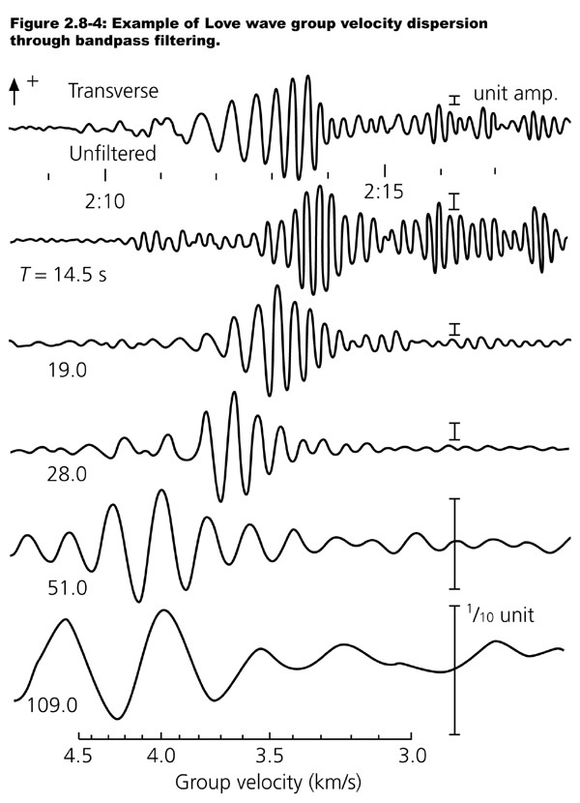
Measuring dispersion
By filtering a seismogram to include waves of different frequencies, we can measure the phase and group velocities as a function of frequency
Longer period waves “feel” deeper in the earth than shorter period waves
Longer period surface waves travel faster → velocity increases with depth
figures from Shearer, 2009

Slide 35
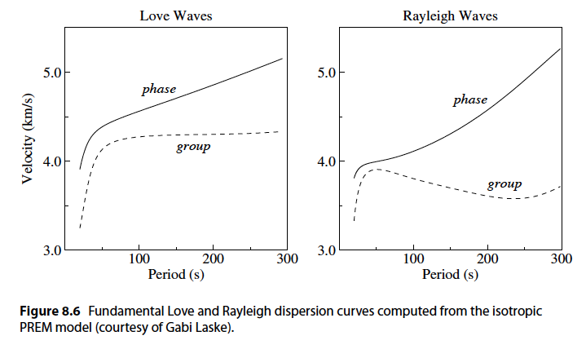
Love & Rayleigh Dispersion
At periods where group velocity attains a maximum or minimum, large amplitude surface waves are seen → “Airy” phases
figures from Shearer, 2009

Slide 36
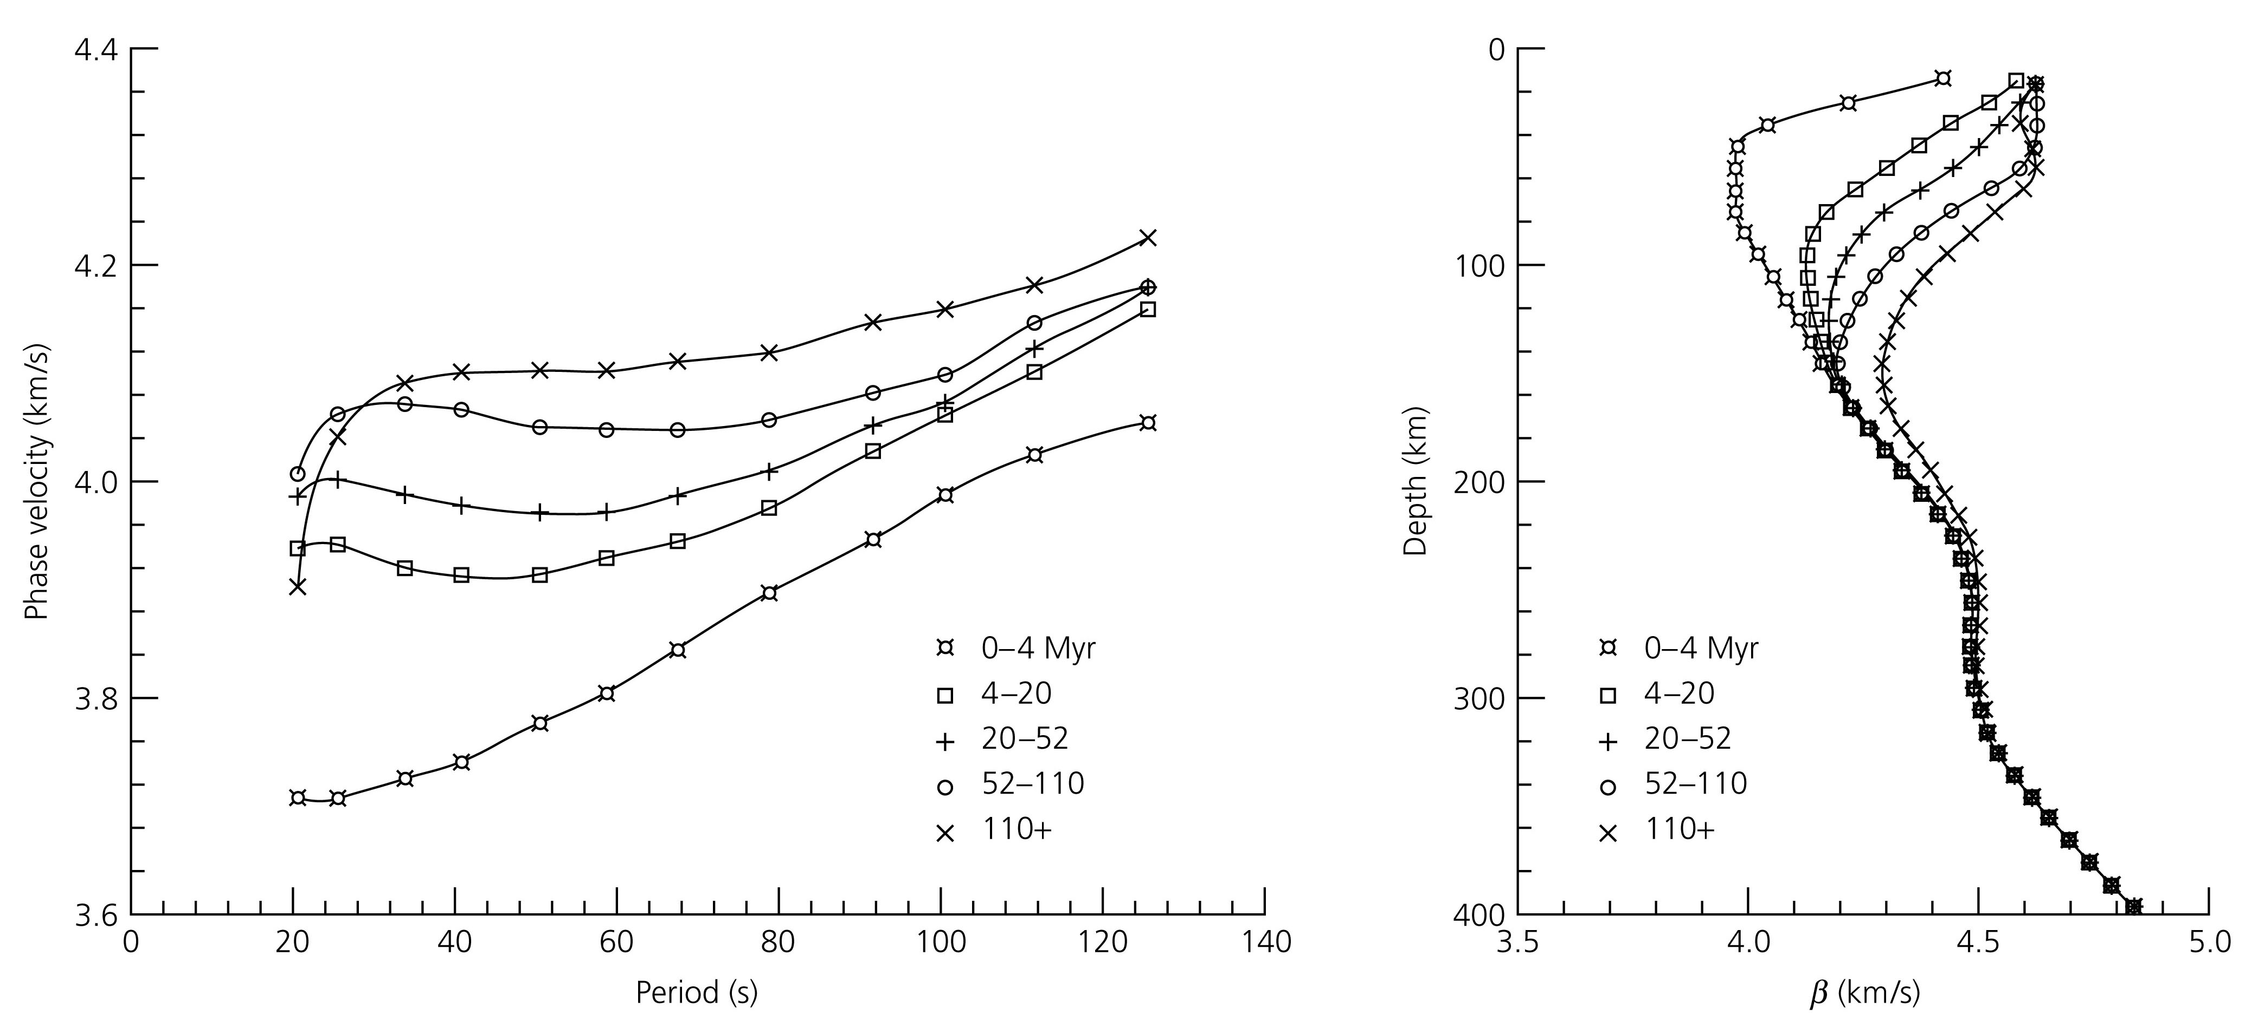
Signature of plate cooling
Phase velocity measurements of Rayleigh waves allowed seismologists to infer how velocities increase with plate age (colder temperatures → faster velocities)
(Figure from Stein and
Wysession, 2003)

Slide 37

Exploiting ambient noise
Impact of ocean waves on the shores (primary microseism) and pressure variations on the ocean floor due to ocean waves (secondary microseism) create Rayleigh waves that propagate around the Earth in all directions
By computing cross-correlations of noise at pairs of seismometers we can extract and measure Rayleigh wave dispersion
These measurements can be used to image the Earths’ interior (ambient noise tomography)
Shapiro & Campillo 2004

Slide 38


Lateral variations in structure
We can infer 3D velocity distribution using:
  Absolute and differential travel-times measured across many different paths
  Similarly, phase / group velocity measurements at different frequencies and on different paths
  Directly analyzing full waveforms recorded on different paths
French et al. 2013

Slide 39
Amplitudes - Relative
So far, we have just discussed travel times of waves through the Earth (only depend on velocity)
What factors cause amplitudes to change as waves propagate?
  Reflection / transmission coefficients
  Geometric spreading
  Scattering / redistribution of seismic energy
  Focusing / defocusing by structure
  Intrinsic attenuation

Slide 40



Reflection/transmission coefficients
Impose continuity of displacements and tractions across solid-solid interface
R/T coefficients depend on impedance: the product of velocity with density
α₁, β₁, ρ₁
α₂, β₂, ρ₂
figures from Shearer, 2009

Slide 41

SS and PP precursors (reflection)
SS (or PP) precursors are waves reflected from a discontinuity in the subsurface and observed before the arrival of the surface-reflected wave
Their amplitude (as a function of epicentral distance) can constrain both Vp, Vs and density jumps across mantle discontinuities!
Figure by Schmerr

Slide 42

SS precursors (reflection)
SS (or PP) precursors are waves reflected from a discontinuity in the subsurface and observed before the arrival of the surface-reflected wave
Their amplitude (as a function of epicentral distance) can constrain both Vp, Vs and density jumps across mantle discontinuities!
http://terpconnect.umd.edu/~nschmerr/Research.html

Slide 43
Receiver Functions (transmission)
T_{P} – T_{Ps} = H (η_{S} – η_{P})
H
Teleseismic waves can convert from P-to-S or S-to-P beneath a seismometer
Relative timing between P(S) and Ps(Sp) arrivals constrains the depth of the interface
Relative amplitude of P/Ps and S/Sp constrains impedance contrast across interface
α₁, β₁, ρ₁
α₂, β₂, ρ₂
P-waves from distant quake
S-waves converted across interface

Slide 44

Focusing by slow anomalies
Transverse-component velocity waveforms from the 4/11/2010 Spain event
Stations in 91º -102º epicentral distance range → S waves grazing the core-mantle boundary
S/Sdiff waveforms show amplitude focusing and travel-time delays
FOCUSING
Lekic et al. EPSL 2012

Slide 45


Seismic attenuation
Extrinsic attenuation
incoming elastic energy
is conserved
Intrinsic attenuation
incoming elastic energy
is transformed
Geometrical spreading
Focusing/Defocusing
Scattering
Anelasticity
(dislocations, diffusion, … )
Karato & Spetzler [1990]
Q (quality factor) or q (absorption)
q = 1/Q = - ΔE/2πE = - ΔA/πA

Slide 46

Scattering
Seismic waves can scatter from heterogeneities within the elastic medium
Scattering is efficient if the size of the scatterer is similar to the wavelength
Scattering re-distributes energy, decreasing amplitudes at the beginning of a seismogram, and increasing them in the back (the “coda”)

Slide 47
Characterization of intrinsic attenuation
Elastic energy of waves is consumed in dissipative processes (Knopoff, 1964)
Many different dissipation mechanisms exist in the mantle
(e.g. Jackson and Anderson 1970)
external gradient

Slide 48
Characterization of intrinsic attenuation
Incident seismic wave
Elastic energy of waves is consumed in dissipative processes (Knopoff, 1964)
Many different dissipation mechanisms exist in the mantle
(e.g. Jackson and Anderson 1970)
external gradient

Slide 49
Characterization of intrinsic attenuation
energy cost G(P,T,x)
= attenuation
Incident seismic wave
Elastic energy of waves is consumed in dissipative processes (Knopoff, 1964)
Many different dissipation mechanisms exist in the mantle
(e.g. Jackson and Anderson 1970)
external gradient

Slide 50


Characterization of intrinsic attenuation
Global entropy increase
energy cost G(P,T,x)
= attenuation
Incident seismic wave
Elastic energy of waves is consumed in dissipative processes (Knopoff, 1964)
Many different dissipation mechanisms exist in the mantle
(e.g. Jackson and Anderson 1970)
external gradient
Frequency dependence
Often assumed thermal activation

Slide 51



Dispersion due to attenuation
Because they have more oscillations per unit distance, higher frequencies are more attenuated
If all frequencies travelled at the same speed, then causality would be violated
Low frequency waves are slowed down more than high frequency waves
figures from Shearer, 2009

Slide 52
Earth attenuation structure
Dziewonski & Anderson (1981)
Widmer et al. (1991)
Durek & Ekström (1996)
Lawrence & Wysession (2006)
Hwang & Ritsema (2011)
figure by Matas

Slide 53




Frequency dependence
Q depends on frequency
Q is frequency independent
figure from Shearer, 2009
Lekic et al., 2009

Slide 54



Amplitudes - absolute
To get at absolute amplitudes, we have to consider the seismic source
Can an earthquake be represented by a single body force?
To conserve both linear and angular momentum (no net acceleration, no net torque), body forces representing earthquake sources must appear in pairs of force couples (a.k.a. double couples)

Slide 55




Double-couple mechanisms
μ – rigidity of rock
D – average slip on fault
A – area of that slipped

Slide 56


Radiation from moment tensors

Slide 57


P-wave radiation pattern
P-wave amplitude is:
Most positive in the direction of the tension axis
Most negative along compression axis
Zero along primary and auxiliary plane directions

Slide 58
S-wave radiation pattern
S-wave amplitude is:
Greatest along primary and auxiliary plane directions
Particle motions are away from P-axis and toward T-axis

Slide 59

Beach-Balls
We can graphically represent a moment tensor by shading areas where first-arriving P wave would be positive → “beach-ball” representation
Extend along shaded portions, compress along unshaded

Slide 60

Centroid Moment Tensors
“Harvard” CMT (Dziewonski & Woodhouse, 1983): www.globalcmt.org

Slide 61
Conclusions
Seismology is a big field!
Questions?

