Slide 1
Cooperative Institute for Dynamic Earth Research
http://www.deep-earth.org/
Barbara Romanowicz, Univ. of California, Berkeley
Funded by
CSEDI program, and now by FESD:
CIG C

Slide 2
Motivation and goals
Initiative originated in 2002
Inter-disciplinary Synthesis Center
Research Incubator
Integrative framework:
To tackle the fundamental question of the nature of global dynamic processes that drive plate tectonics on Earth

Slide 3
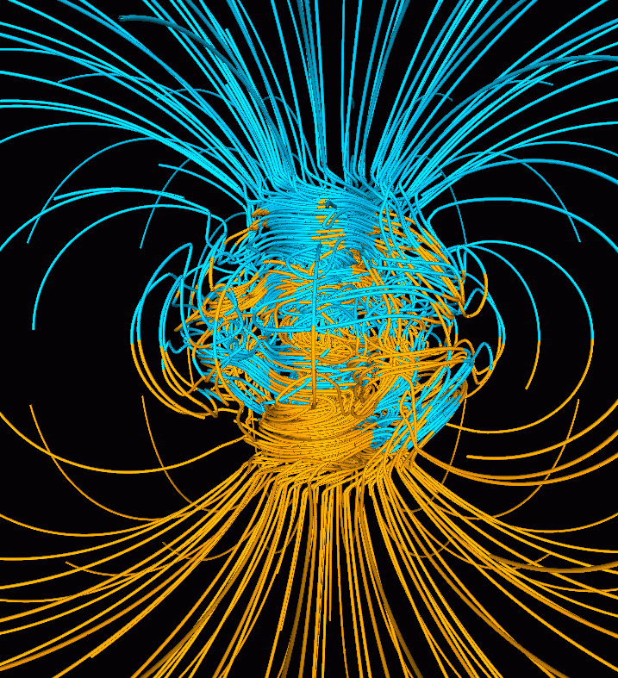
Understanding how the Earth’s interior works requires a synthesis of..
Geomagnetism

Slide 4
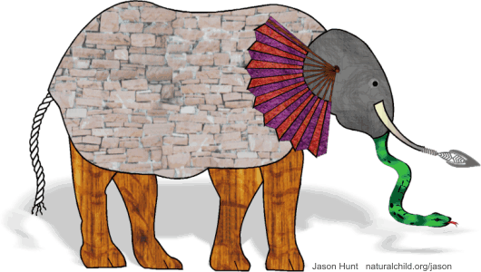
“Blind men and the elephant”
Jason Hunt naturalchild.org

Slide 5
Recognizing the need for more effective communication and understanding between the different disciplines, CIDER’s goal is to provide:
An intellectual framework for integrated multi-disciplinary research in the geosciences
The necessary complement to growing infrastructure for data gathering and distribution
Across-disciplinary educational environment to prepare the next generation of earth scientists

Slide 6
CIDER: A”research incubator”:
Working model: KITP ( Kavli Institute for Theoretical Physics, UC Santa Barbara)
Programs on particular themes last 4-6 months
typically start with a workshop
Framework for informal interactions
at any given time ~20 participants
each participant commits to stay at least 3 weeks.
Adapt this model to the unique needs of Geosciences

Slide 7
CIDER activities 2003-2010
(1) Two community workshops
May 2003 (Marconi Center, CA)
Define the scope and format of CIDER
Resulted in proposal to NSF/CSEDI-> funded 4 summer programs (2004, 2006, 2008, 2010)
May 2009 (Marconi Center, CA)
Review past activities, define the scope of CIDER-II -> “D” changed from “Deep” to “Dynamic”
Resulted in proposals to NSF/CSEDI (2011 summer program) and preproposal to FESD- sept 2010

Slide 8
2004 Summer Program:07/12/04-08/06/04
“Relating seismological and geochemical heterogeneity in the earth’s mantle”
2 weeks tutorial + 2 weeks workshop
30 grad students/post-docs
21 junior/senior scientists
2008 Summer Program: 06/23/08-08/05/08:
“Boundary Layers in the Earth”
3 weeks KITP style (overlap with “Dynamos” + 2 weeks tutorial + 2 weeks workshop (incl. VLAB)
35 graduate students/post-docs
35 junior/senior scientists
2006 Summer Program : 07/16/06-08/06/06
“The earth’ s transition zone”
Overlapping 2 weeks tutorial/2 weeks workshop
35 grad students/postdocs
20 junior/senior scientists
2010 Summer Program: 06/12/10-07/18/108:
“Fluids and volatiles in the Earth’s mantle and core”
2 weeks KITP style (overlap with “Physics of Glasses” + 2 weeks tutorial + 1 week workshops
35 graduate students/post-doc
30 junior/senior scientists
->Followed by SEDI international Symposium
->Follow up research activities
All held at KITP, Kohn Hall, UCSB campus
funded by NSF/CSEDI, infrastructure provided by KITP.

Slide 9
- CIDER 2011 program: June 19-July 22, 2011 “Dynamics of Mountain Building” Held at U.C. Berkeley - 1 week informal program, - Imaging workshop June 22-24 - 2 weeks of lectures/tutorials - 1 week of “workshop” - CIDER-II funded by the FESD program of NSF - yearly summer program - funding for other activities

Slide 10
CIDER summer program structure
1-2 weeks of “informal”, KITP style program
4 weeks of tutorial/workshop
In alternate years: theme focused on “deep” earth, versus “shallow”
2013 summer program (UC Berkeley):
“Formation and evolution of continents”

Slide 11
CIDER Summer Program Products
Presentations at AGU
Papers published as a result of CIDER interactions
Proposals written to CSEDI –some funded !
Students have gone on to post-doc and/or faculty positions

Slide 12
Interdisciplinary research groups formed at CIDER 2010
Probing the existence of a stratified layer at the top of the outer core (DI41A-1935)
Developing regional seismological Reference Earth Models for mineral physics applications (DI52A-07)
Quantifying Earth’s Deep Water Cycle and its Role in Plate Tectonics
Origin of the F-layer by “snowfall” in the Earth’s core (DI41A-1920)
What is the temperature of the mantle wedge and how does it relate to various subduction parameters?
Notes:
In the center bottom of the figure are geodynamical models that predict the sign and thickness of the layer we are looking for. From the synthetics we find these layers to be undetectable.
Instead in the normal modes we find a slower layer and a positive density perturbation. We show the figure of the velocity perturbation in the lower right. In the top left is a figure of the SmKS study and we quantified the effect of CMB topography for this specific event in different models. The bounce points here are plotted on a model of Lassak and McNamara. If anything this event shows a positive deviation. We have a mineral physics story to support a high deviation of density compared to PREM in the top outer core (the layer isn't unstable).
The geochemistry observations in the lower left do not show evidence of an FeO flux into the core.
Our poster is on Thursday morning, so I guess before the talk.

Slide 13
Research groups formed during the summer program continue to function after the end of the summer program (AGU posters, publications)
More generally: collaborations leading to publications and/or proposals (e.g. NSF/CSEDI program)
In 2011, we initiated a one day “post-AGU” CIDER workshop, held at Berkeley on the Saturday following AGU
2012: sat. Dec 8th, 2012.

Slide 14
II- Proposed CIDER “in-house” activities
Short term visitors (2 weeks to 3 months)
Working groups: (10-12 participants collaborating intensively on a topic related to CIDER goals – meet 3-4 times over 2 years, each meeting 3-7 days)
“Catalysis Meetings “ ~30 scientists to work on a major question or research area with a central theme

Slide 15
CIDER STEERING COMMITTEE 2003-2007
:
D. DePaolo UC Berkeley Geochem.
A. Dziewonski (chair) Harvard Seismology
S. Hart WHOI/MIT Geochem.
R. Jeanloz UC Berkeley Mineral Phys.
L. Kellogg UCD Geodynamics
D. Kent Rutgers Geomagnetism
M. Manga UC Berkeley Geodynamics
G. Masters UCSD Seismology
P. Olson Johns Hopkins Geodynamics
B. Romanowicz UC Berkeley Seismology
L. Stixrude U. Michigan Mineral Phys.
E. Stolper Caltech Geochem.
D. Weidner SUNY Mineral Phys.

Slide 16
CIDER STEERING COMMITTEE 2008-2011
:
C. Constable UCSD Geomagnetism
D. DePaolo UC Berkeley Geochemistry
T. Duffy Princeton Mineral Phys.
A. Dziewonski Harvard Seismology
S. Hart WHOI/MIT Geochem.
M. Hirschmann U. Minn. Min. Phys/Geoch.
L. Kellogg (Chair) UCD Geodynamics
C.T. Lee Rice Geochemistry
M. Manga UC Berkeley Geodynamics
G. Masters UCSD Seismology
B. Romanowicz UC Berkeley Seismology
L. Stixrude U. Michigan Mineral Phys.

Slide 17
CIDER-II governance
Executive Committee:
B. Buffett, M. Hirschmann, L. Kellogg, A. Levander, S. Mukhopadhyay,
Ex officio: B. Romanowicz (PI)
Advisory Committee:
In progress
PI’s: B. Romanowicz, M. Manga, B. Buffett, R. Allen, R. Burgmann (U.C. Berkeley)

Slide 18
Seismology
IRIS
Earthscope
COMPRES
Mineral Physics
Geodynamics
CIDER
Synthesis Center
Thermo-chemical dynamics of the Earth’s interior
m
Geomagnetism
CIG,
Grace
MagIC PMAG
Oersted, Champ,
Swarm
Geochemistry
KITP
Physics
Other
fields
PetDB
GEOROC

Slide 19
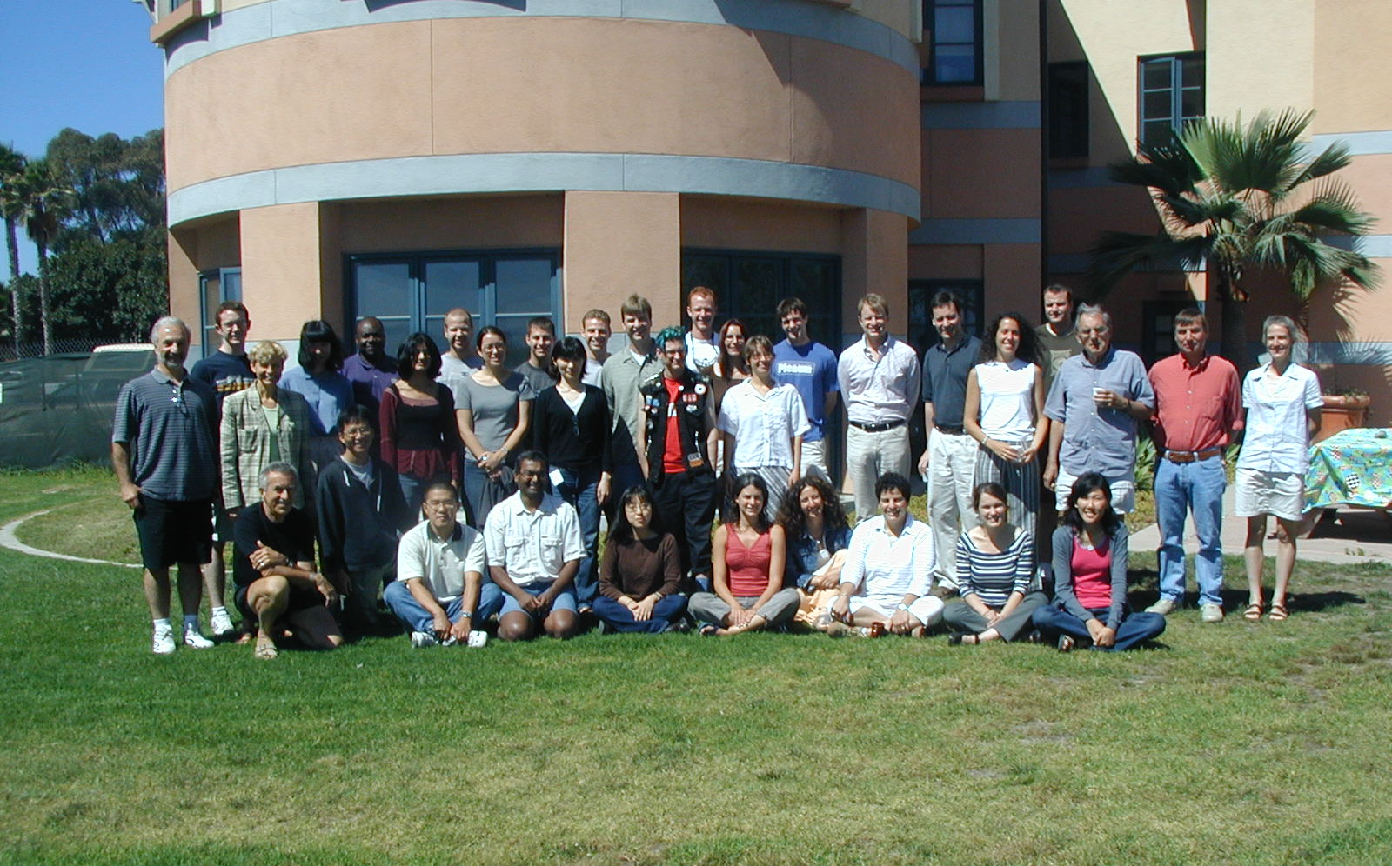
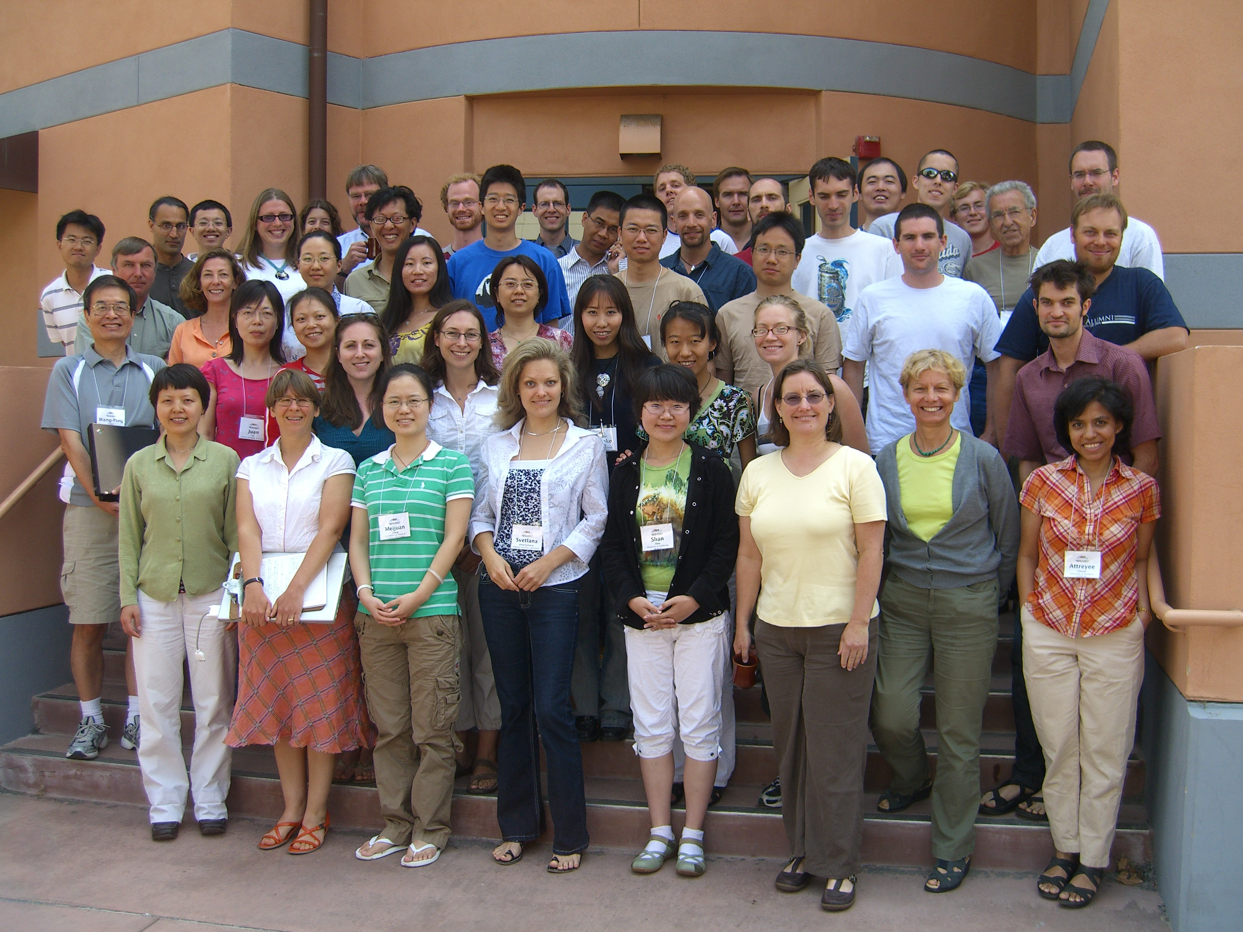
2004
2008
Total over 4 summer programs:
134 grad students/post-docs
106 faculty/scientists incl. 31 instructors
40 US institutions
18 foreign institutions

