Slide 1
Determining the nature of the LLSVP
CIDER Workshop 2012
Maxim Ballmer, Jamie Barron, Rohan Kundargi, Curtis Williams, Rick Carlson,
Jasper Konter, Jackie Li, Sujoy Mukhopadhayay

Slide 2
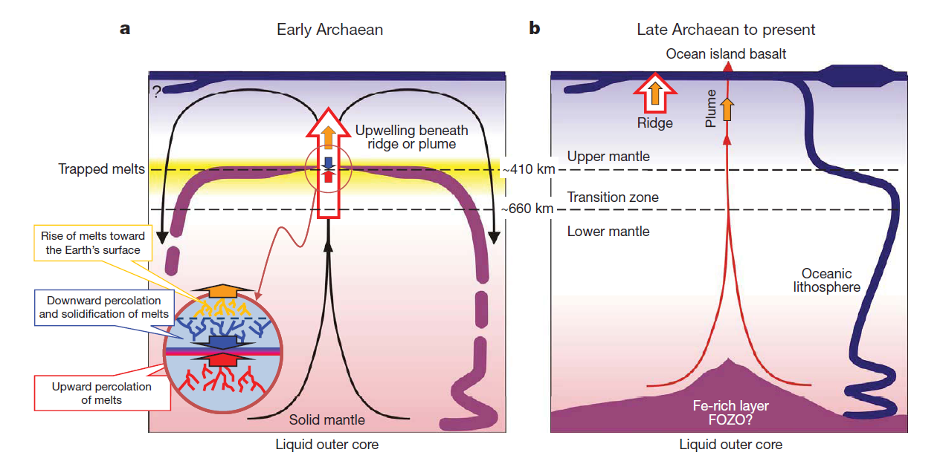
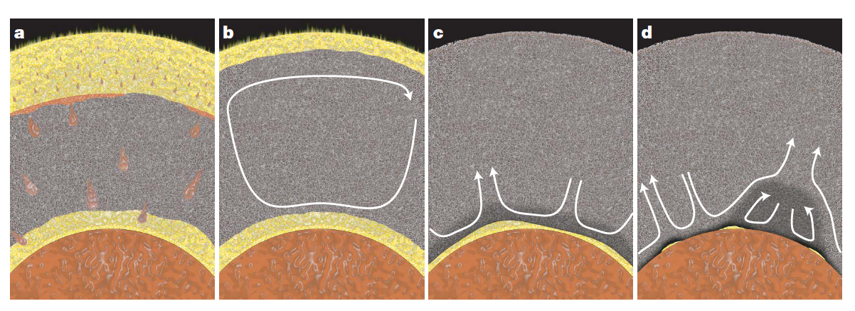
Motivation
Why LLSVPs?
(1) “hidden” geochemical reservoir (2) secular evolution of the Earth
Continental Crust
Upper Mantle / Lower Mantle
Early Enriched Reservoir = ???
= LLSVP ?
Lee et al. (2010)
Labrosse et al. (2007)
Bulk Silicate Earth = ???

Slide 3
What are the LLSVPs?
Seismic tomography shows two large low shear velocity regions in the lowermost mantle: a degree 2 pattern centered on the Pacific and Africa
Garnero et al. (2007)

Slide 4
Pacific LLSVP
Garnero & McNamara (2008)

Slide 5
Dense
thermochemical
pile
Garnero et al. (2007)

Slide 6
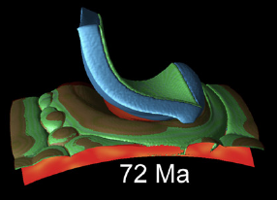
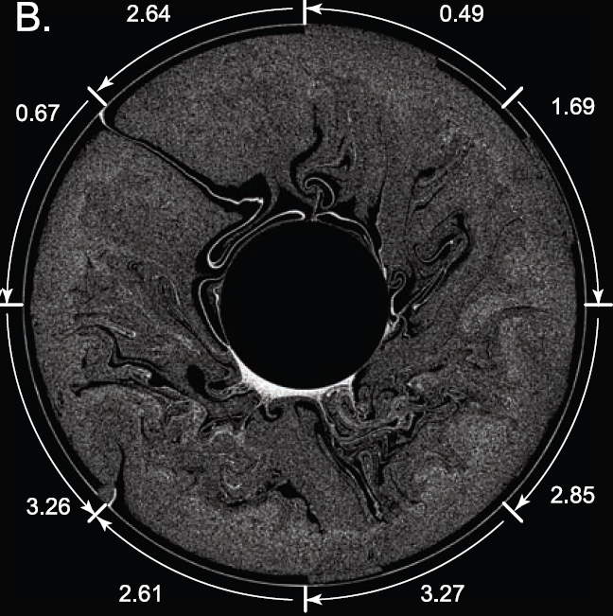
Scenarios for Origin of BAsal Reservoir (aka LLSVP)
Brandenburg and van Keken (2007)
Labrosse et al. (2007)
Tackley (2011)
Slab Graveyard
- accumulated over time
(2) Primordial Reservoir
- magma ocean product (MOP)
Slab graveyard
32
Hybrid Scenario
- both primordial and replenished by slabs

Slide 7
Our goal… test hypotheses
CompositionalModels
Volume Calculation
from seismic models
Compute Physical
Properties
Seismic Test
Assess Dynamic Stability

Slide 8
Plan of Attack
(1) Primitive Reservoir
(2) Slab Graveyard
(3) Hybrid Scenario
Team BMO
Calculate physical properties of compositions at CMB pressure and temperature
(Jackie Li’s code and/or BurnMan)
Mg/Si-group
Density
Vp
Vs
Geodynamical test – can we obtain stable piles?
Seismological test – can we match observed seismic signature of piles?

Slide 9
Hypothetical Compositions of LLSVPs (1) slab graveyard (2) primordial reservoir
Brandenburg and van Keken (2007)
Labrosse et al. (2007)
Tackley (2011)
Magma Ocean Product
<= team BMO
Magma Ocean Cumulate
KREEP-like
Fe-rich differentiate
Early Enriched Reservoir
Calculated from volumes of
LLSVPs and BSE-estimates
MORB + harzburgite
Pyrolite
MORB alone
Ancient Fe-enriched
oceanic crust

Slide 10
Compute the LLSVPs’ volumes
Volume estimation depends on:
Tomographic model used (level of damping, regularization scheme)
Contour chosen (model-dependent)
Assumed height of LLSVP
We need to find some way to choose these parameters sensibly…

Slide 11
LLSVP volume - models
Damping varies between models – need to choose different isosurface of LLSVP for each
Choose based on gradient of model
(next slide)
Contours shown on models are:
saw24b16: -0.6%
S362ANI: -0.6%
S40RTS: -0.4%

Slide 12
LLSVP volume - choosing contours
saw24b16
0.6%
contour
S362ANI
0.6%
contour
S40RTS
0.4%
contour
Choose contour so it goes through region of steep gradient at edge of LLSVP
(compositional change should be associated with sharp gradient)

Slide 13
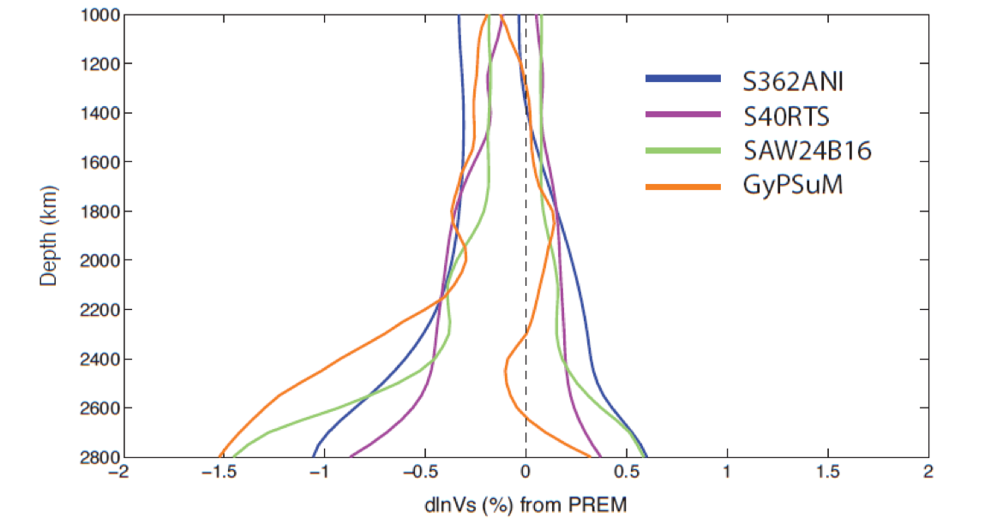
LLSVP volume – choosing height
From clustering analysis – all models show change in gradient for slow cluster at approximately the same depth, around 2100km.
Lekic et al (in review, 2012)

Slide 14
LLSVP volume – prel. results
Calculate the volume within isosurface chosen for model, from CMB to 2100km depth
LLSVP cap

Slide 15
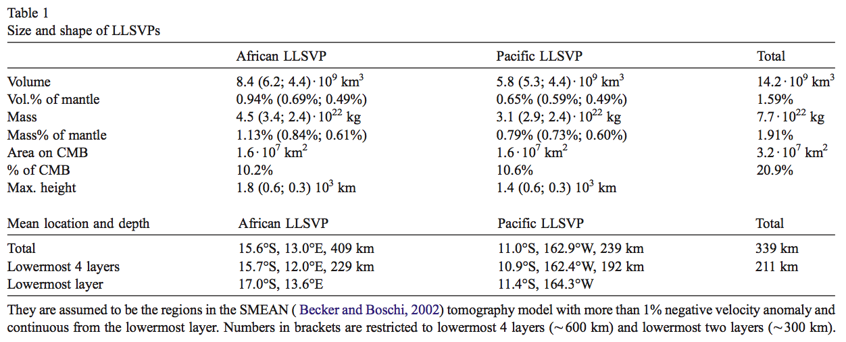
LLSVP volume - benchmark
Estimates from Burke et al (2008) using SMEAN model:
Smaller LLSVP inferred
different choice of seismic model and contour
consider material that is continuous from CMB only

Slide 16
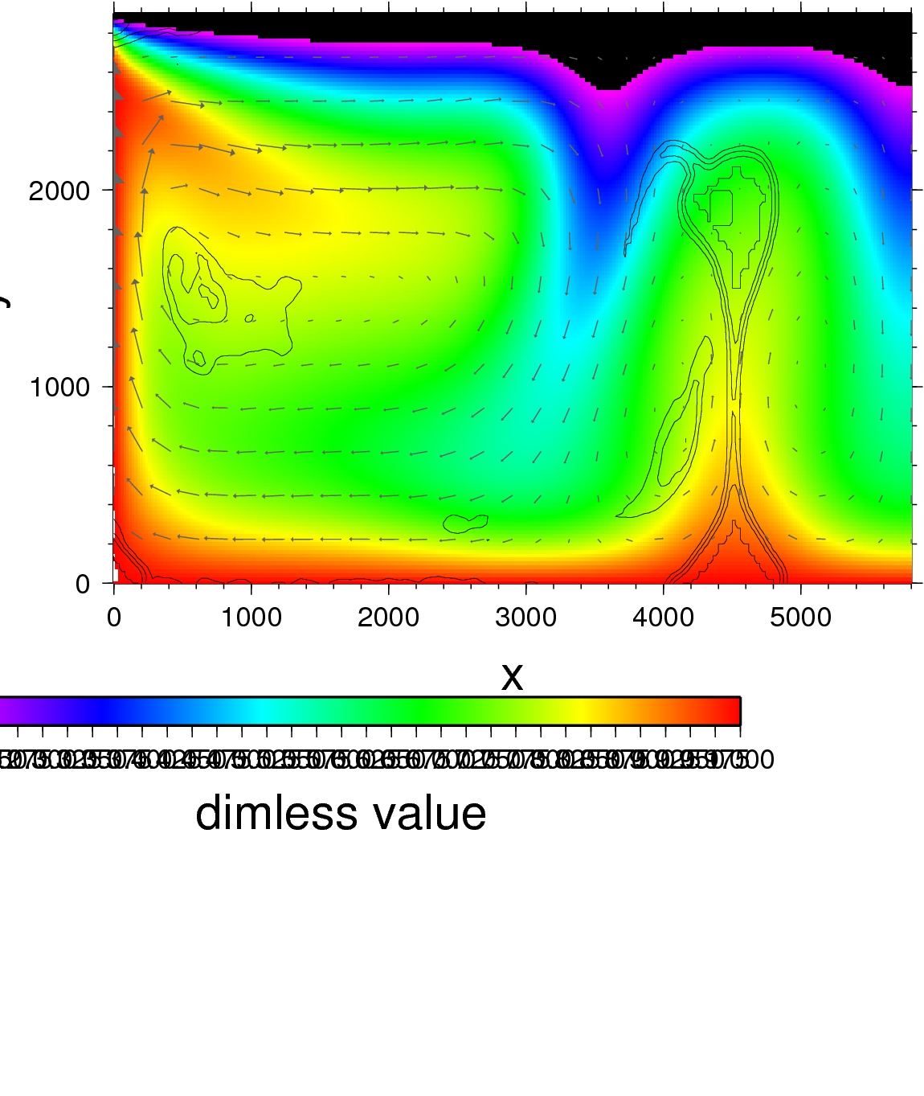
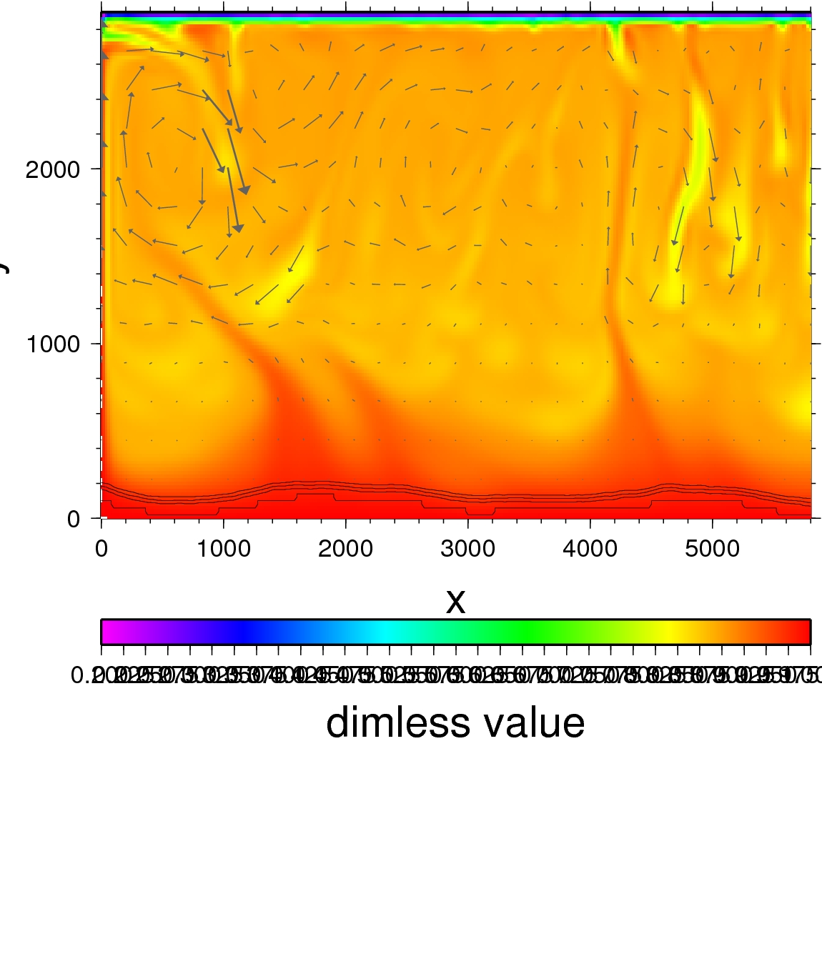
geodynamic test: preliminary results
760 temperature [°C] 3800

Slide 17
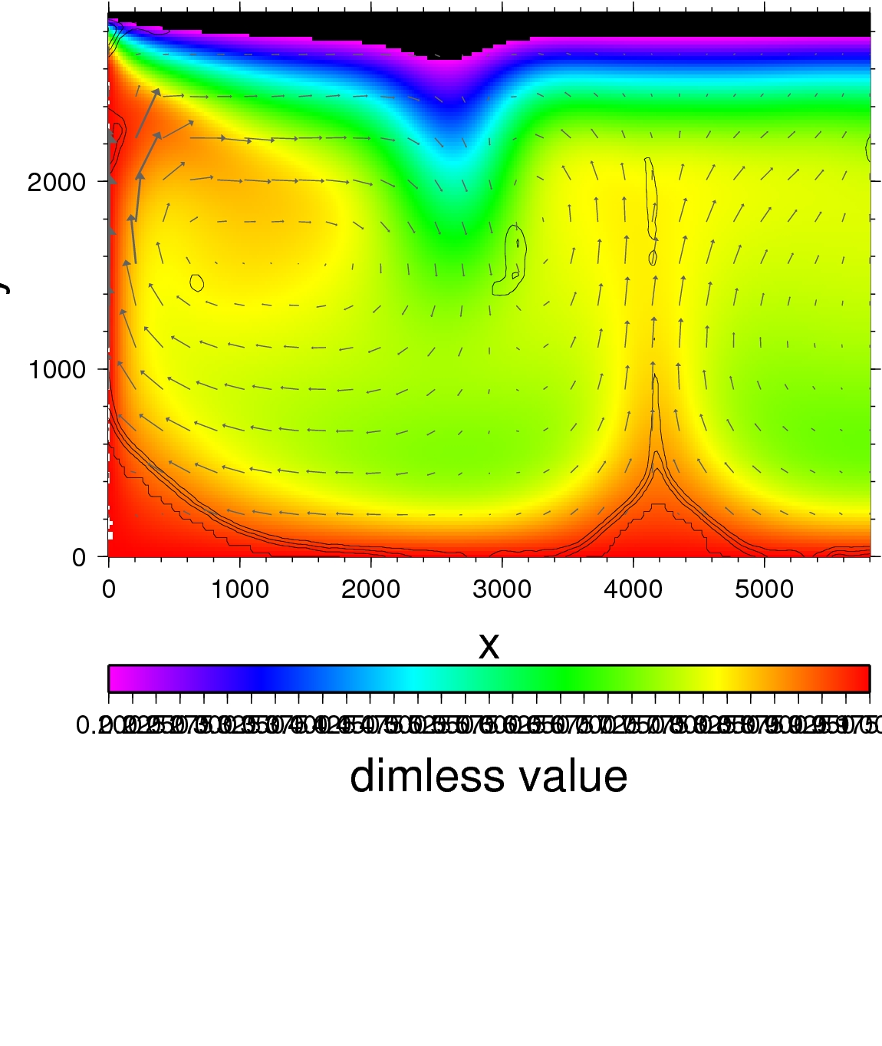
geodynamic test: preliminary results
more realistic depth-dependence of mantle rheology
viscosity contrast LLSVP vs. mantle
radiogenic heating in LLSVPs
depth-dependence of thermal expansivity
adiabatic heating
760 temperature [°C] 3800

Slide 18
numerical parameter study
Layer
with
Topo-
graphy
Convective
Overturn
Layer
without
Topo-
graphy
(basal layer)
Piles
Δρ(basal layer)
αρΔT(basal layer)
Buoyancy number B =

Slide 19
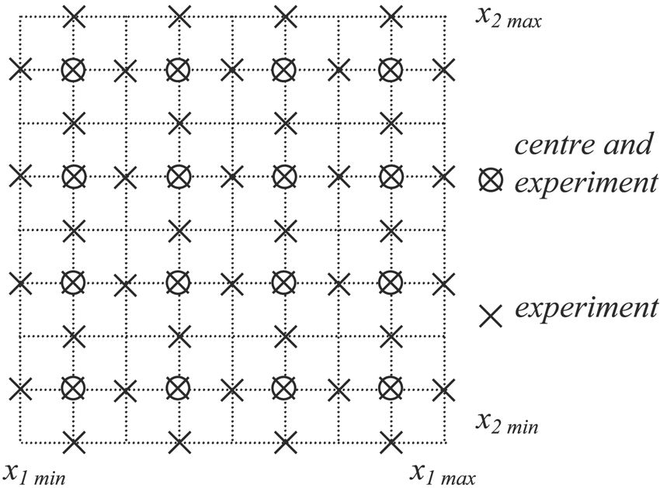
numerical parameter study
Layer
with
Topo-
graphy
Convective
Overturn
Layer
without
Topo-
graphy
(basal layer)
Piles
Δρ(basal layer)
αρΔT(basal layer)
rheology
Buoyancy number B =

Slide 20
numerical parameter study
time
Layer
with
Topo-
graphy
Convective
Overturn
Layer
without
Topo-
graphy
(basal layer)
Piles
Δρ(basal layer)
αρΔT(basal layer)
rheology
Buoyancy number B =

Slide 21
outlook
good plan, but a lot of work remains to be done
rule out a couple specific hypotheses for the composition of the LLSVPs
perhaps rule out a family of hypotheses for their origin (e.g. the slab graveyard hypothesis)
present results at EGU 2013
semantics (LLSVP, BAR, MOP)

Slide 22
Our goal…
To test the physical properties and implications of the suggested geochemical models of the origin and composition of the LLSVPs
Geodynamic stability
Comparison with seismic observations
Calculate LLSVP volume from seismic tomography

Slide 23
Composition and origin of the LLSVPs
Several proposed models for a compositionally dense layer:
Primordial reservoir
Slab graveyard
Some mixture of the two endmembers
Major element variability and primitive helium signatures in ocean island basalts could be explained by a primordial dense reservoir
Whole mantle convection models and seismic images of slabs penetration of the lower mantle lead to the idea of a slab graveyard
OIB geochemical endmembers (e.g., HIMU, EM ?) display a slab sigature

