Slide 1
Seismology
Introduction to body wave seismology – Steve Grand (steveg@geo.utexas.edu)
Normal modes and constraints on 1D and 3D structure – Miaki Ishii
Tomography? – Ved Lekic
Anisotropy and surface waves – Jean-Paul Montagner
Body wave anisotropy – Maureen Long
The core – Jessica Irving

Slide 2
Outline
1) Introduction to seismic waves
2) Fundamental equations of seismology
3) Waves in layered media
4) Ray theory – structure and waves in Earth
5) Examples of studies with body waves

Slide 3
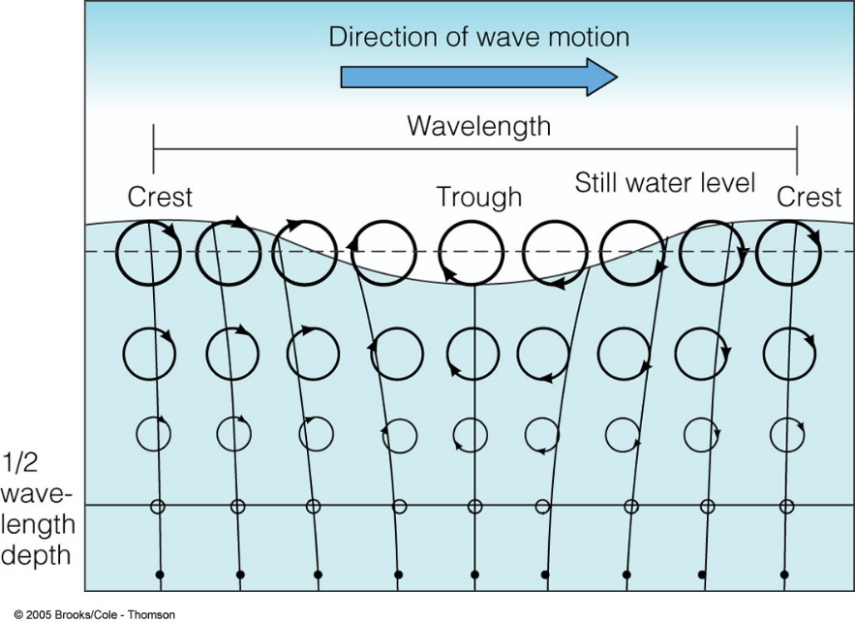

Seismology
Study of vibrations (elastic waves) that propagate through the Earth – gives info on medium (rock) through which the waves propagate as well as info about the source that created the waves

Slide 4
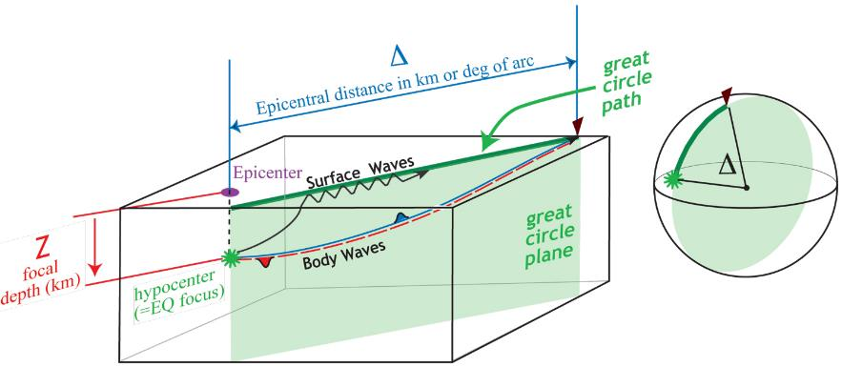
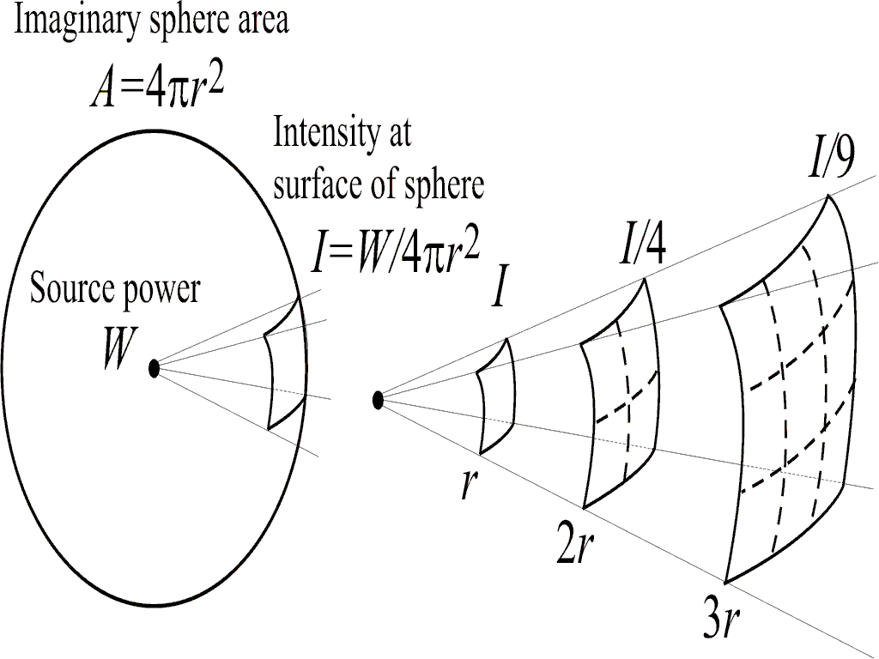
Body Waves – travel in 3D through Earth – decay as 1/r, Surface Waves along the surface decay as 1/r^{1/2}

Slide 5
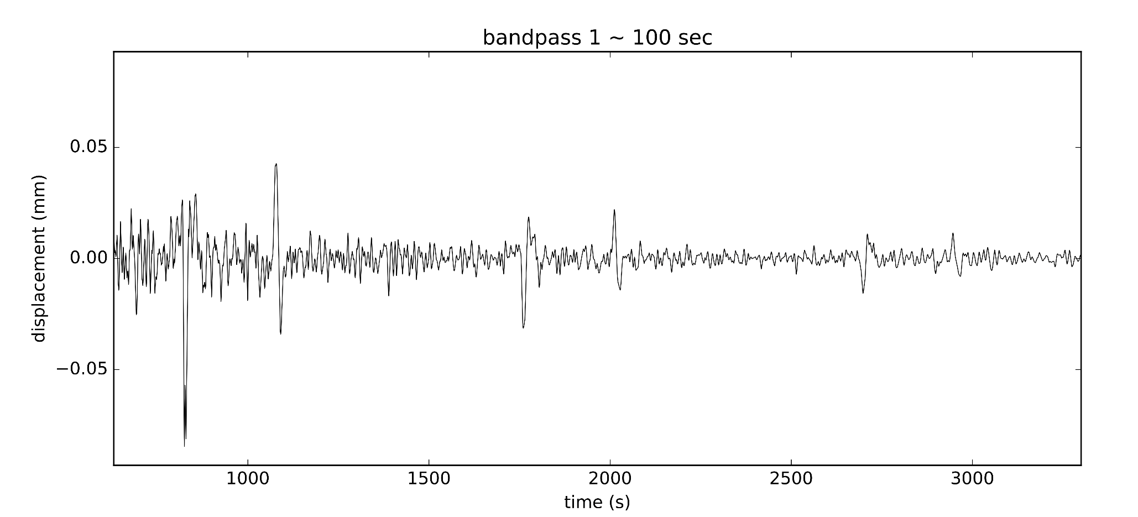
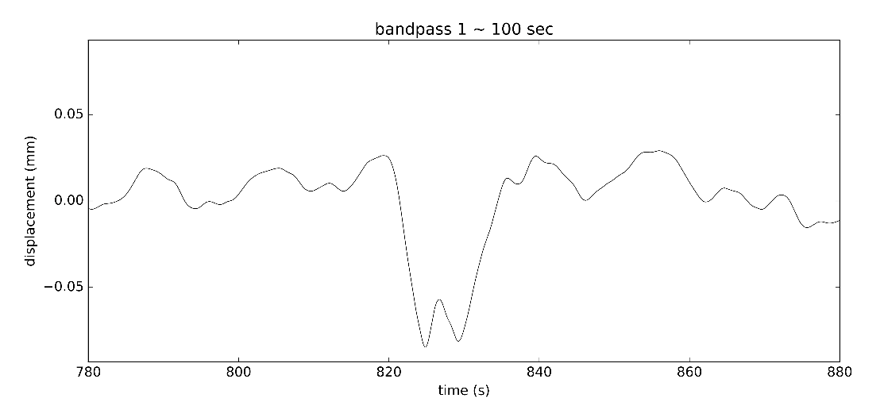
Ground movement in EW direction recorded at La Paz, Bolivia produced by a deep South American Earthquake to the south
Blow up of first pulse – shows wave shape or waveform

Slide 6
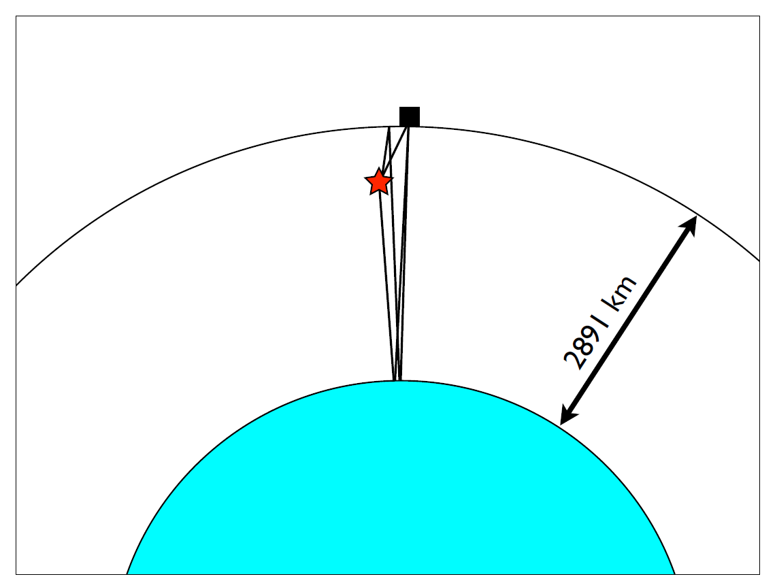
The pulses are seismic waves that have traveled up and down from the core to the surface – can easily get average speed of waves between core and surface from this seismogram
Travel time and distance gives us speed: v=X/T
Average speed of the seismic wave throughthe mantle and crust:
2x2891 / 930 = 6.21 km/sec

Slide 7
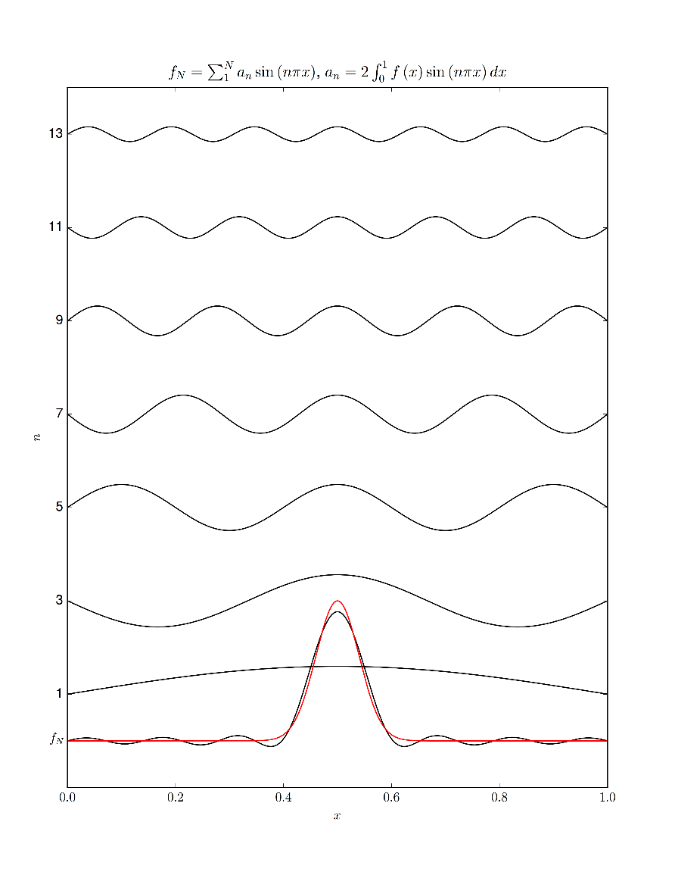
Fourier Series – any time series can be represented by a sum of sin’s and cos’s

Slide 8
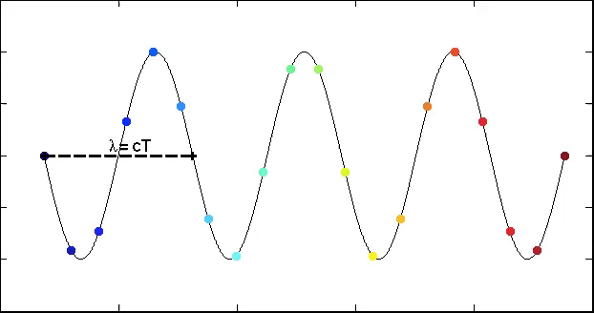
A wave can be composed of cos and sin waves – cos2π(kx-ft)
Resolution of properties of media wave travels through limited by wavelength (λ/4)
Can get average property in wavelength but no detail
cos2π(kx-ft)
Period =
Frequency ⁻¹
T = 1/f
Wavelength = Wavenumber⁻¹
λ= 1/k
Speed (c):
c = λf = f/k =λ/T
Amplitude
Distance
Courtesy Ved Lekic

Slide 9

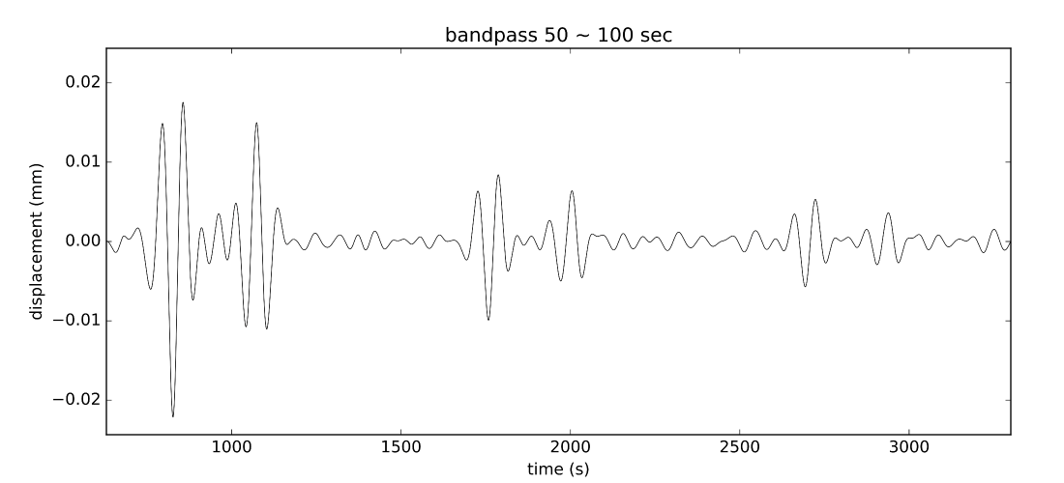
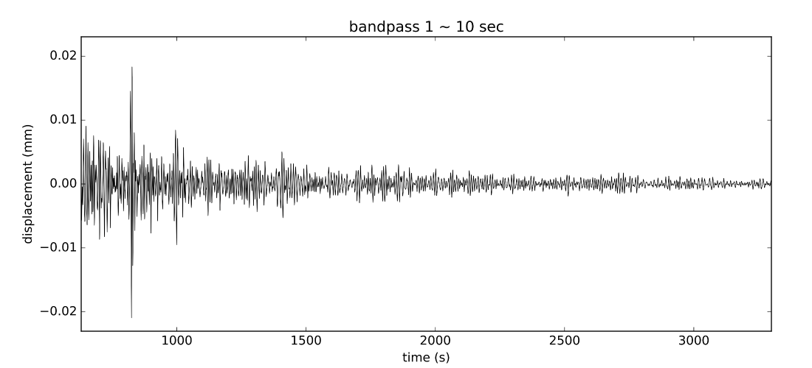
Often in seismology data are filtered for a range of frequencies – places limits on resolution

Slide 10
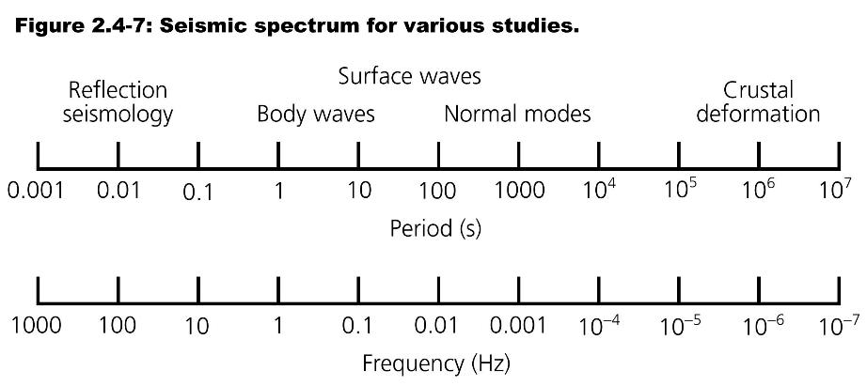
Seismology spans ~5 orders of magnitude in frequency, from waves that oscillate >100 times in a second, to those that take >1000 seconds to oscillate once

Slide 11
Basic equations governing seismic waves
Same equations for body waves, surface waves, normal modes

Slide 12
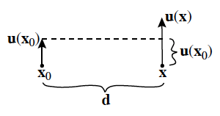
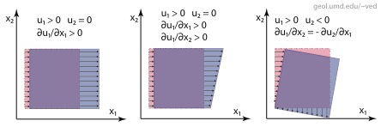
Seismic waves are propagating deformations – how do we describe deformation in a rock? – displacement vector u(x,y,z) gives movement of particle at (x,y,z) – spatial derivative of displacement gives change in shape (deformation) – time derivative gives velocity of particle at (x,y,x,t)
Ved Lekic, 2014

Slide 13
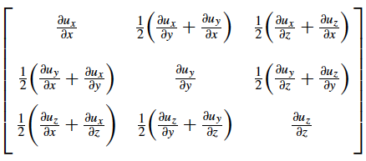
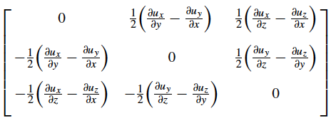
Strain - e_{ij}
No net rotation only if ∂u_{i}/∂x_{j} – ∂u_{j}/∂x_{i} = 0
Decompose relative movements into Strain and Rotation matrices:
                +
Strain is a dimensionless quantity (ΔL/L )
Diagonal elements are stretching along axes, off diagonal represent change in initial right angles – true for small strain only
Strain due to passage of seismic waves are typically <10⁻⁵

Slide 14
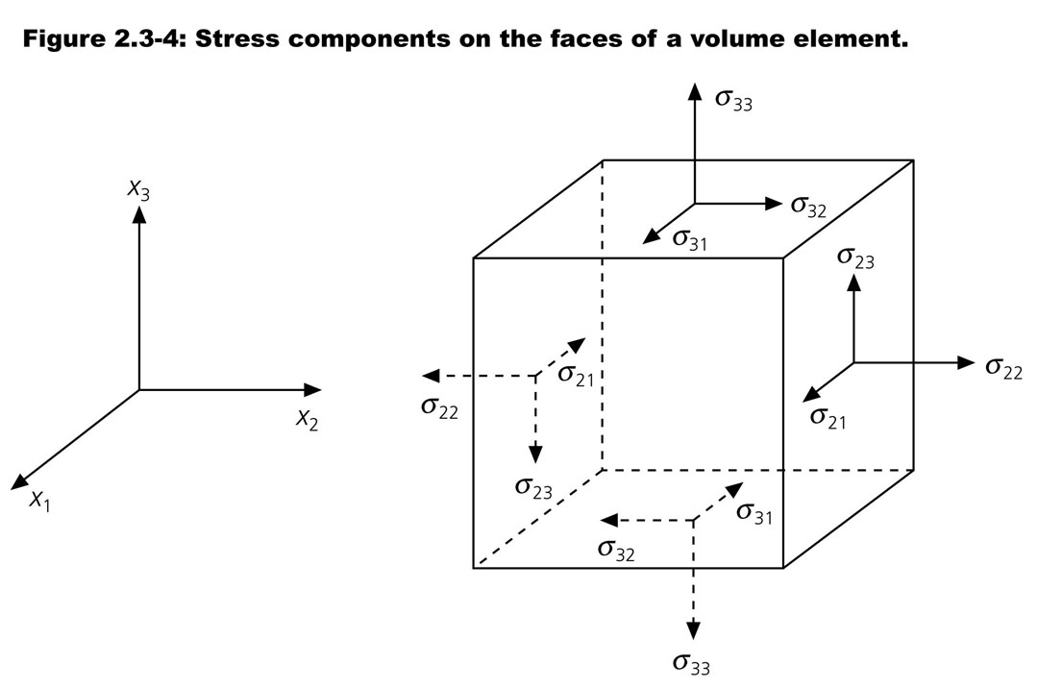
1) Forces acting on an element in a continuum – body forces proportional to volume (ex. gravity) and surface forces (contact forces) acting on the surface of element
2) Surface forces called stress – 6 independent components for a point element σ_{ij} is force in i direction acting on face perpendicular to j direction – 𝜎_{ij}=𝜎_{ji}
3) Units are force/area - Pa
4) Stress causes deformation

Slide 15
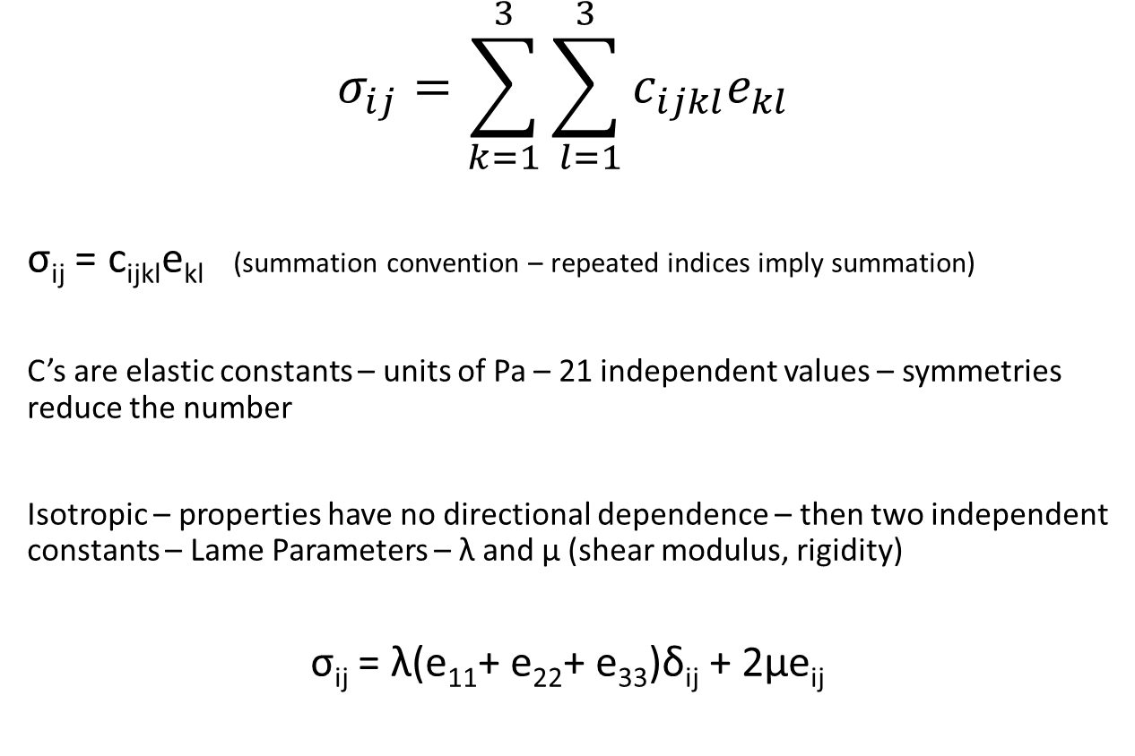
For small strains and short times most materials exhibit linear elastic behavior – stress linearly proportional to strain, instantaneous, reversible
Constitutive Law

Slide 16


Other elastic constants – not independent of λ and μ
σ_{ij} = 2μe_{ij} i≠j
Shear modulus: measure of the resistance of material to shear. (Fluid defined as material with zero shear modulus)
Bulk modulus: measure of incompressibility of a material. Given by hydrostatic stress divided by fractional volume change.
Poisson’s ratio: lateral contraction of a cylinder divided by longitudinal extension.

Slide 17

Seismic Waves
Consider small element within material – use F = Ma to get its acceleration
Gradients in stress give overall force on element
Need to add body force as well and then equate to acceleration – called equation of motion
𝜌𝜕²u_{i}/𝜕t² = 𝜕_{j}𝜎_{ij} + f_{i}
where 𝜌 is density

Slide 18
Far from source – drop body force
𝜌𝜕²u_{i}/𝜕t² = 𝜕_{j}𝜎_{ij}
For isotropic linear elastic solid (anisotropic lots of c’s)
𝜎_{ij} = 𝜆𝛿_{ij}𝜕_{k}u_{k} + 𝜇(𝜕_{i}u_{j} + 𝜕_{j}u_{i})
Substitute in equation of motion and arrange terms to get
Terms with gradient of elastic constants make equation difficult to solve

Slide 19
3 approaches to solving equation:
Assume homogeneous material – for Earth one then assumes the elastic properties consist of homogeneous layers – becomes a matter of the boundary conditions between layers
Approximate solution – assume high frequency solutions (waves) where one can neglect the gradient terms – leads to ray theory
Numerically solve the equation

Slide 20


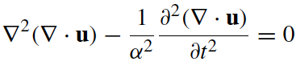





In a homogeneous medium, or in the high-frequency approximation, the gradients of λ and μ can be neglected:
Taking the divergence of the equation (remember ): )
Taking the curl of the equation - remember ):

Slide 21
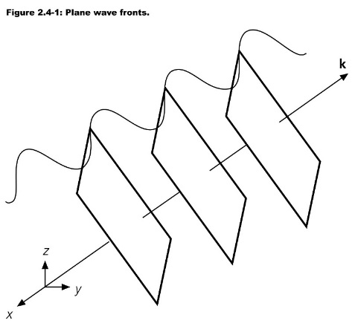
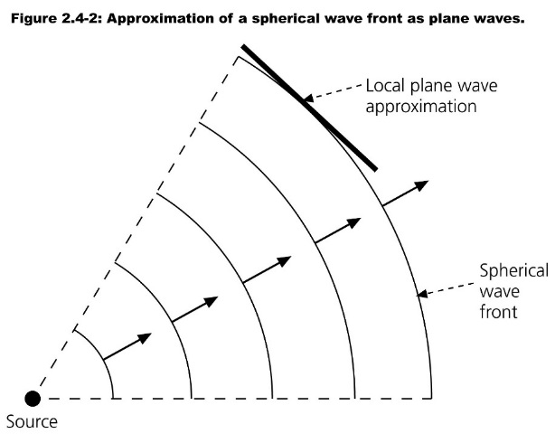
The previous two equations are identical – called wave equation – give solutions in space and time for div u and curl u
Solutions are of the form f(n⦁x-ct) or f(n⦁x+ct) – propagating disturbances at velocity c on plane ⊥ n, (n is unit vector, c is α or β) – for spherical waves get f(r-ct)/r
First equation represents P waves – wave velocity is ((𝜆+2𝜇/𝜌))^{1/2} or ((𝜅+4/3𝜇)/𝜌))^{1/2} – ground motion is in direction of wave propagation
Second equation represents S waves – wave velocity is (𝜇/𝜌)^{1/2} - ground motion is perpendicular to the direction of wave propagation – note shear wave velocity 0 in fluid
Key points – away from external forces in whole space can only have P and S wave disturbances – velocity of waves only depends on elastic constants and density – not amplitude, pulse shape, frequency …..
From Stein and Wysession, 2003

Slide 22
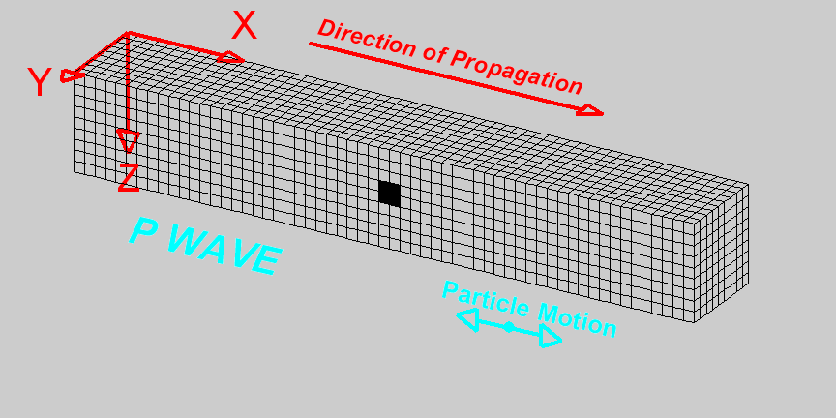
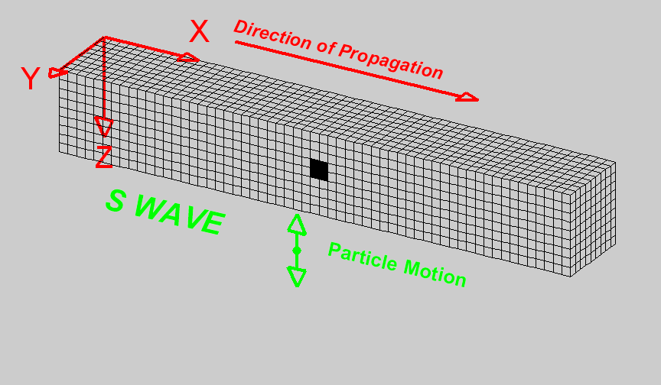


Movie of how waves deform media and propagate – courtesy of Ved Lekic

Slide 23
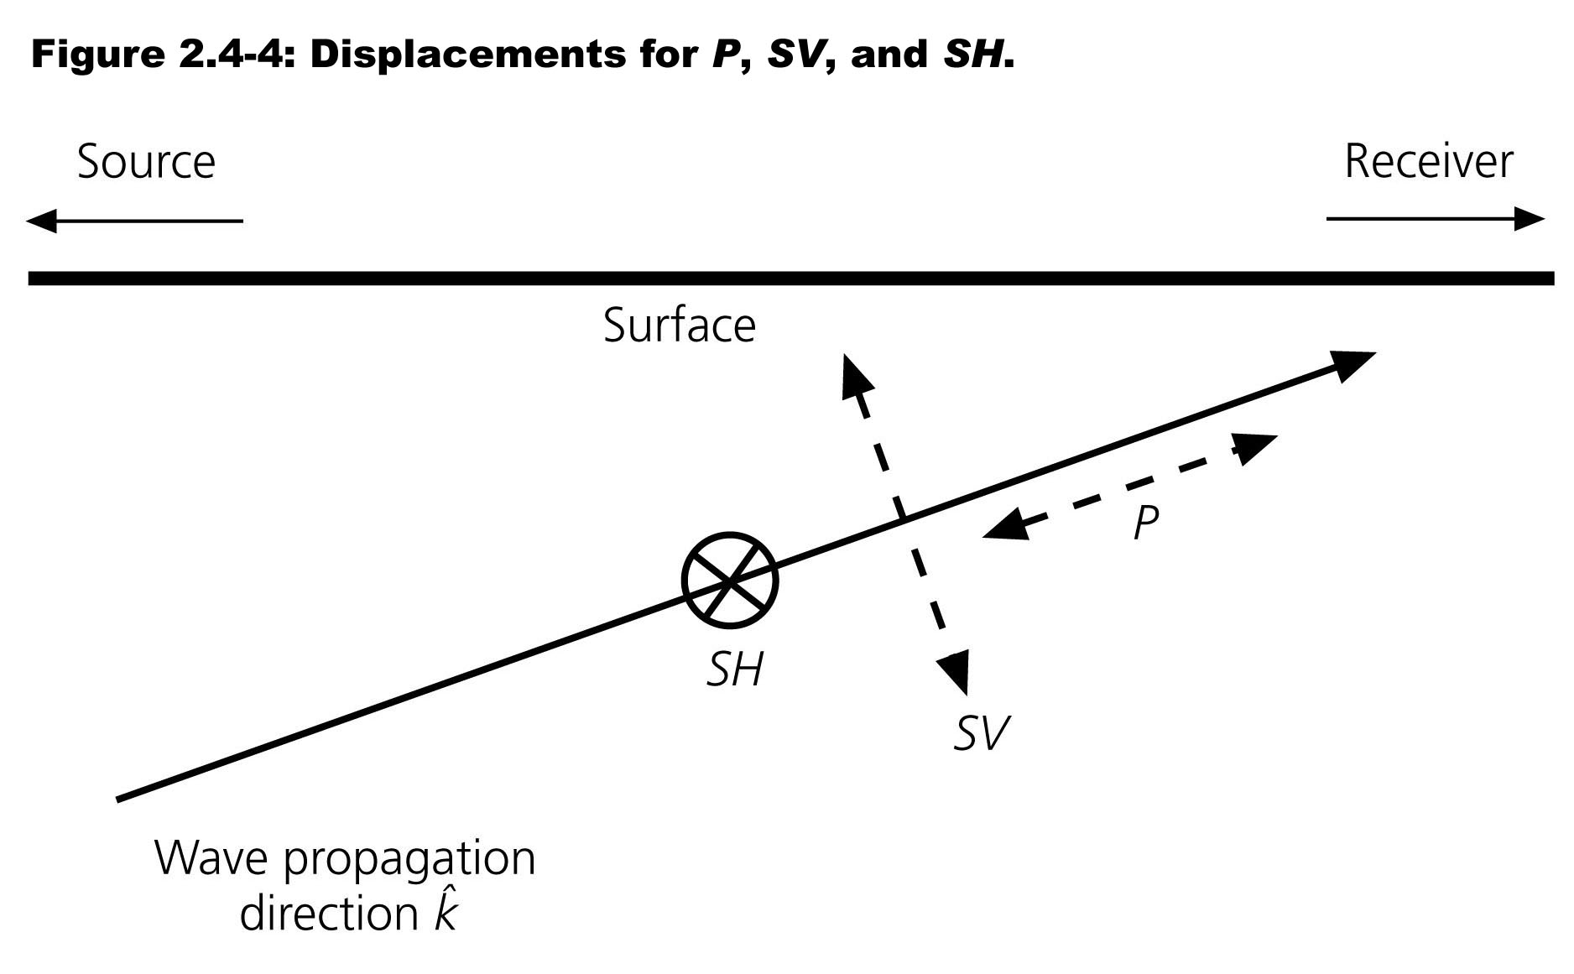
S waves have polarization – only know that motion is perpendicular to wave propagation direction – convention is to divide S waves into SH and SV components

Slide 24
Seismology can only give elastic constants and density – usually just P and S speeds. What Controls P and S Speed?
α²=(λ+2μ)/ρ=(𝜅+4/3μ)/ρ
β²=μ/ρ
φ²=α²-4/3β²=𝜅/ρ= bulk sound speed
Temperature Up – Velocity Down
Pressure Up – Velocity Up
Chemistry – Fe content in Olivine up – Velocity Down
Mineralogy – At constant molecular wt – Density Up – Velocity Up (Birch’s Law)
Volatile Content (H₂O)
Phase – Partial Melting – Velocity Down (especially for S)
Porosity – Porosity Up – Velocity Down
Pore Fluid – Gas Up – Velocity Down

Slide 25
Caveat – anelastic behavior causes absorption of energy in P and S as waves propagate (intrinsic attenuation, internal friction) – something else to measure and complicate matters
Define 1/Q = -ΔE/2πE - fractional energy loss in 1 period of deformation
Results in amplitude decay of waves (beyond spreading and elastic scattering)
A(x)=A₀e^{-ωx/2cQ(ω)} (x distance traveled, ω frequency, c vel)
Observations show Q not strongly dependent on frequency Q~ω^{α} – α from 0 to .3 in different studies, different frequency bands
Most mechanisms for intrinsic attenuation involve shear stress/strain – implies Q_{P} = 9/4 Q_{s}
Implications
High frequencies are lost with propagation more than low frequencies
S waves are attenuated far more than P waves – limits resolution

Slide 26
Most mechanisms for intrinsic attenuation involve motion of defects in crystals – point defects, dislocations, grain boundaries, melt squirt ….
These mechanisms tend to be “thermally activated” and thus are very sensitive to temperature
Q = Q₀e^{(αH*/RT)} (T is temperature)
If measured gives more information on Earth – temperature mostly – more difficult than finding P and S velocities

Slide 27
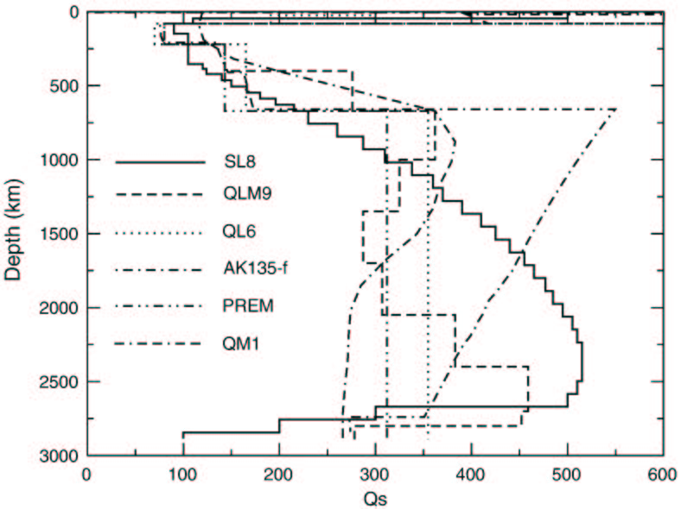
Earth attenuation structure
From Matas&Bukowinski, 2007

Slide 28
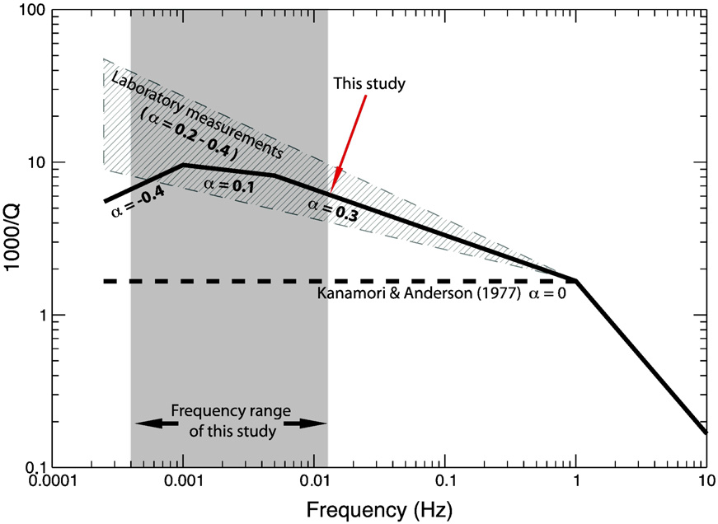
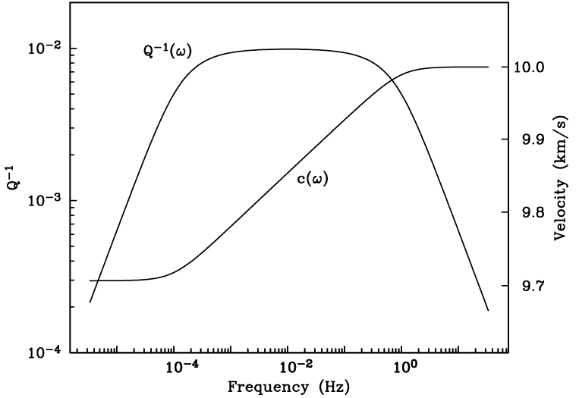


Anelastic behavior requires that seismic velocities vary with frequency (dispersion)! Important for using mineral physics to interpret seismic velocities – (few % differences possible)
Q depends on frequency
Q is frequency independent
figure from Shearer, 2009
Lekic et al., 2009
q=1/Q

Slide 29
Waves in media with homogeneous layers
Can compute exact responses

Slide 30
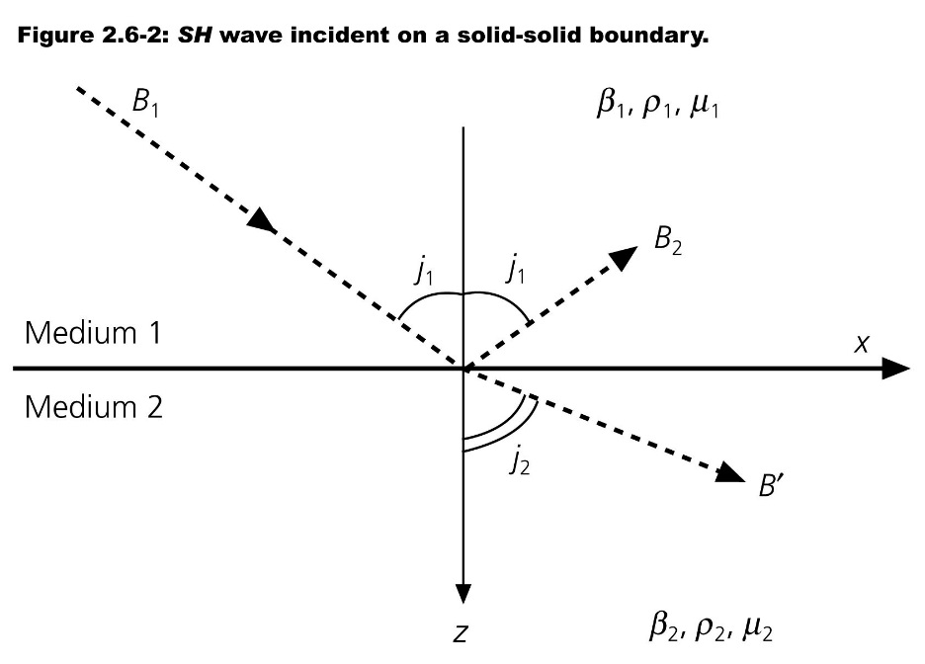
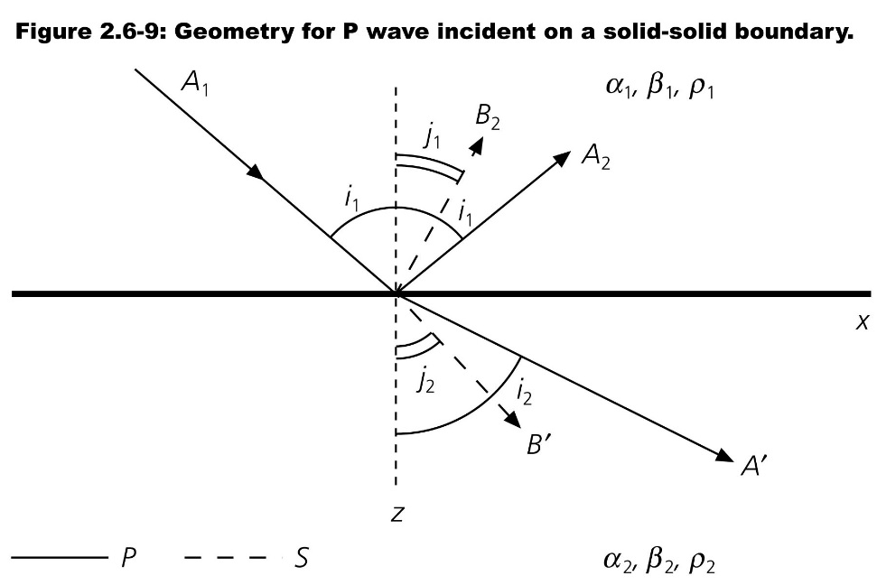
What happens when the media is composed of layers of material with different properties – each layer can only have P and S waves – find some energy reflects some transmitted. When the layers are “flat” have the following:
Incident SH wave
Incident P wave, similar for incident SV wave
1) The amplitudes of reflected and transmitted waves depend on angle of incidence as well as density and P,S velocity contrasts between media
2) Note conversions of P to SV or SV to P – SH does not convert thus reflection from mantle-core boundary or at surface is 1
3) Angles of reflected and transmitted waves only depend on velocity contrast (see later slide)

Slide 31

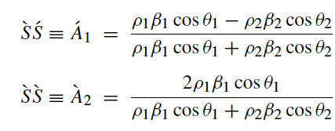
Complicated formulas for the amplitude of transmitted and reflected waves – simplest for SH – note depends on change in ρβ across boundary – called impedance
Note change from j’s to 𝜃’s

Slide 32
Receiver Function technique makes use of P to S converted phase to map sharp boundaries – Moho, upper mantle discontinuities
Black is P, seen mostly on vertical Red is S seen on horizontal
H
Teleseismic waves can convert from P-to-S or S-to-P beneath a seismometer
Relative timing between P(S) and Ps(Sp) arrivals constrains the depth of the interface if velocities known
Relative amplitude of P/Ps and S/Sp constrains contrast across interface constrains mostly S jump across interface
α₁, β₁, ρ₁
α₂, β₂, ρ₂
P-waves from distant quake
S-waves converted across interface

Slide 33
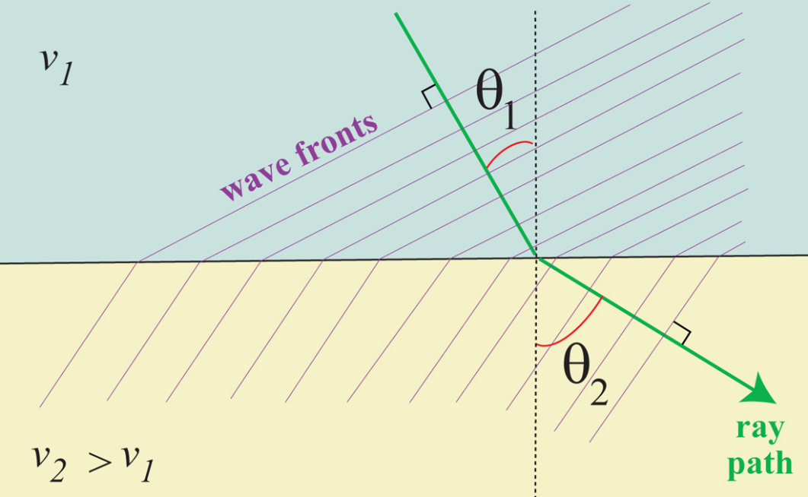
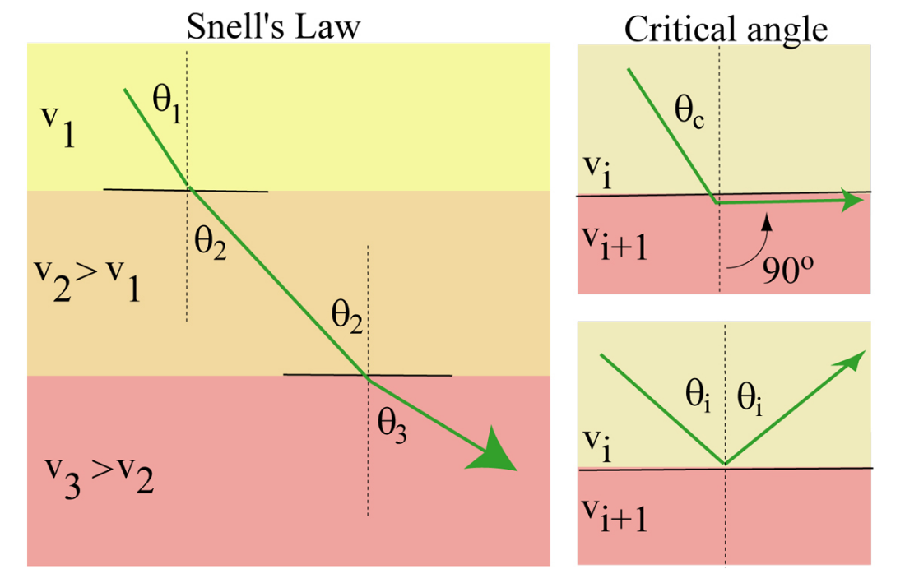
The angle at which the waves travel governed by Snell’s Law – consequence of continuity of wavefield across boundary
P is called the ray parameter – for a media with flat homogeneous layers P remains constant as a plane wave propagates – physically it is the apparent slowness (1/v) in the horizontal direction
Note – if the lower media is faster than the upper media there is some incidence angle such that
Sin(𝜃_{c})/v_{i}= 1/v_{i+1} – wave travels horizontally along boundary and continually radiates a wave upwards – called a head wave

Slide 34
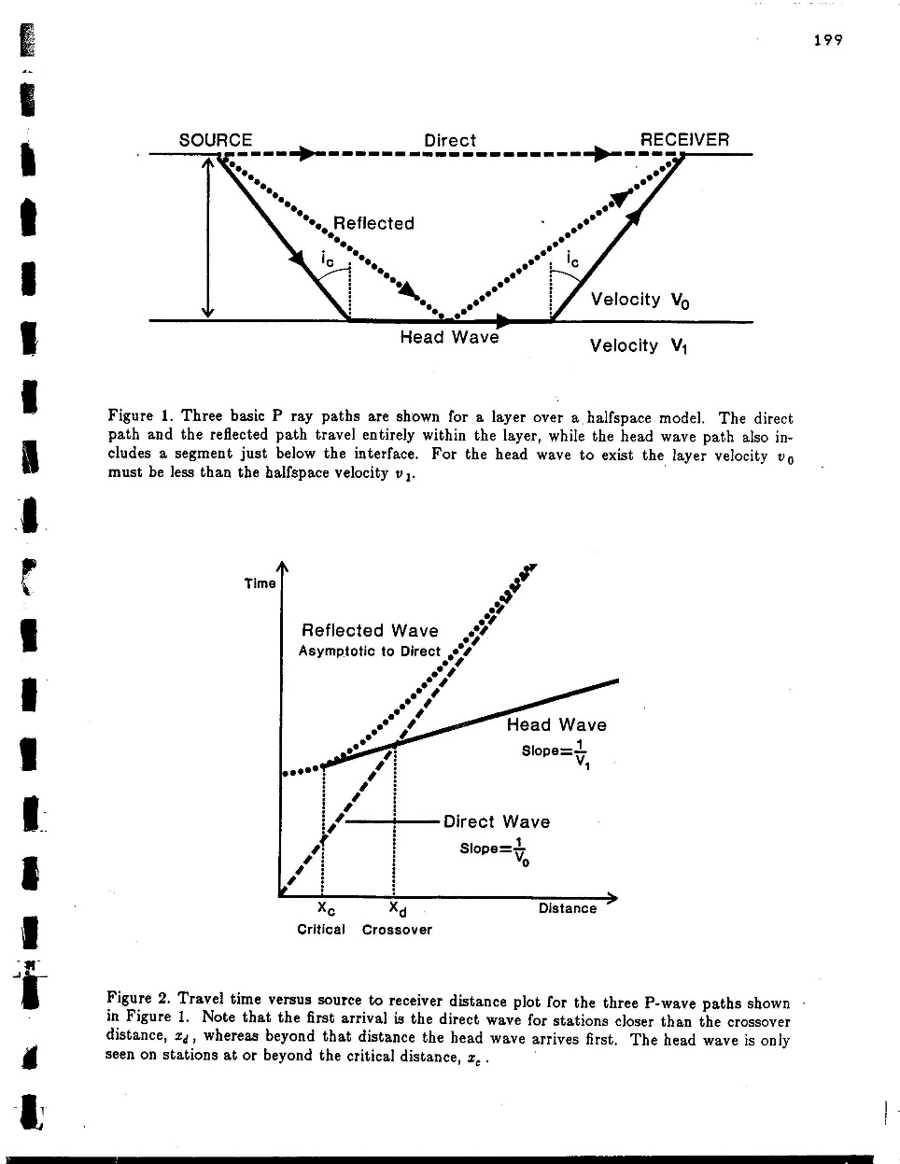
Travel times recorded at surface can be easily predicted for flat layers – plot of time of arrival versus distance called “travel time curve”

Slide 35
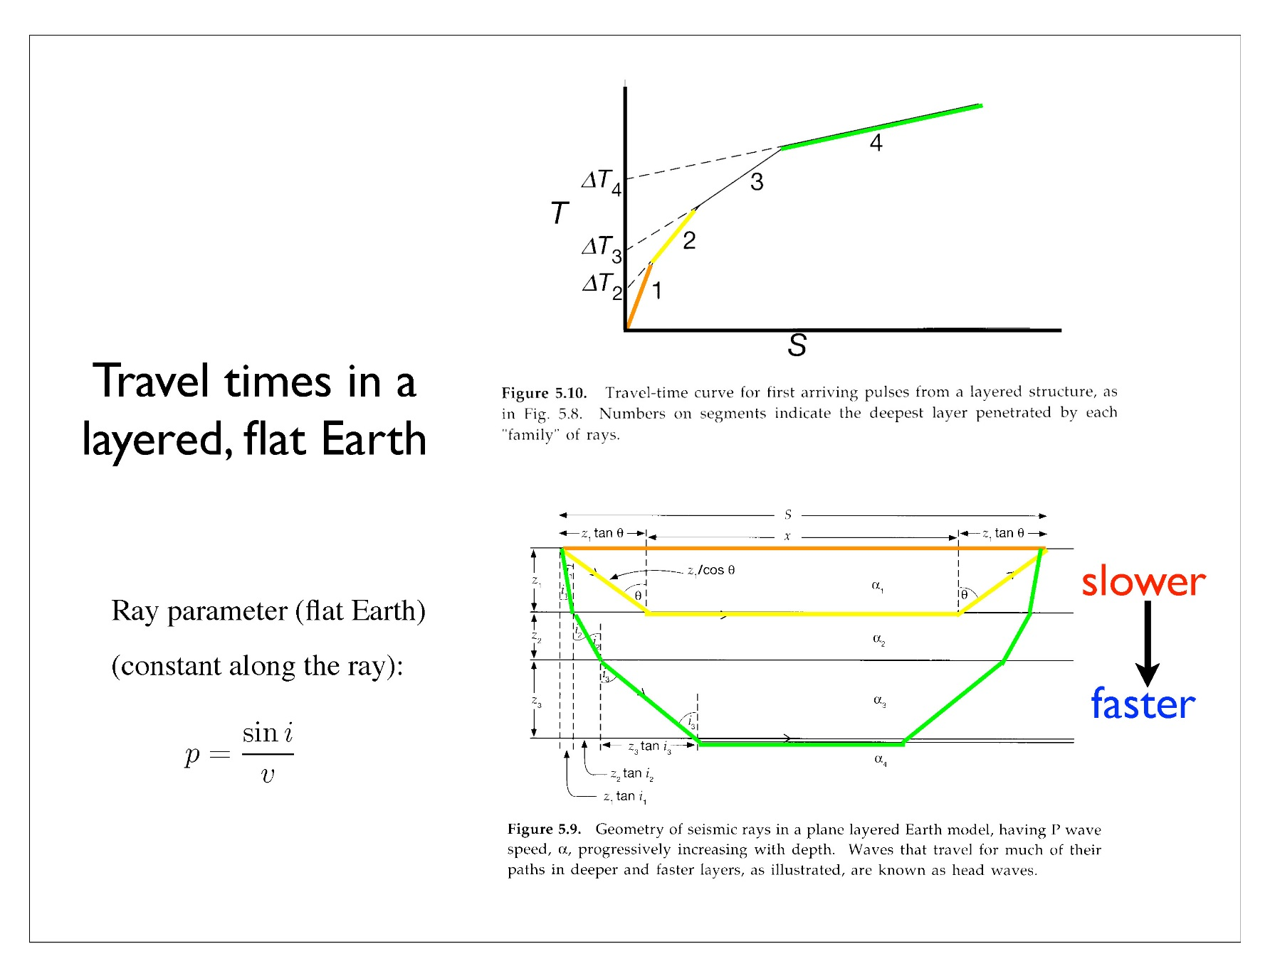
Refraction method – from first arrival travel times versus distance one can determine the thickness and velocities of layers of rock in the subsurface – uses slope of travel time curve and “intercept times”

Slide 36
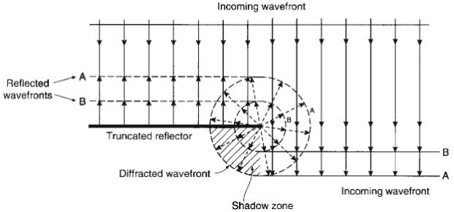
Caveat – if layers not flat or have different shape velocity bodies all the above rules fail – scattered waves in all directions, diffractions
Diffraction from an edge in reflector – when the wavefield is discontinuous get diffracted waves
Scattered P waves for a point body with a P velocity difference and separately for a density anomaly. Incoming wave is traveling from top to bottom – Virieux&Operto, 2009

Slide 37
Waves in media with slowly varying properties
Approximate solutions – Ray Theory
Easy and Intuitive

Slide 38
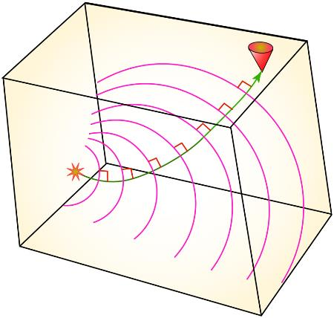
Ray Theory – approximate solution of displacement equation – accurate for high frequency waves i.e. accurate at frequencies where the media heterogeneity changes little over 1 wavelength – good for smoothly varying media
Raypaths obey Snell’s Law (for 1D structure or equivalent for 3D). Motion at receiver occurs at time given by ∫1/c(r) ds and has the same shape as the pulse at the source – amplitude can vary, however.
Simple and fast – especially for media that varies only with depth - intuitive
Shortcomings
Does not predict diffracted waves, head waves
Limitations in predicting the effects of 3D heterogeneity on waves

Slide 39
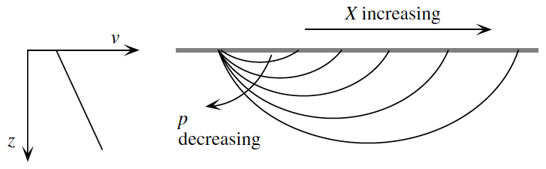
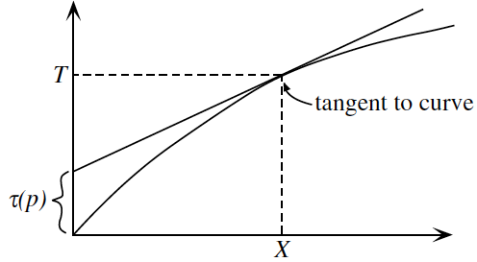
For a medium with slowly increasing velocity with depth rays slowly bend and turn back up
Easy equations to compute raypaths as well as travel time versus distance
Ray bottoms when p = 1/v(z) – spherical when p = r/v(r)
Using slope of travel time curve and intercept times can determine velocity as a function of depth – called Herglotz-Wiechert method – similar to refraction method

Slide 40
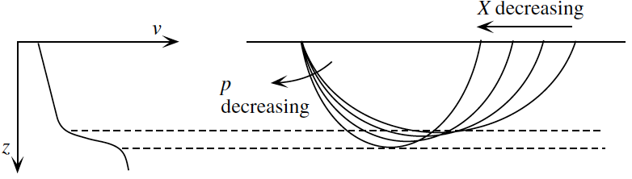
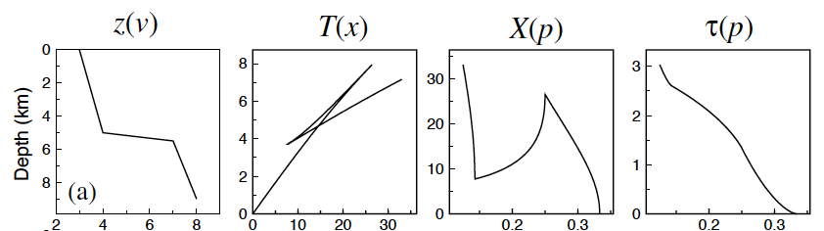
High gradients with depth result in multiple seismic waves arriving at the same distance (different times) – result in travel time curve with triplications
From Shearer, 2009

Slide 41
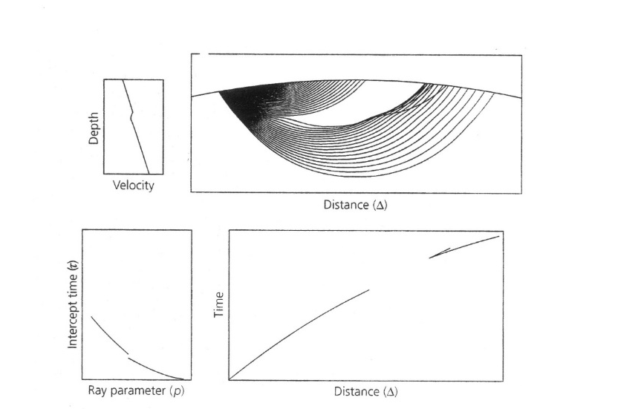
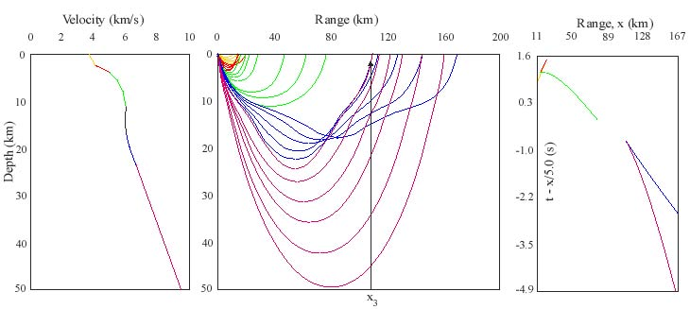
Decrease in velocity with depth results in a shadow zone (distance range with no arrivals) and multiple arrivals at larger distances

Slide 42
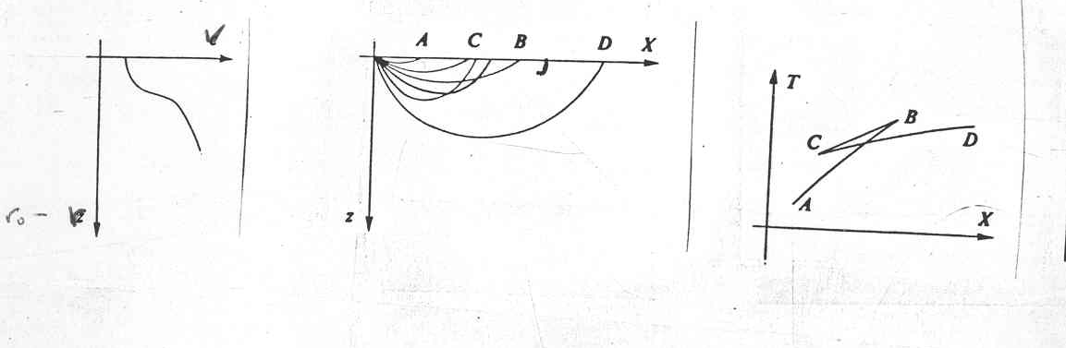
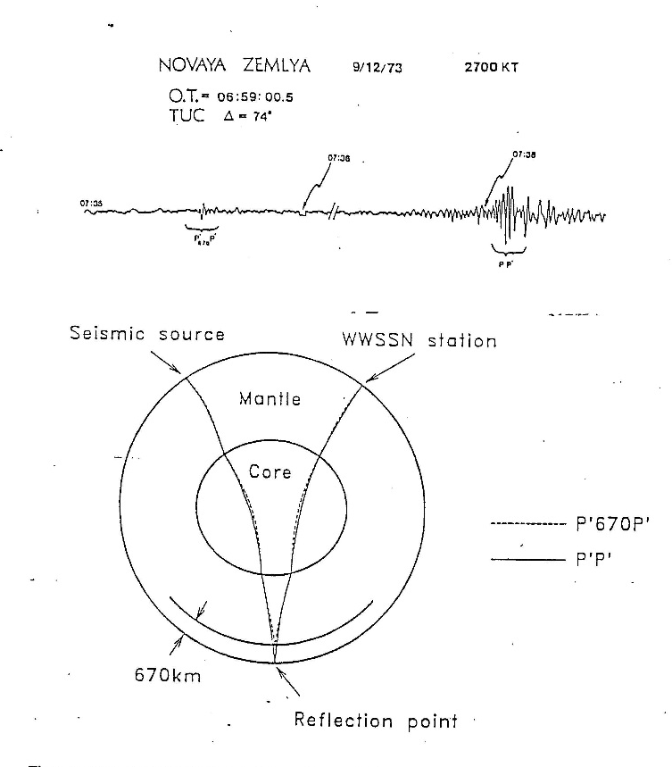
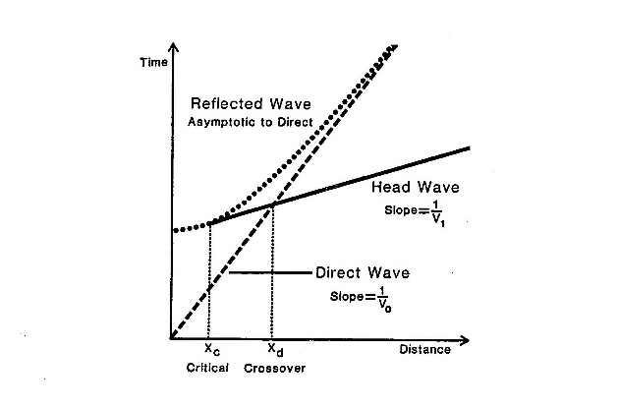
Note similarity between sharp boundary and high gradient travel time curves – both produce bowtie curves but gradient has no reflected waves at short distances
To tell if a boundary in Earth is “sharp” or a high gradient zone need to look for high frequency vertical reflections
Adams, 1971

Slide 43
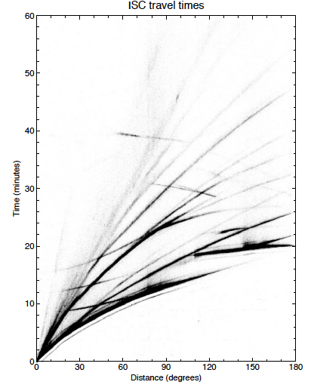
ISC travel times as a function of distance give basic structure of Earth
P waves show evidence of low velocity zone in deep Earth - core – S waves show no waves making it through the core – core is fluid
S?
Use Herglotz-Wiechert to get velocity in outer part of Earth – mantle – then trial and error to get velocities within core
S
P
P

Slide 44
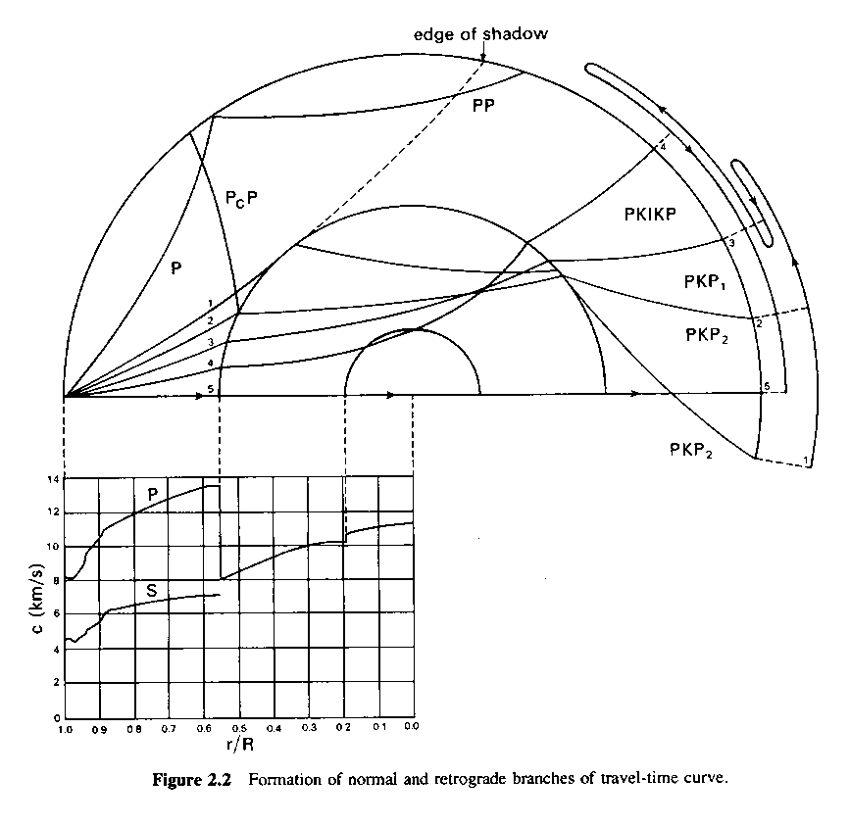
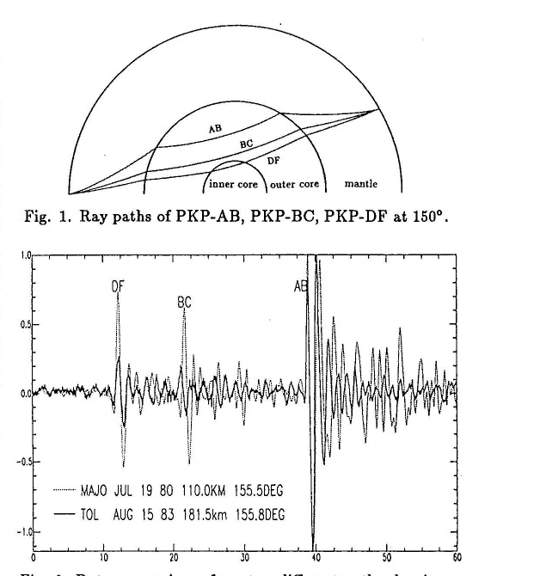
Simple mantle core model does not explain arrivals at shorter distances (~110-130⁰ distance) must have jump in velocity within the core – hence outer core – inner core
At distances near 150⁰ four different waves arrive at same distance – all sampling the core with different bottoming depths fig below from Song&Helmberger

Slide 45
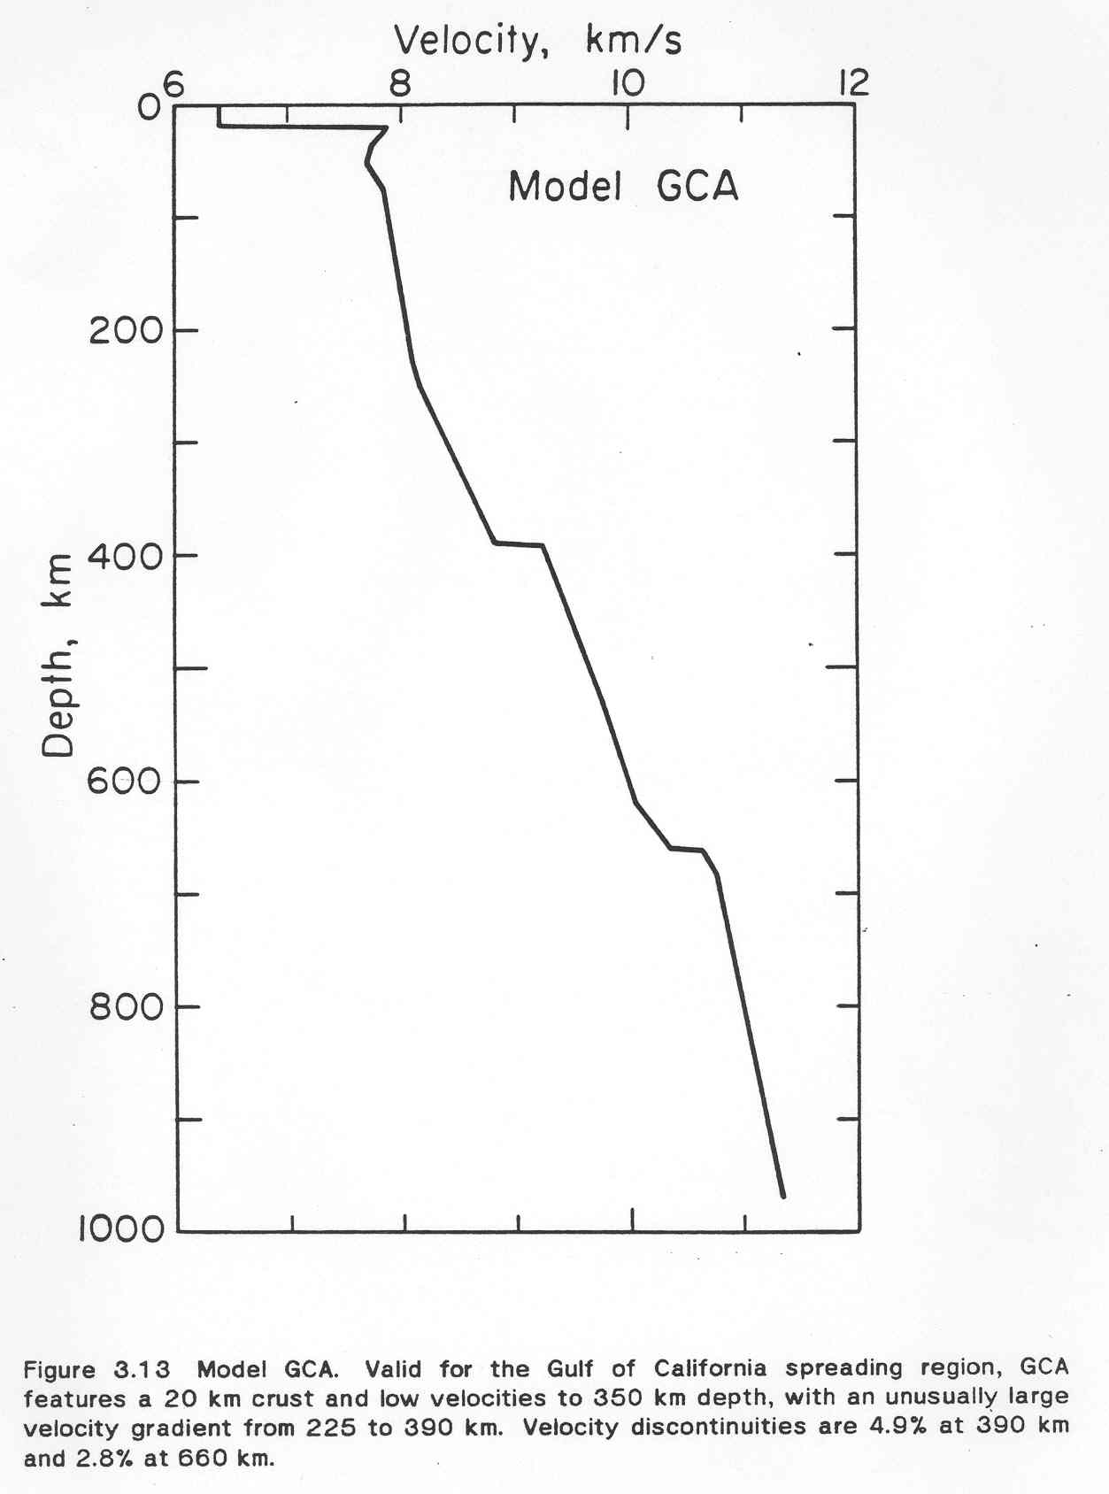
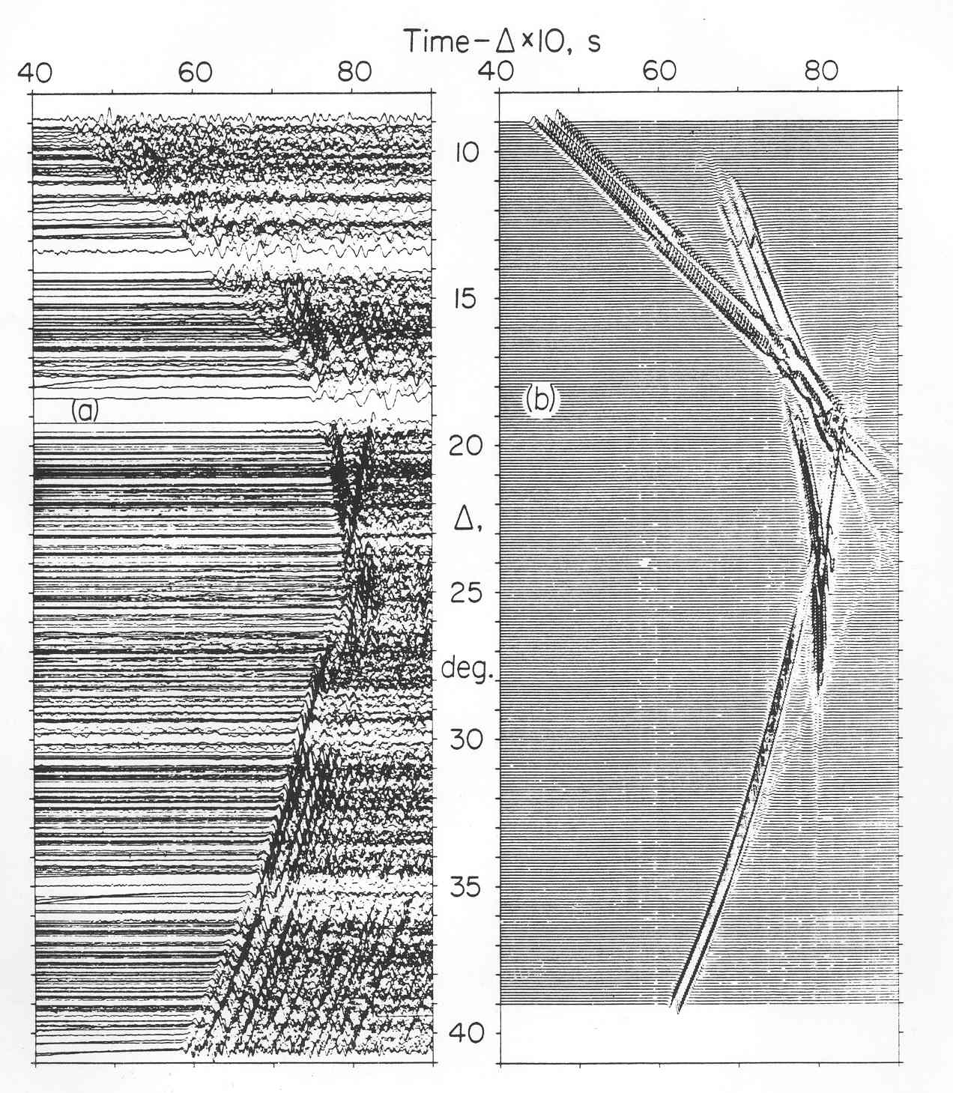
From 10⁰ to 30⁰ distance, travel times show sharp breaks in slope and later arrivals (triplications) – imply jumps in velocity near 410 km and 660 km depth marking the “upper mantle” as opposed to the smoother “lower mantle”
Walck&Helmberger, 1984

Slide 46
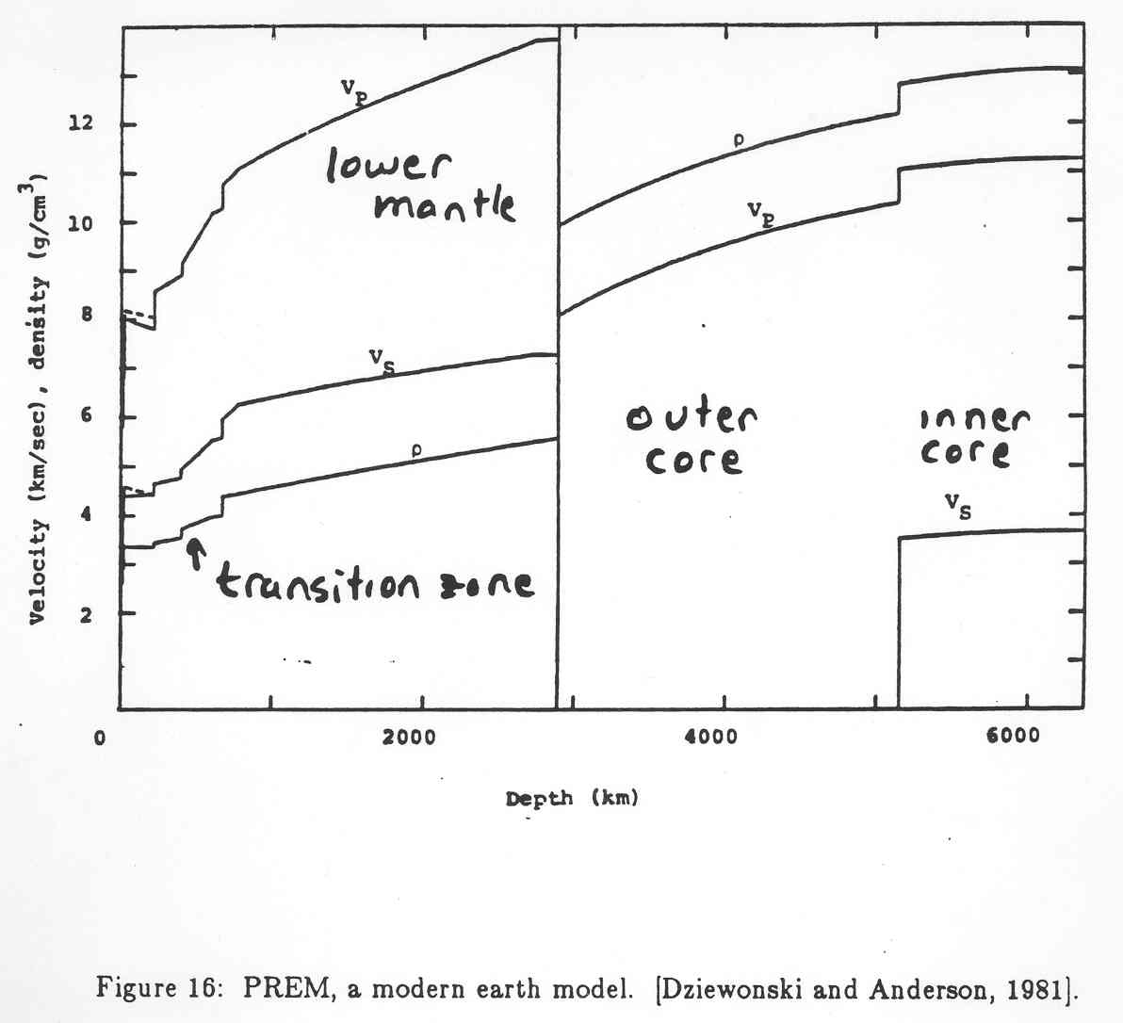
Earth 1D Structure
A number of 1D Earth models have been developed: PREM (Dziewonski and Anderson, 1981), ak135 (Kennett et al., 1995), IASP91 (Kennett and Engdahl, 1991).
Seismically fast top (lithosphere?)
Seismically slow below (LVZ) – asthenosphere?
Velocity jumps at 410 and 660 km define the transition zone from the upper and lower mantle
CMB is at ~2891 km depth
ICB is at ~5150 km depth
PREM has density – Adams-Williamson + normal modes

Slide 47

Simple Earth model but seismic propagation still complicated
P waves
S waves
Seismic waves take a variety of paths and sample all parts of the Earth
They provide most complete and direct information on present-day state of the deep interior
M. Thorne animation

Slide 48

One can imagine an infinite number of waves that can exist in Earth – given a velocity model one can raytrace a particular imagined wave and calculate when and where it will arrive at the surface for a given source – need nomenclature for these waves to communicate
Compressional through mantle – P Shear through mantle – S
Compressional through core – K
Compressional inner core – I
Shear inner core – J
Reflection from CMB – c
Reflection from ICB – i
Reflection from Moho – m
Up P from source – p
Up S from source - s

Slide 49


Travel time curve aids in identification of arrivals on seismograms – also allows one to know where to look for a particular kind of wave for a particular scientific goal example – interested in outer most core? – use SKKS – distance 90 - 110⁰

Slide 50

Many arrivals visible in a single seismogram – some are small and require special processing to see – note the transverse component only records SH waves

Slide 51
Body Wave Studies
Practical Considerations
Examples

Slide 52


Two basic approaches to investigate Earth with body waves – 1) reflection 2) transmission (refraction)
Good for sharp contrasts, layering – depth and possibly velocity – density constraints – sharpness constraints
Good lateral resolution (oil industry uses)
Good for bulk property of volumes – usually just velocity – tomography – less lateral resolution
Good for vertical velocity gradients under assumptions

Slide 53
Global Studies – throw everything you have in and hope for the best – 1D models, global tomography
High Resolution Studies
  For given target decide what type of wave to use, not just P or S but also path through mantle
  For wave type one is limited by source-receiver geometry – limits the coverage of high resolution images ex. ultra low velocity zones (ulvz)
  What approximations to make in analysis
  Even if sources and stations exist – the mechanism of the source also has to be considered

Slide 54



Earthquake sources radiate P, SH, SV at different strengths in different directions – called radiation pattern. If interested in PcP in a certain direction – earthquake might not radiate P in that direction – no PcP visible in that case
P
SV
SH
(modified from Shearer, 2007
Modified from Garnero

Slide 55
Some examples of deep mantle body wave studies
(not comprehensive)

Slide 56









Niu et al. (2003) Very short period waves from a deep earthquake beneath Mariana’s recorded by large array in Japan. An arrival between the P and S not predicted by standard model

Slide 57

Using amplitude, time, waveshape of x arrival find a dipping tabular 12 km thick body with little P wave contrast, 2-6% S wave decrease, 2-9% density increase. The tabular anomaly is about 1100 km deep and must have lateral dimensions ~ 100 km
Sharp boundaries seen beneath other subduction zones in shallow lower mantle

Slide 58




Upper mantle discontinuity depths found using SS precursors and Receiver Functions
Liu et al. (2015) receiver functions show 690-700 km deep converter
Shearer, 2013 - depth of 660 – from long period body waves, 20-30 sec

Slide 59


D” region (bottom 300 km of mantle) complicated – Lay discontinuity – different for SH and SV
Matzel et al., 1996
Lay&Helmberger, 1983

Slide 60

Many 1-D models proposed for D” region

Slide 61

Detailed modeling of body waves sometimes shows much larger velocity contrasts than tomography models show
3% S velocity reduction needed in green boxed area – from CMB to 1400 km depth – tomography shows about 1% anomaly in this region
Ni et al., 2002

Slide 62




S
P
Note with increasing distance the S wave is very slow but the P wave shows very little anomaly
Rays through tomography model of French et al., 2015

Slide 63



Base of the mantle sometimes see a layer with very low P velocity 5-50 km thick - ULVZ
Large P and S wave
velocity reductions
δV_{P}: up to -10%
δV_{S}: up to -30%
Large density increase:
δρ ~ +10%
Values consistent
with partial melt of
deepest mantle rock
Originally seen from SKpiffS
Garnero, 2014; McNamara et al. 2010

Slide 64



Recent study shows maybe S and P drops are more similar
Brown et al., 2015, Both Vp and Vs drop by about 23%

Slide 65
Parting Comments
Body wave modeling gives highest resolution information about interior of Earth.
Many combinations of data types used in studies.
Weakness is that studies are local.
Most studies involve some approximation – care needs to be taken in evaluation.
Seismic arrays are necessary for the highest resolution studies – with expansion further regions can be studied.

