Slide 2

Speculations on the Origin and Evolution of Continental Crust
Earth’s thermal evolution poorly understood
- parameterized models yield contrasting predictions w.r.t. onset of plate tectonics
- possibility of discontinuous transitions
Models of continental growth are widely disparate due to:
- Differing views of continental age distribution as growth or preservation record
- Differing views of origin and evolution of plate tectonics
- Changing estimates of relative arc magmatism vs. subduction erosion rates
- Differing lessons taken from other terrestrial planets
- Differing views on importance of ‘freeboard’
- Differing emphasis & views of trace elements & isotopes
- Continental composition reflects growth model and v.v.
- Untested assumptions regarding crustal composition
Composition of the continental crust
- Diverse compositional estimates, particularly regarding nature of the lower crust
- Disagreements about the composition of arcs
?
Notes:
2
We were originally scheduled to give a talk entitled When Did Plate Tectonics Start? but our enthusiasm for doing so was considerably diminished when Jeroen last week gave a talk entitled When Did Plate Tectonics Start? Instead, given the enthusiasm of a large group to do a project on continental lithosphere evolution we thought we’d take a romp through the history of continental growth models and show the strengths and many weaknesses of these speculations. For my part, I think we need to unlearn a fair bit of what we think we know before we can make progress. We’ll start by adding a possible connection between heat loss and plate tectonics that hasn’t been covered yet and go on to the interactive portion of the presentation where you the audience get to select models to review. As we wind that up, we’ll introduce a mystery guest to review his recent addition to the fray. Lastly we’ll talk about broadly shared assumptions regarding continental composition and challenges to their plausibility.

Slide 3
Heat Sources & Sinks
dT/dt ∝ Heat Sources (H) - Heat Loss (Q)
Heat Production
Heat Source/Sink
melt extraction
Total Heat Loss (Q)
convection
conduction
Tm
Temperature

Slide 4
Discontinuous transitions
melt extraction
plate tectonic
convection
Heat Source/Sink
stagnant-lid
convection
conduction
Tm
Temperature

Slide 5
Discontinuous transitions
melt extraction
Heat Production
plate tectonic
convection
Heat Source/Sink
stagnant-lid
convection
conduction
Tm
Temperature

Slide 6
Discontinuous transitions
melt extraction
Heat Production
plate tectonic
convection
Heat Source/Sink
stagnant-lid
convection
conduction
Tm
Temperature

Slide 7
Discontinuous transitions
melt extraction
Heat Production
plate tectonic
convection
Heat Source/Sink
stagnant-lid
convection
conduction
Tm
Temperature

Slide 8
Discontinuous transitions
melt extraction
Heat Production
plate tectonic
convection
Heat Source/Sink
stagnant-lid
convection
conduction
Tm
Temperature

Slide 9
Discontinuous transitions
melt extraction
Heat Production
plate tectonic
convection
Heat Source/Sink
stagnant-lid
convection
conduction
Tm
Temperature

Slide 10
Discontinuous transitions
melt extraction
Heat Production
transition
plate tectonic
convection
Heat Source/Sink
stagnant-lid
convection
conduction
Tm
Temperature

Slide 11
Discontinuous transitions
melt extraction
Heat Production
plate tectonic
convection
Heat Source/Sink
stagnant-lid
convection
conduction
Tm
Temperature

Slide 12
Discontinuous transitions
melt extraction
Heat Production
plate tectonic
convection
Heat Source/Sink
stagnant-lid
convection
conduction
Tm
Temperature

Slide 13
Discontinuous transitions
melt extraction
Heat Production
plate tectonic
convection
Heat Source/Sink
transition
stagnant-lid
convection
conduction
Tm
Temperature

Slide 14
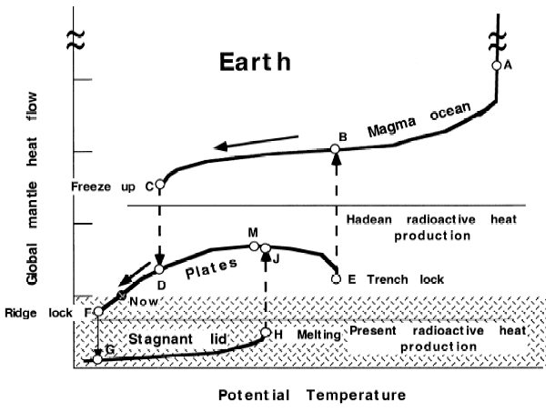
Do such discontinuous transitions occur?
Sleep 2000
Uhh…maybe

Slide 15
Continental Crust Growth Models
Harrison (2009)

Slide 16
Fyfe (1978): Early Continents with Greater Continental Mass at ~2.5 Ga
Lots of early continental crust
Unique model: present crustal volume not peak value
Major role for ancient hotspot addition to continental crust + plate boundary interactions
Evidence:
  Subduction mass balance indicates shrinking
  Higher freeboard in the past may indicate more continent

Slide 17
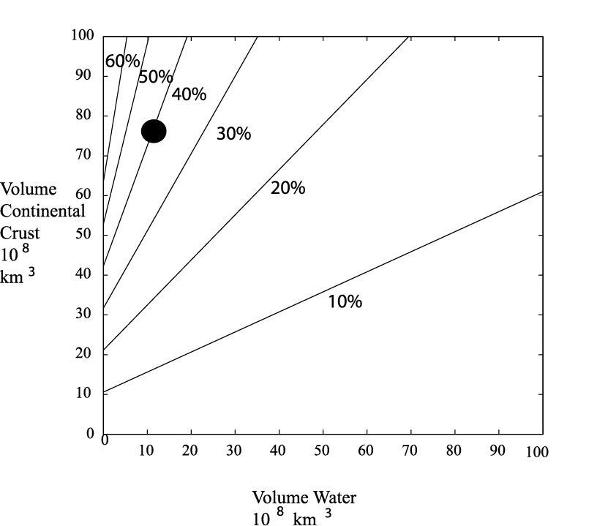
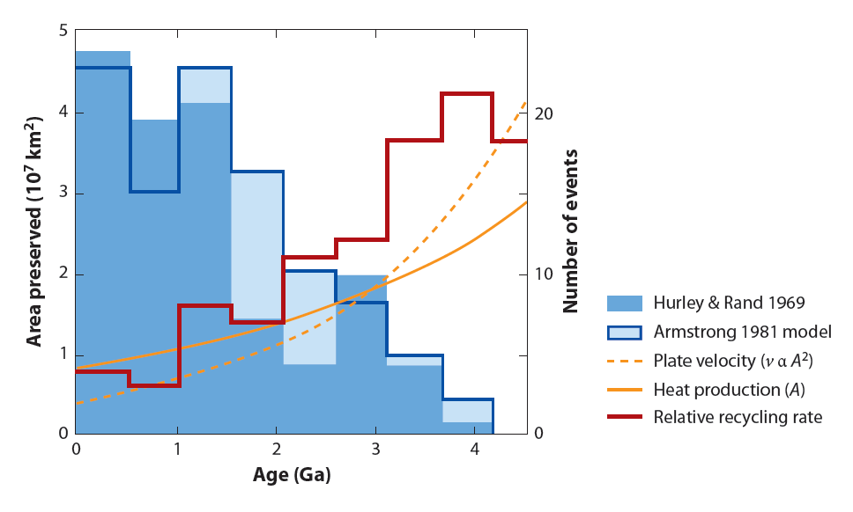
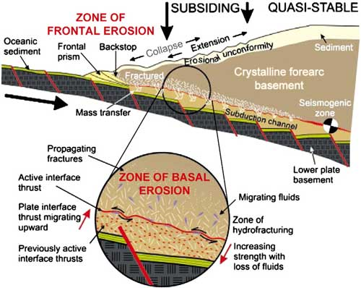
Armstrong (1981): Steady State Recycling
All terrestrial bodies differentiated at 4.5 Ga into constant mass core, depleted mantle, enriched crust & fluid reservoirs
Steady state crustal mass achieved by early Archean.
Evidence:
- Uniform thickness of CC with age
- Constancy of freeboard
- Arc magmatism & sediment
subduction currently about equal
- Mantle Sr & Nd isotopes consistent
w/ recycling constant continent mass
- Recycling model fit growth estimate
of Hurley & Rand (1969)

Slide 18
Warren (1989): Present Volume by ~4 Ga
Similar to Armstrong (1981) but with near steady state achieved even earlier.
Based on an analogy to the growth history of the lunar crust.
The initial continental crust is anorthositic to tonalitic but comparable buoyancy to present day

Slide 19
Reymer & Schubert (1984): Early Continents Followed by Slow Growth
Based on Phanerozoic island arc growth rates (note: all arc material assumed primary)
Includes Archean growth rates 3-4 times the present rate
Also considered: hot spot contributions to the crust.
Evidence:
  island arc mass balance (& scaling by heat production)
  Constant freeboard actually requires growth due to deepening ocean basins w/ time

Slide 20
Brown (1979): Minor Hadean Continental Crust Followed by Slow Growth
Minor early continental crust with slow growth since Early Archean
The evidence:
  Brown disputes significant sediment subduction
  Modern accretion rates fit a growth model if corrected for higher heat flows with age
  Granites predominately reflect mantle addition, so → higher crustal addition rates

Slide 21
Campbell (2003): Minor Hadean Continental Crust with Slow Growth
Similar to Brown’s model in the rates and timing of growth.
But even less crust in the early Hadean
Evidence
- Nb-U-Th systematics in mantle derived from 2.7-3.5 Ga volcanics

Slide 22
O’Nions et al. (1979): Slow Continental Growth Since ~2.5 Ga
Two-reservoir box model w/ time-dependent coefficients for transport between the reservoirs
Generation of continents involved > half of mantle
Maximum rate of continental growth between 3.5-2.5 Ga (present day rate only 20% of max)

Slide 23
Dewey & Windley (1981): Slow Continental Growth Since ~2.5 Ga
Emphasis on decline in heat production from smaller, thinner, faster moving plates to slower, thicker, slower moving plates 1/6th the Archean rate:
  85% of CC by 2.5 Ga
Based on early Proterozoic indicators that plate interacting w/ a lithosphere of similar size to present:
  Large continental areas show high degree of structural cohesion
  Widespread basement reactivation adjacent to linear thrust belts (i.e., like present)
Also: lots of high-K minimum-melting granites over calc-alkaline rocks at 2500-700 Ma implies dominance of crustal differentiation over growth

Slide 24
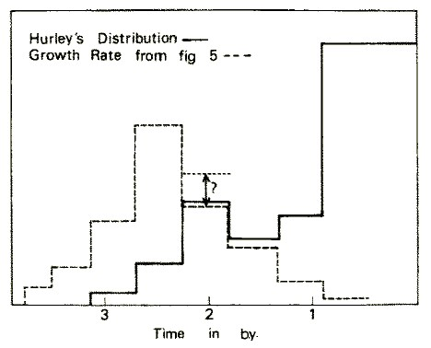
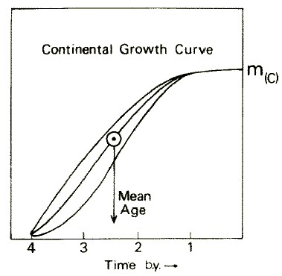
Allègre (1982): Slow Continental Growth Since ~2.5 Ga
Box modeling of Nd-Sr correlation interpreted due to rapid growth of continental crust at ~2.5 Ga
Sr-Nd isotope systematics viewed as evidence of ‘continental pumping’
Mean age of continents of 2.5 Ga continents were formed throughout geological time and not suddenly
Assumes knowledge of mantle volume depleted by crust formation and composition of undepleted mantle

Slide 25
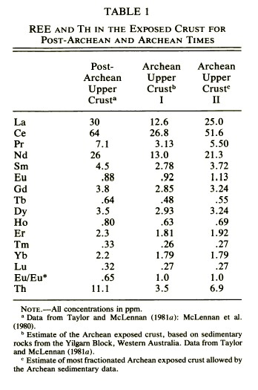
McLennan & Taylor (1982): Slow Continental Growth Since ~2.5 Ga
No significant change in REE and Th abundances in post-Archean shales
Modeling of REE and Th abundances suggest minimum ratio of post-Archean to Archean upper CC required to eliminate Archean upper crustal signature is ~4:1
They propose 65-75% of CC formed during 3.2-2.5 Ga and 70-85% formed by 2.5 Ga – consistent w/ continental freeboard over past 2.5 Ga

Slide 26
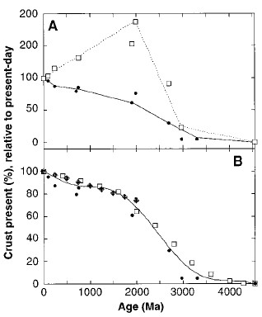
Collerson & Kamber (1999): Slow Continental Growth Since ~2.5 Ga
Th, U, and Nb are strongly incompatible elements during the melting of mantle
Differences in CC, undifferentiated mantle, and depleted mantle:
  A deficit of Nb in relation to Th & U
Thus differences in U & Th vs U can be used to infer crustal mass through time
Recycling of CC is most likely reason for decoupling U and Th due to soluble U in oxygenating atmosphere
Strong net growth recorded between 3.0-2.0 Ga, slowed down after 2.0 Ga due to increased erosion, and renewed increase of growth from ~250 Ma to present day shows faster growth during times of continental dispersal

Slide 27
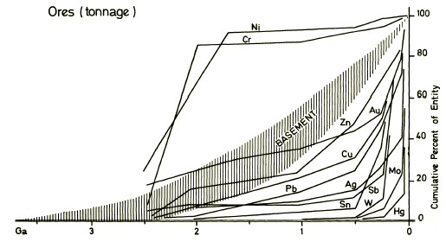
Veizer & Jansen (1979): Slow Continental Growth Since ~2.5 Ga
Basement and sedimentary recycling
Measured cumulative age distribution:
  continental age provinces
  areas and thicknesses of seds
  mineral reserves
Distributions follow an exponentially increasing function due to recycling
Simulation favors continual CC growth through time w/ slow growth in early Archean & fast at 3.0-2.0 Ga
Sediment chemical & isotopic trends support a mafic → felsic transition in the CC at ca. 2.5 Ga
Sm/Nd suggests sedimentary cycle is ~65% cannibalistic system, thus present day sedimentary mass is more mafic than upper CC"

Slide 28
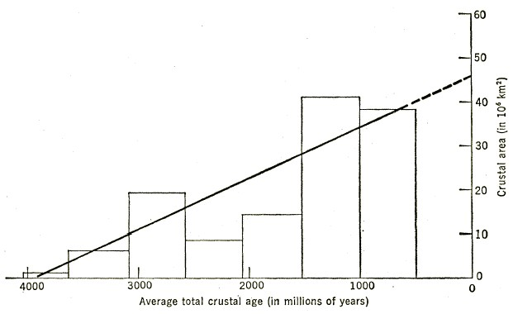
Hurley & Rand (1969): Linear Growth of Continents Since ~3.8 Ga
K-Ar ages of continental crust:
  All available age data representing ~2/3 of continental area
  Age patterns represent mix of primary ages and thermal overprint
  Growth of continents largely peripheral and concentric about Laurasia & Gondwana in pre-drift positions
Histogram of areal extent of crust shows accelerating generation starting at 3.8 Ga
Problem: K-Ar ages unlikely to record continental growth

Slide 29
Hacker et al. (2011): Continental Relamination
During subduction, mafic rocks become eclogite & sink whereas SiO₂-rich rocks are transformed into less dense felsic gneisses
These felsic rocks may rise buoyantly, undergo decompression melting & relaminate at base of the crust
Thus the lower crust need not be mafic & the bulk continental crust may be more SiO₂ enriched than typically thought

Slide 30
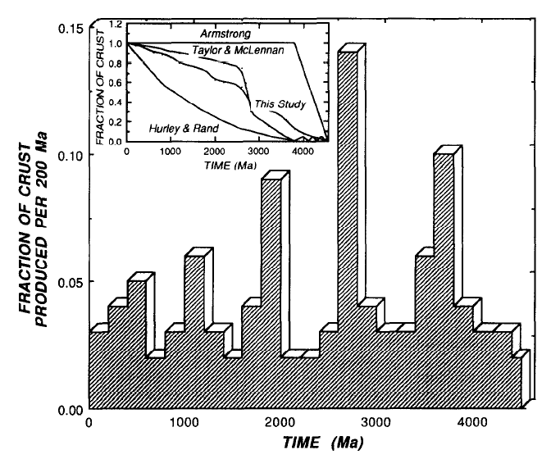
Preservation vs. Growth: Age Provinces
Sm-Nd model ages of basement rocks from Australia, North America and Scandinavia
Bennett & McCulloch (1994)
If this is growth record, why does heat production vary systematically with age province?
Are we confident that our sampling distribution is adequate?

Slide 31
Preservation vs. Growth: Detrital Zircon
8 peaks on ≥5 more cratons @ 0.75, 0.85, 1.76, 1.87, 2.1, 2.65, 2.7 & 2.93 Ga
reflect subduction system episodicity but not on continental/supercontinental scale
- 5 major peaks at 2.7, 1.87, 1.0, 0.6 & 0.3 Ga closely tied to supercontinents
Condie & Aster (2010)

Slide 32
Does Continental Crust Form in Arcs?
Widespread view that composition of arcs ≠ continental crust
15
10
CaO
5
0
5
10
15
20
MgO
Courtesy Jon Davidson

Slide 33
Primary arc magma ≠ continental crust
Explanations:
We’ve misestimated the composition of the continental crust
We’ve misestimated bulk arc composition
Primary arc magmas are not high MgO (could be slab melts?)
Crust formed in the past by a different mechanism
There is a complementary crust-mantle return flux of cumulates/residues

Slide 34
Delamination of mafic cumulate
removal of ultramafic cumulate by delamination through density instability following orogenesis
dif
ferentiate
seismological
Moho
lithosphere
genetic
cumulate
Moho
removal of ultramafic cumulate through thermal erosion associated with wedge convection
magma input from sub lithosphere
= primitive arc magma
Courtesy Jon Davidson

Slide 35
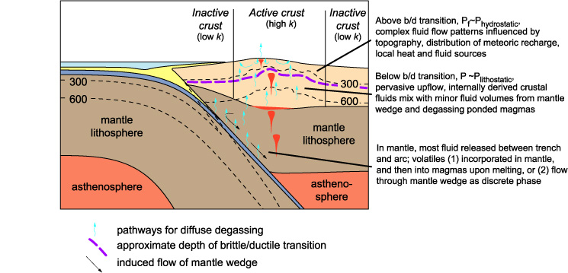
Longstanding assumptions of regarding continental crust
1) The crust is vertically stratified from mafic to felsic
“(metapelites) have velocities that overlap the complete velocity range displayed by meta-igneous lithologies” (Rudnick and Fountain, 1995)
2) U, Th, K are redistributed upward to create a thin radioactive layer
geophysical basis of observation non-unique
proposed mechanisms for upward transport in the crust not viable (e.g., anatexis enriches lower crust in U and Th; high a_{CO2}) or untested (e.g., brines)
granulites not clearly depleted in U, Th & K
estimates of heat generation of lower crust differ by factor of two
3) Orogenesis is a bit player in establishing crustal architecture
“(Orogenic P-T paths) are probably not representative of the deep crust but are merely upper crustal rocks that have been through an orogenic cycle” (Rudnick and Fountain, 1995)
Ingebritsen and Manning (2002)

Slide 36
K, U and Th in granulites typical of ‘average continental crust’ (Rudnick et al., 1985)

Slide 37
Can tectonic models tell us about crustal structure & mass transfer?
Continental crust is portion of Earth furthest from thermodynamic equilibrium
>90% processed through ≥1 orogenic cycle
- Is this circular (e.g., assumes distribution of radioactivity)?
Is there a process whereby a homogenized crust returns rapidly to a stratified state?
Are models sufficiently well-constrained; i.e., do free parameters overwhelm constraints?
- Seismic cross sections & active orogens appear inconsistent with assumption that surface rocks characterize the crustal column

Slide 38
Numerous tectonic models; most emphasize horizontal transport

Slide 39
Why such disparate continental growth rates?
Differing views whether present continental age distribution is a growth or preservation record?
Differing views of origin and evolution of plate tectonics
Changing estimates of relative rates of arc magmatism and subduction erosion (0.1-1 km³/yr in 80s; currently ~3-5 km³/yr for both)
Differing views on lessons from other terrestrial planets
Differing views on importance of freeboard arguments
Differing emphasis & views of trace elements & isotopes
Knowledge of the composition of the lower continental crust is poor
Estimates of the composition of the continental crusts reflects how the estimator think it forms and grows and v.v.
Notes:
39

Slide 40
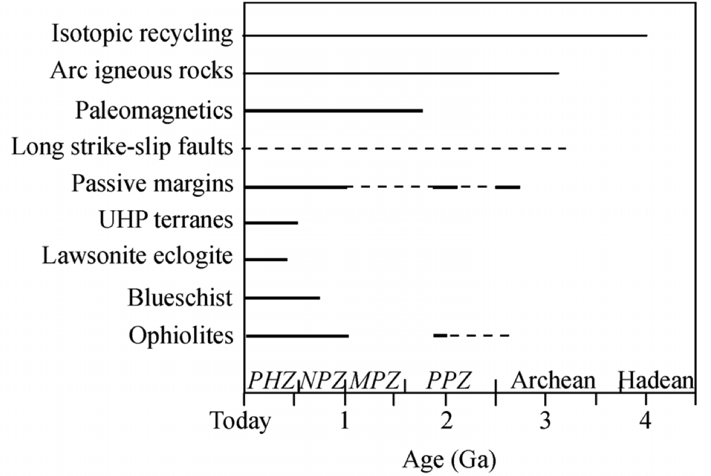
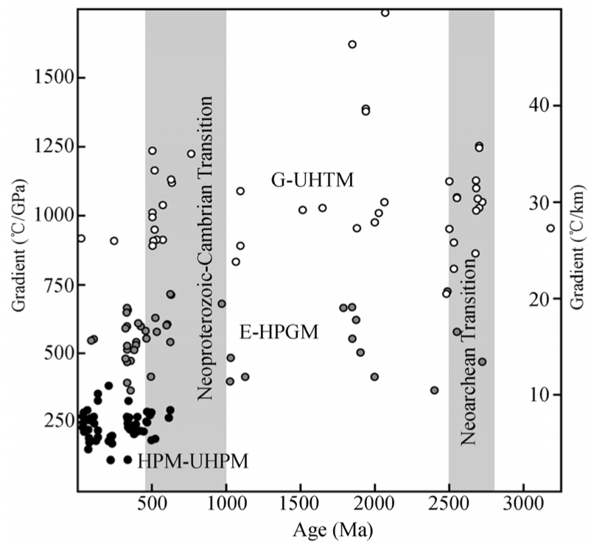
When Did Plate Tectonics Begin?
Stern – Chinese Bull. Sci. 2007
Notes:
Definitive evidence of subduction in the past is difficult to come by. A variety of field – geological – relationships are distinctive of convergent margins, but many of these would be expected to be overprinted by later metamorphism of Archean and Hadean rocks. Exceptions include geochemical signals in volcanic rocks indicative of melting of mantle peridotite fluxed with water from downgoing slabs, and direct evidence of crustal material transported down into the upper mantle at least to the depths of diamond formation.
40

Slide 41
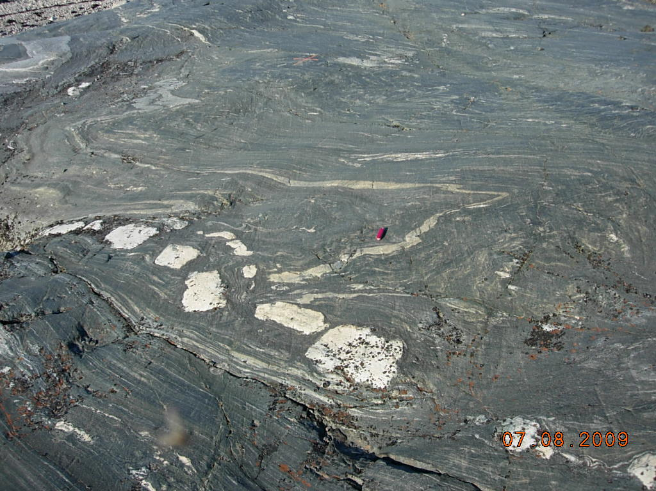
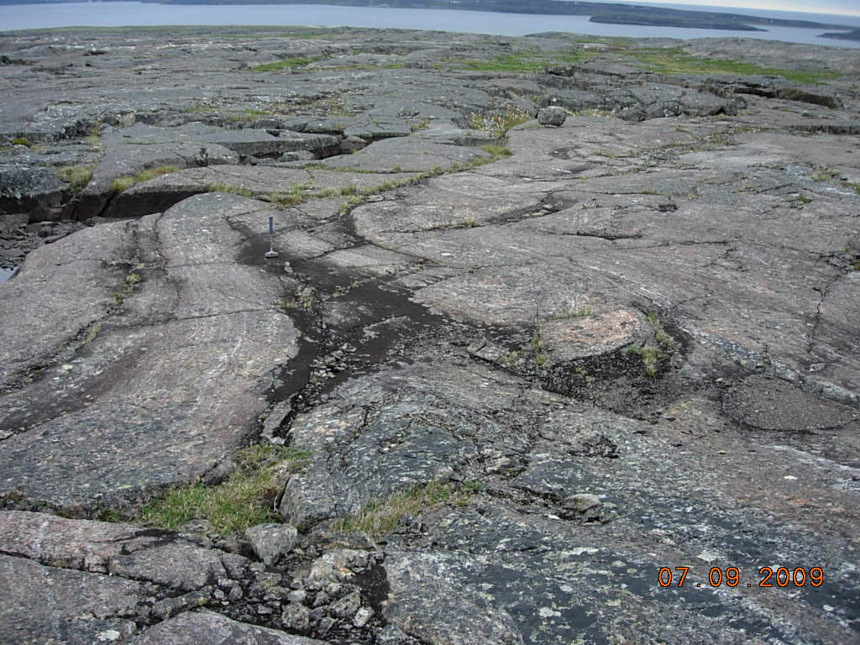
Preserving Original Structures in Multiply Deformed Old Rocks – Not Easy!
Nuvvuagittuq, Quebec
Notes:
An example of the rough life of an old terrane. Here, the white blocks are a.2.6 Ga pegmatite vein broken and stretched out in the 4.4 Ga mafic rocks of the Nuvvuagittuq greenstone belt. The right panel shows large scale folding of the mafic rocks, which have peak metamorphic temperatures of around 650C that developed at 2.6-2.7 Ga, 1.8 Ga after the volcanic rocks were erupted into an Hadean ocean.
41

Slide 42
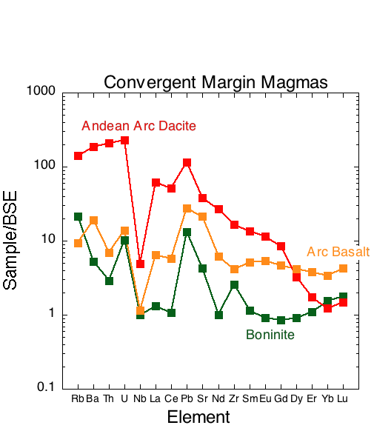
Melting in a Convergent Margin Involves Fluids Released from the Subducted Slab These are characterized by incompatible element enrichment, particularly Pb, but also Nb, Ti depletion.
Stern, RoG 2002
Notes:
Wet melting of either basalt or peridotite creates distinctive trace element patterns characterized by large depletions in high-charge cations like Nb, and large excesses in fluid mobile elements such as Ba, Sr, and particularly Pb. The extreme end member of such processes are boninites – a distinctive high Mg and high Si magma that shows an unusual pattern of depletion in the middle REE (e.g. Sm) compared to the heavy REE (e.g. Lu). This commonly is interpreted as evidence that boninites are derived from a mantle source that was previously depleted by melting, but was melted again due to the addition of water contributed to the hot mantle wedge via subduction.
42

Slide 43
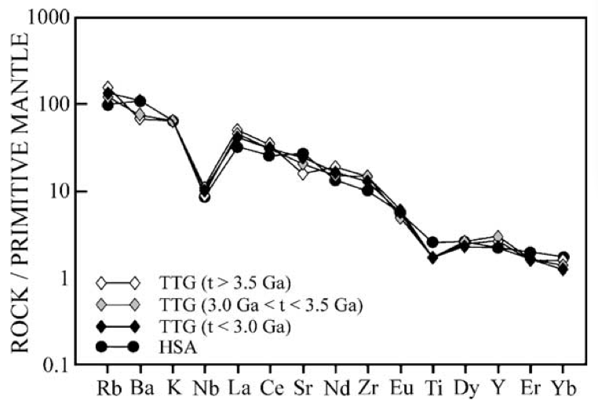
The “Granitic” component of Archean crust
TTG – Tonalite, Trondhjemite, Granodiorite
Martin et al., Lithos 2005
Notes:
The most common felsic rock type in Archean terranes belongs to the TTG family. The composition of many TTGs match the composition of melts of subducted basaltic crust, a modern analog of which is high-silica adakites (HSA). This type of wet basalt melting doesn’t require a subduction zone, but it is consistent with one.
43

Slide 44
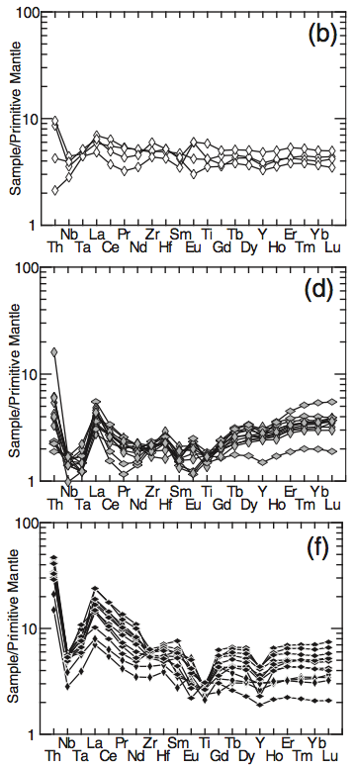
High-Ti
1
5
High-Ti
y
1
0
c
n
ue
Basalt
Basaltic
q
andesite
Andesite
e
r
5
F
1
0
depleted Low-Ti
Depleted Low-Ti
5
y
1
0
c
n
ue
q
e
r
5
F
0
1
5
enriched Low-Ti
Enriched Low-Ti
y
1
0
c
n
ue
q
e
r
5
F
0
4
2
4
4
4
6
4
8
5
0
5
2
5
4
5
6
5
8
6
0
6
2
6
4
6
6
6
8
S
i
O
2
(wt. %)
Nuvvuagittuq Mafic Crust
Arc tholeiites and boninites at 4.4 Ga?
O’Neil et al., J. Pet. 2011
Notes:
The 4.4 Ga Nuvvuagittuq greenstone belt consists of a variety of mafic composition rocks, now metamorphosed to amphibolite to granulite grade. Compositional study suggests that before metamorphism, these rocks were basaltic volcanic rocks with trace element patterns that range from similar to dry tholeiitic basalts (high-Ti compositional type) to rocks consistent with wet parental melts including one group (Depleted low-Ti) that shows the mid to heavy REE depletion characteristic of boniinites.
44

Slide 45
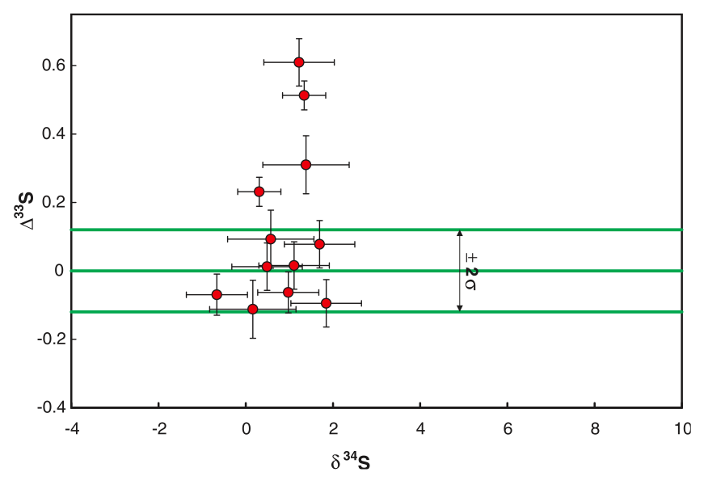
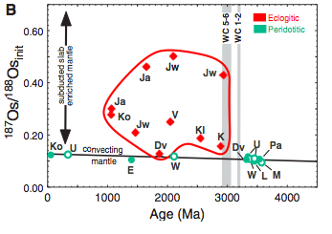
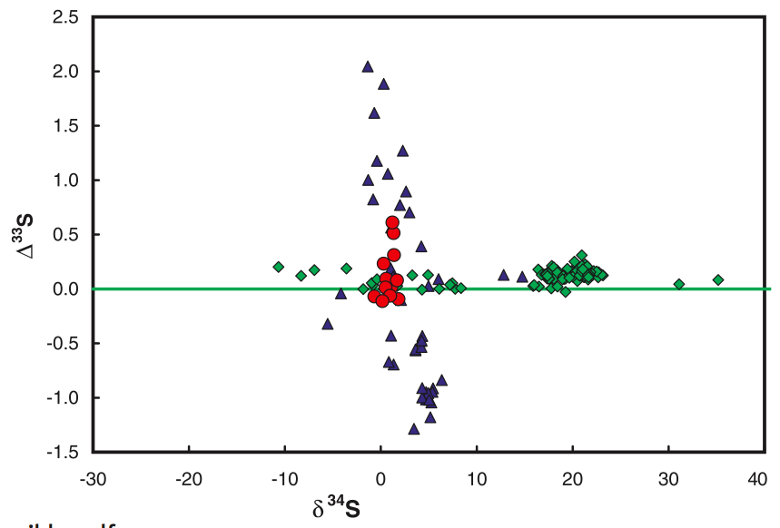
Another Consequence of Subduction:
Injecting Crustal Material into the Mantle
Diamond inclusion sulfide sulfur isotopic composition
Preservation of Eclogitic Diamond
Blue Triangles
Archean Sediments
Shirey and Richardson, Science 2011
Green Diamonds
Post-Archean Sediments
Farquhar et al., Science 2002
Notes:
More direct evidence of subduction is the occurrence of crustal material in the deeper upper manlte, for example as inclusions in diamond. Fe-Ni-Cu sulfides found as inclusions in diamond have sulfur showing non-mass dependent isotope fractionation that can only occur by UV irradiation of SO2 in the atmosphere. Similarly, other sulfide diamond inclusions show radiogenic Os isotope compositions indicative of the subduction of basalt into the deep upper mantle. Eclogite diamond inclusions first appear around 3.0 Ga, which has been interpreted as the start of subduction, but this may be a preservation issue.
45

Slide 46
Eclogites in the Mantle
The Start of Subduction, or the Start of Preservation?
Carlson et al., RoG, 2005
Notes:
46
Tomography and xenolith studies show circa 200 km thick sections of melt-depleted peridotite beneath Archean cratons. These lithospheric mantles appear to have been formed in the Archean and have remained attached to the overlying crust since that time.

Slide 47
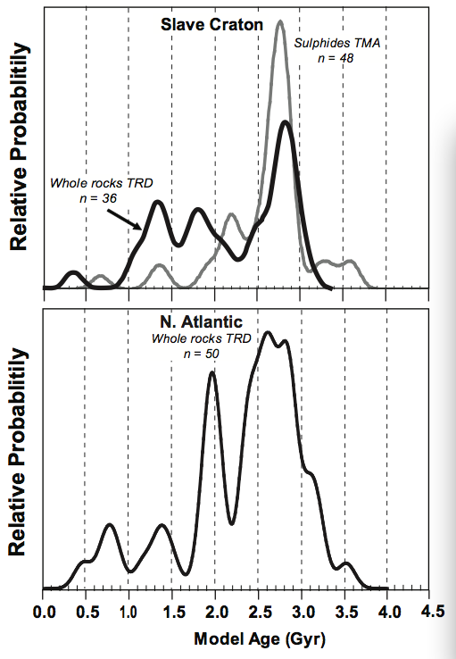
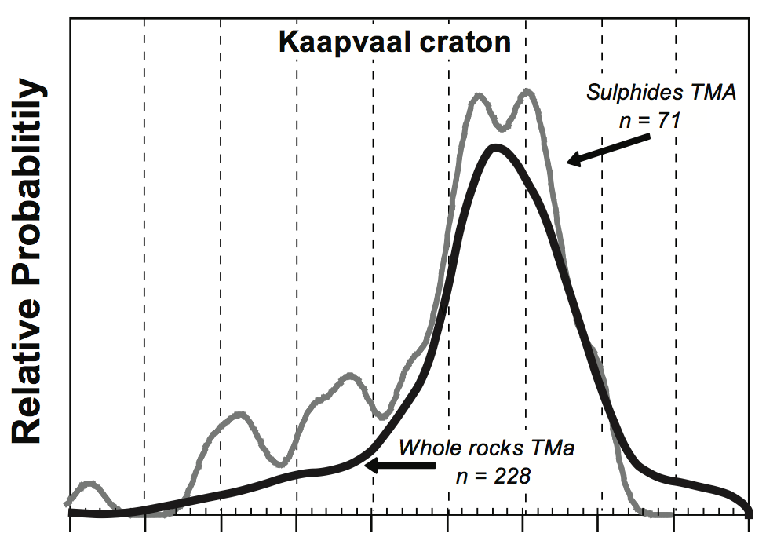
Re-Os model ages for many peridotite xenoliths from the subcontinental lithospheric mantle provide age peaks near 2.9 Ga. Mantle lithosphere cool enough and thick enough to retain the evidence of subduction?
0.5 1.0 1.5 2.0 2.5 3.0 3.5 4.0
Pearson &Wittig, ToG, in press
Notes:
Re-Os ages of peridotite senoliths from the subdontinental mantle indicate that most of the cratonic lithospheres stabilized primarily between 2.5 and 2.9 Ga. Is this an indication that the initiation of subduction contributed to lithosphere formation or instead that you could not preserve the evidence of crustal subduction into the mantle until you created the thick long-term stable lithosphere sections that preserve the evidence of subduction? The younger age peak in the Slave Craton data comes from the deeper section of the lithosphere and reflects the two-layer lithosphere in this area that Barbara showed yesterday.
47

Slide 48
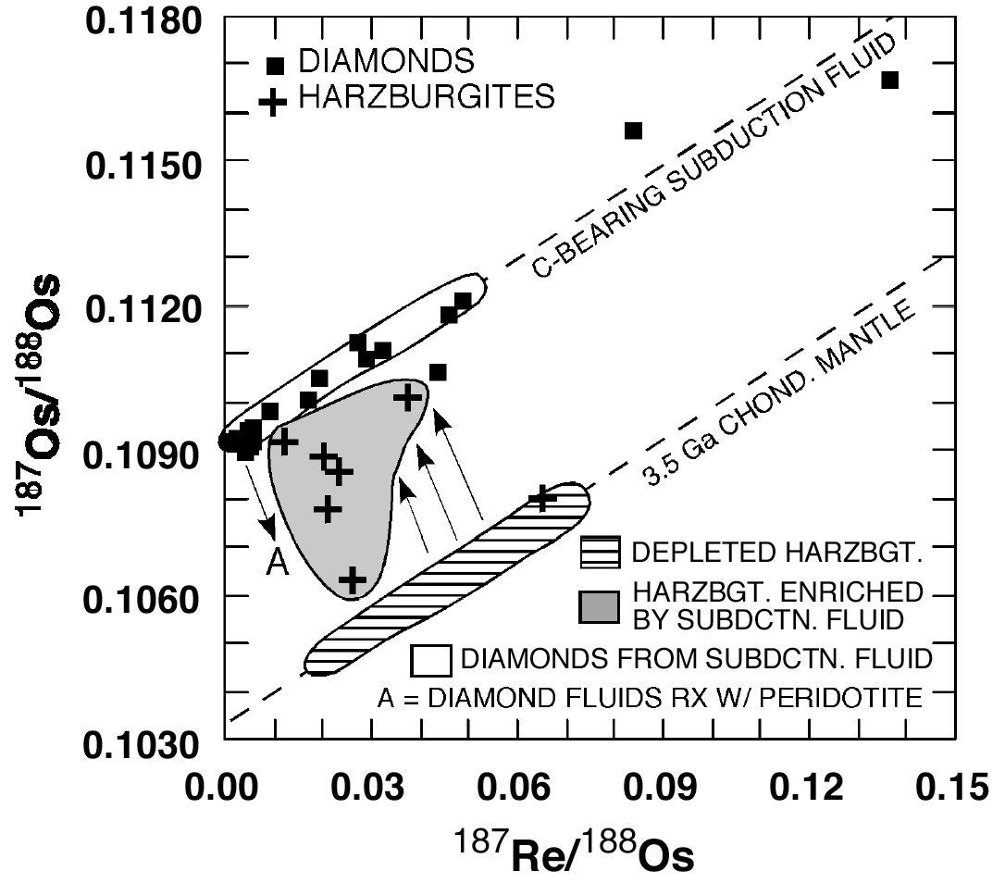
Diamond Inclusions from the Panda (Slave Craton) Kimberlite:
A 3.5 Ga Re-Os age and a high initial ¹⁸⁷Os/¹⁸⁸Os suggestive of formation from a crustal component with high Re/Os
Diamond Inclusion Age
3.52 ± 0.17 Ga
γ_{Os} = +6
Panda (Slave Craton, Canada) diamond inclusions and harzburgite xenoliths (Westerlund et al., CMP, 2006)
Notes:
One example of a pre 3 Ga subduction event – sulfide inclusions in diamonds from the Panda kimberlite in the Slave Province of northern Canada define a Re-Os isochron of 3.5 Ga age with an initial Os isotopic composition much higher than present in the mantle at the time. Crust has high Re/Os, and hence will rapidly develop high 187Os/188Os, so a ready explanation here is that the diamond forming fluids were derived from fluid released from subducted crustal materials at 3.5 Ga.
48

Slide 49
Why such disparate continental growth rates?
Differing views whether present continental age distribution is a growth or preservation record?
Differing views of origin and evolution of plate tectonics
Changing estimates of relative rates of arc magmatism and subduction erosion (0.1-1 km³/yr in 80s; currently ~3-5 km³/yr for both)
Differing views on lessons from other terrestrial planets
Differing views on importance of freeboard arguments
Differing emphasis & views of trace elements & isotopes
Knowledge of the composition of the lower continental crust is poor
Estimates of the composition of the continental crusts reflects how the estimator think it forms and grows and v.v.
Notes:
49

