Slide 1
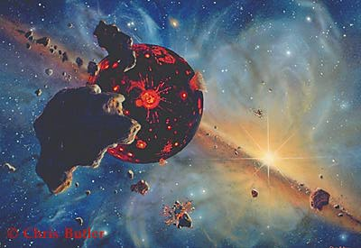
Earth’s Initial Condition
Dave Stevenson
Caltech
CIDER, KITP, July 18

Slide 2
Estimating Processes
Timescales, Energies, Mixing, Unmixing, Equilibration
Why is Earth (probably ) completely molten after a giant impact?
  But this does not imply good mixing
  Problems with impact simulations
Why can impacts inject volatiles? (Net gain)
Why might imperfect equilibration occur in core addition events arising from giant impacts?
  Siderophiles in the core & Hf/W chronology
Do magma oceans lead to a differentiated state?
  Is a basal magma ocean likely?
  Timescales
Why might mixing be easier in solids than in liquids!?
  Preservation of a basal layer in a giant impact
Why are some things so poorly understood?
  Looking to the future

Slide 3
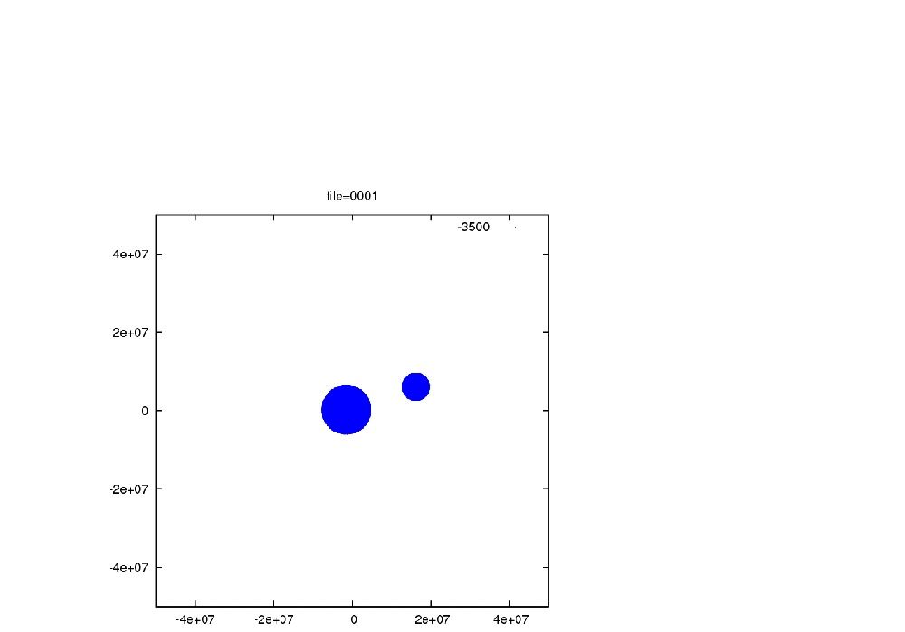
Moon-forming Giant Impact
(Ongoing work with Miki Nakajima)

Slide 4
Entropy Distribution in Disk & Planet
Initial entropy

Slide 5
Entropy distribution in Post-Giant Impact Mantle
Initial entropy

Slide 6
Why is Earth (probably ) completely molten after a giant impact?
The pre-impact state is surely near the solidus.
  This is crucial to the argument… initially cold material will not all melt
  Near solidus pre-impact state expected because of enormous heat input from previous impacts; not enough time for that energy to escape
Giant impact calculations indicate an entropy increase in the deep mantle ~2 x entropy of fusion (ΔS_{fusion}~ 500J/kg.K)
A small amount may escape melting at mantle base but this will be enveloped in hotter material (like putting an ice cube in coffee and stirring)

Slide 7
Entropy distribution in Post-Giant Impact Mantle
Initial entropy
Entropy increasing with radius is stably stratified! According to SPH, the particles are not well mixed (deep mantle largely undisturbed).

Slide 8
Stable Density profile but unstable velocity (differential rotation) profile?
(Ri~0.3?, Ri<1/4 needed for overturn)
(a)
(b)

Slide 9
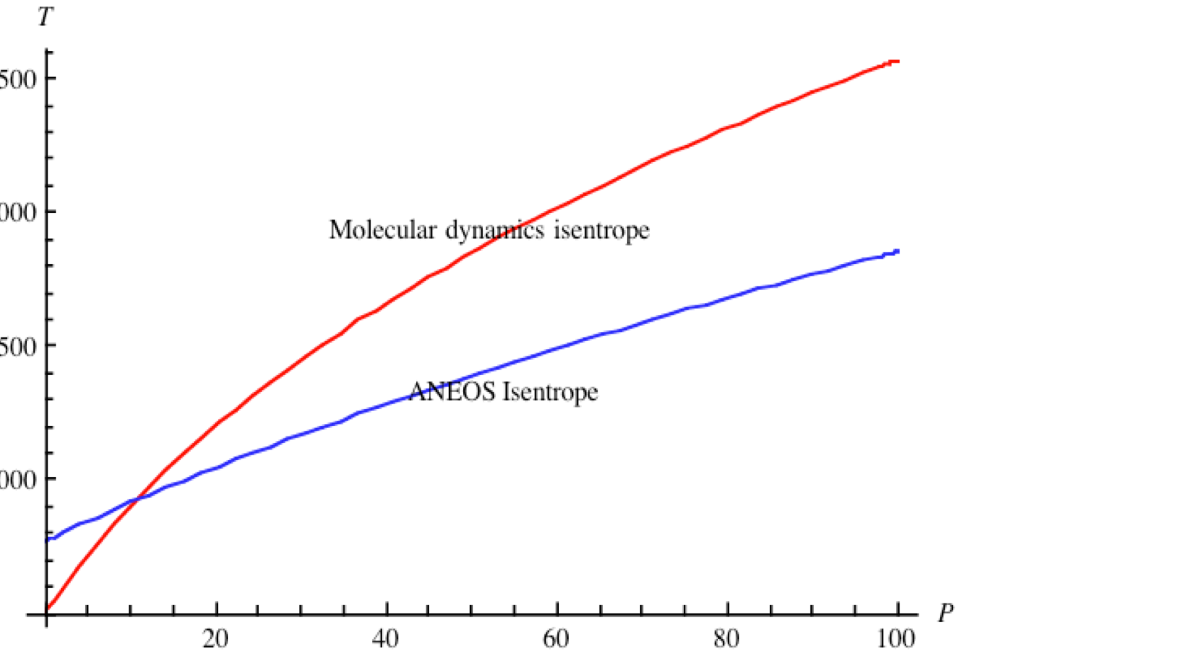
Need to improve thermodynamics
“Something is rotten in the state of Denmark“ (actually ,everywhere)

Slide 10
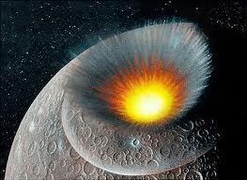
Why can impacts inject volatiles? (Net gain)
During an impact, a transient
cavity forms and the interface
between projectile and target
develops rapid shear
(Kelvin-Helmholtz) instabilities).
Turbulence ensues down to the Kolmogorov inner scale length (typically mm)
Diffusion (e.g. water into molten silicates) can proceed a mm in the timescale of the strong shear flow (tens of seconds to minutes)- big impacts are better than small; may fail below tens of km. Comets on the moon?

Slide 11
Core Formation with Giant Impacts
Diffusion time ~R²/D ~hours for R~ few cm; transport time is ~ (few years) /R^{1/2} (R in cm) provided Re>10³ . For large R, get disequilibrium
Blobs “fission” when they fall their own diameter so only the largest blobs are expected to make it without fragmenting all the way to droplets. Droplet size determined by surface tension.
Molten mantle
Unequilibrated blob
Core

Slide 12
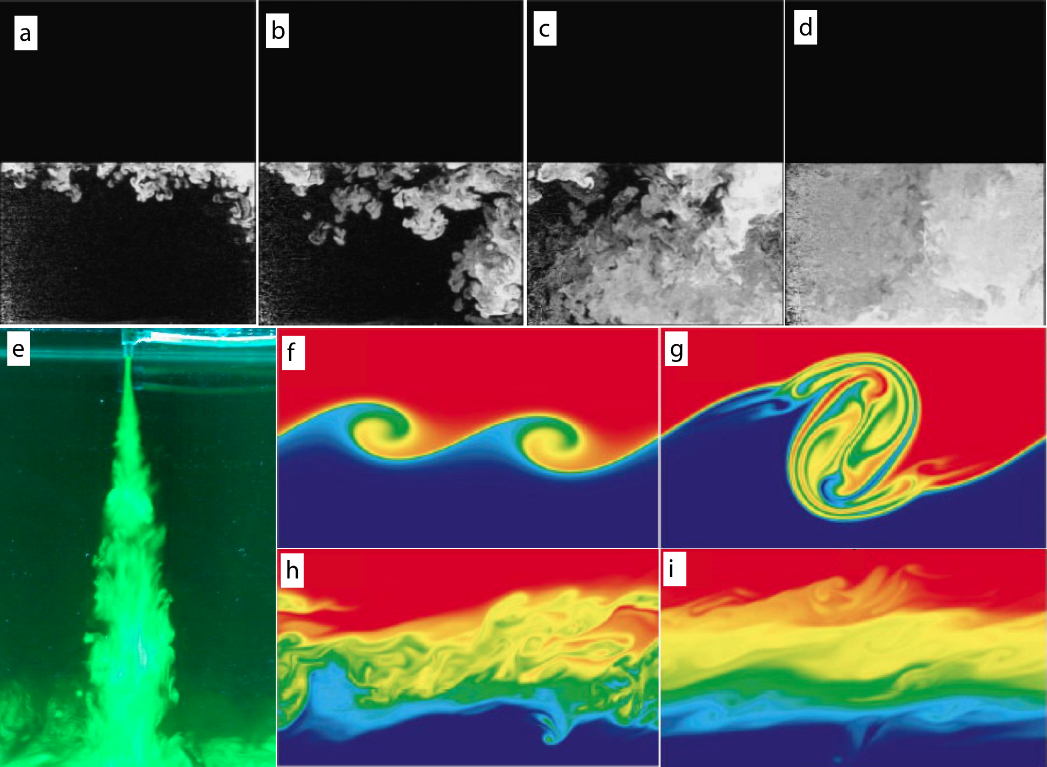
Turbulent mixing of fluids
Rayleigh-Taylor Instability
dense
light
Dalziel et al.
J. Fluid Mech. 1999
light
dense
Turner
J. Fluid. Mech 1986
Smyth et al.
J. Phys Ocean. 2001
light dense
Kelvin-Helmholtz Instability
See also Dahl & Stevenson, 2010, EPSL
Notes:
RT-instability develops when a heavy fluid rest on top of a light fluid, or equivalently, when a heavy fluid is accelerated into a light fluid. The instability builds up from small scale (centimeters) and cascade into larger and larger vortices. The spectrum of turbulent motions fulfill a Kolmogorov spectrum (-5/3 power law of wave number) that appears during rapid breakup of large vortices down to scales determined by viscosity and/or surface tension. Both at or below centimeter scale where chemical diffusion is fast enough that isotopes can equilibrate in reasonably short time (e.g. years).

Slide 13
Why might imperfect equilibration occur in core addition events arising from giant impacts?
Iron from the core of the projectile may be distributed heterogeneously onto Earth- some parts of the mantle may not “see” this iron and therefore some of the Hf-derived ¹⁸²W has no opportunity to go into the core
The SPH does not resolve break-up of the iron but some of it may be in large enough blobs to ”crash” through the molten mantle in a few hours (almost free fall time)
Can it break up into small enough droplets to equilibrate?

Slide 14
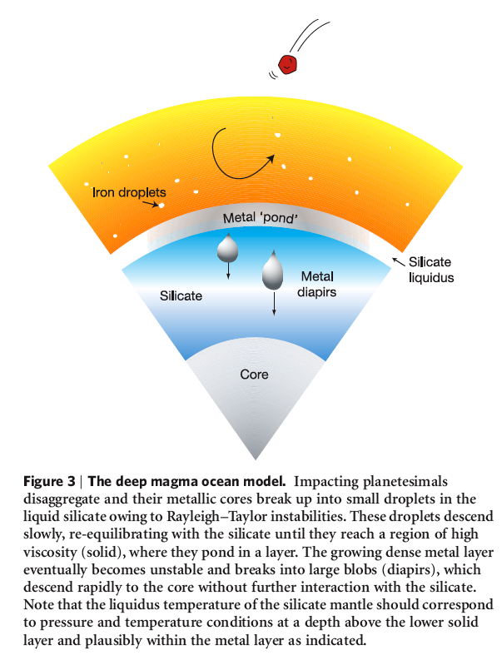
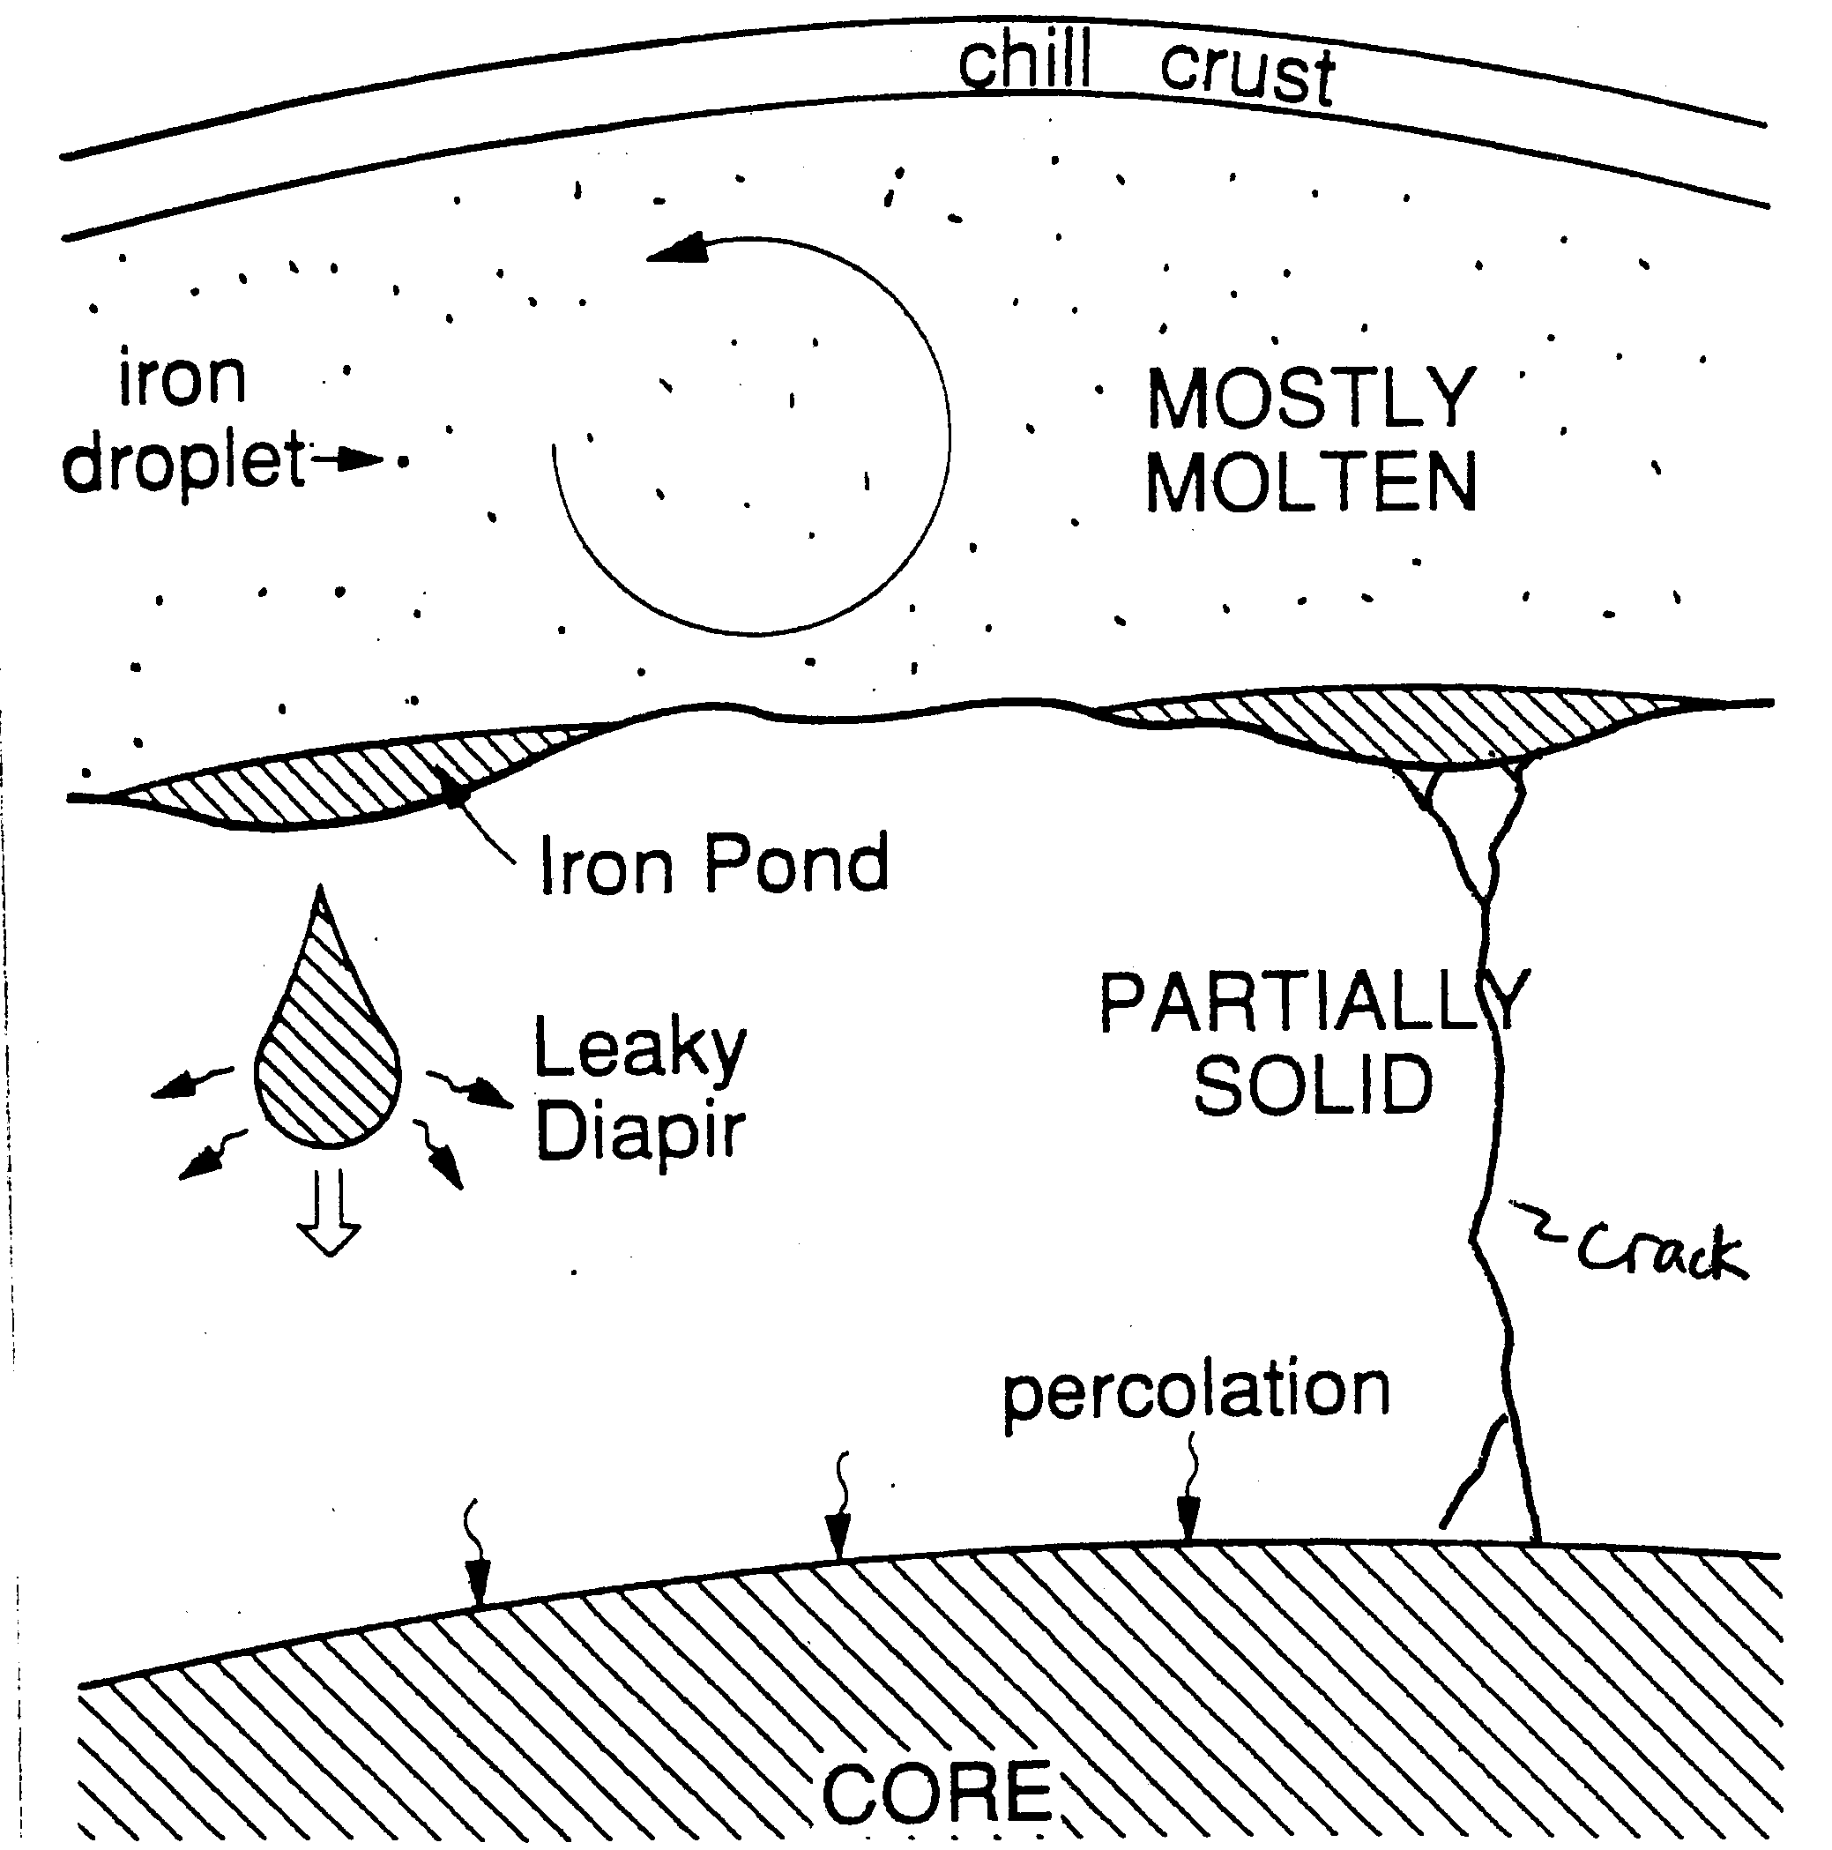
Popular Cartoons of Core Formation
Wood et al, 2006
Stevenson, 1989

Slide 15
 | Giant Impacts | Small Impactors
Thermal effect | Resets the magma ocean to great depth & pressure | Helps maintain magma ocean to ~ transition zone
Equilibration | Poor for the Fe core of the projectile | Good for all components
T, P for any equilibration | Extends up to core-mantle boundary P and very high T (plausibly 6000K) | Modest T (2500K) and P(maybe 30GPa)
Implications for Hf/W | Could mislead chronology (but some disequilibrium is OK) | Can give good guide to chronology
Implications for siderophiles | Not known since we don’t know the partition coefficients at extreme T and P | Can be estimated; some evidence for agreement with observation

Slide 16
Three Kinds of Magma Oceans
Naked
  Earliest stage of lunar magma ocean?
Veiled (or Blanketed)
  Silicate vapor, water, CO₂, H₂…
  Earth (throughout much of accretion)
Capped
  Stable or Unstable (foundering) crust
  Late stage lunar magma ocean
  Io? (Khurana et al, 2010)
  Conceptually, Europa’s ocean and Earth’s outer core are magma oceans
  Earth in transition zone or above CMB

Slide 17
What Regime (for Earth)?
Giant impact will melt the entire mantle, allow efficient core formation, but also cool fast, perhaps “healing”. (Could even have a water ocean quickly in few million years!)
Large (~100-1000km scale) impactors create transient magma oceans, or add to existing magma ocean.
Background quasi-continuous flux of small bodies can sustain an “equilibrium” shallow (few to 500 km thick) magma ocean indefinitely, provided the flux exceeds a critical value (of order 1M_{Earth}/100Myr; but set by opacity of overlying atmosphere).
A partially molten state could persist for a long time…potentially up to present

Slide 18
Characteristic Timescales
If magma ocean depth d and temperature T radiates at T_{e} then time to cool to 0.9T (with no freezing) is 0.1ρC_{p}Td/σT_{e}⁴ ~ (300yr)(T/2000K) (d/1000km)(1000/T_{e})⁴
But capped magma oceans can cool on very long (thermal diffusion) timescale (Stefan problem):
3 million yr. (d_{cap} /10km)²
Capping can also arise from the lower slope of the solidus in the transition zone, so cooling of a mid-mantle magma ocean can take hundreds of millions of years.
Foundering crust models can have T_{e} ~few hundred K so cooling times are intermediate but can be short (e.g., ten or hundred thousand yr).

Slide 19
Differentiation in the Mantle?
Dense suspension, vigorously convecting. May be well mixed Solomatov & Stevenson(1993)
Much higher viscosity, melt percolative regime. Melt/solid differentiation?
High density material may accumulate at the base. May be relevant to ¹⁴²Nd
CORE

Slide 20
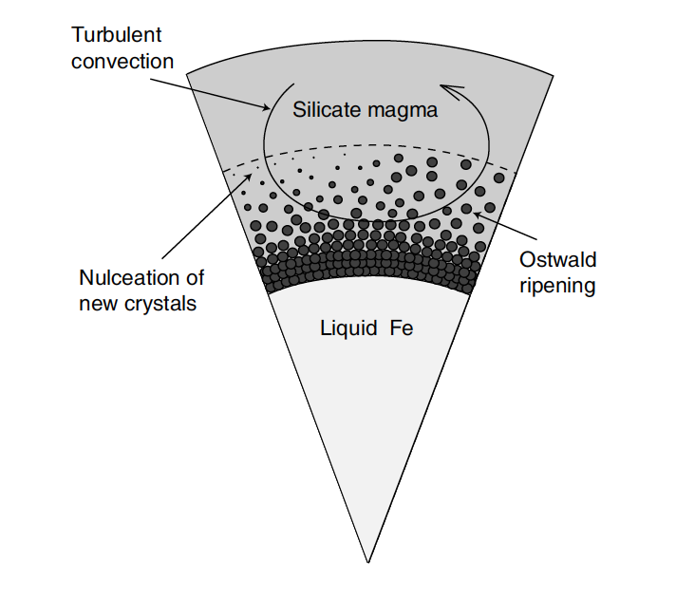

Slide 21
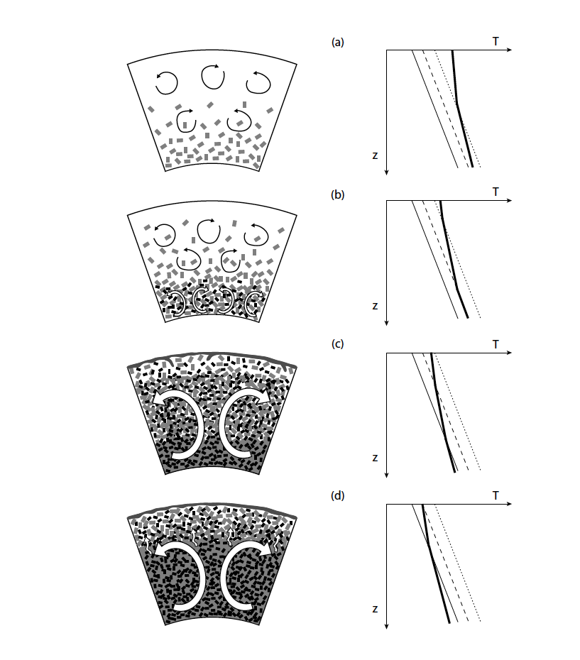

Slide 22
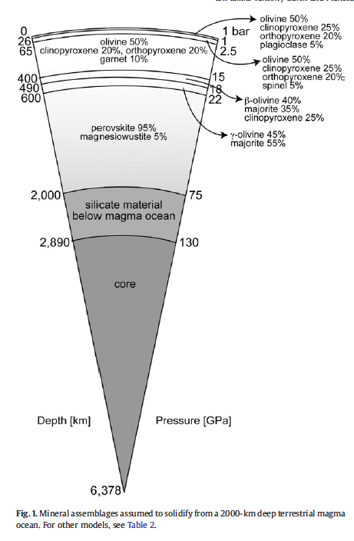
Elkins-Tanton,2008

Slide 23
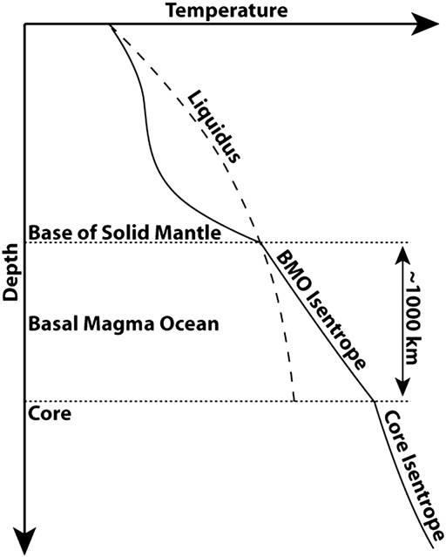
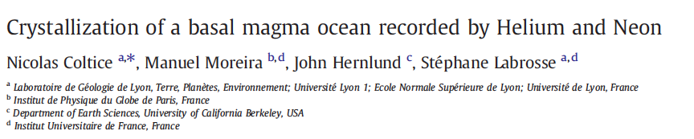
Coltice et al ,2011

Slide 24
Two Ways to have a very long-lived magma ocean
Flotation Crust
  Lunar case
  Borg et al(2011) may be explained this way.
Cross-over of adiabat & solidus/liquid
isentrope
Melting curve
SOLID
MAGMA OCEAN

Slide 25
Do magma oceans lead to a differentiated state?
Not in a vigorous early stage, despite crystallization (assuming it starts out homogeneous)
Yes, when you enter the percolative regime (crystal fraction exceeds 20 or 30%)
But if this evolves to an unstable state then large scale Rayleigh –Taylor can remix
We lack sufficient information to be sure this remixing happens

Slide 26
Why might mixing be easier in solids than in liquids!?
ρ-Δρ
solid
liquid
solid
ρ
liquid
In a solid, the density changes due to temperature anomalies are significant & viscous stresses can be large
In a liquid, the density changes due to temperature anomalies are tiny & viscous stresses very small… can get double diffusive convection

Slide 27
Why are some things so poorly understood?
Material properties
  Especially at extreme conditions
Inability of numerical codes to handle multiple scales (impact events, emulsification, very high Reynolds number)
  Divide & conquer
Possible futility in attempting to reconstruct the particular (non-unique?) way in which our solar system reached its observed state

Slide 28
“Doubt may be uncomfortable but certainty is absurd” -Voltaire

