Slide 1
When did the continents grow?

Slide 2
Records of continental growth
Continental crust
Cratonic mantle
Convecting mantle
Atmosphere

Slide 3
Two Big Themes
Preservation vs Production
Uniformitarianism vs Catastrophism

Slide 4
Continental Crust

Slide 5
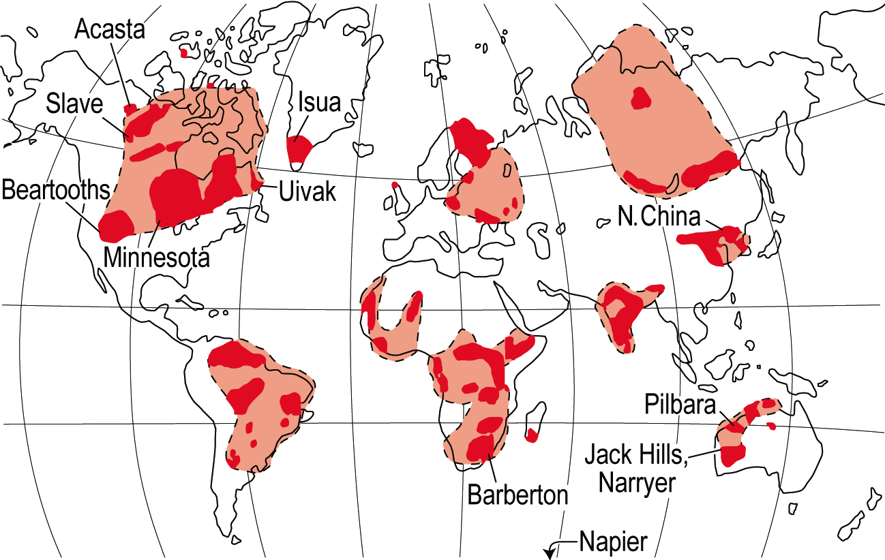
Valley, 2007 Orange areas are >2.6 Ga, named areas are >3.6 Ga

Slide 6
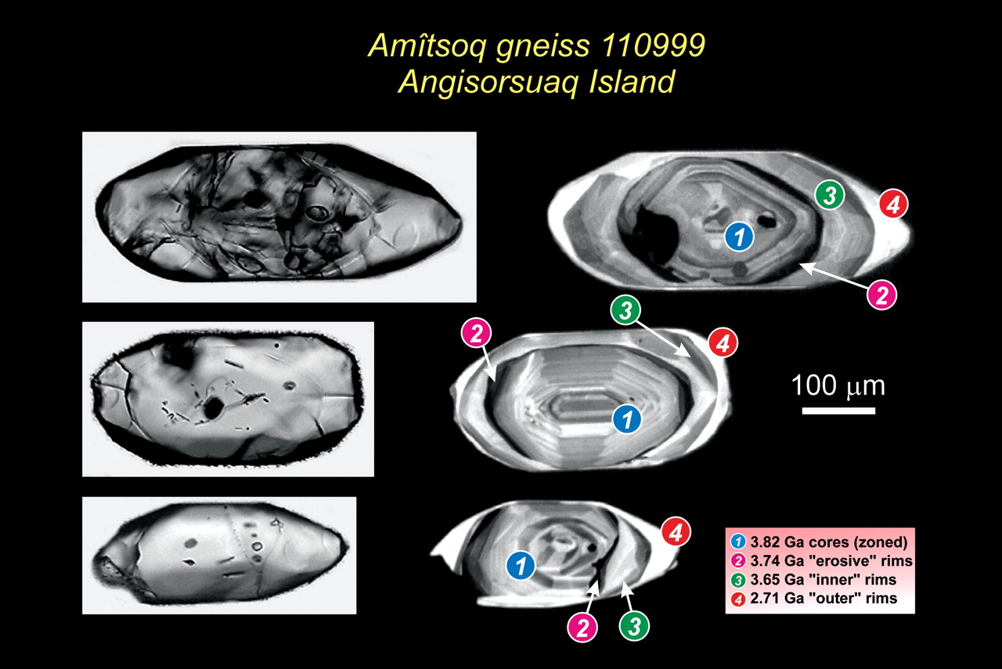
Erik E. Scherer, Martin J. Whitehouse, and Carsten Münker
Zircon as a Monitor of Crustal Growth
ELEMENTS 3(1): 19-24

Slide 7
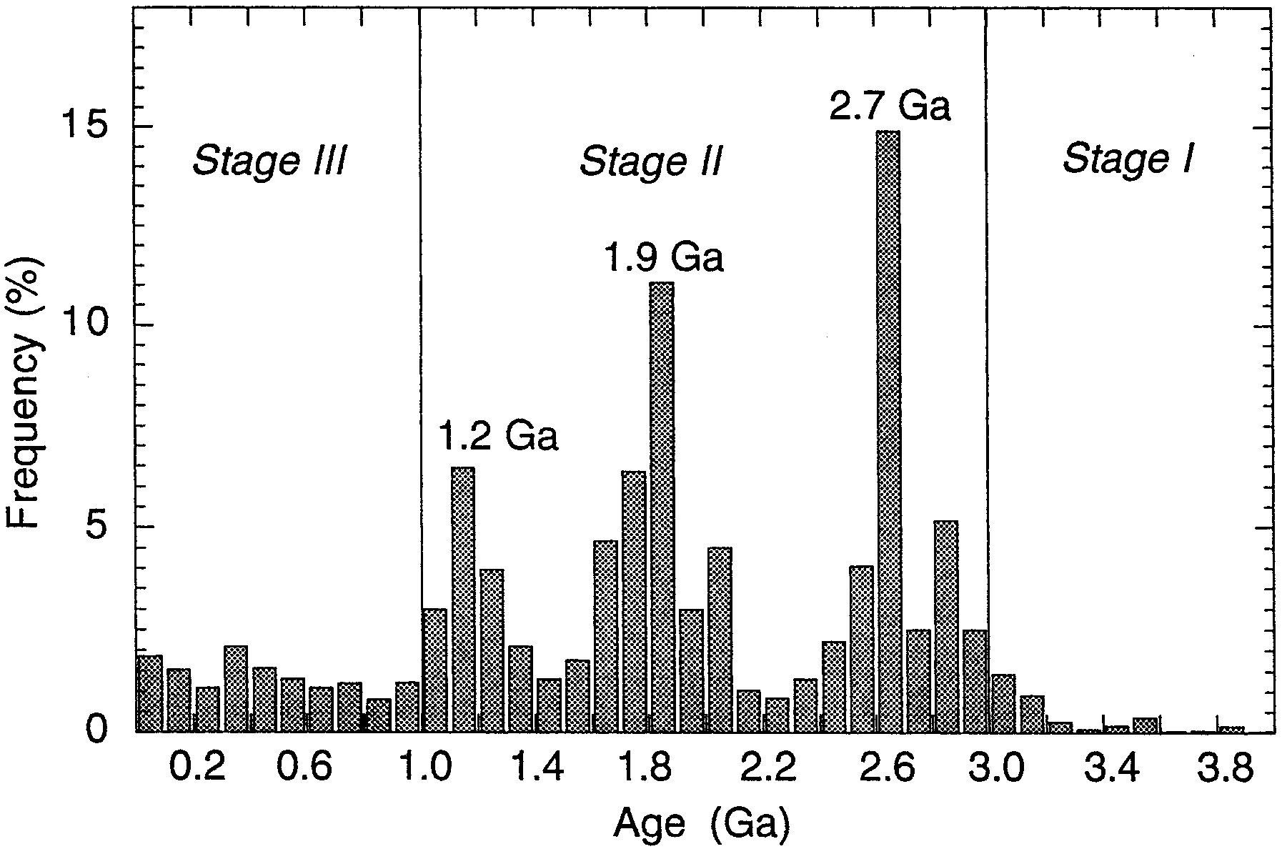
Condie, EPSL 1998

Slide 8
~50% of crust in 3 large age peaks
Superia
Sup
ZirconU-Pb ages
8,928 igneous
28,027 detrital
Nuna
Gondwana
Rodinia
Condie and Aster, 2010
Notes:
Are there peaks at 3.3 Ga, 0.6 Ga??

Slide 9
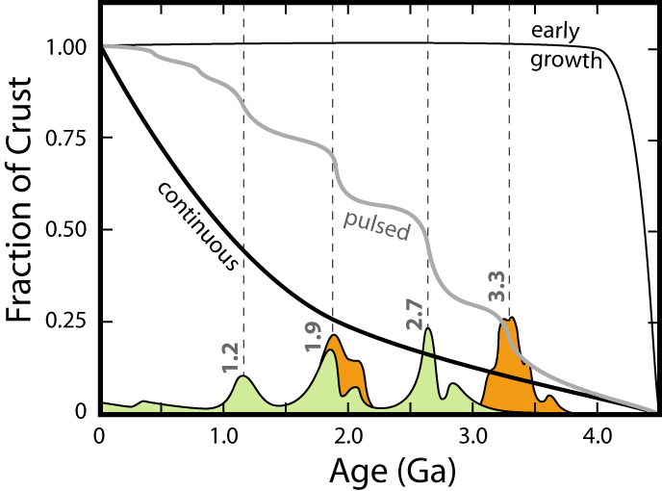
Armstrong, Moorbath, Reymer&Schuber, Taylor&McLennan, Condie, Hofmann, Wasserburg, Jacobsen, Bowring, Valley, Harrison, Kemp&Wood…

Slide 10
Lu-Hf model ages
Lu-Hf age peaks are not the same as the U-Pb ages
Peaks are generally older
One interpretation is that this indicates U-Pb ages are ‘reset’
Another interpretation is that Lu-Hf ages are affected by crustal contamination
Hawkesworth et al, 2010

Slide 11
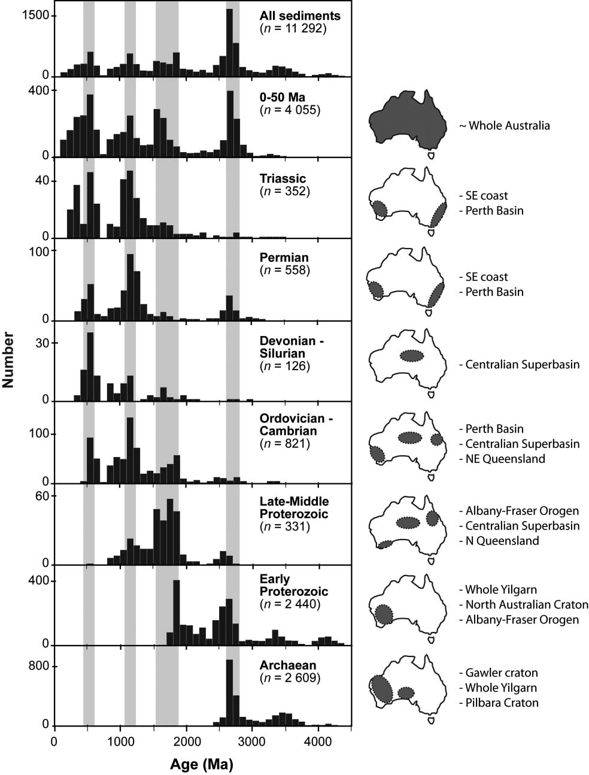
Peaks don’t change position with time
Hawkesworth et al, 2010

Slide 12
Cratonic Mantle

Slide 13
Cratonic mantle is thick
Kaapvaal
O’Neil et al, 2010; after James et al, 2001

Slide 14
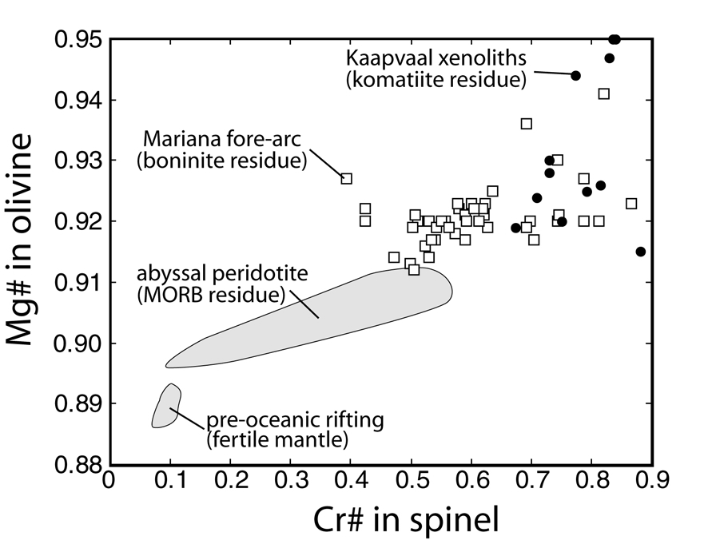
Cratonic mantle is heavily depleted
Parman et al, 2004

Slide 15
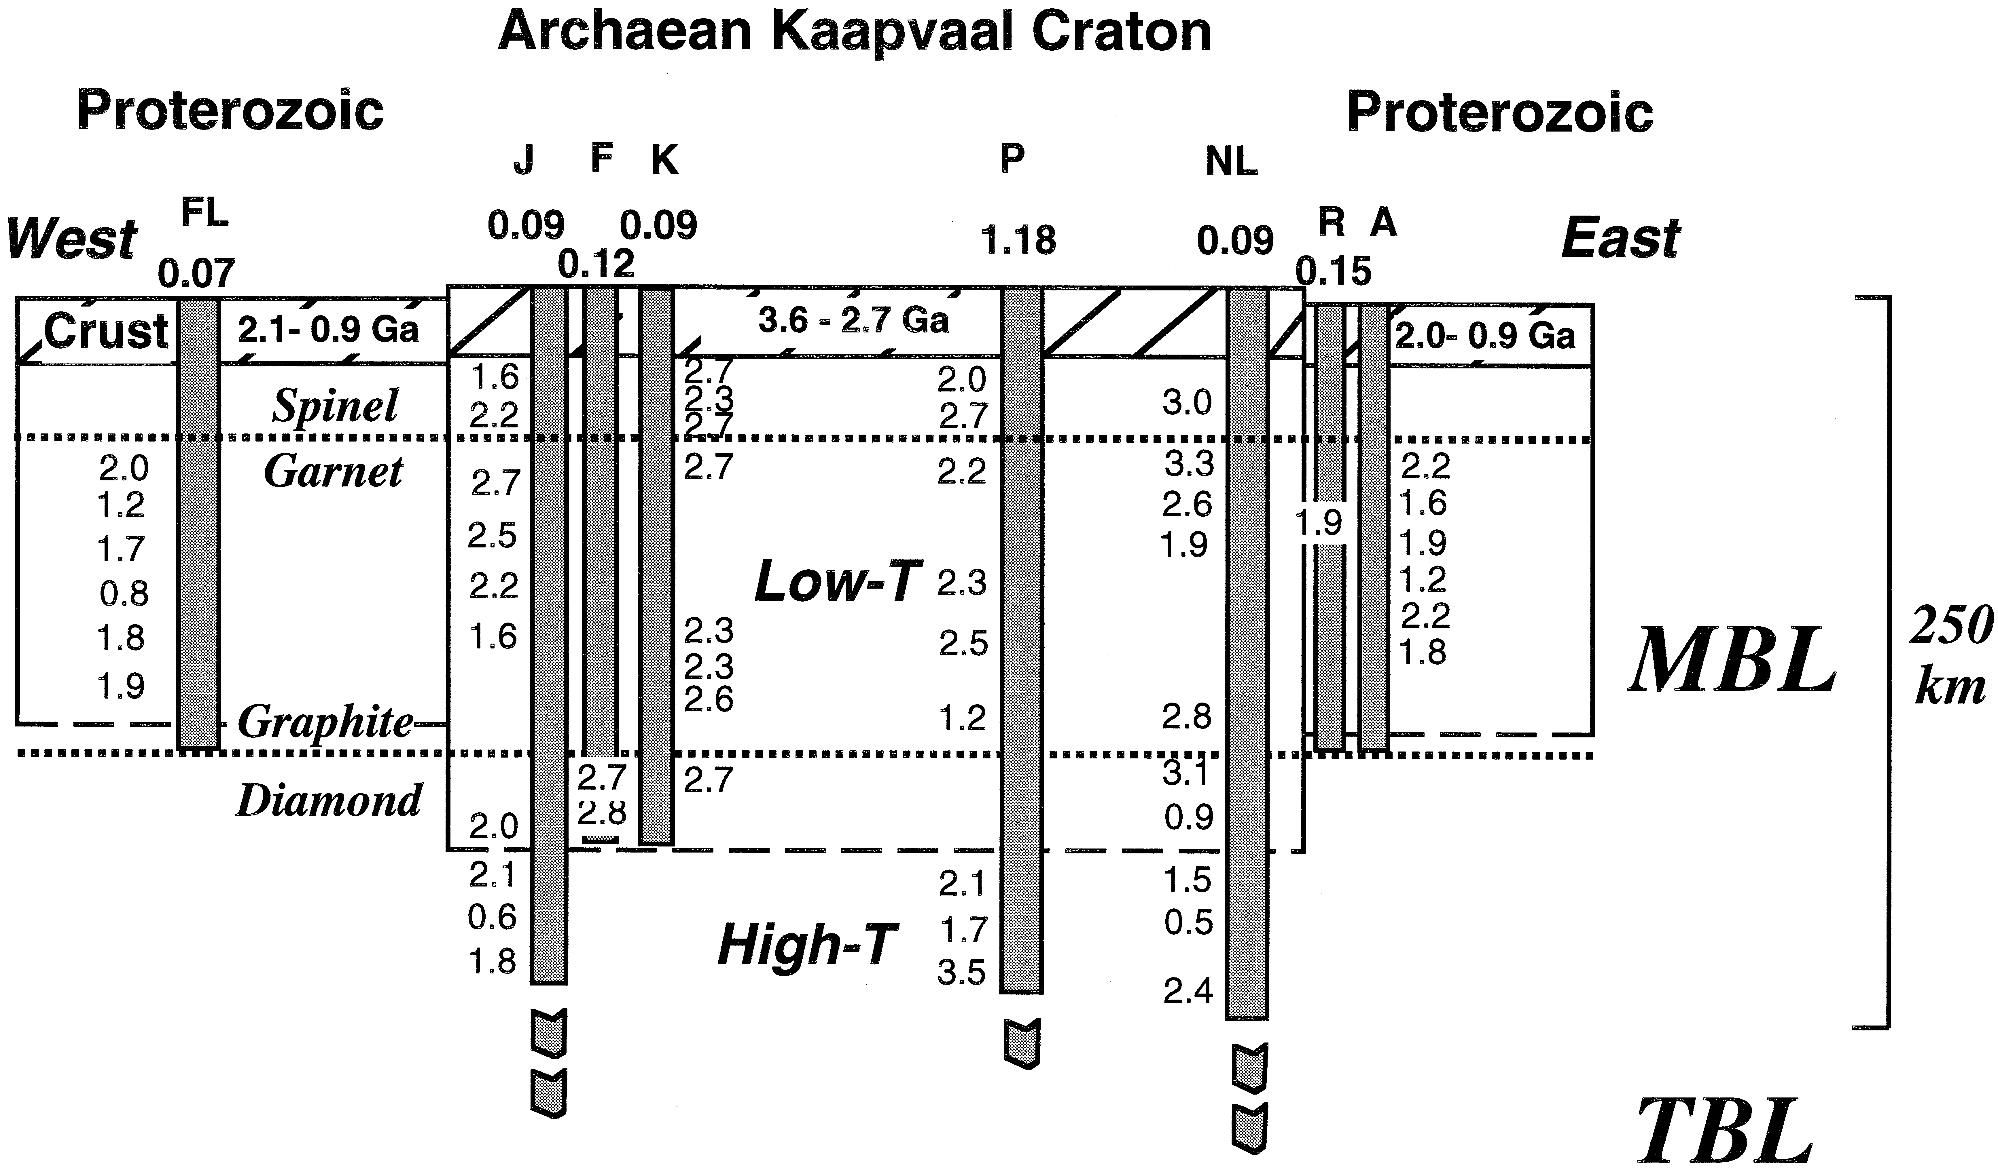
Cratonic mantle is old
Pearson, 1999

Slide 16
Age distributions of cratonic mantle
Pearson et al, 2007

Slide 17
Convecting Mantle

Slide 18
Crust extraction left an chemical imprint on the upper mantle (MORB source)
Jackson et al, G³ 2007

Slide 19
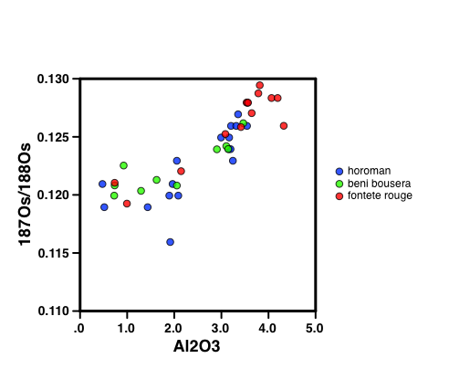
Orogenic peridotites
1.2 Ga
1.9 Ga

Slide 20
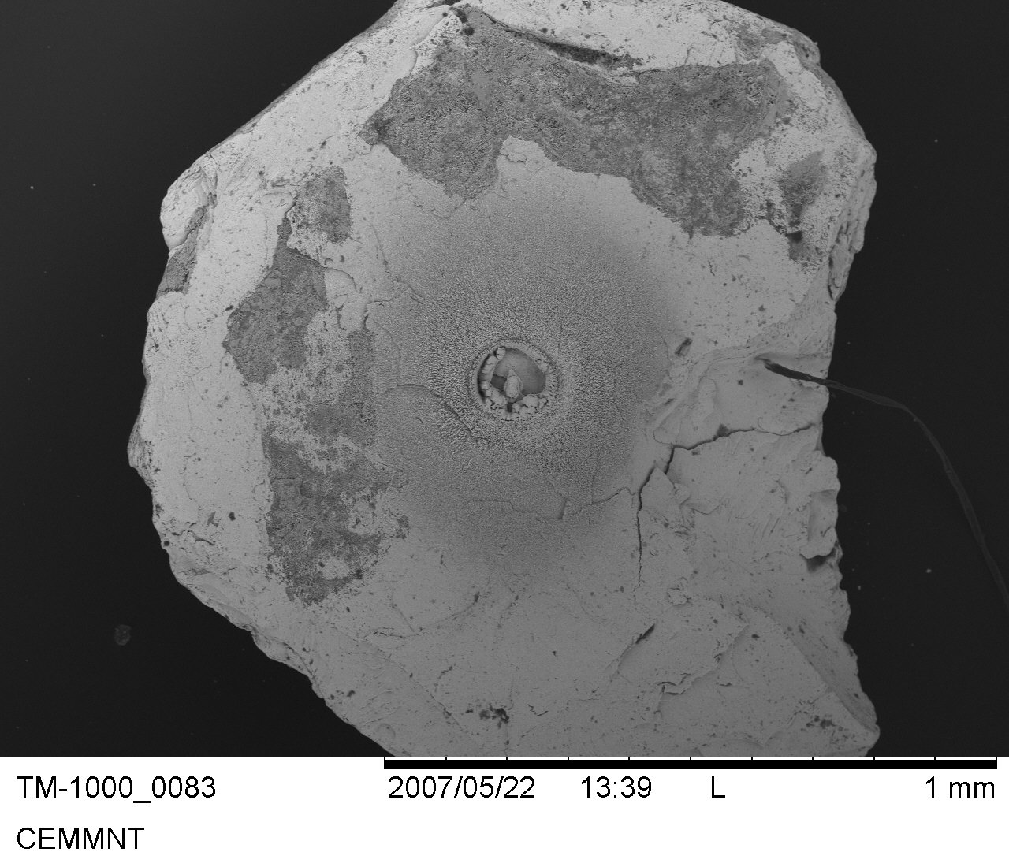
Laser ablation Os isotope analyses
Grain is ~ 1mm diameter

Slide 21
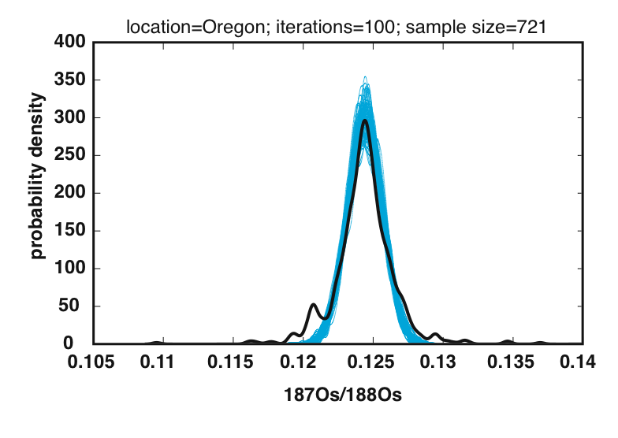
2.7 Ga
1.9 Ga
1.2 Ga
chondrite
Meibom et al., 2002

Slide 22
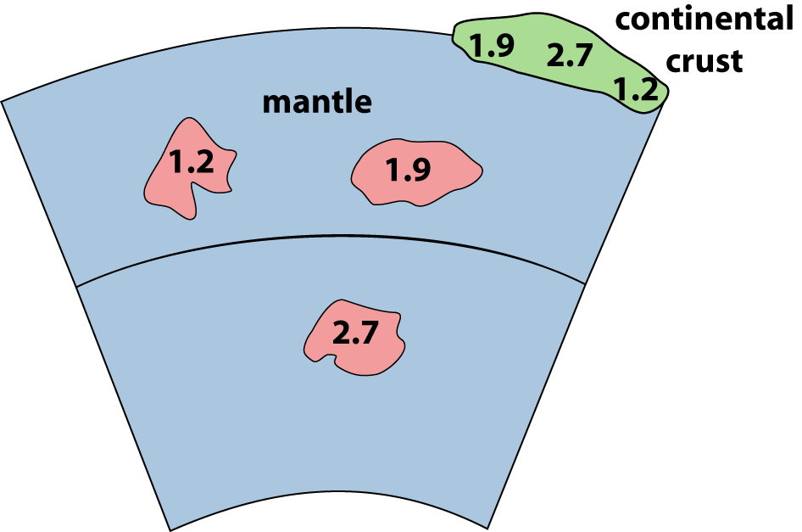
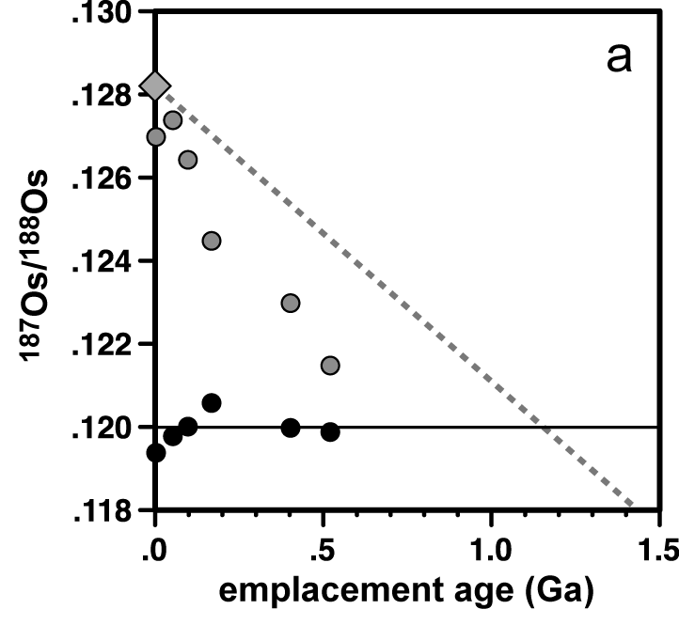
Pearson, Parman & Nowell, Nature 2007

Slide 23
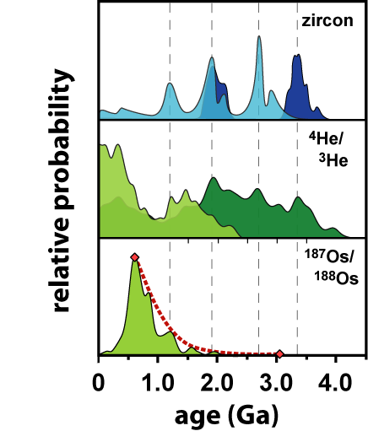
conv.
plume
conv.

Slide 24
Atmosphere

Slide 25
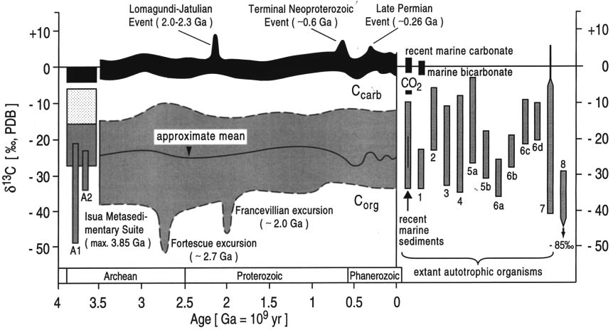
Atmosphere/ocean record of crustal growth pulses
Schidlowski, Precambrian Res 2001

Slide 26
Competition between production and preservation

Slide 27
Punctuated cooling of the Earth
Davies, EPSL (1995)

Slide 28
Conclusions
Competition between production and preservation
Weight of evidence suggests episodic growth of continents in 3-4 large events

