Slide 1
Empirical ejecta thickness laws for impact craters:
McGetchin, Settle & Head EPSL 20 (1973) RADIAL THICKNESS VARIATION IN IMPACT CRATER EJECTA:
IMPLICATIONS FOR LUNAR BASIN DEPOSITS
t = 0.14R^{0.74} (r/R)^{-3.0} What is used here. McGetchin takes R to be final crater radius, not “transient crater radius” as erroneously indicated by Melosh.
Pike EPSL 23 (1974) EJECTA FROM LARGE CRATERS ON THE MOON: COMMENTS ON THE GEOMETRIC MODEL OF McGETCHIN ET AL.
t = 0.033R (r/R)^{-3.0} Won’t use this anymore now that crater radius confusion has been cleared up.
Based on lunar Imbrium Basin, Copernicus, plus terrestrial smaller craters and nuclear explosions.

Slide 2
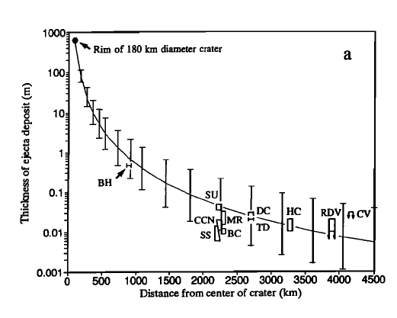
Chicxulub ejecta thickness with distance from crater center from:
Vickery, Kring, Melosh (1992) LPSC XXIII p1473 and also in
Kring (1995) JGR, Vol 100, no. E8, p16979 - neither paper addresses Yucatan Peninsula
First paper claims to use McGetchin formula with transient crater radius of 60 km while second paper claims to use McGetchin formula with final crater radius of 90 km.

Slide 4
Two Questions:
1) Assumming Chicxulub crater is the only large KT boundary impact crater, how does breccia thickness on the Yucatan peninsula compare with expected power law decay with distance?
Apparently not very well: Yucatan PEMEX well sections show KT boundary breccia thickness apparently does not decrease with distance east and southease of the Chicxulub rim. And breccia layers approximately one crater radius from the rim are much thicker (400-500 m) than predicted (100 m or less).
2) What ejecta thicknesses are expected for a hypothetical proximal doublet consisting of a 200 km Chicxulub crater and 600 km Greater Antilles crater whose centers are separated by ~700 km?
PEMEX drill hole data and figures taken from Ward, Keller, Stinnesbeck and Adatte. Geology v. 23 no. 10, 1996 “Yucatán subsurface stratigraphy: Implications and constraints for the Chicxulub impact”
UNAM drill hole data and figures taken from Urrutia-Fucugauchi, Marin, and Trejo-Garcia. Geophysical Research Letters, v. 23 no. 13, 1996 “UNAM Scientific drilling program of Chicxulub impact structure”

Slide 5
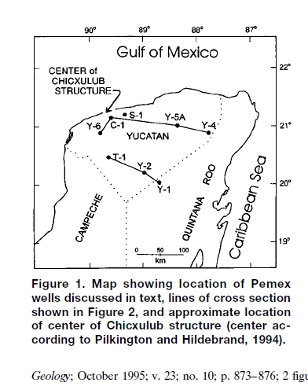
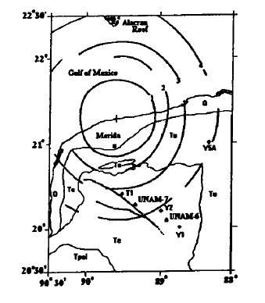
Ward et al. 1996
PEMEX wells
Urrutia-Fucugauchi 1996
UNAM wells

Slide 6
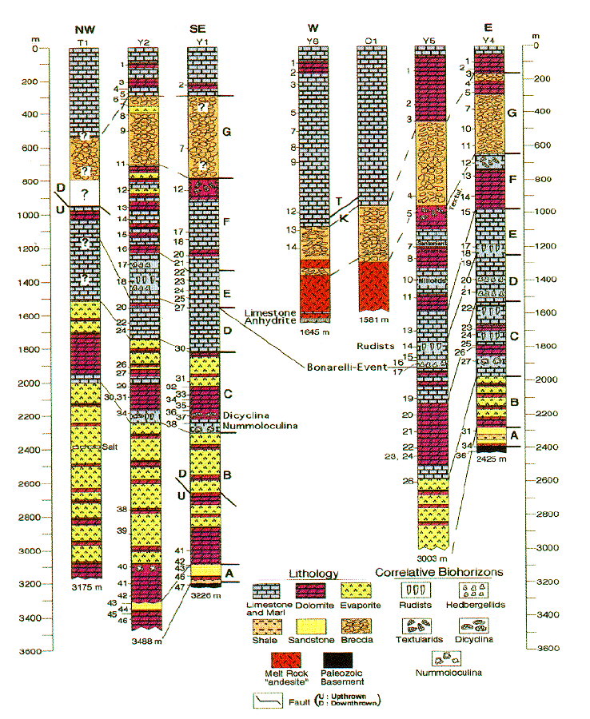
From Ward et. al.
1996

Slide 7
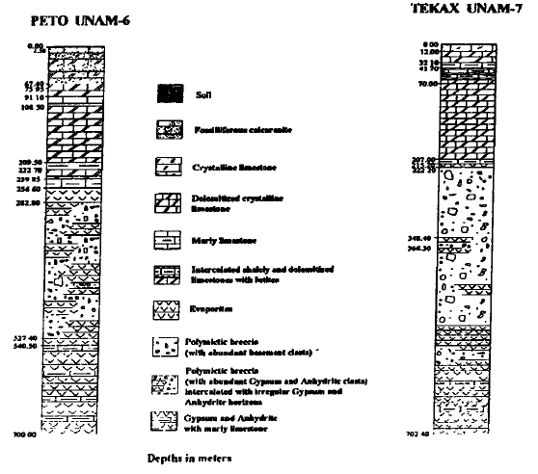
Figure 1. (a) Schematic map of the Chicxulub impact structure, Yucatan peninsula Mexico [Sharpton e t al., 1993] showing the concentric ring pattern derived from gravity anomaly interpretation and location of exploratory boreholes UNAM and PEMEX boreholes are marked by o and o, respectively. Schematic lithological columns for (b) UNAM-6 and (c) UNAM-7 boreholes.

Slide 8
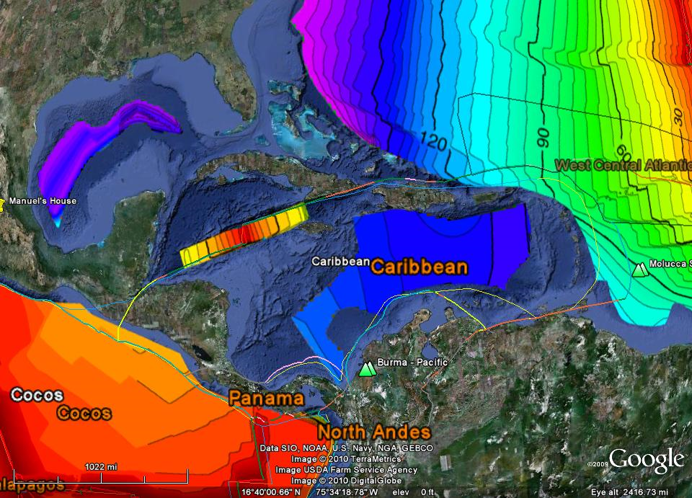
Yucatan Basin bathymetry with Muller age data (Google Earth).
Measured separation distance between Chicxulub and hypothetical Antilles crater centers to be ~700 km.

Slide 9
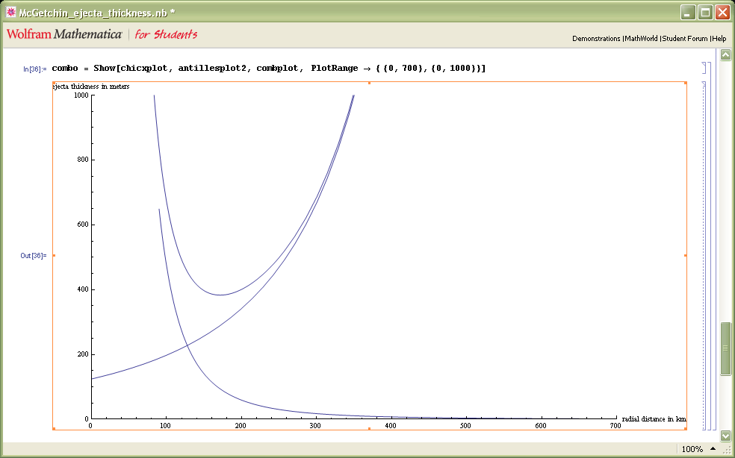
Curve indicates predicted ejecta thickness for impact craters 180 km and 600 km in diameter (90 and 300 km in radius) whose centers are separated by 700 km using power law McGetchin et al., 1973. T= 0.14R^{0.74}, b=3.0 .
KT breccia layer thicknesses for PEMEX drill holes are also plotted as a function of distance from the center of Chicxulub.
PEMEX drill holes outside of Chicxulub crater
(assumes KT breccia layer is impact ejecta layer.)
Vertical bar length indicates uncertainty in layer thickness.
At one crater radius from Chicxulub’s rim, expect by far the most ejecta to be contributed by the hypothetical 600 km crater, not Chicxulub.
T1 Y5 Y2 Y1 Y4
Antilles crater
?
rim
center
Chicxulub crater
UNAM 6
UNAM 7
eroded according to Urrutia
center
rim

Slide 10
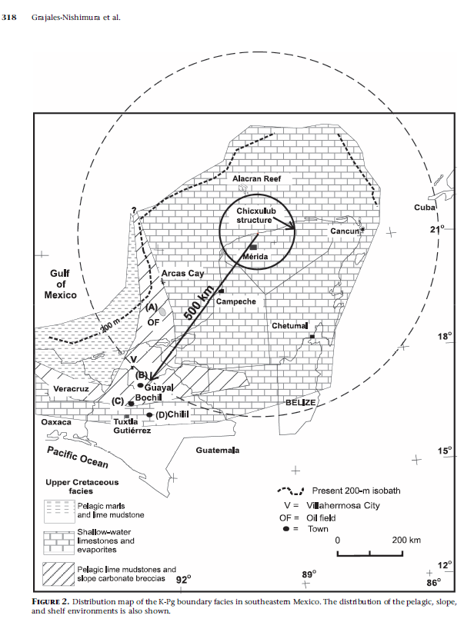
KT sections in Chiapas area 500 km SW of Chicxulub center. Expect thickness ~15m or less. Figure 2. from Grajales-Nishimura et. al. 2009.

Slide 11
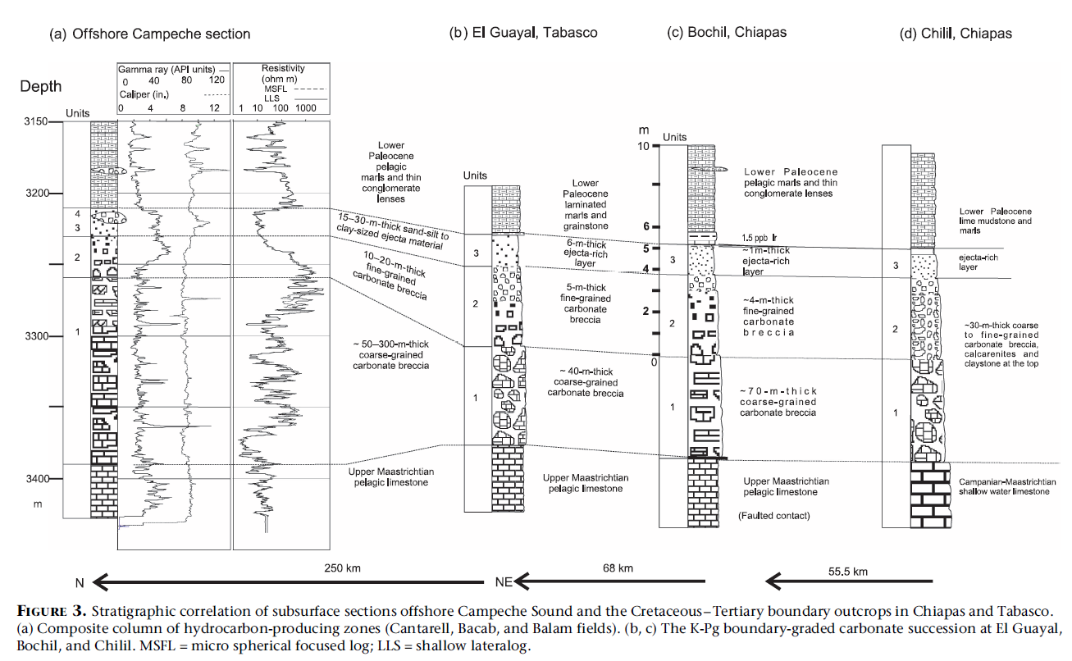
Actual thickness of Chiapas KT sections.
Grajales-Nishimura et. al. Figure 3.
Thickness 51 m 75 m 30 m
Distance ~500 km ~600 km ~600 km

Slide 12
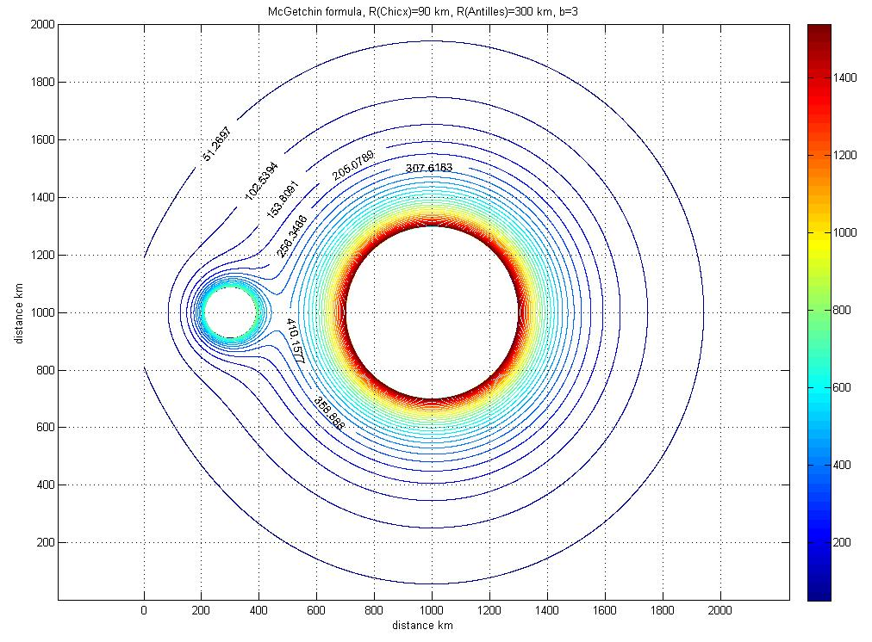
Thickness of Chiapas sections is better explained by the doublet hypothesis.
Here the thickness is contoured for a McGetchin exponent of -3.

Slide 13
Possible Yucatan ejecta thickness complications:
Are PEMEX wells biased towards channel deposits where transport has occurred? According to PEMEX consultant friend, petroleum reservoirs on the Yucatan peninsula are in upper Cretaceous rocks.
Ejecta rays? Asymmetry in ejecta blanket thickness due to low angle impact?
Reworking due to Yucatan platform being submerged, hence affected by impact tsunamis? The Yucatan peninsula was submerged in Maestrichtian time by several tens of meters of seawater.
Compositional gradients in the ejecta? Ultramafic mantle ejecta may weather or dissolve in less than a million years. Silicic crustal ejecta will stay around for a long time. What is the volume change associated with olivine weathering to smectite?
Erosion? Original thickness (now 16 m) of Albion formation in Albion Island, Belize is unknown due to erosion. UNAM 6 and 7 holes give minimum KT section thicknesses according to Jaime Urrutia-Fucugauchi.
Does KT breccia have seismic origin rather than impact ejecta origin?
Sensitivity to assumed transient crater radius? No longer a problem since McGetchin clearly meant to use final crater radius in his formula. Melosh needs to make a correction in his book.
Lack of consensus on first term and exponent used in the power law? Pike’s modification of McGetchin’s formula implies greater thickness at the rim.

