Slide 1
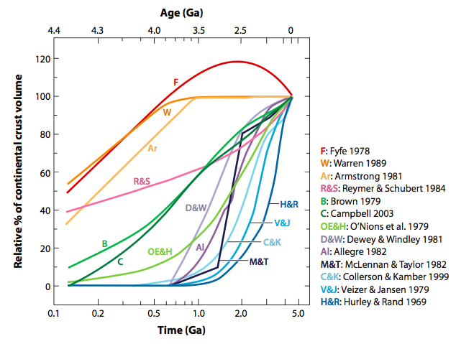
Radiogenic Isotopes and Crust-Mantle Differentiation
Estimates of Continental Volume vs Time
From Harrison, AREPS 37, 2009
Notes:
Estimates of continental volume versus time include almost every possibility. This embarrassing situation arises in part because of the difficulty in determining the formation ages of crustal sections, particularly old crustal sections with complicated metamorphic and reworking histories, but the main uncertainty is the rate of crustal recycling with time as the return of crust into the mantle followed by its subsequent stirring back into the mantle via mantle convection effectively erases the evidence of the recycled crust’s existence.

Slide 2
Why is Estimating Continental Volume
Through Time so Difficult?
Accuracy/precision of geochronology
Unraveling events in ancient lithosphere
Bias created by dependence on zircon
Interpretation of new vs. reworked crust
Relation of crust to mantle lithosphere
Rate of continental lithosphere recycling

Slide 3
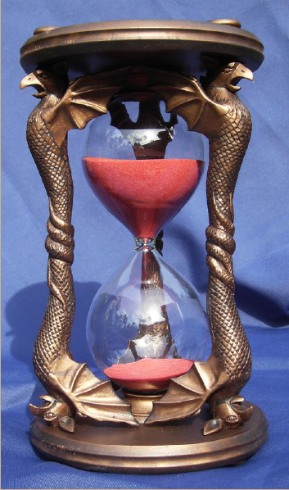
How Does Radioactive Dating Work?
Parent isotopes:
40Potassium (K), 87Rubidium (Rb), 146Samarium, 147Samarium (Sm), 176Lutetium (Lu), 187Rhenium (Re), 230Thorium (Th), 235Uranium, 238Uranium (U)
Decay Rate:
Half-lives of millions to hundreds of billion years
1 ppm U = 45 decays per hour
After 1 billion years = 700 nanograms of 206Lead (Pb)
Daughter Isotopes:
40Argon (Ar), 87Strontium (Sr), 142Neodymium
143Neodymium (Nd), 176Hafnium (Hf), 187Osmium (Os), 208Lead, 207 Lead, 206Lead
Notes:
Different systems provide ability to track different chemical processes with different sensitivities to chemical and/or thermal resetting.

Slide 4
Different Systems – Different Strengths/Weaknesses.
Range of chemical behaviors allow dating of a wide range of Earth differentiation processes.
Long-lived radioactive isotopes
Actively-used short-lived radioactive isotopes
Parent Isotope | Atom % | Half-life (Ma)
235U | 0.72 | 704
40K | 0.012 | 1270
238U | 99.27 | 4469
232Th | 100 | 14010
176Lu | 2.59 | 35700
187Re | 62.6 | 41600
87Rb | 0.278 | 48800
147Sm | 15.0 | 106000
Parent Isotope | Atom % | Half-life (Ma)
26Al | 0.005 | 0.73
60Fe | 3.7 x 10⁻⁷ | 1.5
53Mn | 0.00063 | 3.7
107Pd | 0.0015 | 6.5
182Hf | 0.0037 | 9
129I | 0.011 | 15.7
244Pu | ²⁴⁴Pu/²³⁸U = 0.0068 | 80
146Sm | 0.026 | 68
Condensation – Volatile Loss: Al-Mg, Mn-Cr, Pd-Ag, I-Xe, K-Ar, U,Th-Pb, Rb-Sr
Metal – Silicate Separation: Fe-Ni, Pd-Ag, Hf-W, U,Th-Pb, Re-Os
Silicate Differentiation: Al-Mg, Fe-Ni, Mn-Cr, Hf-W, Sm-Nd, U,Th-Pb, K-Ar, Lu-Hf, Rb-Sr
Low-T, Cooling, Uplift, Erosion: U-He, K-Ar, U-Pb, U-Th
Notes:
Short-lived systems more than double the number of chronometers available and have a wide range of chemical properties that allow the investigation of numerous processes important in solar system evolution

Slide 5
Radioactive Geochronology – The Math
P = P₀e^{-λt} P₀ = # atoms of parent present initially, decaying to P atoms present at time t, λ = decay constant, half-life: P/P₀ = 0.5, = ln(2)/λ
D = P₀-P D = # atoms of daughter isotope produced by decay
D = D₀ + P(e^{λt}-1)
The example for lead:
²⁰⁶Pb/²⁰⁴Pb = (²⁰⁶Pb/²⁰⁴Pb)₀ + ²³⁸U/²⁰⁴Pb(e^{λ}238^{t} – 1)

Slide 6
Requirements for an Accurate Age:
Chemical fractionation of parent from daughter element
All samples on isochron initially had the same daughter isotopic composition
Parent not fractionated from daughter after event being dated
Diffusion of daughter element does not erase radiogenic ingrowth
Time = T, Minerals and whole rock evolve to different lead isotopic compositions dependent on uranium to lead ratio
²⁰⁶Pb
²⁰⁴Pb
Slope of “isochron” proportional to age
Time = 0,
Rock Forms, all minerals have the same lead isotopic composition
Mineral 1
Whole Rock
Mineral 2
²³⁸U/²⁰⁴Pb
²⁰⁶Pb/²⁰⁴Pb = (²⁰⁶Pb/²⁰⁴Pb)₀ + ²³⁸U/²⁰⁴Pb(e^{λ}238^{t} – 1)

Slide 7
What Event Will A Radiometric Age Date?
On a Mineral Scale - Cooling Below Diffusional Closure Temperature
  At 1000 °C: D = 1.1 x 10⁻¹⁵ cm²/sec for Sr
  Diffusion distance (x) = square root (D*time(sec)):
In 1 Ma, x = 1.9 mm
Closure Temperature =[22440/(20.9-log(dT/dt)]-273
  For mantle materials rising at 1 to 5 cm/yr (convective velocities) through a geotherm of 1-5°C/km, cooling rate (dT/dt) = 10 - 250°C/Ma, closure temperature = 850-950 °C
Notes:
Diffusion of elements back and forth through the crystal lattice can erase the ingrowth of the radiogenic isotope by “mixing” with surrounding minerals. Diffusion is a temperature activated process that also depends on the crystal lattice through which the element has to diffuse, so different isotope systems, in different minerals will be more or less affected by diffusion. For example, without any ionic charge, noble gases tend to diffuse quickly, leading to low closure temperatures for noble gas systems, particularly U-Th-He.

Slide 8
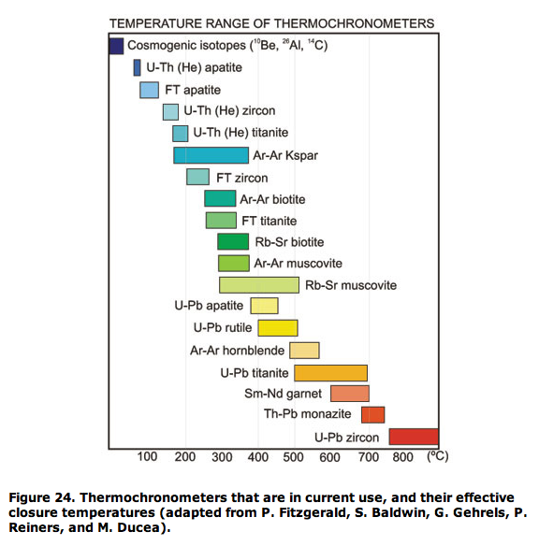
All Radioactive Chronometers are Thermochronometers
Radiometric geochronometers really are thermochronometers measuring the time when the rock temperature dropped below the diffusional blocking temperature of the elements in use. Sensitivities range from detecting forest fires, km-scale uplift events, regional mountain building, to crystallization from magma.
http://pangea.stanford.edu/~dpollard/NSF/content.html
Notes:
Different isotope systems in different minerals “close” to diffusion at different temperatures. In essence, if the mineral is held above, or the temperature is increased above the closure temperature, the radioactive clock either never starts recording time, or it is reset to the time when high temperatures are experienced. The range of closure temperatures allow thermochronology to address a wide range of Earth processes, from cooling times of intrusions, to the temperature history of sedimentary basins, to the uplift history of mountain ranges. The concept of “closure temperature”, however, can complicate attempts to get at the original crystallization age of an igneous rock.

Slide 9
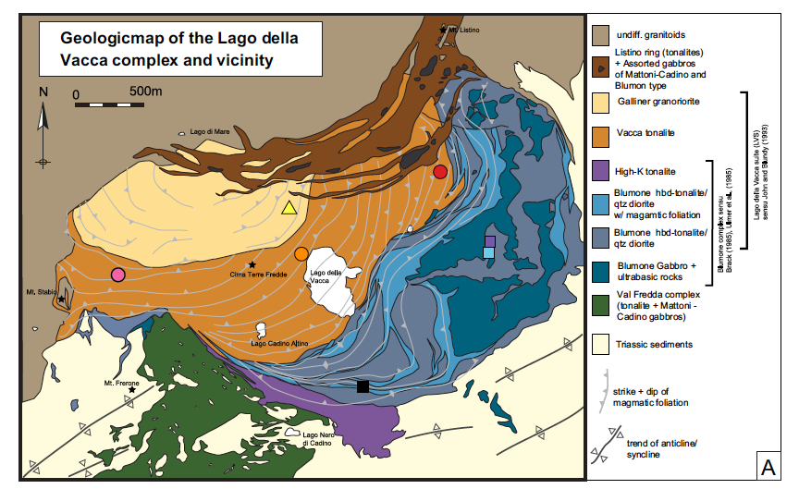
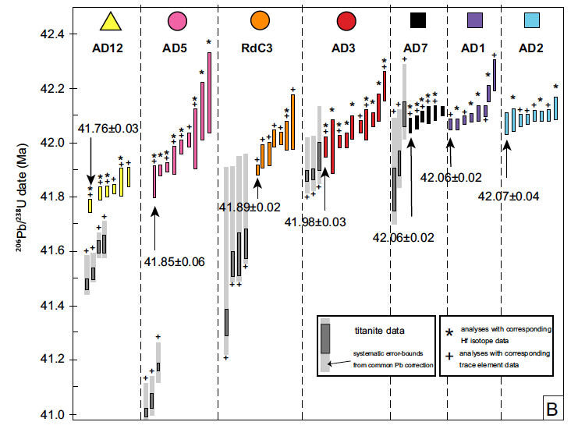
Understanding What Event is Being Dated
Schoene et al., EPSL 355, p162, 2012
Notes:
Ultra-high age precision, however, comes with its own problems, in this case a range of up to 400,000 years in the crystallization of a single, small igneous intrusion in the Italian Alps. The zircons in this example are recording the time span of crystallization of this intrusion. The titanites (grey bars) are recording an even younger age – what is being dated by this age – cooling of the intrusions through the closure temperature of U-Pb in titanite.

Slide 10
Both Accuracy and Precision are Important
Whole-Rock K-Ar
Age Precision +/- few Myr
Problems with:
Limited radiogenic Ar
Ar gain/loss
Ar-Ar
Age Precision +/- tenths Myr
Improvements:
Reduced Ar blank
Ability to detect/eliminate Ar gain/loss

Slide 11
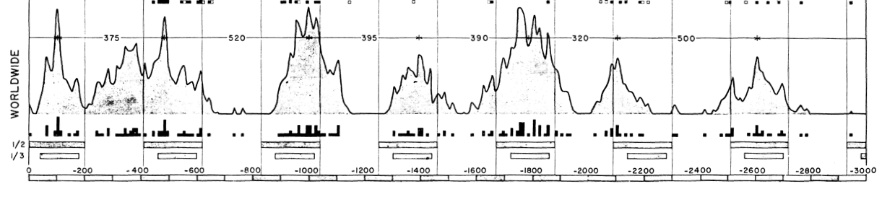
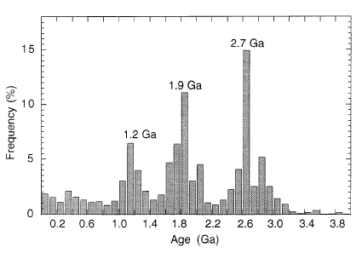
Different Chronometers Give Different Results
Gastil, AJS, 1960
Condie, Tectonophysics, 2000
Notes:
Closure temperatures is one reason that various compilations of ages for crustal rocks give different results. The plot from Gastil, 1960 includes a number of ages from the K-Ar and Rb-Sr systems, both of which are prone to resetting by metamorphism, or giving young ages as a result of slow cooling of igneous intrusions.

Slide 12
Why is Estimating Continental Volume
Through Time so Difficult?
Accuracy/precision of geochronology
Unraveling events in ancient lithosphere
  Reading through metamorphism to initial crust formation
Bias created by dependence on zircon
Interpretation of new vs. reworked crust
Relation of crust to mantle lithosphere
Rate of continental lithosphere recycling

Slide 13
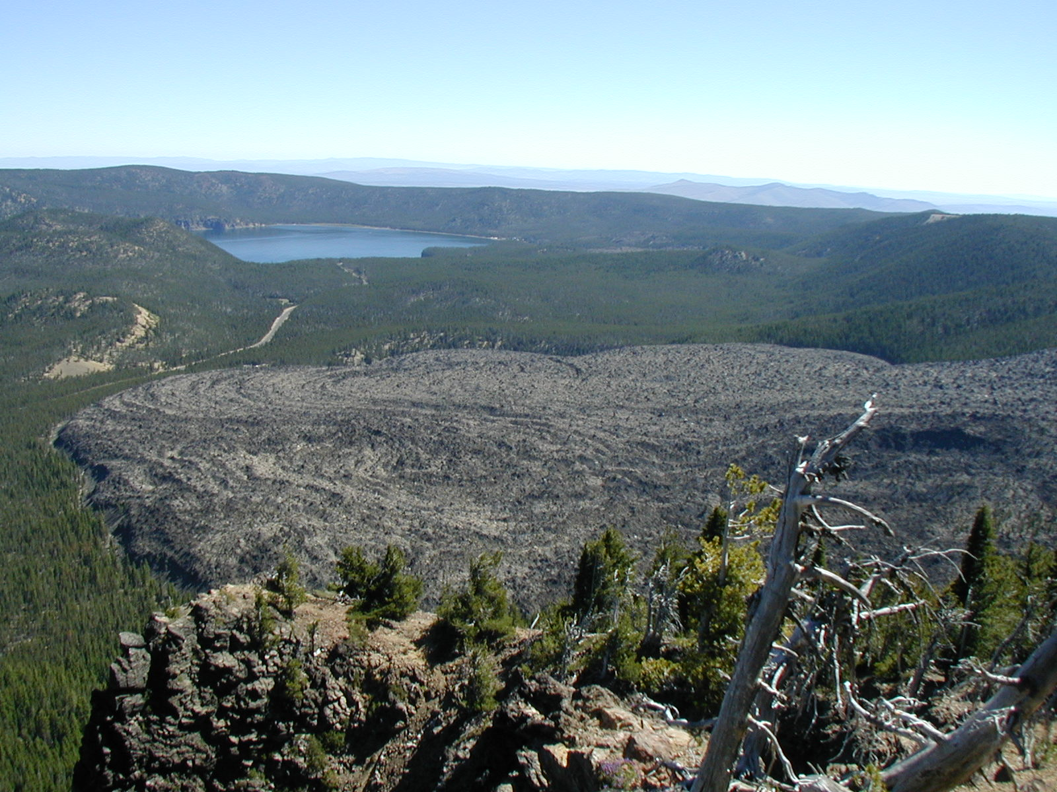
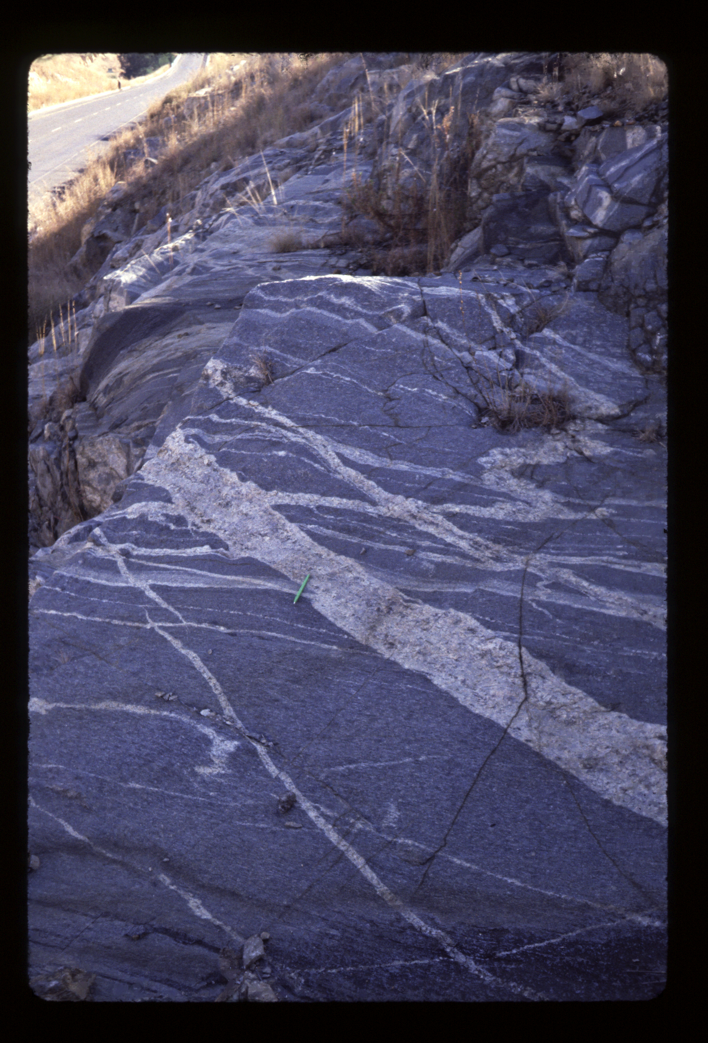
Unraveling the Geologic History of Ancient Crust
Now looks like this: A small roadcut exposure of the “Bimodal Suite” of the 3.54 billion year old Ancient Gneiss Complex, Swaziland that shows intimately intermixed silica-poor (basalt) and silica-rich (rhyolite/obsidian) layers
What once looked like this - a large ~1400 year old obsidian flow over basalt at Newberry Volcano, Oregon
Notes:
Burial and lower to mid-crustal metamorphism can cause unrelated rocks to flow together, often making a single outcrop of different rock types that may be millions to hundreds of millions of years different in age. Which age you get for the old rock on the right depends on which part you sample.

Slide 14
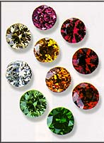
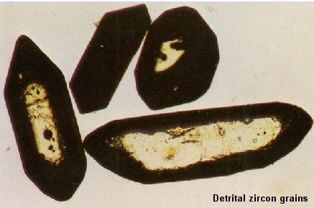
Use a Mineral with Slow Diffusion
Zircon - a mineral that doesn’t reset easily, is resistant to weathering, and has a crystal structure that slows diffusive loss
Zircon - ZrSiO₄
  Contains hundreds of ppm uranium, little lead
  Uranium-Lead is a particularly good chronometer since it contains two isotopes of uranium (235 and 238) with different half-lives that independently decay to two isotopes of lead (207 and 206).
  Not present in all rocks, but abundant in some
  Hard mineral - survives weathering and sediment transport, crystal structure doesn’t easily allow loss of lead or uranium
Notes:
Another, much more common, approach to getting accurate crystallization ages for old rocks – use a mineral that contains a good chronometer, and that has a closure temperature not a lot lower than its crystallization temperature. U-Pb in zircon fulfills these criteria.

Slide 15
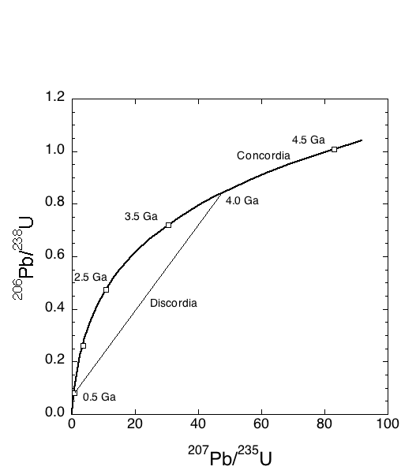
If There is No Pb Present Initially
²³⁸U_{t} = ²³⁸U₀ e^{-λt}
²⁰⁶Pb_{t} = ²³⁸U₀ – ²³⁸U_{t}
(²⁰⁶Pb/²³⁸U)_{t} = e^{λ238t} + 1
(²⁰⁷Pb/²³⁵U)_{t} = e^{λ235t} + 1
Notes:
Because zircon so strongly concentrates U over Pb, the Pb measured in the zircon is highly dominated by radiogenically produced Pb, so corrections for Pb initially present can be small. In addition, since two isotopes of U (235 and 238) decay to two different isotopes of Pb (207 and 206) one can simultaneously compare 238U-206Pb and 235U-207Pb ages using the concordia diagram shown above. Pure radiogenic Pb will lie along the dark curve at a position determined by its age. If an old (say 4 Ga) zircon core, is overgrown with a young (say 0.5 Ga) zircon rim, then mixtures of the core and rim will define a “discordia” line that connects the rim and core ages. Diffusion of Pb or U will create similar discordia, with a more complicated interpretation of the lower intercept age.

Slide 16
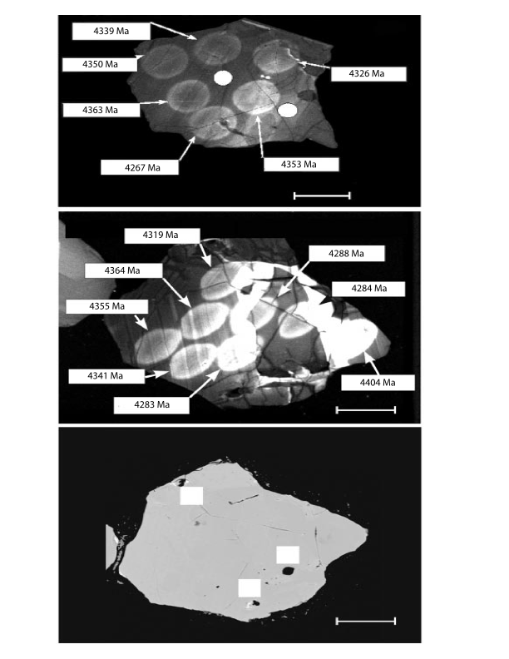
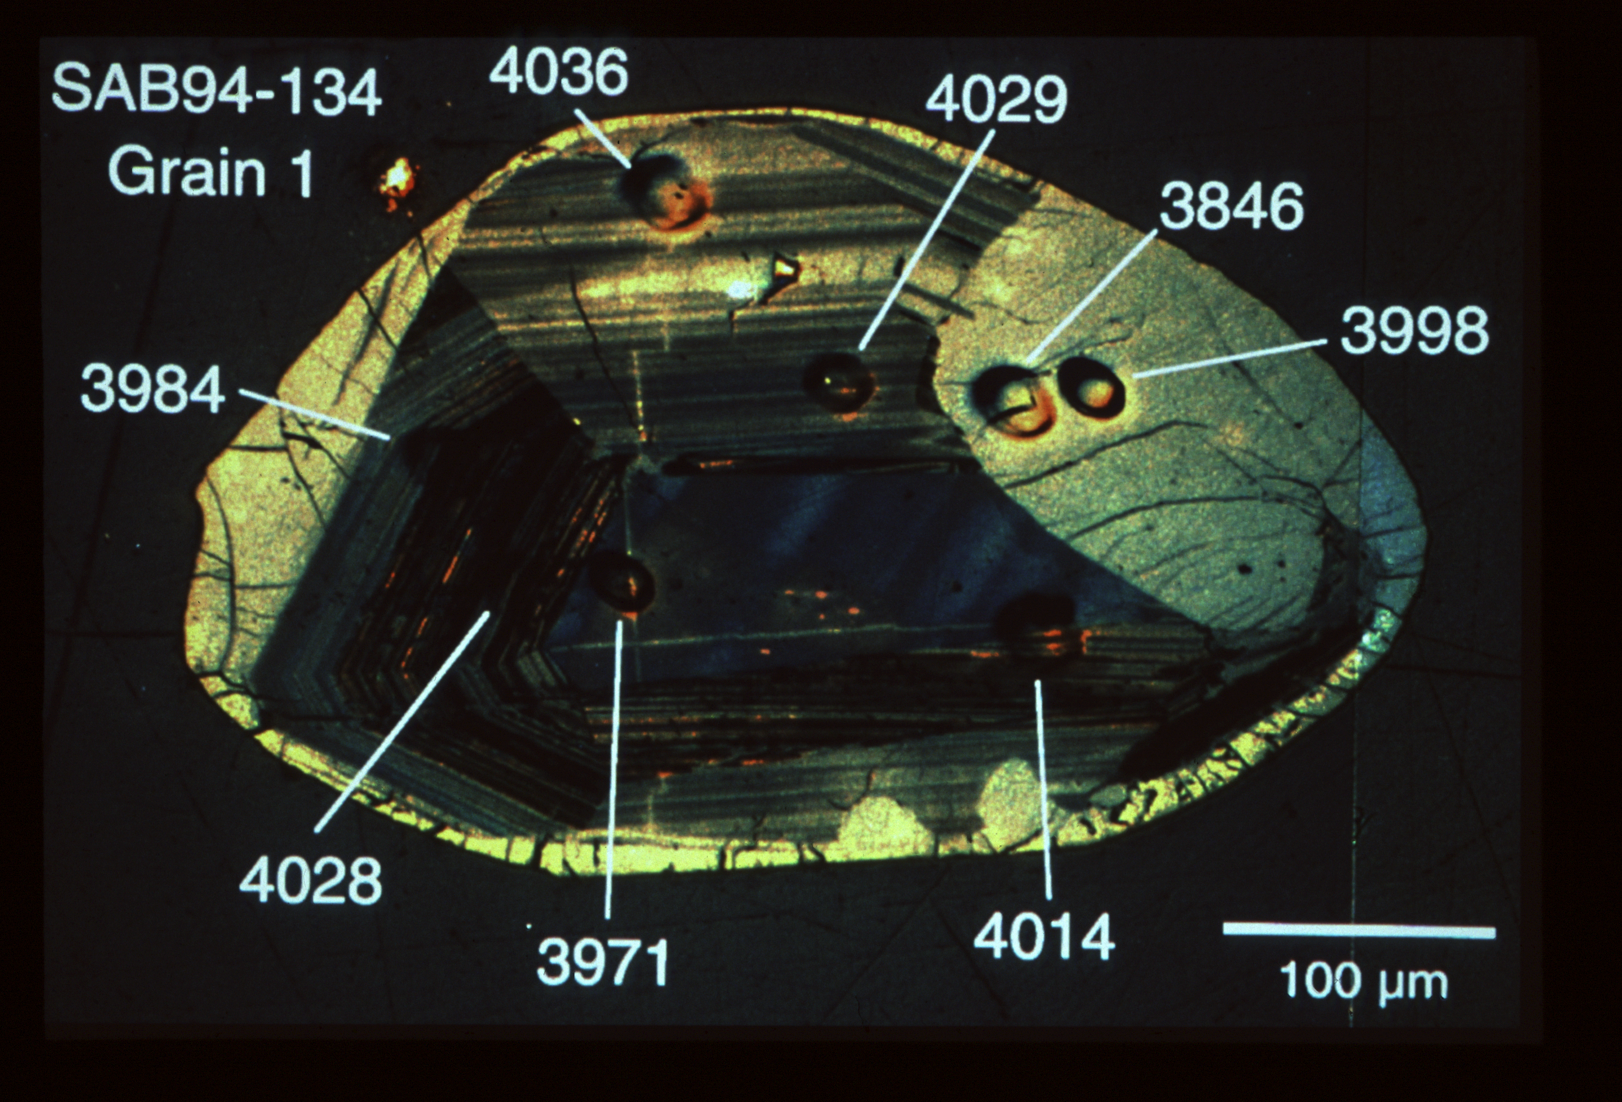
The Beginning of Terrestrial Crust Formation
Jack Hills, Australia
Zircon = 4363 +/- 8 Ma
(Wilde et al., 2002)
Acasta Gneiss
Slave Craton, Canada
Zircon = 4036 Ma
(Bowring et al., 1990)
Notes:
Another advantage to zircon is that the radiogenic Pb so dominates over common Pb that one can determine ages even for small (>10 micron) spots on zircons using the ion probe or laser-ablation ICP-MS. Such high spatial resolution allows extracting age histories from complicated zircons. Most zircons in ancient rocks are complicated by the metamorphic history of the host rock, so being able to obtain ages for both old cores and younger overgrowths allow reconstruction of the zircon growth history, even in the oldest of terrestrial zircons.

Slide 17
Why is Estimating Continental Volume
Through Time so Difficult?
Accuracy/precision of geochronology
Unraveling events in ancient lithosphere
Bias created by dependence on zircon
Interpretation of new vs. reworked crust
Relation of crust to mantle lithosphere
Rate of continental lithosphere recycling

Slide 18
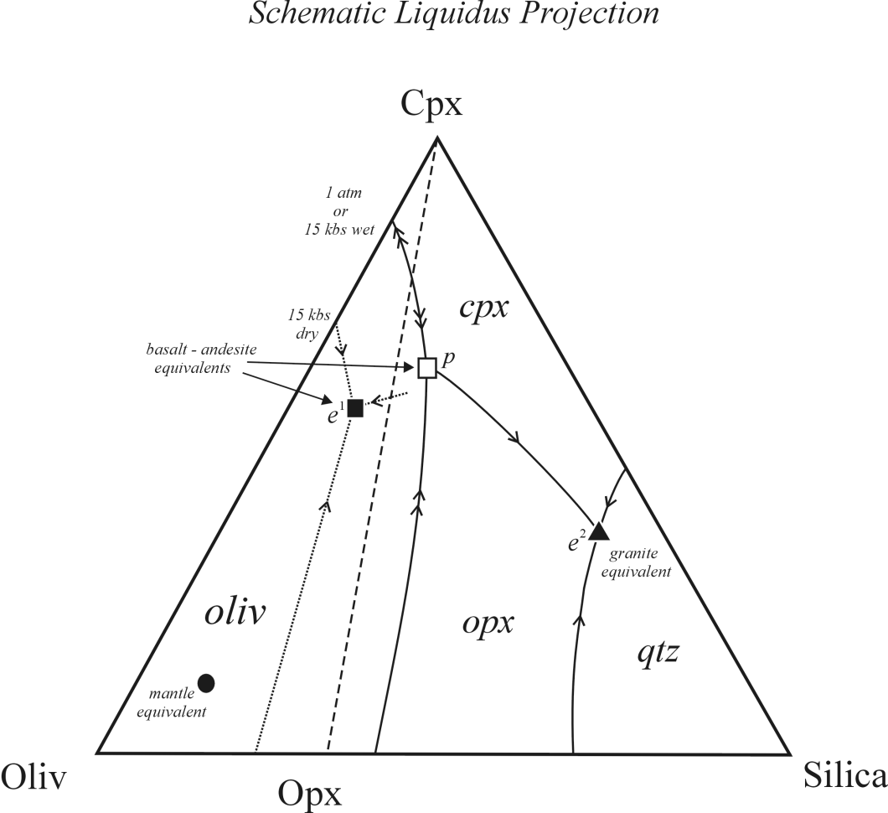
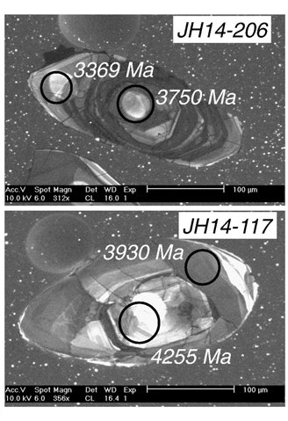
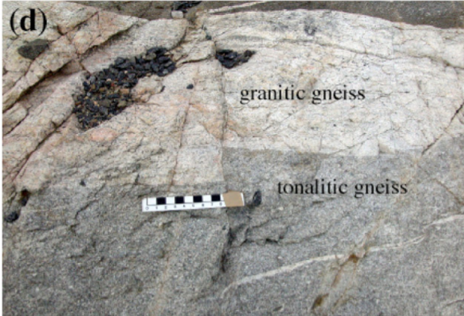
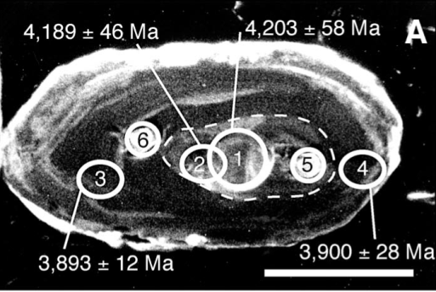
Kemp et al., 2010
Jack Hills
detrital zircons
1st melt = basaltic
mantle
composition
Granitic
Cavosie et al., 2007
Acasta
gniesses
Iizuka et al., 2006,
2007
Notes:
Zircons occur most commonly in felsic rock compositions, but felsic (e.g. granitoid) compositions are not produced by melting of the mantle – basalt is. The reliance on zircon for crustal growth histories potentially ignores the potential that the first step in continent formation involves mafic magmas, not granites. In this case, zircons could primarily record crustal reworking, not initial crust formation.

Slide 19
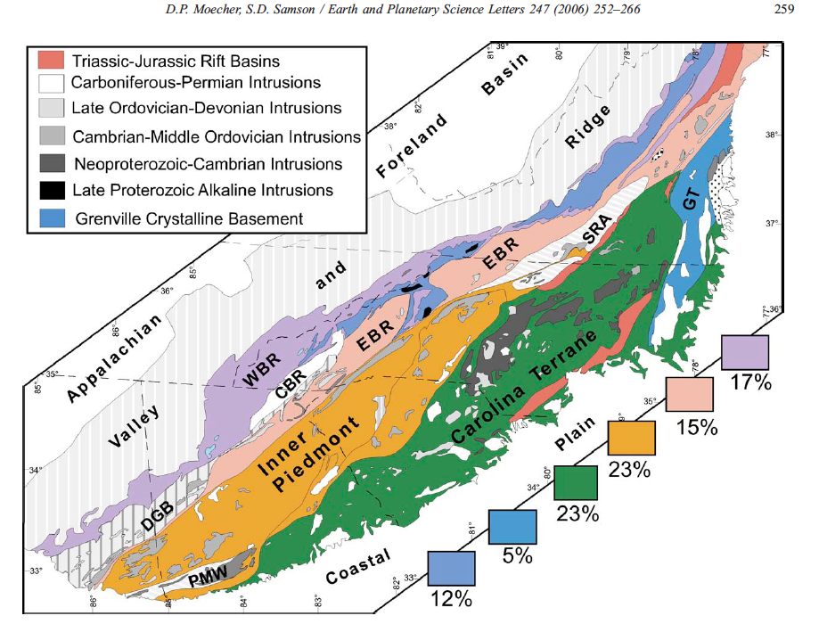
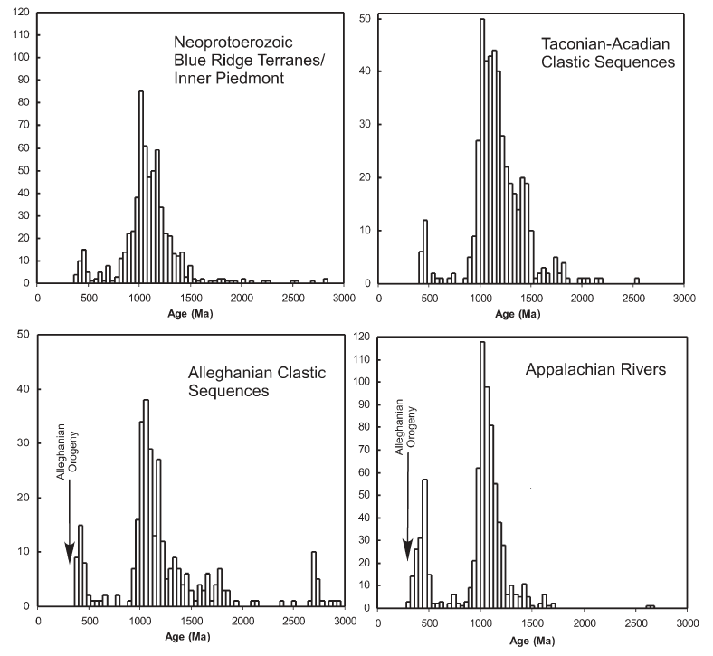
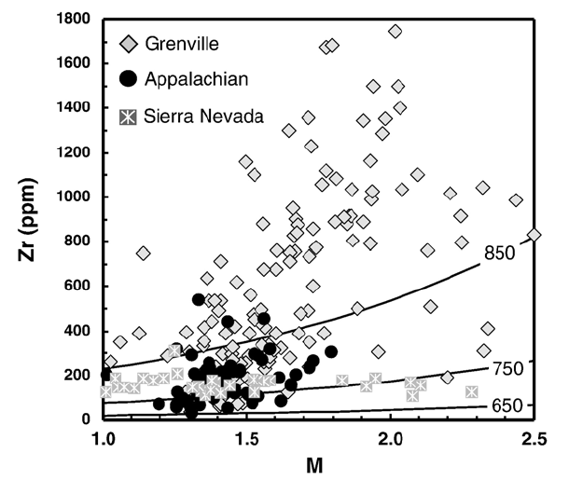
Zircons are an imperfect sample of continental crust
Moecher and Samson, EPSL 247, 2006
Notes:
Zircons also vary in abundance quite dramatically in different rock types. In this example from the Appalachian, Grenville (1.1 Ga) age rocks constitute only 12% of the exposed basement, but zircons of Grenville age highly dominate the detrital zircon population in the restricted sedimentary basins in the area. The reason is that Grenville rocks have unusually high Zr concentrations, and hence lots of zircon, so they contribute a disproportionate amount of zircon to the sedimentary basins compared to other rock types.

Slide 20
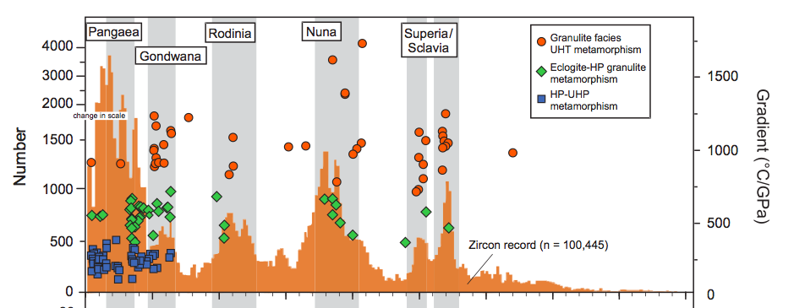
Do Peaks in Zircon Ages Reflect Crustal Growth Peaks, or Zircon Production/Preservation Peaks?
Cawood et al., GSA Bull. 2013
Notes:
Peaks in the zircon age histogram coincide with times of high-pressure metamorphism, and supercontinent assembly. Do the age peaks reflect peaks in crust formation rate, the fact that the rock types produced in continental collisions tend to be zircon-rich, or the ability of continent assembly to preserve zircons through their capture into sedimentary basins?

Slide 21
Why is Estimating Continental Volume
Through Time so Difficult?
Accuracy/precision of geochronology
Unraveling events in ancient lithosphere
Bias created by dependence on zircon
Interpretation of new vs. reworked crust
Relation of crust to mantle lithosphere
Rate of continental lithosphere recycling

Slide 22
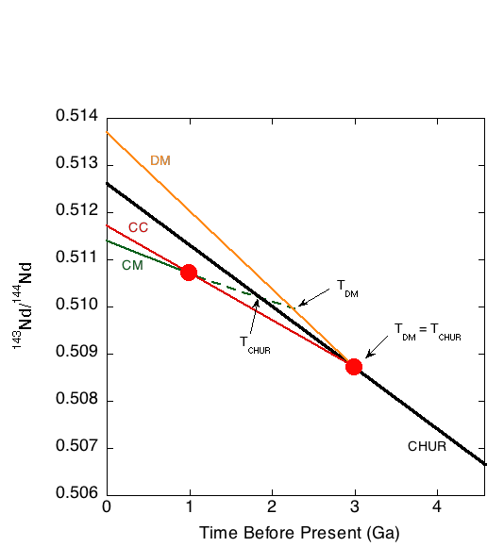
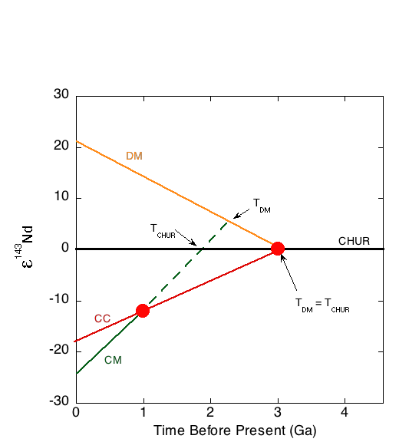
Model Ages: Distinguishing New from Reworked Crust
T_{CHUR} = 1/λ x ln((¹⁴³Nd/¹⁴⁴Nd)_{M} –(¹⁴³Nd/¹⁴⁴Nd)_{CHUR})/((¹⁴⁷Sm/¹⁴⁴Nd)_{M} – (¹⁴⁷Sm/¹⁴⁴Nd)_{CHUR})
T_{DM} = 1/λ x ln((¹⁴³Nd/¹⁴⁴Nd)_{M} –(¹⁴³Nd/¹⁴⁴Nd)_{DM})/((¹⁴⁷Sm/¹⁴⁴Nd)_{M} – (¹⁴⁷Sm/¹⁴⁴Nd)_{DM})
ε_{Nd} = ((¹⁴³Nd/¹⁴⁴Nd)_{Sample}/(¹⁴³Nd/¹⁴⁴Nd)_{CHUR} – 1) * 10,000
Notes:
If one assumes that “primary” crust is generated by melting of the mantle, then its initial isotopic composition should follow the temporal evolution of that isotope system in the mantle (black line). Melting events will create low Sm/Nd crustal melts (red) leaving high Sm/Nd residual materials in the mantle (yellow). These will evolve along different Nd isotope trajectories because of their different Sm/Nd ratios from a mantle with chondritic Sm/Nd ratio (CHUR). If a portion of crust is remelted – in this example at 1 Ga – its initial Nd isotopic composition will be less radiogenic than expected for a mantle-derived melt. Using its measured Sm/Nd and 143Nd/144Nd ratios, one can calculate its “model age” – the time when the rock began to evolve with a different Nd isotope trajectory compared to the mantle model. In the case of a single-stage melting event (CC), the model age will equal the time of the melting event. For multiple-stage crustal reworking (CM) the model age will be older than the igneous event, but need not have any strict temporal significance. The model age also is obviously dependent on what isotope evolution one chooses for the “model” mantle.

Slide 23
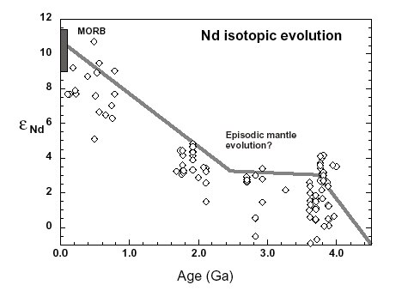
Model Mantle Evolution in Nd and Hf is not a Given – it Reflects the Integrated History of Crust-Mantle Differentiation on Earth
Increasing
Mantle
Depletion
Mantle-derived rocks
Rapid Early Depletion
SteadyState?
Chondritic
Primitive Mantle
A Period of Rapid Crust Recycling?
Bennett, TOG 2003
Notes:
A straight line on a plot of eNd (or eHf) versus time implies a constant Sm/Nd (or Lu/Hf) ratio. Rocks believed to be direct melts of the mantle do not have isotopic compositions that follow a straight line on these evolution diagrams. There is considerable discussion about whether this reflects: 1) changing rates of crust formation and recycling, 2) inaccurate initial eNd or eHf due to metamorphic changes to Sm/Nd or Lu/Hf ratios after rock formation, or 3) incorrect identification of purely “mantle-derived” crustal rocks.

Slide 24
A Change in Crust Formation Processes at ~3 Ga?
Mantle-derived rocks show a rapid increase in ε_{Nd} between 4.4 and 3.5 Ga. Could this reflect rapid and voluminous crust production right at Earth formation with the onset of major crustal recycling not starting until ~3 Ga?
¹⁴²Nd/¹⁴⁴Nd in Archean Mantle-Derived Rocks
Initial ε¹⁴³Nd in Mantle-Derived Rocks
Figure after Shirey et al., 2007 with data from numerous literature sources
From Carlson & Boyet, Phil. Trans. 2008
Notes:
The presence of a high Sm/Nd mantle source as required by the superchondritic 142Nd/144Nd of Archean rocks from Greenland is supported by the variability seen in 143Nd, which is produced by the decay of 106 billion year half life 147Sm. The 147Sm-143Nd system was then further affected by the extraction of low Sm/Nd continental crust over Earth history causing the mantle Sm/Nd, and hence 143Nd/144Nd, to increase. This long term continental crust formation did not affect 142Nd because 146Sm was extinct by about 4 Ga.

Slide 25
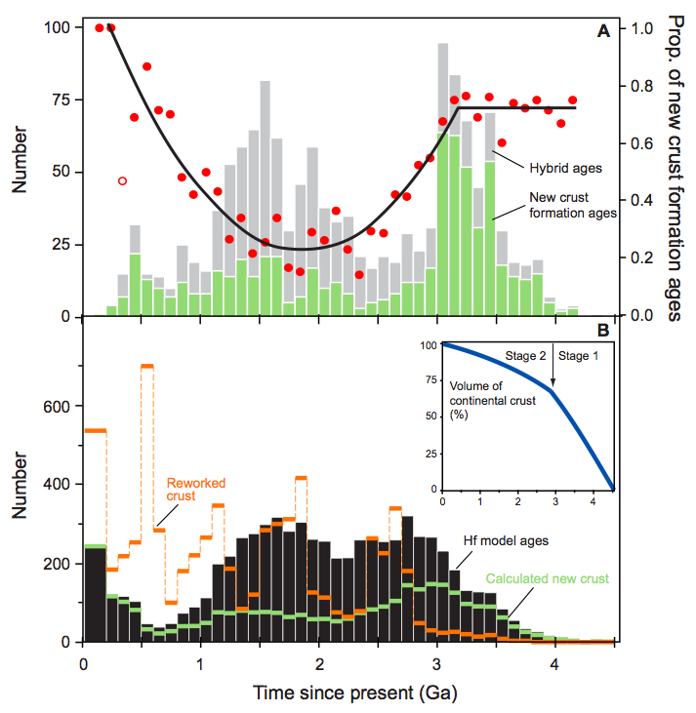
Strong change in ratio of new to reworked/ crust at ~3 Ga. Mirrored by increased crustal recyling into mantle?
Dhuime et al., Science 2012
Crustal Recycling
Notes:
Proportion of reworked crust varies widely in time. Many possible interpretations. 1) Abundance of new crustal additions prior to 3 Ga reflects the limited abundance of >3 Ga crust, so there was no crust to rework? 2) Increase in new crust in Phanerozoic a preservation phenomena – primitive crust is easily recycled? 3) Abundance of reworked crust in Proterozoic indicates a shut-down in convergent margin volcanism in favor of magmatism associated with continental collisions?

Slide 26
Why is Estimating Continental Volume
Through Time so Difficult?
Accuracy/precision of geochronology
Unraveling events in ancient lithosphere
Bias created by dependence on zircon
Interpretation of new vs. reworked crust
Relation of crust to mantle lithosphere
Rate of continental lithosphere recycling

Slide 27
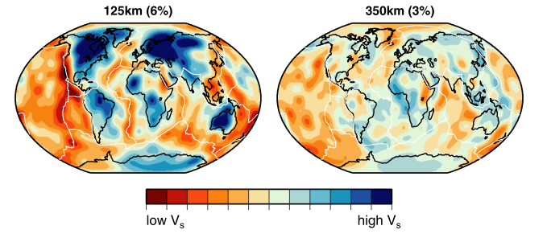
Continents are Not Just the Crust
s20rts seismic velocity model from Ritsema et al. (2004)
Notes:
The continent-ocean distinction continues to depths of 100-200 km as indicated by high shear wave velocities of continental lithospheric mantle.

Slide 28
Understanding Continental Lithosphere History:
Age Dating the Continental Lithospheric Mantle

Slide 29
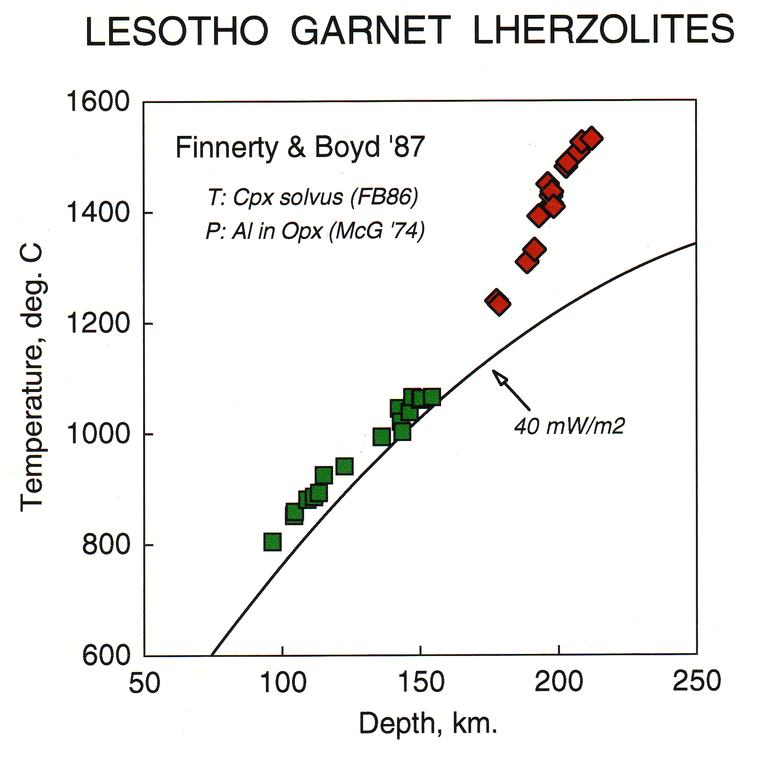
High Temperatures, and Lack of Zircon, in Mantle Lithosphere Confounds Age Dating
Notes:
Intermineral chemical exchange, through diffusion, also is the basis for mineral geothermobarometers that allow one to deduce the last pressure and temperature of equilibration of metamorphic rocks, in this case, peridotite xenoliths carried to the surface by explosive kimberlite volcanism in Lesotho, southern Africa.

Slide 30
Mineral Isochrons at Mantle Temperatures
Notes:
Sm-Nd mineral isochrons for mantle peridotite tend to give ages approximating the age of eruption of the host lava. This doesn’t mean these pieces of mantle formed at the same time as the volcanism, only that their storage temperatures in the mantle were too high for the Sm-Nd radioactive clock to begin to record time. Once the xenoliths cooled by being brought to the surface, then the Sm-Nd clock started.

Slide 31
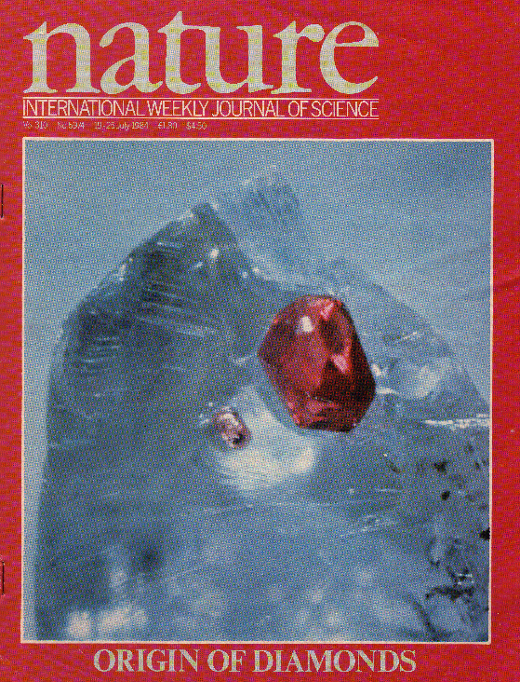
The First Evidence for Ancient Lithospheric Mantle
Richardson et al., Nature, 1984
Notes:
First demonstration of the antiquity of mantle lithosphere – Sm-Nd model ages for garnets included in diamonds. Again, the diamond served as a diffusion barrier that kept the garnet from exchanging its Nd with surrounding mantle, preserving the record of its encapsulation by the diamond.

Slide 32
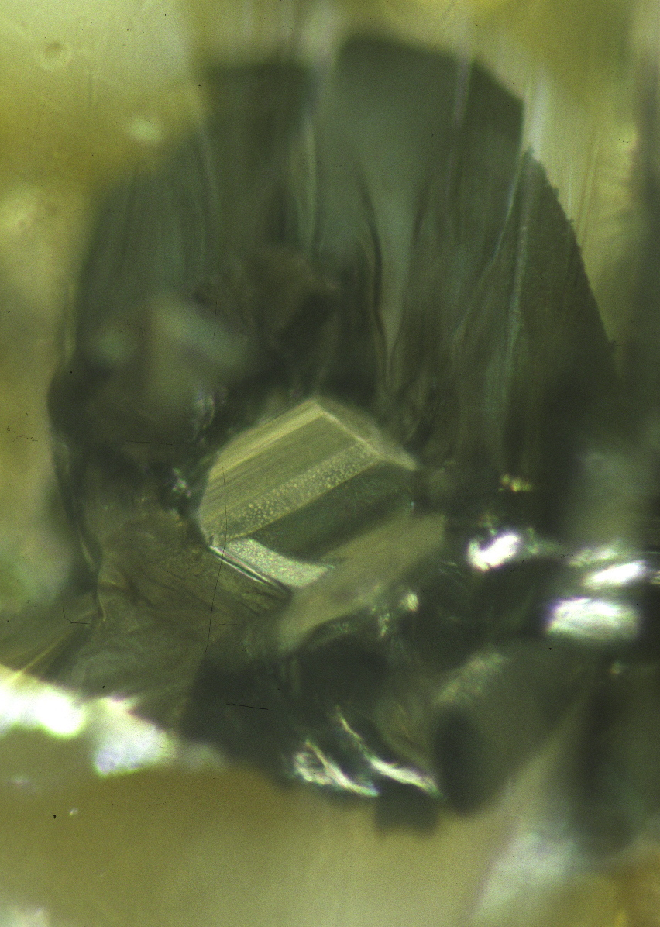
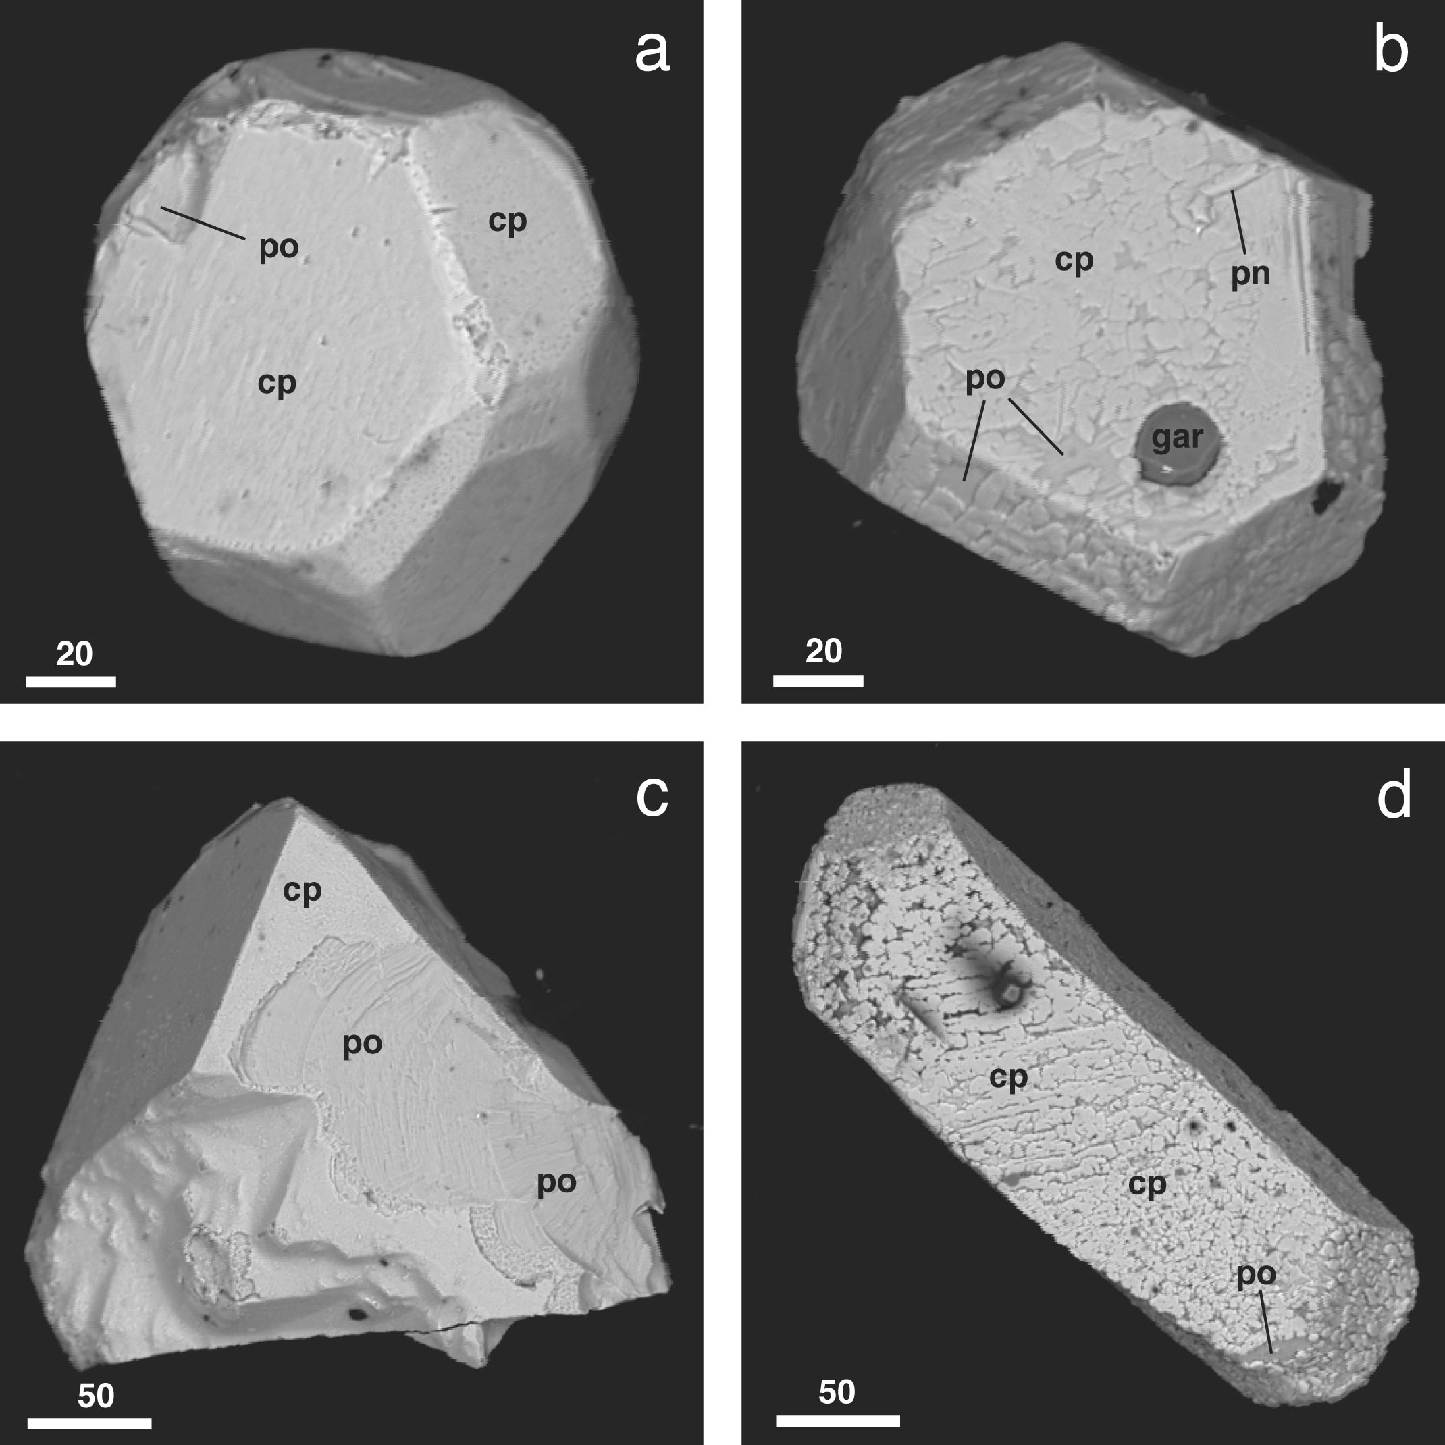
Diamond – A Good (but unfortunately somewhat rare) Diffusion Barrier
20 μm
100 micron sulfide grain seen through a diamond
SEM images of sulfides extracted from inside diamonds
Photographs courtesy of Steve Shirey
Notes:
To get at crystallization ages for high-T rocks – use conventional minerals, in this case, sulfide, encased in a diffusion barrier, in this case diamond.

Slide 33
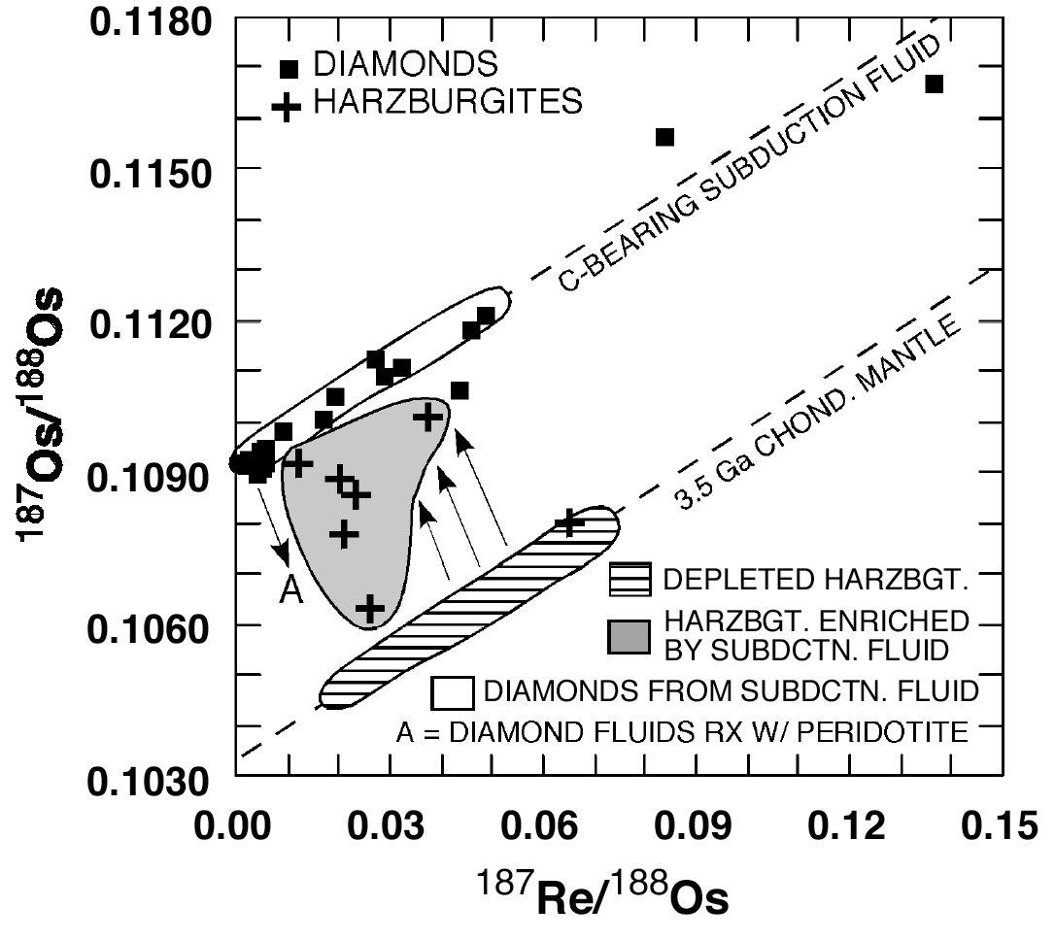
Diamond as a Diffusion Barrier:
A Rhenium-Osmium Isochron for Sulfides Extracted from Diamonds
Squares are measurements of sulfides included in diamonds from the Panda kimberlite pipe, Slave Craton, Canada.
Age = 3.56 ± 0.15 billion years
(Westerlund et al., CMP 2006)
Notes:
The diamond surrounding the sulfide inclusion keeps the inclusion from exchanging Re and Os with surrounding mantle. In essence, even though sulfide has a low Re-Os closure temperature, the diamond surrounding the sulfides imposes its very high closure temperature on the included sulfide. This is an example from the Slave Craton of northern Canada, where diamond inclusions define a 3.56 Ga Re-Os isochron age, with an initial 187Os/188Os substantially higher than expected for the mantle a that time (the lined balloon). The crosses represent peridotite xenoliths that appear to be mixtures between 3.5 Ga mantle, and the fluids with high 187Os/188Os from which the diamond inclusion sulfides crystallized. High 187Os/188Os is a characteristic of crustal rocks, perhaps implying that this diamond isochron reflects diamond formation in the relatively deep (> 150 km) upper mantle due to subduction and dewatering of crustal materials.

Slide 34
The Rhenium-Osmium Isotope System
¹⁸⁷Re decays to ¹⁸⁷Os, half-life = 41.6 Gyr
During Melting in the Mantle:
  Re, incompatible, goes into the melt
  Os, compatible, stays in the residue
    Like no other radiometric system!
Therefore:
Melts will have high Re/Os
Mantle Residues will have very low Re/Os
  Old mantle residues will evolve low ¹⁸⁷Os/¹⁸⁸Os
Mantle Residues will have high Os Content
  Insensitive to metasomatism
Notes:
Re-Os uniquely suited to dating mantle lithosphere formation because Re is removed from the mantle by partial melting, while Os is enriched in residual mantle. This makes Os in the mantle relatively resistant to the overprinting caused by metasomatism that affects most other radioactive dating systems.

Slide 35
Notes:
At the degrees of partial melt removal typical of cratonic peridotites (>30%), Re will have been quantitatively extracted, stopping the ingrowth of 187Os.

Slide 36
Residues of Continent Formation Persist for as Long as the Continent
Re-Os Model Ages for Continental Mantle Xenoliths
(Carlson et al., ROG, 2005)
Notes:
Archean crust, in general, is underlain by Archean lithospheric mantle. Younger sections of continent, are underlain by younger sections of lithospheric mantle. A couple of cratons (China, Wyoming) show evidence of lithosphere removal, but these are the exception.

Slide 37
191, 2001)
Notes:
Close correspondence between crust formation, melt depletion in the mantle, and formation of sulfide inclusions in diamond, showing temporal coincidence of crust formation and mantle lithosphere differentiation to at least the depth of diamond formation.

Slide 38
In Many Cases, There is a Good Correlation Between Age of the Crust and Lithospheric Mantle
Murowa
Carlson et al., ROG 2005
Notes:
Average age of peridotite xenoliths from across southern Africa mirror the age range of the crust. The Archean Kaapvaal craton is outlined in red – all but one xenolith locality within the craton gives Archean average Re-Os model ages. The one exception is Premier, a kimberlite that erupted through the 2.0 Ga Bushveld intrusion. Off craton, most xenolith model ages are mid-Proterozoic, as are crustal ages.

Slide 39
Why is Estimating the
Continental Growth Rate so Difficult?
Accuracy/Precision of geochronology
Unraveling events in ancient lithosphere
Interpretation of new or reworked crust
Bias created by dependence on zircon
Relation of crust to mantle lithosphere
Rate of continental lithosphere recycling

Slide 40
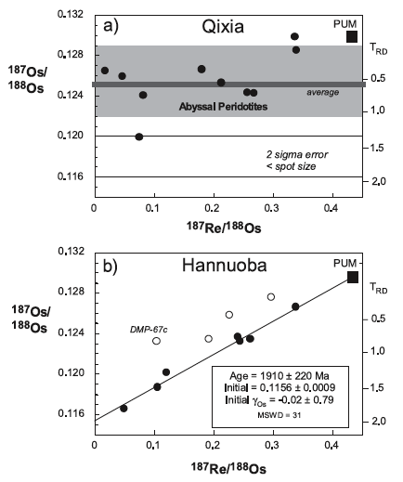
Evidence for the Loss of Lithosphere
North China Craton
Gao et al., EPSL, 2002

Slide 41
Subduction of Continental Crust is Extremely Effective at Modifying Mantle Composition
Notes:
Because of its high concentrations of incompatible trace elements, recycling of continental crust into the mantle will strongly modify the incompatible element concentration of the mantle. Most mantle-derived magmatic rocks, however, show very limited variation in ratios like, e.g. Ba/Nb, implying either that the rate of crust recycling is low, or that recycled crust is rather rapidly mixed into a large volume of mantle, diluting its impact.

Slide 42
Remaining Challenges in Refining
Continental Growth Curves
Significant progress is being made on getting the chronology right. Problems remaining include:
  Understanding and accounting for biases created by reliance on zircon
    insensitivity to mafic crust
    variable zircon abundance depending on rock type and rock petrogenetic path
    preferential preservation
  Significant problems remain in the interpretation of ages from the oldest crust – seeing through multiple metamorphic events
Crustal recycling rates are the big unknown
  Lithosphere delamination popular, but abundance of Archean mantle beneath Archean crust argues against this as a routine mechanism
  What fraction of subducted sediments get underplated to the crust, or returned to the crust in convergent margin magmatism?

Slide 43
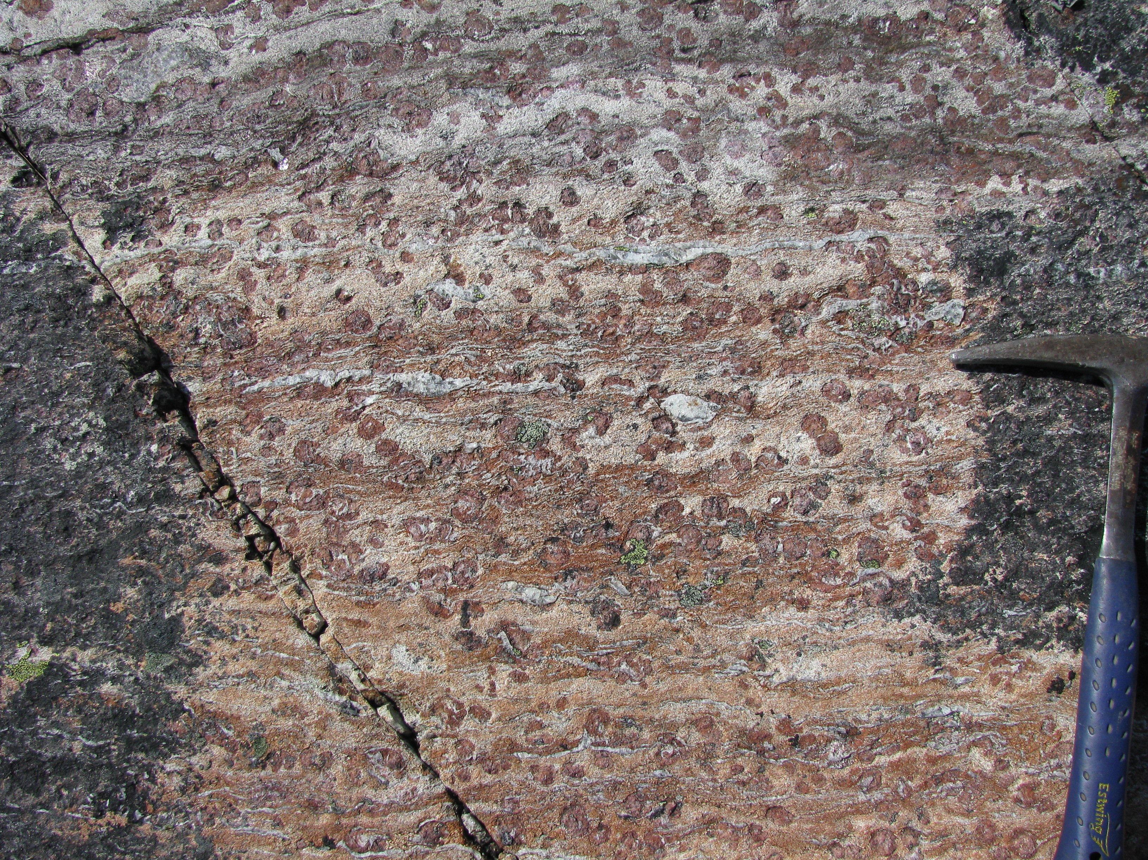
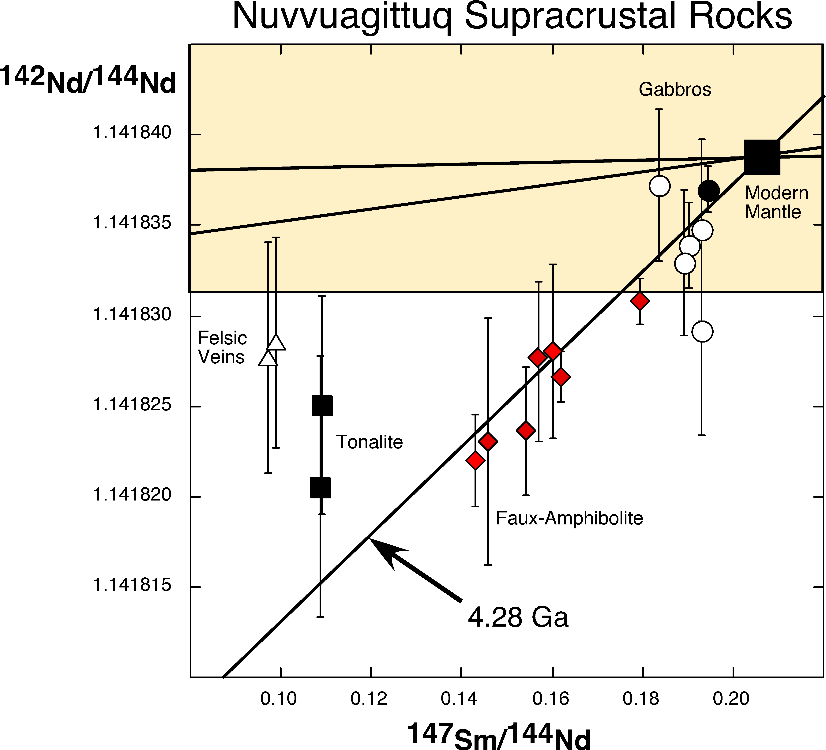
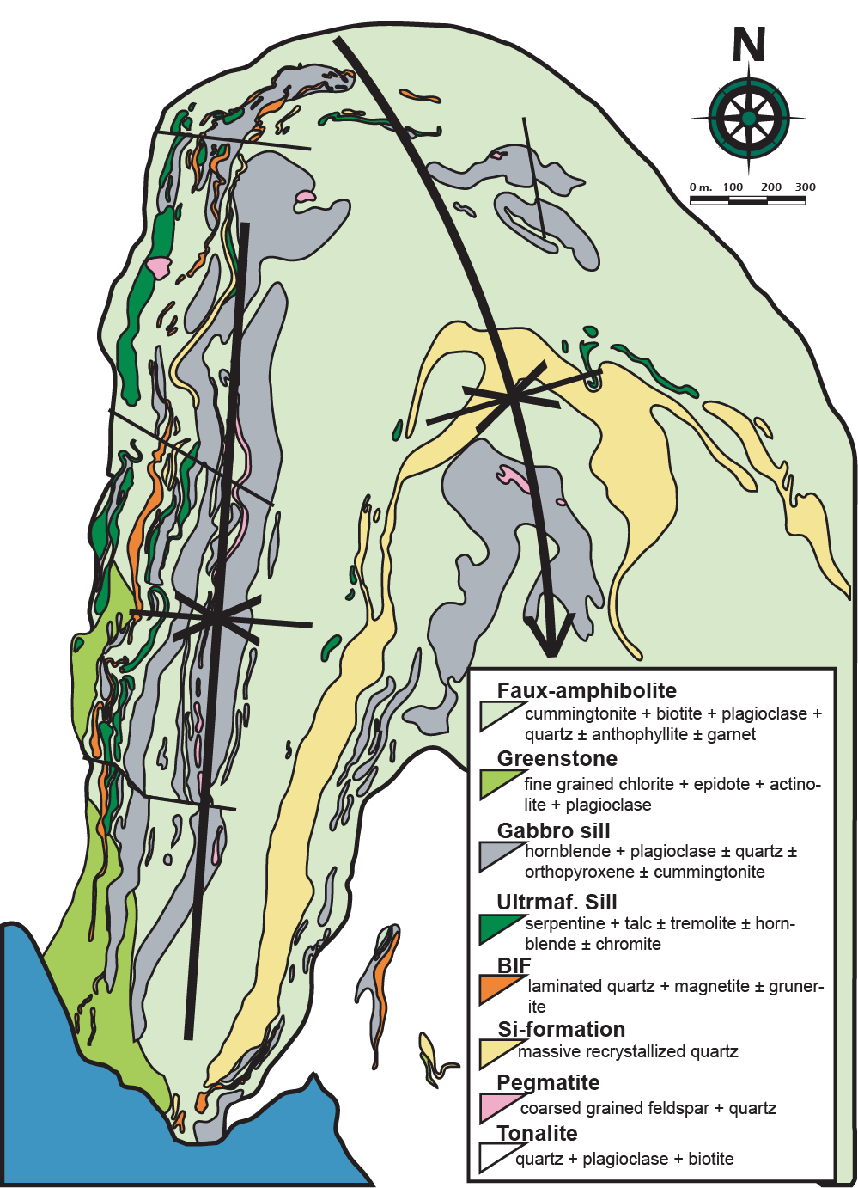
Using Short-Lived Radionuclides to Resolve Ancient Crust Formation from Later Metamorphism
3.8 Ga
4.0 Ga
O’Neil et al., Science, 2008
Notes:
Exploring the relative sensitivity of long- and short-lived systems to late metamorphic disturbance – an example from the Archean/Hadean Nuvvuagittuq Greenstone Belt, Quebec, Canada. Variability in 142Nd/144Nd in the Nuvvuagittuq mafic rocks (called the Ujaraaluk formation) correlates with Sm/Nd ratio, but 142Nd is created by the 68 Ma half-life decay of 146Sm. By 4.0 Ga, 146Sm essentially is dead as modern precision for 142Nd/144Nd measurements (brown box) cannot resolve the slopes expected for any age younger than 4 Ga.

Slide 44
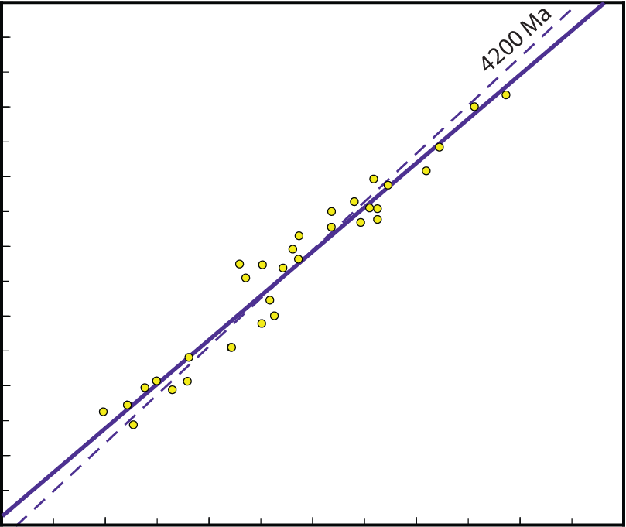
¹⁴⁷Sm⁻¹⁴³Nd Isochron for the Nuvvuagittuq Ujaraaluk Unit
0.5132
3814 ±300 Ma
Initial εNd : +0.2
MSWD = 120
0.5128
0.5124
¹⁴³Nd / ¹⁴⁴Nd
0.5120
0.5116
0.5112
1.0
0.5108
0.8
0.5104
0.12
0.14
0.16
0.18
0.20
0.22
¹⁴⁷Sm / ¹⁴⁴Nd
Notes:
The 147Sm-143Nd isochron shows considerable scatter with a best fit line of ~3.8 Ga. What aspect of these rocks is causing them to scatter around any given line? Multiple generations of unrelated rocks plotted on the same isochron? Metamorphic changes to Sm/Nd or 143Nd/144Nd ratios in rocks that otherwise would define a single line?

Slide 45
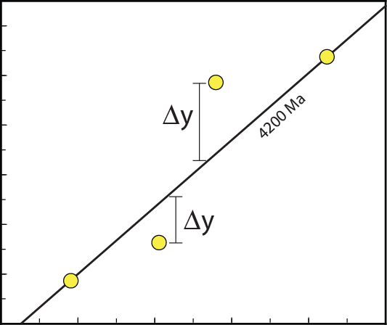
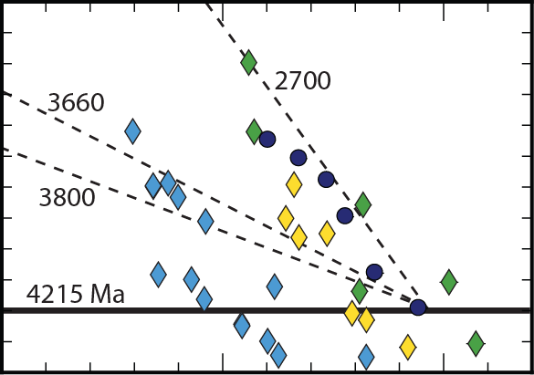
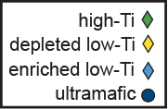
Overall correlation a mixture of ~2.7 Ga slopes for individual chemical units. 2.7 Ga is the time of peak metamorphism as recorded by garnet Sm-Nd and metasomatic zircon ages
¹⁴³Nd / ¹⁴⁴Nd
1.0
0.8
¹⁴⁷Sm / ¹⁴⁴Nd
0.6
^{Δy}
(‰)
0.4
0.2
¹⁴³Nd / ¹⁴⁴Nd
0
-0.2
0.10
0.12
0.14
0.16
0.18
0.20
0.22
¹⁴⁷Sm / ¹⁴⁴Nd
Notes:
Looking at the scatter closely, and identifying the different points by the chemical group to which they belong, breaks the scatter into a series of relatively shallow sloped (~2.7 Ga) slopes. 2.7 Ga also is the age of pegmatite intrusion and formation of the garnet in these rocks, so this age likely is reflecting the peak metamorphic event. The ~3.8 Ga isochron from the previous slide is little more than drawing a line through a series of scattered 2.7 Ga slopes for chemically unrelated rocks.
really a series of 2.7 Ga slopes starting from an initial spread consistent with an older age.

Slide 46
But ¹⁴⁶Sm-¹⁴²Nd still records 4.4 Ga
(4.3 Ga with old decay constant) ages for all chemical groups
O’Neil et al., PC Res 2012
Notes:
At 2.7 Ga, the 68 Ma half-life 146Sm, that decays to 142Nd, is long dead. Diffusion or chemical exchange between the whole rocks can eliminate variation in 142Nd/144Nd, but not create it. Changes to Sm/Nd ratio after 146Sm is dead will have no effect on the rock’s 142Nd/144Nd ratio, but will add scatter to the isochrons.

Slide 47
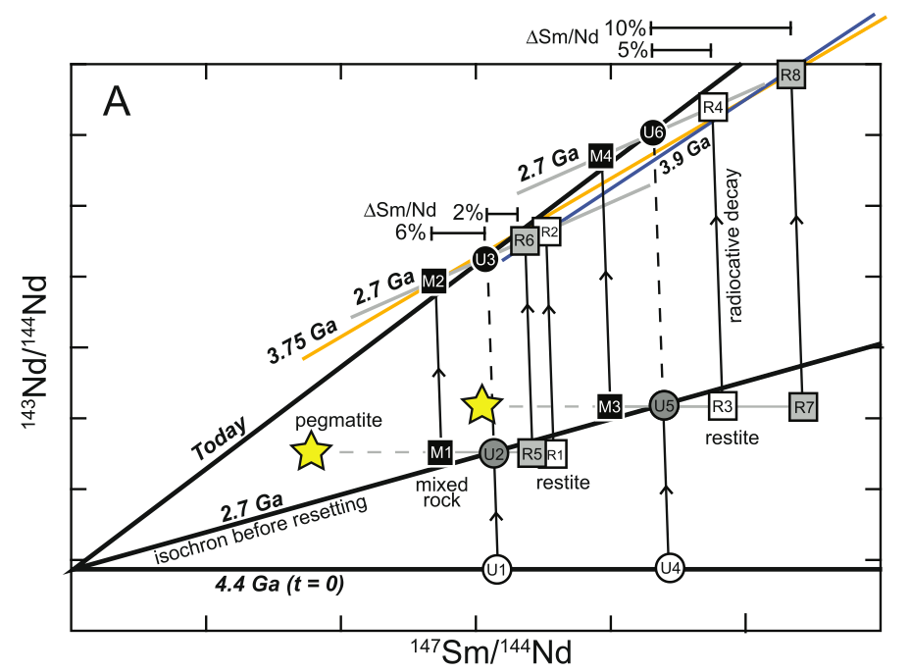
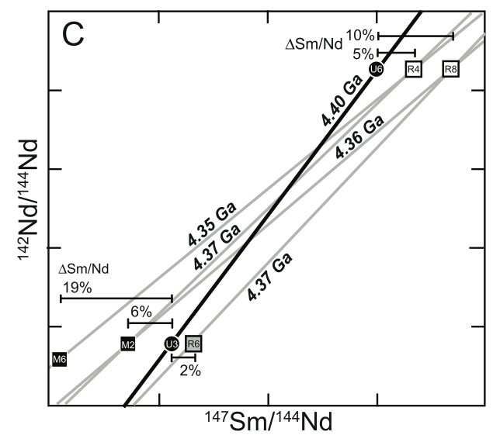
The Different Effect of Late Metamorphism on
Short- and Long-Lived Radiometric Systems
The model: Rock formation at 4.4 Ga. Metamorphism at 2.7 changes Sm/Nd ratio
From O’Neil et al., PC Res. 2012
Notes:
Changing a 4.3 Ga 147Sm-143Nd isochron to a 3.8 Ga slope requires fairly small changes in Sm/Nd. Changes of this magnitude will have limited effect on the 146Sm-142Nd age. In this model, the left figure starts at 4.4 Ga with two rocks (U1, U4) with different Sm/Nd ratios, but the same initial 143Nd/144Nd. If these rocks remain untouched to the present day, they end up at U3, U6 to define an isochron with slope corresponding to 4.4 Ga. In this model, at 2.7 Ga, each rock is allowed to undergo small amounts of melting, to make a felsic melt like the pegmatites (yellow stars). Removal of the low Sm/Nd melt then creates restites (R5, R1, R3, R7) depending on the degree of melt extraction, and creates another rock (M1, M3) that is a mixture of the pegmatite and the restites. With their new Sm/Nd ratios, these rocks evolve to the present day to define points M2, R6, R2, M4, R4 and R8. Drawing lines through different groupings of these points then creates “isochrons” that range in age from 3.9 to 2.7 Ga. In contrast, changes to Sm/Nd ratio of the magnitude shown in the left figure result in 146Sm-142Nd isochrons ranging from 4.35 to 4.4 Ga, illustrating the relative insensitivity of this system to later disturbance.

