Slide 1
Geodynamics
Day Lecturer Lectures
1 BB Introduction
1 MM Equations of Mantle convection
2 AM Large-Scale Mantle Convection and Numerical Modeling of it
4 JA Rotating Fluid Dynamics and Essential Flows in Planetary Cores
3-I CIG Aspect Tutorial (mantle)
6 MM Mixing
8 LM Global tectonics on terrestrial planets
9 CLB Mantle Dynamics and Surface Observables
9-II CIG Calypso Tutorial (core)
11 BB Planetary Dynamos

Slide 2
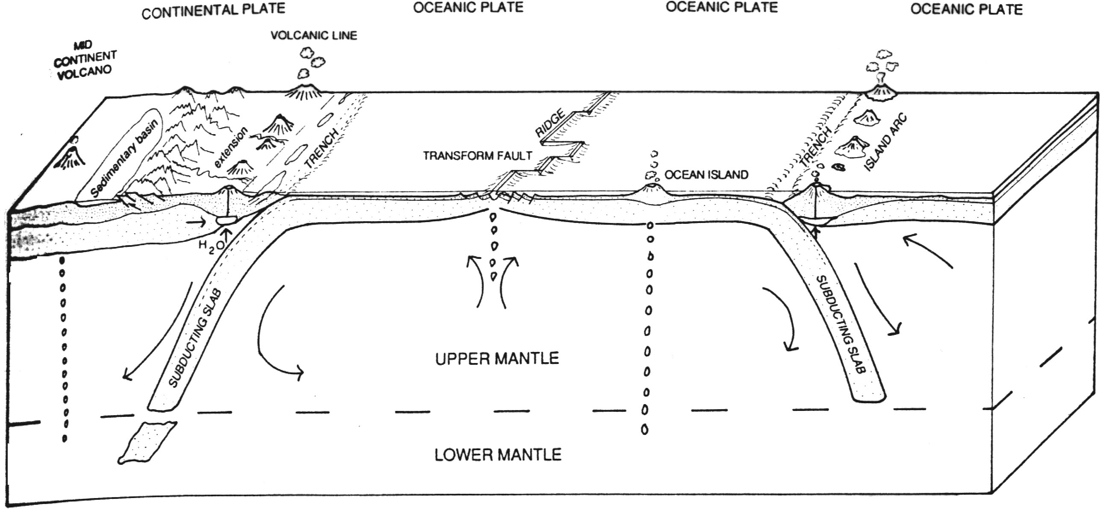
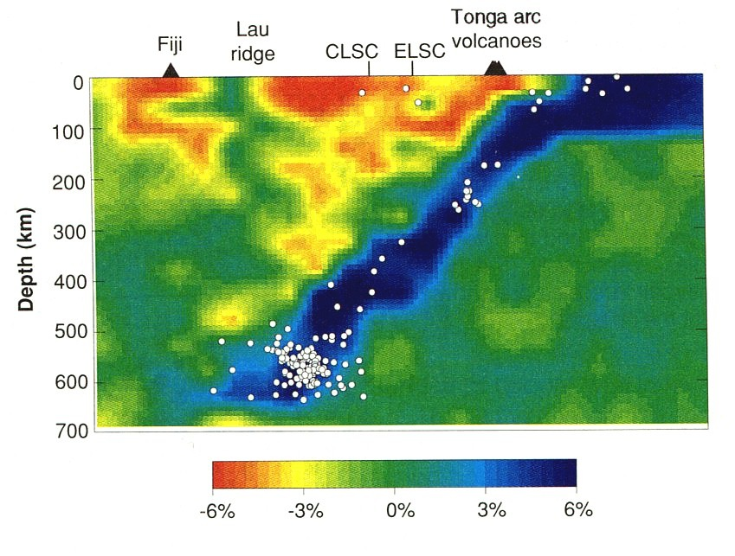
Plates Mantle Convection
Continuous generation of
dynamical (thermal) +
geochemical (compositional) = seismic heterogeneity
[including phase transitions (TZ!!)]
[Zhao et al., 1997]

Slide 3
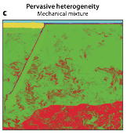
Chemical Heterogeneity Seismic
[Stixrude & Lithgow-Bertelloni, 2012]
Continuous generation of
dynamical (thermal) +
geochemical (compositional) = seismic heterogeneity

Slide 4
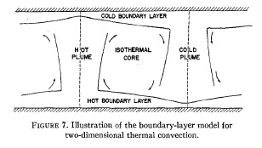
Mantle Convection and Plate Tectonics
[Turcotte and Oxburgh, 1972, Annual Reviews of Fluid Mechanics]
Notes:
Simple model prescribed: cellular, two dimensional rolls, fluid confined between two planes; Thin thermal boundary layers. Simplifcation of Navier Stokes
2-D can solve with stream functions analytically. Theory predicts accepted values for the velocity associated with continental drift and predict good values for the heat flux
At the Earth’s surface.

Slide 5
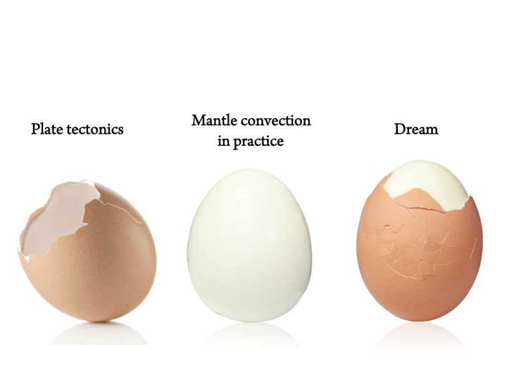
Mantle Convection and Plate Tectonics
[courtesy of Nicolas Coltice ]
Notes:
Simple model prescribed: cellular, two dimensional rolls, fluid confined between two planes; Thin thermal boundary layers. Simplifcation of Navier Stokes
2-D can solve with stream functions analytically. Theory predicts accepted values for the velocity associated with continental drift and predict good values for the heat flux
At the Earth’s surface.

Slide 6
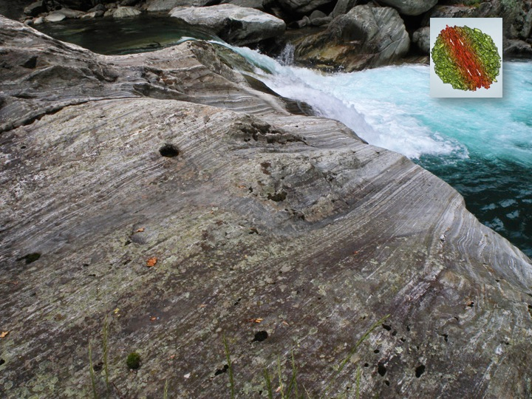
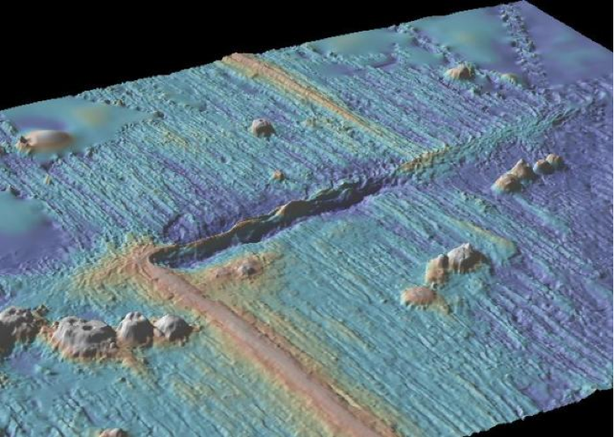
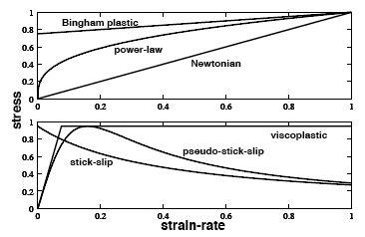
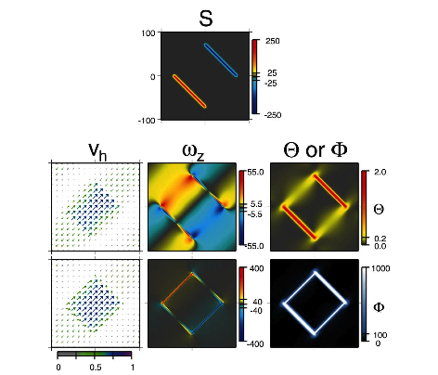
Making plates: theory
Shear-localizing feedback mechanisms required
Broad, strong plate-like regions
Weak, narrow plate boundaries
Toroidal motion (almost transforms)
Ridge localization
Physical basis?
Many characteristics not reproduced
Subduction initation
Asymmetry
Temporal evolution and plate rearrangement
[Bercovici, 2003]
Notes:
the lithosphere, to develop broad and strong plate-like segments separated by narrow, weak and rapidly deforming boundaries; ideally, such models also permit significant strike-slip (toroidal) motion, passive ridges (i.e. pulled rather than pried apart), and self-consistent initiation of subduction A major outcome of work so far is that nearly all aspects of plate generation require lithospheric rheologies and shear-localizing feedback mechanisms that are considerably more exotic than rheologies typically used in simple fluid-dynamical models of mantle flow. The search for plate-generating behavior has taken us through investigations of the effects of shear weakening (‘stick-slip’) and viscoplastic rheologies, of melting at ridges and lowviscosity asthenospheres, and of grain-size dependent rheologies and damage mechanics. Many such mechanisms, either by themselves or in combination, have led to self-consistent fluid-mechanical models of mantle flow that are remarkably plate-like, which is in itself a major accomplishment. However, many other important problems remain unsolved, such as subduction initiation and asymmetry, temporal evolution of plate geometry, rapid changes in plate motion, and the Archaean initiation of the plate-tectonic mode of convection.
The stress versus strain-rate curves for various rheologies. A Newtonian rheology is represented by a linear constitutive relation between stress and strain rate. A non-Newtonian power-law rheology has a non-linear constitutive
relation in which strain rate goes as stress to some power ns1 (the curve shows the case for n= 3 which is typical of deep mantle silicates). Both Bingham plastic and viscoplastic rheologies describe discontinuous stress ^ strain-rate relations whereby, at a particular yield stress, an abrupt transition in how behavior occurs from strong (immobile or highly viscous) to weak (viscous or with only a maximum strength or allowable stress). Stick-slip and pseudo-stick-slip behavior make transitions at a peak stress from strong (immobile or highly viscous) to one where strength (i.e. the allowable stress or resistance to deformation) is lost with faster deformation.

Slide 7
What is a plate?
Lithospheric Fragment
Strong non-deforming interior
Diffuse plate boundaries?
Narrow, weak, rapidly deforming boundaries
Ridges-passive
Subduction zones-asymmetric
Transforms?
Motion described by rotation
Plate motions
Non-accelerating
Piecewise continuous velocity field in space and time
Hard for fluid dynamics
Significant toroidal motion (I.e transform-like)
Part of convecting system (top thermal boundary layer…)
Continental plates
Notes:
the lithosphere, to develop broad and strong plate-like
segments separated by narrow, weak and rapidly deforming boundaries; ideally, such models also permit significant
strike-slip (toroidal) motion, passive ridges (i.e. pulled rather than pried apart), and self-consistent initiation of
subduction

Slide 8
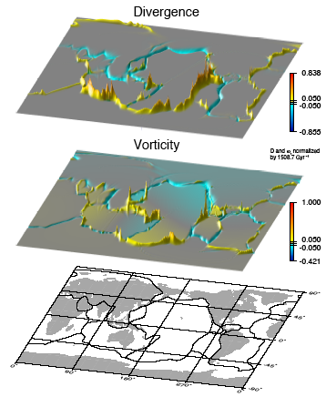
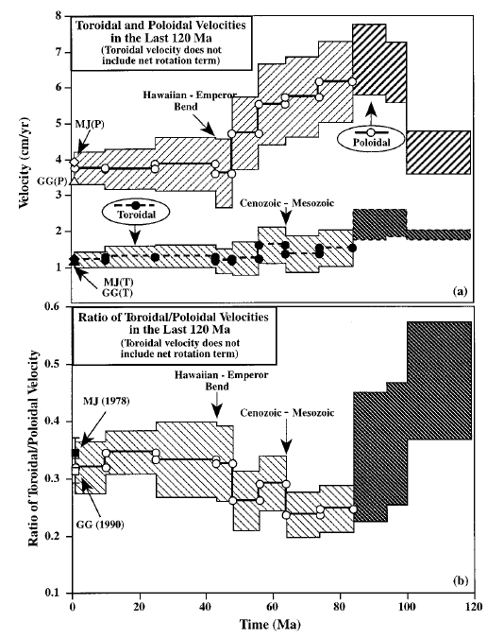
Toroidal Motions
-Homogeneous convecting
fluid-No toroidal power
-Lateral viscosity variations
i.e. PLATES!
-But why? Dissipates no heat
-Ratio: Plate characteristic
Horizontal divergence
(poloidal)
Radial vorticity
(toroidal)
[Dumoulin et al., 1998]

Slide 9
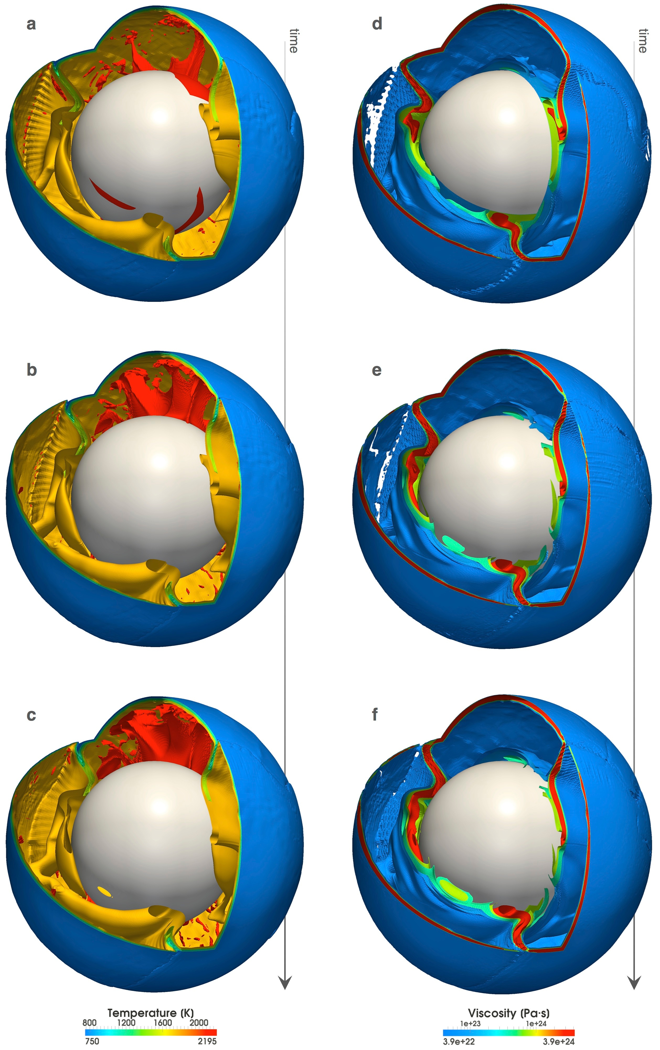
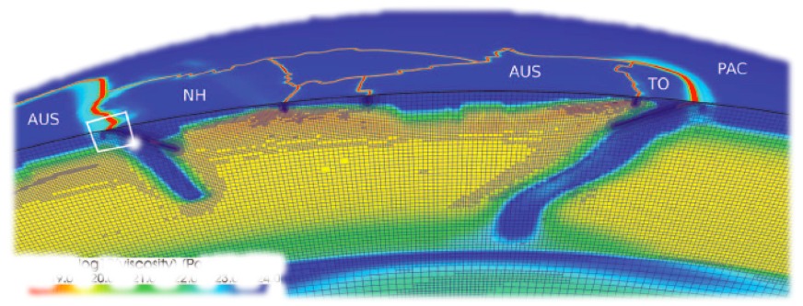
Reproducing Plate Tectonics
[Stadler et al., 2010, Science]
[Crameri et al., 2011]

Slide 10
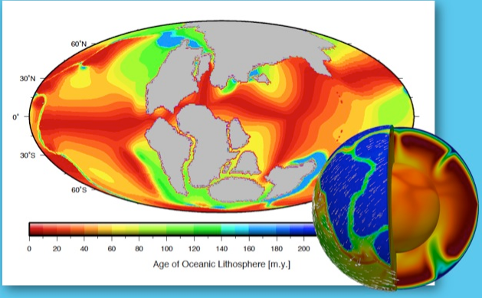
Mantle Convection and Continental Drift
No Pure Transforms
[Coltice et al., 2012 Science]

Slide 11
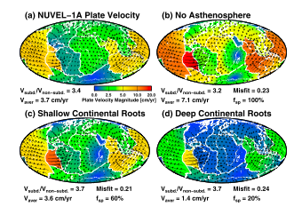
Predicting Plate Motions
[van Summeren et al., 2012]

Slide 12
Types of Observations
Elements of Plate Tectonics
Plate kinematics/dynamics
Poloidal/Toroidal partitioning
Nature of plates
Nature of plate driving forces
Implications
Mantle convection
Speed (absolute viscosity)
Coupling to mantle (viscosity structure-radial, geographical)
Plate motions past and present
Magnetic anomalies
Plate reconstructions
Changes in Plate Dynamics?
Subduction History
Topography and Heat flow
Bathymetry and Heat Flow
Half-space cooling, plate model
Secondary convection
Dynamic topography
Flooding record
Sea level
Mass distribution and change
Post-Glacial Rebound
Geoid and free air gravity
Viscosity structure
Geoid and topography over subduction zones

Slide 13
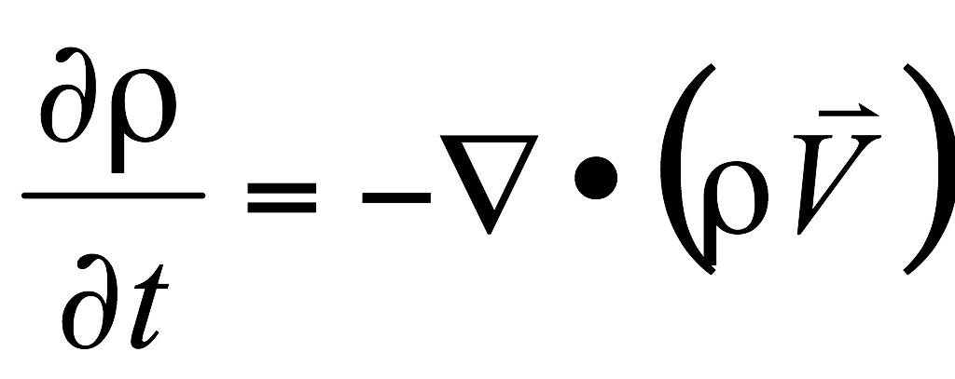
Summary: Conservation Equations (No approximations)
Mass
Momentum
Energy

Slide 14
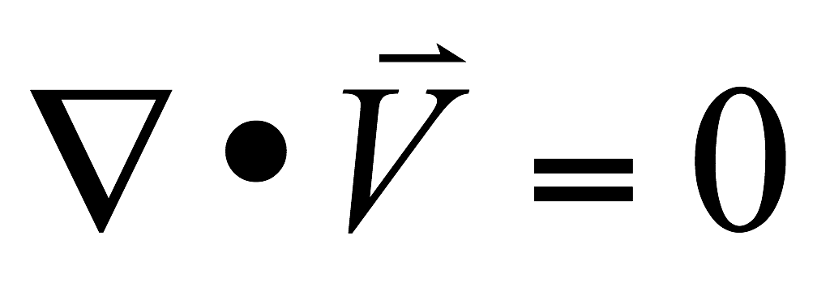
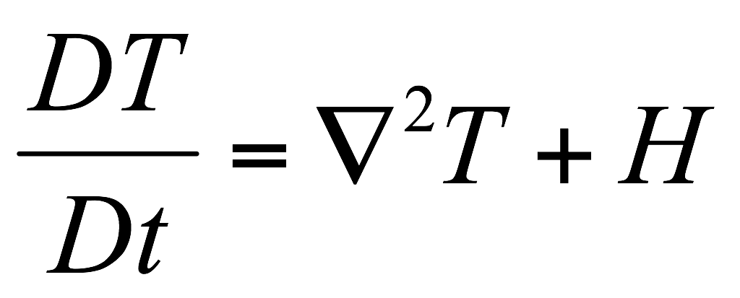
Summary: Non-dimensional Conservation Equations, with reference model. Primes have been dropped. Approximations: Boussinesq Approximation (BA), infinite Prandtl number, static gravitational field.
Mass
Momentum
Energy

Slide 15
Simplifications
-Infinite Prandtl # fluid: i.e. Inertial forces are not important
-Fluid is Incompressible, Newtonian
-Properties Homogeneous
But suppose you know ?
Notes:
Mass, Momentum give you Navier-Stokes, couple it to Energy equation, what does it give you F.

Slide 16
Solve Stokes in a self-gravitating Earth
Take each variable:
Expand using spherical harmonics, scalar:
and vector fields:
[Alterman et al., 1959; Takeuchi and Hasegawa, 1965; Kaula, 1975; Hager and O’Connell, 1979; 1981]
Notes:
Suppose now you want to obtain some useful solutions. Well, assuming the Fluid is Newtonian and incompressible let’s us solve by separation
Of variables. How can we obtain a solution for a spherical shell?

Slide 17
Aside: Spherical Harmonics
The spherical harmonics are the angular portion of the solution to Laplace's equation in spherical coordinates
Spherical Harmonics

Slide 18
Continuing…..
[So for example the continuity (mass conservation) equation]
…. Substitute the expansions for velocity, stress, with those for pressure and
density… We end with 6 coupled ODEs
…..We could solve NUMERICALLY… but if we perform a simple variable
substitution for each spherical harmonic coefficient
….. We get two nicely defined differential equations
[See Hager and O’Connell, 1979 and 1981 or better yet, ask Guy for his lecture notes!!!]
Notes:
Substituting the expansions for velocity and stress together with those for pressure and density reduces (1-3) to a set of 6 coupled ordinary first-order differential equations (four poloidal and two toroidal) [Kaula, 1975; Hager and O'Connell, 1979]. For instance, denoting the radial derivative of by , the continuity equation (1) reduces to 8 which depends only on the poloidal components of the velocity field.
By specifying six boundary values, the six coupled ODE's are solved for the three components of the velocity and the three components of the stress as a function of radius. The boundary conditions are taken to be no-slip at the surface ( specified everywhere) and free slip at the core-mantle boundary . The equations are solved analytically via propagator matrices [Hager and O'Connell, 1979]. For radially varying viscosity the propagator matrices for the various layers are multiplied together yielding the solution for the entire mantle.

Slide 19
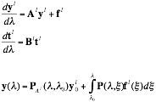
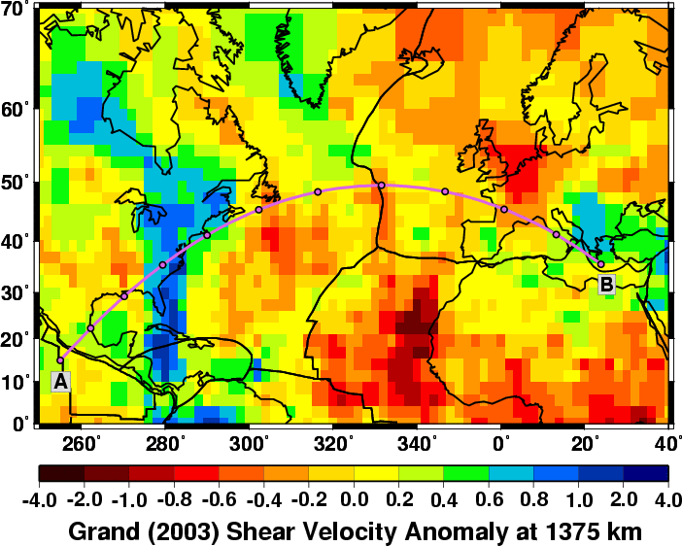
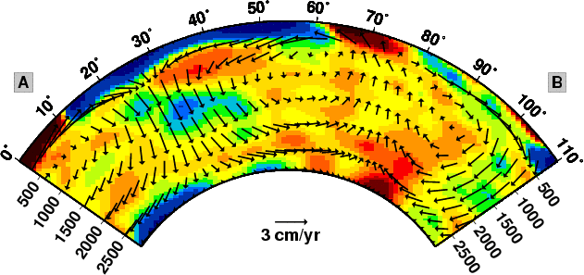
Propagator Matrices
Computing Mantle Flow
[Poloidal]
[Toroidal]
These equations can be solved via Propagator matrices
[See Gantmacher]
We can now solve for velocities and stresses at any depth once P is known!
Boundary Conditions: Continuity of velocity and stresses at boundary interfaces
Use: Free-slip at CMB; Free-slip or no-slip at surface
[Hager & O’Connell, 1979]

Slide 20
Advantages and Disadvantages
-Spectral Solutions VERY FAST! (You’ll see)
-Can change radial viscosity profile (explore effects of viscosity structure)
-Spherical Shell
-Predict observables (Geoid, Topography, Plate Motions, Flow (Anisotropy))
-Can explore compressibility (less than 10% effect at long wavelengths)
-LACK OF RHEOLOGICAL COMPLEXITY
Lateral viscosity variations
Plate boundary rheology
-MUST ASSUME A DENSITY HETEROGENEITY
-No TIME DEPENDENCE
[Hager & O’Connell, 1979]

Slide 21
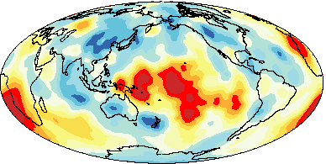
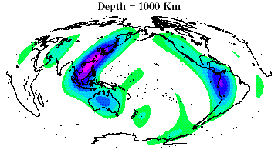
So now what?
Seismic Tomography- Convert velocity to density---- BUT HOW?
Mantle Density Heterogeneity Model
[ Masters and Bolton]
Based on Geologic Information-Plate Motion History
[ Lithgow-Bertelloni and Richards, 1998]
[Hager & O’Connell, 1979]

Slide 22
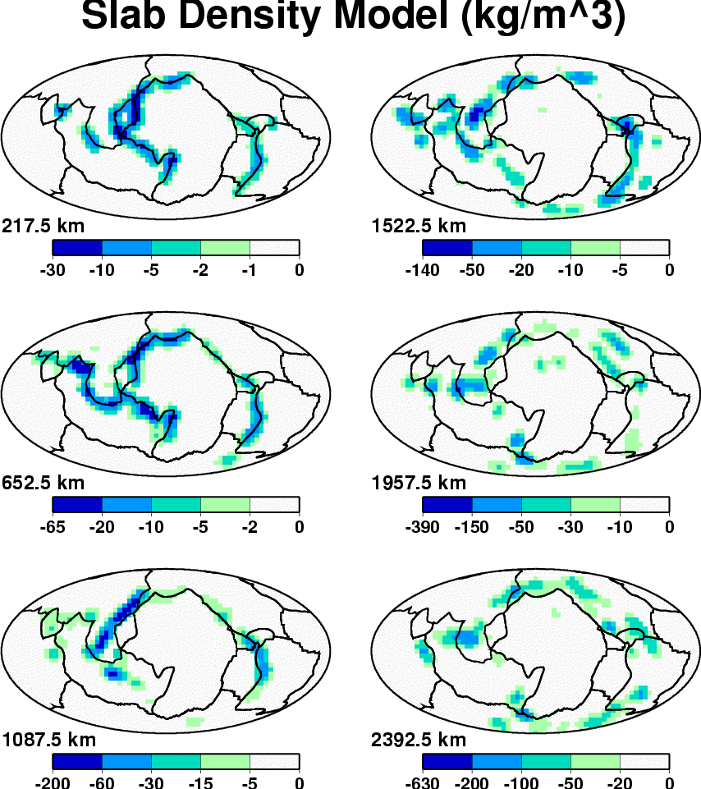
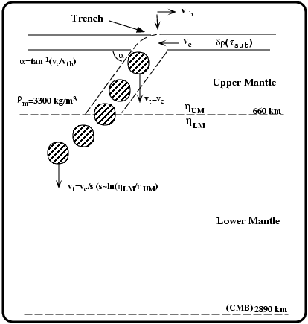
Slab Model
Drop plates into the mantle at
regions of convergence
After Lithgow-Bertelloni and Richards [1998]

Slide 23
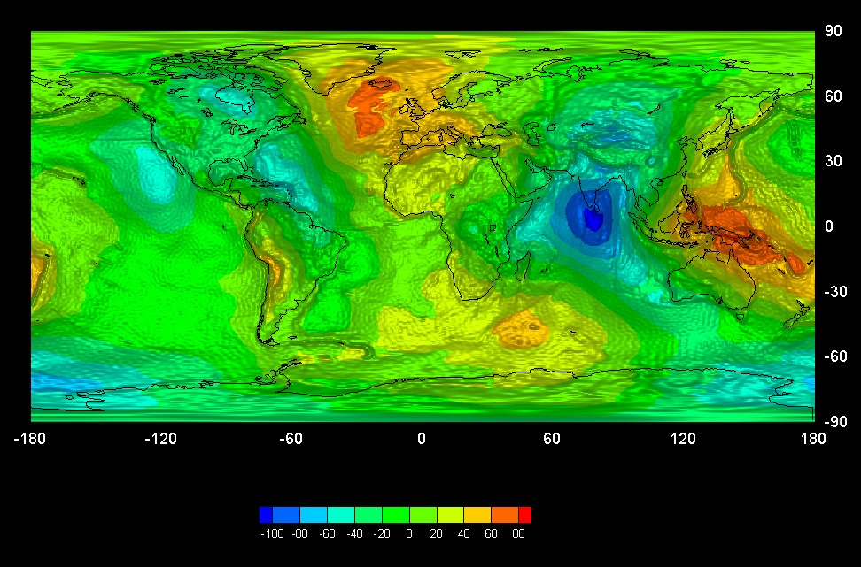
Geoid Anomalies

Slide 24
Geoid Anomaly
Earth
R
Self-gravitation
Deflection of upper surface represents a mass deficit that opposes mass excess of sphere. Amount of deflection depends on viscosity structure.
Downward deflection of core-mantle boundary also a mass deficit

Slide 25
Geoid Anomaly
R
Earth
Formally separate structure (D_{lm}) and dynamics (G)
Green’s function or Kernel G(r,l) is the geoid anomaly due to a unit density anomaly of wavelength l at depth r
G depends on viscosity structure. Compute separately.

Slide 26
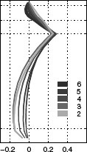
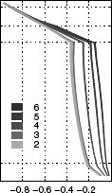
Geoid Anomaly
R
Earth
Geoid Kernel
Dynamic topography
Standard η structure
LM~50xUM
Panasyuk et al. (2000)

Slide 27
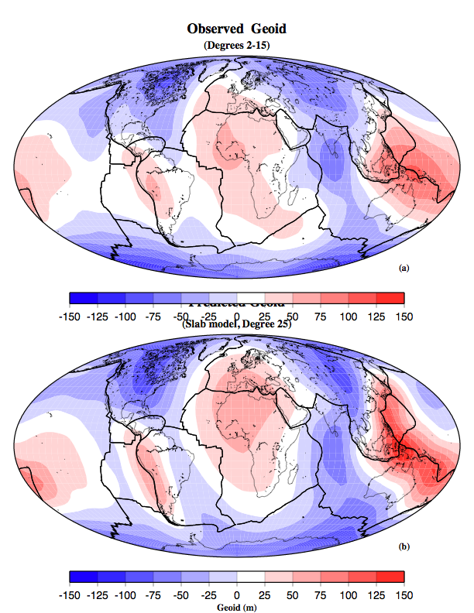
Predicted Geoid
Best fitting viscosity structure
Lithosphere-10 * UM
Lower Mantle-50 * UM

Slide 28
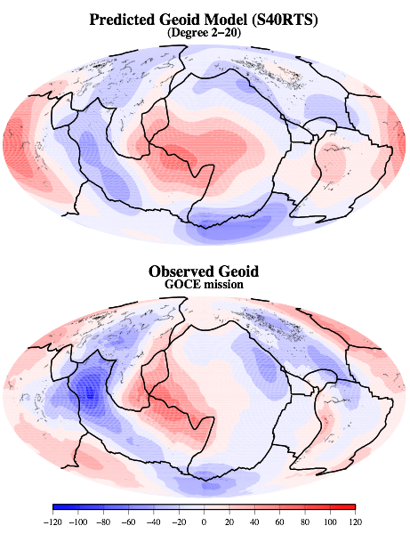
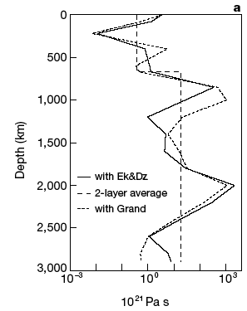
Predicted Geoid
Best fitting viscosity structure
Lithosphere ~10 * UM
Lower Mantle ~40 * UM
[Forte and Mitrovica, 2001]

Slide 29
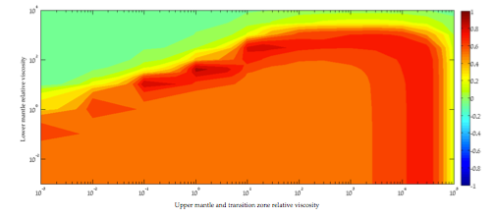
Viscosity Structure

Slide 30
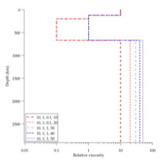
Viscosity Structure

Slide 31
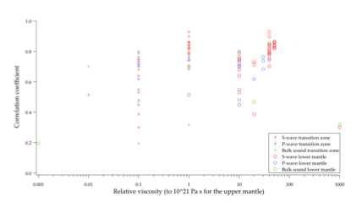
Viscosity Structure

Slide 32
Geoid Anomaly
Earth
R
Self-gravitation
Deflection of upper surface represents a mass deficit that opposes mass excess of sphere. Amount of deflection depends on viscosity structure.
Downward deflection of core-mantle boundary also a mass deficit

Slide 33
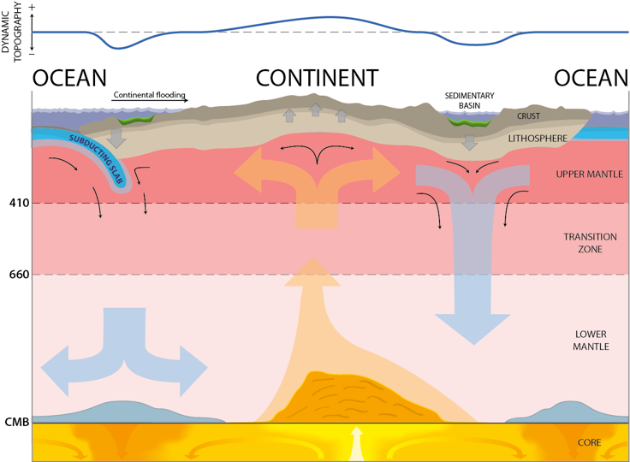
Dynamic Topography
h=− τ_{r}/δρg

Slide 34
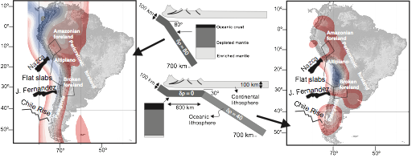
Dynamic Topography over flat slabs
[ Dávila and L-B, 2012; submitted]

Slide 35
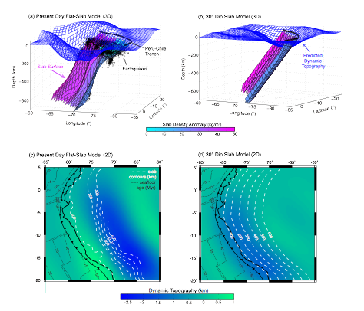
Amazon Basin
[ Eakin et al., revised]

Slide 36
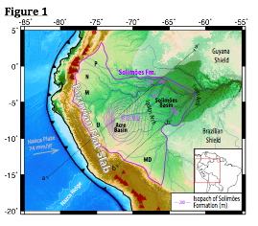
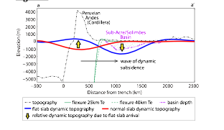
Amazon Basin

Slide 37
So now what?
Seismic Tomography- Convert velocity to density---- BUT HOW?
Mantle Density Heterogeneity Model
[ Masters and Bolton]
Based on Geologic Information-Plate Motion History
[ Lithgow-Bertelloni and Richards, 1998]
[Hager & O’Connell, 1979]

Slide 38
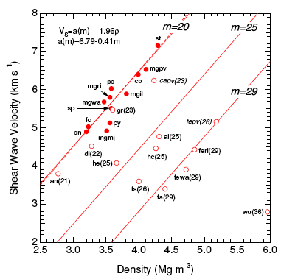
Velocity-Density Scaling
Birch’s law
δv=aδρ
Factors=0.1-0.5 g s/km cm³
[Hager & O’Connell, 1979]

Slide 39
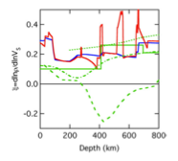
Density-Velocity Scaling
[ Stixrude and Lithgow-Bertelloni, 2007]
Notes:
The scaling relates lateral variations in velocity to lateral variations in density
If these variations are due only to lateral variations in temperature, one can write the scaling in terms of the thermal expansivity (-first term on RHS) and the T-dependence of the velocity. Both of these can be measured experimentally.
One has to worry about attenuation since this increases the T-dependence of VS significantly in the seismic band, and therefore decreases the value of R_r/S
For single phases and for our current understanding of material properties, the ratio decreases with increasing pressure, but cannot be negative.
So, if negative values found in the Earth, this would seem to require lateral variations in composition.
But the conclusion is incorrect because it ignores phase transformations, which can reverse the sign of the thermal expansivity as you saw in the tutorial.

Slide 40
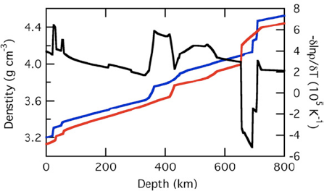
Dynamics and Thermodynamics

Slide 41
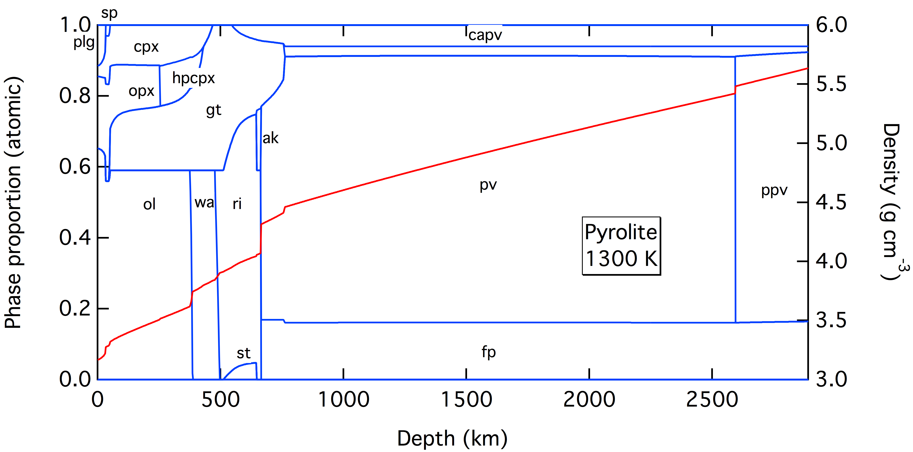
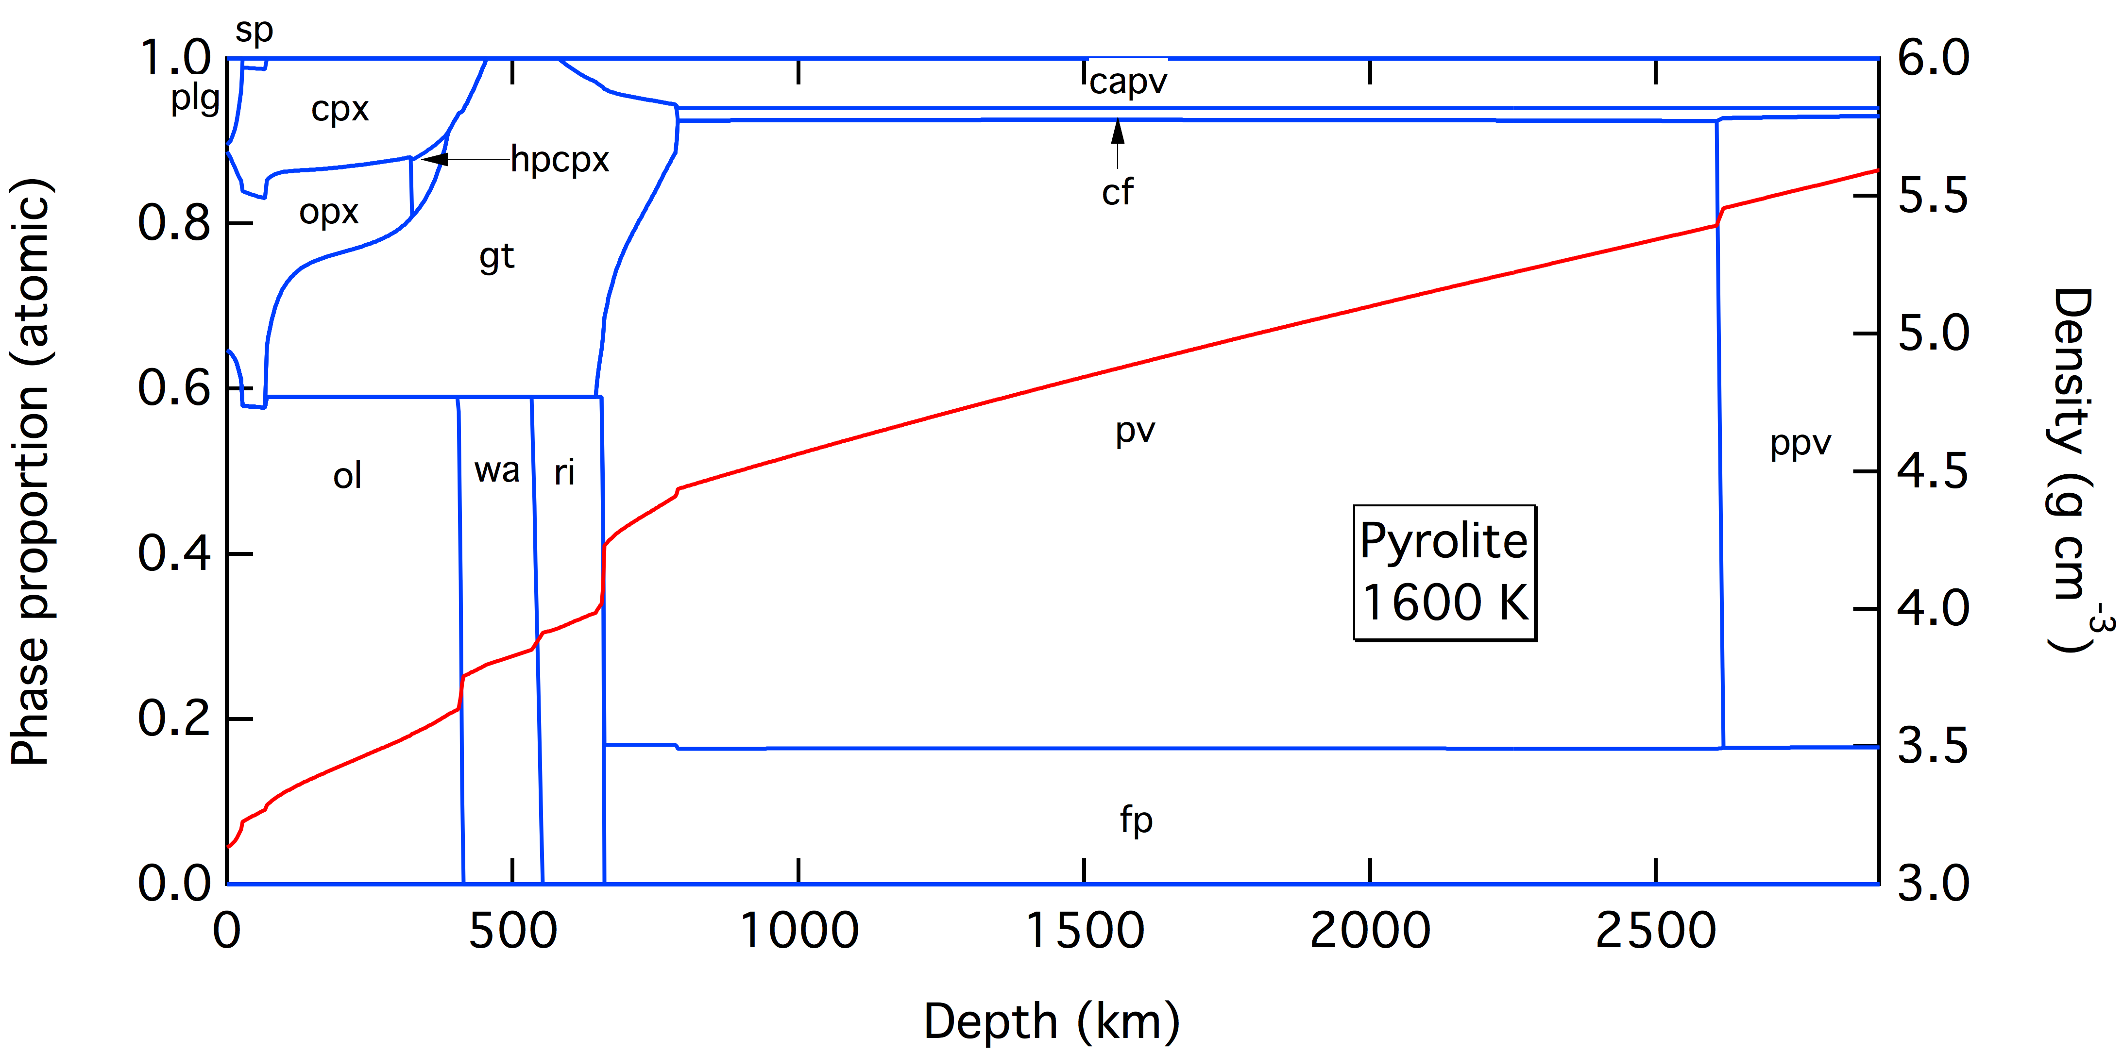
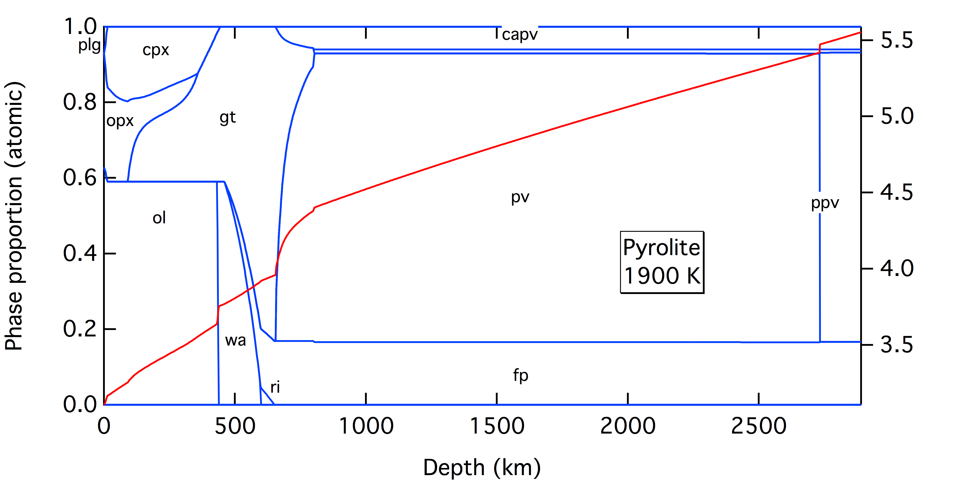
Phase assemblage T-dependent

Slide 42
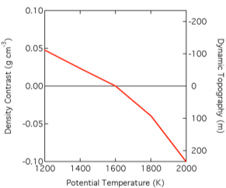
Consequence for Dynamic Topography

