Slide 1
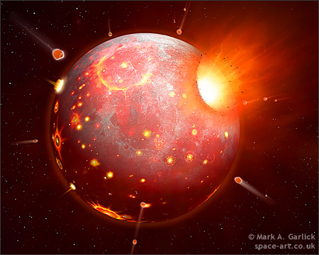
Introduction to Deep Time Physics Perspective
Dave Stevenson
Caltech
CIDER, July 2012

Slide 2
The Main Issues
Formation
Thermodynamic state, Provenance, Timescales, Energetics
Earth’s initial condition
Thermodynamic state, core, magma ocean, hydrosphere & atmosphere
Healing & Transition to a Recognizable World
Solidification, ocean & atmosphere, dynamo, mantle convection, continents, plate tectonics

Slide 3
EARTH HISTORY
This
Some multidimensional space
Initial condition
Evolutionary path
Present state
That

Slide 4
EARTH HISTORY
This
Some multidimensional space
Initial condition
Focus of this talk
Astronomy, geochemistry, physical modeling
Geophysics
Evolutionary path
Geochemistry, geology, geobiology
Present state
That

Slide 5
The (logarithmic) way one should think about time if you want to understand processes and their outcome
Phanerozoic
10⁶ yr
10⁷
10⁸
10⁹
10¹⁰ yr

Slide 6
Formation What should you believe? What is merely this week’s story?
Context is well established
Cosmic composition disk, roughly the necessary material (maybe more), roughly in the right place (but the terrestrial planets are a side show)
Planetesimal formation still poorly understood but once it happened, things go fast (10⁶yr) then slow down in the end game (10⁸yr)
Some timescales only known to factor of ~2
This week’s story may not be next week’s story
But the hot debates may not affect Earth’s story?

Slide 7
Example: The Grand Tack (Walsh et al, 2011)
4 orbits are Jupiter, saturn , Uranus & Neptune. Note that some blue things (ice) end up in the terrestrial zone. This story might explain smallness of Mars.

Slide 8
Terrestrial Planet Formation An example from John Chambers(2004)

Slide 9
The Importance of Giant Impacts
Simulations indicate that Mars-sized bodies probably impacted Earth during it’s accumulation.
These events are extraordinary… for a thousand years after one, Earth will radiate like a low-mass star!
A large oblique impact places material in Earth orbit: Origin of the Moon

Slide 10
Formation: The Main Points
Giant impacts are an essential part of Earth formation. Not just the lunar forming impact.
Small impactors are also essential & contemporaneous.(20-40% of the total mass?)
Much of Earth could have formed in as little as 3Ma but the last giant (lunar-forming) impact was at 30-100Ma.
Mostly after Jupiter formation and mostly after removal of the solar nebula.
Change in provenance (Oxidation, volatiles) with time?
Amount of water is highly uncertain
Mixing but extent is uncertain

Slide 11
Some Important Numbers
GM/RC_{p}~ 4 x 10⁴K where M is Earth mass, R is Earth radius, C_{p} is specific heat
GM/RL ~1 where L is the latent heat of vaporization of rock
Equilibrium temp. to eliminate accretional heat ~400K (but misleading because of infrequent large impacts and steam atmosphere)
E_{grav}~10 E_{radio} where E_{grav} is the energy released by Earth formation and E_{radio} is the total radioactive heat release over geologic time

Slide 12
Entropy Distribution in Disk & Planet Earth is molten after a giant impact Mantle is stably stratified (inhibits mixing) Disk is melt +vapor

Slide 13
Core Formation with Giant Impacts
Imperfect equilibration⇒ no simple connection between the timing of core formation and the timing of last equilibration
No simple connection between composition and a particular T and P.
Molten mantle
Unequilibrated blob
Core

Slide 14
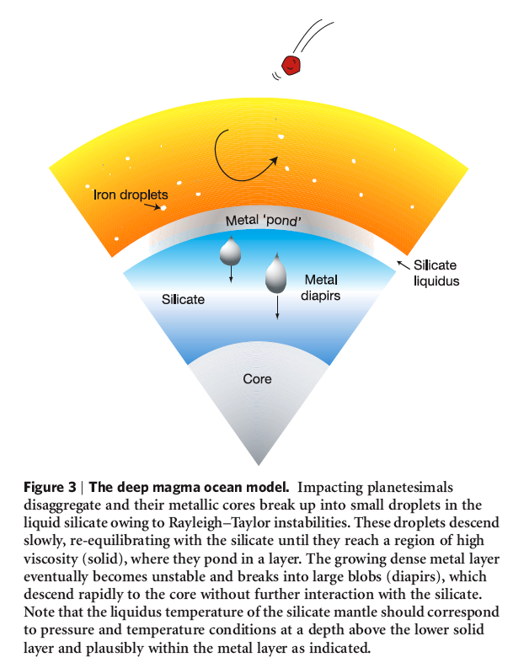
Popular Cartoons of Core Formation
Wood et al, 2006
Stevenson, 1989

Slide 15
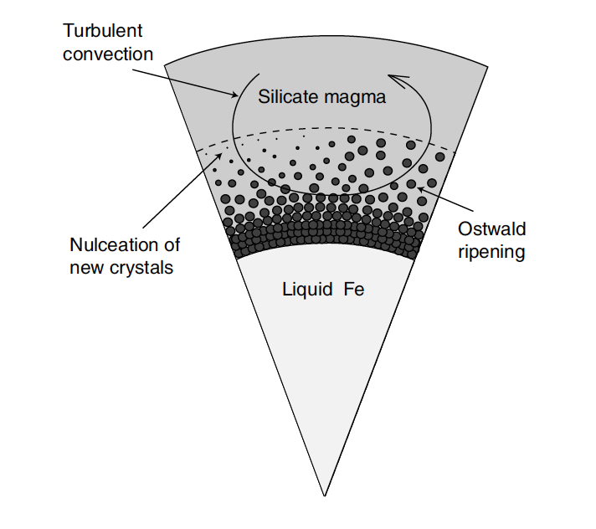

Slide 16
Initial Condition: The Main Points
Everything is melted. Some vaporization.
Core formation contemporaneous with accretion. But that does not exclude some later core-mantle interaction.
Rapid cooling and partial crystallization of the magma ocean.
Magma ocean freezing creates initial condition for subsequent evolution including possibility of a mantle turnover (Rayleigh-Taylor instability; Elkins-Tanton).
Complete mixing on the mantle is in doubt: there could be a basal magma ocean.
Many uncertainties in dynamics & material properties (phase diagrams, partitioning )
Large uncertainty in the timing and amount of volatiles, but they might have been mostly delivered early. (They are not removed by a giant impact). Not comets.

Slide 17
Hydosphere/Atmosphere Evolution?
Silicate vapor: short-lived after giant impacts (thousands of years)
Steam atmosphere: sustained by accretion can die in millions of years.
Can be as much or more water in the magma ocean
Will accumulate as a hydrosphere even before a major part of the magma ocean crystallizes
Augmented as magma ocean crystallizes
Composition of primordial atmosphere determined by oxidation state
Water cycle not well understood!

Slide 18
Why do we have Plate Tectonics?
Mantle convection is easy to understand but plate tectonics does not follow from any straightforward stability analysis
It is not mandatory for removing heat.
It is “more efficient” in removing heat (but there is no variational principle that optimized heat delivery)
We don’t even know if it is deterministic or contingent behavior.
Mantle convection is determinstic
Climate change, dynamos.. are somewhat contingent.
Relevant to understanding continental evolution

Slide 19
Plate Tectonics & the Role of Water
Water lubricates the asthenosphere
Water defines the plates
Maintenance of water in the mantle depends on subduction; this may not have been possible in our solar system except on Earth

Slide 20
Origin of the magnetic field?
Core is metallic
Core is (partly) liquid
This is not obvious , but seems universal because of presence of alloying constituents
Core is convective
This is a close call! High electrical conductivity means high thermal conductivity (Wiedemann-Franz relationship)
A convective core probably sustains a dynamo for most realistic parameters.
Inner core nucleation was later? Can provide compositional convection.

Slide 21
Core Superheat
Early core
Core Superheat
This is the excess entropy of the core relative to the entropy of the same liquid material at melting point & and 1 bar.
Corresponds to about 1000K for present Earth, may have been as much as 2000K for early Earth.
It is diagnostic of core formation process...it argues against percolation and small diapirs.
T
Adiabat of core alloy
Present mantle and core
depth

Slide 22
Transition to a Recognizable World: Main Points
Rapid cooling at first: surface can be cold within millions of years (no problem with the oldest zircon ages?)
Early evolution of ocean & atmosphere not well understood.
Part of magma ocean may take a long time to solidify. Basal magma ocean might persist for billions of years.
Dynamo initiated early by core cooling?
Developments of plate tectonics, origin of continents still mysterious.

Slide 23
Where do we stand?
Context of Earth formation is understood; compatibility with geochemical record is quite good, but
The devil is in the details: Oxygen isotopes, Nd, degree of mixing,
Initial condition of Earth:
Molten
Prompt core formation
Transition to a Recognizable Earth:
Rapid freezing of most but not all of the magma ocean
Mixing?
Plate tectonics?

